Slide 1
INTERNAL AUDIT SERVICES
for ABC INTEGRATED SERVICES LTD.

Slide 2

7 November 2025
ABC INTEGRATED SERVICES LTD.
XXX
Dear Sir or Madam,
PROPOSAL FOR PROVISION OF INTERNAL AUDIT SERVICES
Thank you for the opportunity to submit our proposal for the provision of internal audit services to ABC Integrated Services Ltd. (“ABC”). We look forward to the prospect of working with you on this engagement and we wish to assure you of our most sincere commitment to provide you with the best resources of our organisation.
We have prepared this document which outlines our approach and methodology, our focus on quality including our qualifications, resources, cost and commitment to serve you.
Your team at In.Corp has substantive relevant experience in internal audits, enterprise risk management, and sustainability reporting engagements with various public listed companies, multinationals, government ministries, organs of state, statutory boards, financial institutions, institutions of a public character and SMEs. Please see Section 3 of this proposal document.
If we can be of any further assistance in the meantime, please do not hesitate to contact me at 6028 4346.
Yours faithfully
For and behalf of
In.Corp Business Advisory Pte. Ltd.
Ruby Rouben
Director – Head, Risk Assurance
Singapore

Slide 3


Overview
About InCorp
Risk Assurance Practice
Our Professional Track Record
Your Service Team
Internal Audit Services
Professional Fees
InCorp’s Strengths and Differentiators
Value-added Services

Slide 4

About
InCorp

Slide 5









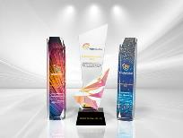




InCorp Global
Indonesia
Mainland China
Malaysia
India
Philippines
Australia
Hong Kong SAR
Singapore
Vietnam
20,000+
Clients
1,500+
Employees
20,000+
Entities
12,000+
Compliance Transactions
Per Year
30+
Years Operating
Track Record

Slide 6

About InCorp
In.Corp Business Advisory Pte Ltd, a subsidiary of InCorp Global Pte Ltd has been in operations since 28 October 2008. InCorp Business Advisory has experience in providing internal audit services since 2016.
InCorp Global, an Ascentium Company, is a leading corporate services provider in Asia Pacific. Headquartered in Singapore, we have a strong regional presence across 9 strategic markets: Singapore, Australia, India, Indonesia, Malaysia, Vietnam, the Philippines, mainland China, and Hong Kong SAR.
With a team of over 1,500 dedicated professionals serving over 20,000 clients, we offer a comprehensive suite of services, including corporate secretarial, accounting, tax, payroll, HR, and other business advisory solutions.
As part of Ascentium, a global business services platform with more than 2,300 professionals across 44 cities in 22 markets spanning Asia-Pacific (APAC), the Middle East, the Americas, and Europe, supporting over 50,000 client entities, we are expanding opportunities for our clients and partners by offering access to new markets and an even broader range of corporate services, finance and accounting, HR services, as well as fiduciary and trust services.

Slide 7
Why InCorp
Unparalleled Expertise Across Borders | Optimized Cost-Value | Long Term Relationships | Support Across 8 Countries
Bespoke Service Delivery | Trusted Advisors | Driven By Technology | Simplified & Seamless Process

Slide 8

Startups
Small and
Medium Enterprises
Multi National Enterprises
Fund and Asset Managers
Family
Offices
Non Profit Organizations
Government Agencies
Listed
Companies
Large
Corporates
Our
Clientele

Slide 9
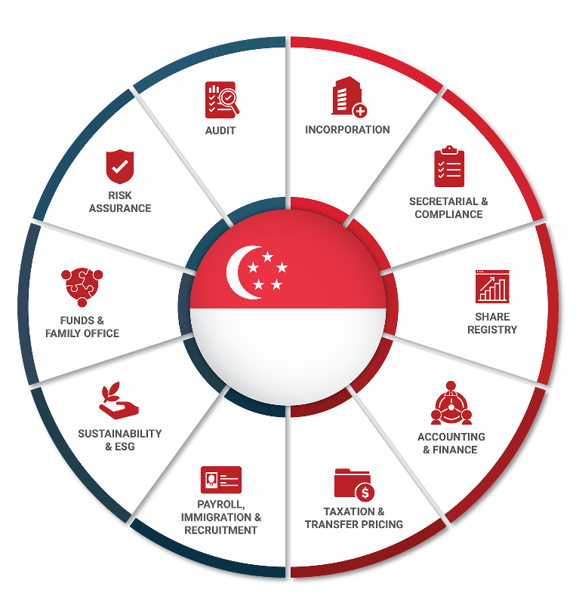

Overview Of InCorp Singapore
Singapore Key Stats
200+ Employees
Corporate Secretarial
& Legal Compliance
Accounting
& Tax
Internal Audit
& ESG
8K+
Clients
500+
New Company Incorporations Annually
7K+
Accounting & Tax Clients
480K+
Annual Transactions
100+
Clients
200+
Annual Projects

Slide 10
Risk Assurance Practice

Slide 11

Risk Assurance Practice
At InCorp, we specialise in the following services:
Internal Audit
Sustainability Reporting Services
Pre-IPO Internal Controls Review
Enterprise Risk Management
and we put our client’s success first

Slide 12
Our
Professional Track Record

Slide 13
Our Professional Track Records (Past 5 Years)
- Public Sector
We are on the following Framework Agreements/Panels:
1. MOH
2. MSF
3. MHA
4. NHB
5. MPA
S/N | Organisation
1 | MUIS Group (MUIS, Warees Group, MMWSS, Mosques)
2 | Ministry of Home Affairs
3 | ASTAR Research Entities
4 | Attorney-General’s Chambers
5 | Civil Aviation Authority of Singapore
6 | Civil Service College
7 | ISEAS - Yusof Ishak Institute
8 | ISTANA
9 | Land Transport Authority
10 | Maritime Port Authority
11 | Ministry of Education
12 | Ministry of Health
13 | Ministry of National Development
14 | Council for Estate Agencies
15 | Board of Architects
16 | Professional Engineers Board
17 | Ministry of Social and Family Development
S/N | Organisation
18 | National Archives of Singapore
19 | National Heritage Board
20 | National Library Board
21 | Ngee Ann Polytechnic
22 | People's Association
23 | Republic Polytechnic
24 | Science Centre Board Group (SCB, SVPL, SSCG)
25 | Singapore Civil Defence Force
26 | Singapore Food Agency
27 | Singapore Courts
28 | The Competition and Consumer Commission of Singapore
29 | Government Technology Agency of Singapore
30 | Info‑communications Media Development Authority
31 | Singapore Prison Services
32 | Singapore Police Force
33 | Immigration and Checkpoints Authority
34 | Central Narcotics Bureau
35 | Home Team Academy

Slide 14
Our Professional Track Record
- Charities/IPCs
S/N | Organisation
1 | Association for Persons with Special Needs
2 | AWWA Ltd
3 | Beyond Social Services
4 | Covenant Evangelical Free Church
5 | Loving Heart Multi-Service Centre
6 | Management Development Institute of Singapore (MDIS)
7 | Muslimin Trust Fund Association
8 | ABC
9 | Riding for the Disabled Association of Singapore
10 | St John's Home for Elderly Persons
11 | Special Needs Trust Company Limited
12 | Sree Narayana Mission
13 | Thong Kheng Welfare Services Society
14 | Yayasan Mendaki
15 | Rahmatan Lil Alamin Foundation
S/N | Organisation
16 | Muslim Kidney Action Association
17 | Mindset Care Limited
18 | Ronald McDonald House Charities Singapore
19 | Sam Kiang Huay Kwan Charity Clinic
20 | Kidney Dialysis Foundation
21 | Sunlove Abode for Intellectually Infirmed
22 | Diabetes Singapore
23 | The Smile Mission Ltd
24 | Asia Cornea Foundation
25 | Society for Continence (Singapore)
26 | Breast Cancer Foundation
27 | Bone Marrow Donor Programme
28 | Sian Chay Medical Institution
29 | Ren Ci Hospital
30 | Shan You

Slide 15
Our Professional Track Record
- Listed Companies
S/N | Organisation | Industry | Professional Services Provided
1 | Old Chang Kee Ltd | Food Manufacturing and Retail | Internal Audit & Internal Review on SR Process
2 | UOB-Kay Hian Holdings Limited | Financial Services / Stockbroking | Internal Audit & Internal Review on SR Process
3 | Nordic Group Limited | Automation System Integration & Engineering | Internal Audit & Internal Review on SR Process
4 | Marco Polo Marine Limited | Marine Logistics and Offshore Services | Internal Audit & Internal Review on SR Process
5 | Hor Kew Corporation Ltd | Building Construction and Prefabrication | Internal Audit & Internal Review on SR Process
6 | Tritech Group Limited | Specialist Engineering Services, and Ground and Structural Engineering Services | Internal Audit & Internal Review on SR Process
7 | Addvalue Technologies Ltd | Technology / Telecommunications Equipment | Internal Audit & Internal Review on SR Process
8 | Prospera Global Limited | Lodging and boarding houses and backpackers' hostel | Internal Audit & Internal Review on SR Process
9 | Union Steel Holdings Limited | Steel Manufacturing and Fabrication | Internal Audit & Internal Review on SR Process
10 | Asia Vets Holdings Ltd | Veterinary Services | Internal Audit & Internal Review on SR Process
11 | Polaris Ltd | Industrial Products and Services | Internal Audit & Internal Review on SR Process
12 | Vin’s Holdings Ltd | Integrated Automotive Solutions Provider | Pre-IPO Internal Controls Review & Internal Audit
13 | HG Metal Manufacturing Limited | Metal Manufacturing | Internal Review on SR Process
14 | Matex International Limited | Specialty Chemicals | Sustainability Report (SR) Services
15 | Koda Ltd | Original Design Manufacturer of Furniture | Sustainability Report (SR) Services
16 | Autagco Ltd | Restaurant and Assisted Living | Sustainability Report (SR) Services
17 | Assurance Healthcare Limited | Healthcare Solutions | Sustainability Report (SR) Services
18 | Dyna-Mac Holdings Ltd | Offshore Engineering and Construction | Internal Audit & Internal Review on SR Process
19 | ISEC Healthcare Ltd | Healthcare Services | Internal Audit & Internal Review on SR Process
20 | CFM Holdings Limited | Metal Stamping and Tooling | Internal Review on SR Process
21 | YKGI Limited | Food and Beverage | Sustainability Report (SR) Services
22 | China Mining International Limited | Mining and Resources | Sustainability Report (SR) Services
23 | F J Benjamin Holdings Ltd | Retail and Distribution of Luxury and Lifestyle Brands | Sustainability Report (SR) Services
24 | Wilton Resources Corporation Limited | Exploration, Mining and Production of Gold | Sustainability Report (SR) Services
25 | Unusual Limited | Production and Promotion of Live Events and Concerts | Sustainability Report (SR) Services
26 | Kim Heng Ltd | Integrated Offshore and Marine Value Chain Services Provider | Sustainability Framework/Policy Services
27 | Metech International Limited | Lab-grown Diamond and Supply-Chain Management | Internal Audit
28 | Noel Gifts International Ltd | Gifts, Hampers and Flowers | Internal Review on SR Process
29 | Rich Capital Holdings Limited | Property Development, Investment and Management, and Specialist Construction Services | Sustainability Report (SR) Services
30 | Basel Medical Group Ltd (NASDAQ) | Healthcare Services | Internal Audit
31 | Zheng Li Holdings Limited (HKEX) | Automotive Service Provider | Internal Audit
32 | CW Group Holdings Limited (HKEX) | Precision Engineering Solutions Provider and Machine Tool Manufacturer and Distributor | Internal Audit

Slide 16
Your Service Team

Slide 17
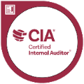


Your Service Team – Key Management
Role
Responsibility
Senior Manager/
Manager
Assistant Manager
Engagement Director
Overall responsibility for service and quality delivery
Ruby Rouben
Engagement Director
> 16 Years of Relevant Experience
Kwok Jing Yi
Jespreet Kaur
Responsible for project management and monitoring of timeline and deliverables
Senior Manager
> 10 Years of Relevant Experience
Manager
> 6 Years of Relevant Experience
Teo Wei Kang
Calvin Wong
James Yeo
Lead team in executing the project, fieldwork and documentation
Assistant Manager
> 5 Years of Relevant Experience
Assistant Manager
> 4 Years of Relevant Experience
Assistant Manager
> 4 Years of Relevant Experience
*The Risk Assurance Team has 15 team members.

Slide 18
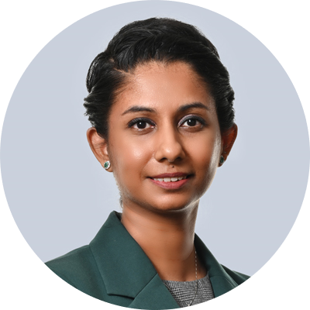
Your Service Team
Professional Experience
Ruby is the Director, Head – Risk Assurance at In.Corp. She has more than 16 years of experience in the audit profession, of which 10 years have been in a supervisory position.
Ruby has led the internal audit and risk advisory engagements with various Ministries (eg. MHA, MSF, MOH, MND, MOE, MCI), Organs of State (eg. Judiciary - Supreme Court of Singapore, President’s Office – ISTANA), Statutory Boards (eg. The Agency for Science, Technology and Research (A*STAR), ISEAS – The Yusof Ishak Institute, People’s Association, Civil Aviation Authority of Singapore, National Library Board, Council of Estate Agencies, Government Technology Agency, Land Transport Authority and Science Centre Board), Institutions of Higher Learning (eg. Ngee Ann Polytechnic, Republic Polytechnic, MDIS, Singapore School of the Arts), Multinationals (eg. Boeing Asia Pacific, ST Engineering), Public Listed Companies (eg. Old Chang Kee, Nordic Group, Union Steel, Asia Vets, Addvalue Technologies, Sinjia Land), Financial Institutions, Charities and Institutions of a Public Character (i.e. Yayasan Mendaki, Ang Mo Kio-Thye Hua Kwan Hospital, Sree Narayana Mission (Singapore).
Her involvement included the planning, execution and review of the different internal audit assignments. The various internal audit assignments have provided her with the necessary knowledge and skill set regarding the design and operating effectiveness of internal controls and procedures.
Ruby also provided her insights at the IIA conference panel discussions on data analytics and the whistleblowing process in August 2023 and May 2024, respectively.
She started her career in Ernst & Young LLP and worked on external audits and special audits for diverse industries notably property development, education, trading and telecommunications for international MNCs and SMEs.
Qualifications and Professional Memberships
Certified Internal Auditor (IIA)
Chartered Accountant, Singapore
Certificate in Sustainability for Finance
Bachelor of Accountancy (Nanyang Technological University)
Masters of Science – Management (University College Dublin)
Member, The Institute of Internal Auditors Singapore (IIA)
Member, Institute of Singapore Chartered Accountants (ISCA)
Member, Information Systems Audit and Control Association (ISACA)
Ruby Rouben
Engagement Director
Email
ruby@incorp.asia

Slide 19

Your Service Team
Professional Experience
Jing Yi has been in the audit profession for more than 10 years and has vast experience in a broad spectrum of industries such as financial institutions, education, property development, construction, trading, service providers, shipping, investment holding and solicitors’ audits. She has been also involved in various internal audits of government ministries, organs of state and statutory boards such as MOE Schools, Ministry of Home Affairs, Supreme Court of Singapore, Ministry of National Development, Ministry of Social and Family Development, Ministry of Health, Land Transport Authority, Science Centre Board, Ngee Ann Polytechnic, Charities, Institutions of Public Character (i.e. Yayasan Mendaki, Ang Mo Kio-Thye Hua Kwan Hospital, Sree Narayana Mission (Singapore)), public listed companies (i.e. Old Chang Kee, Asia Vets Holdings, Union Steel, Addvalue Technologies, Nordic Group, Sinjia Land, Dyna-Mac) and other private sector organisations (i.e. Boeing Asia Pacific Aviation Services, ST Engineering e-Services).
She is involved with Internal Audits, Enterprise Risk Management (ERM) and Sustainability Reporting work for companies listed on the SGX (i.e. Addvalue, Sinjia Land, Asia Vets Holdings, Koda Ltd) and GEMS HKEx. Jing Yi has also completed a consultancy project for the SME Business & Financial Management (BFM) Programme which involves working closely with her client to formulate a financial growth strategy and enhance their expansion plans.
Qualifications and Professional Memberships
Certified Internal Auditor (IIA)
Certificate in Sustainability Reporting
Certificate in Sustainability Frameworks and Ethics (CertSFE)
BSc (Hons) in Accounting and Finance
Member, The Institute of Internal Auditors Singapore (IIA)
Kwok Jing Yi
Senior Manager
Email
jingyikwok@incorp.asia

Slide 20

Your Service Team
Professional Experience
Jespreet has been in the auditing profession for more than 6 years and has vast experience in a broad spectrum of industries such as public healthcare, education, manufacturing, professional services firm and investment holding companies.
She has been also involved in various internal audits of government ministries and statutory boards such as MOE Schools, Ngee Ann Polytechnic, Ministry of Home Affairs, Ministry of Social and Family Development, Charities, Institutions of Public Character (i.e. Sree Narayana Mission (Singapore)), public listed companies (i.e. Old Chang Kee, Asia Vets Holdings) and other private sector organisations.
Her involvement included the planning and execution of the different internal audit assignments.
Jespreet started her career in Ernst and Young LLP and worked on external audits and special audits across diverse industries.
Qualifications and Professional Memberships
Chartered Accountant, Singapore
Bachelor of Accountancy (Nanyang Technological University)
Member, Institute of Singapore Chartered Accountants (ISCA)
Jespreet Kaur
Manager
Email
jespreetkaur@incorp.asia

Slide 21
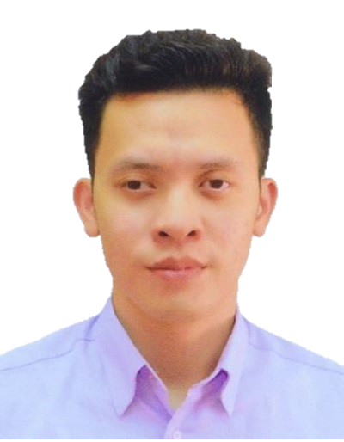
Your Service Team
Professional Experience
Wei Kang has over 5 years of experience in the audit profession, with a strong focus on internal audit and risk management. He has conducted comprehensive internal audits across business units, subsidiaries, and joint ventures—both local and overseas—covering industries such as engineering and construction, property management, manufacturing, professional services, and healthcare. His work includes evaluating the effectiveness of internal controls, identifying operational and financial risks, and recommending practical solutions to enhance efficiency and mitigate risk.
In addition to his internal audit expertise, Wei Kang has a solid foundation in financial audit through his roles at Big 4 and international accounting firms. He has managed statutory audits for SMEs, MNCs, listed companies, and NGOs across sectors such as retail, investment holding, healthcare, and manufacturing. He also participated in IPO audit engagements under U.S. GAAP, collaborating with U.S. counterparts to ensure audit quality and compliance.
Wei Kang is a Certified Internal Auditor (CIA) and holds a cybersecurity certification from ISC². His professional strengths include internal audit, risk assessment, regulatory compliance, and cross-border audit coordination.
Qualifications and Professional Memberships
Certified Internal Auditor (CIA)
CC – Certified in Cybersecurity
Bachelor of Accounting (Hons)
Member, The Institute of Internal Auditors Singapore (IIA)
Teo Wei Kang
Assistant Manager
Email
Weikang.teo@incorp.asia

Slide 22

Your Service Team
Professional Experience
James has 4 years of experience as a data protection professional, including more than 2 years specializing in IT governance, information security, and business continuity management. James's expertise extends to designing and implementing Privacy Information Management System (PIMS) and Information Security Management System (ISMS) frameworks to fortify data protection measures and effectively mitigate cybersecurity and data privacy risks.
In his previous role as Deputy Data Protection Officer for a Singapore-based organization with operations in Malaysia, Indonesia, and Vietnam, James was pivotal in developing and implementing a comprehensive ISMS compliant with ISO/IEC 27001:2013 standards. He managed key areas such as risk management, incident response, and business continuity. His contributions significantly enhanced the organization’s IT security posture and operational resilience.
He has also been involved in public sector internal audits such as MUIS. James is also involved in internal audits for Charities and Institutions of Public Character like Sree Narayana Mission and Public Listed Companies like Old Marco Polo Marine Limited and Dyna-Mac Holdings Ltd.
Qualifications and Professional Memberships
CC – Certified in Cybersecurity
Diploma in Business IT (Temasek Polytechnic)
ISO/IEC 27701 Provisional Implementer (PECB)
Advanced Certificate in Data Protection Principles (Singapore Management University)
James Yeo
Assistant Manager
Email
jamesyeo@incorp.asia

Slide 23

Your Service Team
Professional Experience
Calvin has been in the audit profession for over 4 years. Having started his career at PricewaterhouseCoopers LLP, Calvin led statutory audits across a diverse range of industries including F&B, wholesale trade and software development. He was mainly involved in executing of the audit plan, determining task allocation for team members and ensuring completion of deliverables within tight audit deadlines. He also worked on audits of property development, manufacturing and investment holding companies, as well as agreed-upon procedures and IPO audits. Having worked with multiple stakeholders on cross-border and group engagements, Calvin possesses strong stakeholder management.
Coming from an external audit background, Calvin built a strong internal audit foundation by conducting walkthroughs and performing test of controls over key business processes, as well as reviewing of internal audit reports. Through relevant audit procedures, he identified control deficiencies and subsequently proposed internal controls recommendations to management.
Qualifications and Professional Memberships
Chartered Accountant, Singapore
Bachelor of Accountancy (Singapore University of Social Sciences)
Member, Institute of Singapore Chartered Accountants (ISCA)
Calvin Wong
Assistant Manager
Email
calvin.wong@incorp.asia

Slide 24
Internal Audit Services

Slide 25
Internal Audit Plan – Background Information
We have performed a search on the Portal as at 7 November 2025:

Slide 26
Internal Audit Plan – Scope of Work (3 Year Plan)
The scope of the Internal Audit will span across 3 years taking a paced and phased approach for the following processes/ records of ABC:
Year | Year 1 | Year 2 | Year 3
Scope of Work | Compliance with Regulatory Framework and Governance Best Practices Procurement and Payments Human Resources and Payroll Processes Follow-up Review of Prior Report | Receipts and Collections Management of Grants and Compliance with Funding Agreements Donations and Fundraising Procedures Follow-up Review of Prior Report Enterprise Risk Management Review existing risks and update Risk Registers and ERM Policy Manual | Review Compliance with Personal Data Protection Act Fixed Assets and Capital Expenditure Management Information Technology Process Follow-up Review of Prior Report

Slide 27

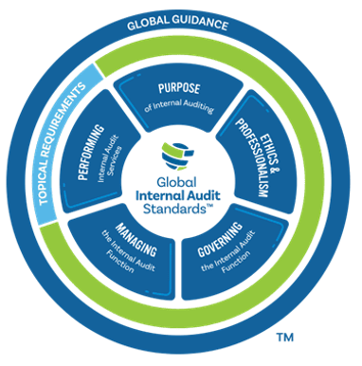





Internal Audit Methodology and Approach
Our Audit Methodology
The International Professional Practices Framework® (IPPF®) organises the authoritative body of knowledge promulgated by the IIA for the professional practice of internal auditing.
The Institute of Internal Auditors’ Global Internal Audit Standards guide the worldwide professional practice of internal auditing and serve as a basis for evaluating and elevating the quality of the internal audit function.
At the heart of the Standards are 15 guiding principles that enable effective internal auditing.
Each principle is supported by standards that contain requirements, considerations for implementation, and examples of evidence of conformance.
Domain I
Purpose of Internal Auditing
Domain II
Ethics and Professionalism
Domain III
Governing the Internal Audit Function
Domain IV
Managing the Internal Audit Function
Domain V
Performing Internal Audit Services

Slide 28





Internal Audit Methodology and Approach
OUR APPROACH TO INTERNAL AUDIT
Review and evaluate the adequacy and effectiveness of internal controls in the identified process.
Identify non-conformance, gaps, risks and potential implications in the process.
Make recommendations to improve internal controls for the identified areas of inadequacies or weakness.
Identify areas of improvement in terms of efficiency, economy and effectiveness and provide reasonable and practical recommendations.

Slide 29
Internal Audit Plan at a Glance
STRATEGISE
1
Re-confirmation of scope and testing requirements.
Sharing of preliminary risk analysis and discussion of expectations with management.
1
PLAN
STRATEGISE
PLAN
2
Detailed risk assessment using TeamMate Analytics and PowerBI
Identification of key risks and controls in the scope provided.
Identification of key process owners and scheduling of interviews.
Preparation of relevant documents/ information required.
2
5
2
KNOWLEDGE TRANSFER
EXECUTE
EXECUTE
Entrance meeting with key process owners.
Obtaining information through interviews and walkthroughs.
Evaluation and assessment of key internal controls in place, and identification of omitted controls or areas of weaknesses.
Testing of controls and gap analysis of policies and procedures.
Documentation and discussion of findings and recommendations.
3
4
3
FINALISE
FINALISE
4
Preparation of draft report for management’s comments action plans.
Conduct exit meeting with process owners.
Issuance of final report to management.
COMMUNICATION
KNOWLEDGE TRANSFER
5
Presentation of final report.
Post-implementation or follow-up reviews.

Slide 30
Internal Audit Plan – Scope of Work
Focus Area | Audit Procedures
1. Compliance with Regulatory Framework and Governance Best Practices | Review of compliance with the following relevant sections of the Regulations: Charities Act (cap 37) Part IV Charity Accounts, Reports and Returns Duty to keep Accounting Records Financial Statements Annual Audit Annual Reports Charities (Registration of Charities) Regulations Provisions relating to registered charities Charities (Accounts and Annual Report) Regulations Annual Report Charities (Institutions of A Public Character) Regulations Part IV Reporting and Disclosure Requirements Duty to furnish documents Requirements relating to financial statements and audits Charities (Institutions of A Public Character) Regulations Extension of approval of institution of a public character Review the key processes and internal controls in place to ensure compliance with the relevant laws and regulations. Assess the level of compliance of the corporate governance of the charities and/ or IPCs as stipulated in the relevant provisions in the Regulations. Report on the current state of governance/ management structures in the charities and/ or IPCs, and the extent to which existing structures comply with the Regulations. Take reference from the Code of Governance (“the Code”) applicable to the Charities and /IPC according to the applicable Tiers as defined in the Code.

Slide 31
Internal Audit Plan – Scope of Work
Focus Area | Audit Procedures
2. Procurement and Payments | Perform an end-to-end review on the procurement and payments process for all procurement types. Understand and evaluate key controls over purchases, in particular over the tendering, authorisation, and approval process. Review the internal control process over significant non-tender purchases. Review the effectiveness of procurement procedures and access if they are processed in compliance to the applicable policies and procedures and to prescribed Financial Approval limits. Review vendor evaluation process. Use of Data Analytics (if feasible) Perform data extraction and analysis on procurement transactions to identify potential irregularities that might be fraudulent in nature (e.g. questionable payments; irregular transactions with vendors/suppliers; suspicious purchasing patterns; potential duplicate payments; split purchase orders; potential conflict of interests between staff and vendors/suppliers etc).

Slide 32
Internal Audit Plan – Scope of Work
Focus Area | Audit Procedures
3. Human Resources and Payroll Processes | Evaluate human resource policies and procedures for compliance to employee compliance of policies, standard procedures and applicable laws and regulations. Walkthrough and testing of the key controls to ensure controls are operating effectively and consistently. Analyse and evaluate findings, identifying opportunities for improvements in controls and its recommendation. Recruitment Process Review recruitment and appointment. Assess compliance with policies, rules and procedures. Review to ensure accurate/ valid creation and approval of HR. Staff Record (including basic pay/ allowances/ deductions) To ensure that there is proper procedure in place for manpower planning; Changes to manpower establishment should be documented and approved. Review contract renewal. Assess key personnel appointment and renewal. Review to ensure accurate/ timely update of changes and approval in HR Staff Record. Review accuracy of increments/ bonus computations in accordance with approved/ established formulas. Resignation/Termination Process Review exit clearance process for staff termination/resignation. Review to ensure accurate/ timely termination of HR Staff Record.

Slide 33
Internal Audit Plan – Scope of Work
Focus Area | Audit Procedures
3. Human Resources and Payroll Processes | Payroll Payment Ensure payroll payments are valid and accurate (permanent and temporary staff); Review of regular and off-cycle payroll runs. Review controls over allowances, deductions and staff benefits. Review controls over cheque payments (including termination payouts). Review budgetary controls and monitoring over payroll fluctuations.

Slide 34
Internal Audit Plan – Scope of Work
Focus Area | Audit Procedures
4. Receipts and Collections | Perform an end-to-end review on the revenue and receipts process for all revenue streams. Review the revenue recognition method and controls. Understand and evaluate key controls over cash collections and contributions and services rendered. Evaluate safeguarding, banking-in and recording of collections. Evaluate safeguarding, banking-in and recording of services and receipts. Review recording and tracking of receipts. Test samples of income to relevant supporting documents, including bank statements and agreements to ensure proper cut-off. Use of Data Analytics (if feasible) Perform data extraction and analysis on sales transactions to identify potential irregularities that might be fraudulent in nature (questionable sales transactions; unrecorded sales transaction; suspicious transactions with customers; potential duplicate of sale records, etc).

Slide 35
Internal Audit Plan – Scope of Work
Focus Area | Audit Procedures
5. Management of Grants and Compliance with Funding Agreements | Review adequacy of relevant SOP to ensure adequate internal controls. Review delegations of authority from accounting officer to officers for processing and approving funding and payment to grant recipients. Review delegations of authority from accounting officer to officers for approving disbursement requests. Assess roles and responsibilities of the appointed officers to ensure proper segregation of duties with no conflict of interest. Evaluate budgeting and project monitoring mechanics to ensure that the ABC does not draw down excessively. Review controls to ensure prudent use and proper management of resources as well as proper accounting for any interest or revenue generating from resources held by ABC. Assess the funding application evaluation process in accordance to approved funding policy, principles, quantum and condition.

Slide 36
Internal Audit Plan – Scope of Work
Focus Area | Audit Procedures
6. Donations and Fundraising Procedures | Review adequacy of relevant SOP to ensure adequate internal controls. Understand and evaluate key controls over donations and the fund-raising process and test key controls. Review the effectiveness of policies/procedures in accounting for donations and expenditures associated with the fund-raising activities. Evaluate safeguarding, banking-in and recording of donations received from fund-raising activities. Review the process of engaging commercial fund-raisers. Check that written agreements are signed by all entities that wish to raise funds for the Charity. Assess the maintenance of donation records Evaluate reconciliation and review of donation monies received and receipts issued for fund-raising events. Review issuance of tax deduction receipts for fund-raising activities. Determine the sources of donations and assess accountability of donations. Review fund-raising committee (or other relevant party) roles and responsibilities. Review communication with the public / donors for fund-raising activities. Review tracking and recording of fund-raising instruments. Review tracking of donor intentions. Review tracking of fund-raising expenditure (i.e. 30/70 rule). Evaluate disclosure and reporting of fund-raising activities.

Slide 37
Internal Audit Plan – Scope of Work
Focus Area | Audit Procedures
7. Review Compliance with Personal Data Protection Act | Obtain inputs from stakeholders through the use of questionnaires. Conduct department interviews to develop baseline of PDPA readiness. Review definitions of sensitive personal data. Evaluate collection and identification of information assets and personal data. Assess personal data flow diagrams using data life cycle approach to map sensitive data (data acquisition, using, sharing, archiving, and disposing). Understand the IPC’s risk tolerance as it relates to PDPA compliance of the following 10 obligations: Accountability Obligation Notification Obligation Consent Obligation Purpose Limitation Obligation Accuracy Obligation Protection Obligation Retention Limitation Obligation Transfer Limitation Obligation Access and Correction Obligation Data Breach Notification Obligation Assess current status of personal data protection within the organization against Singapore PDPA to identify gaps related to the compliance of the 10 obligations in the PDPA and areas for improvement. Develop final recommendations to meet the 10 obligations and remediate the identified risks.

Slide 38
Internal Audit Plan – Scope of Work
Focus Area | Audit Procedures
8. Fixed Assets and Capital Expenditure Management | Review adequacy of relevant SOP to ensure adequate internal controls. Evaluate fixed asset policies and procedures for compliance to fixed assets policies, standard procedures and applicable laws and regulations. Understand the types of fixed assets and perform a quantitative review of fixed assets. Review and assess controls over acquisition, transfer, recording, maintenance and disposal of fixed assets. Review computation and review of depreciation expenses. Review the adequateness and appropriateness of capital expenditure requirements established by ABC. Assess if capital expenditures have been accurately accounted for. Determine if capital expenditures have been approved by the relevant and authorized personnel.

Slide 39
Internal Audit Plan – Scope of Work
Focus Area | Audit Procedures
9. Information Technology and Cybersecurity Process | Check that policies and procedures relating to IT systems, including physical security and logical security are established, approved and communicated to all relevant staff for adherence; Check that data security policy is established, approved and communicated to all relevant staff for adherence; Check that policies and procedures (including approval matrix) relating to organisation and management structure of access rights control, including segregation and monitoring of user access rights; Evaluate Information Technology and Cybersecurity policies and procedures for compliance to applicable regulations, standards and guidelines (e.g. NIST 2.0 Framework). Review the process over user access management (including user access, privileged access and remote access). Check that roles and responsibilities are defined for third-party IT vendors. Check that procedures are in place for management of third party services. Check that policies and procedures relating to request, feasibility studies and approval of system development, acquisition, updates and maintenance, are established, approved and communicated to all relevant staff for adherence; Check that requests for system developments, software applications, updates, enhancements and maintenance are approved by management, documented, tested, approved and implemented; Review adequacy of physical security and control of computer system server from unauthorised access and risk of physical damage; Review that a robust IT service management framework is in place. IT service management activities include configuration management, technology refresh management, patch management, change management, software release management, incident management and problem management.

Slide 40
Internal Audit Plan – Scope of Work
Focus Area | Audit Procedures
9. Information Technology and Cybersecurity Process | Check that cybersecurity monitoring and threat detection systems (e.g. Endpoint Detection and Response, Antivirus, Intrusion Prevention System, Intrusion Detection System and Security Information and Event Management) are in place and updated; Check that password controls are in place; Check that firewalls are in place; Check that usage of external storage device is limited; Check whether access to external websites are restricted; Check that critical and confidential/ sensitive data are protected, backed up and procedure is in place to assess the restorability of back-up data; Check incident reporting mechanisms are in place; and Check that disaster recovery and business continuity plan with regard to failure of IT systems are developed and duly approved.

Slide 41
Internal Audit Plan – Scope of Work
Focus Area | Audit Procedures
Review existing risks and update Risk Registers and ERM Policy Manual | To conduct a Risk Awareness and Risk Identification and Prioritisation Session/Workshop. To assist management to review and update existing Risk Inventory. To assist management to review the existing Tier 1 risks using tailored Risk Parameters and identify any new Tier 1 risks. To assist management to review the existing Risk Heat Maps for Tier 1 risks and prepare Risk Heat Maps for newly identified Tier 1 risks. To assist management to review and update existing ERM Policy and Framework.

Slide 42
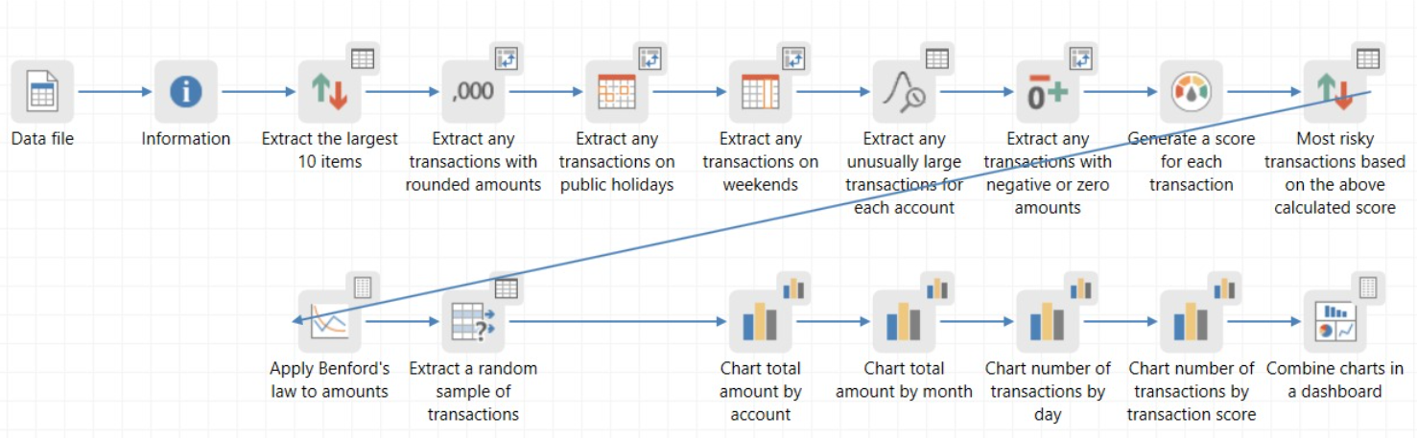

Internal Audit Plan – General Sampling Flow (An Illustration)
Selecting an initial sample
Testing the sample
Projecting the results
Verifying the outcome
We will estimate an appropriate sample size based upon their understanding of the population.
The selected sample is tested according to the predefined test criteria and the sample results calculated.
The implications for these results are projected across the population, providing a valid statistical estimate.
We will assess whether the result has sufficient precision/confidence for their purpose.

Slide 43
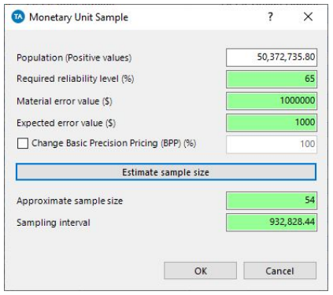

Internal Audit Plan – General Sampling Flow (An Illustration)
- Types of Sampling Methods
S/N | Type of Sampling Method | Illustrative Extract from
1 | Monetary Unit Sample Test (estimates, extracts and evaluates a statistically selected sample from your data)
2 | Random Sample Test (extracts several randomly sampled items from your data)

Slide 44
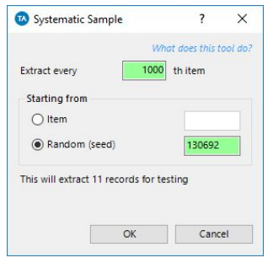
Internal Audit Plan – General Sampling Flow (An Illustration)
- Types of Sampling Methods
S/N | Type of Sampling Method | Illustrative Extract from
3 | Systematic Sample Test (extracts every ‘nth’ item from your data.)

Slide 45
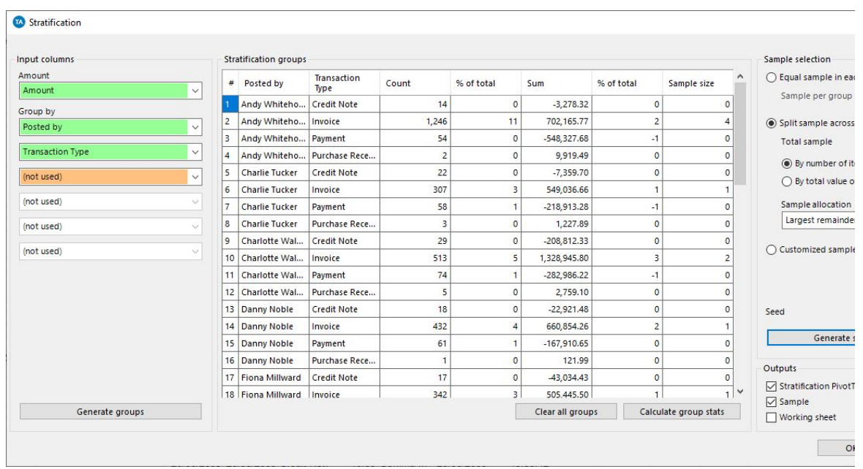
Internal Audit Plan – General Sampling Flow (An Illustration)
- Types of Sampling Methods
S/N | Type of Sampling Method | Illustrative Extract from
4 | Stratified Sample Test (splits your data into bands based on a numeric or date column, and selects a random sample from each band)

Slide 46
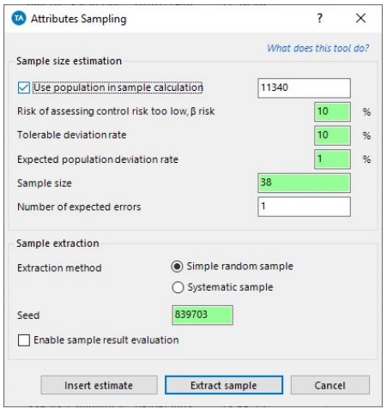
Internal Audit Plan – General Sampling Flow (An Illustration)
- Types of Sampling Methods
S/N | Type of Sampling Method | Illustrative Extract from
5 | Attributes Sample Test (calculates a sample size based on methodologies published by the IIA and AICPA then extracts the samples using Random or Systematic methods. You can also evaluate the results of the tested samples.)

Slide 47
Internal Audit Plan – Our Sampling Methodology
The samples will be selected and capped as follows:
Frequency of control activity | Assumed transactions size | Minimum sample size
 |  | Risk of failure
 |  | High | Medium | Low
Annual | 1 | 1 | 1 | 1
Quarterly | 4 | 2 | 2 | 2
Monthly | 12 | 5 | 3 | 2
Weekly | 52 | 15 | 10 | 5
Daily | 250 | 40 | 30 | 20
Recurring manual control (multiple times per day) | Over 250 | 60 | 40 | 25
For control activities that are under 250 or do not fall under any of the frequencies, 30% of the population is adopted to determine the sample size.

Slide 48





Internal Audit Plan – Our 5-Part Sample Report
Our Internal Audit Report Would Comprise the Following 5 Components, which include Data Analytics Insights, Positive Controls and Good Practices, Opportunities for Improvements and Best-fit and Curated Sample Templates to Assist Management on the Proposed Management Action Plans.
Data Analytics Insights (if applicable)
Positive Controls and Good Practices
Main Audit Observations
Opportunities for
Improvement
Best-fit and Curated Sample Templates
Using our Audit Tools, we share Business Insights and Data Visuals with management, in addition to adopting a Risk-Based Audit Approach and Targeted Testing for our internal audit.
We distinguish our audit reports by including the Positive Controls and Good Practices that we observe during the course of our audit work so that our report presents a balanced output.
We will identify non-conformance, gaps, risks and potential implications in the processes and procedures and make recommendations to improve internal controls
Focus on Root Cause Analysis.
We will identify Opportunities for Improvement in terms of efficiency, economy and effectiveness and provide reasonable and practical recommendations.
We will provide Best-fit and Curated Sample Templates to Assist Management to effectively implement the Proposed Management Action Plans.

Slide 49
Internal Audit Plan – Structure of Audit Report
Observation – [Title of Observation]
Risk Ranking | High | Medium | Low
Recommendations
Proposed recommendations
Summary, Criteria and Current Reality
Management Comments
Details of audit observation (including Condition, Criteria, Cause and Effect)
Details on Management’s explanations and rectification actions on the observations. These should also address the root cause of the observations
Root Cause
Root cause analysis relating to the following areas:
Process
People
Technology
Target Implementation Date
Date should show commitment of when the rectification actions would be completed
Possible Implications
Person / Unit Responsible
Possible risk / effects arising from the observation
An appropriate person with a senior level of seniority or the accountable unit should be identified

Slide 50


Internal Audit Plan – Root Cause Analysis
Root cause analysis is a process for understanding 'what happened' and solving a problem by looking back and drilling down to find out 'why it happened' in the first place. Then, rectify the issue(s) so that it does not happen again or reduce the likelihood of it happening again.
Root Cause Category (Level 1) | Root Cause Category (Level 2) | Root Cause Category (Level 3)
People | Skill / Knowledge | Lack of relevant skills, expertise, and experience
 |  | Lack of awareness, including risk awareness
 | Oversight / Attention failure/ Misperception in senses | Carelessness (e.g. missing / incorrect / timeliness of action)
 | Deliberate / malicious intent | Omitting action or procedure with deliberate intention
 |  | Collusion / Fraud
 | Assessment / Consideration / Judgement | Poor planning
 |  | Failure to note or analyse applicable information
 | Execution / Implementation | Misunderstanding of procedures or instructions
 |  | Insufficient resources (e.g. financial or manpower)
 | Communication | Insufficient communication
 | Leadership/Culture | Lack of emphasis towards governance, risk, and internal control
 |  | Management override (includes the conduct of activities that are not in line with guidelines)
Process | Design | Insufficient or lack of relevant tools / controls implemented
 |  | SOPs, procedures, processes, workflow not clearly/correctly defined
 | Implementation | Controls/Automated tools not implemented adequately or correctly
 | Monitoring | Insufficient monitoring or testing scenarios by relevant authority and/or 3rd party vendor(s)
Technology | Hardware / Premises | Inadequate Physical Security (Unauthorized access, theft, sabotage, etc.)
 | Data | Inadequate data management practices
People
Technology
Process

Slide 51
Internal Audit Plan – Audit Risk Rating System
Category | Low | Medium | High
Compliance | Controls are generally in place; and/or Minor deviation from established policies and procedures resulting in minimal impact Where sampling is conducted, the number of erroneous samples does not exceed 10% of the total sample size | Minor control weaknesses exist; and/or Moderate deviation / non-compliance from established policies and procedures resulting in moderate impact Where sampling is conducted, the number of erroneous samples is between 10% to 50% of the total sample size | Significant control weaknesses exist; and/or Significant deviation / non-compliance from established policies and procedures resulting in significant impact Where sampling is conducted, the number of erroneous samples exceeds 50% of the total sample size
Operational | Minor disruptions to the core operations; and/or Minimal operational ineffectiveness and inefficiency | Moderate disruption to the core operations; and/or Moderate operational ineffectiveness and inefficiency | Major disruption to the core operations; and/or Significant operational ineffectiveness and inefficiency
Financial | Minor losses relative to the process, i.e. <10% | Moderate losses relative to the process, i.e. <40% | Significant losses relative to the process, i.e. >40%
Legal | Minor breaches of statutory/regulatory requirements and/or contractual provisions resulting in minimal impact | Moderate breaches of statutory/regulatory requirements and/or contractual provisions resulting in moderate impact | Significant breaches / non-compliance of statutory /regulatory requirements and/or contractual provisions resulting in significant impact
Reputational | Unlikely loss of stakeholders’ trust and/or confidence | Negative media publicity or possible loss of stakeholders’ trust and/or confidence | Adverse media publicity or likely loss of stakeholders’ trust and/or confidence
Safety | Negligible safety threat | Moderate safety threat | Serious safety threat

Slide 52
Internal Audit Plan – Proposed Engagement Conclusion
Engagement Conclusion | Evaluation Criteria | Basis and Implications of Rating | Management Actions Needed
Adequate and Effective | No High or Medium finding | If there were no finding Our review indicates that the organisation has designed controls that are generally adequate, effective and operating as intended to provide reasonable assurance that risks are being managed and objectives should be met. | Continual monitoring and on-going compliance with internal controls.
 |  | If there were only Low findings Our review indicates that the organisation has designed controls that are generally adequate and effective in achieving their intended objectives, some controls are not consistently applied, with potential low risk impact.
Acceptable with Isolated Exceptions | No High finding; and 1 - 5 Medium findings | Our review indicates that although the organisation has designed controls that are fairly adequate and effective in achieving their intended objectives, a couple of controls are not consistently applied, with potential low to medium risk impact. | Prompt actions to address the control deficiencies and/ operating effectiveness exceptions noted while continuing to monitor and comply with internal controls.
Some Improvements Needed | No High finding; and 6 - 10 Medium findings | Our review indicates that although the organisation has designed controls in place in achieving their intended objectives, several controls are inadequate/ineffective or are not consistently applied, with potential medium risk impact. | Management should follow up promptly on the audit recommendations by the agreed implementation dates and to assess if any additional internal controls need to be established.
Requires Prompt Management Attention | High finding; or 11 or more Medium findings | Our review indicates that although the organisation has designed controls in place in achieving their intended objectives, there are one or more critical controls and/or many controls that are inadequate/ineffective or are not consistently applied, with potential medium to high-risk impact to the organisation. | Management should follow up on the audit recommendations on an immediate basis and to conduct further reviews to improve the overall control environment.

Slide 53
Internal Audit Plan – Proposed Timeline
Internal Audit | Timeline
 | Wk 1 | Wk 2 | Wk 3 | Wk 4 | Wk 5 | Wk 6 | Wk 7 | Wk 8 | Wk 9 | Wk 10 | Wk 11 | Wk 12 | Wk 13 | Wk 14 | Wk 15
Entrance Meeting to Kick-start the Audit
Request for Information and selection of samples
Conduct Process Walkthroughs and perform fieldwork and clarifications
Internal Discussions and Reviews of Potential Audit Observations
Discuss Potential Observations
Draft Observations and Recommendations
Submit Draft Audit Report and Conduct Exit Meetings
Obtain Management Responses
Review Management Responses
Submit Final Report
Present to Management/Board (where applicable)

Slide 54
Professional Fees

Slide 55
Professional Fees
The proposed fee in Singapore dollars for our professional services is set out below:
Year | Description | Professional Fees (S$)
Year 1 (2026) | Provision of Internal Audit Services for ABC (3 audit areas)
Year 2 (2027) | Provision of Internal Audit Services for ABC (3 audit areas)
 | Review existing risks and update Risk Registers and ERM Policy Manual for ABC
Year 3 (2028) | Provision of Internal Audit Services for ABC (3 audit areas)
Notes
Our proposed fee excludes goods and services tax (GST) and reasonable out-of-pocket expenses which will be billed as incurred.
The Internal Audit Services will be engaged on a year-on-year renewal.
Fees will be payable 30 days upon issuance of invoice by In.Corp. In.Corp shall issue invoices for the Services as follows:
30% of the fees upon commencement of fieldwork, 50% of the fees upon issuance of the draft report; and
Balance upon issuance of the final report or one month after issuance of the draft report, whichever is earlier.

Slide 56
InCorp’s Strengths and Differentiators

Slide 57




InCorp’s Strengths and Differentiators
InCorp has served over 30 Charities/IPCs and 12 Welfare Homes over the last five years. As such, the firm and service team have institutional knowledge of the code of governance and operations for Charities/IPCs and Welfare Homes.
InCorp has supported the Institute of Internal Auditors (IIA) for the Charity Transparency Awards (CTA) assessment validations in 2020, 2022 and 2024.
InCorp utilises data analytics and visualisation tools such as TeamMate Analytics and PowerBI for improved understanding of the data and communication.
InCorp has been appointed to the ISCA Charities Anti-Money Laundering and Countering the Financing of Terrorism (AML/CFT) Services Panel in October 2024. In collaboration with the Office of the Commissioner of Charities, ISCA set up a Charities Anti-Money Laundering and Countering the Financing of Terrorism (AML/CFT) Services Panel to provide charities with subsidised services to help strengthen their AML/CFT measures.

Slide 58
Value-added Services

Slide 59




Value Added Services - Advisory
Advisory of Emerging Risks for Charities and Controls to Mitigate Identified Risks
Identify emerging risks specific to the religious sector (financial, governance, reputational, operational, and external).
Assess current control frameworks and benchmark them against best practices.
Advise Board, Audit Committee and Management on key emerging risks and controls.
The Advisory of Emerging Risks for Charities and Controls to Mitigate Identified Risks, as a value-added service, is to share insights about the charity environment and also learning lessons gathered from other charities.

Slide 60

Thank You!
Group HQ’s website
www.incorp.asia

