Slide 1
HSP - Proposal for Vietnam Services
29 June 2026
PRIVATE & CONFIDENTIAL

Slide 2
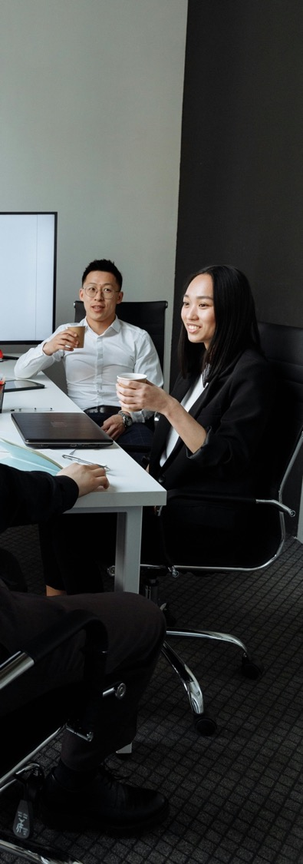
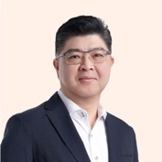

Our Background
Founding Management
Mr. Lennard Yong
Founding Management & Group CEO of Ascentium
Industry Advisor for Hillhouse
CEO for last 13 years and previously Group CEO for Tricor (exited 2021)
25+ years in the financial and professional services industry and CA/CPA
Ms. Wendy Wang
Founding Management & Group President of Ascentium
Industry Advisor for Hillhouse
Previous Group COO/CFO for Tricor (exited 2021)
25+ years in the business services industry and CPA
2

Slide 3












Why Partner with Ascentium?
Industry Reputation
50+
Years Operating Track Record
59
Cities
Served
27
Markets Covered
High-Quality Service
2,900+
Professionals
5,400+
New Incorporations
Annually
16,000+
Tax Filings Annually
Tech-Enabled Client Platform
65,000+
Client Entities
40,000+
Active Clients
488,000+
Payslips Processed Annually

Slide 4

Our Global Footprint
Asia Pacific
From Americas to APAC
Singapore (Headquarters)
Australia
Chinese Mainland
Hong Kong SAR
India
Indonesia
Japan
Labuan
Macau SAR
Malaysia
Mongolia
Philippines
South Korea
Taiwan
Thailand
Vietnam
From APAC to Europe, UK & Middle East
From Europe, UK & Middle East to Americas
Europe, UK & Middle East
Cyprus
Germany
Italy
Poland
United Kingdom
United Arab Emirates
From Europe, UK & Middle East to APAC
Americas
Brazil
British Virgin Islands
Cayman Islands
United States
Uruguay
From APAC to Americas

Slide 5
Corporate Services
Our Service Offerings
Incorporation & Business Formation
Company Secretarial & Compliance (Private Co, ListCo, MNC, etc.)
Director Services
Trademark, Licenses, Copyright Registration
Share Registry
Advisory
Financial Advisory
M&A Advisory
Insolvency / Liquidation
Fund, Trust and Fiduciary Services
Cross Border / FDI Specialist Services
Trust Services
Fund Governance & Administration
Trustee & Trust Administration
Market Entry Advisory
Industrial Park & Business Partners
Cross-Border Compliance
China’s ODI & Registration in Circular 37
UAE Free Zone & Mainland Trade License
International Expansion
Accounting and Tax Services
Accounting & Finance
Tax Filing & Compliance
Tax Advisory
Transfer Pricing
Government Incentive Plans
Risk Assurance & Audit
Private Client Services / Family Office
Internal Audit
Risk Assurance
ESG (Environmental, Social & Governance)
Compliance & Governance Solutions
Audit
Private Wealth
Family Office
Tax Planning
Escrow, Custody & Administration of Project Funds
HR Services
Business Intelligence
Immigration & Expatriate Services
Payroll Outsourcing & PEO/EOR Services
Outplacement Services
Professional Resources Solutions & Recruitment
HR Outsourcing & Advisory
Market & Sector Analysis
Location & Site Benchmarking
Partner, Supplier, & Ecosystem Screening
Regulatory, Policy, & Incentive Assessment
Market Entry & Expansion Feasibility
Government & Economic Development Organisation Support

Slide 6
Vietnam Fee Schedule
Corporate Services |  | Occurrence | Fees (USD)
1 | Foreign Direct Investment (FDI) Liability Limited Company (LLC) Registration (100% foreign owned company), includes Investment Registration Certificate (IRC) and Enterprise Registration Certificate (ERC) Proposed Business Activities: To be confirmed Estimated timeline: 40-60 working days | One-off | 3,500 – 5,000 Subject to location and business activities
2 | Bank account opening Estimated timeline: 15-20 working days | One-off | Inclusive in incorporation
3 | Government, translation and other administration fees | One-off | 250
4 | Virtual office – in HCMC only | Annually | 1,200
5 | Application of Business License To be confirmed based on affirmed business activities | One-off | To be confirmed
Fees exclude taxes, disbursements and out-pocket-expenses.

Slide 7
Vietnam Fee Schedule
Corporate Services |  | Occurrence | Fee (USD)
6 | Nominee Legal Representative – if necessary To fulfill residency requirement services, non-executive role, requires executive Legal Representative from client for business/commercial matters Subject to concurrent engagement of Accounting and Tax Compliance Services Requires signing Letter of Indemnity | Annually | 6,000 3,000 One-off deposit applies, to be returned upon service termination
7 | VNeID account registration for Nominee Legal Representative - if needed | One-off | 250
8 | VNeID account registration for Company – if needed | One-off | 500
9 | Company Secretarial Preparation of corporate governance documentation e.g. Meeting Minutes, Resolutions Update changes which are relating to the ERC Storage of documents Stamping support | Annually | 1,800
Fees exclude taxes, disbursements and out-pocket-expenses.

Slide 8
Vietnam Fee Schedule
Accounting & Tax Compliance Services |  | Occurrence | Fees (USD)
1 | Initial accounting system set up | One-off | 1,000
2 | Bookeeping and Reporting - Up to 10 transactions per month Chief Accountant appointment Quarterly Corporate Income Tax (CIT) and Value-Added Tax (VAT) filing Annual CIT finalization Foreign Investment & Statistical Reporting | Annually | 6,275 100 one-off for additional 30 transactions per month – if any
3 | Treasury support Up to 05 invoices per month Up to 05 payments per month | Annually | 1,200 40 one-off for additional 5 invoices or payments per month – if any
4 | Annual Vietnam Accounting Standard (VAS) Financial Report and audit liaison | Annually | 750
Fees exclude taxes, disbursements and out-pocket-expenses.

Slide 9
Vietnam Fee Schedule
HR and Payroll Services |  | Occurrence | Fees (USD)
1 | Initial set up including HR templates | One-off | 1,000
2 | Monthly Payroll, Insurances, Personal Income Tax Processing & Reporting (up to 10 local employees) | Monthly | 325
3 | Labour Report Preparation and Submission | Annually | 200
4 | Year end Personal Income Tax Finalization for the Company (up to 20 local employees) | Annually | 200
5 | Routine HR and admin support (up to 10 employees) | Monthly | 75
6 | Work Permit (up to 2 years) | One-off | 700 / application
7 | Temporary Residence Card (up to 2 years) | One-off | 700 / application
8 | Business visa application (up to 3 months, multiple entries) | One-off | 500 / application
Fees exclude taxes, disbursements and out-pocket-expenses.

Slide 10

We Are Ascentium
We are the professionals you'd recommend to a friend. We are the team that gets it, stays on it, and solves it.
We are human-first, technology-enabled, and relentlessly focused on your experience.
We believe in better.
Do you?

Slide 11
Contact Us
Lok Kah Seng, Associate Director – Group Commercial
E : kahseng.lok@ascentium.com
M : +65 8454 8107 (SG) I +84 335 411 329 (VN)

