Slide 1
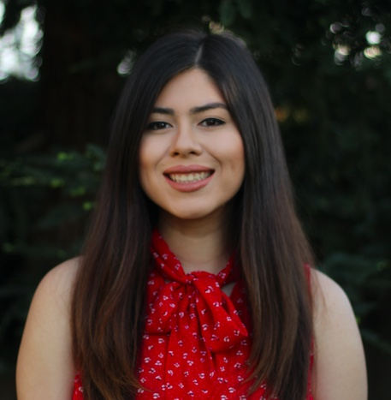
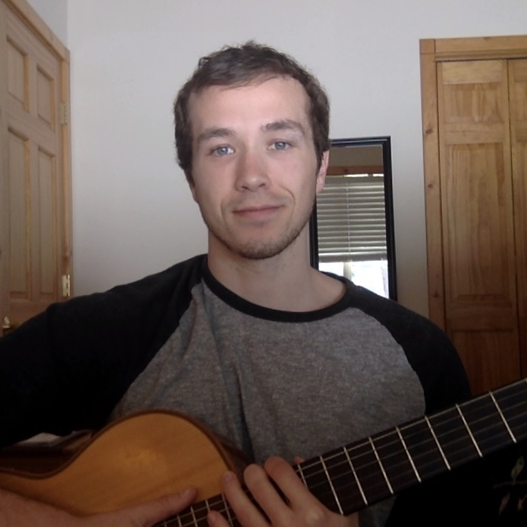

Dynamics of Disease Spread: COVID-19
Abby Saenz
Chris Lefrak
Philip Esguerra

Slide 2
Objectives:
Use an SIR/SEIR model to study COVID-19 as a dynamical system.
Implement agent-based modeling.
Make predictions about how various behaviors and parameters (i.e. the mandated shelter in place) will effect the system in coming months.
Propose an optimal method to vaccinate once a vaccine is available.

