Slide 1
Outline
Overview of existing literature
Fuller et al
Sept 2016 review
Methods overview
Emphasize distinctions form what they’ve seen
Meld review of what’s in the paper and what they have seen with how we responded to their recommendations
Initial high level results, eg several example communities 2020 only
Flagging how these fill gaps in ESR
Next deeper results, eg 2020 vs 2016-19 for a few important communities
Horizon pointing
MDS
Diff sp groupings, eg CVA high vs low ranks
Pre post catch shares

Slide 2
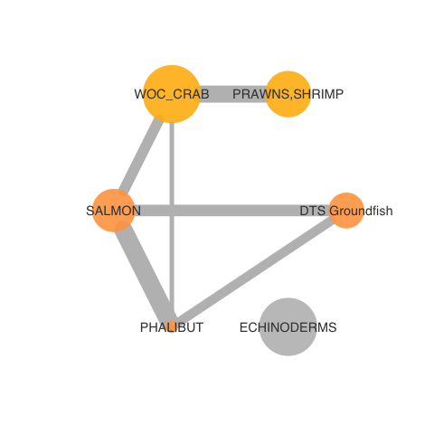
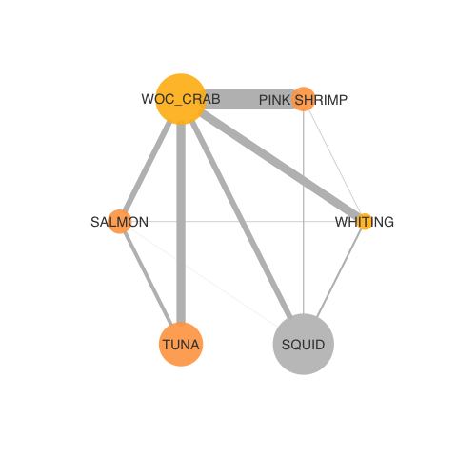
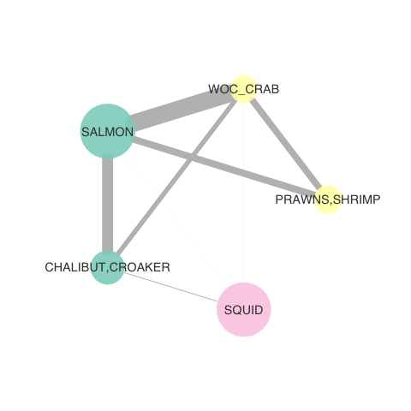
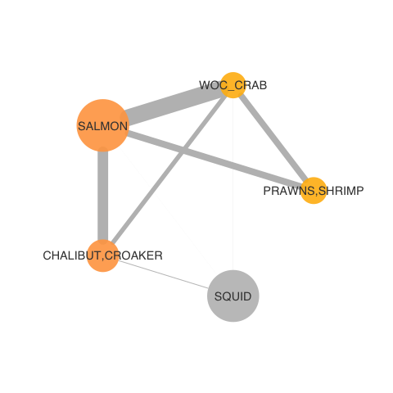
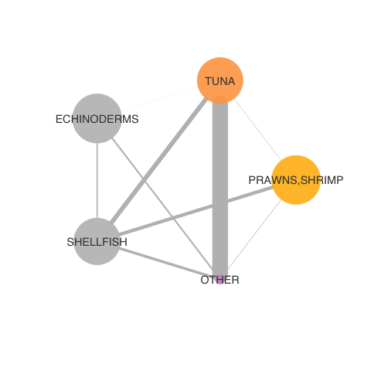
2019-2020 fisheries participation networks (by IOPAC port group)
North Washington Coast
Nodes: 6
Newport
Nodes: 6
Monterey
Nodes: 5
San Diego
Nodes: 5

Slide 3
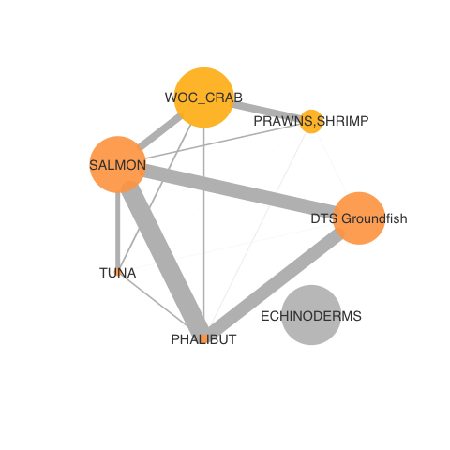
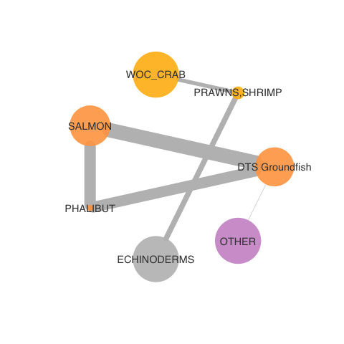
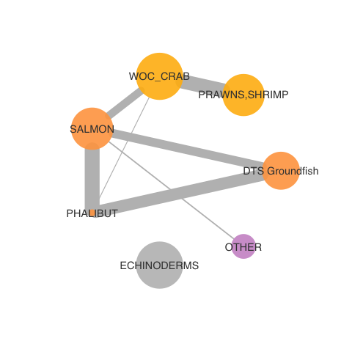
North WA Coast over time: simplifying?
2016-17
2017-18
2018-19
2019-2020

Slide 4
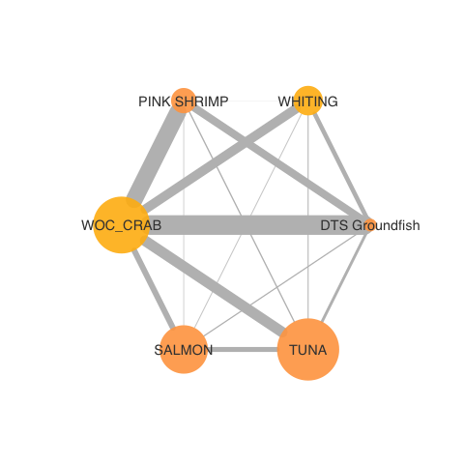
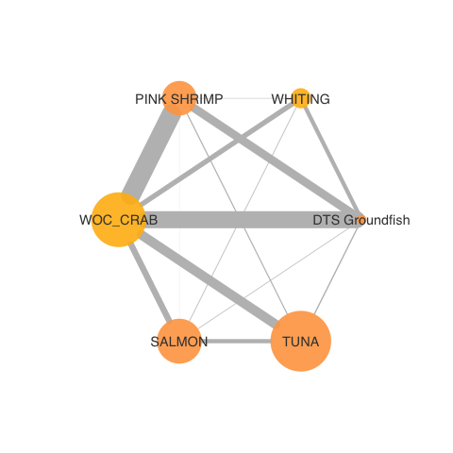
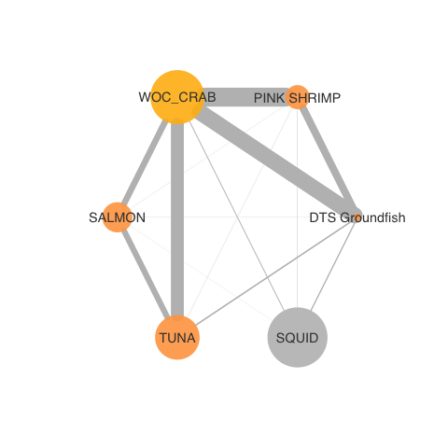
Newport over time: less connected?
2016-17
2017-18
2018-19
2019-2020

Slide 5
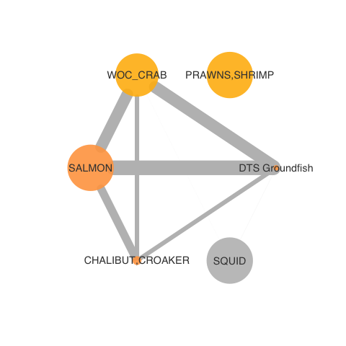
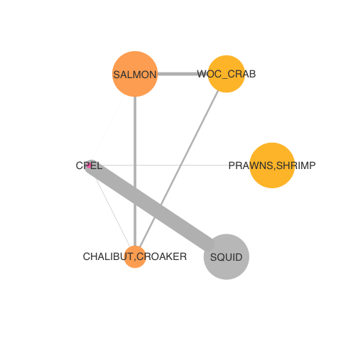
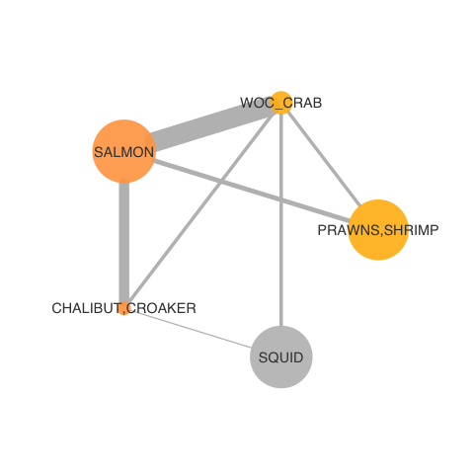
Monterey over time: variable?
2016-17
2017-18
2018-19
2019-2020

Slide 6
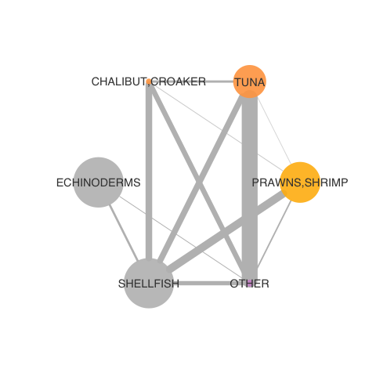
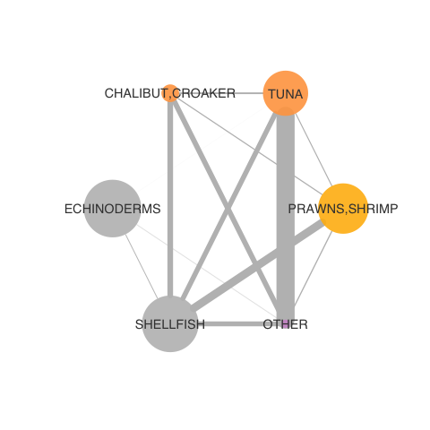
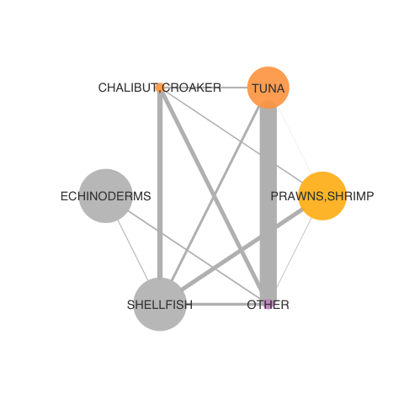
San Diego over time: consistent?
2016-17
2017-18
2018-19
2019-2020

