Slide 1
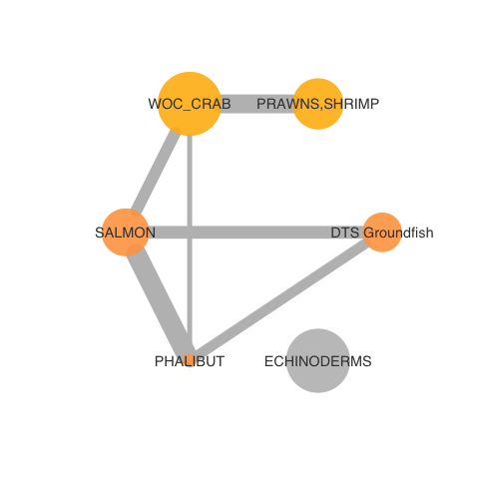
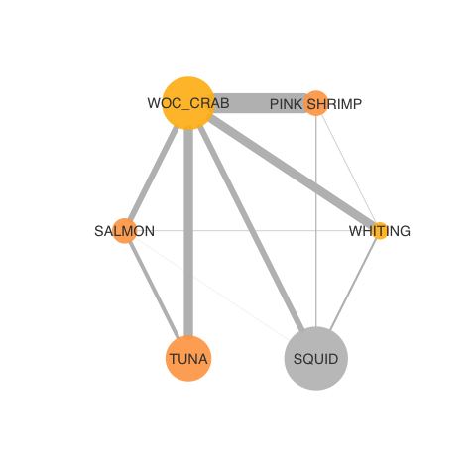
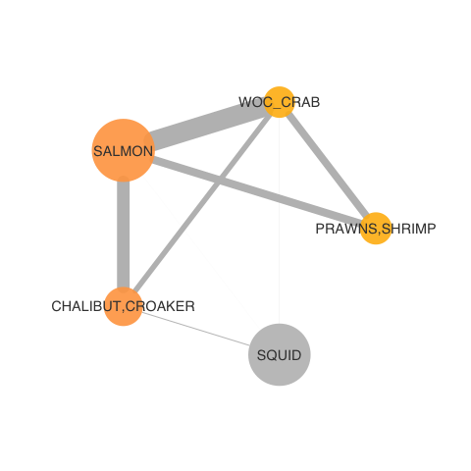
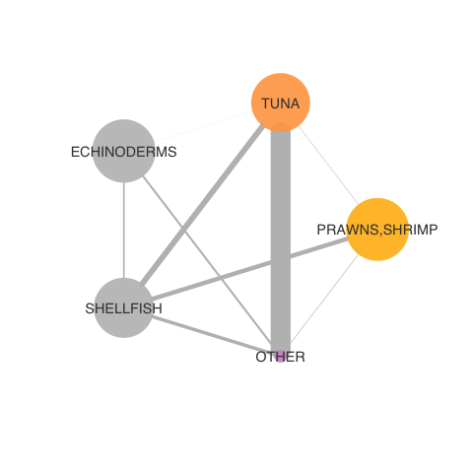
2019-2020 fisheries participation networks (by IOPAC port group)
North Washington Coast
Nodes: 6
Newport
Nodes: 6
Monterey
Nodes: 5
San Diego
Nodes: 5

Slide 2
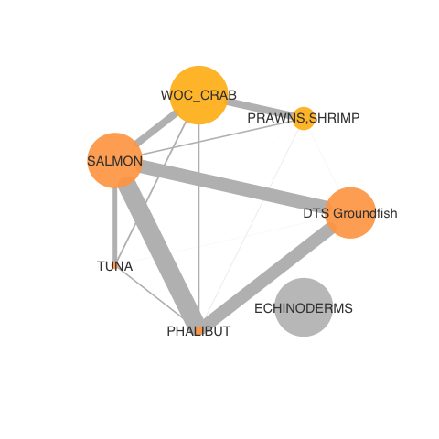
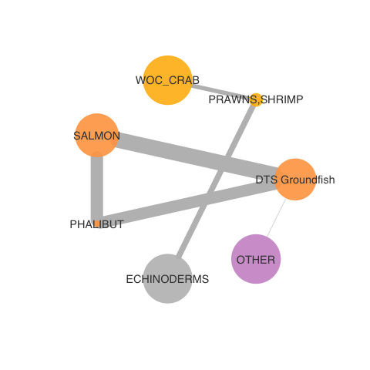
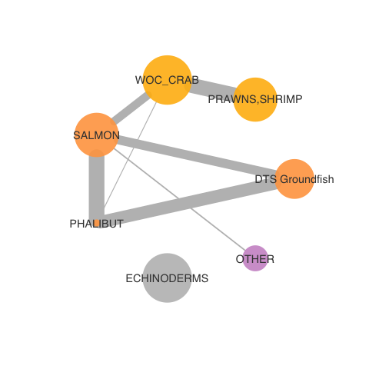
North WA Coast over time: simplifying?
2016-17
2017-18
2018-19
2019-2020

Slide 3
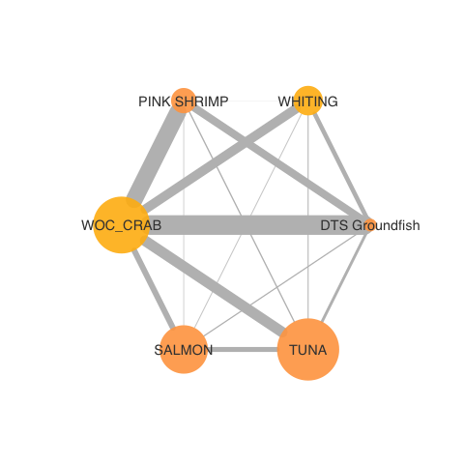
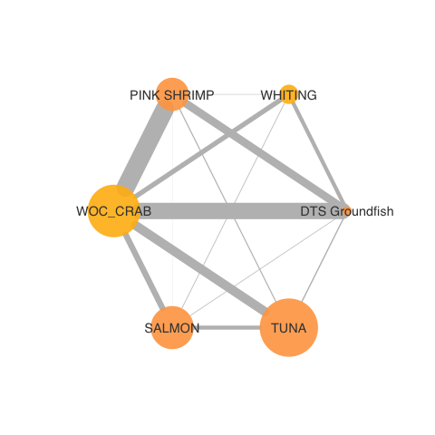
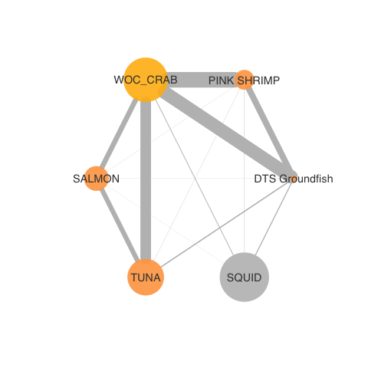
Newport over time: less connected?
2016-17
2017-18
2018-19
2019-2020

Slide 4
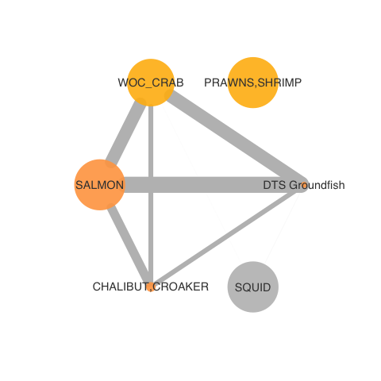
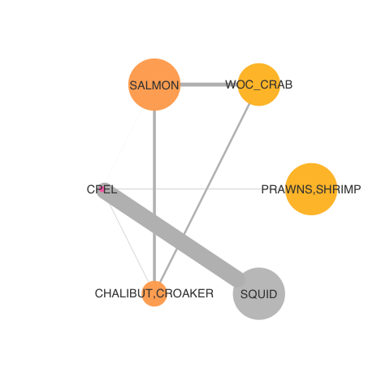
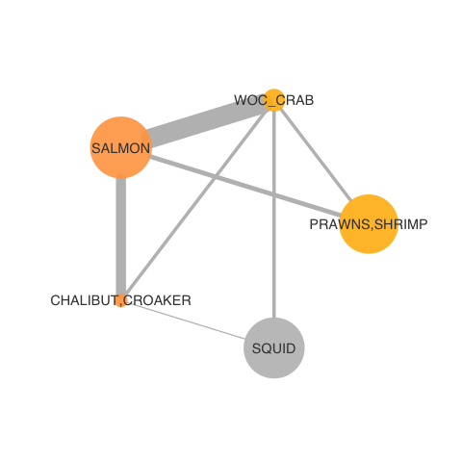
Monterey over time: variable?
2016-17
2017-18
2018-19
2019-2020

Slide 5
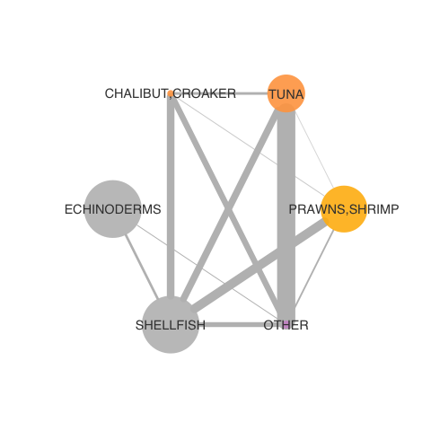
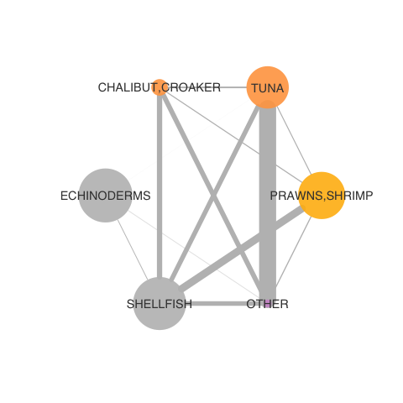
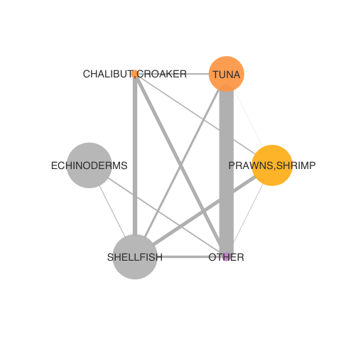
San Diego over time: consistent?
2016-17
2017-18
2018-19
2019-2020

