Slide 1
Discriminant function analysis
(A supervised machine learning algorithm)

Slide 2
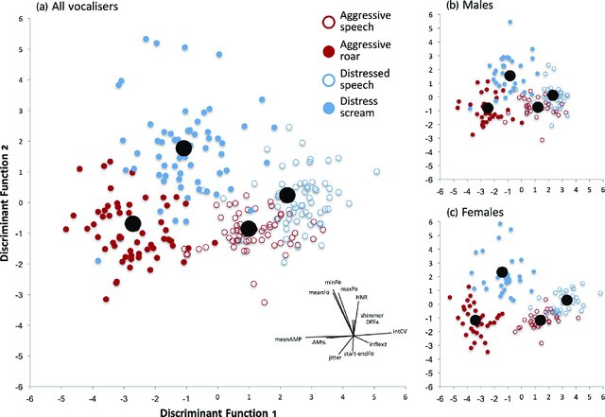
Main Goals
A multivariate test of differences between
groups
Determine the minimum number of dimensions
needed to describe these differences
Classify unknown observations based on the
variables analyzed (prediction)
Main assumptions
Multivariate normal distribution
each of the dependent variables is normally distributed within groups,
any linear combination of the dependent variables is normally distributed
subsets of the variables must be multivariate normal.
Homogeneity of variances/covariances
Absence of outliers
Low multicollinearity
Alternatives
Quadratic Discriminant Analysis
k-nearest neighbors (KNN),
Logistic regression
Random forest
…

Slide 3
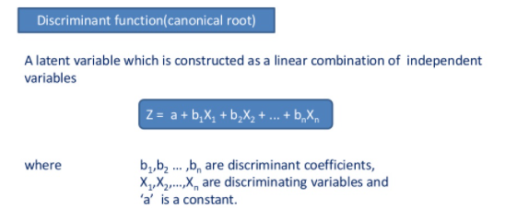
Discriminant function analysis is multivariate analysis of variance (MANOVA) reversed.
MANOVA
DA
Home range | Time still | Last time recorded
1 | 20 | 7
0.7 | 10 | 20
1.1 | 30 | 30
5 | 1 | 3
7 | 5 | 4
11 | 3 | 5
Group
Dead
Dead
Dead
Alive
Alive
Alive
Group
Dead
Dead
Dead
Alive
Alive
Alive
Home range | Time still | Last time recorded
1 | 20 | 7
0.7 | 10 | 20
1.1 | 30 | 30
5 | 1 | 3
7 | 5 | 4
11 | 3 | 5
~
~

Slide 4
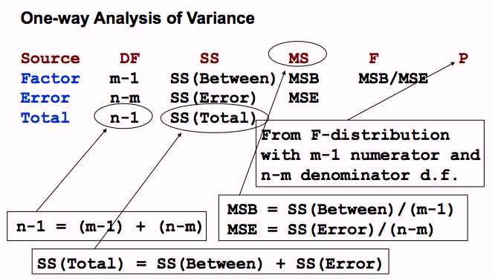
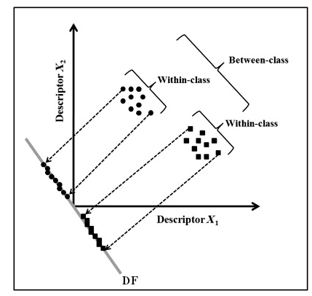
First step
multivariate F tests
Second step
If significant:
- See which of the variables have significantly different means across the groups
Determine some optimal combination of variables so that the first function provides the most overall discrimination between groups, the second provides second most, and so on.
Classification is then possible from the discriminant functions. Sampling units are classified in the groups in which they had the highest classification scores.

Slide 5
There is one discriminant function for 2- group discriminant analysis.
For higher order DA, the number of functions is the lesser of (g - 1), where g is the number of groups, or p,the number of discriminating (independent) variables.
Each discriminant function is orthogonal to the others.

