Slide 1

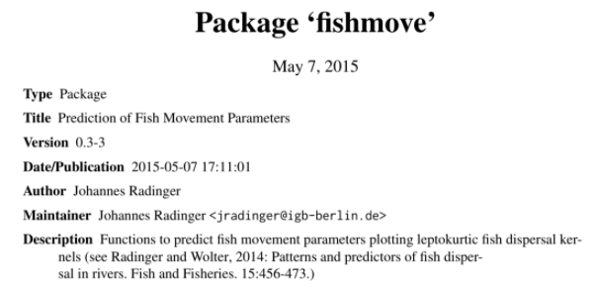
Movement is affected by:
fish body size
aspect ratio of the caudal fin
stream order
duration of the study

Slide 2
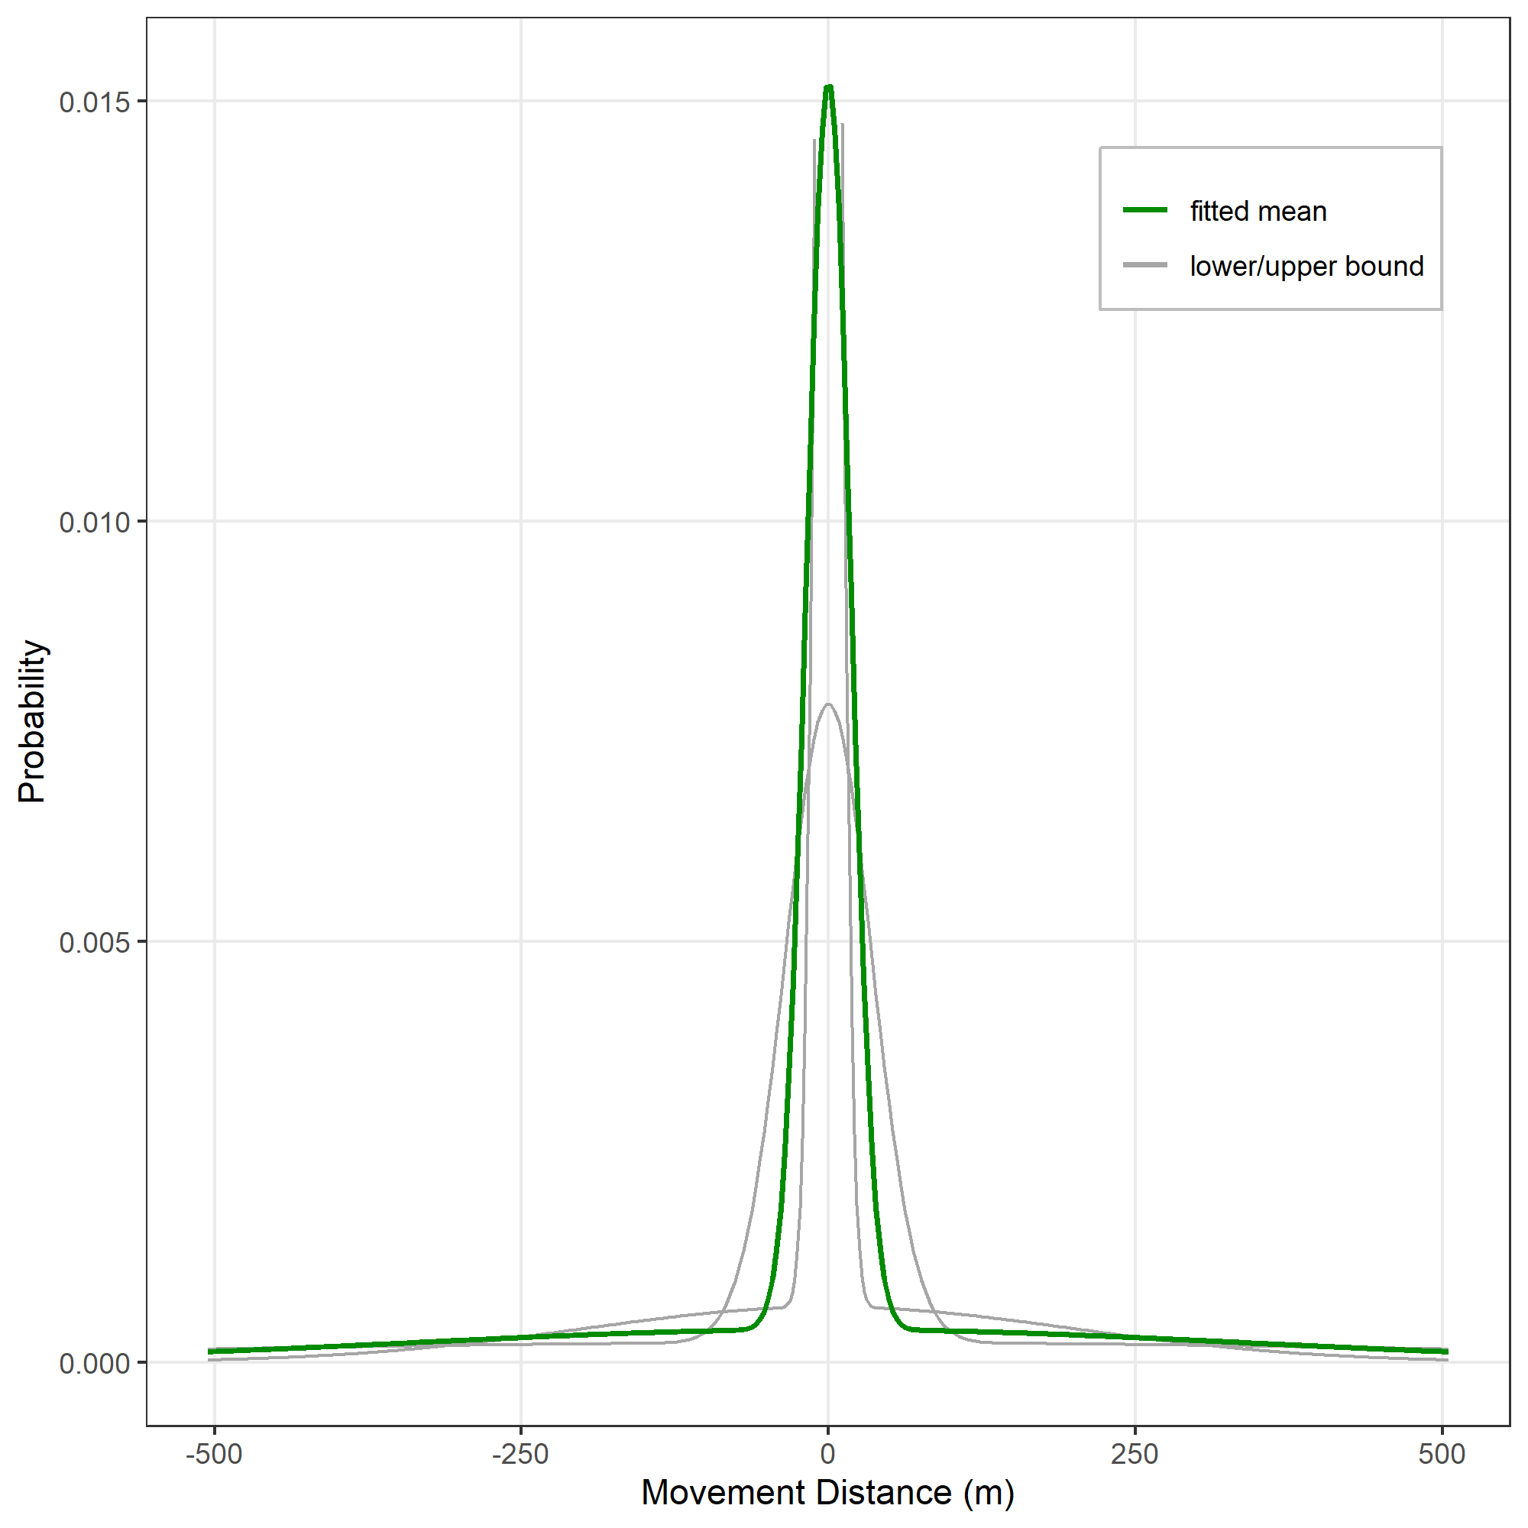
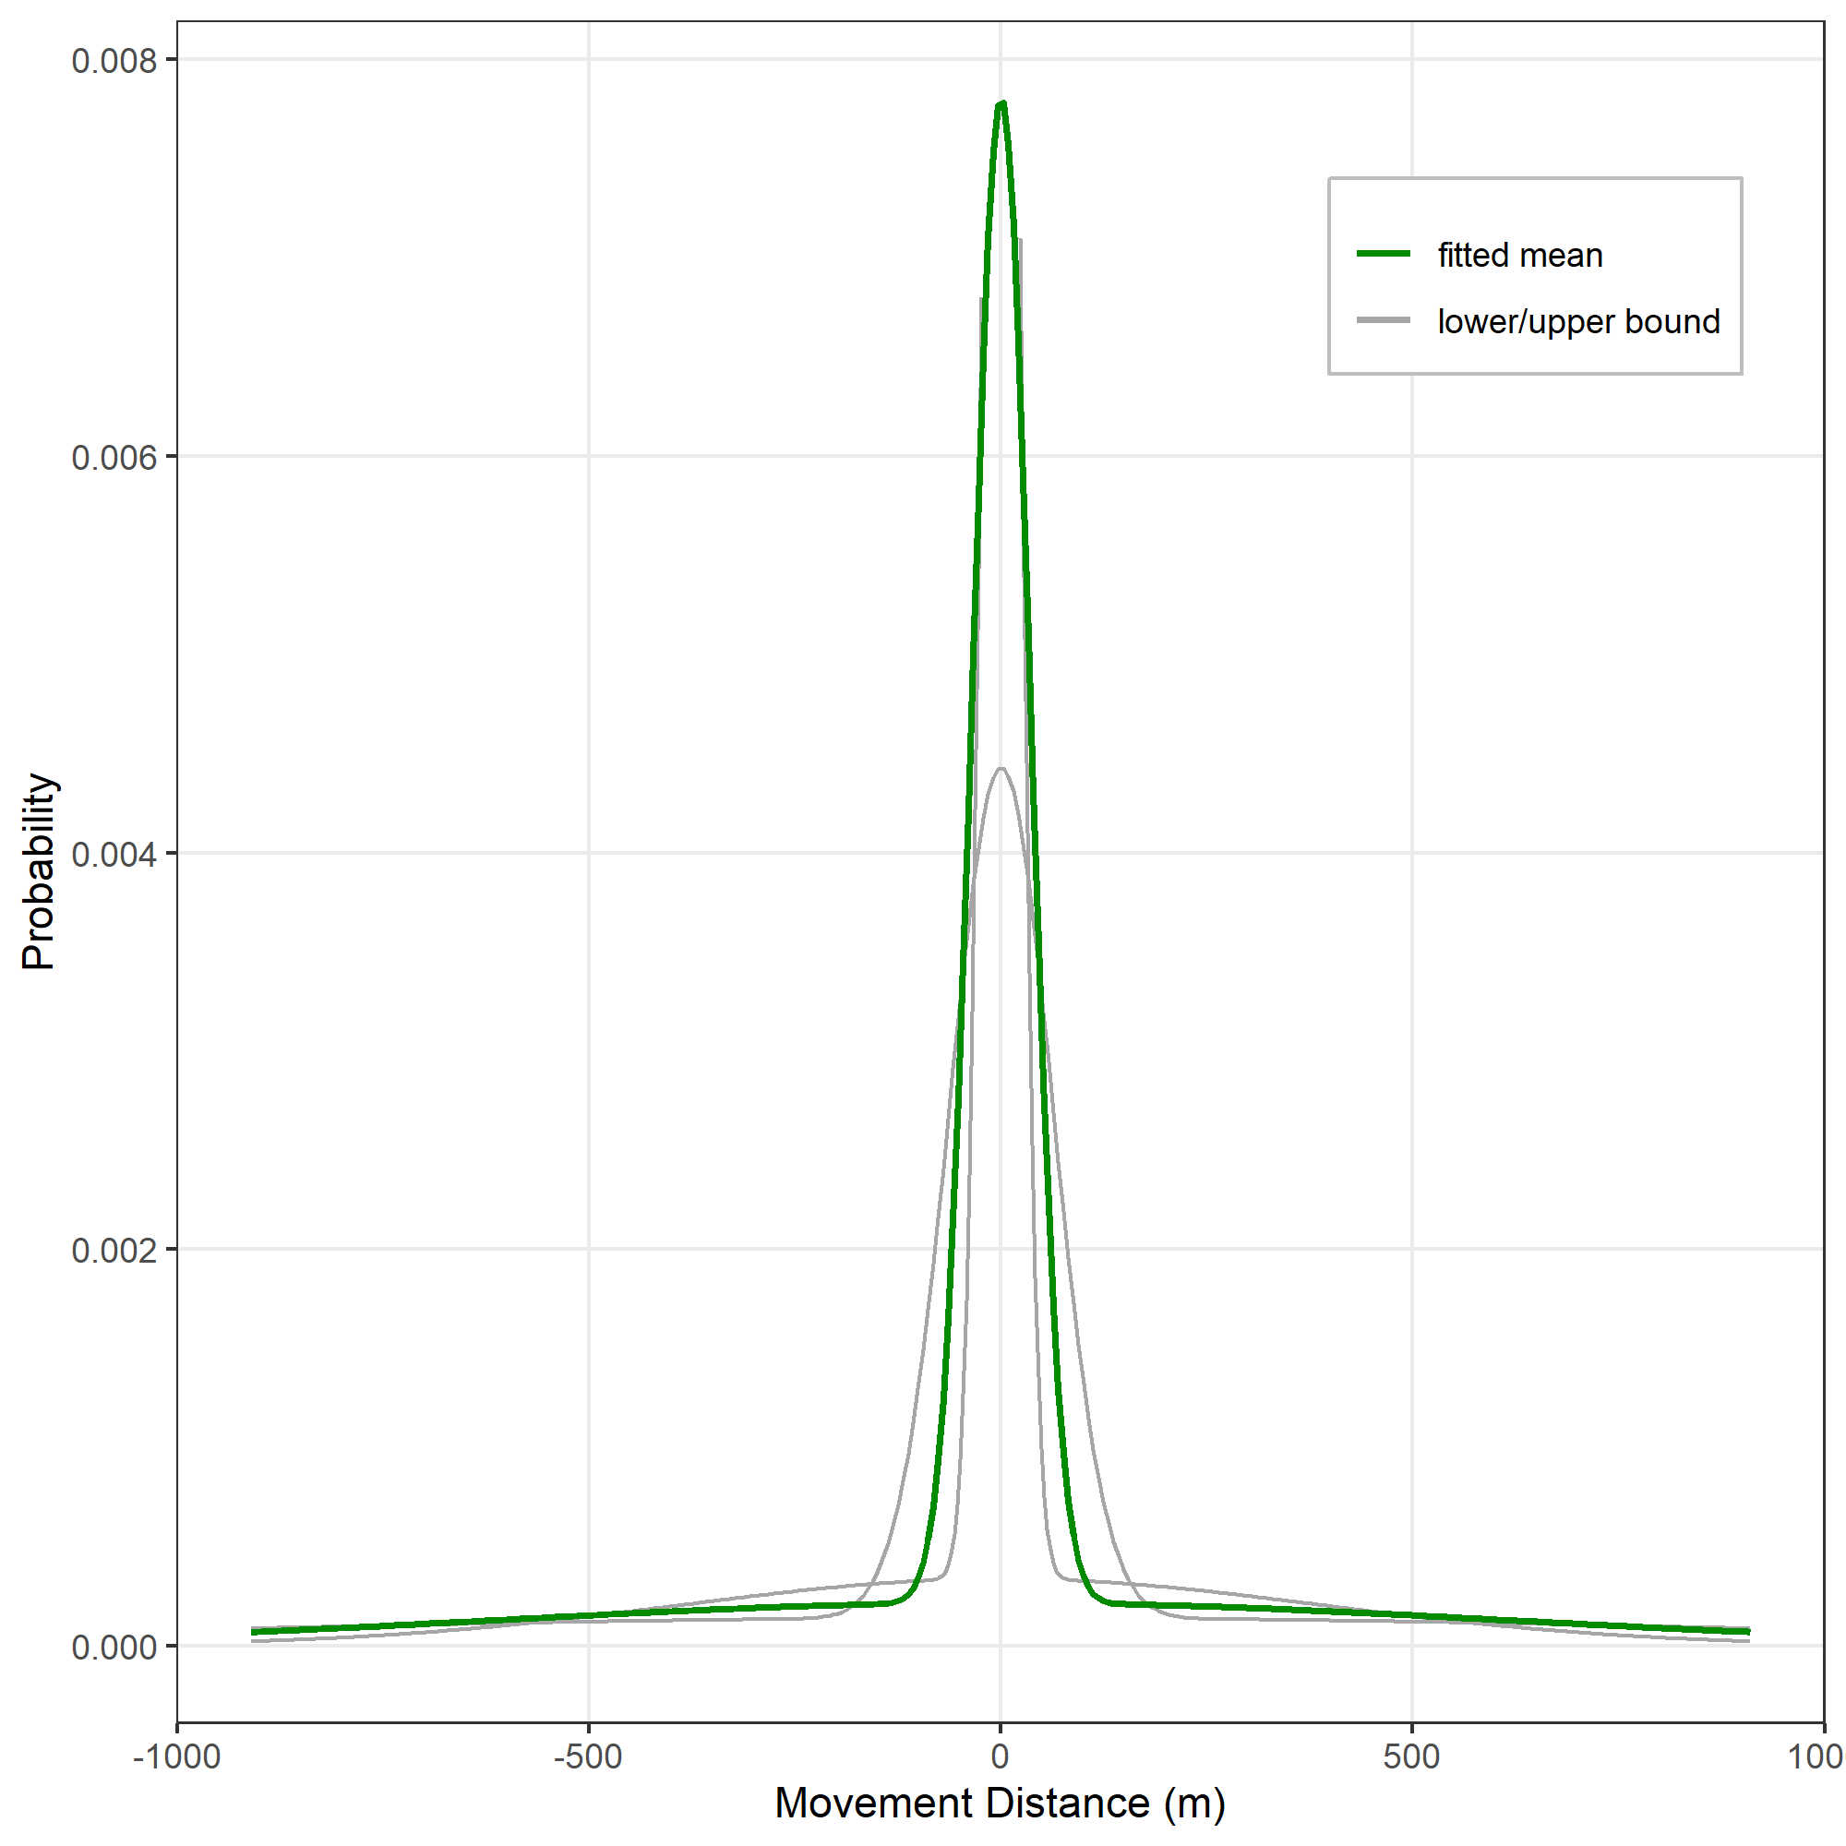
Bluegill movement – 30 days
Bluegill movement – 30 days
Body size: 120 mm
Body size: 180 mm

Slide 3
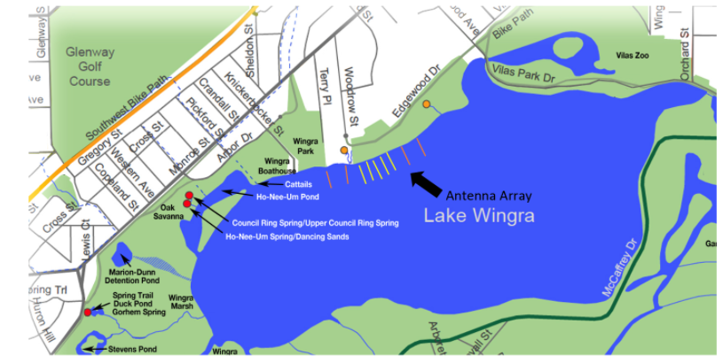
5 antennas running perpendicular to shore and spaced maybe 40-60’ (12.19-18.29 meters) apart
The remaining 4 antennas would be a bit further out - say 150’ (45.72 meters) apart
Total Antenna array: 800 feet (243.84 m)

Slide 4
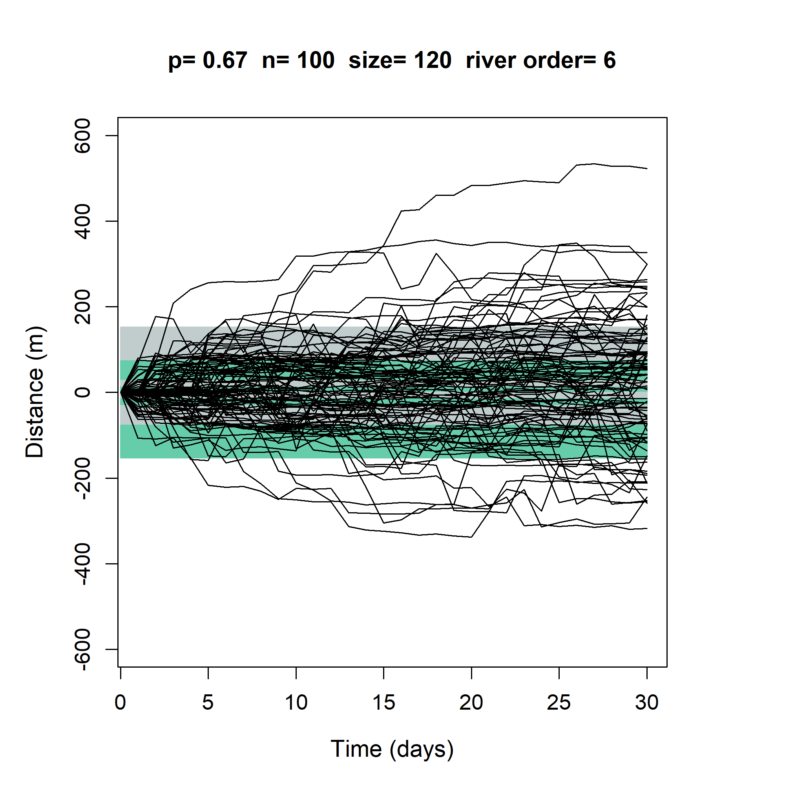
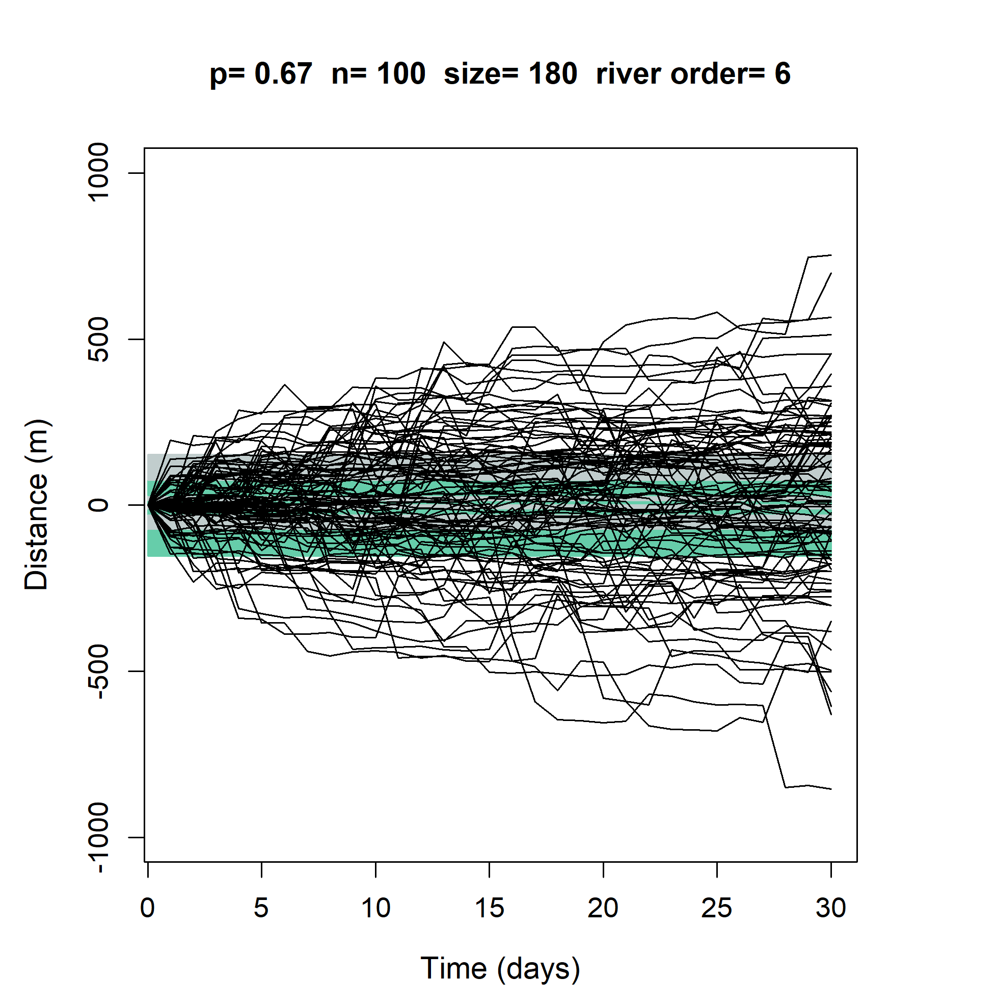
P= Stationary component of the population

Slide 5
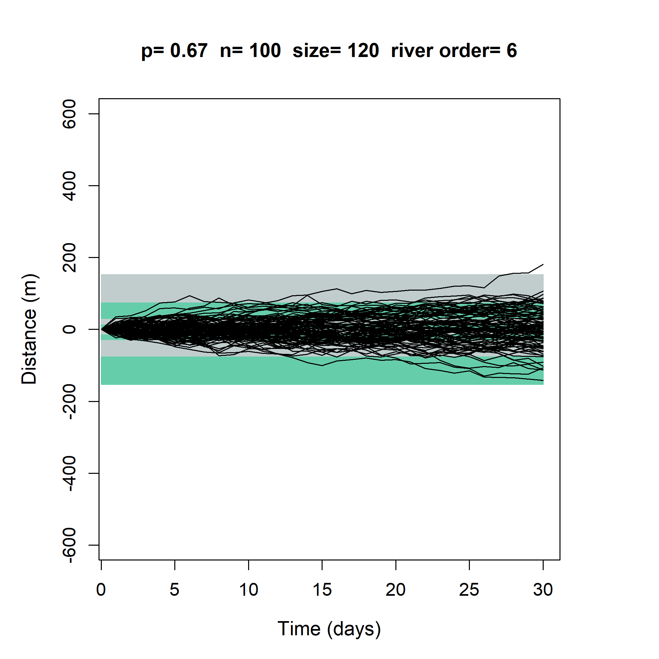
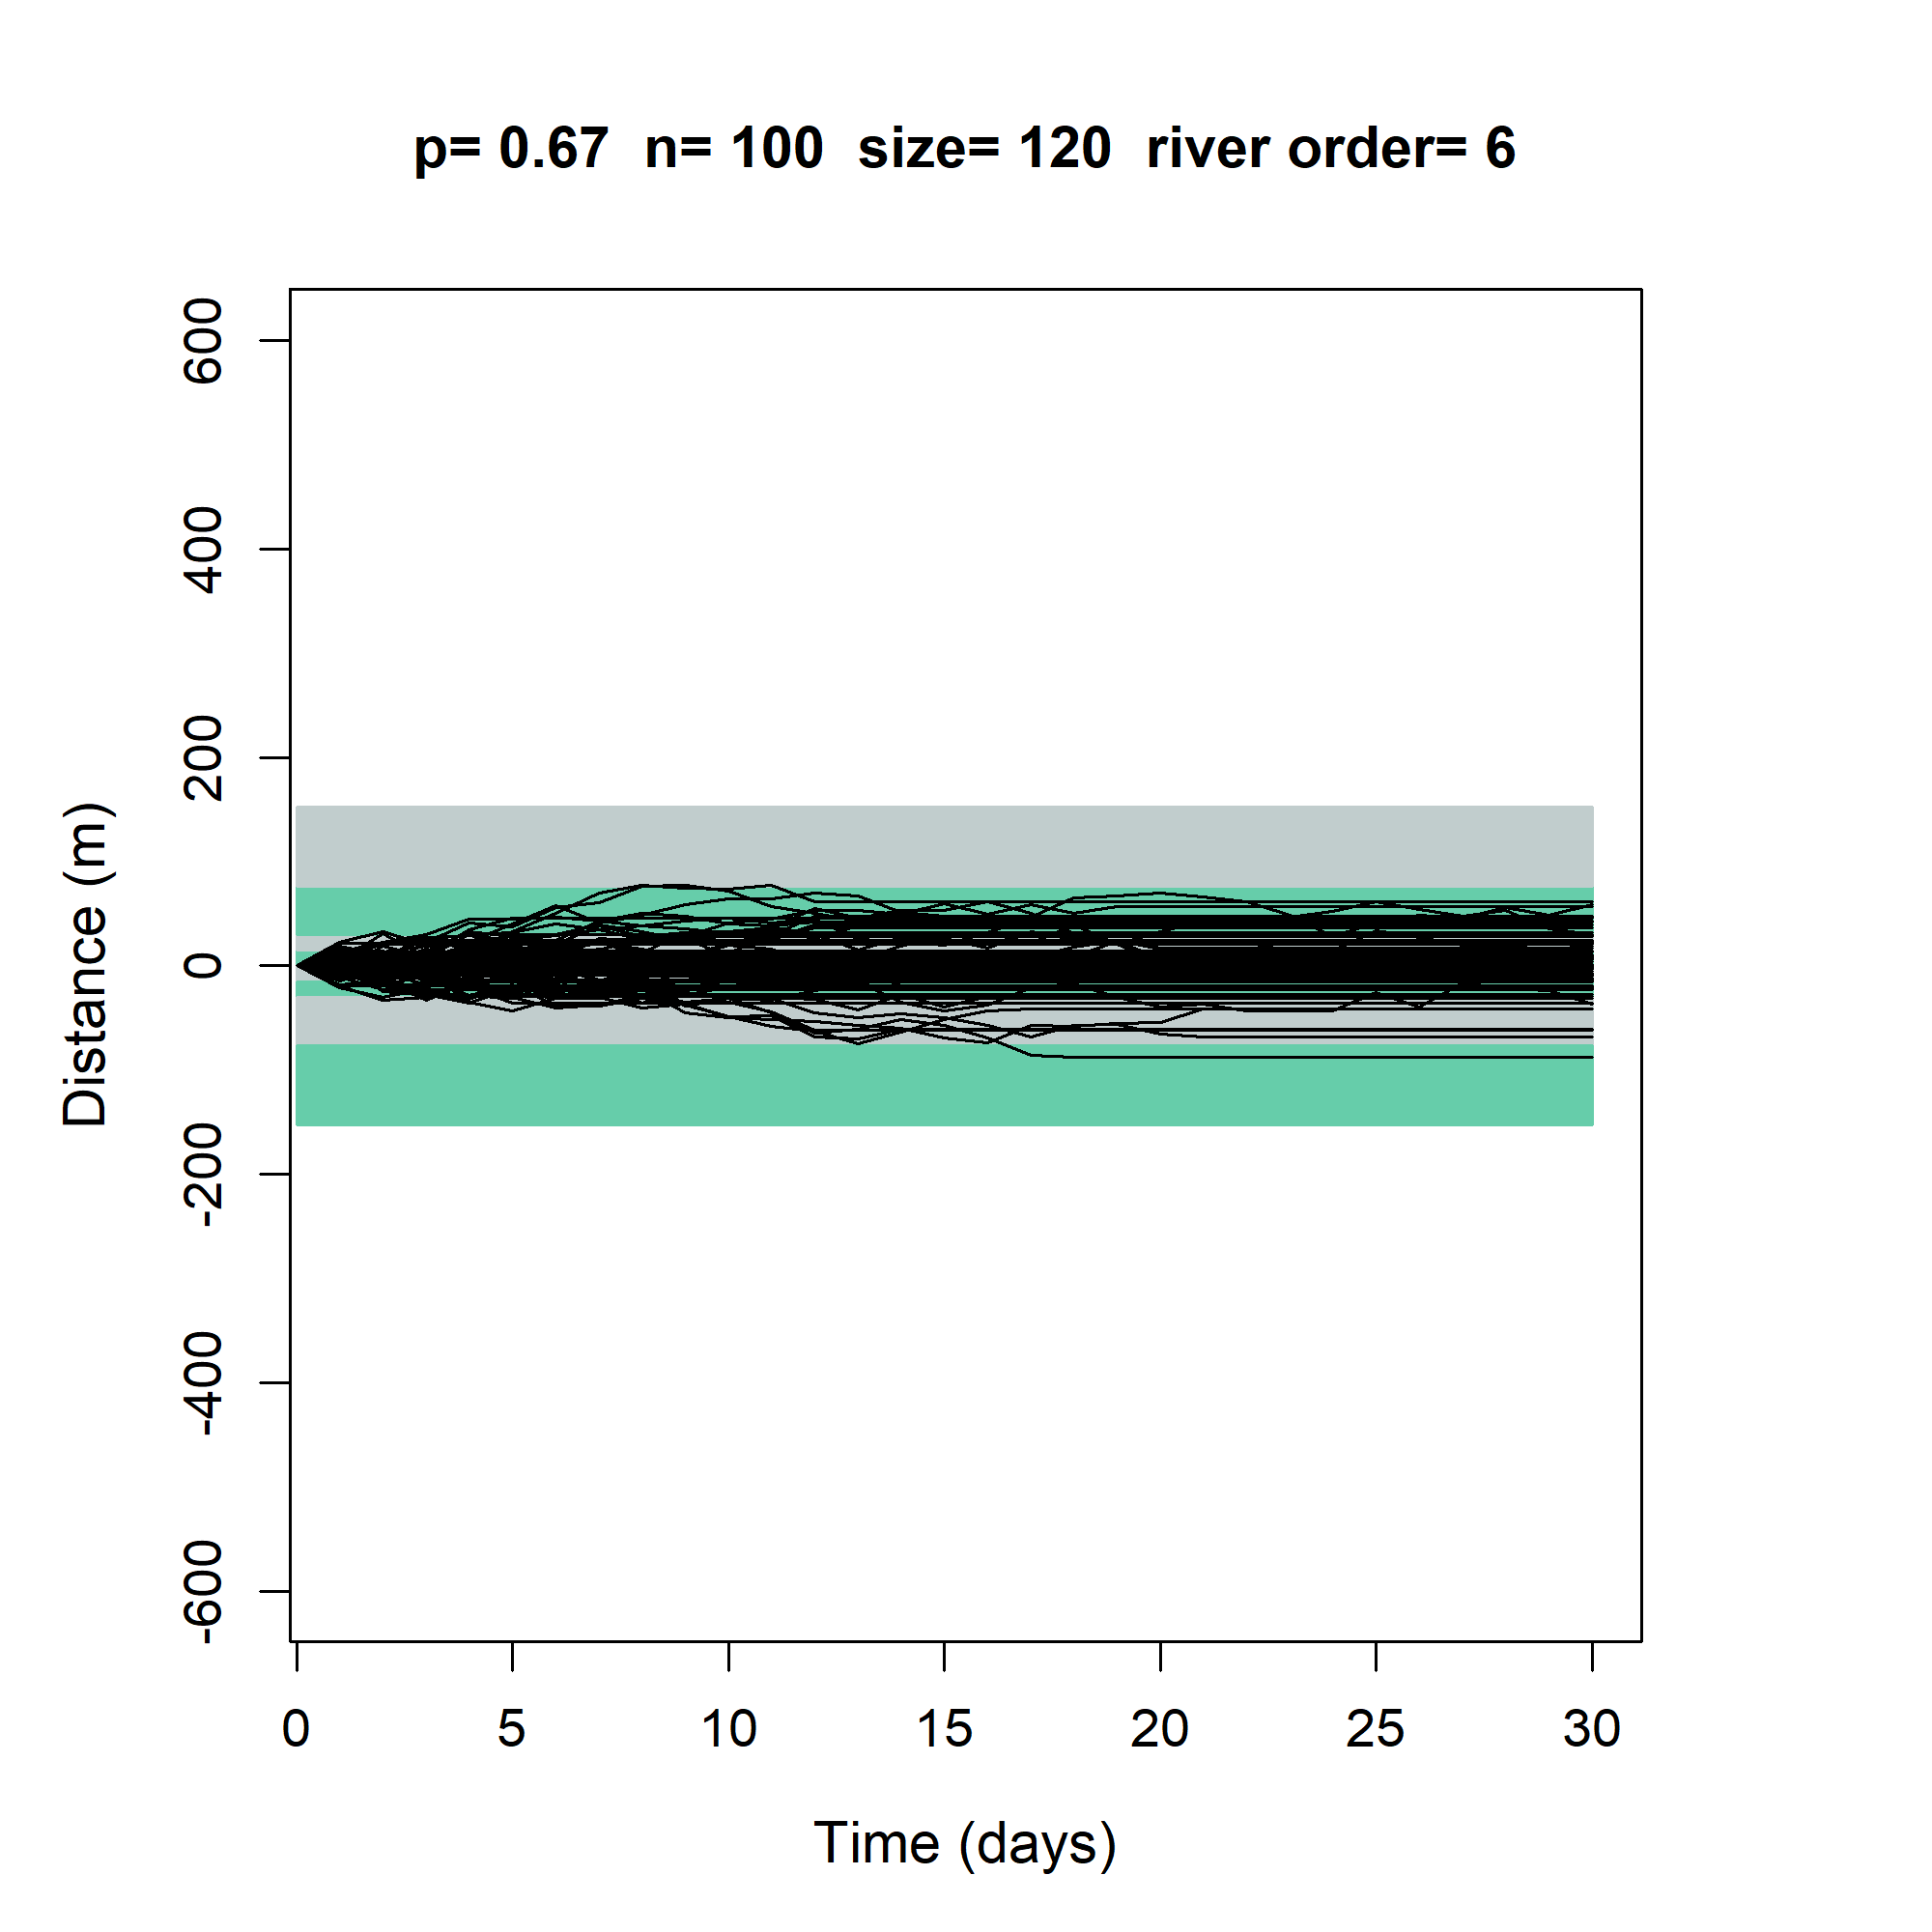
Dead fish - Random walk (Gaussian kernel,
mean=0, sd=10)
Dead fish - Random walk with a chance to disappear (0.1)

Slide 6
Movement tracked by the antennas
Variables calculated:
Last time recorded
Number of days without movement
Total distance traveled
Coefficient of variance associated with movement

Slide 7
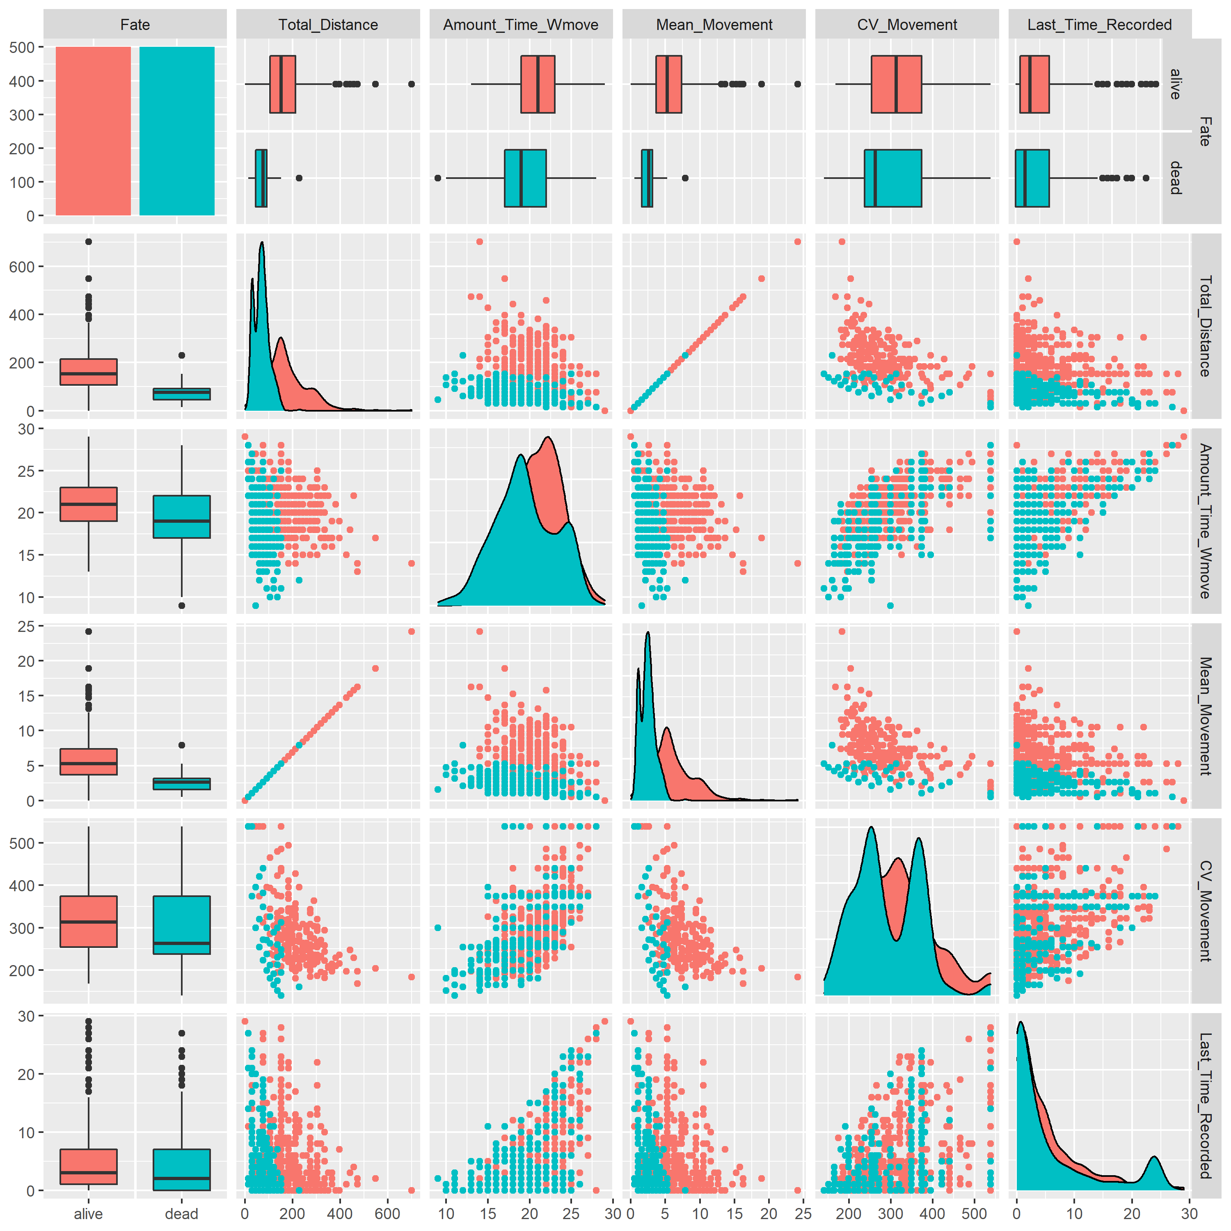
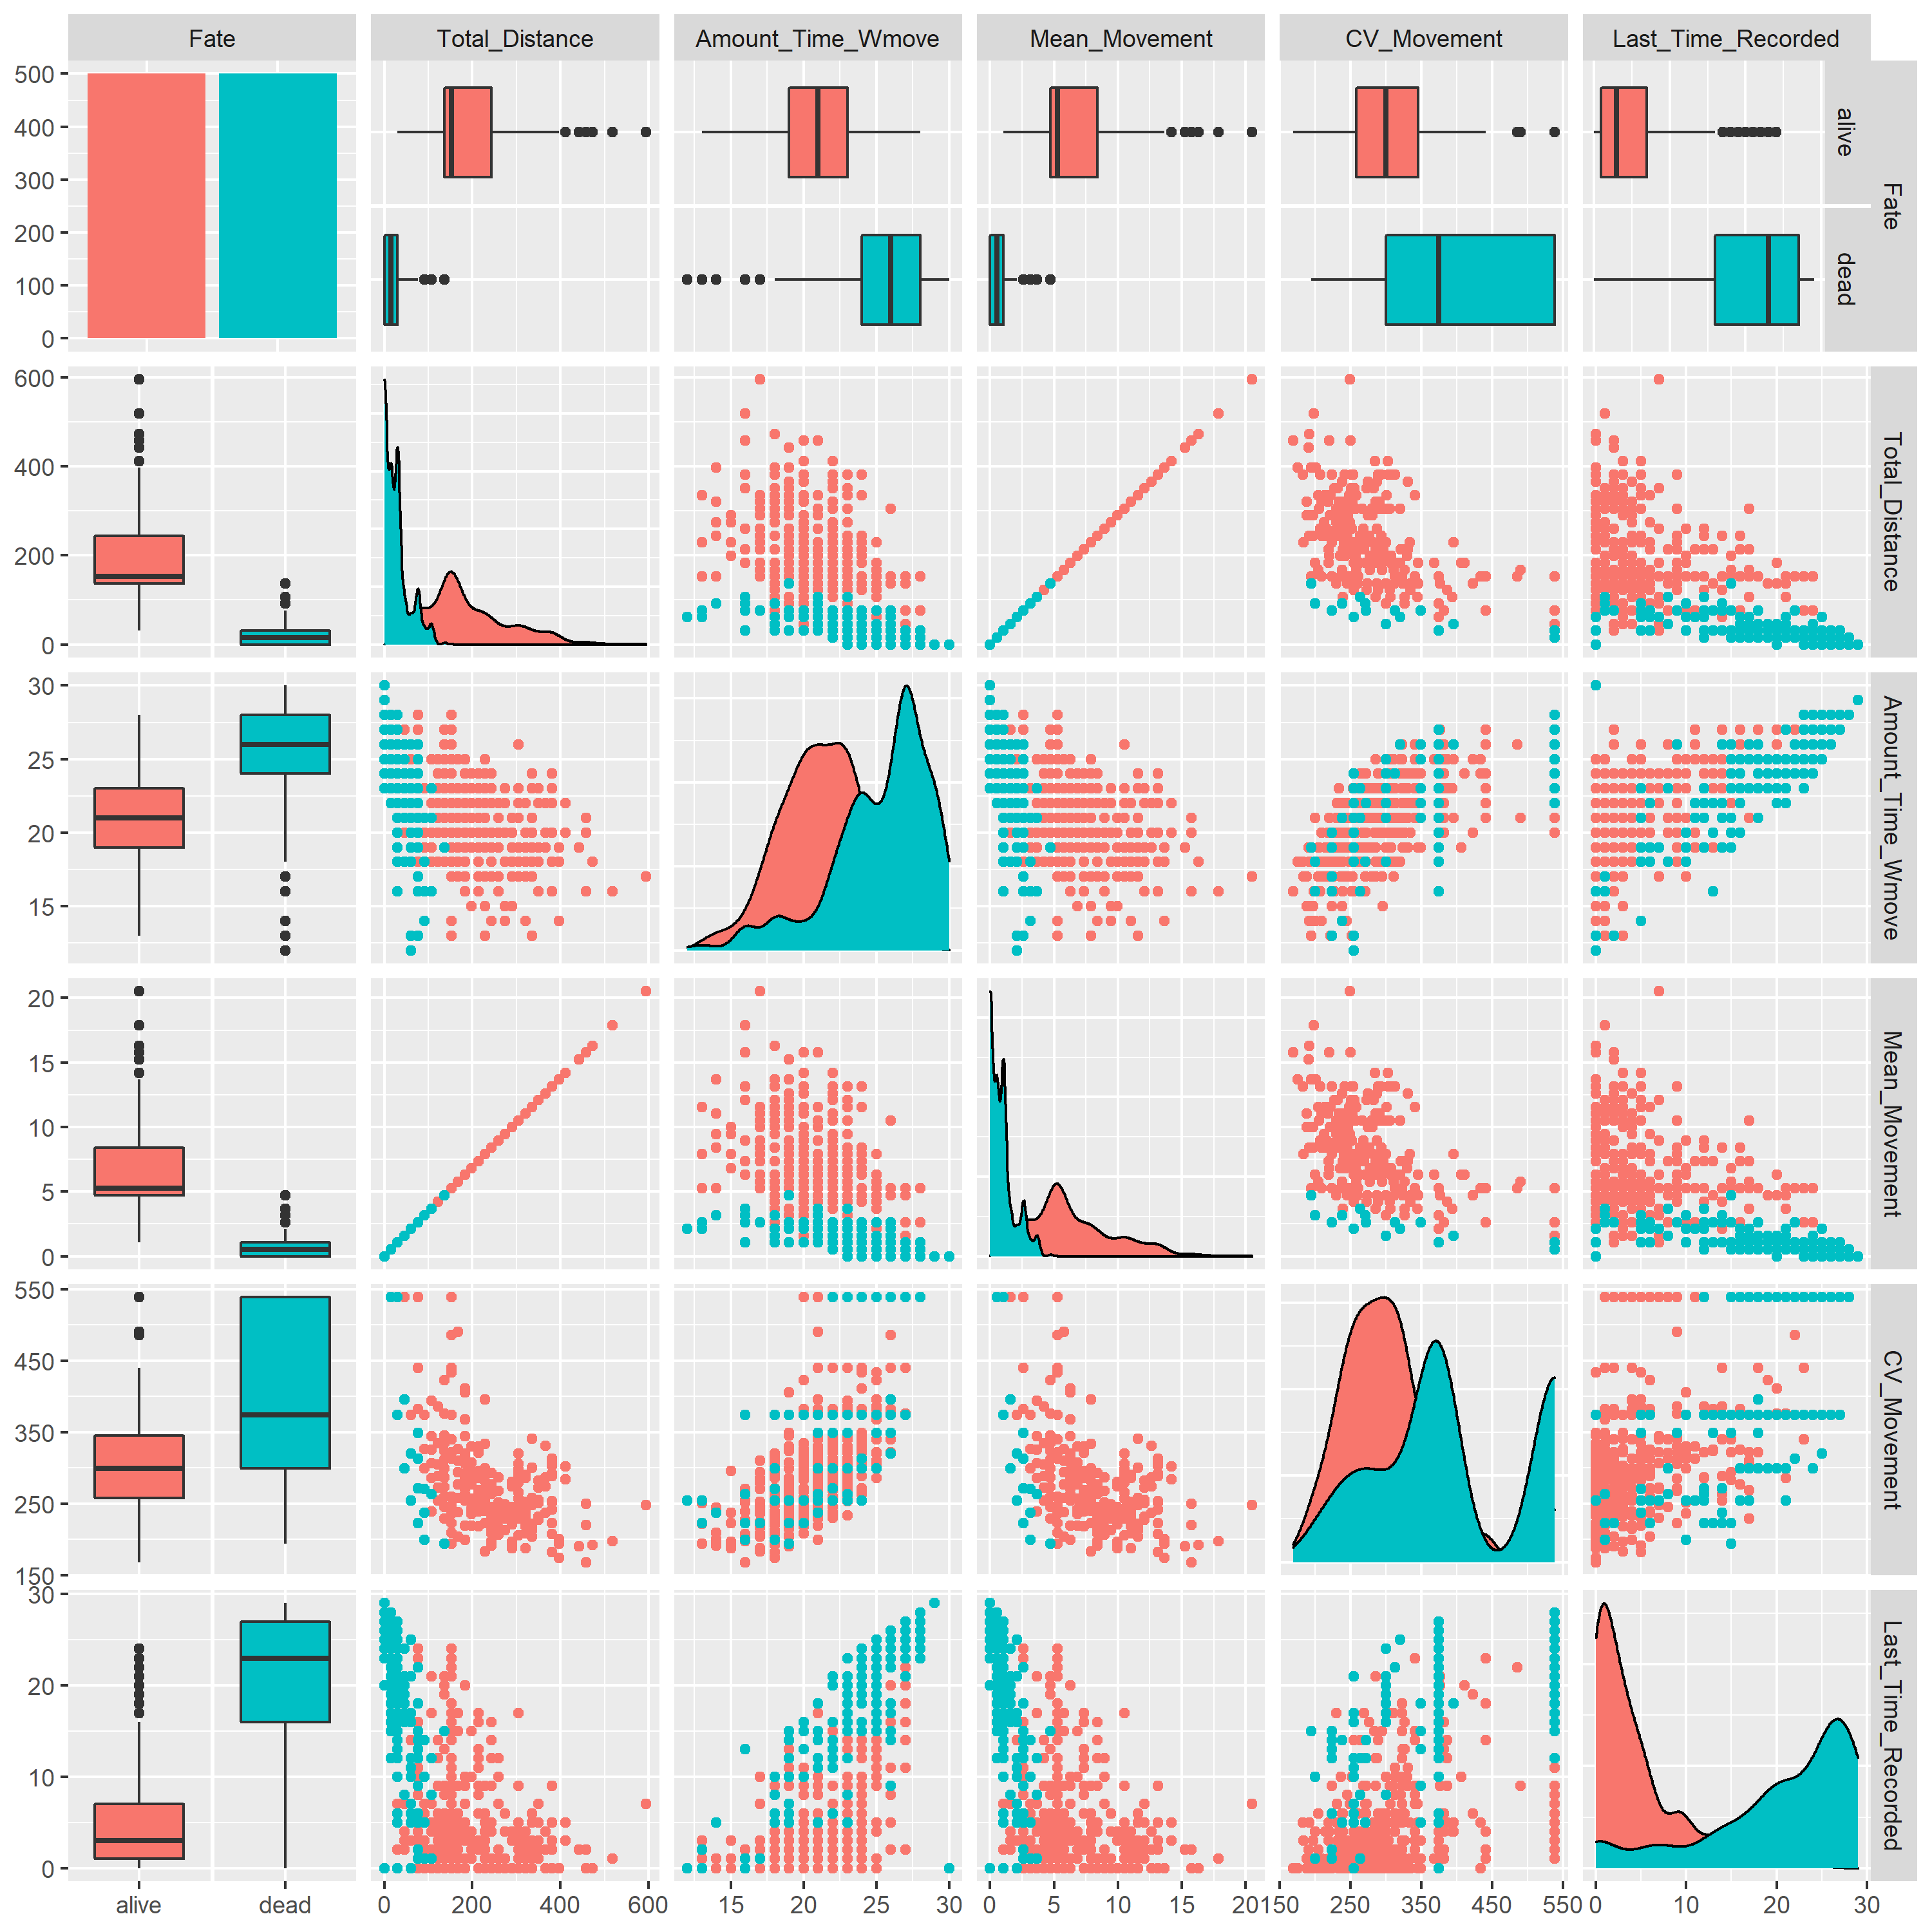
Size 120 mm
Dead fish – random walk
Dead fish – random walk with a chance to disappear

Slide 8
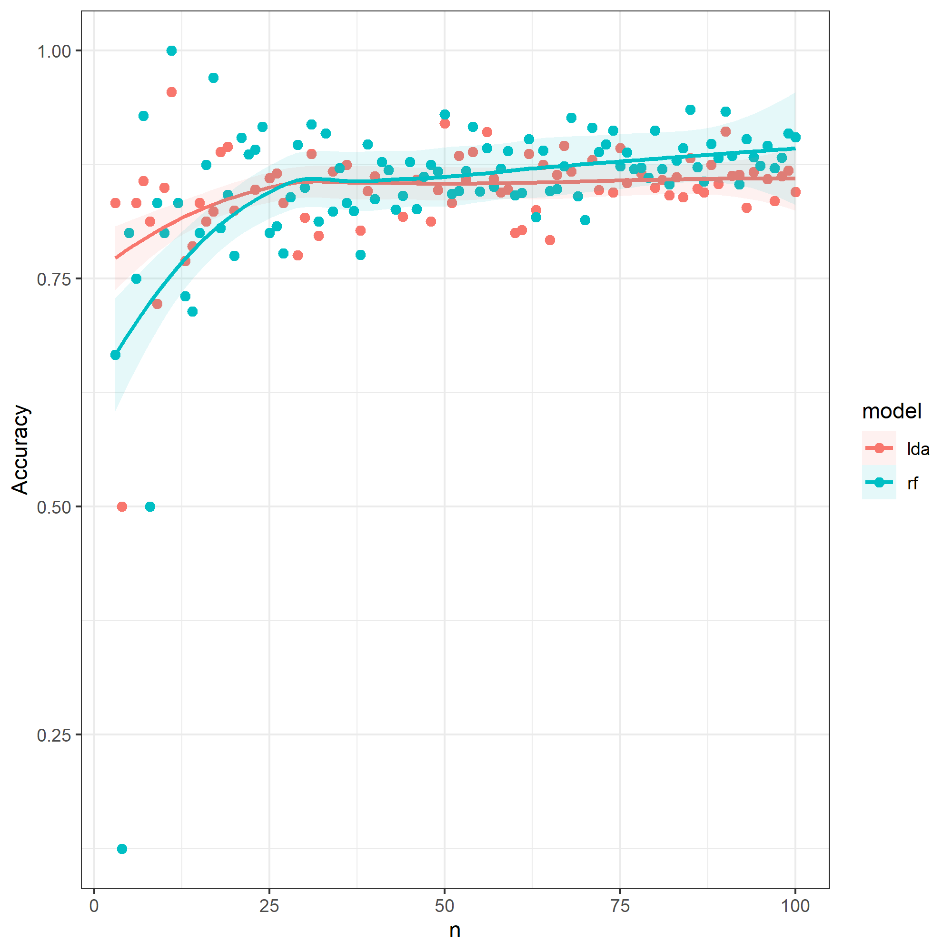
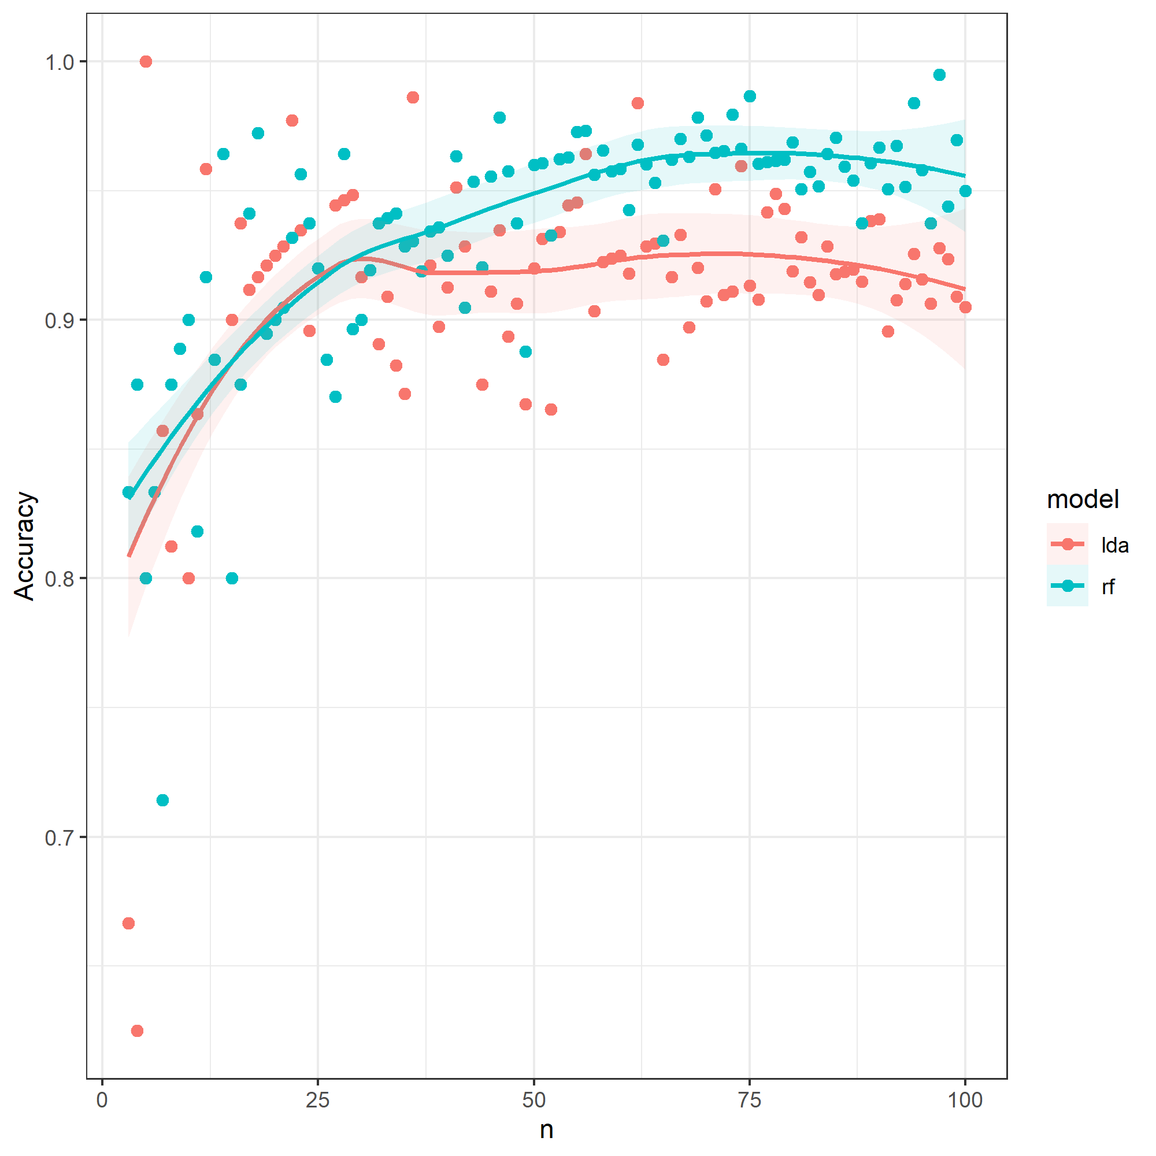
Size 120 mm
Dead fish – random walk
Dead fish – random walk with a chance to disappear

Slide 9
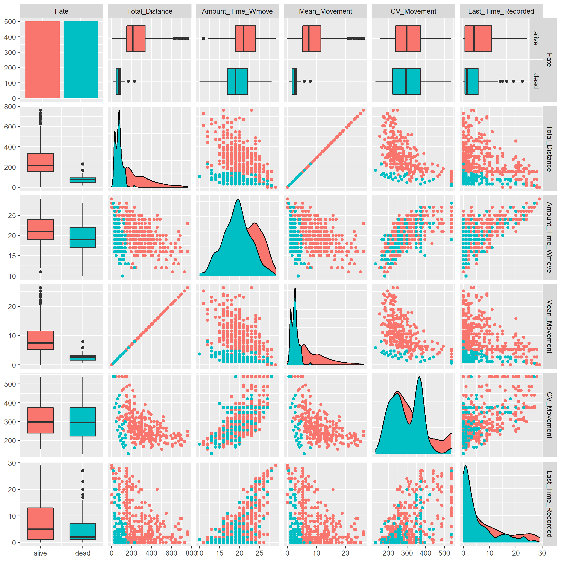
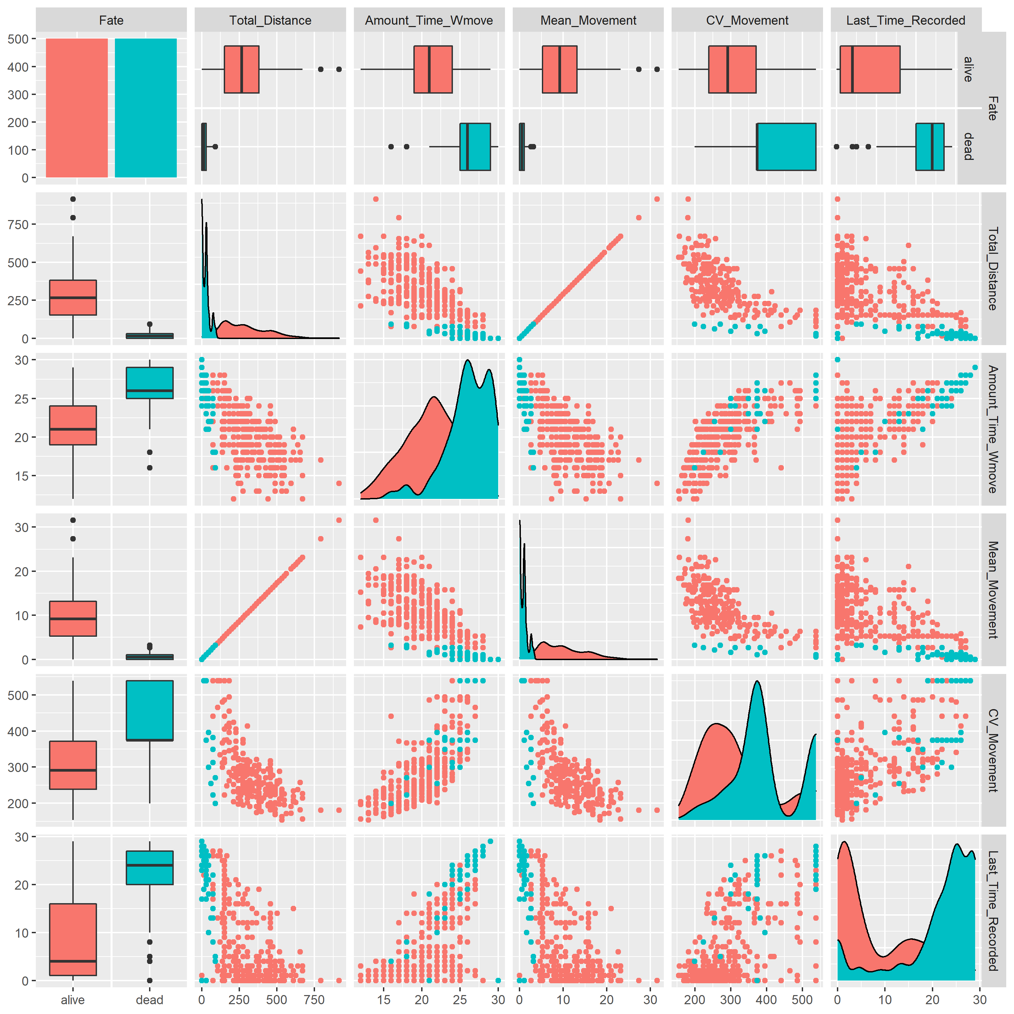
Size 180 mm
Dead fish – random walk
Dead fish – random walk with a chance to disappear

Slide 10
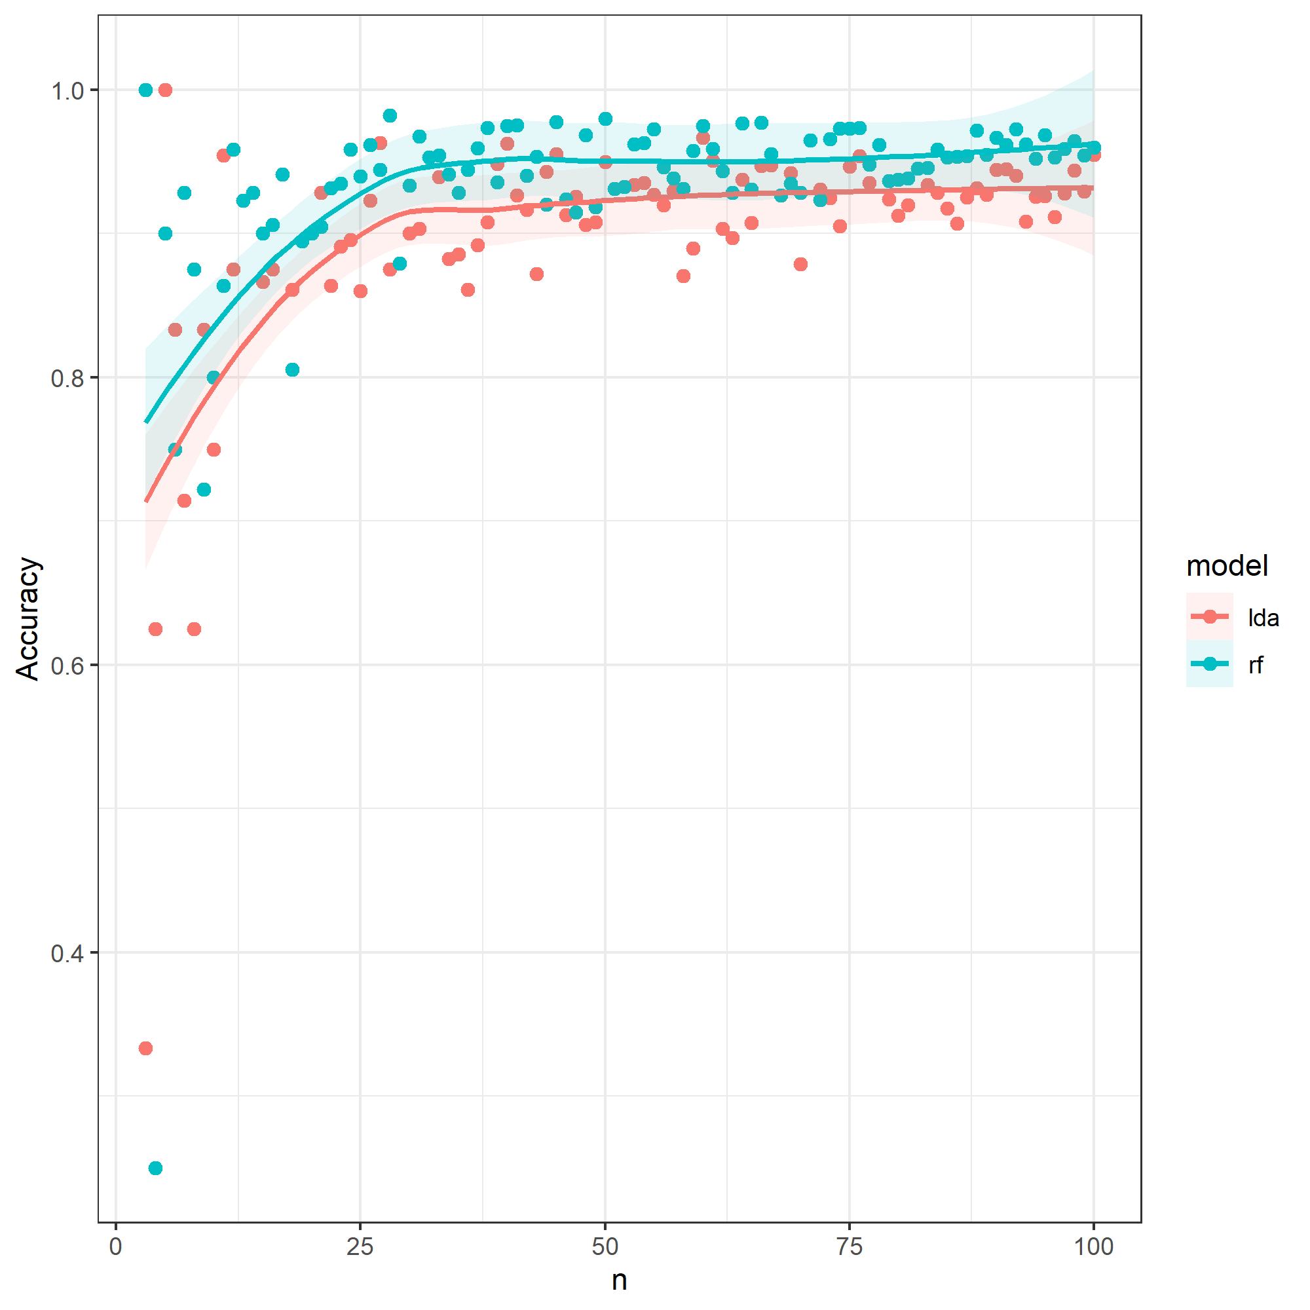
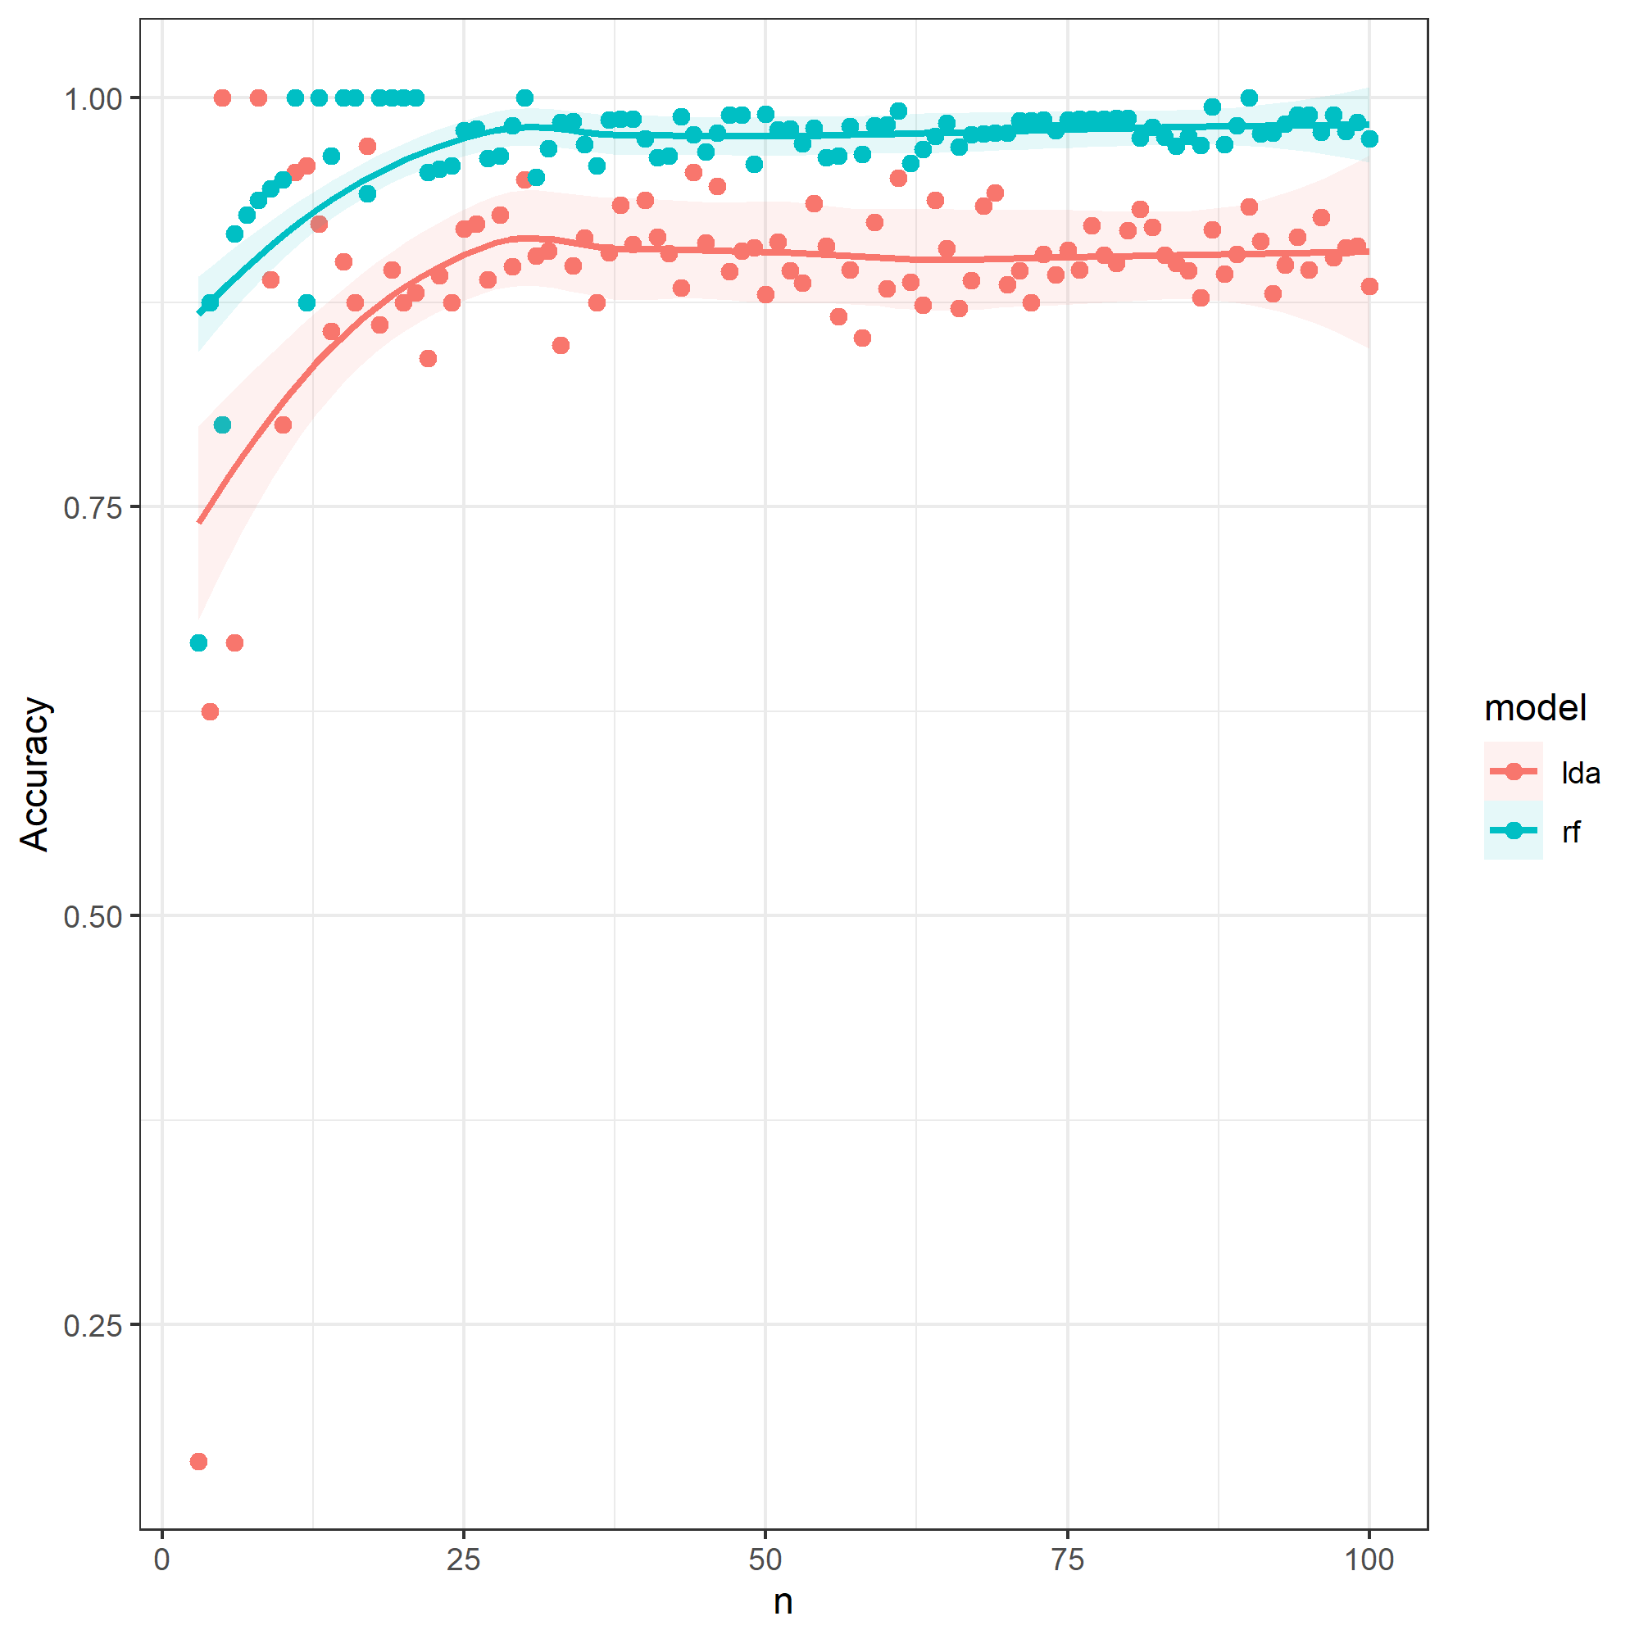
Size 180 mm
Dead fish – random walk
Dead fish – random walk with a chance to disappear

