Slide 1
Simulation testing
Gills on Ice All-Hands meeting
Oct. 13, 2020
Friedrich Keppeler and Abigail Golden

Slide 2
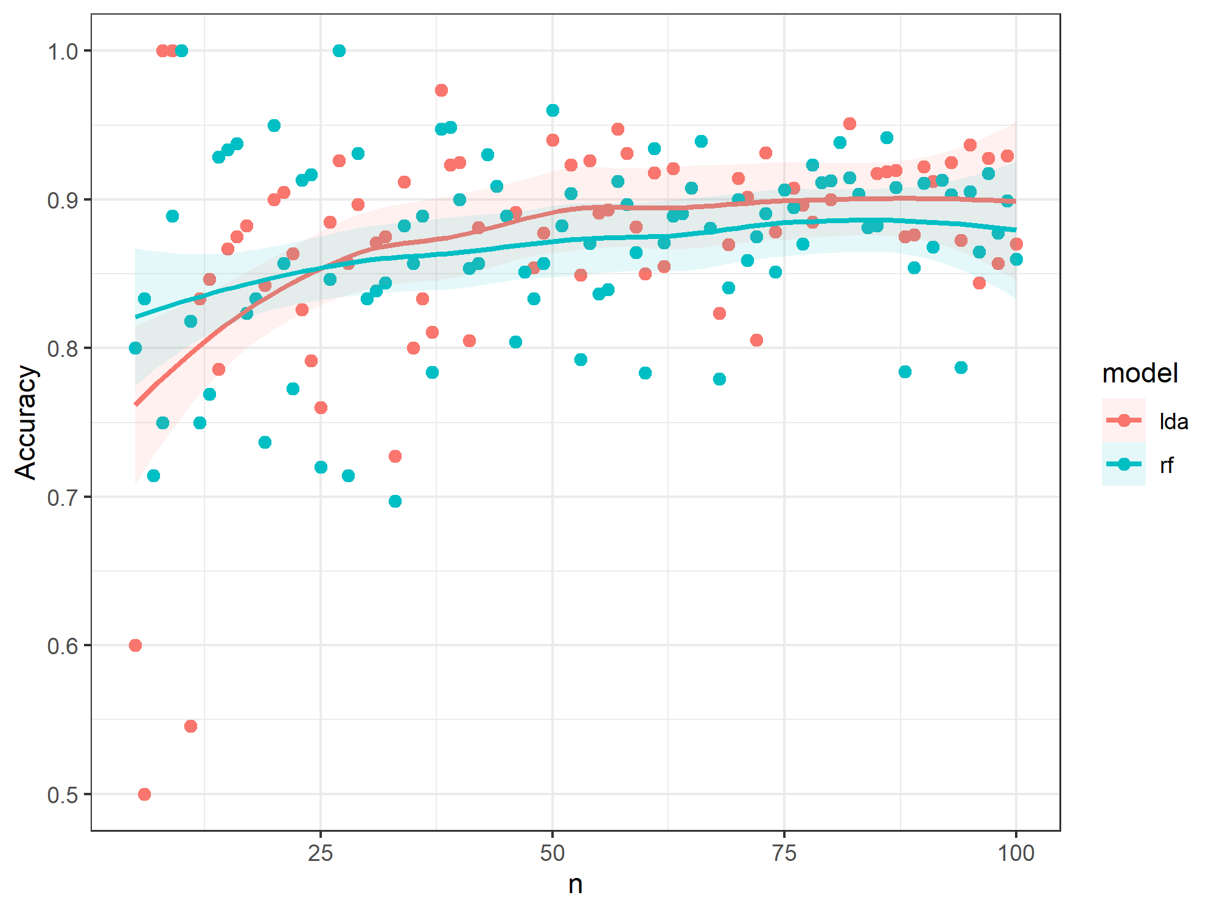

Slide 3

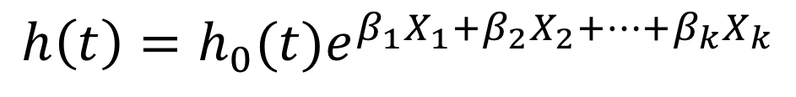
Cox Proportional Hazards Model
$$h\left(t\right)=h_{0}(t)e^{β_{1}X_{1}+β_{2}X_{2}+…+β_{k}X_{k}}$$
instantaneous hazard rate at time t
covariate vector
instantaneous hazard rate
$$h\left(t\right)=h_{0}(t)e^{β_{1}Temp+β_{2}HandTim+β_{3}Caged+ β_{4}Temp∗HandTim}$$
Notes:
h(t,X) represents the probability of experiencing an event of interest at time t given covariate vector X, scaled by the fraction of the population alive (i.e. event-free) at time t

Slide 4
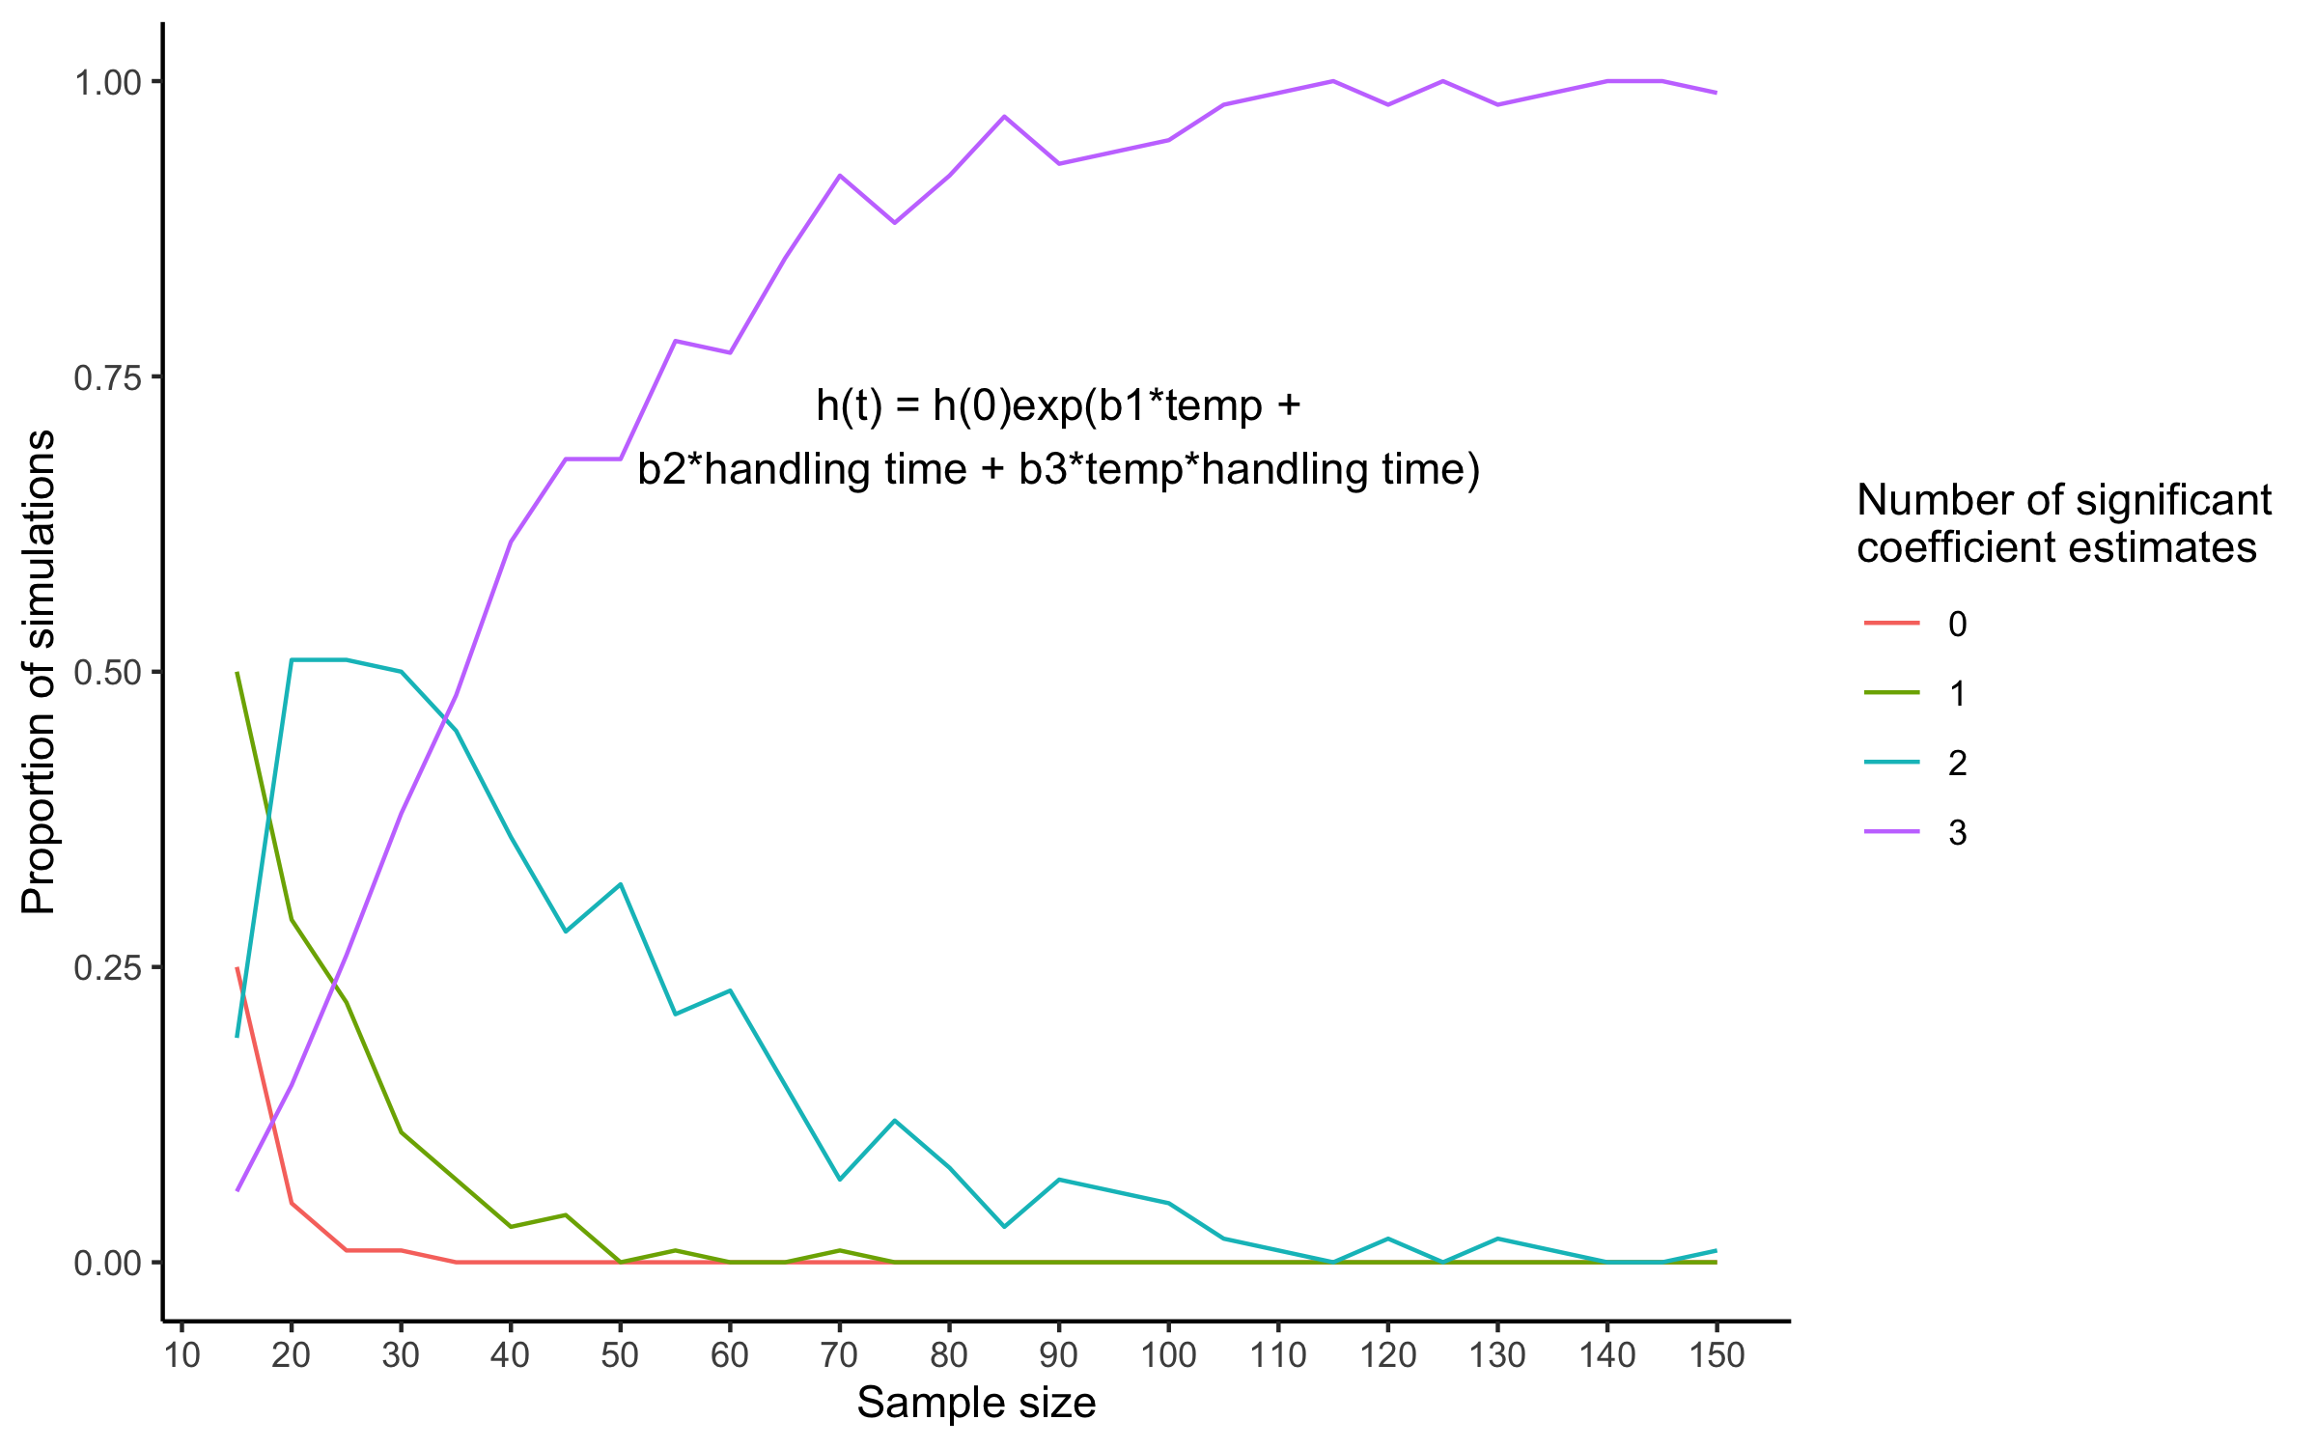

Slide 5
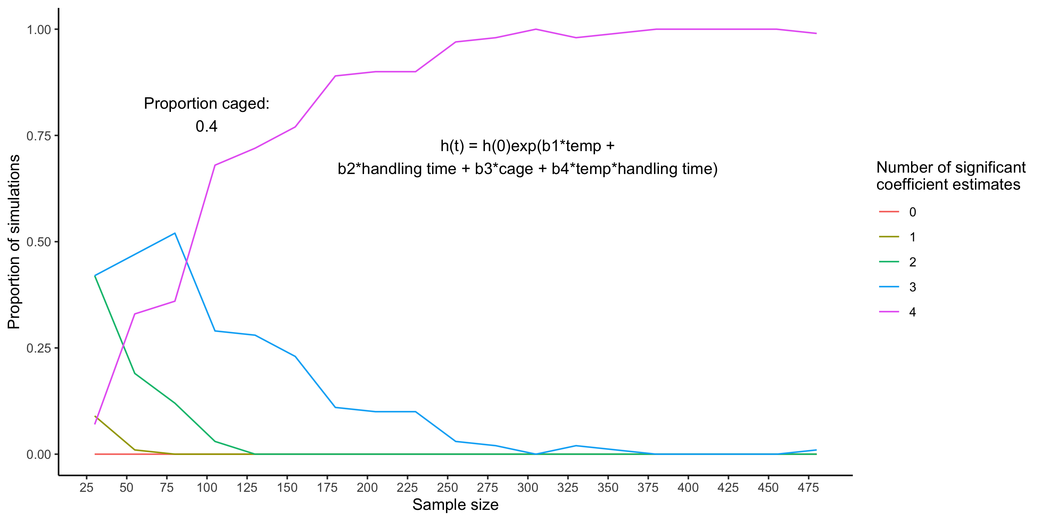

Slide 6
https://github.com/abigailgolden/gillsonice

