Slide 1

Time-to-event data
X
X
Individuals
right censoring
X
Time

Slide 2
Assumptions
We care about not just whether an event (mortality) occurs, but when
We have enough follow-up time and a large enough number of events to have statistical power
Non-informative censoring assumption: individuals that are censored have the same probability of experiencing a subsequent event as individuals that remain in the study.

Slide 3
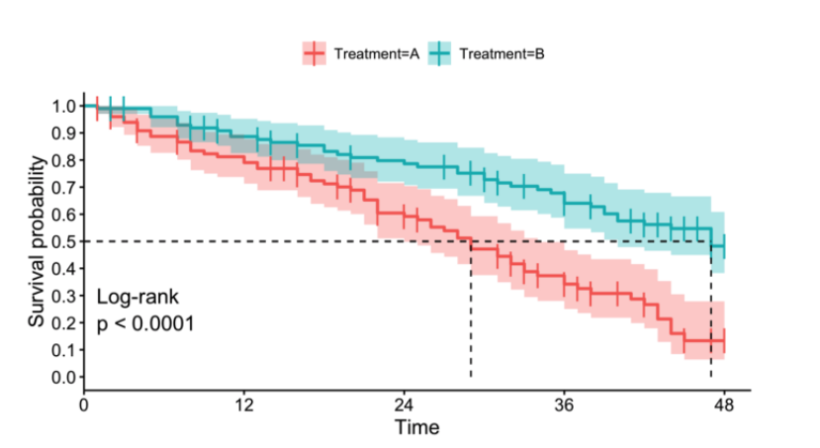
Kaplan-Meier survival estimator
towardsdatascience.com
https://rubenvp.shinyapps.io/kmplotter/

Slide 4
Kaplan-Meier survival estimator
Non-parametric
Often used for data exploration when covariates are binary or categorical
towardsdatascience.com
https://rubenvp.shinyapps.io/kmplotter/

Slide 5
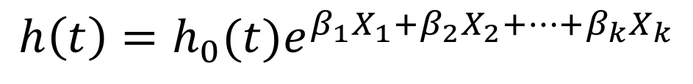
Cox Proportional Hazards Model
$$h\left(t\right)=h_{0}(t)e^{β_{1}X_{1}+β_{2}X_{2}+…+β_{k}X_{k}}$$
instantaneous hazard rate at time t
covariate vector
instantaneous hazard rate
$$h\left(t\right)=h_{0}(t)e^{β_{1}Temp+β_{2}HandTim+ β_{3}Temp∗HandTim}$$
Notes:
h(t,X) represents the probability of experiencing an event of interest at time t given covariate vector X, scaled by the fraction of the population alive (i.e. event-free) at time t

Slide 6
Cox Proportional Hazards Model
Semi-parametric
Depends on the proportional hazards assumption: there is a constant relationship between the dependent variable and the covariate vector, such that the hazard functions for any two individuals are proportional at any point in time
cox.zph() in ”survival” package in R

Slide 7

Resources
https://www.publichealth.columbia.edu/research/population-health-methods
Survival package in R: https://cran.r-project.org/web/packages/survival/index.html

