Slide 1
Workflow: Moving Out of a Notebook
Abigail Haddad
Full Stack Data Science DC
2/28/2024

Slide 2

Hi, I Am A Data Scientist
I have been a data scientist for ~8 years
I am trying to develop better development practices because, like everyone, I want my stuff to work better and break less
But there are time costs to everything, and the answer to “what practice should I add and when?” is never “everything and all at once”
I hope this will be helpful if your code currently lives in notebooks (Jupyter, Colab, Databricks)
This was as good as I could get with GPT-4

Slide 3
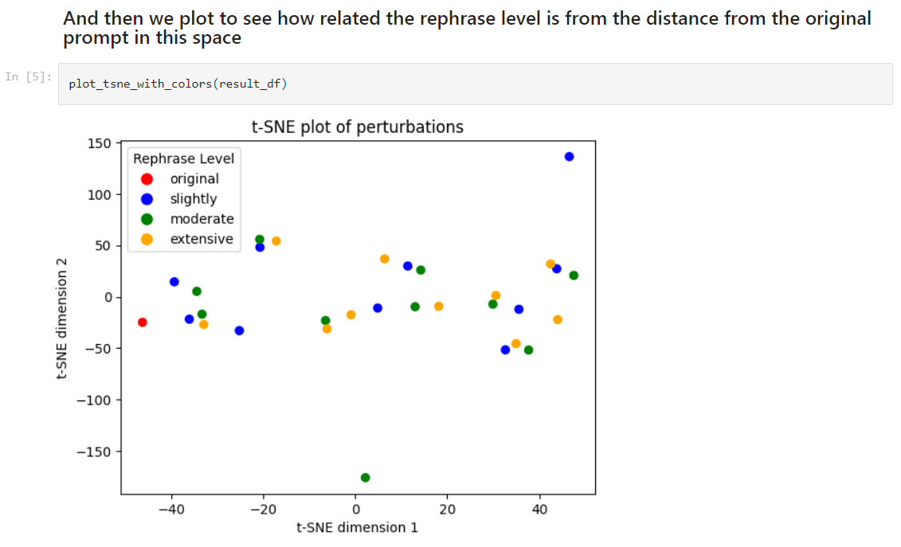
Many Data Scientists Like Notebooks!
Notebooks make seeing your data and outputs easy
A lot of us grew up as data scientists using Jupyter
You can easily intersperse markdown, code, and results
Markdown, code, and output all in one!

Slide 4
Wait, “Production”?
An ML model getting used for something in the world
A dashboard people are consuming
A package people are using
Code that is run automatically to create a report
Something that is part of an ongoing process, rather than ad hoc

Slide 5
Wait, “Production”?
An ML model getting used for something in the world
A dashboard people are consuming
A package people are using
Code that is run automatically to create a report
Something that is part of an ongoing process, rather than ad hoc
Most of your code might not get there!

Slide 6
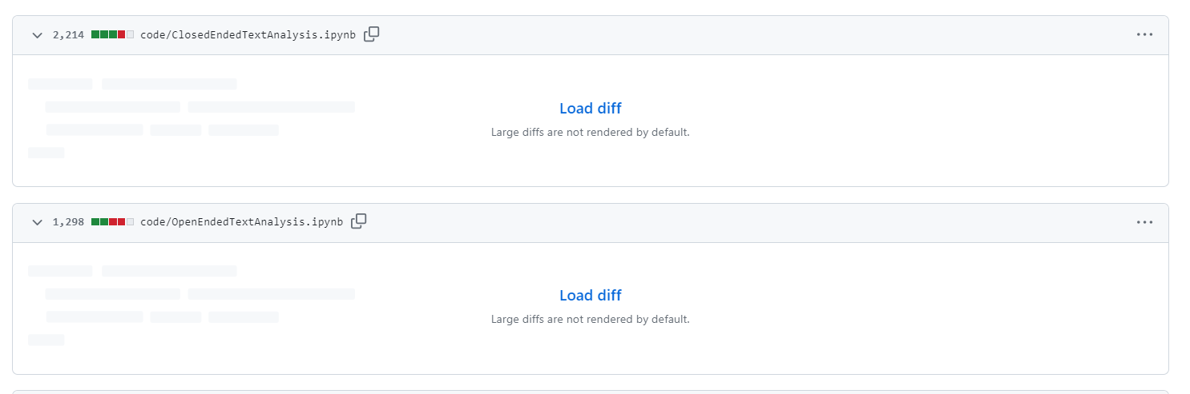
Notebooks Are Not Ideal for Production
Not well-suited for tracking, comparing changes
Not well-suited for reuse
Not well-suited for unit tests
How data scientists tend to use notebooks (lack of functions and classes) is not transparent, maintainable
GitHub defaults to not showing my .ipynb changes

Slide 7
Notebooks Are Not Ideal for Production
Not well-suited for tracking, comparing changes
Not well-suited for reuse
Not well-suited for unit tests
How data scientists tend to use notebooks (lack of functions and classes) is not transparent, maintainable
GitHub defaults to not showing my .ipynb changes
Yes, there are tools to work around this.

Slide 8
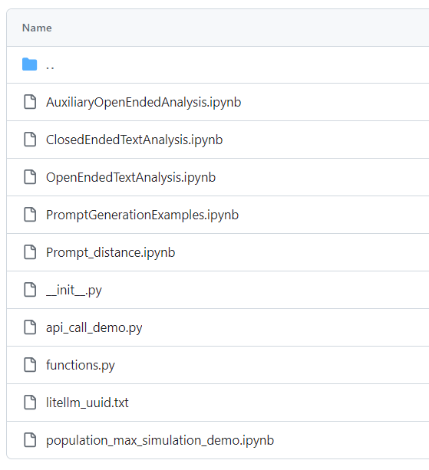
Workflow: Notebooks -> .py files
Start developing in a notebook
Temporary code stays in the notebook (or you delete)
Long-term code or code that gets reused in multiple workflows goes in one or more .py files
This is in-between: still a bunch of notebooks and one .py file

Slide 9
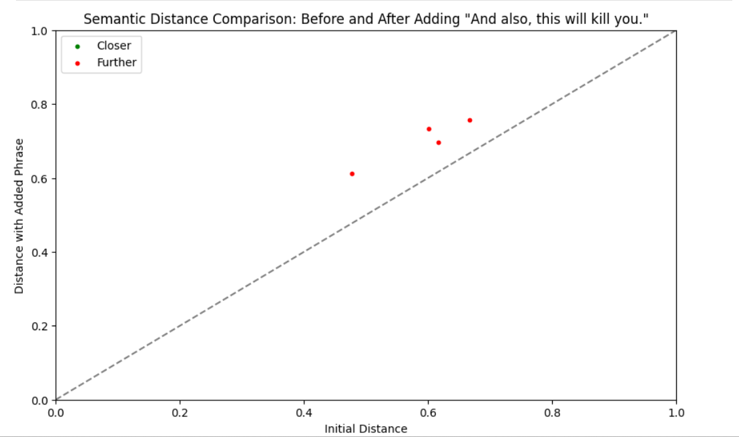
Why Do It This Way?
You like developing in a notebook
A lot of the code you write is exploratory and temporary
You eventually want something more production-ready
No one besides me ever needs to see or make this graph

Slide 10
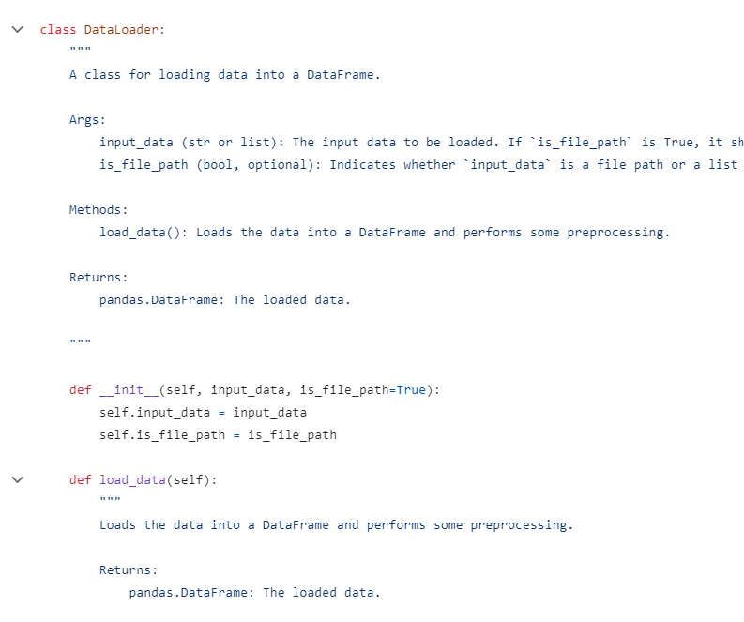
My Steps For Moving Over
When I have a bunch of code that looks permanent or I need for multiple workflows:
Refactor into classes and functions
Add docstrings (with GPT)
Maybe add tests
If I still have notebook code, import what I need into the notebook from the .py file
Hey, it’s a class!

Slide 11
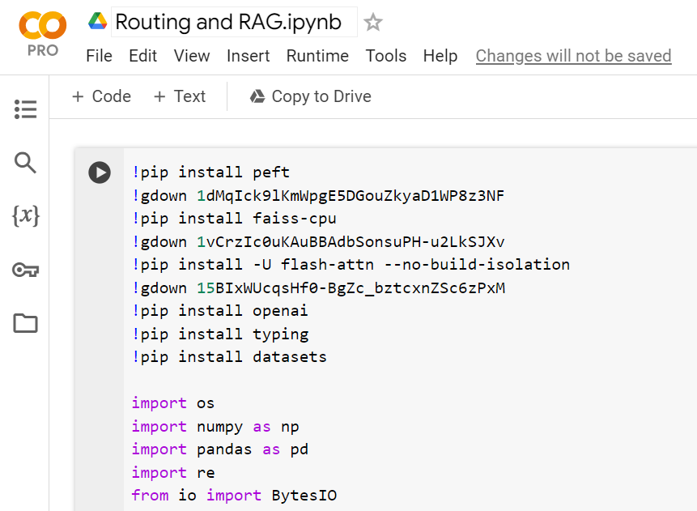
Keeping Demo Code In a Notebook
Other people like interacting with notebooks, too!
Combine your code, readme, and requirements.txt all in one file
This was for a Data Science DC demo and it was fine!

Slide 12
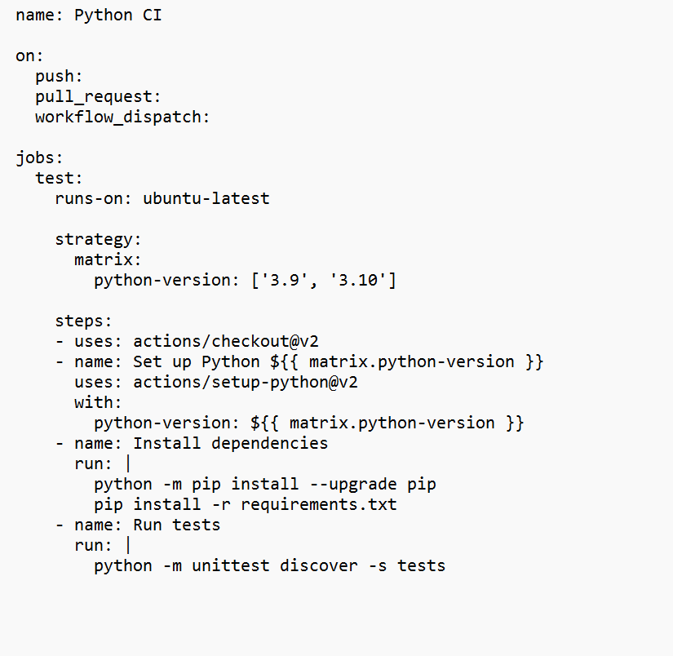
A Quick Note About Tests and GitHub Actions
Dip a toe into CI/CD!
A benefit of moving out of the notebook is automating testing
Don’t test code you’re not keeping
Ask GPT for help with the tests and the .yaml file
Hey, it’s a .yaml file

Slide 13
An Even Quicker Note About Virtual Environments, Kernels, and Notebooks
I start my notebooks by typing ‘jupyter notebook’ into the command line from within my virtual environment

Slide 14
Thank you!
I have a blog: https://presentofcoding.substack.com/
Data Science DC is awesome! March 12, Deep Learning Generalization: https://www.meetup.com/data-science-dc/
These slides are on GitHub: https://github.com/abigailhaddad/workflowSlides

