Slide 1
Final Project
Biol 792
Abby Miller

Slide 2
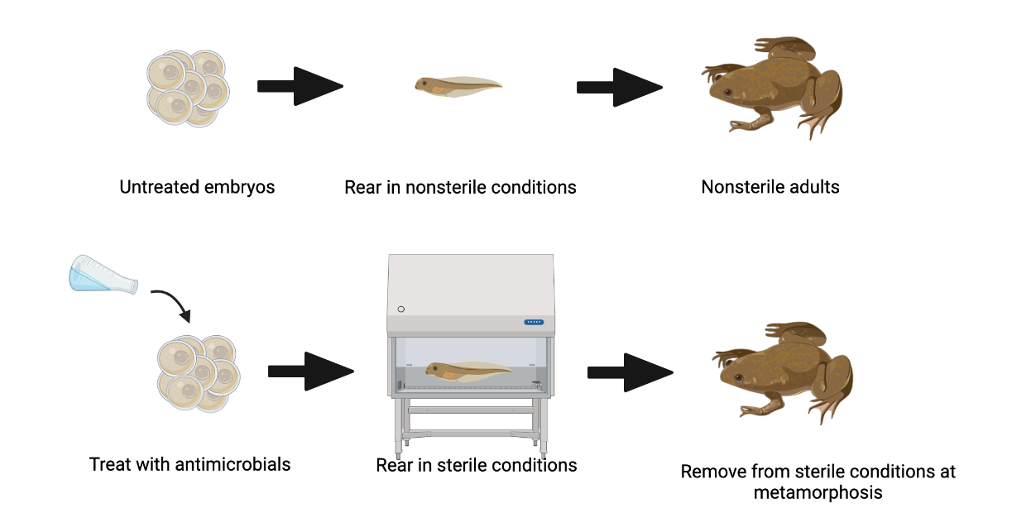
Experimental design: How does a disruption to the microbiome affect immune system development
Notes:
-My dissertation is focused on how the microbiome is involved in the development of the immune system in amphibians
-For my pilot project, I wanted to see how if I could create “germ-free” frogs or frogs with no microbiome in order to see how a disruption to the microbiome during development might affect immune function
- so I started by treating xenopus laevis embryos with either a mixture of antimicrobials to deplete the microbiome as much as possible or a sham mixture of just sterile water
-The sterile groups I treated with antimicrobials were reared in sterile conditions inside a biosafety cabinet with sterilized tanks and water and fed sterilized food
-The nonsterile groups not treated with antimicrobials were reared in normal lab space so they would be exposed to microbes in the air, and housed in nonsterile conditions with nonsterile food

Slide 3
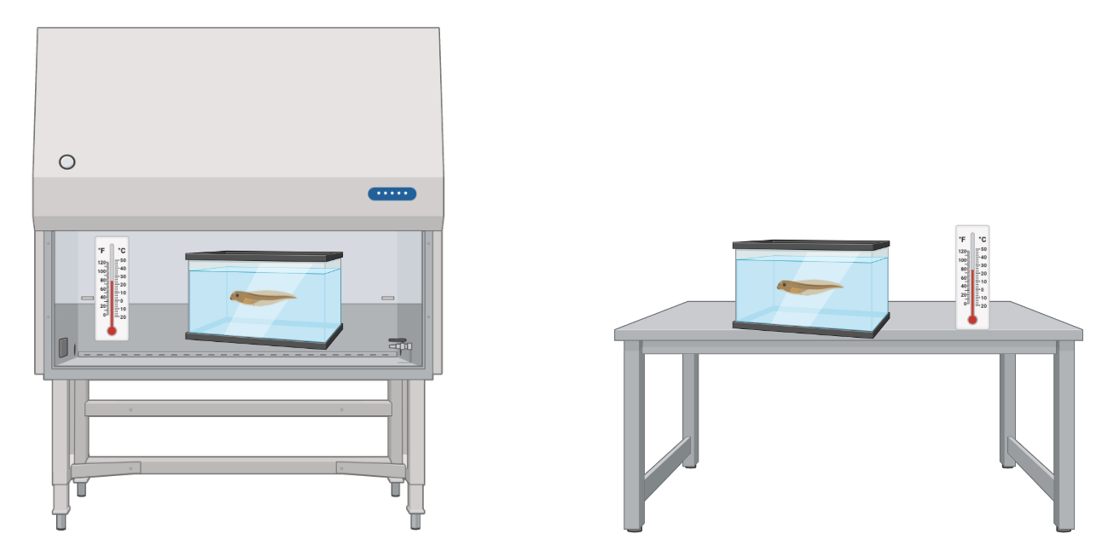
Problem: different temperatures can mean different development times
Tadpoles developing inside BSC
Tadpoles developing outside BSC
Notes:
-The conditions I have to rear the nonsterile vs sterile animals in means they have to be placed in two different spaces in the lab
-This can lead to problems if they are different temperatures because different development temperatures can mean different development times and survival rates which can be confounding
-To make sure my temperatures are the same inside and outside the biosafety cabinet, I used iButton loggers which can be programmed to log temperature at varying intervals

Slide 4
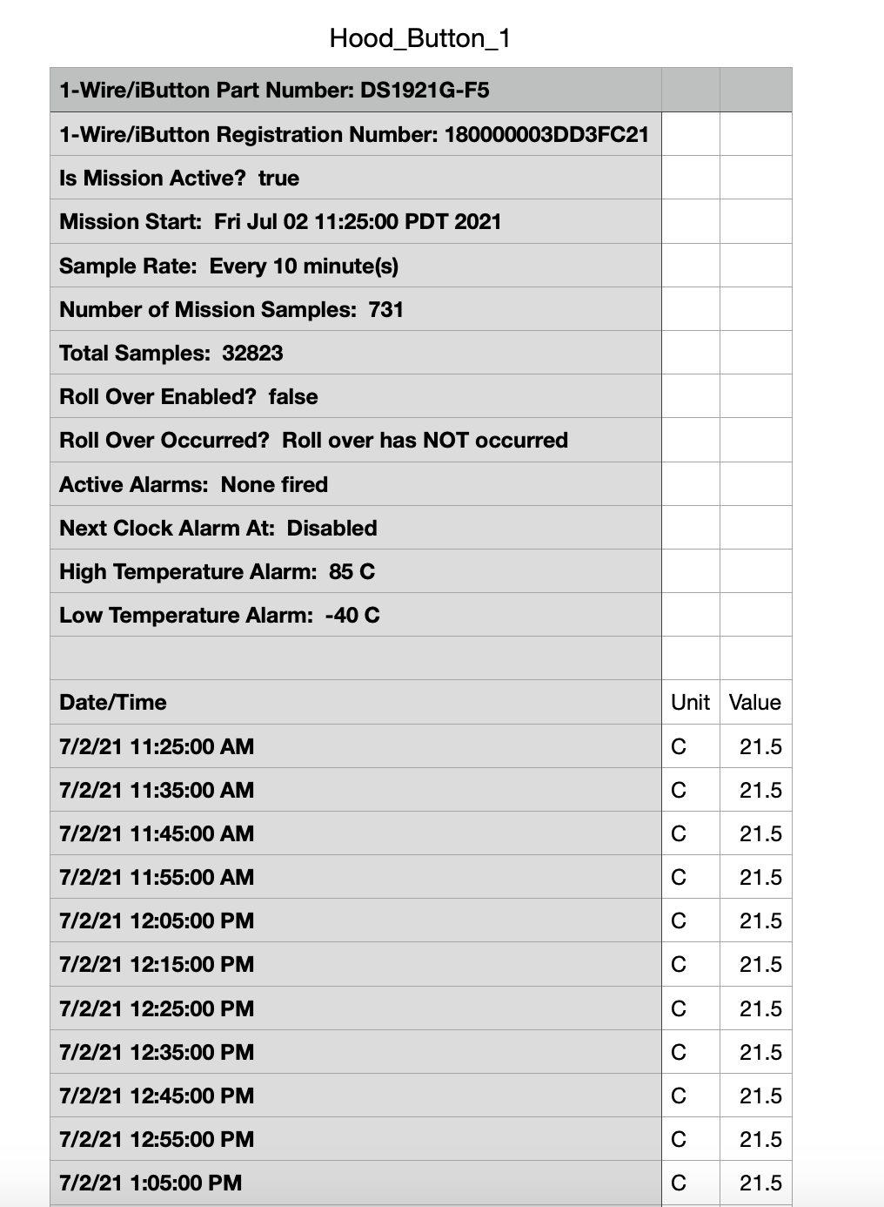
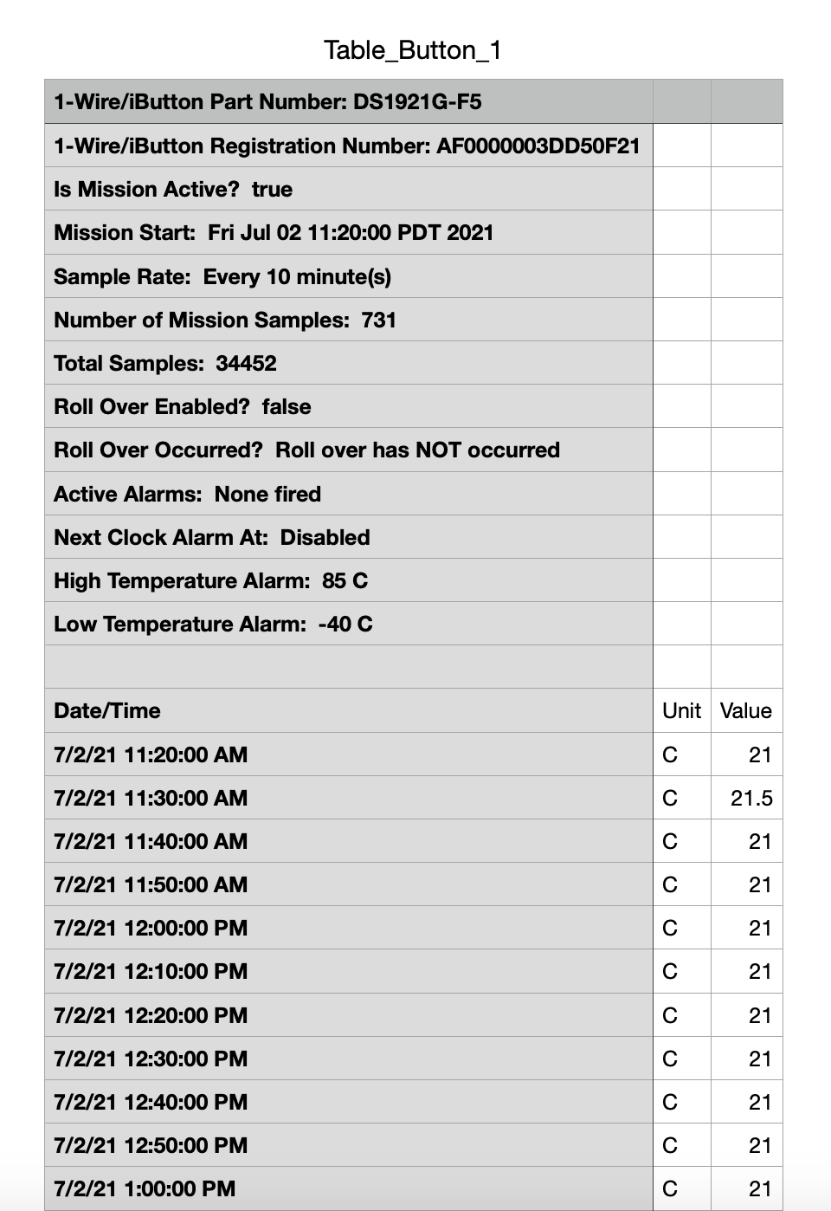
iButton data example
Don’t need these diagnostic lines
Want to average these temp values for each button (731 temp readings taken every 10 min)
Notes:
-I randomly placed 6 iButtons inside the biosafety cabinet and 6 iButtons outside the cabinet in the lab
-And this is an example of what the iButton data looks like when you pull it from the loggers
-You get a CSV file for each iButton with this diagnostic data on the top and then the temp readings
-I basically want to know what the average temperature over time is for my different iButtons so I can see if it differs between locations, so I don’t need these first 15 lines, and I want to average these 731 readings that were taken every 10 minutes

Slide 5
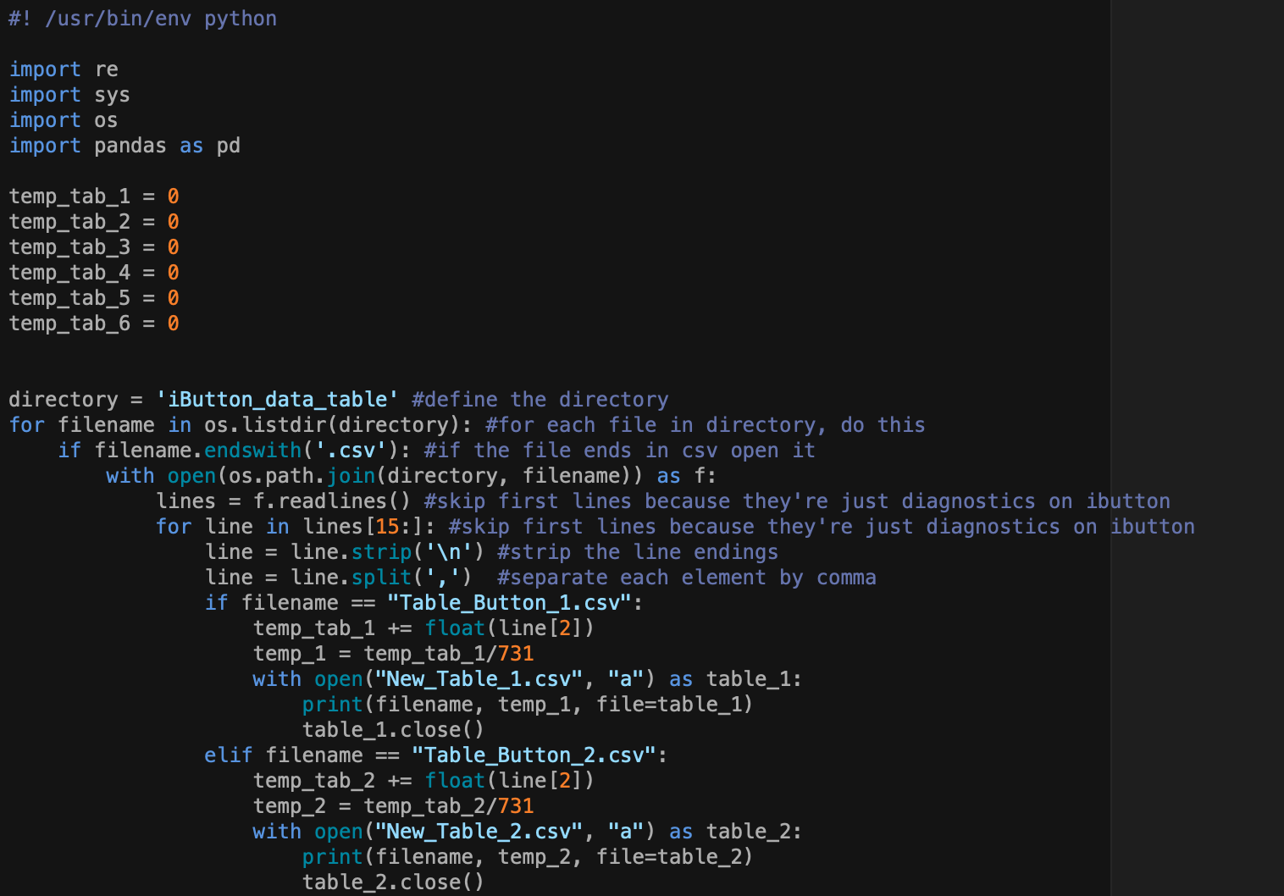
Python script 1: get average temps
Skip the first 15 lines
-Open each file
-Take the 3rd column (temp) and get average
-Create new .csv file with average temp
-Same thing with next file
Notes:
-So in the past I’ve just averaged them by hand, but I wanted to try to write a python script to do it for me
-This is my first try and it works but I don’t this it’s the most straightforward or easiest way to get the results I want so I’m gonna keep working on it but for now I have 2 scripts:
-This is the first one, it basically skips the first 15 lines in the file that I don’t need, and calculates the average temperature for me by taking the temperature column and adding all the values together and then dividing by the total number of temp readings which was 731
-Then it saves the info as a new file for each iButton

Slide 6
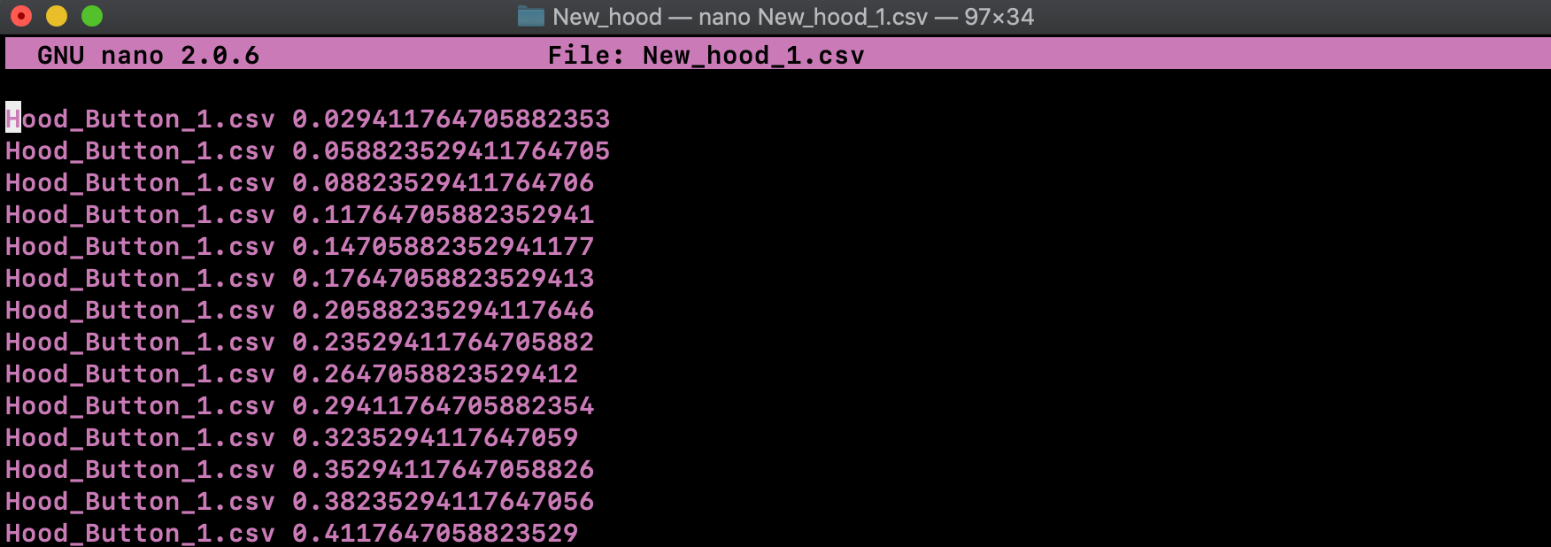
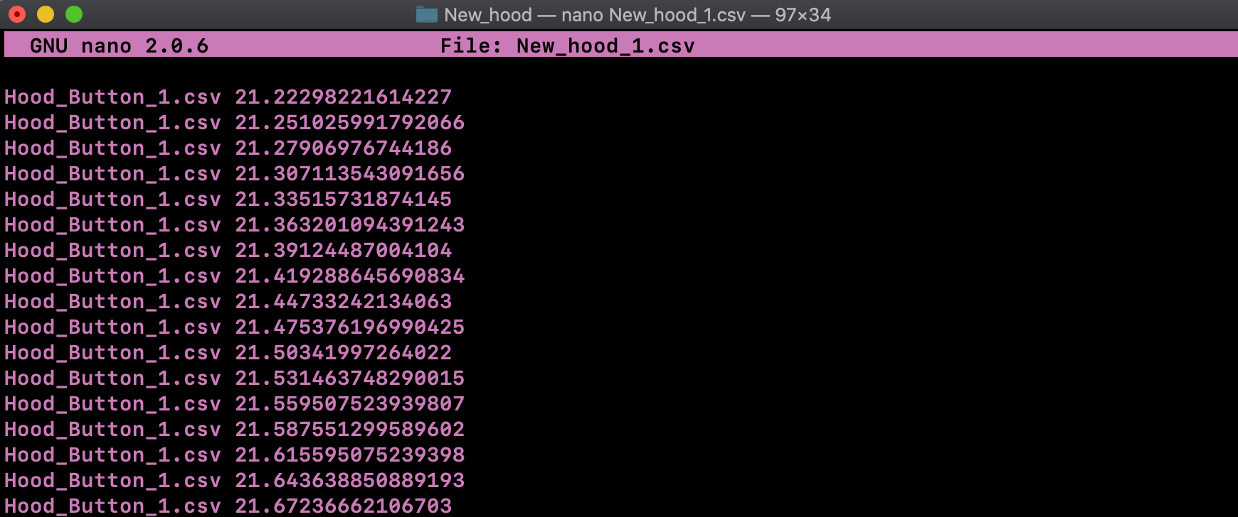
The way I wrote my code, each line is added to the next and divided by the total number of lines (731), so my output file looks like this
The last line in the file is the actual average temp over time for this iButton
Notes:
-This is what the new file looked like and where I had a little problem because of the way I wrote the code I had basically said to take each temperature line and add it to the next and then divided by the total number of readings each time, so I ended up with this large file that had printed each iteration of my for loop, but I only really care about the last line which is the actual average temperature (or all the temp lines added together then divided) if that makes sense

Slide 7
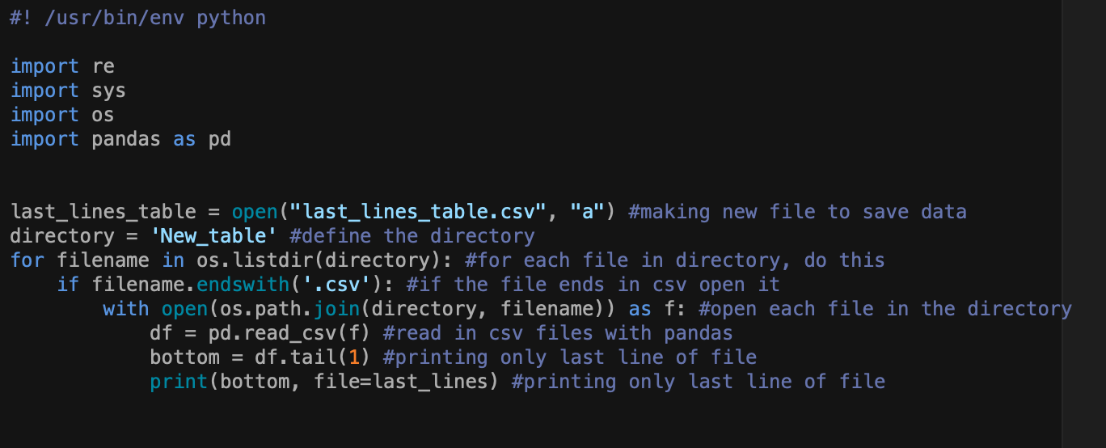
Python script 2: create new CSV with average temps
Use pandas to print just the last line of the file (the average temp), add it to new file
Notes:
-So I ended up having to write one more script where I just used pandas to print only the last line of each file to a new file, and that ended up giving me the data file that I could use which had each iButton ID and then the average temperature for that iButton over those 731 readings

Slide 8
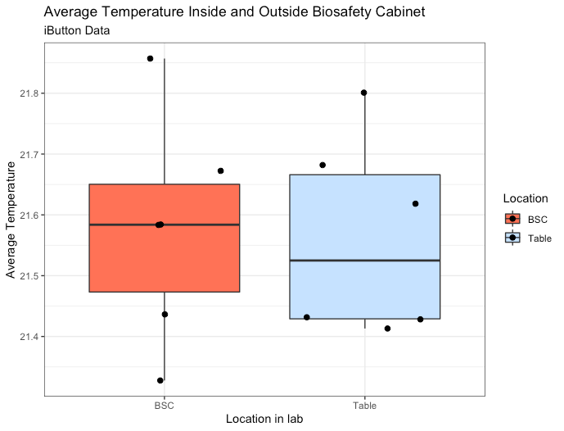
ggplot visualization
T-test, p = 0.88
Notes:
-And then I just plotted those averages for each iButton in each location and ran a t-test to see if they differed, and they didn’t which is the same result I found when I did it by hand previously
-And I tried to use colors here that Bobby talked about during the visualization class that had enough contrast

Slide 9
Thank you!
Biol 792
Abby Miller

Slide 10
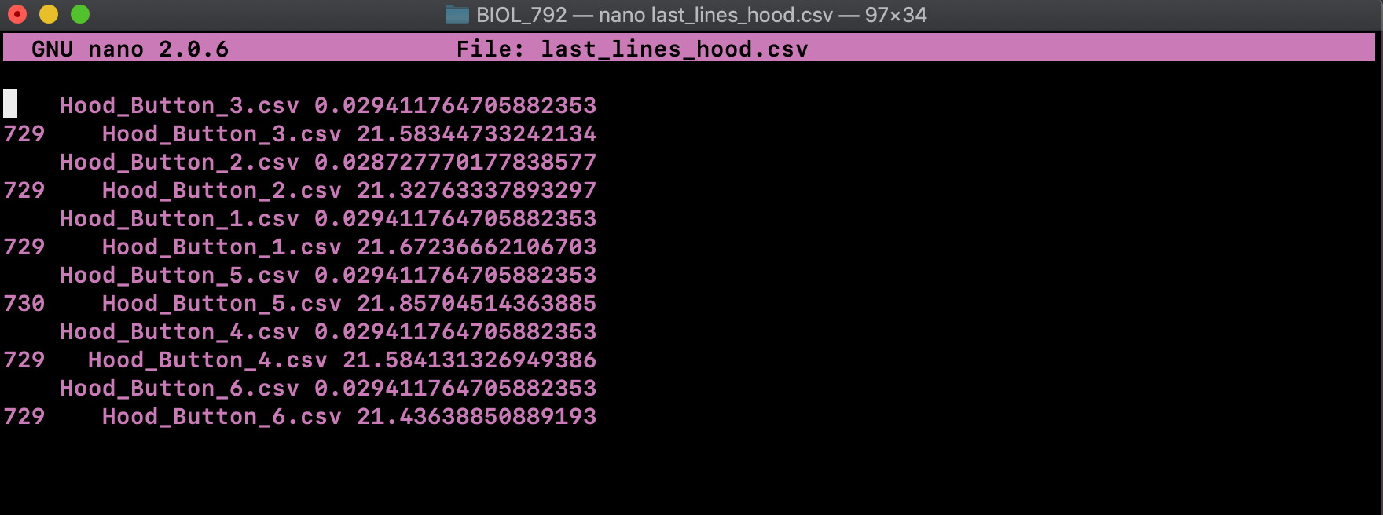
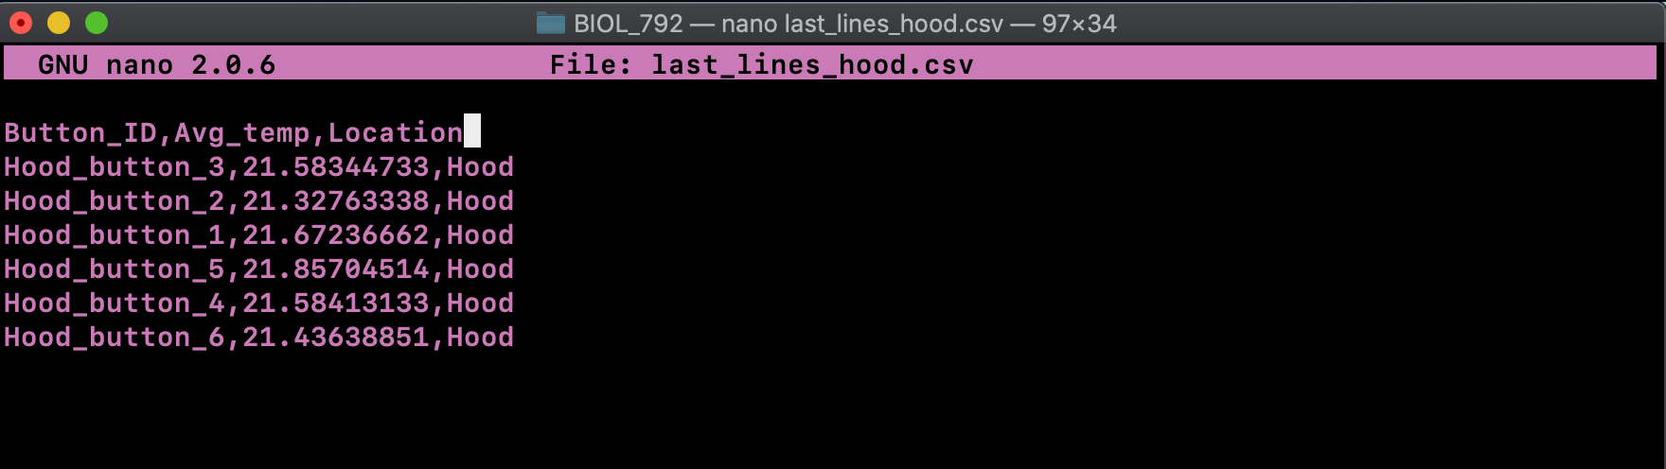
Python script 2: create new CSV with average temps
Use pandas to print just the last line of the file (the average temp), add it to new file
This is the output file after I fix the formatting
This is the actual output file from my script
Notes:
-So I ended up having to write one more script where I just used pandas to print only the last line of each file to a new file

