Slide 1
GEOL 599
Applied Machine Learning for Geoscience Data
Lecture 11
Parts of a neural network
Forward and back propagation
Activation functions
Dropout

Slide 2
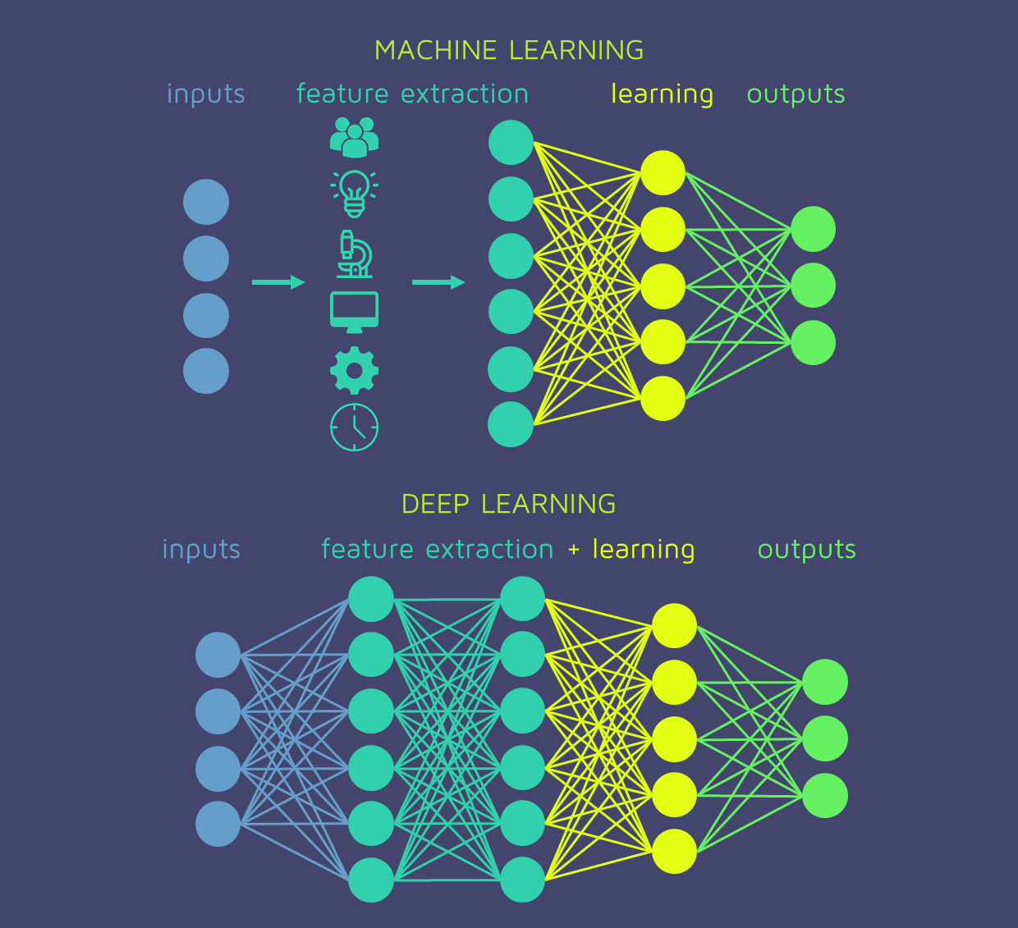
Traditional ML vs Deep Learning

Slide 3
What is deep learning
A machine learning subfield of learning representations of data.
Exceptional effective at learning patterns.
Deep learning algorithms attempt to learn (multiple levels of) representation by using a hierarchy of multiple layers
Does feature identification and processing in a series of stages, just as our brains seem to.
New algorithms for training many-layer networks
If you provide the system tons of information, it begins to understand it and respond in useful ways.

Slide 4
Why deep learning
Deep learning is useful when relationships are complex, nonlinear, and difficult to specify manually.
Good fits:
  Images, maps, rasters, satellite data
  Time series and sequences
  Text and language
  High-dimensional environmental data
  Problems where feature engineering is difficult
Less ideal fits:
  Small tabular datasets
  Problems where interpretability is the main goal
  Problems with limited training data
  Problems where simpler models already work well

Slide 5
What deep learning needs
Deep learning works best when you have:
  Enough training data
  A clear prediction target
  A useful validation strategy
  Scaled or normalized inputs
  Enough computation
  Careful monitoring of overfitting
Deep learning struggles when:
  Data are limited
  Labels are noisy
  Validation is poorly designed
  The model learns sampling artifacts
  The prediction task differs from the training data

Slide 6
Parts of a deep learning model
Input Layer: This is where the network receives its input data. Each input neuron in the layer corresponds to a feature in the input data.
Hidden Layers: These layers perform most of the computational heavy lifting. A neural network can have one or multiple hidden layers. Each layer consists of units (neurons) that transform the inputs into something that the output layer can use.
Output Layer: The final layer produces the output of the model. The format of these outputs varies depending on the specific task like classification, regression.

Slide 7
Terminology
Neurons: The basic units that receive inputs, each neuron is governed by a threshold and an activation function.
Connections: Links between neurons that carry information, regulated by weights and biases.
Weights and Biases: These parameters determine the strength and influence of connections.
Propagation Functions: Mechanisms that help process and transfer data across layers of neurons.
Learning Rule: The method that adjusts weights and biases over time to improve accuracy.

Slide 8
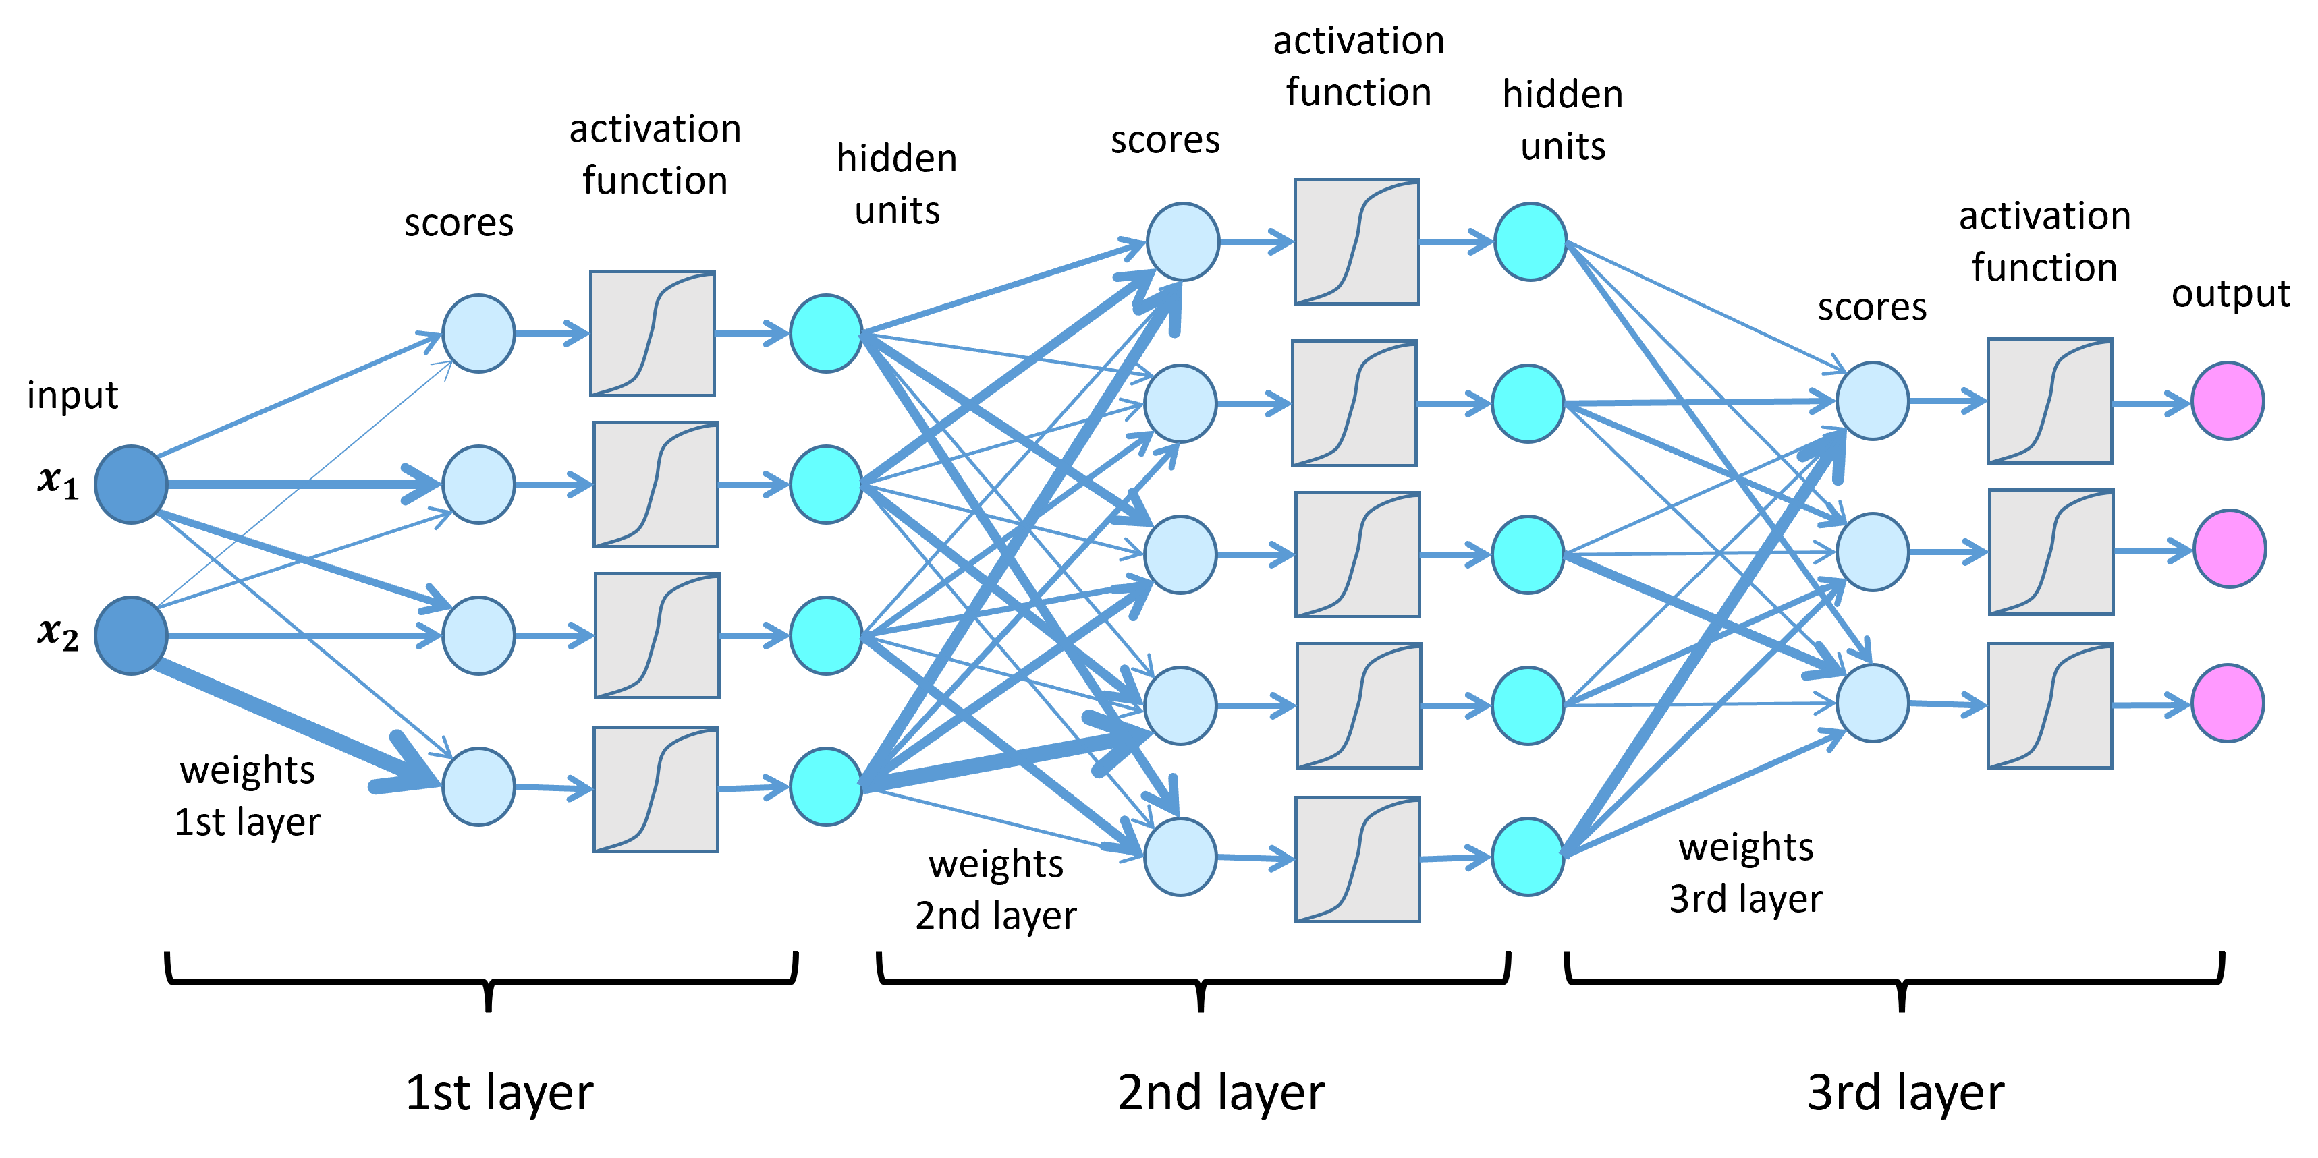
Neural Network Overview

Slide 9
Input Layer
The input layer is the first layer
Receives raw input data.
Each neuron corresponds to a feature in the dataset
Does not perform calculations, only forwards data

Slide 10
Hidden Layers
Located between input and output layers
Perform the main computations in the network
Transform input data into more meaningful representations to help the network learn complex patterns.
Apply weights and biases to input data
Use activation functions to introduce non-linearity
Number and size depend on the complexity of the task

Slide 11
Output Layer
Produces the final output or prediction
Number of neurons depends on classes (classification) or outputs (regression)
Uses different activation functions based on the task
  Softmax for multi-class classification
  Sigmoid for binary classification
  Linear for regression

Slide 12
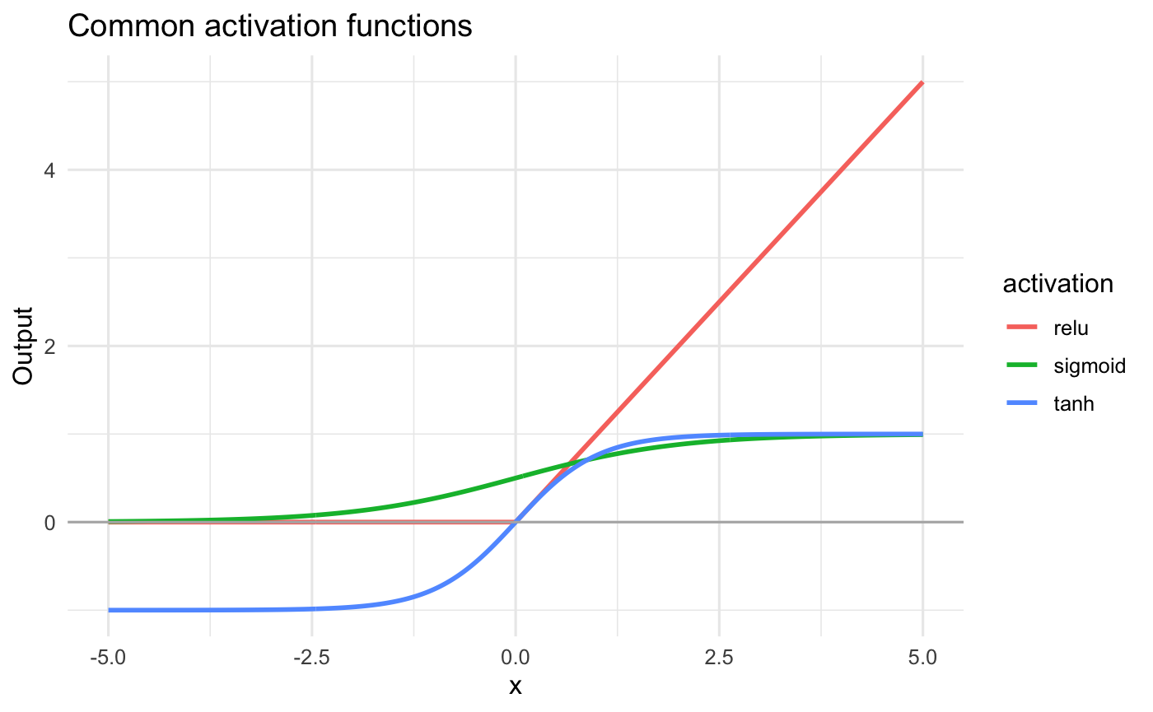
Activation Function
Activation functions decide how much signal passes forward.

Slide 13
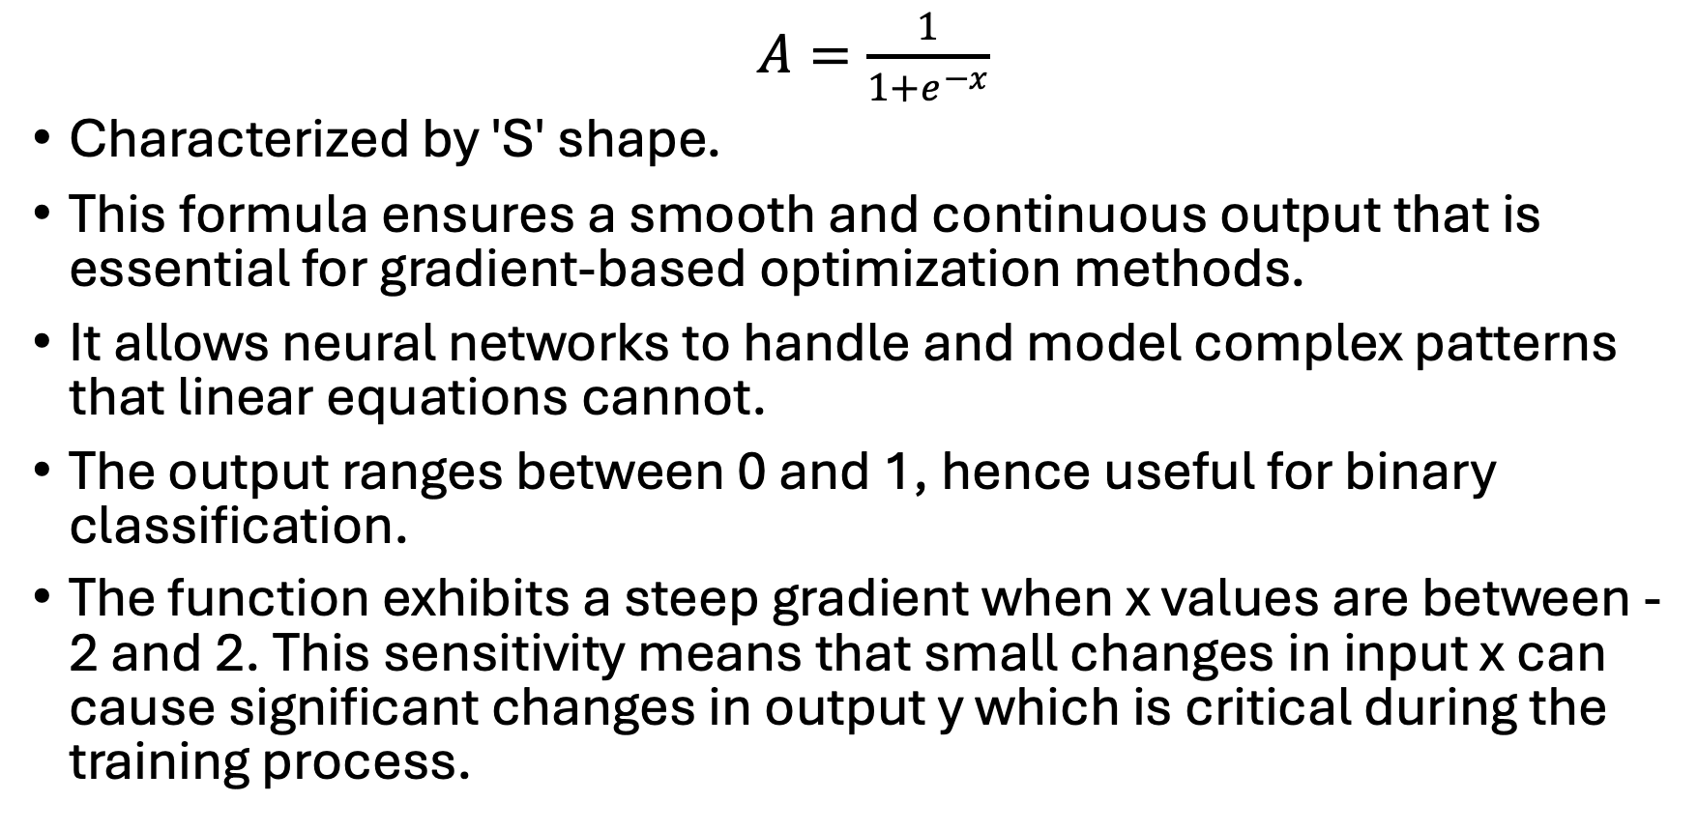
Sigmoid Function
$A=\frac{1}{1+e^{−x}}$​
Characterized by 'S' shape.
This formula ensures a smooth and continuous output that is essential for gradient-based optimization methods.
It allows neural networks to handle and model complex patterns that linear equations cannot.
The output ranges between 0 and 1, hence useful for binary classification.
The function exhibits a steep gradient when x values are between -2 and 2. This sensitivity means that small changes in input x can cause significant changes in output y which is critical during the training process.

Slide 14
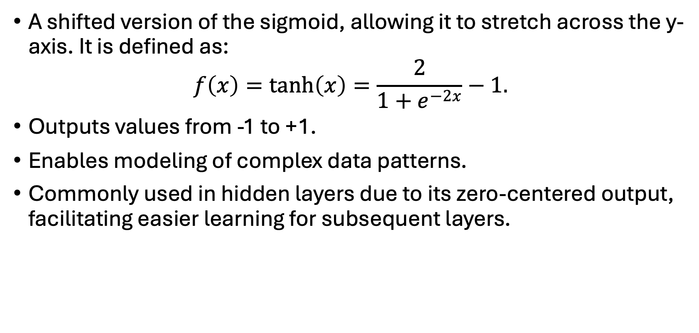
Tanh Activation Function
A shifted version of the sigmoid, allowing it to stretch across the y-axis. It is defined as:
$$f\left(x\right)=tanh⁡\left(x\right)=\frac{2}{1+e^{−2x}}−1.$$
Outputs values from -1 to +1.
Enables modeling of complex data patterns.
Commonly used in hidden layers due to its zero-centered output, facilitating easier learning for subsequent layers.

Slide 15
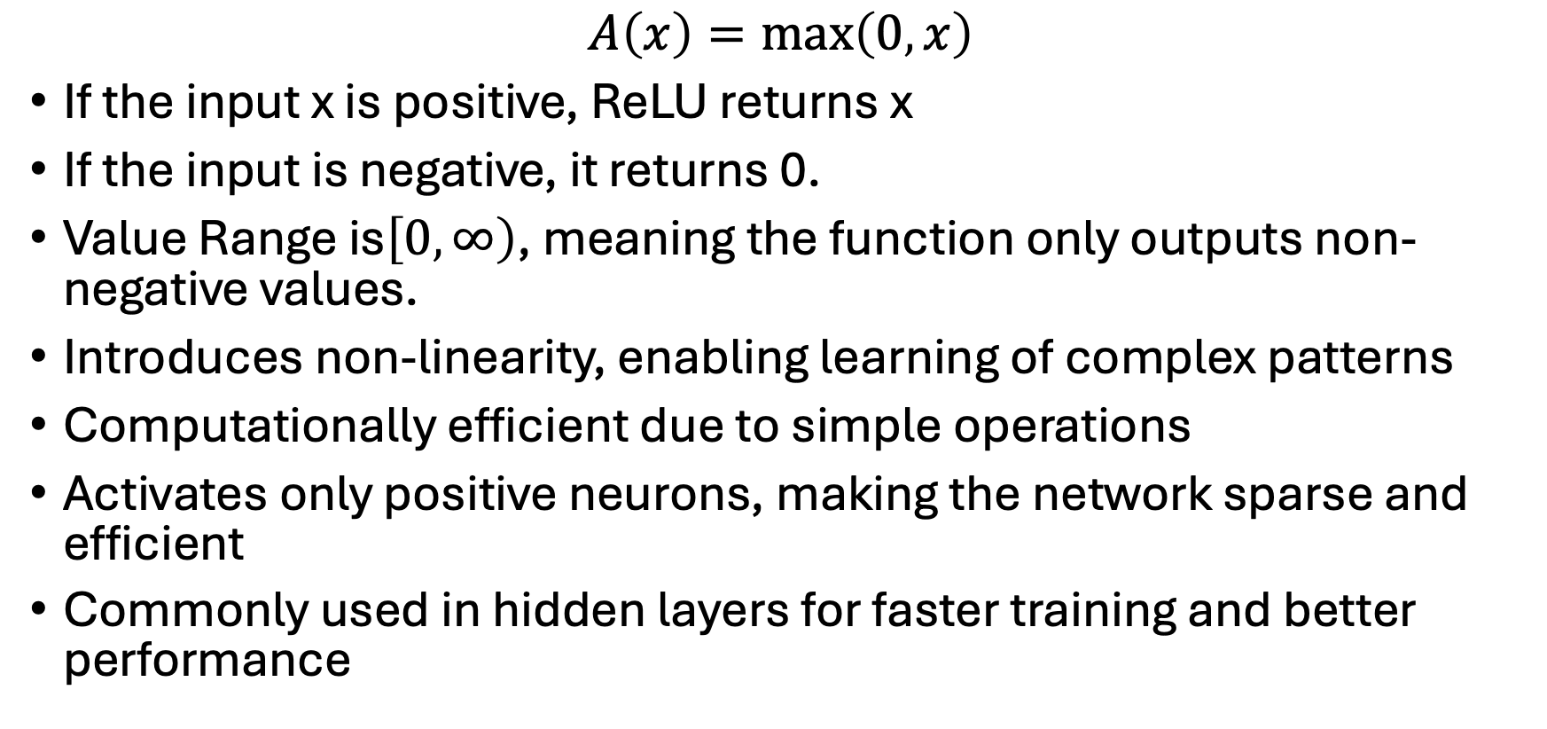
ReLU (Rectified Linear Unit) Function
$$A\left(x\right)=\max\left(0 , x\right)$$
If the input x is positive, ReLU returns x
If the input is negative, it returns 0.
Value Range is$\left[0 , ∞\right)$, meaning the function only outputs non-negative values.
Introduces non-linearity, enabling learning of complex patterns
Computationally efficient due to simple operations
Activates only positive neurons, making the network sparse and efficient
Commonly used in hidden layers for faster training and better performance

Slide 16
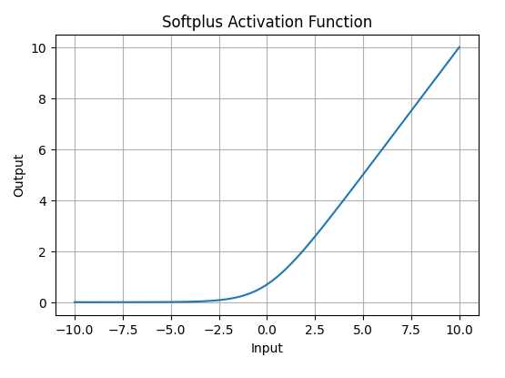
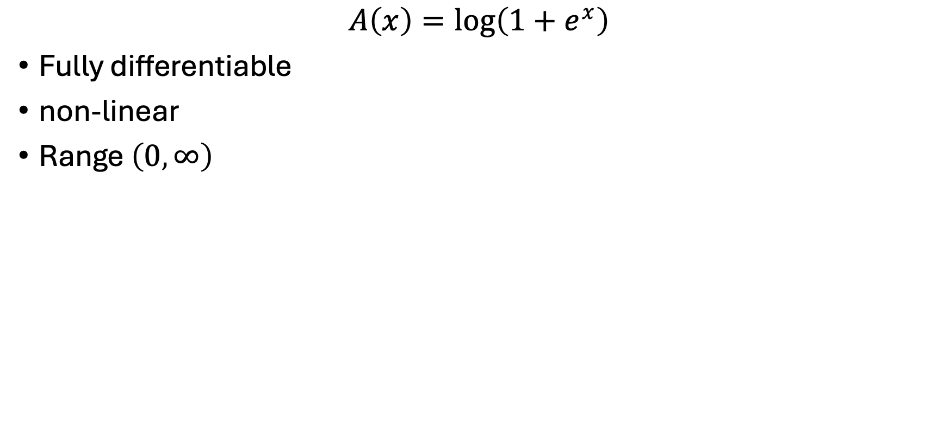
SoftPlus Function
$$A\left(x\right)=\log\left(1+e^{x}\right)$$
Fully differentiable
non-linear
Range $\left(0 , ∞\right)$

Slide 17
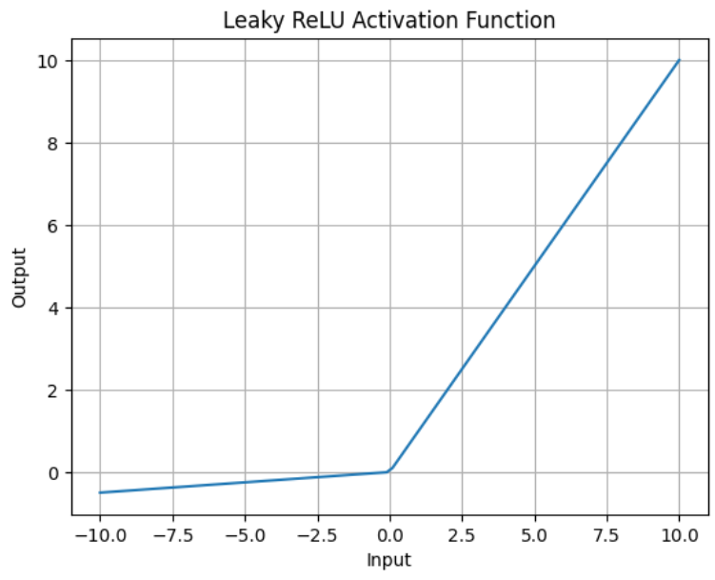
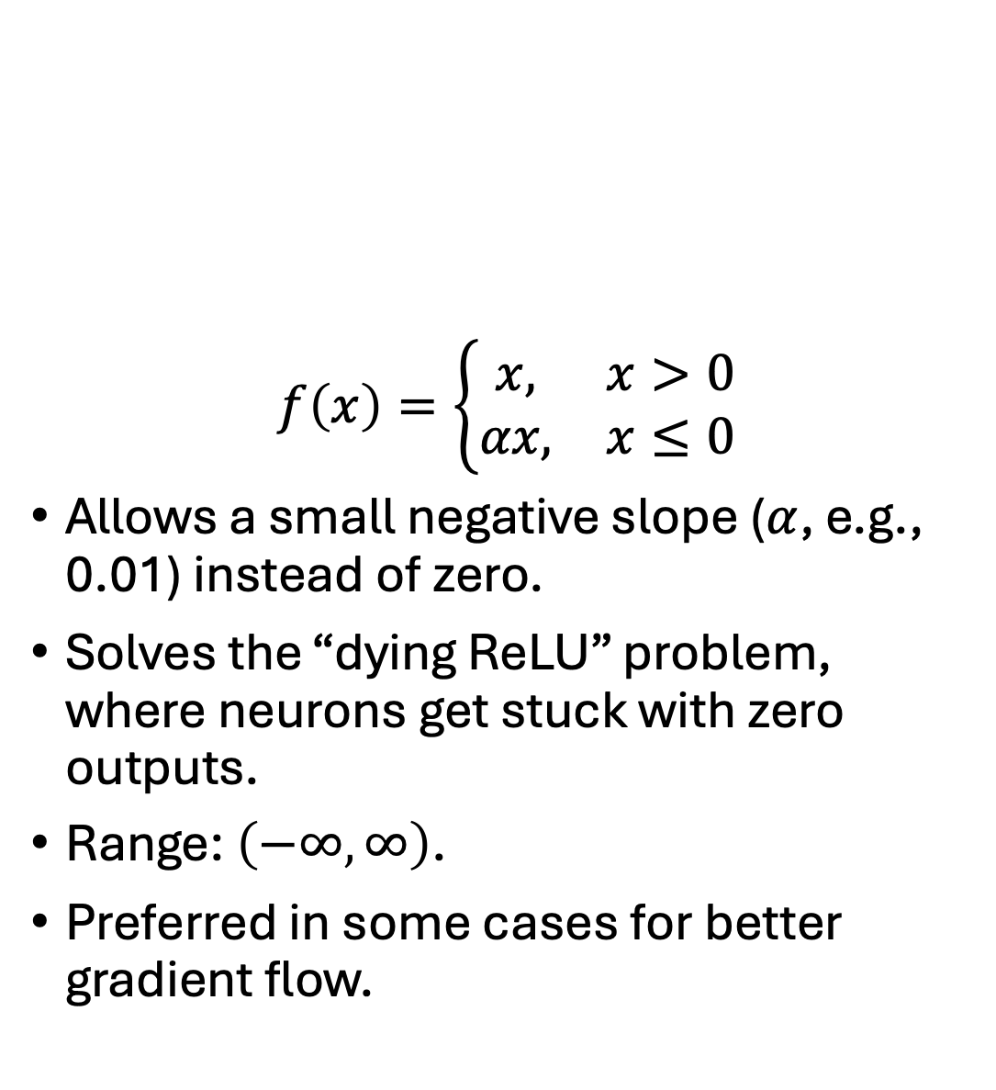
Leaky ReLU
$$f\left(x\right)=\left\{\begin{matrix}x, & x>0 \\ αx, & x≤0\end{matrix}\right.$$
Allows a small negative slope ($α$, e.g., 0.01) instead of zero.
Solves the “dying ReLU” problem, where neurons get stuck with zero outputs.
Range: $\left(−∞ , ∞\right)$.
Preferred in some cases for better gradient flow.

Slide 18
Neural Network Overview

Slide 19
Loss function
A loss function measures how wrong the model is.
Training tries to find weights that minimize the loss.
Task | Common Loss
Regression | Mean squared error
Binary classification | Binary cross-entropy
Multiclass classification | Categorical cross-entropy

Slide 20
Training a neural network
Training loop:
Start with random weights.
Make predictions.
Compute loss.
Compute gradients using backpropagation.
Update weights using an optimizer.
Repeat for many epochs.
Term | Meaning
Epoch | One pass through the training data
Batch | A subset of training examples used for one update
Gradient | Direction that reduces the loss
Optimizer | Algorithm that updates weights
Learning rate | Size of each update

Slide 21
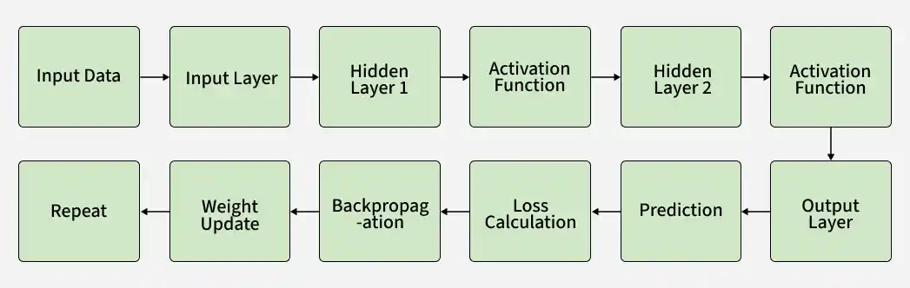
Model Training
Each connection between neurons in these layers has an associated weight that is adjusted during the training process to minimize the error in predictions.

Slide 22
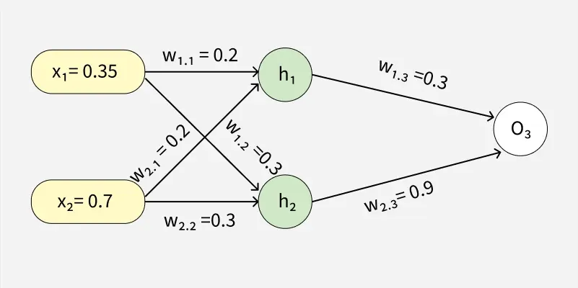
Forward Pass Work
Input data moves through the network to generate an output.
  Input data is passed to the input layer and forwarded to hidden layers
Each neuron computes a weighted sum and adds a bias
Activation functions are applied to produce outputs
Outputs from one layer become inputs to the next layer
Final layer uses functions to produce predictions

Slide 23
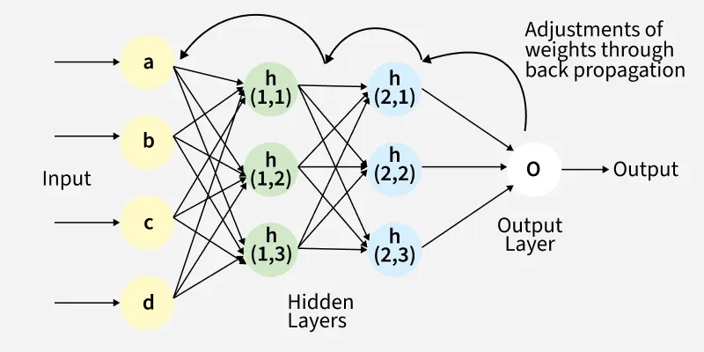
Backward Pass
Error between predicted and actual output is propagated backward to update weights and biases
Gradients are computed using the chain rule
Weights and biases are updated to reduce the error
Process continues layer by layer from output to input
Derivatives of activation functions are used to compute gradients effectively

Slide 24
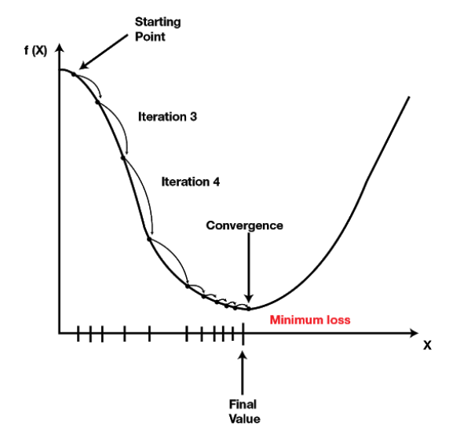
Learning Rate
The learning rate controls how large each weight update is.
Learning rate is one of the most important deep learning hyperparameters.
small learning rate = cautious updates
large learning rate = aggressive updates
Learning Rate | Effect
Too high | Training may bounce around or diverge
Too low | Training may be very slow
Well chosen | Loss decreases steadily

Slide 25
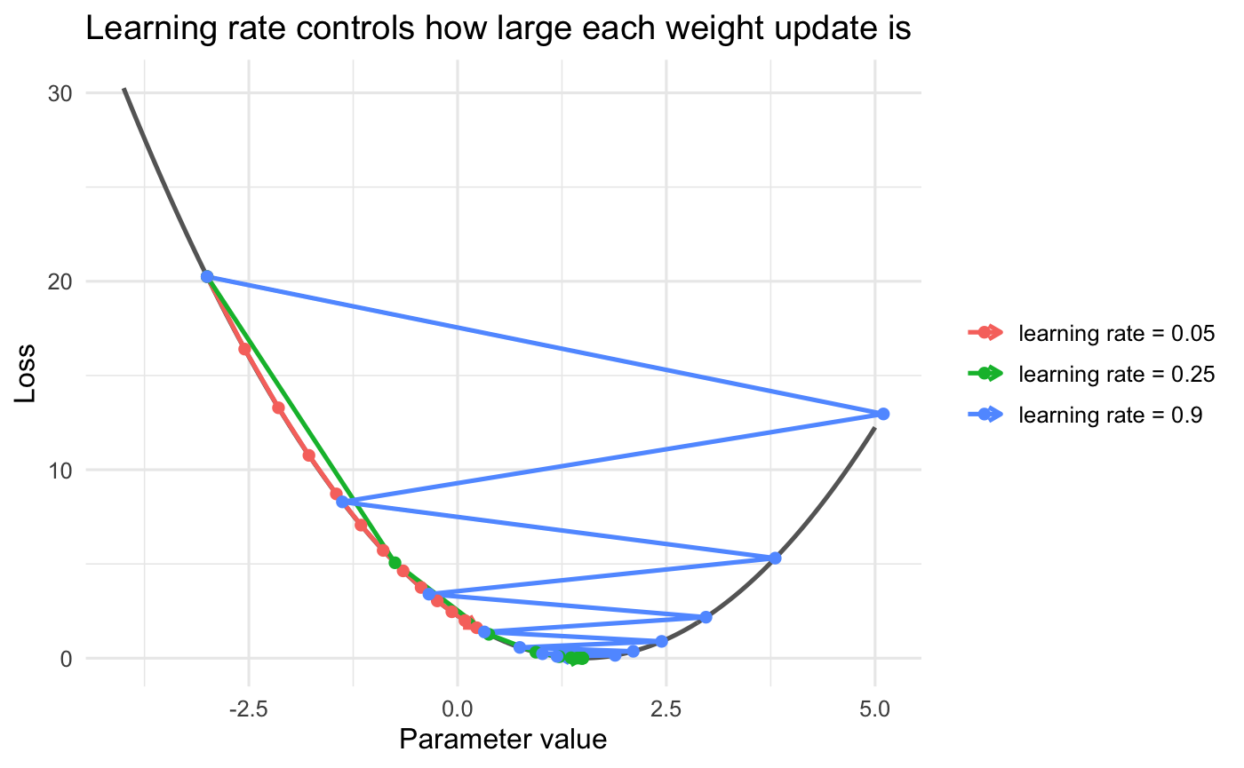
Learning Rate Example

Slide 26
Iteration
This process of forward propagation, loss calculation, backpropagation and weight update is repeated for many iterations over the dataset. Over time, this iterative process reduces the loss and the network's predictions become more accurate.

Slide 27
Classification Example
Let's consider a record of an email dataset:
To classify this email, we will create a feature vector based on the analysis of keywords such as "free" "win" and "offer"
The resulting feature vector is:
  free: Present (1)
  win: Absent (0)
  offer: Present (1)
Feature Vector: [1, 0, 1]
Email ID | Email Content | Sender | Subject Line | Label
1 | "Get free gift cards now!" | spam@example.com | "Exclusive Offer" | 1

Slide 28
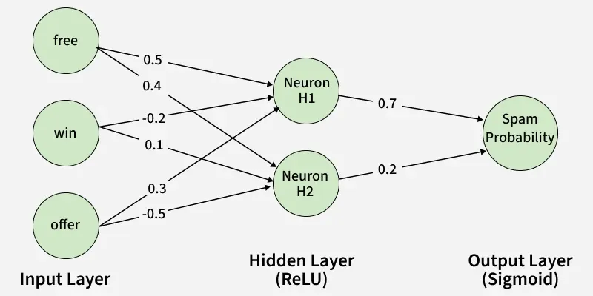
Hidden Layer Calculation:
Assume the hidden layer contains two neurons with the following weights
Neuron H1: [ 0.5, −0.2, 0.3]
Neuron H2: [ 0.4, 0.1, −0.5]
For the input vector [1, 0, 1], the weighted sums are:
For H1: (1 × 0.5) +(0 × −0.2) + (1 × 0.3) = 0.5 + 0 + 0.3 = 0.8
For H2: (1 × 0.4) +(0 × 0.1) + (1 × −0.5) = 0.4 + 0 − 0.5 =−0.1

Slide 29
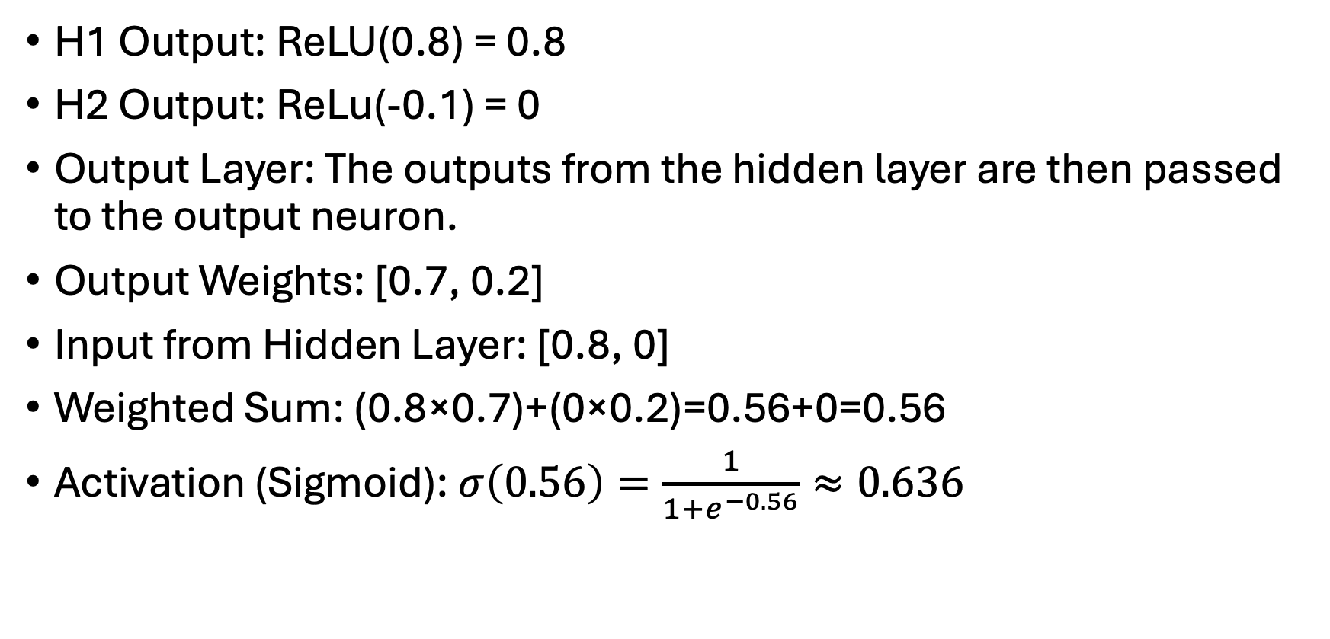
Applying the ReLU activation function
H1 Output: ReLU(0.8) = 0.8
H2 Output: ReLu(-0.1) = 0
Output Layer: The outputs from the hidden layer are then passed to the output neuron.
Output Weights: [0.7, 0.2]
Input from Hidden Layer: [0.8, 0]
Weighted Sum: (0.8×0.7)+(0×0.2)=0.56+0=0.56
Activation (Sigmoid): $σ\left(0.56\right)=\frac{1}{1+e^{−0.56}}≈0.636$

Slide 30
Final Classification
The output value of approximately 0.636 indicates the probability of the email being spam.
Since this value is greater than 0.5, the neural network classifies the email as spam (1).

Slide 31
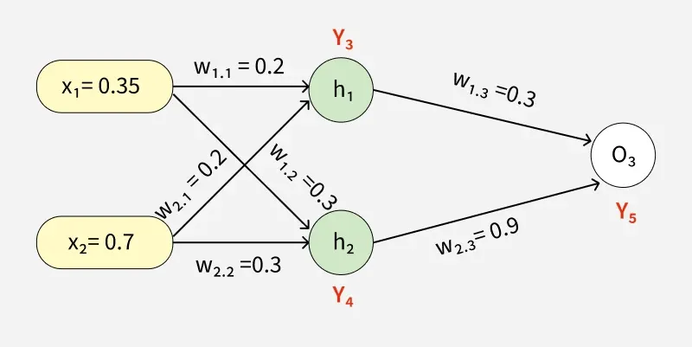
Second Example

Slide 32
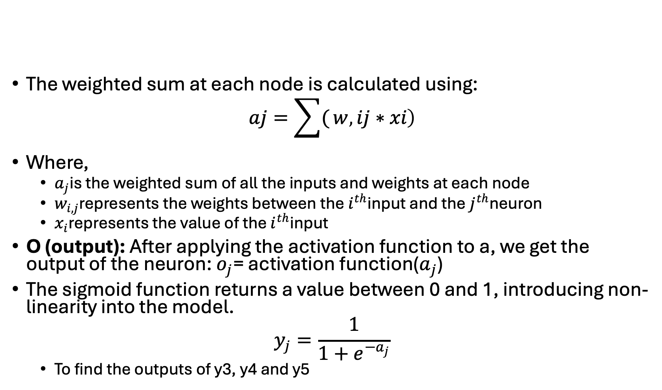
Forward Propagation
The weighted sum at each node is calculated using:
$$aj\text{​}=\sum{(}\left.w , i\text{​}j∗xi\text{​}\right)$$
Where,
  $a_{j}$is the weighted sum of all the inputs and weights at each node
  $w_{i,j}$represents the weights between the $i^{th}$input and the $j^{th}$neuron
  $x_{i}$represents the value of the $i^{th}$input
O (output): After applying the activation function to a, we get the output of the neuron: $o_{j}$= activation function($a_{j}$)
The sigmoid function returns a value between 0 and 1, introducing non-linearity into the model.
$$y_{j}=\frac{1}{1+e^{−a_{j}}}$$
  To find the outputs of y3, y4 and y5

Slide 33
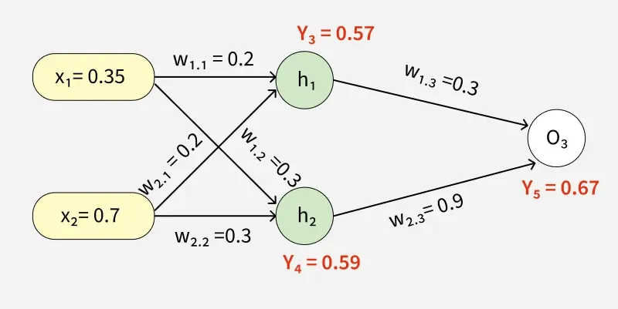
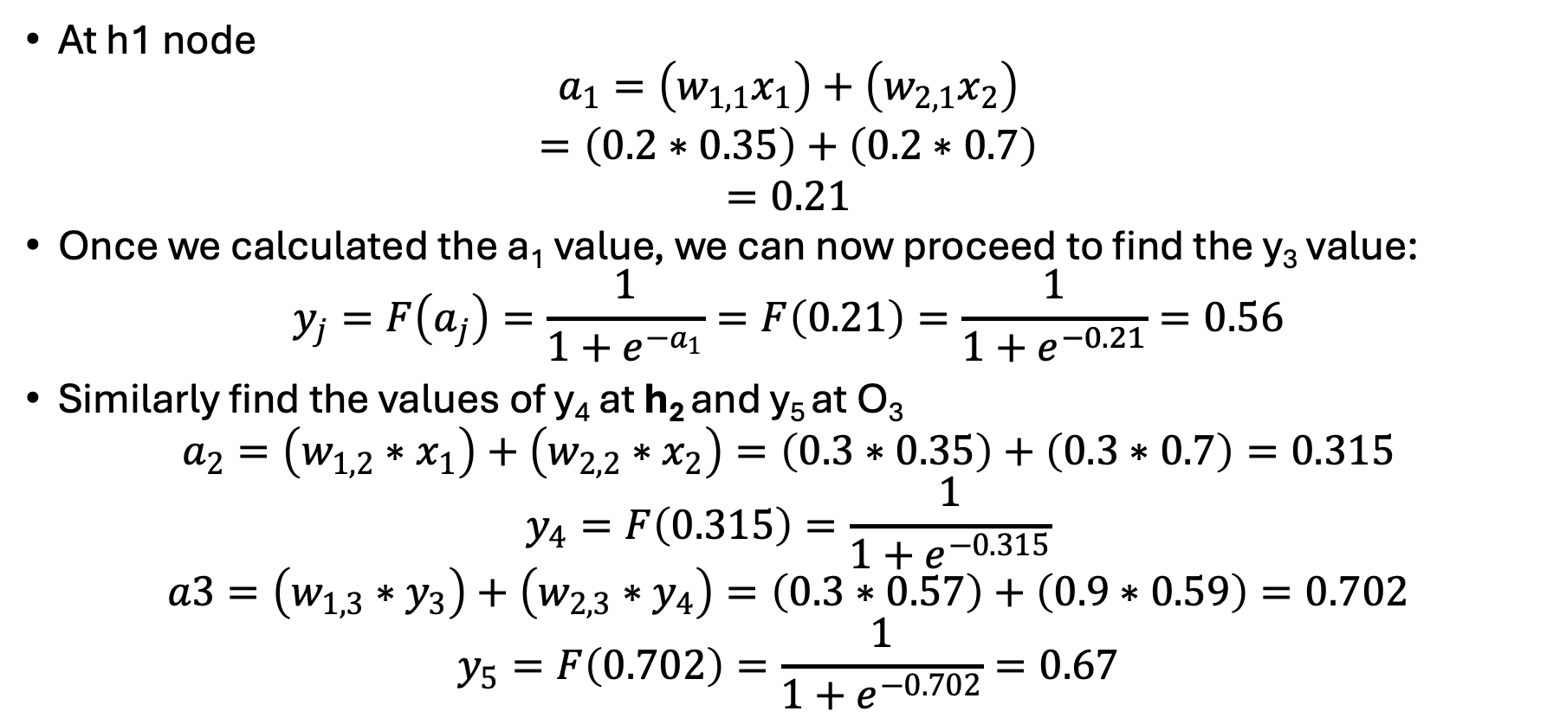
Computing Outputs
At h1 node
$$\begin{aligned}a_{1}=\left(w_{1,1}x_{1}\right)+\left(w_{2,1}x_{2}\right) \\ =\left(0.2∗0.35\right)+\left(0.2∗0.7\right) \\ =0.21\end{aligned}$$
Once we calculated the a₁ value, we can now proceed to find the y₃ value:
$$y_{j}=F\left(a_{j}\right)=\frac{1}{1+e^{−a_{1}}}=F\left(0.21\right)=\frac{1}{1+e^{−0.21}}=0.56$$
Similarly find the values of y₄ at h₂ and y₅ at O₃
$$a_{2}=\left(w_{1,2}∗x_{1}\right)+\left(w_{2,2}∗x_{2}\right)=\left(0.3∗0.35\right)+\left(0.3∗0.7\right)=0.315$$
$$y_{4}=F\left(0.315\right)=\frac{1}{1+e^{−0.315}}$$
$$a3=\left(w_{1,3}∗y_{3}\right)+\left(w_{2,3}∗y_{4}\right)=\left(0.3∗0.57\right)+\left(0.9∗0.59\right)=0.702$$
$$y_{5}=F\left(0.702\right)=\frac{1}{1+e^{−0.702}}=0.67$$

Slide 34
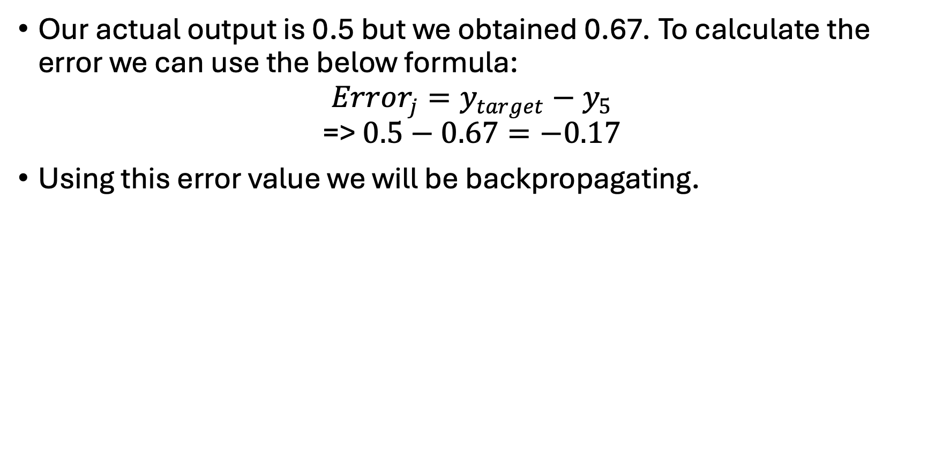
Error Calculation
Our actual output is 0.5 but we obtained 0.67. To calculate the error we can use the below formula:
$$Error_{j}=y_{target}−y_{5}$$
$$\text{=> }0.5−0.67=−0.17$$
Using this error value we will be backpropagating.

Slide 35
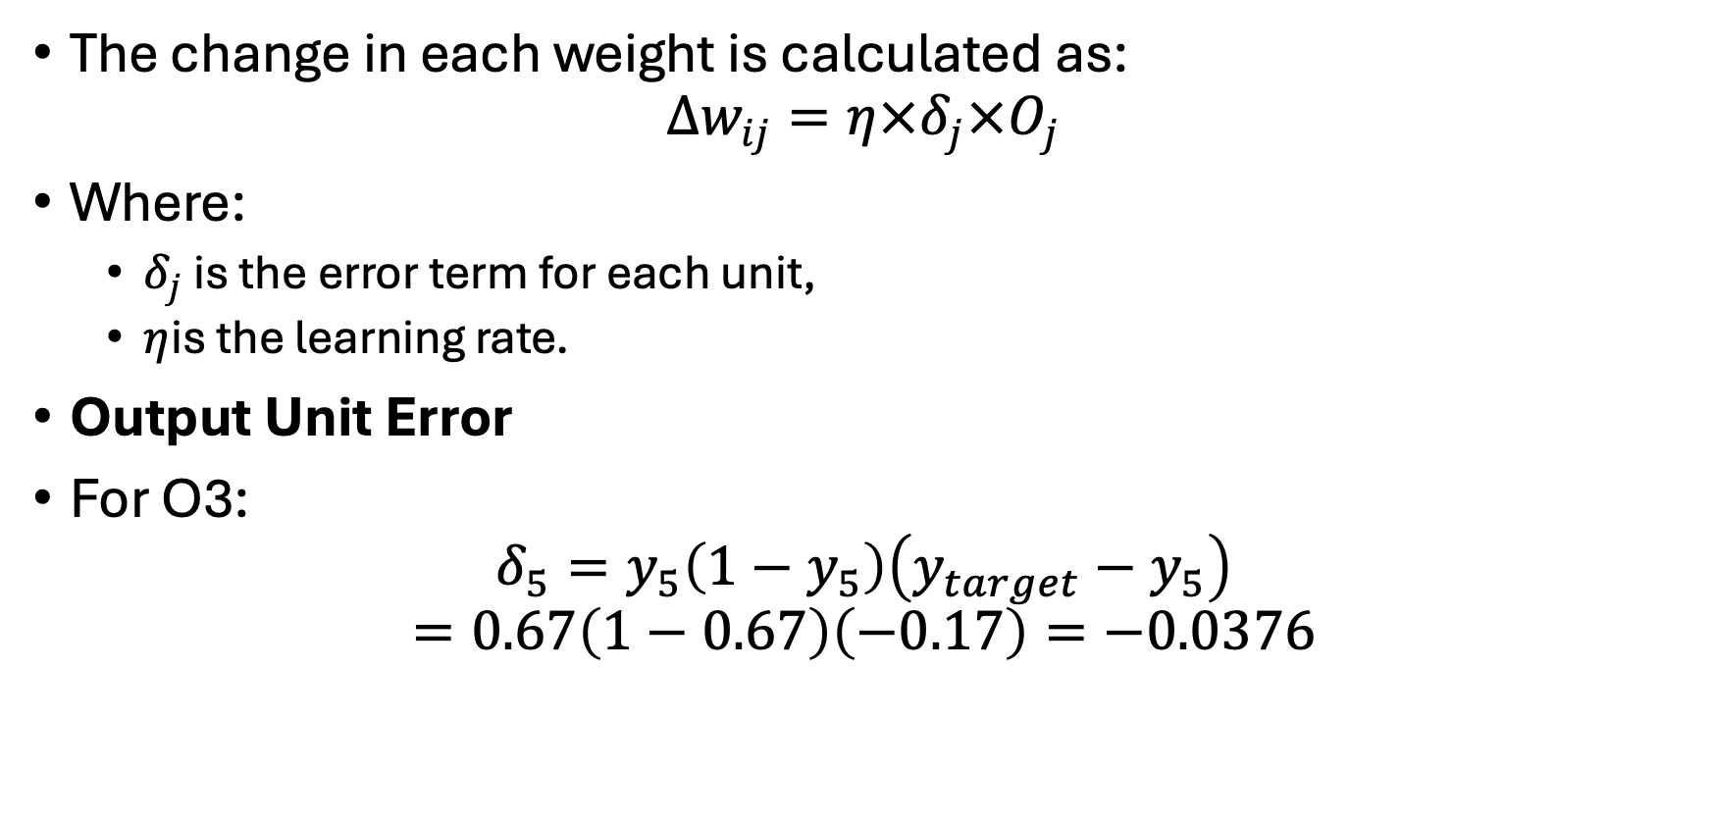
Back Propagation
The change in each weight is calculated as:
$$Δw_{ij}=η×δ_{j}×O_{j}$$
Where:
  $δ_{j}$​ is the error term for each unit,
  $η$is the learning rate.
Output Unit Error
For O3:
$$δ_{5}=y_{5}\left(1−y_{5}\right)\left(y_{target}−y_{5}\right)$$
$$=0.67\left(1−0.67\right)\left(−0.17\right)=−0.0376$$

Slide 36
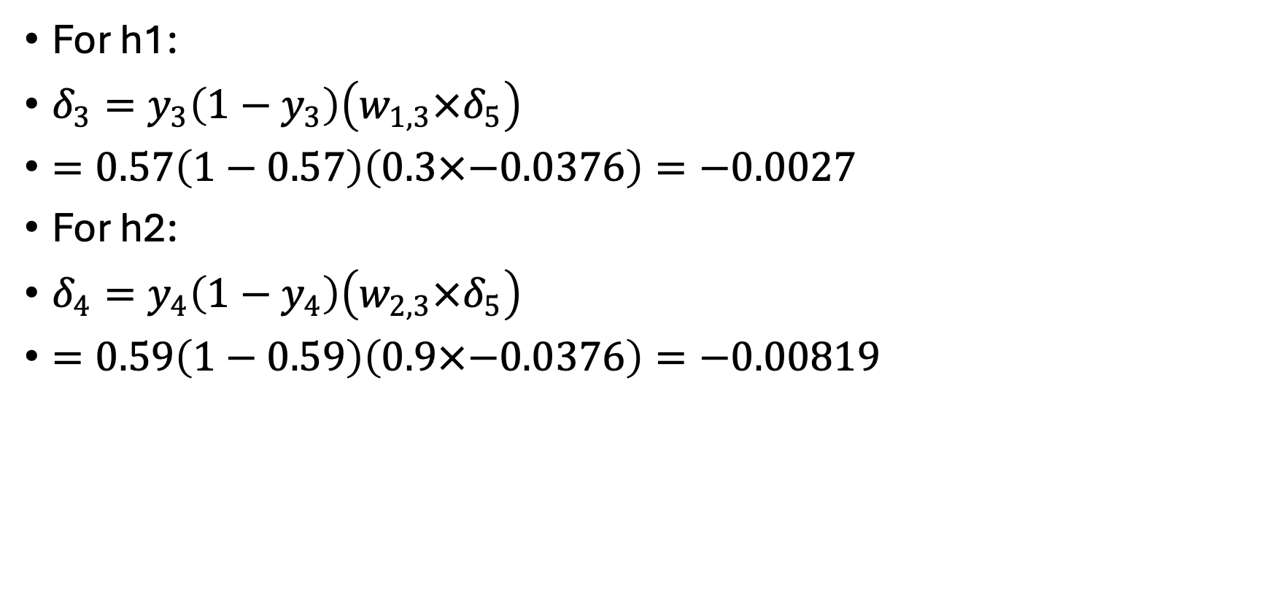
Hidden Unit Error
For h1:
$δ_{3}=y_{3}\left(1−y_{3}\right)\left(w_{1,3}×δ_{5}\right)$
$=0.57\left(1−0.57\right)\left(0.3×−0.0376\right)=−0.0027$
For h2:
$δ_{4}=y_{4}\left(1−y_{4}\right)\left(w_{2,3}×δ_{5}\right)$
$=0.59\left(1−0.59\right)\left(0.9×−0.0376\right)=−0.00819$

Slide 37

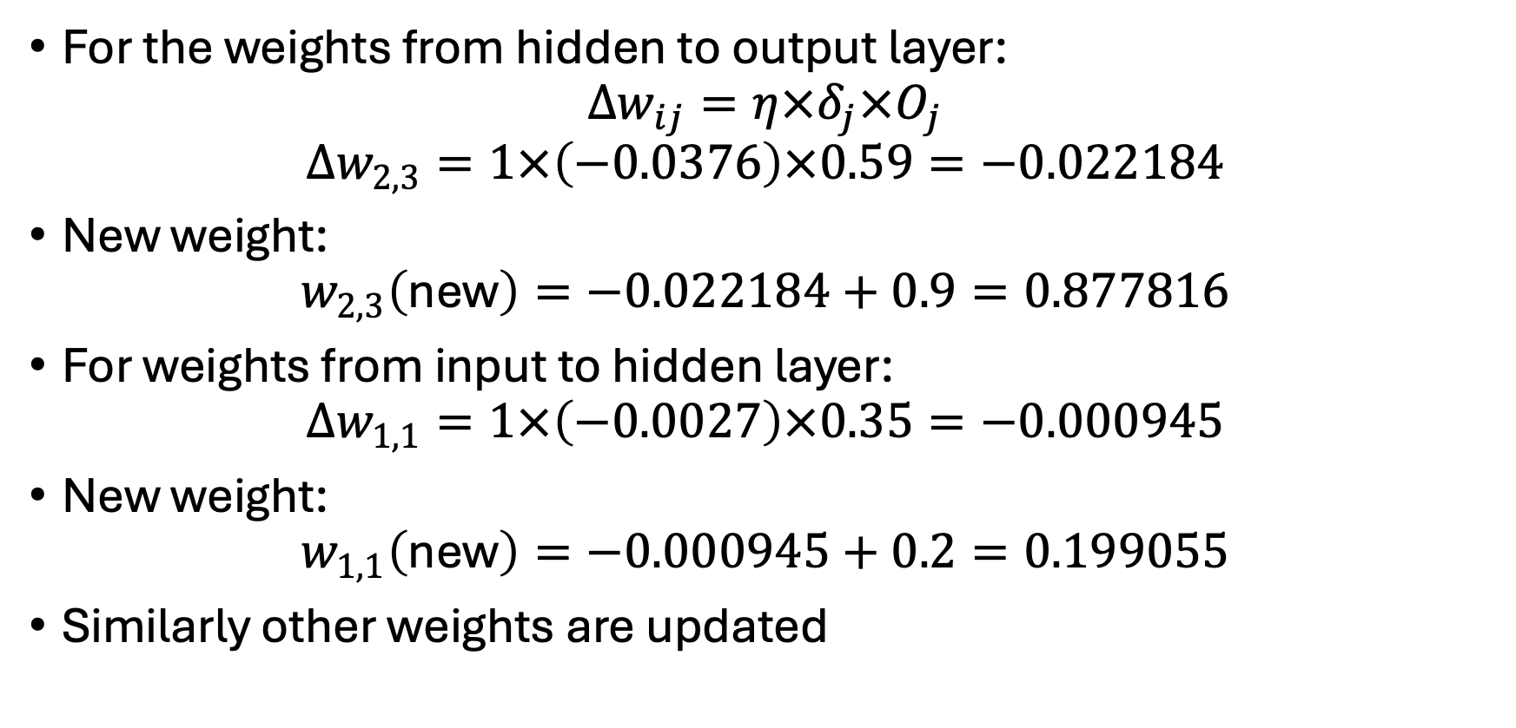
Weight Updates
For the weights from hidden to output layer:
$$Δw_{ij}=η×δ_{j}×O_{j}$$
$$Δw_{2,3}=1×\left(−0.0376\right)×0.59=−0.022184$$
New weight:
$$w_{2,3}\left(\text{new}\right)=−0.022184+0.9=0.877816$$
For weights from input to hidden layer:
$$Δw_{1,1}=1×\left(−0.0027\right)×0.35=−0.000945$$
New weight:
$$w_{1,1}\left(\text{new}\right)=−0.000945+0.2=0.199055$$
Similarly other weights are updated

Slide 38
Combating Overfitting
Deep learning models can have millions of parameters (weights and biases).
  That makes them powerful, but also easy to overfit.
Signs of overfitting:
  Training loss keeps decreasing
  Validation loss stops improving or gets worse
  Training accuracy is much higher than validation accuracy
Strategy | What It Does
More data | Gives model more examples
Data augmentation | Creates realistic variation
Dropout | Randomly removes neurons during training
Weight decay | Penalizes large weights
Early stopping | Stops training when validation performance stops improving
Smaller model | Reduces flexibility

Slide 39
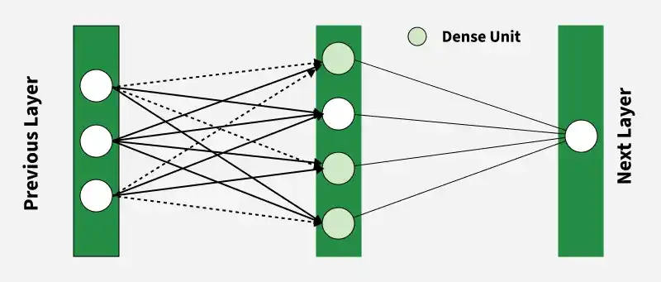
Dense Layers
Hidden layers can be of different types, each designed to perform specific computations and improve learning.
Dense (Fully Connected) Layer
  most common hidden layer where each neuron is connected to every neuron in the previous layer.
  It performs a weighted sum of inputs followed by an activation function to learn complex patterns.

Slide 40
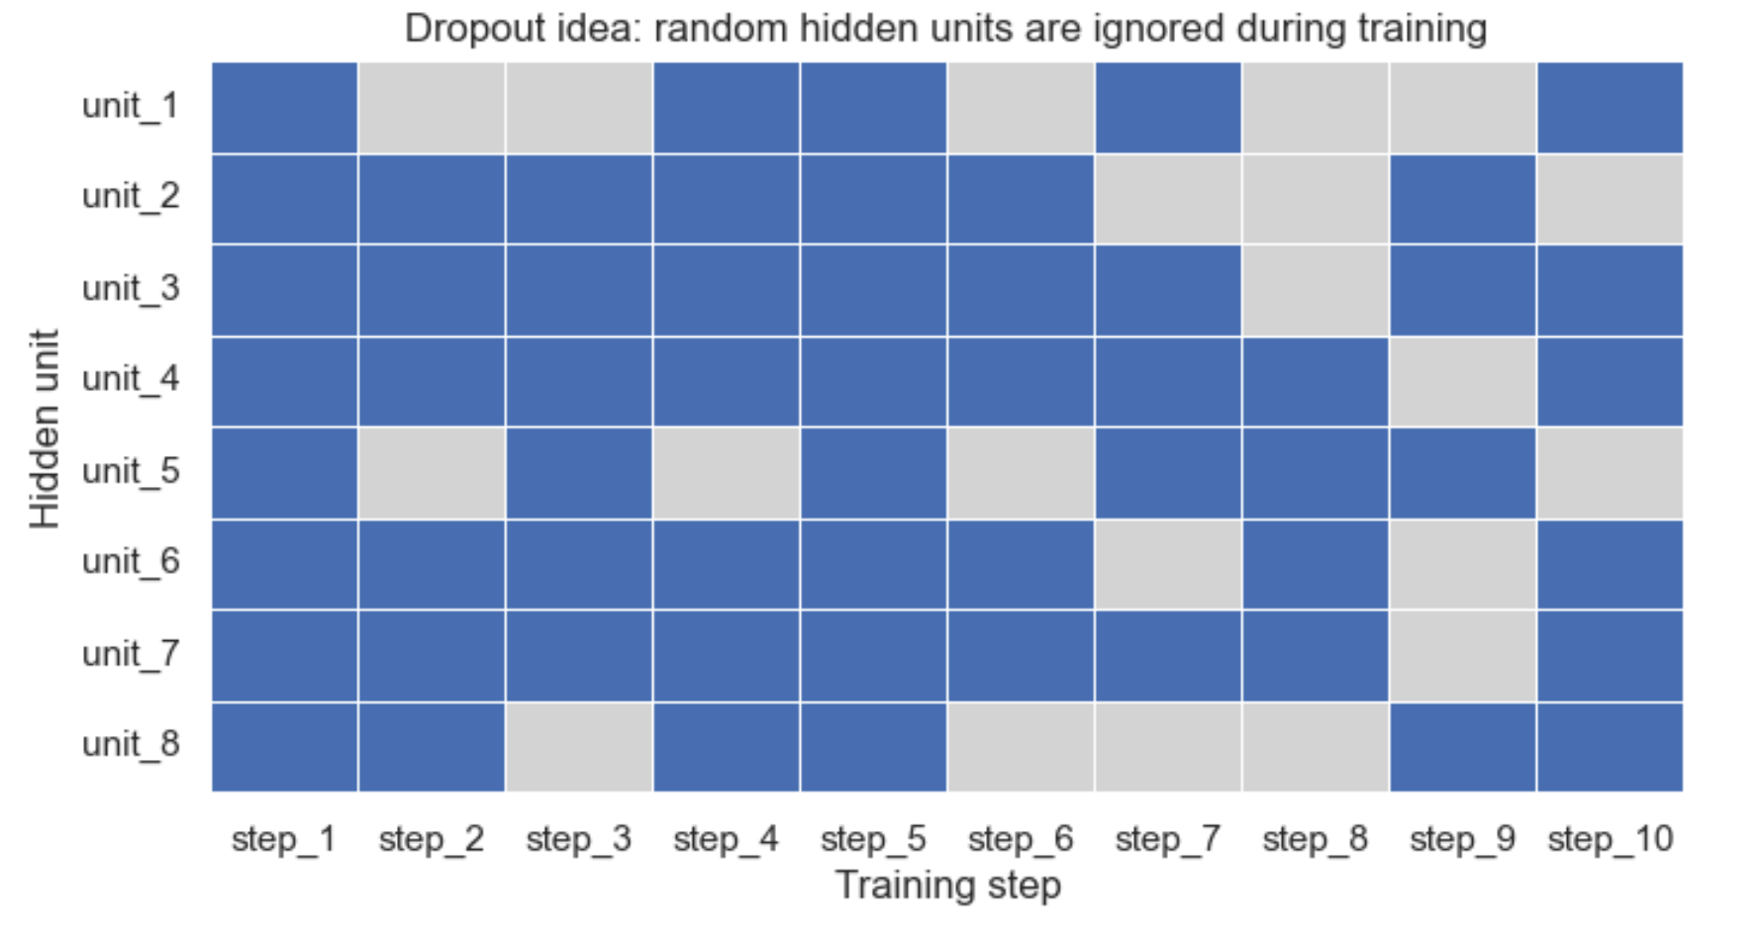
Dropout Layer
A regularization technique to reduce overfitting by randomly deactivating some neurons during training
  Helps prevent overfitting
  Reduces dependency on specific neurons
  Improves generalization of the model

