Slide 1
GEOL 599
Applied Machine Learning for Geoscience Data
Lecture 12
Optimizers
Hyperparameters

Slide 2
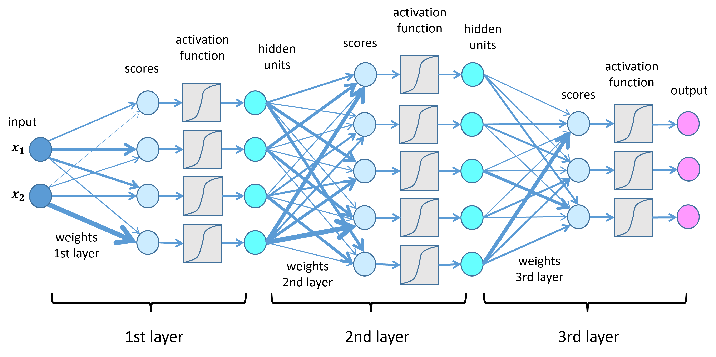
Neural Network Overview

Slide 3
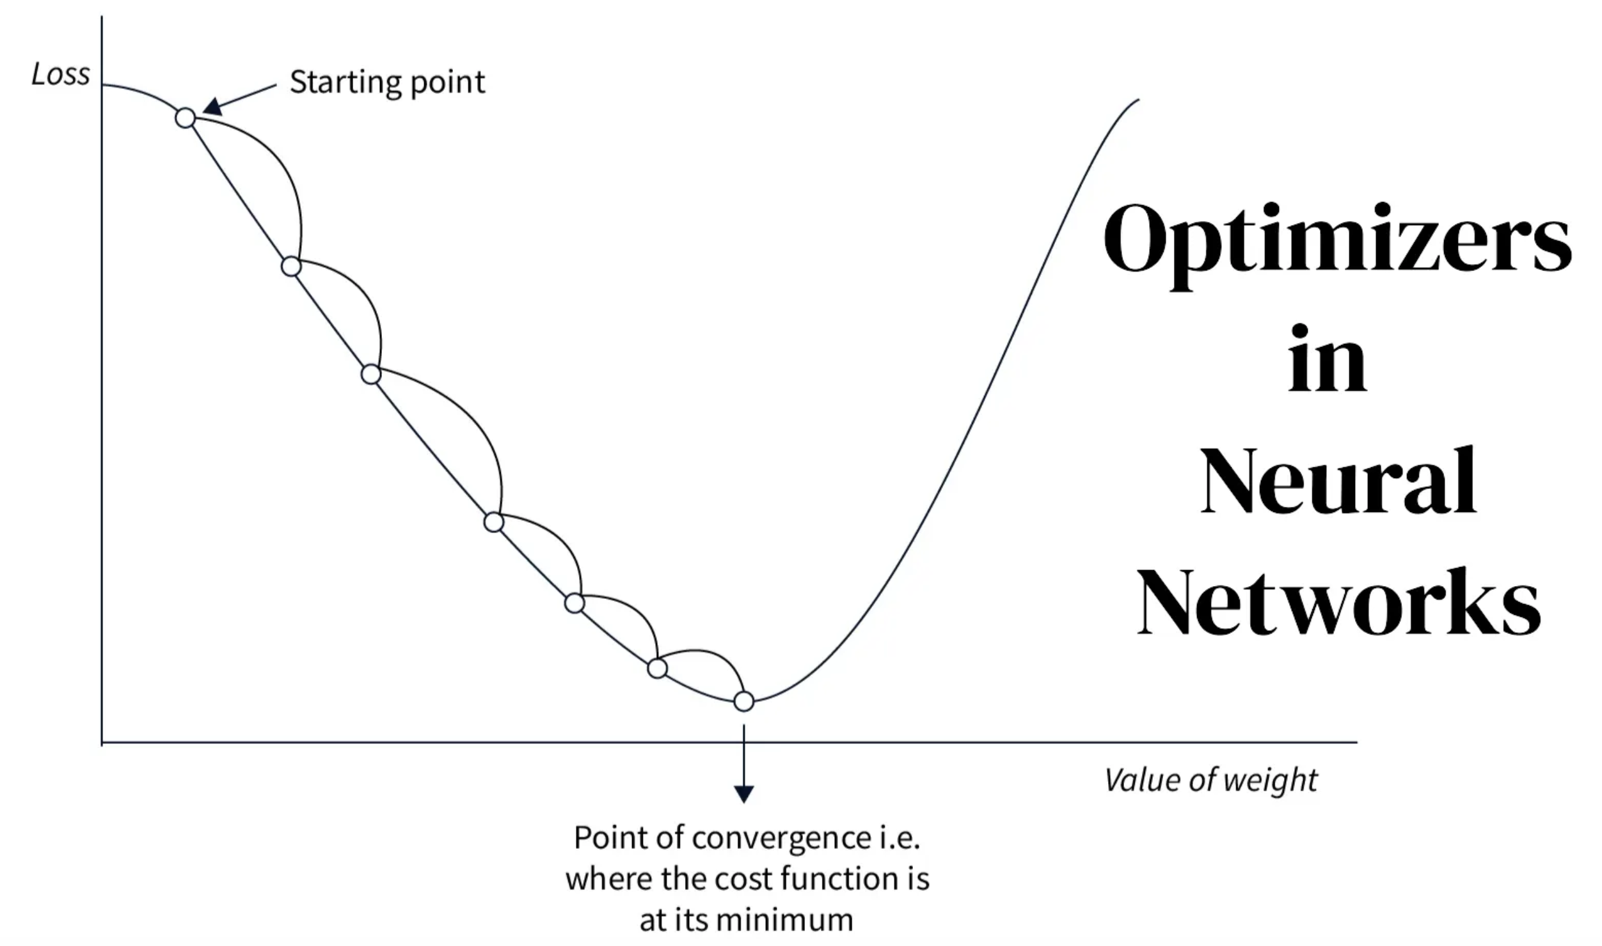
Optimizers
Optimizers efficiently navigate the complex landscape of weight parameters, reducing the loss function, and converging toward the global minima

Slide 4
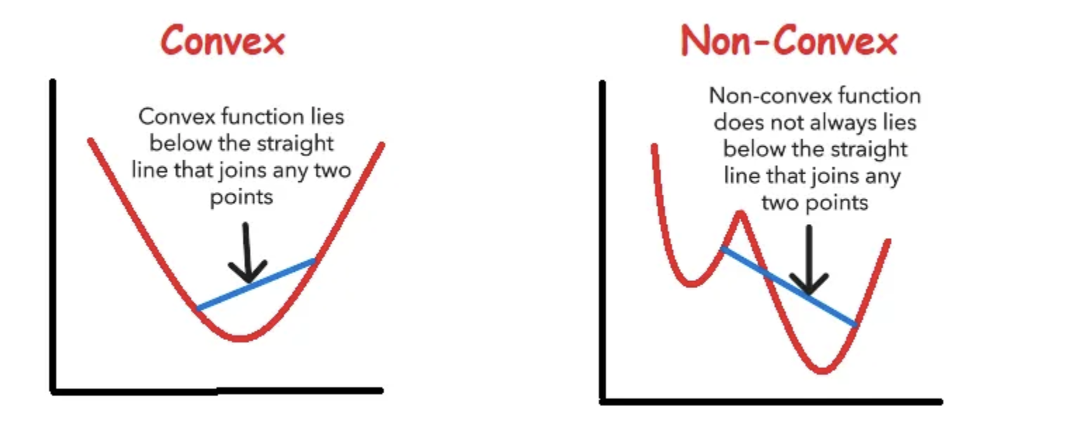
Convex vs. Non-Convex Optimization

Slide 5
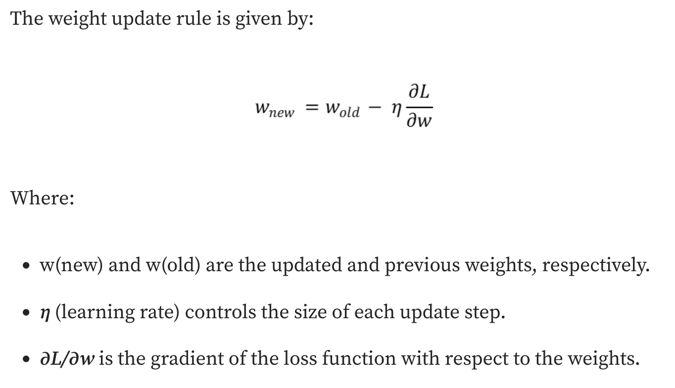
Optimizer to update weights

Slide 6
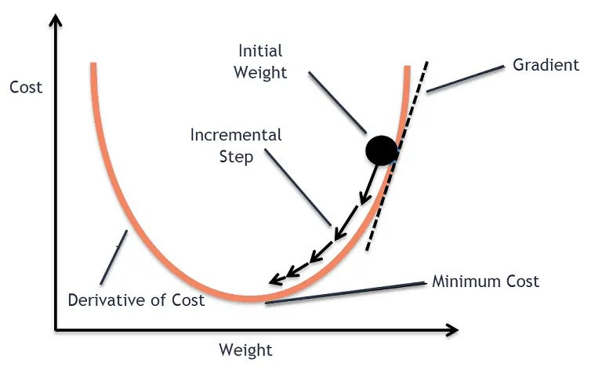
Gradient Descent

Slide 7
Stochastic/Mini-Batch Gradient Descent
Randomly selects a single sample or small batch (Mini-Batch Gradient Descent) from the dataset to update the weights during each iteration.
Initialization:
Select initial weight parameters (w) and learning rate (η).
Data Shuffling:
Randomly shuffle the dataset at the beginning of each epoch to prevent biased learning.
Weight Updates:
For each randomly selected sample or group of samples, compute the gradient of the loss function and update weights

Slide 8
Why (not) SGD
Pros of Stochastic Gradient Descent
  Efficiency with Large Datasets
  Faster Convergence
  Online Learning
Cons of Stochastic Gradient Descent
  Noisy Optimization Path
  Increased Number of Iterations
  Hyperparameter Sensitivity
  Poor Convergence Stability

Slide 9
Stochastic Gradient Descent with Momentum
Momentum introduces a moving average of past gradients, smoothing out oscillations and pushing the optimizer toward a more stable path.
Faster Convergence
Reduced Noise
Escaping Local Minima
Improved Generalization
Hyperparameter Sensitivity
Overshooting Risk
Complexity
Diminished Impact in Complex Landscapes

Slide 10
RMSProp (Root Mean Square Propagation)
Solves the variation in gradient magnitudes across parameters.
In some cases, gradients may be small, while others may be disproportionately large, leading to inefficient updates when using a uniform learning rate for all weights.
Maintains a moving average of squared gradients and dividing the gradient by the square root of this average
  Larger oscillations receive smaller updates.
It is ideal for tasks involving sequential data due to its adaptability to changing gradients.

Slide 11
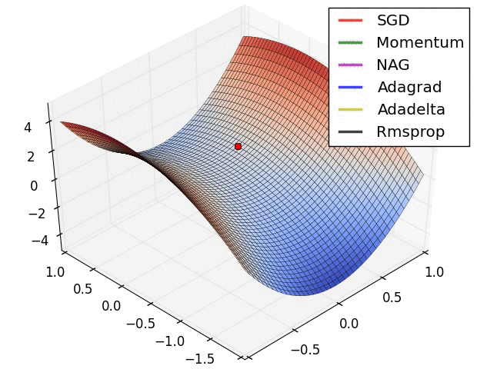
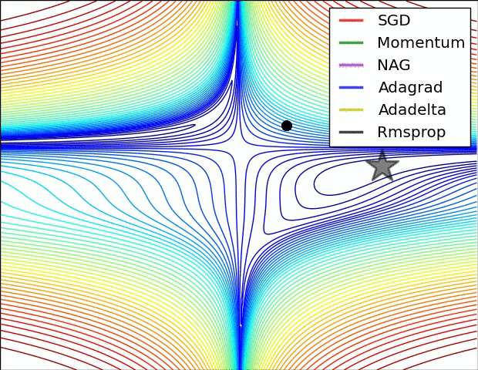

Slide 12
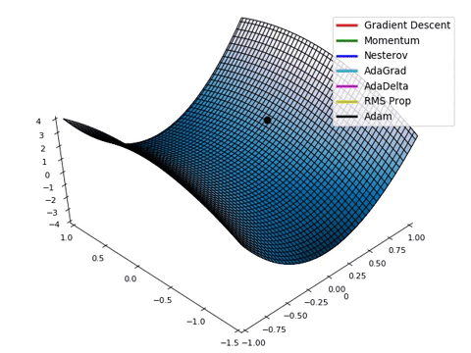
Adaptive Moment Estimation (Adam)
Combines the advantages of Momentum and RMSProp.
Uses both the mean and variance of gradients to adapt the learning rate for each parameter.
Fast, combines momentum and RMSProp
Memory-intensive, computationally expensive

Slide 13
Hyperparameters
Hyperparameter | What it controls | Good geoscience search range | Good starting value
Hidden layers | Network depth | 1–4 | 2
Units per layer | Network capacity | 8–256 | 32–64
Activation | Nonlinearity | ReLU, tanh, GELU | ReLU
Learning rate | Weight-update size | 1e-5–1e-2 | 1e-3
Batch size | Samples/update | 16–256 | 32 or 64
Dropout | Regularization | 0–0.5 | 0.1–0.2
L2 / weight decay | Regularization | 1e-6–1e-2 | 1e-4
Optimizer | Optimization algorithm | Adam, AdamW, SGD | Adam
Max epochs | Maximum training time | 100–1000 | 500
Early-stopping patience | When training stops | 10–50 epochs | 20
LR scheduler | Reduces LR during training | none / plateau / cosine | plateau

Slide 14
In Class Assignment
Complete In Class Assignment 7 found on Blackboard or in the course GitHub Repo

