Slide 1
GEOL 599
Applied Machine Learning for Geoscience Data
Lecture 8
Project discussion
Model interpretation
SVM practice

Slide 2
Discuss with a partner
For the next 10 minutes, discuss your project with a partner:
Describe your dataset
What you hope the model will do
Which model type you are thinking about using
Any challenges you might encounter in the modeling
Partners should ask clarifying questions on points of confusion and can help talk through solutions to any challenges.

Slide 3
How do we know a model works well?

Slide 4
Why model interpretation
Model interpretation tools help answer:
Which predictors matter most?
How does a predictor affect predictions?
Are relationships linear or nonlinear?
Do predictor effects differ among observations?
Is the model learning something scientifically reasonable?
  Interpretation tools explain the model, not necessarily the real-world process.

Slide 5
Model interpretation
Tool | Best for | Main idea
Coefficients | Linear/logistic models | Direction and strength of predictor effects
Standardized coefficients | Linear/logistic models | Compare predictors on common scale
Feature importance | Tree/boosted models | Which variables helped predictions most
Permutation importance | Many models | How much performance drops when a feature is shuffled
Partial dependence plots | Nonlinear models | Average effect of one predictor
ICE plots | Nonlinear models | Individual-level version of partial dependence
SHAP values | Complex models | Feature contributions to individual predictions

Slide 6
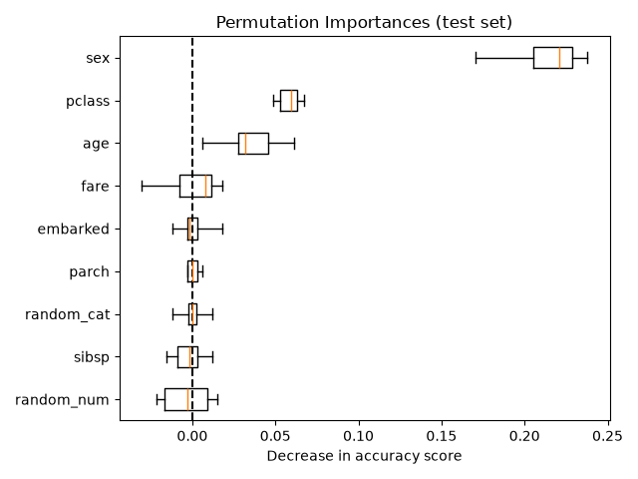
Permutation importance
Permutation importance measures how much model performance gets worse when one predictor is randomly shuffled.
Steps
  Fit a model.
  Measure model performance on test data.
  Randomly shuffle one predictor column.
  Make predictions again.
  Measure how much performance decreases.
  Repeat for each predictor.
If shuffling a predictor makes the model much worse, the model depended strongly on that predictor.

Slide 7
Permutation Importance: Strengths
Works with almost any model.
Uses test or validation data, so it reflects predictive importance.
Easy to explain.
Useful for black-box models.
Measures importance in terms of model performance.
Good for:
  Random forests
  XGBoost
  SVMs
  Neural networks
  Ensembles

Slide 8
Permutation Importance: Limitations
Correlated predictors can make importance hard to interpret.
  If two predictors contain similar information, shuffling one may not hurt much.
Importance depends on the metric used.
Importance depends on the test dataset.
It does not show the direction of the effect.
It does not prove causation.

Slide 9
Partial Dependence
A partial dependence plot, or PDP, shows the average predicted response as one predictor changes.
Steps
  Replace that predictor with a fixed value for every observation.
  Keep all other predictors as observed.
  Use the model to predict every row.
  Average the predictions.
  Repeat across many values.

Slide 10
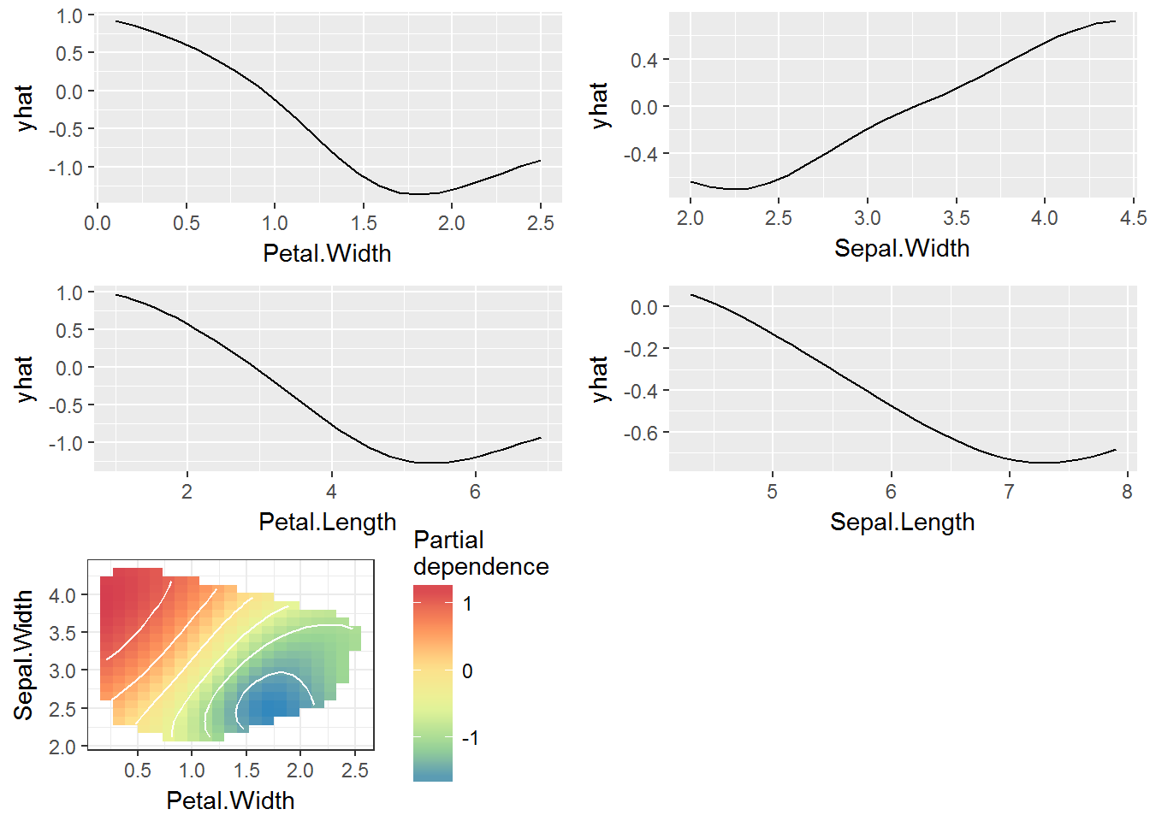
Partial Dependence Plot

Slide 11
Partial Dependence: Strengths
Shows direction and shape of model relationships.
Works with nonlinear models.
Helps identify thresholds or saturation effects.
Easier to interpret than raw feature importance.
Useful for explaining model behavior to scientific audiences.
Good for questions like:
  Does predicted risk increase with precipitation?
  Is the relationship between elevation and snow persistence linear?
  Does vegetation cover have a threshold effect?
  How does predicted SST change with month or latitude?

Slide 12
Partial Dependence: Limitations
Show average effects and can hide heterogeneity.
They can be misleading when predictors are strongly correlated.
They may evaluate unrealistic predictor combinations.
They do not show individual-level differences.
They explain the model, not the true physical process.

Slide 13
Individual Conditional Expectation (ICE)
ICE plots are similar to PDPs, but instead of averaging over all observations, they show one curve per observation.
A PDP is the average of many ICE curve
Steps
  Keep all other variables fixed.
  Change the predictor of interest across a range of values.
  Predict the outcome at each value.
  Draw one curve.
  Repeat this for many observations.
If there are 100 observations, the ICE plot may show 100 curves.
The average of those curves is the PDP.

Slide 14
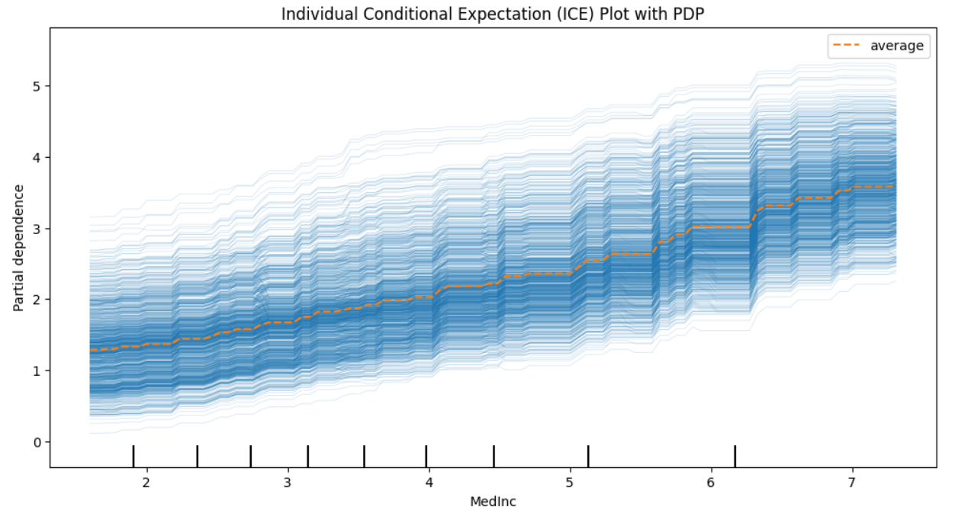
ICE Plot

Slide 15
Individual Conditional Expectation: Strengths
Shows heterogeneity hidden by PDPs.
Helps detect interactions.
Useful when the same predictor has different effects in different contexts.
Can reveal whether the average PDP is misleading.
Helps diagnose model behavior.

Slide 16
Individual Conditional Expectation: Limitations
Can be visually cluttered with many observations.
Like PDPs, can create unrealistic predictor combinations.
Curves can be hard to interpret with correlated predictors.
Does not prove causation.
Requires careful choice of sample size and predictor range.
Useful fixes:
  Plot a random sample of ICE curves.
  Add the PDP as a thick average line.
  Use centered ICE curves.
  Color curves by another variable to reveal interactions.

Slide 17
Important Caution
Interpretation is not causation.
A feature can be important because:
  It has a causal effect.
  It is correlated with a causal feature.
  It is a proxy for location, time, sampling effort, or data source.
  It helps interpolate within the training data.
Example: latitude might “predict” SST well, but latitude is not the physical mechanism by itself.

Slide 18
In Class Assignment
Complete In Class Assignment 5 found on Blackboard or in the course GitHub Repo

