Slide 1
GEOL 599
Applied Machine Learning for Geoscience Data
Lecture 9
Decision Trees
Bagging and Random Forest
Boosting Methods

Slide 2
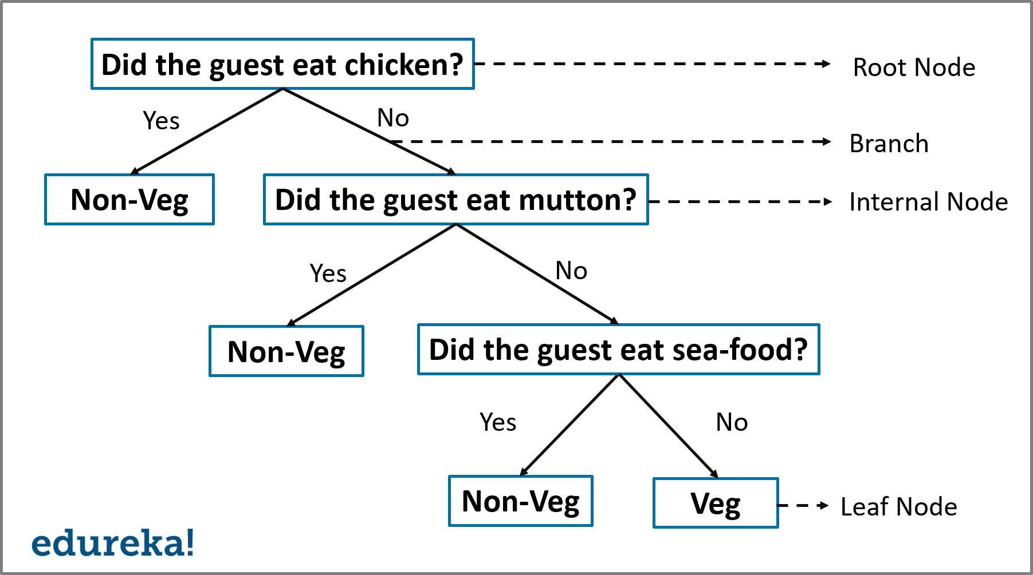
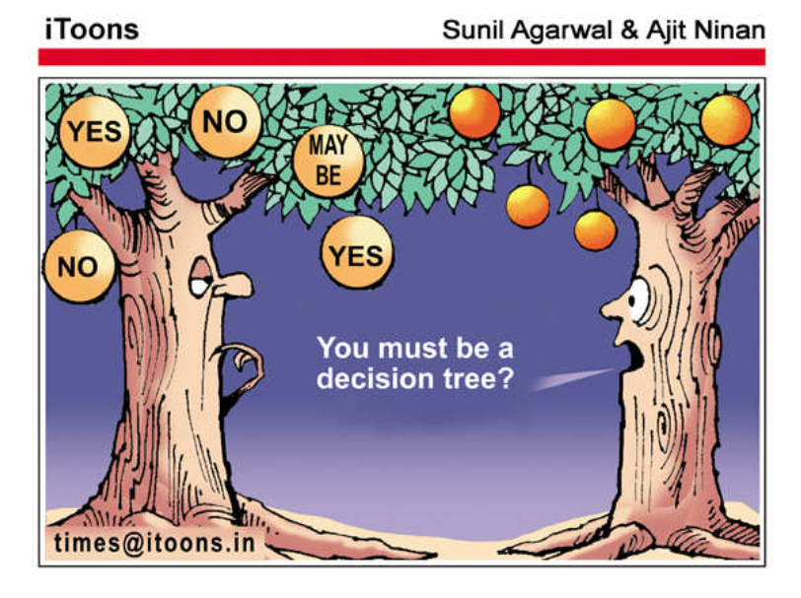
Decision Trees

Slide 3
How to Create a Decision Tree
We first make a list of attributes that we can measure
We then choose a target attribute that we want to predict
Then create an experience table that lists what we have seen in the past
Guest | Chicken | Mutton | Sea food | Vegetarian
1 | 0 | 0 | 0 | 1
2 | 1 | 0 | 0 | 0
3 | 0 | 0 | 1 | 0
4 | 0 | 0 | 0 | 0
5 | 0 | 1 | 0 | 0

Slide 4
Decision Tree Algorithms
The basic idea behind any decision tree algorithm is as follows:
  Choose the best attribute(s) to split the remaining instances and make that attribute a decision node
  Repeat this process recursively for each child
  Stop when:
    All the instances have the same target attribute value
    There are no more attributes
    There are no more instances
  How do we know which one to split at first?

Slide 5
How to determine the best split
We can calculate the entropy of each attribute at the root node
  Entropy is a measure of the amount of uncertainty in the data set
  Information gain is the measure of the difference in entropy from before to after the split on an attribute.
    In other words, how much uncertainty was reduced after splitting the set on the attribute
Entropy is calculated for each remaining attribute.
The attribute with the smallest entropy is used to split the dataset on this iteration.
This is a greedy approach
Gini can also be used a measure of impurity

Slide 6
Stopping criteria for tree induction
Stop expanding a node when all the records
  belong to the same class
  have similar attribute values
Early termination (Pre-pruning)
  Stop the algorithm before it becomes a fully-grown tree
  More restrictive conditions:
    Stop if number of instances is less than some user-specified threshold
    Stop if class distribution of instances are independent of the available features
    Stop if expanding the current node does not improve impurity measures (e.g., Gini or information gain).

Slide 7
Post Pruning
Grow decision tree to its entirety
Trim the nodes of the decision tree in a bottom-up fashion
If generalization error improves after trimming, replace sub-tree by a leaf node.
Class label of leaf node is determined from majority class of instances in the sub-tree

Slide 8
Decision Tree Based Classification
Advantages:
  Inexpensive to construct
  Extremely fast at classifying unknown records
  Easy to interpret for small-sized trees
  Accuracy is comparable to other classification techniques for many simple data sets
Disadvantage:
  HUGE tendency to overfit
  Error propagation
    Since decision trees work by a series of local decisions, what happens when one of these local decisions is wrong?

Slide 9
Regression trees
Tree-based methods can also be used for regression!
Used with continuous outcome variable
Procedure similar to classification tree
Many splits attempted, choose the one that minimizes impurity
Prediction is computed as the average of numerical target variable in the node/leaf
Impurity measured by sum of squared deviations from leaf mean
Performance measured by RMSE

Slide 10
Why (not) use regression trees
Advantages:
  Easy to use, understand
  Produce rules that are easy to interpret & implement
  Variable selection & reduction is automatic
  Do not require the assumptions of statistical models
  Can work without extensive handling of missing data
Limitations:
  Non-robust, so they are sensitive to small changes in the data
  Trees generally do not have the same level of predictive accuracy as some of the other regression and classification approaches we have seen
  Only axis aligned splits
  May not perform well where there is structure in the data that is not well captured by horizontal or vertical splits
  Since the process deals with one variable at a time, difficult to capture interactions between variables (without overfitting)

Slide 11
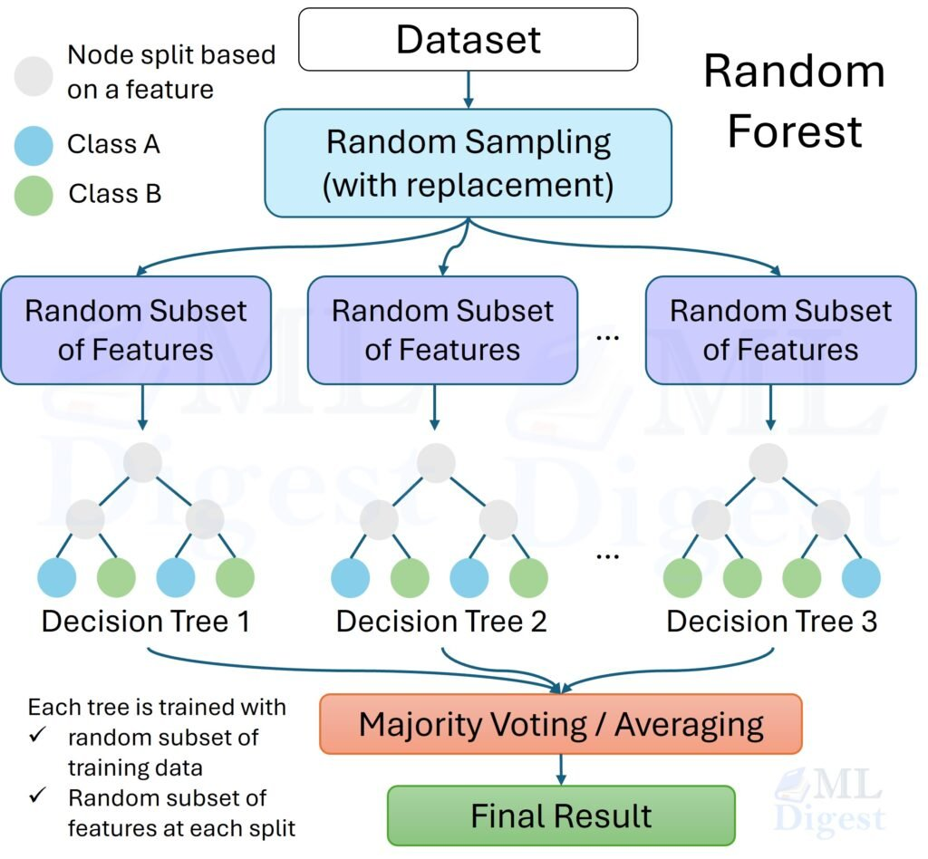
Ensemble methods
A single decision tree does not perform well, but it is super fast
What if we learn multiple, imperfect trees and somehow combine the results?

Slide 12
Bootstrap aggregating (Bagging)
If we split the data in random different ways, decision trees give different results -> high variance.
Bagging is a method that results in low variance.
If we had multiple realizations of the data (or multiple samples) we could calculate the predictions multiple times, then averaging multiple estimations to produce less uncertain results.
  Construct B number (usually hundreds) of trees (no pruning).
  Learn a model for each bootstrap sample and average them for regression or majority vote for classification.

Slide 13
Random Forest
Introducing more stochasticity (randomness) in the process to bagging
Not only a newly bootstrapped sample of observations for each tree, but also only a subset of features are used for each tree, (with replacement)

Slide 14
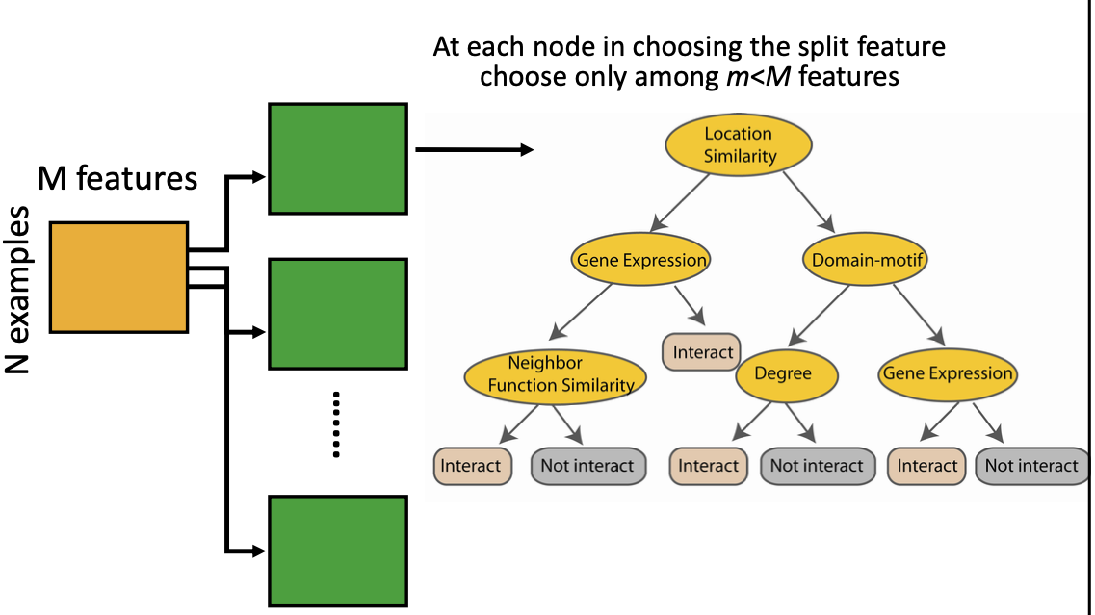
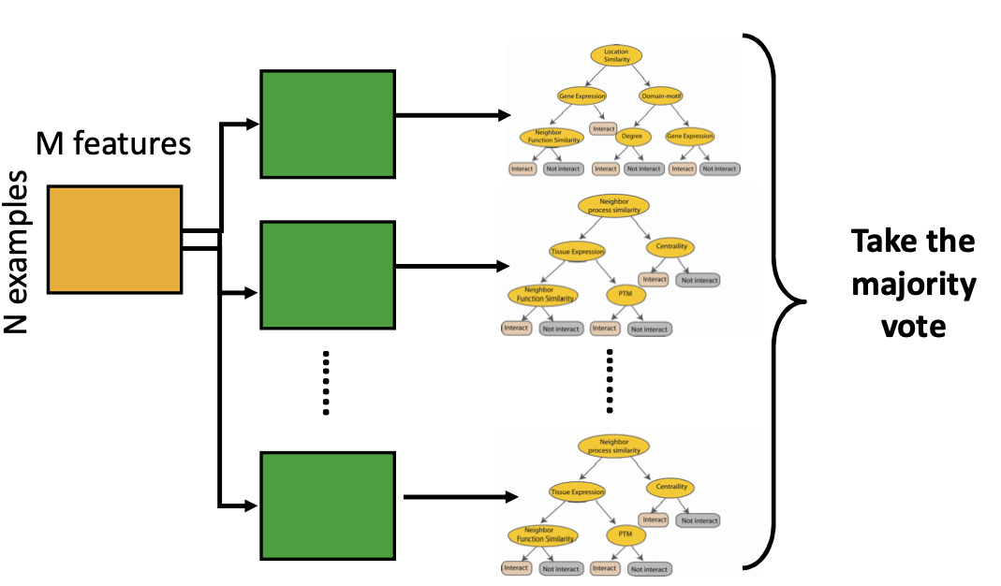
Random Forest Classifier

Slide 15
Boosting
Main Assumption:
  Combining many weak predictors (e.g. tree stumps) to produce an ensemble predictor
Hypothesis (classifier) Space
  Variable size (nonparametric):
    Can model any function if you use an appropriate predictor (e.g. trees)
    Commonly used weak predictor: A decision tree stump
Each predictor is created by using a biased sample of the training data
  Instances (training examples) with high error are weighted higher than those with lower error
Difficult instances get more attention

Slide 16
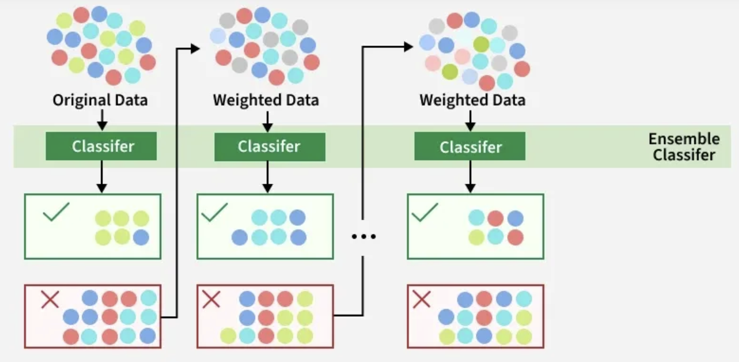
AdaBoost

Slide 17
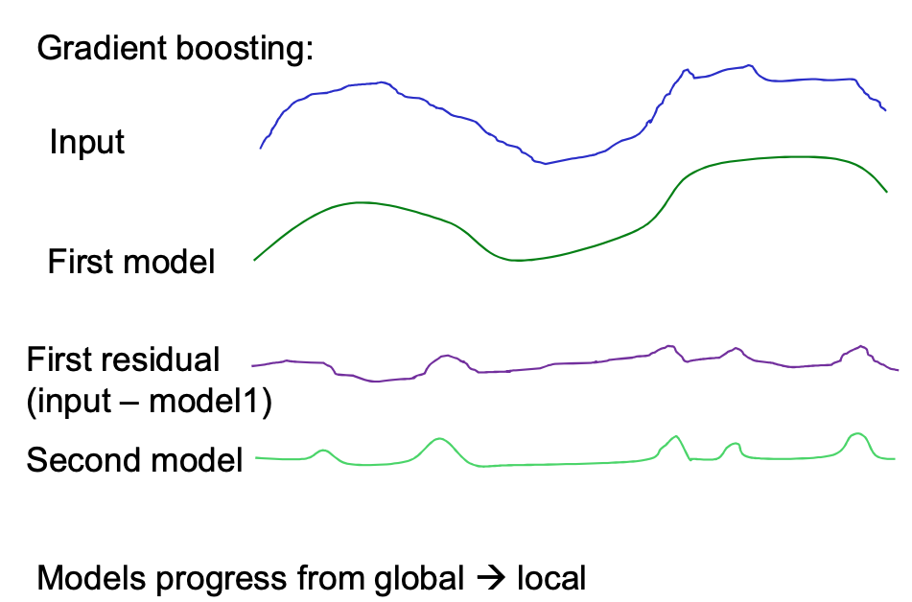
Gradient Boosting
Similar to AdaBoost in that it’s a sequential prediction.
However, Gradient Boosting is a sequential “correction” of the previous model’s errors.
Each model is trained on the previous model’s residual errors as labels (note, subsequent trees are being fit to residuals of previous trees, not the original data).
Weak trees are usually used as the base learner

Slide 18
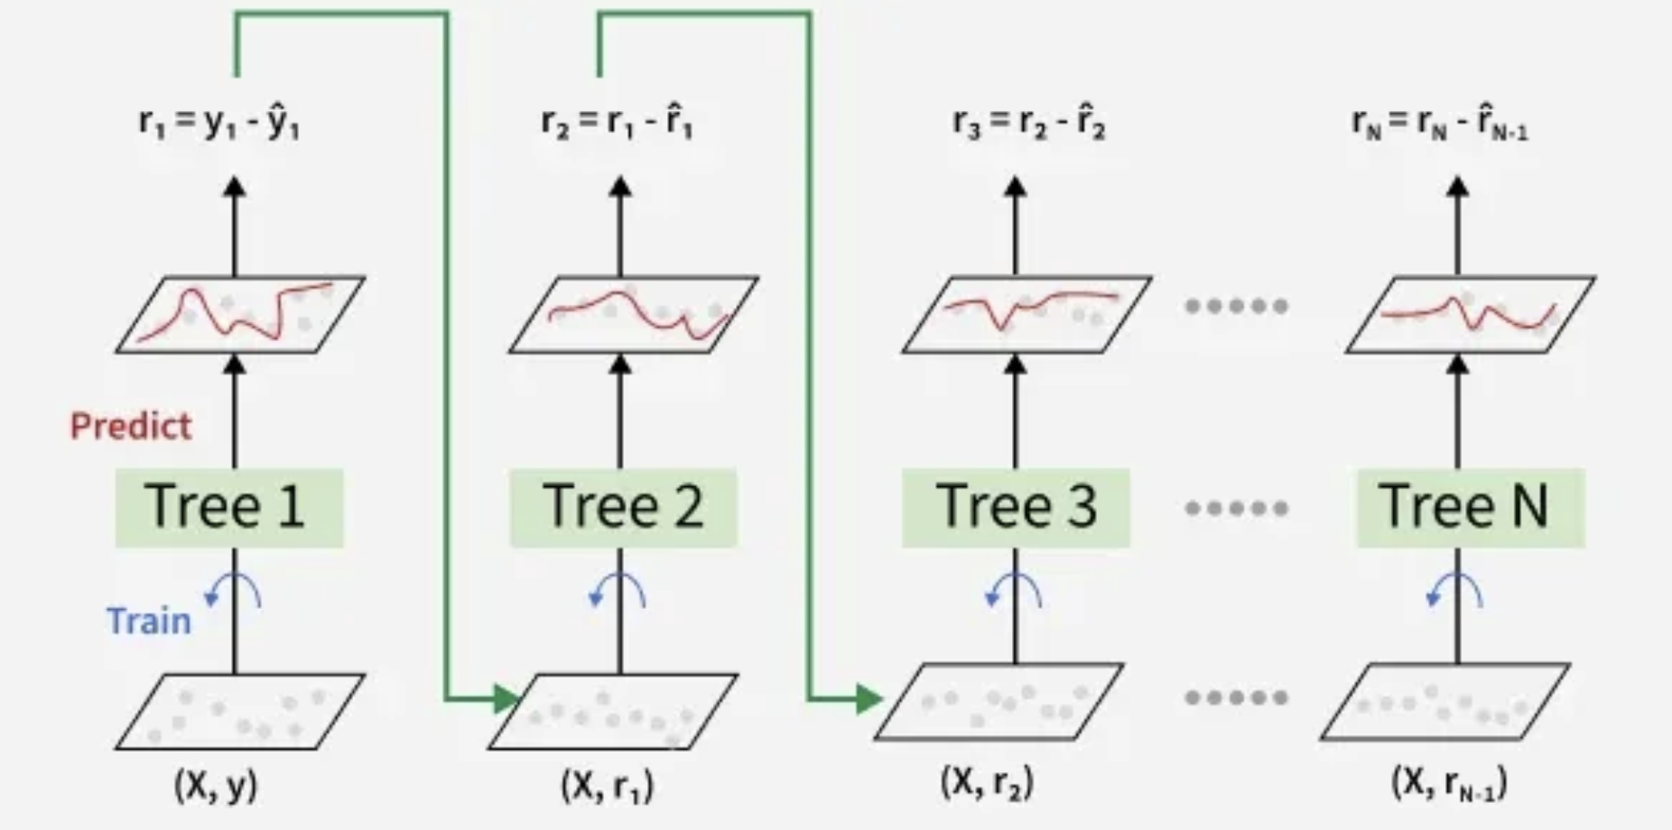
Gradient Boosting Weak Learners
Usually trees
  Maximum # of leaves is usually set to 8 to 32
  Iteration stops when loss is not reduced more than a threshold anymore, or that the specified maximum number of trees have been built.
  The prediction of trees is multiplied by “learning rate”.

Slide 19
Bagging and Boosting Comparison
Ensemble models built from many simpler models
Two main methods:
  Bagging (Bootstrap AGgregation): Train base models on bootstrap samples of the data.
    Take majority vote for classification tasks, or average output for regression.
  Boosting: Learners are ordered: Each learner tries to reduce error (residual) on “hard” examples (those misclassified by earlier learners).
    ADABOOST: weight hard samples more;
    GRADIENT BOOST: use residual to train later models.

Slide 20
XGBoosting (eXtreme Gradient Boosting)
Ever since its introduction in 2014, XGBoost has been lauded as the holy grail of machine learning hackathons and competitions.
Execution Speed: Generally, XGBoost is fast. Really fast when compared to other implementations of gradient boosting
Model Performance: XGBoost dominates structured or tabular datasets on classification and regression predictive modeling problems.

Slide 21
Other boosting methods
Method | Core idea | Main strength | Main weakness
AdaBoost | Sequentially focus on mistakes | Simple boosting method | Sensitive to noise/outliers
Gradient boosting | Sequentially fit trees to residual errors | Very accurate | Can overfit; tuning matters
XGBoost | Regularized gradient boosting | Excellent tabular performance | Many tuning parameters
LightGBM | Fast gradient boosting with leaf-wise growth | Very fast on large data | Can overfit small/noisy datasets
CatBoost | Gradient boosting optimized for categorical variables | Great with categorical predictors | Slightly less transparent
BART | Bayesian sum of trees | Uncertainty-aware, flexible | Slower, less common in basic ML workflows

Slide 22
Key Cautions
They can learn location, sampling design, or seasonality instead of process.
They do not extrapolate well outside the training range.
Feature importance is not causality.
Correlated predictors complicate interpretation.
Spatial and temporal validation are often more important than model choice.

