Slide 1
GEOL 599
Applied Machine Learning for Geoscience Data
Lecture 3
Cross validation
Model evaluation
Baseline models

Slide 2
Trivia of the day
When was the term “machine learning” first used?
1959
1979
1999
2019

Slide 3
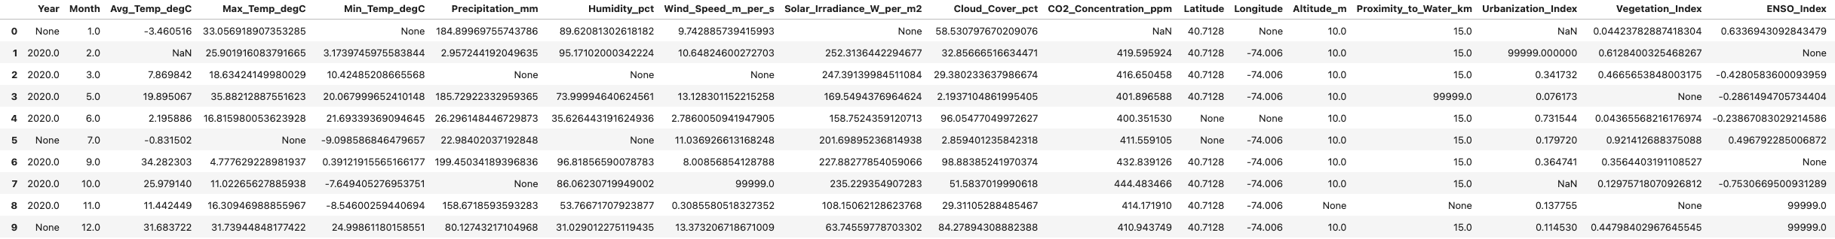
Results from last class
How should missing data be filled?
  Missing months?
  Climate data (air temperature, precipitation, wind speed, humidity, etc)
  Should latitude, longitude, altitude, and proximity to water even be included?
  Prevent temporal leakage?
How should data be split into testing and training?

Slide 4
Number of neighbors
K=3 vs k=5
How to choose the optimal number of neighbors?

Slide 5
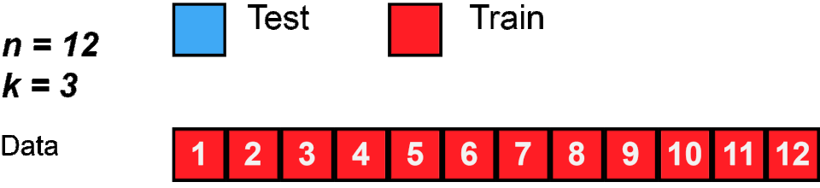
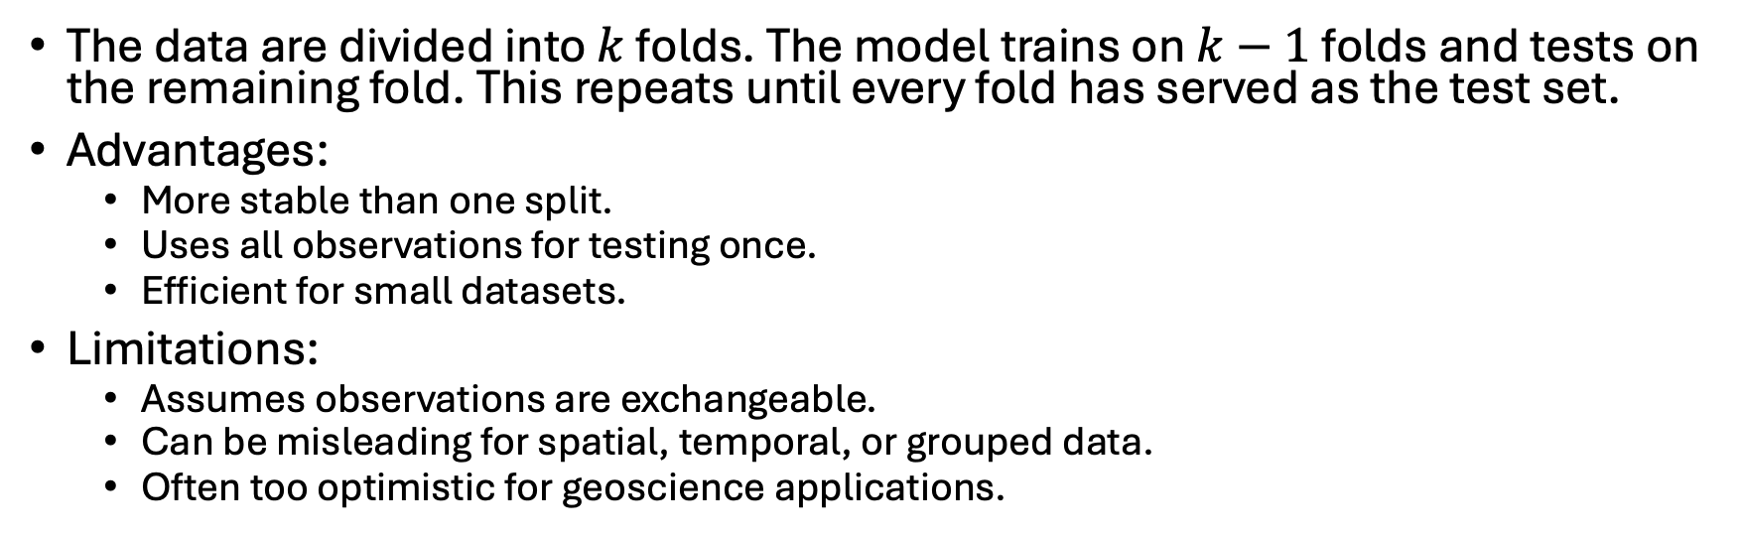
Standard Cross Validation
The data are divided into $k$ folds. The model trains on $k−1$ folds and tests on the remaining fold. This repeats until every fold has served as the test set.
Advantages:
  More stable than one split.
  Uses all observations for testing once.
  Efficient for small datasets.
Limitations:
  Assumes observations are exchangeable.
  Can be misleading for spatial, temporal, or grouped data.
  Often too optimistic for geoscience applications.

Slide 6
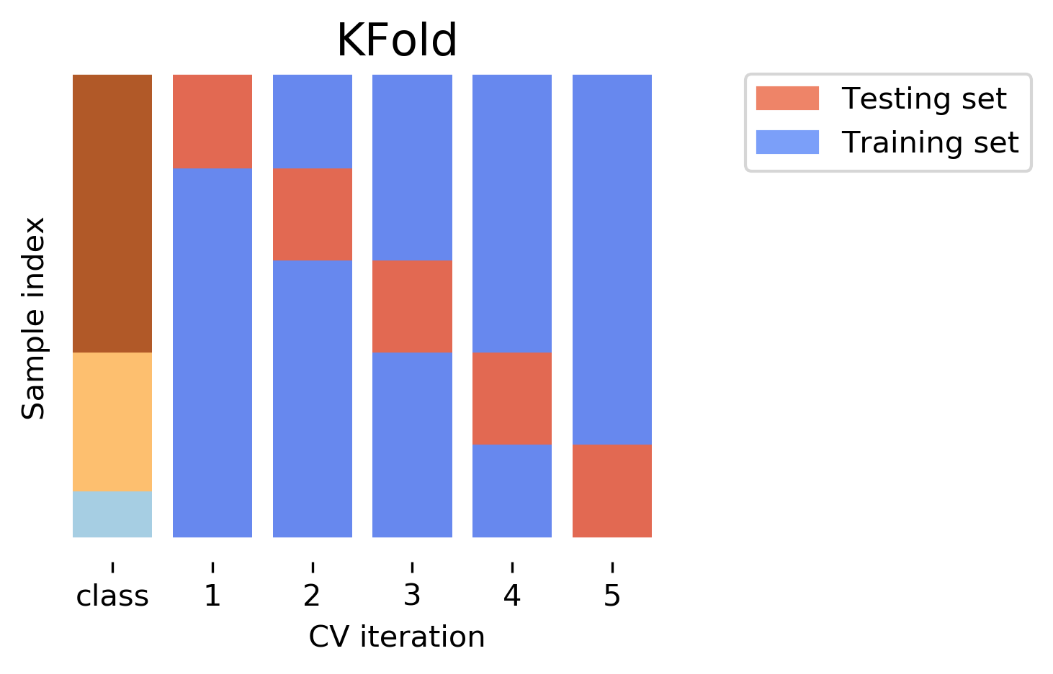
Stratified k-fold cross-validation
Each fold preserves the class distribution.
Useful for:
  Imbalanced classification.
  Rare events.
  Multiclass land-cover classification.
Limitation:
  Stratification by class does not solve spatial or temporal leakage.
  A fold can have the right number of landslide pixels but still include landslide pixels adjacent to training pixels.

Slide 7
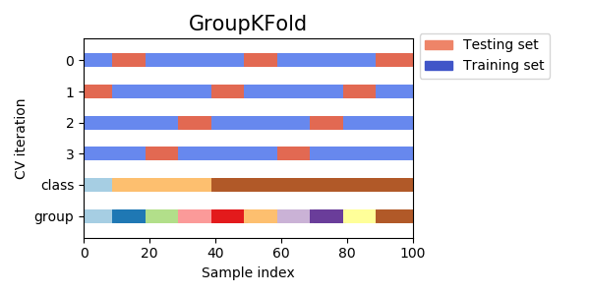
Group k-fold cross-validation
Keeps all observations from the same group in the same fold.
Examples:
  Leave stations out.
  Leave watersheds out.
  Leave remote sensing scenes out.
  Leave storm events out.
  Leave field campaigns out.
Example:
  If the task is to predict streamflow at ungauged basins, the cross-validation groups should be basins, not individual daily observations.

Slide 8
Nested cross-validation
Nested CV separates model tuning from final performance estimation.
Outer loop: estimates performance; Inner loop: tunes hyperparameters.
If you tune hyperparameters and evaluate on the same folds, performance estimates can be optimistic.
Nested CV is especially useful when:
  Comparing algorithms.
  Performing substantial hyperparameter tuning.
  Publishing performance claims.
  Working with small datasets.

Slide 9
Match Model Goal with Method
Generalization goal | Appropriate CV
New random samples from same population | Random k-fold
New locations | Spatial block CV or group-by-location CV
New time periods | Temporal CV or rolling-origin CV
New stations | Leave-station-out CV
New watersheds | Leave-watershed-out CV
New satellite scenes | Leave-scene-out CV
New regions and future periods | Spatiotemporal blocked CV

Slide 10
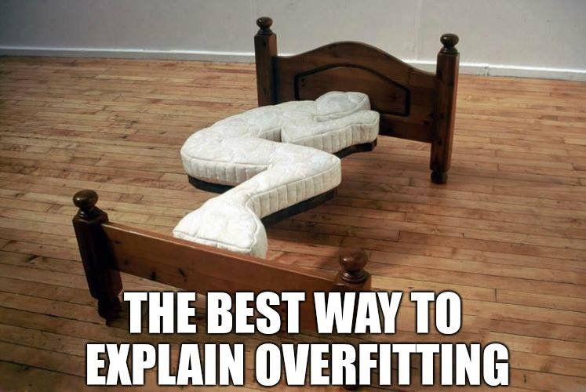
Overfitting
K-fold cross validation helps reduce the possibility of overfitting.
  A model that would just repeat the labels of the samples that it has just seen would have a perfect score but would fail to predict anything useful on yet unseen data.

Slide 11
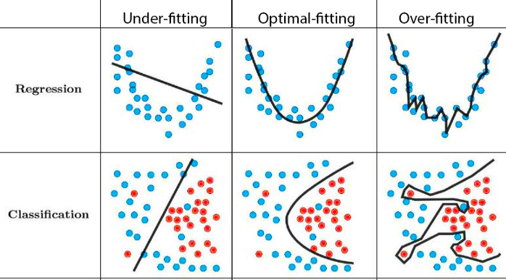
Model complexity vs overfit/underfit

Slide 12
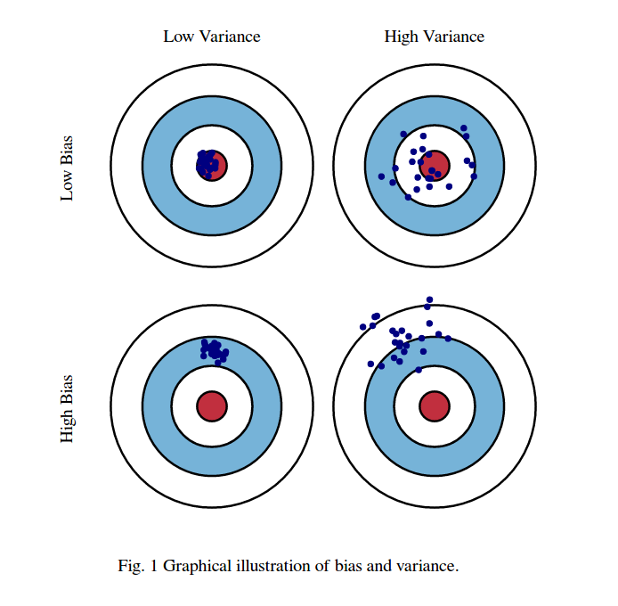
Bias and variance

Slide 13
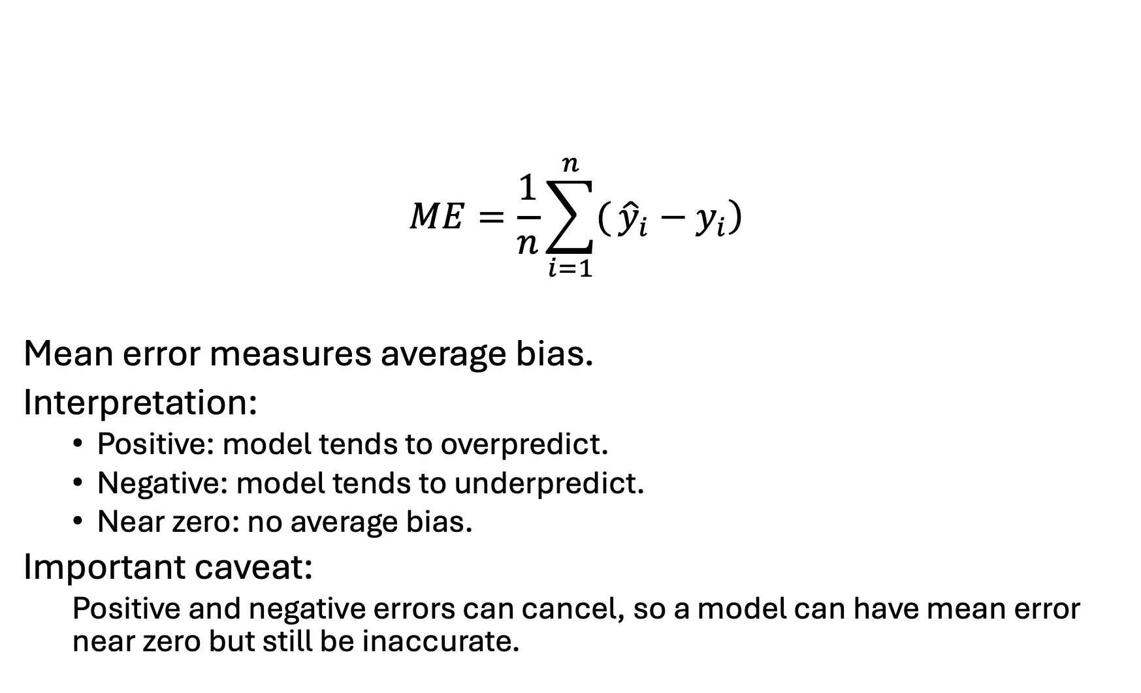
Mean Error
$$ME=\frac{1}{n}\sum_{i=1}^{n}{(}\left.{\hat{y}}_{i}−y_{i}\right)$$
Mean error measures average bias.
Interpretation:
  Positive: model tends to overpredict.
  Negative: model tends to underpredict.
  Near zero: no average bias.
Important caveat:
  Positive and negative errors can cancel, so a model can have mean error near zero but still be inaccurate.

Slide 14
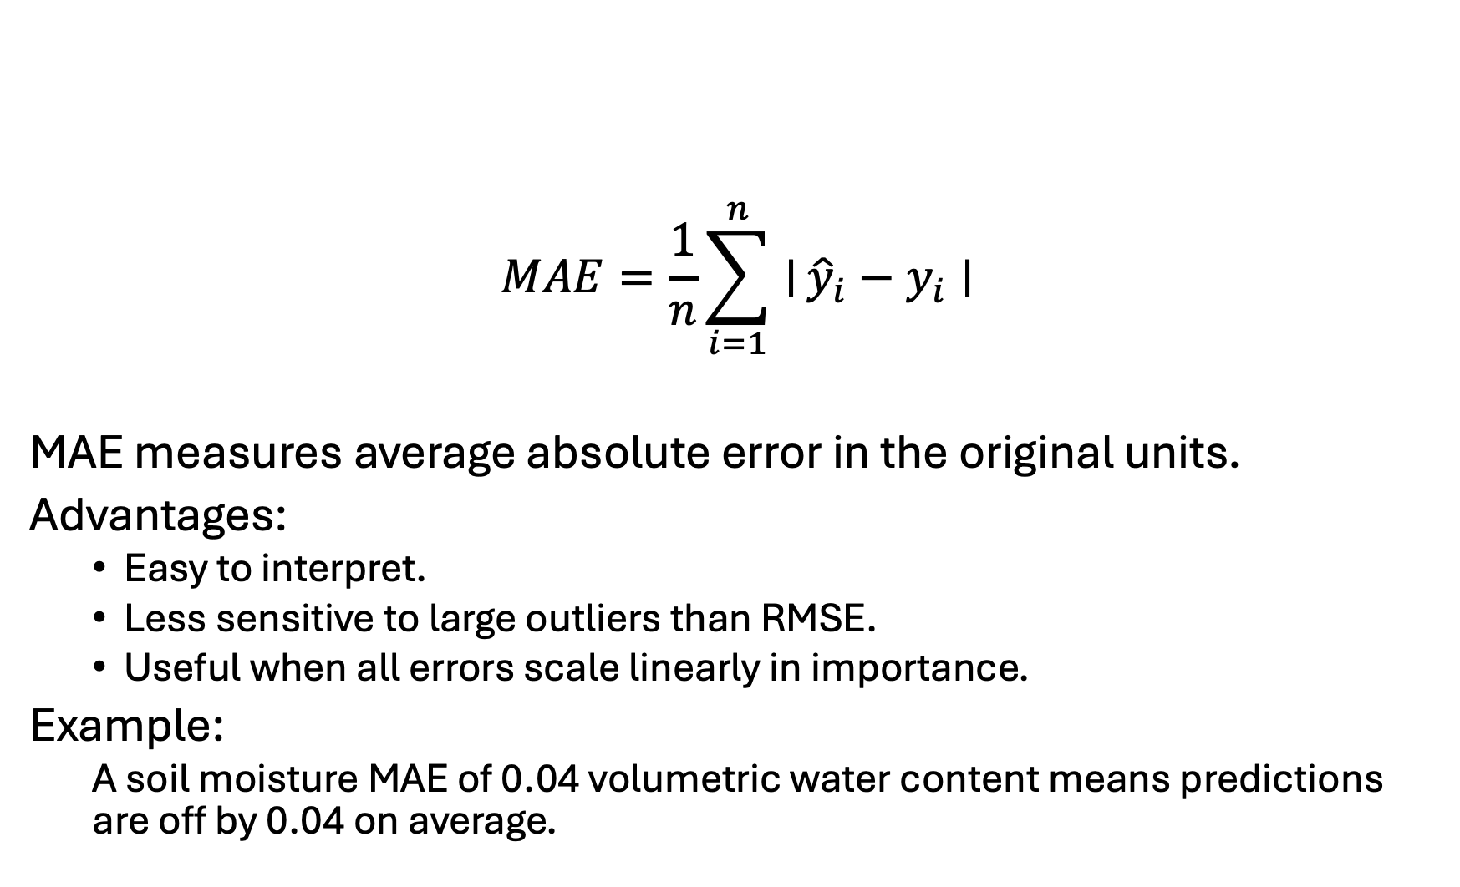
Mean absolute error
$$MAE=\frac{1}{n}\sum_{i=1}^{n}{∣}{\hat{y}}_{i}−y_{i}∣$$
MAE measures average absolute error in the original units.
Advantages:
  Easy to interpret.
  Less sensitive to large outliers than RMSE.
  Useful when all errors scale linearly in importance.
Example:
  A soil moisture MAE of 0.04 volumetric water content means predictions are off by 0.04 on average.

Slide 15
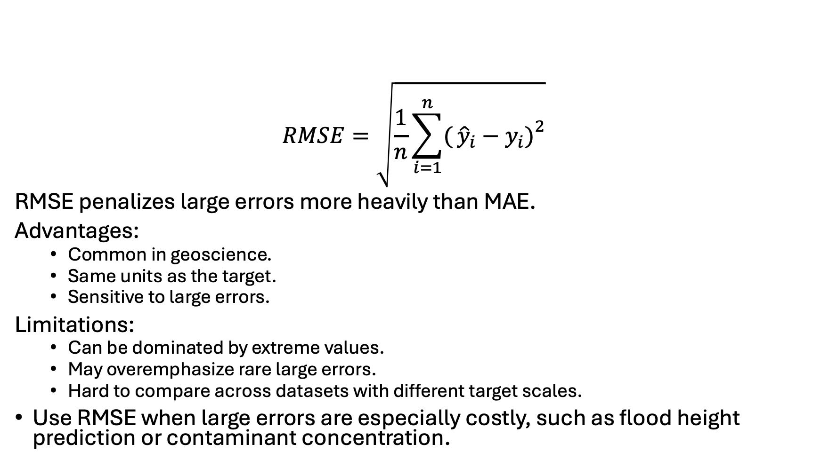
Root mean squared error
$$RMSE=\sqrt{\frac{1}{n}\sum_{i=1}^{n}{(}\left.{\hat{y}}_{i}−y_{i}{\left.)\right.}^{2}\right.}$$
RMSE penalizes large errors more heavily than MAE.
Advantages:
  Common in geoscience.
  Same units as the target.
  Sensitive to large errors.
Limitations:
  Can be dominated by extreme values.
  May overemphasize rare large errors.
  Hard to compare across datasets with different target scales.
Use RMSE when large errors are especially costly, such as flood height prediction or contaminant concentration.

Slide 16
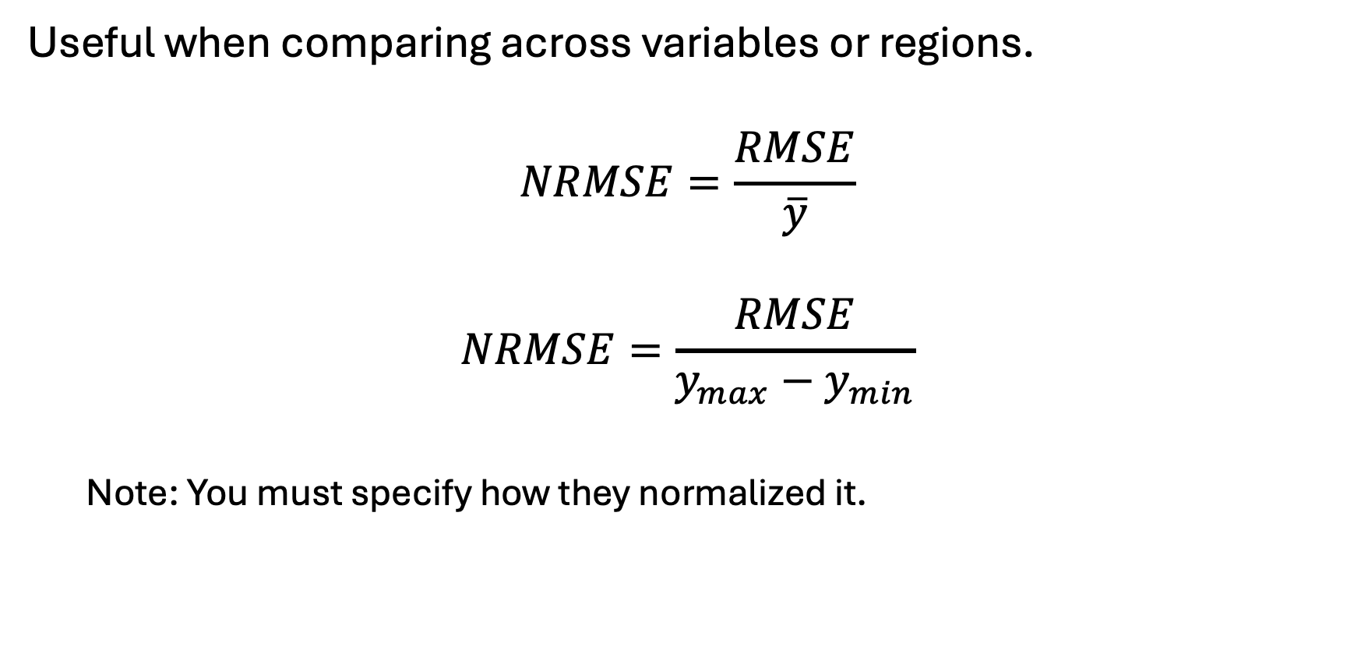
Normalized RMSE
Useful when comparing across variables or regions.
$$NRMSE=\frac{RMSE}{\overline{y}}$$
$$NRMSE=\frac{RMSE}{y_{max}−y_{min}}$$
  Note: You must specify how they normalized it.

Slide 17
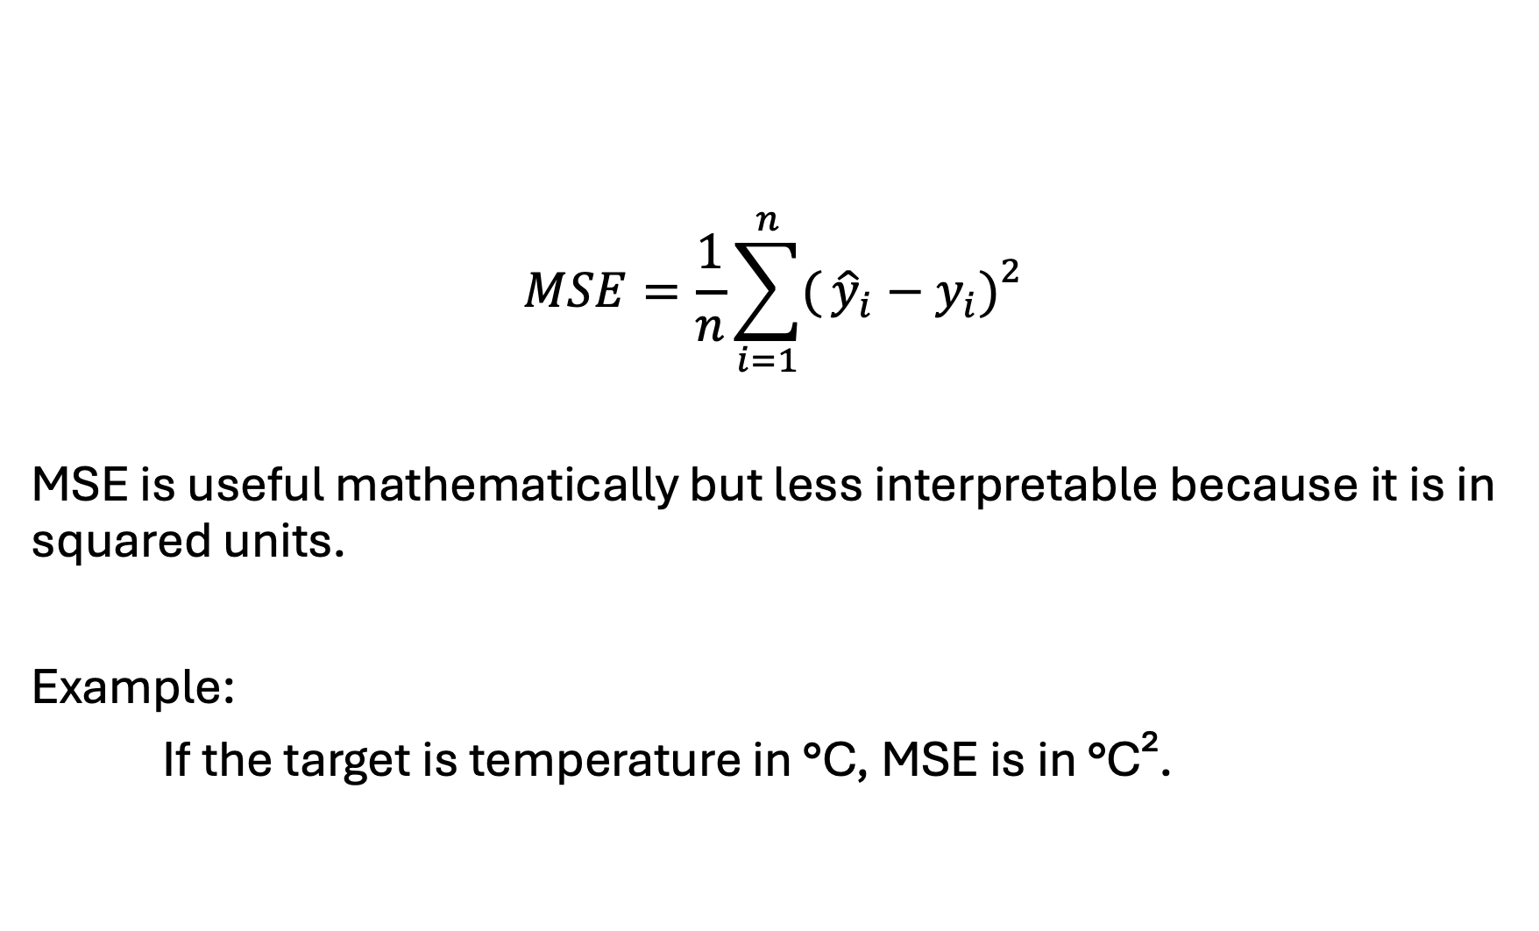
Mean squared error
$$MSE=\frac{1}{n}\sum_{i=1}^{n}{(}\left.{\hat{y}}_{i}−y_{i}{\left.)\right.}^{2}\right.$$
MSE is useful mathematically but less interpretable because it is in squared units.
Example:
If the target is temperature in °C, MSE is in °C².

Slide 18
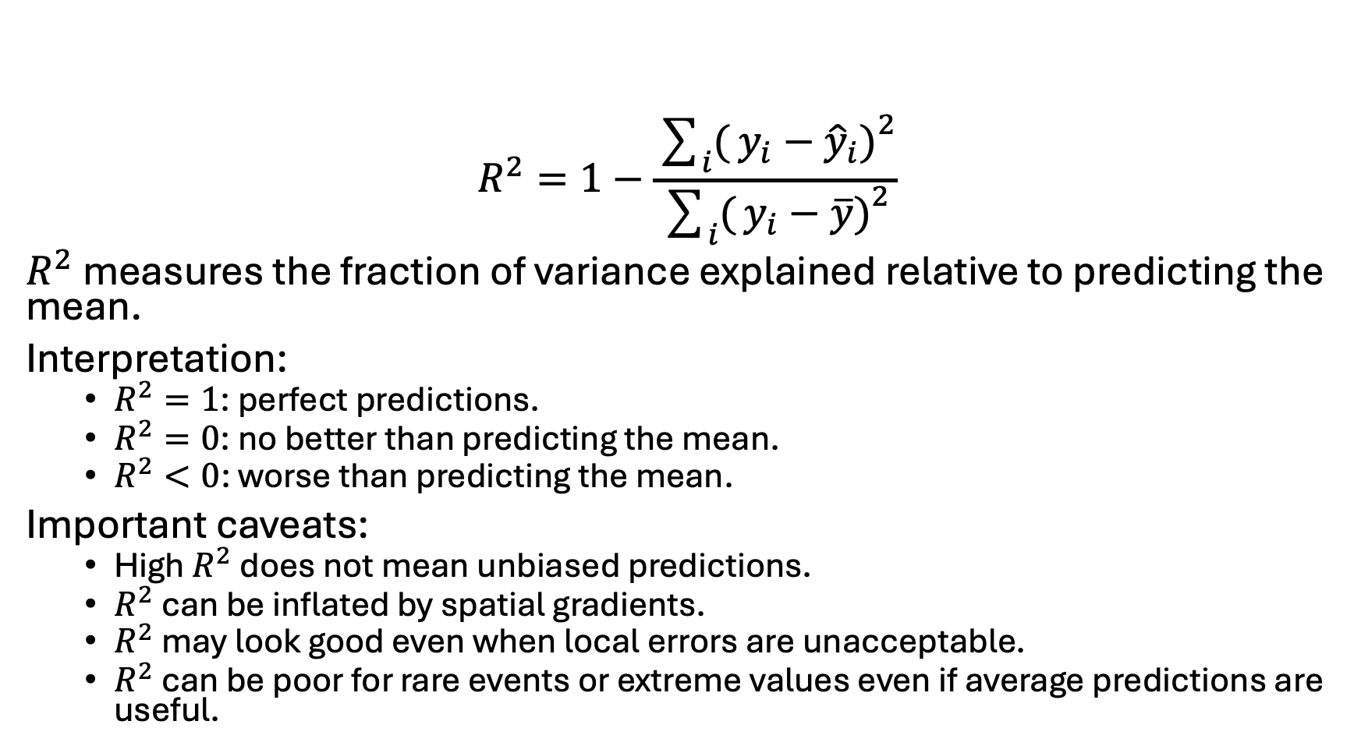
Coefficient of determination (R²)
$$R^{2}=1−\frac{\sum_{i}{(}\left.y_{i}−{\hat{y}}_{i}{\left.)\right.}^{2}\right.}{\sum_{i}{(}\left.y_{i}−\overline{y}{\left.)\right.}^{2}\right.}$$
$R^{2}$ measures the fraction of variance explained relative to predicting the mean.
Interpretation:
  $R^{2}=1$: perfect predictions.
  $R^{2}=0$: no better than predicting the mean.
  $R^{2}<0$: worse than predicting the mean.
Important caveats:
  High $R^{2}$ does not mean unbiased predictions.
  $R^{2}$ can be inflated by spatial gradients.
  $R^{2}$ may look good even when local errors are unacceptable.
  $R^{2}$ can be poor for rare events or extreme values even if average predictions are useful.

Slide 19
Evaluation metric overview
Scientific goal | Useful metric
Average prediction accuracy | MAE, RMSE
Penalize large errors | RMSE
Estimate systematic over/underprediction | Mean error
Explain variance | R²
Compare across scales | Normalized RMSE, normalized MAE
Extreme event accuracy | Tail-specific MAE/RMSE, event-based metrics

Slide 20
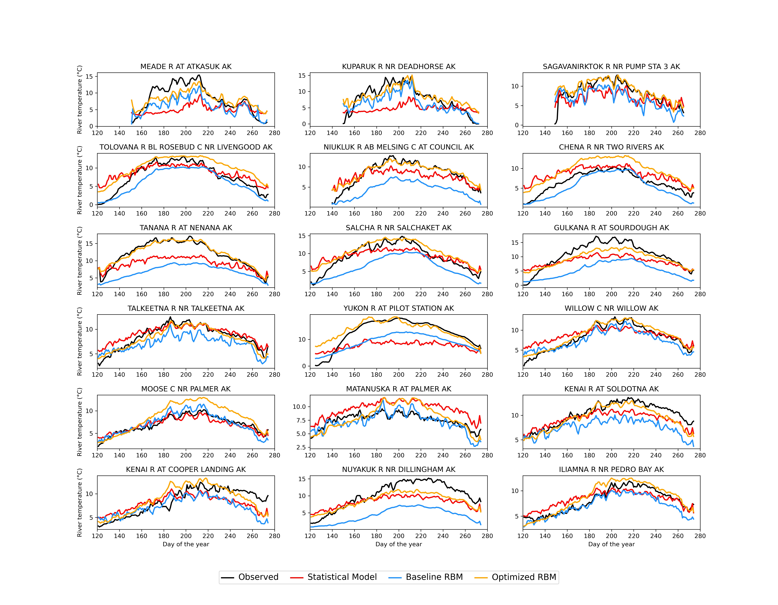
Baselines
Baselines are simple reference models. A complex ML model is not useful unless it beats a meaningful baseline.
Why baselines matter
Is the ML model actually learning something useful?
Without a baseline, performance may be overinterpreted.
If a model does not beat simple baselines, it may not be adding value.

Slide 21
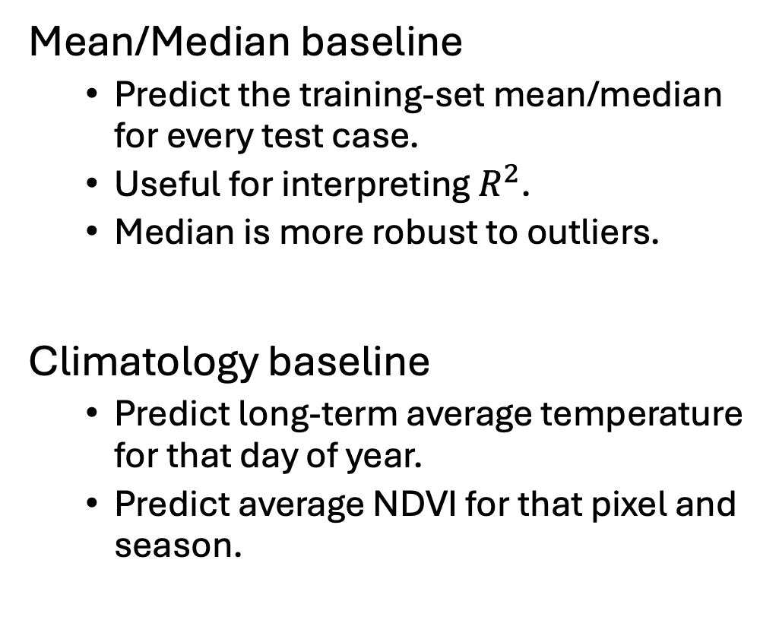
Regression Baselines
Persistence baseline
  Tomorrow’s streamflow equals today’s streamflow.
  Next week’s drought index equals this week’s drought index.
  Persistence is often surprisingly strong.
Spatial interpolation baseline
  Nearest neighbor.
  Inverse distance weighting.
  Kriging.
  Regional mean.
  Watershed mean.
Mean/Median baseline
  Predict the training-set mean/median for every test case.
  Useful for interpreting $R^{2}$.
  Median is more robust to outliers.
Climatology baseline
  Predict long-term average temperature for that day of year.
  Predict average NDVI for that pixel and season.

Slide 22
End-to-end pipeline

Slide 23
In Class notebook
Complete In Class Assignment 2 found on Blackboard or in the course GitHub Repo

