Slide 1
Western European Temperature/ Dew Point Variation by Geography
By Abigale Cole
GIST | GEOG | PLG 457
STATISTICAL TECHNIQUES IN GEOGRAPHY,
REGIONAL DEVELOPMENT & PLANNING
THE UNIVERSITY OF ARIZONA
Fall 2020

Slide 2
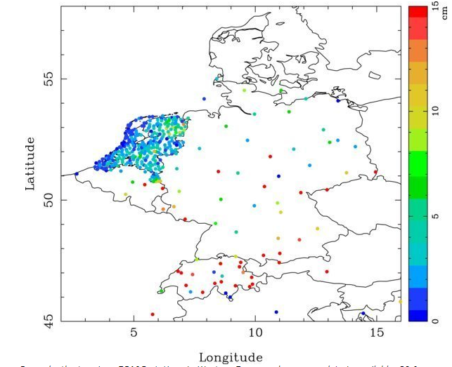
Introduction
In the first image we see snow depths in 2004 which were above average. By tracking dew point and temperature we can attempt to provide information where the anomalous weather is likely to occur.

Slide 3
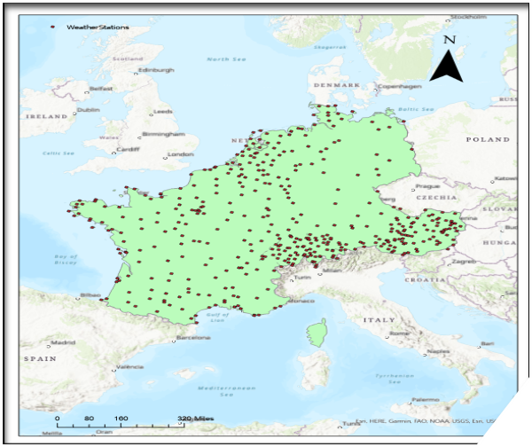
Study area
The study area is in Western Europe and includes 431 weather stations

Slide 4
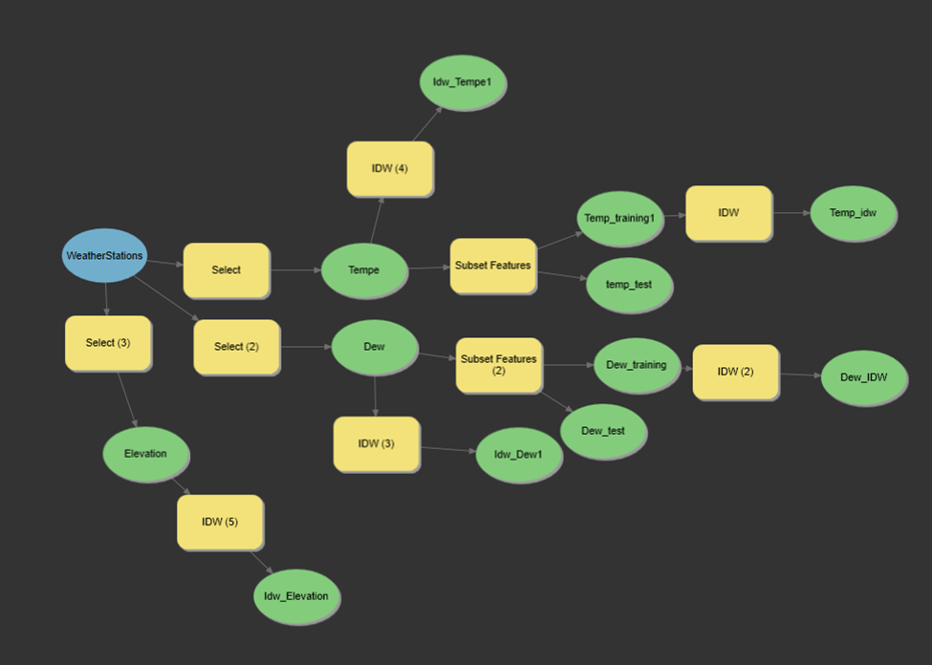
Goals
To create a successful model to allow for IDW interpolation of Western European in respect with Dew Point and Temperature.

Slide 5
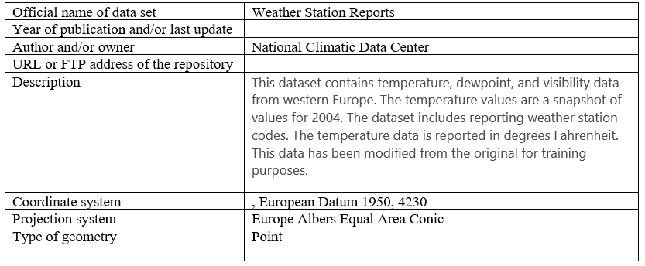
Data
For this analysis I used one data set that was provided to me. The data is from the National Climatic Data Center

Slide 6
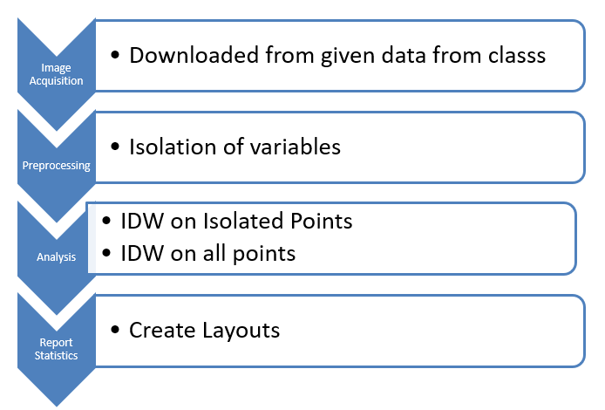
Methods
To solve this problem, I implemented ArcGIS (ESRI ArcGIS Pro 2.6) and ModelBuilder. I first isolated the dew point and temperature variables from the Weather Stations data set (which was given). I then preformed 4 analysis. Two of which were done are each variable. I preformed IDW interpolation on both a random population as well as the entire data set. I did this because I wanted to see the differences in the data

Slide 7
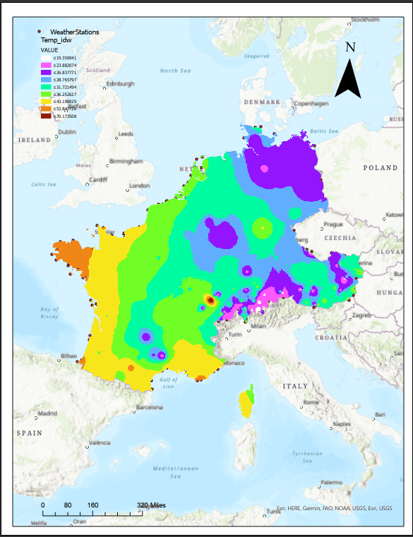
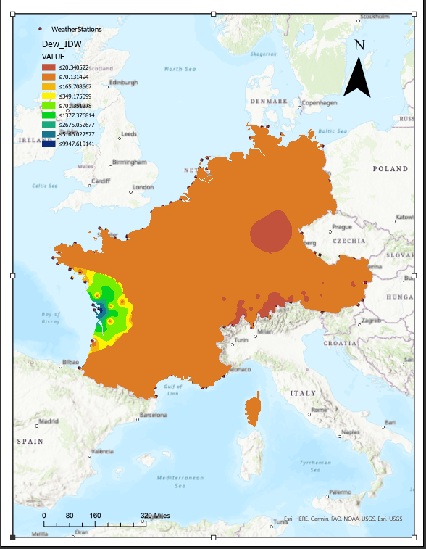
Results
After preforming IDW interpolation we can see a correlation between high elevations and low temperatures during wintertime. There is also a smaller correlation between high elevation and higher dew point event though we see the highest dew points off the Western Coast. We these correlations become ever more apparent in the Alps region where there is a high elevation, high dew point and low average winter temperature. As well as a region near Frankfurt in Germany.

Slide 8
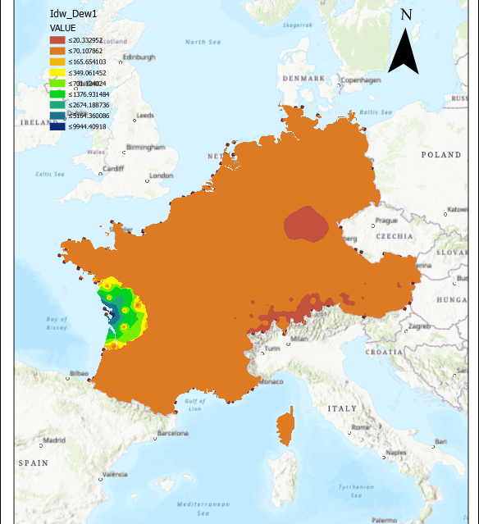
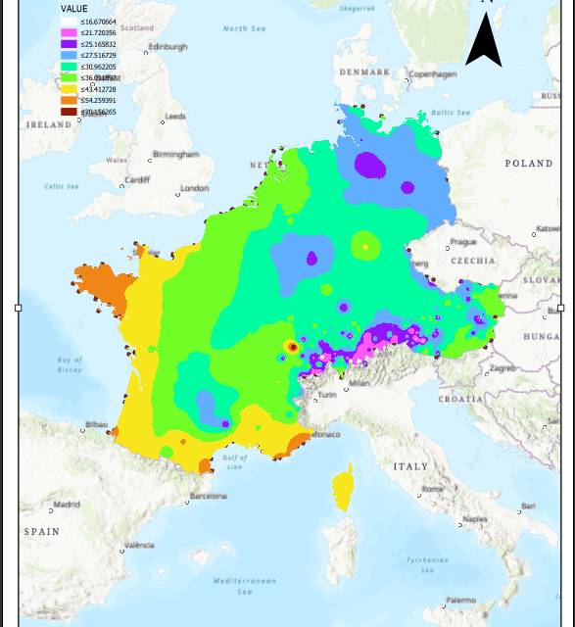
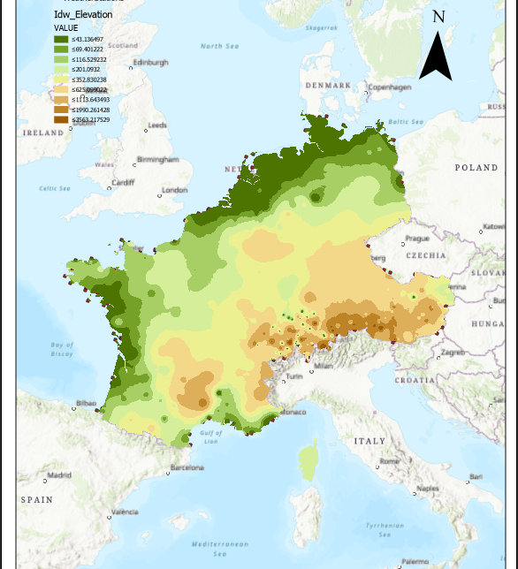
Results

Slide 9
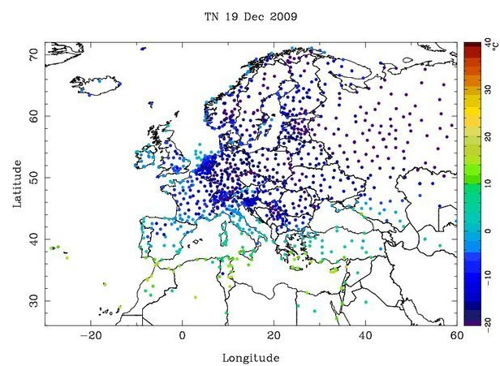
Discussion
By being able to track the cold weather and dew point we can accurately track the areas that are the most susceptible to ice and the runoff that may occur in the summer months. We can also see that the Western Coast has a higher dew point this can translate to an even higher amount of rainfall during the summer months. The image on the left provides a look at low temperature in December 2009 – another anomalous winter.

Slide 10
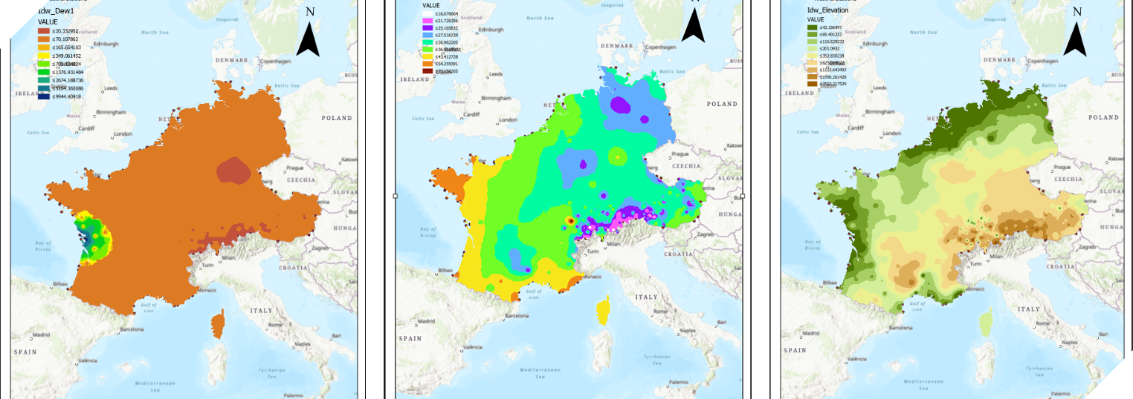
Conclusion
My results will allow climate change scientists to be able to provide a more accurate assessment of where anomalous weather events are more likely to occur. This will be a good tool to use in further analysis.

