Slide 1
Colocation Mining: Exploring Local and Regional Interesting Patterns with the Map-Based Instance Table Approach
Abigail Kelly
Ph.D. Qualifying Exam
Advisor: Dr. Sainju
Department of Computational and Data Science
Middle Tennessee State University

Slide 2
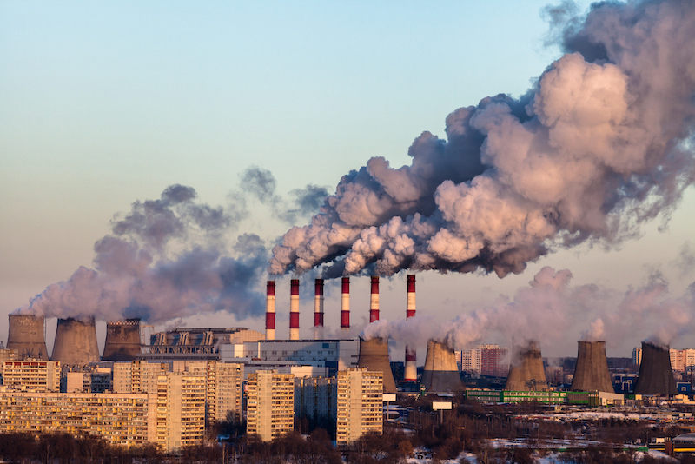
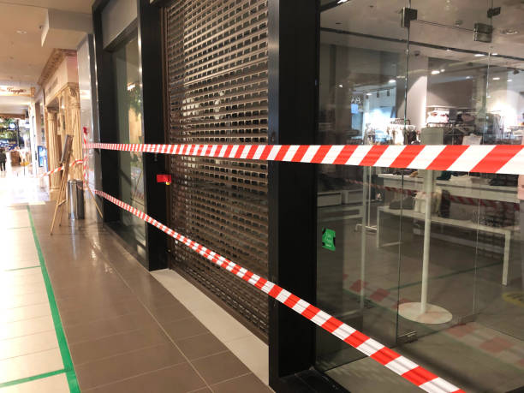
Motivation
Colocation: set of spatial features that commonly appear near each other within a geographical area
Example:
Public Safety: crime events and sources
Ecology: symbiotic relationships between animals or plants
Public Health: diseases and environmental generators
Air Pollution and Lung Cancer
Mall Closing and Crime Events
https://www.beckman.kr/
https://www.istockphoto.com/

Slide 3
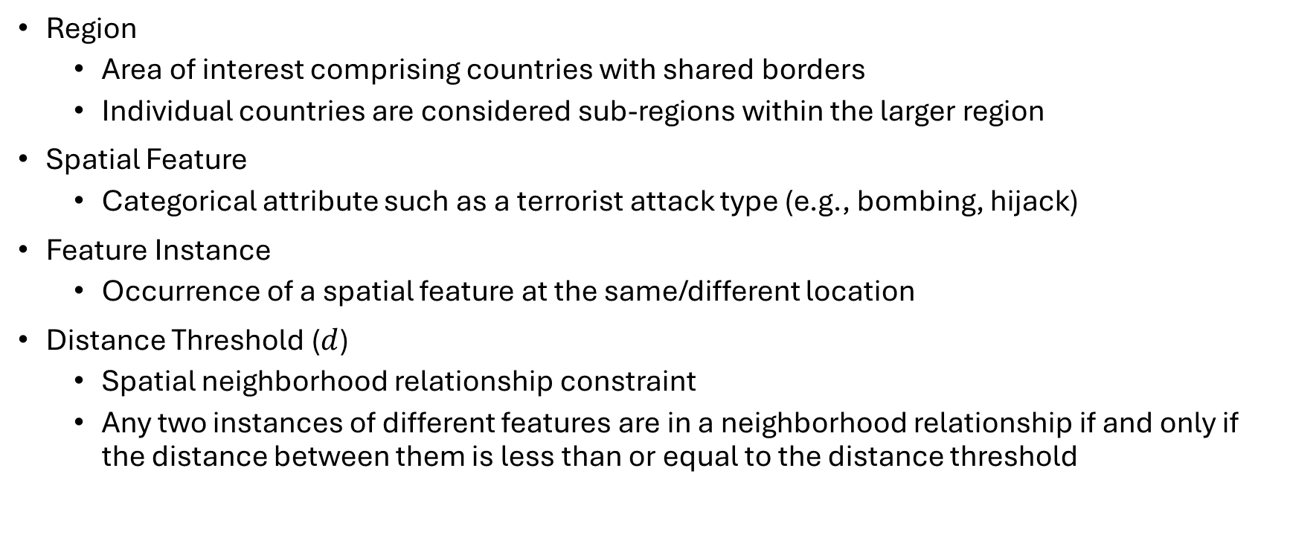
Basic Concepts
Region
Area of interest comprising countries with shared borders
Individual countries are considered sub-regions within the larger region
Spatial Feature
Categorical attribute such as a terrorist attack type (e.g., bombing, hijack)
Feature Instance
Occurrence of a spatial feature at the same/different location
Distance Threshold ($d$)
Spatial neighborhood relationship constraint
Any two instances of different features are in a neighborhood relationship if and only if the distance between them is less than or equal to the distance threshold

Slide 4
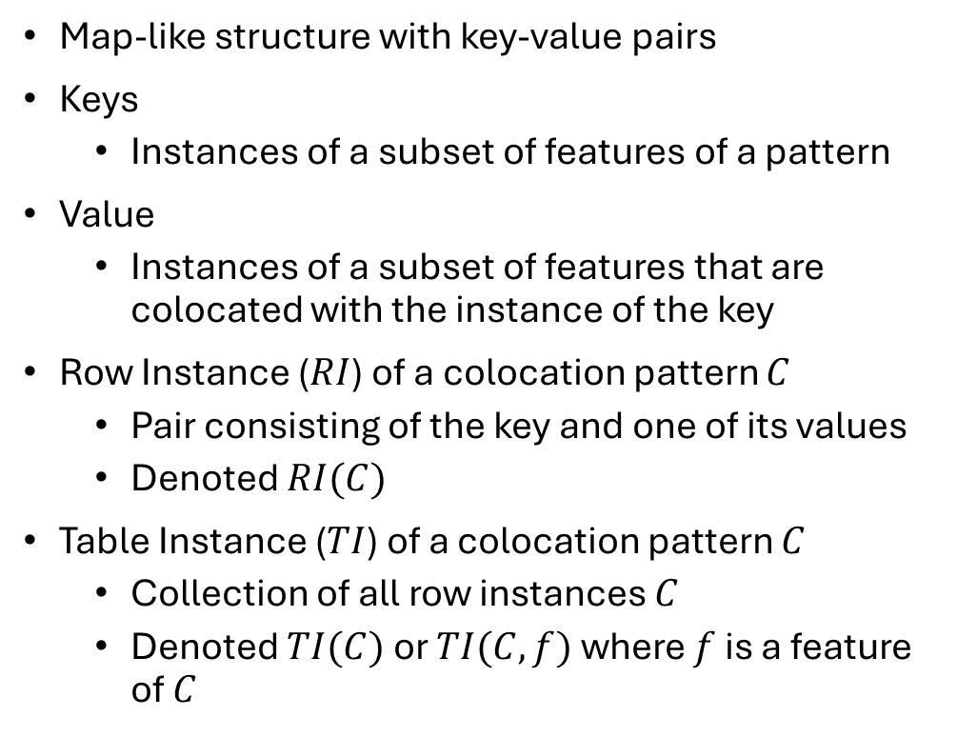

Instance Table
Array-Based
Map-Based
Table holding all instances of colocation pattern $C$
Row Instance ($RI$) of a colocation pattern $C$
Each feature type in $C$ appear only once
Table Instance ($TI$) of a colocation pattern $C$
Collection of all row instances of $C$
Map-like structure with key-value pairs
Keys
Instances of a subset of features of a pattern
Value
Instances of a subset of features that are colocated with the instance of the key
Row Instance ($RI$) of a colocation pattern $C$
Pair consisting of the key and one of its values
Denoted $RI(C)$
Table Instance ($TI$) of a colocation pattern $C$
Collection of all row instances $C$
Denoted $TI(C)$ or $TI(C,f)$ where $f$ is a feature of $C$

Slide 5
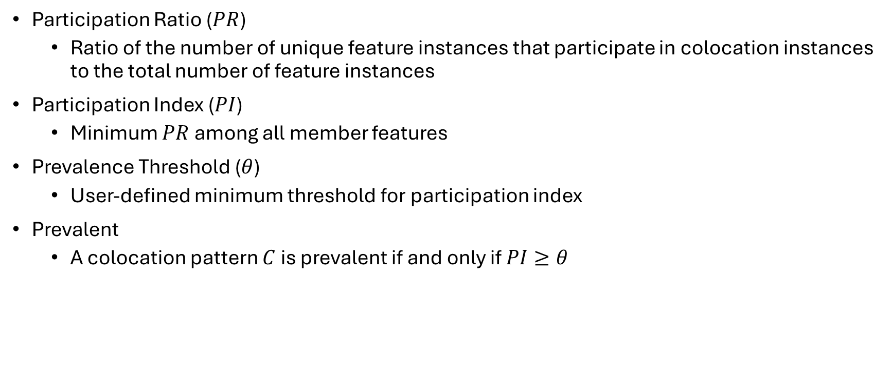
Interestingness Measure
Participation Ratio ($PR$)
Ratio of the number of unique feature instances that participate in colocation instances to the total number of feature instances
Participation Index ($PI$)
Minimum $PR$ among all member features
Prevalence Threshold ($θ$)
User-defined minimum threshold for participation index
Prevalent
A colocation pattern $C$ is prevalent if and only if $PI≥θ$

Slide 6
















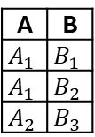




Basic Concept Example: Map-Based
Spatial Feature Types:
A, B, C, D
Feature Instances:
Candidate Colocation:
{A,B} , {A,C}, {A,D}, {B,C}, {B,D}, {C, D}, {A,B,C}, {A,B,D}, {B,C,D}, {A,B,C,D}
Neighbor Relationship (solid line)
(A₁,B₁), (A₁,B₂),…
Table Instance:
$$D_{1}$$
$$C_{2}$$
$$C_{3}$$
$$D_{2}$$
A
$$A_{1}$$
$$A_{2}$$
$$A_{3}$$
B
$$B_{1}$$
$$B_{2}$$
$$B_{3}$$
C
$$C_{1}$$
$$C_{2}$$
$$C_{3}$$
$$C_{4}$$
D
$$D_{1}$$
$$D_{2}$$
$$D_{3}$$
$$B_{3}$$
$$A_{2}$$
$$D_{3}$$
$$A_{3}$$
$$C_{1}$$
$$C_{4}$$
$$A_{1}$$
$$B_{1}$$
$$B_{2}$$
A | B
$$A_{1}$$ | $$B_{1}$$
$$A_{1}$$ | $$B_{2}$$
$$A_{2}$$ | $$B_{3}$$
$PR(\left(A,B\right),A)=$ 2/3 => 0.67
$PR(\left(A,B\right),B)=$ 3/3 => 1
$PI=0.67$

Slide 7
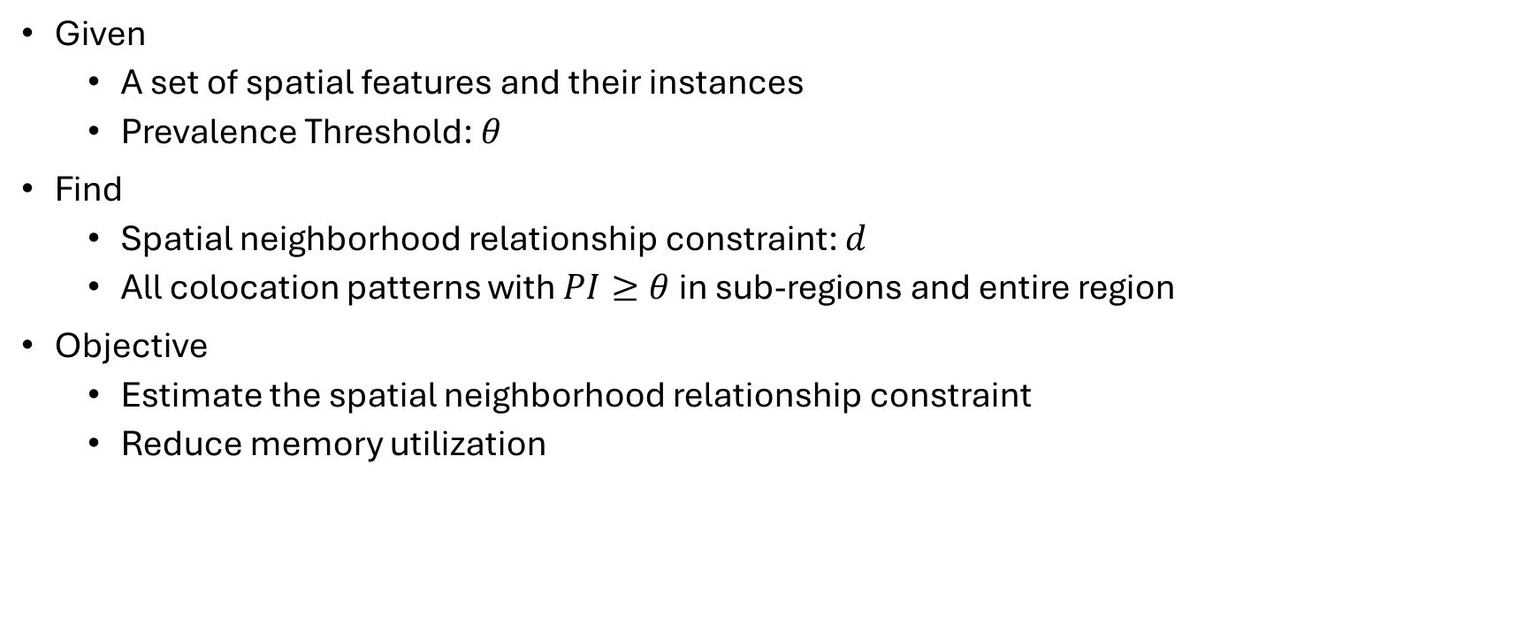
Problem Definition
Given
A set of spatial features and their instances
Prevalence Threshold: $θ$
Find
Spatial neighborhood relationship constraint: $d$
All colocation patterns with $PI≥θ$ in sub-regions and entire region
Objective
Estimate the spatial neighborhood relationship constraint
Reduce memory utilization

Slide 8
Challenges
Checking spatial neighborhood relationships between instances of different types
Number of candidate colocation patterns can grow exponentially
Storing the intermediate collection of collocated instances for each pattern
Determining neighborhood relationship constraint

Slide 9
Related Work
Colocation Mining
Parallel Approaches
Addressing Memory Limitations
Regional Colocation Mining
Neighborhood Relationship Constraint
Max-Min CP-Tree [Sundaram, 2015]
CPI-Tree [Wang, 2008]
iCPI-Tree [Wang, 2009]
Regional Associations [Eick, 2008]
Regional Interest Measures [Mohan, 2011]
Multi-level Framework [Deng, 2017]
Map Reduce Approach [Huang, 2014]
Grid-Based Approach [Sainju, 2017]
Parallel GPU Algorithms [Sainju, 2018]
Delaunay Triangulation [Cai, 2018]
Iterative Edge Selection [Qian, 2012]
Nearest-Neighbor [Qian, 2014]

Slide 10
















Our Distance Estimation Approach
Major Steps:
Calculate distance
R-Tree
Dynamic Programming Table
Estimate optimal k-value
Knee Method
Example with feature type $A$:
$$D_{2}$$
$$C_{3}$$
$$K_{max}=\sqrt{13}≈4$$
$$C_{2}$$
$$A_{2}$$
$$D_{2}$$
$$B_{3}$$
$$D_{3}$$
$$A_{3}$$
$$D=[\left[\left|A_{1}B_{2}\right|, \left|A_{1}C_{1}\right|,\left|A_{1}B_{1}\right|,\left|A_{1}C_{4}\right|\right]]$$
$$C_{1}$$
shortest distance $→$ longest distance
$$C_{4}$$
$$A_{1}$$
$$B_{1}$$
$$B_{2}$$

Slide 11


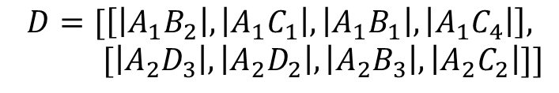
Our Distance Estimation Approach
Major Steps:
Calculate distance
R-Tree
Dynamic Programming Table
Estimate optimal k-value
Knee Method
Example with feature type $A$:
$$D_{1}$$
$$C_{3}$$
$$K_{max}=\sqrt{13}≈4$$
$$C_{2}$$
$$D_{2}$$
$$B_{3}$$
$$A_{2}$$
$$D_{3}$$
$$A_{3}$$
$$D=[\left[\left|A_{1}B_{2}\right|, \left|A_{1}C_{1}\right|,\left|A_{1}B_{1}\right|,\left|A_{1}C_{4}\right|\right],$$
$$[\left|A_{2}D_{3}\right|, \left|A_{2}D_{2}\right|,\left|A_{2}B_{3}\right|,\left|A_{2}C_{2}\right|]]$$
$$C_{1}$$
$$C_{4}$$
$$A_{1}$$
shortest distance $→$ longest distance
$$B_{1}$$
$$B_{2}$$

Slide 12
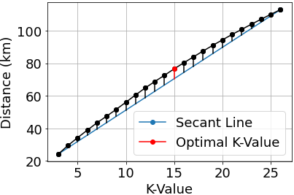

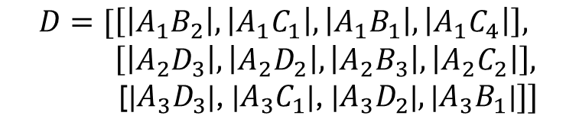








Our Distance Estimation Approach
Example with feature type $A$:
Major Steps:
Calculate distance
R-Tree
Dynamic Programming Table
Estimate optimal k-value
Knee Method
$$D_{1}$$
$$C_{3}$$
$$K_{max}=\sqrt{13}≈4$$
$$C_{2}$$
$$A_{2}$$
$$D_{2}$$
$$B_{3}$$
$$D_{3}$$
$$A_{3}$$
$$C_{1}$$
$$D=[\left[\left|A_{1}B_{2}\right|, \left|A_{1}C_{1}\right|,\left|A_{1}B_{1}\right|,\left|A_{1}C_{4}\right|\right],$$
$$\left[\left|A_{2}D_{3}\right|, \left|A_{2}D_{2}\right|,\left|A_{2}B_{3}\right|,\left|A_{2}C_{2}\right|\right],$$
[|$A_{3}D_{3}$|, |$A_{3}C_{1}$|, |$A_{3}D_{2}$|$,\text{|}A_{3}B_{1}\text{|}]]$
$$C_{4}$$
$$A_{1}$$
$$B_{1}$$
$$B_{2}$$
shortest distance $→$ longest distance
$$T=[\left[\left|A_{1}B_{2}\right|,\left|A_{1}B_{2}\right|+\left|A_{1}C_{1}\right|, \left|A_{1}B_{2}\right|+\left|A_{1}C_{1}\right|+\left|A_{1}B_{1}\right|, \left|A_{1}B_{2}\right|+\left|A_{1}C_{1}\right|+\left|A_{1}B_{1}\right|+|A_{1}C_{4}|\right],$$
$\left[\left|A_{2}D_{3}\right|, \left|A_{2}D_{3}\right|+\left|A_{2}D_{2}\right|, \left|A_{2}D_{3}\right|+\left|A_{2}D_{2}\right|+\left|A_{2}B_{3}\right|,\left|A_{2}D_{3}\right|+\left|A_{2}D_{2}\right|+\left|A_{2}B_{3}\right|+\left|A_{2}C_{2}\right|\right],$
$[\text{|}A_{3}D_{3}\text{|}, \text{|}A_{3}D_{3}\text{|}+\text{|}A_{3}C_{1}\text{|}, \text{|}A_{3}D_{3}\text{|}+\text{|}A_{3}C_{1}\text{|}+\text{|}A_{3}D_{2}\text{|},\text{|}A_{3}D_{3}\text{|}+\text{|}A_{3}C_{1}\text{|}+\text{|}A_{3}D_{2}\text{|}+\text{|}A_{3}B_{1}|]]$
$$k=3$$
calculate average
$$k=4$$

Slide 13

Time Complexity
For each feature type $F$
$$O(N×\sqrt{N}log\left(N\right))$$
where
$N$: number of instances of $F$

Slide 14






















Our Map-Based Approach
$$B_{1}^{1}$$
d
$$C_{2}^{2}$$
$$C_{3}^{2}$$
$$D_{1}^{2}$$
$$D_{2}^{2}$$
$$A_{2}^{1}$$
$$A_{1}^{1}$$
$$B_{3}^{2}$$
$$A_{2}^{2}$$
$$C_{1}^{1}$$
$$D_{3}^{2}$$
$$B_{3}^{1}$$
$$A_{3}^{2}$$
$$D_{2}^{1}$$
$$C_{1}^{2}$$
$$C_{2}^{1}$$
$$C_{4}^{2}$$
$$A_{1}^{2}$$
$$D_{1}^{1}$$
$$B_{1}^{2}$$
$$B_{2}^{1}$$
$$B_{2}^{2}$$
Sub-Region 1
Sub-Region 2

Slide 15

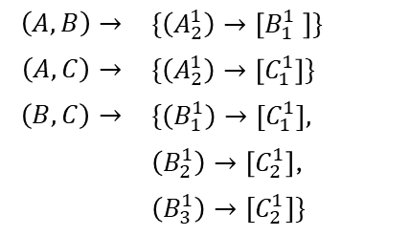
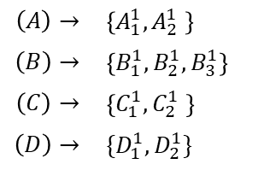
Our Map-Based Approach
$$B_{1}^{1}$$
d
$$C_{2}^{2}$$
$$C_{3}^{2}$$
$$D_{1}^{2}$$
Sub-Region 1 Instance Table:
$$A_{2}^{1}$$
$$D_{2}^{2}$$
k = 1:
k = 2:
$$A_{1}^{1}$$
$$B_{3}^{2}$$
$$A_{2}^{2}$$
$$\left(A\right)→$$ | $$\left\{A_{1}^{1},A_{2}^{1} \right\}$$
$$\left(B\right)→$$ | $$\left\{B_{1}^{1},B_{2}^{1},B_{3}^{1}\right\}$$
$$\left(C\right)→$$ | $$\left\{C_{1}^{1},C_{2}^{1} \right\}$$
$$\left(D\right)→$$ | $$\{D_{1}^{1},D_{2}^{1}\}$$
PI = 0.33
PI = 0.50
PI = 1
$$C_{1}^{1}$$
PI = 1
PI = 1
PI = 1
PI = 1
$$\left(A,B\right)→$$ | $$\{\left(A_{2}^{1}\right)→\left[B_{1}^{1} \right]\}$$
$$\left(A,C\right)→$$ | $$\{\left(A_{2}^{1}\right)→\left[C_{1}^{1}\right]\}$$
$$\left(B,C\right)→$$ | $$\{\left(B_{1}^{1}\right)→\left[C_{1}^{1}\right],$$
 | $\left(B_{2}^{1}\right)→\left[C_{2}^{1}\right]$,
 | $$\left(B_{3}^{1}\right)→[C_{2}^{1}]\}$$
$$D_{3}^{2}$$
$$B_{3}^{1}$$
$$A_{3}^{2}$$
$$D_{2}^{1}$$
$$C_{1}^{2}$$
$$C_{2}^{1}$$
$$C_{4}^{2}$$
k = 3:
$$A_{1}^{2}$$
$$D_{1}^{1}$$
$$\left(A, B, C\right)→$$ | $$\{\left(A_{2}^{1},B_{1}^{1}\right)→\left[C_{1}^{1}\right]\}$$
PI = 0.33
$$B_{2}^{1}$$
$$B_{1}^{2}$$
$$B_{2}^{2}$$
Sub-Region 1
Sub-Region 2

Slide 16
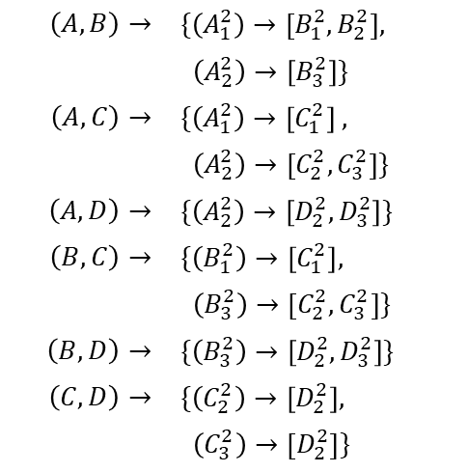
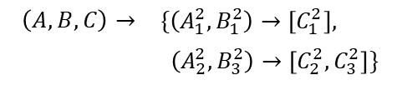
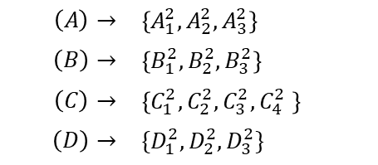
Our Map-Based Approach
Sub-Region 2 Instance Table:
k = 1:
$$\left(A\right)→$$ | $\left\{A_{1}^{2},A_{2}^{2},A_{3}^{2}\right\}$
$$\left(B\right)→$$ | $$\left\{B_{1}^{2},B_{2}^{2},B_{3}^{2}\right\}$$
$$\left(C\right)→$$ | $$\left\{C_{1}^{2},C_{2}^{2},C_{3}^{2},C_{4}^{2} \right\}$$
$$\left(D\right)→$$ | $$\{D_{1}^{2},D_{2}^{2},D_{3}^{2}\}$$
PI = 1
PI = 1
PI = 1
PI = 1
$$B_{1}^{1}$$
d
$$C_{2}^{2}$$
$$C_{3}^{2}$$
$$D_{1}^{2}$$
k = 2:
$$A_{2}^{1}$$
$$D_{2}^{2}$$
$$A_{1}^{1}$$
$$B_{3}^{2}$$
$$A_{2}^{2}$$
$$\left(A,B\right)→$$ | $$\{\left(A_{1}^{2}\right)→\left[B_{1}^{2},B_{2}^{2}\right],$$
 | $\left(A_{2}^{2}\right)→\left[B_{3}^{2}\right]\}$
$$\left(A,C\right)→$$ | $\{\left(A_{1}^{2}\right)→\left[C_{1}^{2}\right]$ $,$
 | $\left(A_{2}^{2}\right)→\left[C_{2}^{2}, C_{3}^{2}\right]\}$
$$\left(A,D\right)→$$ | $$\{\left(A_{2}^{2}\right)→\left[D_{2}^{2},D_{3}^{2}\right]\}$$
$$\left(B,C\right)→$$ | $$\{\left(B_{1}^{2}\right)→\left[C_{1}^{2}\right],$$
 | $\left(B_{3}^{2}\right)→\left[C_{2}^{2},C_{3}^{2}\right]\}$
$$\left(B,D\right)→$$ | $$\{\left(B_{3}^{2}\right)→\left[{D_{2}^{2},D}_{3}^{2}\right]\}$$
$$\left(C,D\right)→$$ | $$\{\left(C_{2}^{2}\right)→\left[D_{2}^{2}\right],$$
 | $\left(C_{3}^{2}\right)→\left[D_{2}^{2}\right]\}$
PI = 0.66
PI = 0.66
PI = 0.33
PI = 0.66
PI = 0.33
PI = 0.33
$$C_{1}^{1}$$
$$D_{3}^{2}$$
$$B_{3}^{1}$$
$$A_{3}^{2}$$
$$D_{2}^{1}$$
$$C_{1}^{2}$$
$$C_{2}^{1}$$
$$C_{4}^{2}$$
$$A_{1}^{2}$$
$$D_{1}^{1}$$
$$B_{1}^{2}$$
$$B_{2}^{1}$$
$$B_{2}^{2}$$
Sub-Region 1
Sub-Region 2
k = 3:
$$\left(A, B, C\right)→$$ | $$\{\left(A_{1}^{2},B_{1}^{2}\right)→\left[C_{1}^{2}\right],$$
 | $\left(A_{2}^{2},B_{3}^{2}\right)→\left[C_{2}^{2},C_{3}^{2}\right]\}$
PI = 0.66

Slide 17

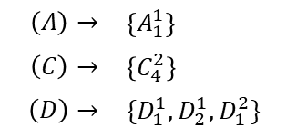
Our Map-Based Approach
$$B_{1}^{1}$$
d
$$C_{2}^{2}$$
$$C_{3}^{2}$$
$$D_{1}^{2}$$
$$D_{2}^{2}$$
$$A_{2}^{1}$$
$$A_{1}^{1}$$
$$B_{3}^{2}$$
$$A_{2}^{2}$$
$$C_{1}^{1}$$
Border Instance Table:
$$D_{3}^{2}$$
k = 2:
k = 1:
$$\left(A\right)→$$ | $$\left\{A_{1}^{1}\right\}$$
$$\left(C\right)→$$ | $$\left\{C_{4}^{2}\right\}$$
$$\left(D\right)→$$ | $$\{D_{1}^{1},D_{2}^{1},D_{1}^{2}\}$$
$$\left(C,D\right)→$$ | $$\{\left(C_{4}^{2}\right)→\left[D_{1}^{1}, D_{2}^{1}\right]\}$$
PI = 0.66
$$B_{3}^{1}$$
$$A_{3}^{2}$$
$$D_{2}^{1}$$
$$C_{1}^{2}$$
$$C_{2}^{1}$$
$$C_{4}^{2}$$
$$A_{1}^{2}$$
$$D_{1}^{1}$$
$$B_{1}^{2}$$
$$B_{2}^{1}$$
$$B_{2}^{2}$$
Sub-Region 1
Sub-Region 2

Slide 18
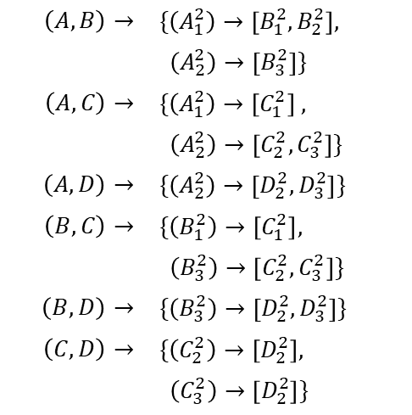

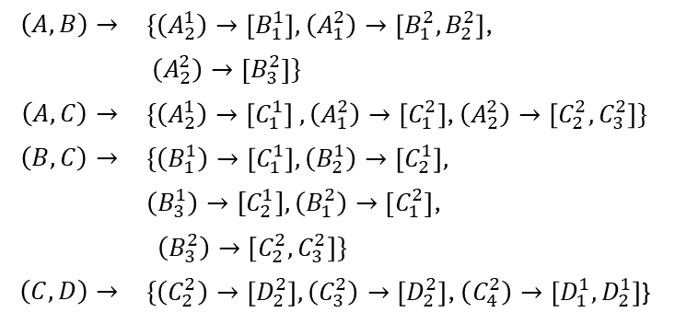
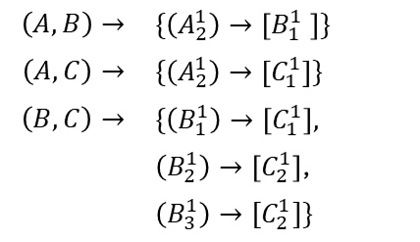
Our Map-Based Approach
Sub-Region 1 Instance Table:
Sub-Region 2 Instance Table:
Regional Instance Table:
k = 2:
k = 2:
k = 2:
$$\left(A,B\right)→$$ | $$\{\left(A_{2}^{1}\right)→\left[B_{1}^{1} \right]\}$$
$$\left(A,C\right)→$$ | $$\{\left(A_{2}^{1}\right)→\left[C_{1}^{1}\right]\}$$
$$\left(B,C\right)→$$ | $$\{\left(B_{1}^{1}\right)→\left[C_{1}^{1}\right],$$
 | $\left(B_{2}^{1}\right)→\left[C_{2}^{1}\right]$,
 | $$\left(B_{3}^{1}\right)→[C_{2}^{1}]\}$$
$$\left(A,B\right)→$$ | $$\{\left(A_{1}^{2}\right)→\left[B_{1}^{2},B_{2}^{2}\right],$$
 | $\left(A_{2}^{2}\right)→\left[B_{3}^{2}\right]\}$
$$\left(A,C\right)→$$ | $\{\left(A_{1}^{2}\right)→\left[C_{1}^{2}\right]$ $,$
 | $\left(A_{2}^{2}\right)→\left[C_{2}^{2}, C_{3}^{2}\right]\}$
$$\left(A,D\right)→$$ | $$\{\left(A_{2}^{2}\right)→\left[D_{2}^{2},D_{3}^{2}\right]\}$$
$$\left(B,C\right)→$$ | $$\{\left(B_{1}^{2}\right)→\left[C_{1}^{2}\right],$$
 | $\left(B_{3}^{2}\right)→\left[C_{2}^{2},C_{3}^{2}\right]\}$
$$\left(B,D\right)→$$ | $$\{\left(B_{3}^{2}\right)→\left[{D_{2}^{2},D}_{3}^{2}\right]\}$$
$$\left(C,D\right)→$$ | $$\{\left(C_{2}^{2}\right)→\left[D_{2}^{2}\right],$$
 | $\left(C_{3}^{2}\right)→\left[D_{2}^{2}\right]\}$
$$\left(A,B\right)→$$ | $\{\left(A_{2}^{1}\right)→\left[B_{1}^{1}\right],$ $\left(A_{1}^{2}\right)→\left[B_{1}^{2},B_{2}^{2}\right]$,
 | $\left(A_{2}^{2}\right)→\left[B_{3}^{2}\right]\}$
$$\left(A,C\right)→$$ | $\{\left(A_{2}^{1}\right)→\left[C_{1}^{1}\right]$ $,\left(A_{1}^{2}\right)→\left[C_{1}^{2}\right]$, $\left(A_{2}^{2}\right)→\left[C_{2}^{2}, C_{3}^{2}\right]\}$
$$\left(B,C\right)→$$ | $$\{\left(B_{1}^{1}\right)→\left[C_{1}^{1}\right],\left(B_{2}^{1}\right)→\left[C_{2}^{1}\right],$$
 | $\left(B_{3}^{1}\right)→[C_{2}^{1}],\left(B_{1}^{2}\right)→\left[C_{1}^{2}\right]$,
 | $\left(B_{3}^{2}\right)→\left[C_{2}^{2},C_{3}^{2}\right]\}$
$$\left(C,D\right)→$$ | $\{\left(C_{2}^{2}\right)→\left[D_{2}^{2}\right],\left(C_{3}^{2}\right)→\left[D_{2}^{2}\right]$, $\left(C_{4}^{2}\right)→\left[D_{1}^{1}, D_{2}^{1}\right]$}
PI = 0.60
PI = 0.60
PI = 0.83
PI = 0.50
Border Instance Table:
k = 2:
Note: (A,D) and (B,D) are not interesting in neither of the sub-regions and the border region. Hence, pruned.
$$\left(C,D\right)→$$ | $$\{\left(C_{4}^{2}\right)→\left[D_{1}^{1}, D_{2}^{1}\right]\}$$

Slide 19
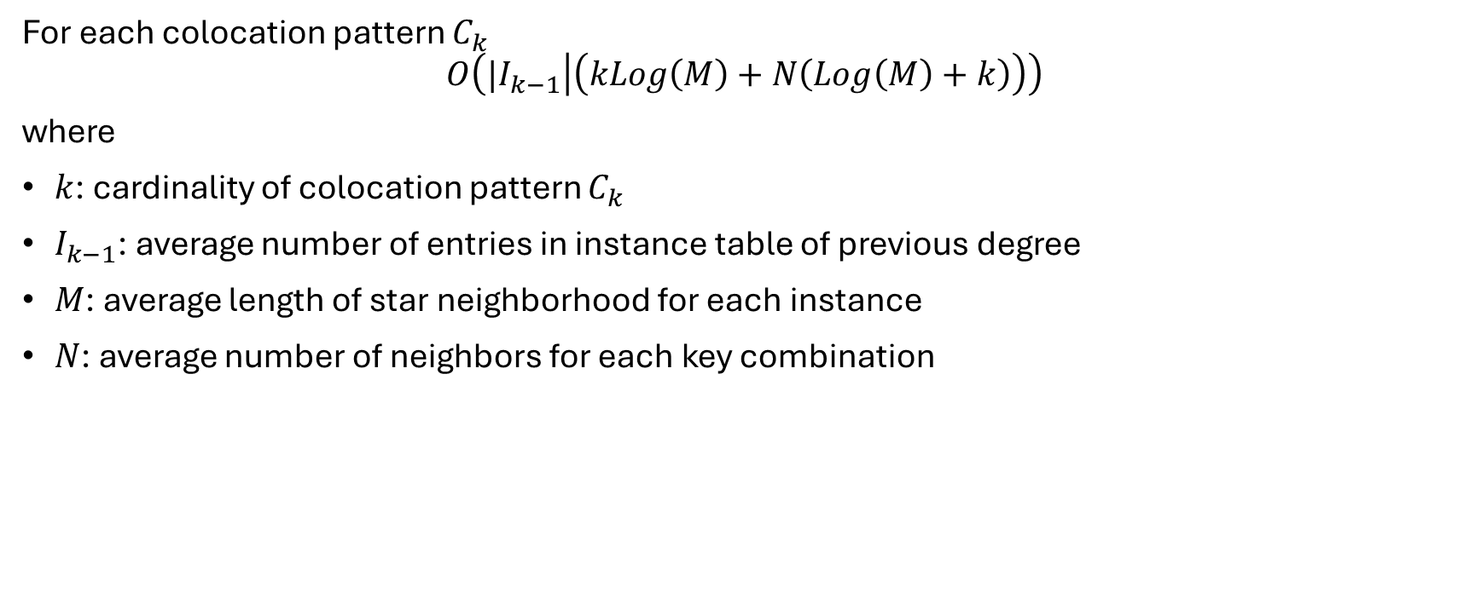
Time Complexity
For each colocation pattern $C_{k}$
$$O\left({|I}_{k−1} | \left(kLog\left(M\right)+N\left(Log\left(M\right)+k\right)\right)\right)$$
where
$k$: cardinality of colocation pattern $C_{k}$
$I_{k−1}$: average number of entries in instance table of previous degree
$M$: average length of star neighborhood for each instance
$N$: average number of neighbors for each key combination

Slide 20

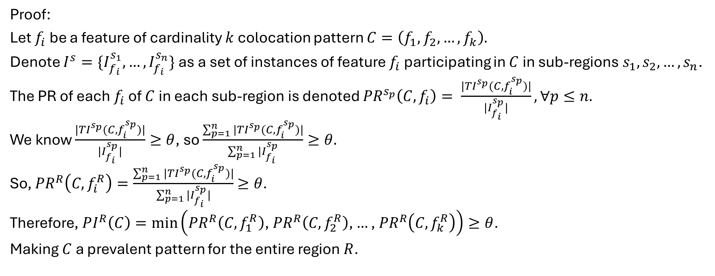
Lemma 1
$Let R be a region with n sub$-$regions s_{1},s_{2},…,s_{n}.$
$$Let C be a colocation pattern such that PI\left(C\right)≥θ ∀s_{1},s_{2},…, s_{n}$$
$$where θ is the prevalence threshold. Then, PI\left(C\right)≥θ for R.$$
Proof:
Let $f_{i}$ be a feature of cardinality $k$ colocation pattern $C=\left(f_{1},f_{2},…, f_{k}\right).$
Denote $I^{s}={\{I}_{f_{i}}^{s_{1}}, …, I_{f_{i}}^{s_{n}}\}$ as a set of instances of feature $f_{i}$ participating in $C$ in sub-regions $s_{1},s_{2},…, s_{n}$.
The PR of each $f_{i}$ of $C$ in each sub-region is denoted ${PR}^{s_{p}}\left(C, f_{i}\right)= \frac{|{TI}^{s_{p}}(C, f_{i}^{s_{p}})|}{|I_{f_{i}}^{s_{p}}|}, ∀p≤n.$
We know $\frac{|{TI}^{s_{p}}(C, f_{i}^{s_{p}})|}{|I_{f_{i}}^{s_{p}}|}≥θ$, so $\frac{\sum_{p=1}^{n}{|{TI}^{s_{p}}(C, f_{i}^{s_{p}})|}}{\sum_{p=1}^{n}{|I_{f_{i}}^{s_{p}}}}≥θ.$
So, ${PR}^{R}\left(C, f_{i}^{R}\right)=\frac{\sum_{p=1}^{n}{|{TI}^{s_{p}}(C, f_{i}^{s_{p}})|}}{\sum_{p=1}^{n}{|I_{f_{i}}^{s_{p}}}|}$ $≥θ$.
Therefore, $PI^{R}\left(C\right)=\min\left({PR}^{R}\left(C, f_{1}^{R}\right)\text{, }{PR}^{R}\left(C, f_{2}^{R}\right)\text{,}…\text{, }{PR}^{R}\left(C, f_{k}^{R}\right)\right)≥θ$.
Making $C$ a prevalent pattern for the entire region $R$.

Slide 21
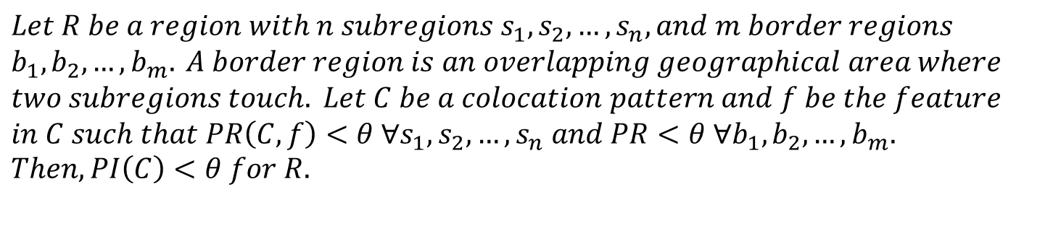
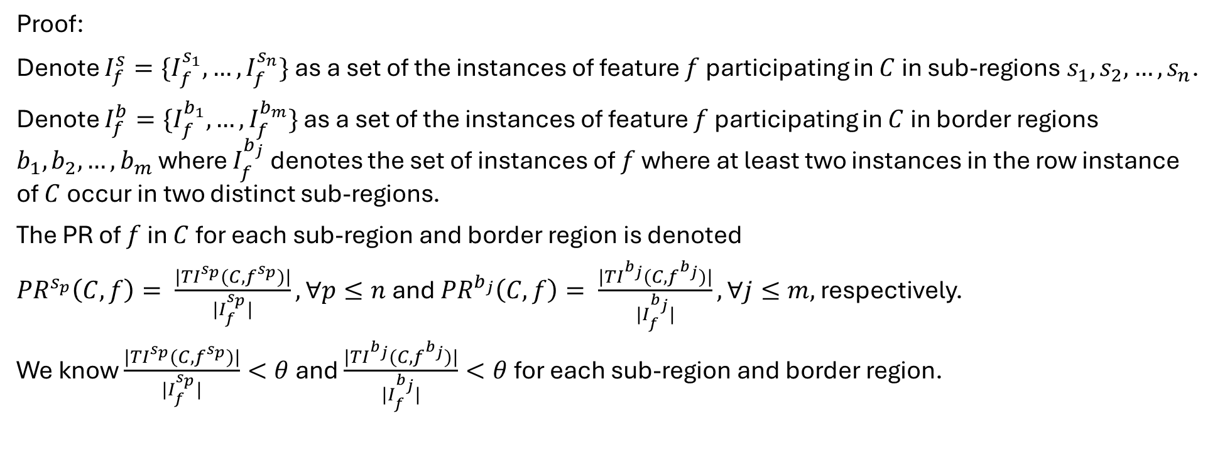
Lemma 2
$$Let R be a region with n subregions s_{1}, s_{2}, …, s_{n}, and m border regions$$
$$b_{1},b_{2},…, b_{m}. A border region is an overlapping geographical area where$$
$$two subregions touch. Let C be a colocation pattern and f be the feature$$
$$in C such that PR\left(C,f\right)<θ ∀s_{1}, s_{2}, …, s_{n} and PR<θ ∀b_{1},b_{2},…, b_{m}.$$
$$Then, PI\left(C\right)<θ for R.$$
Proof:
Denote $I_{f}^{s}={\{I}_{f}^{s_{1}}, …, I_{f}^{s_{n}}\}$ as a set of the instances of feature $f$ participating in $C$ in sub-regions $s_{1}, s_{2}, …, s_{n}$.
Denote $I_{f}^{b}={\{I}_{f}^{b_{1}}, …, I_{f}^{b_{m}}\}$ as a set of the instances of feature $f$ participating in $C$ in border regions $b_{1},b_{2},…, b_{m}$ where $I_{f}^{b_{j}}$ denotes the set of instances of $f$ where at least two instances in the row instance of $C$ occur in two distinct sub-regions.
The PR of $f$ in $C$ for each sub-region and border region is denoted
${PR}^{s_{p}}\left(C, f\right)= \frac{|{TI}^{s_{p}}(C, f^{s_{p}})|}{|I_{f}^{s_{p}}|}, ∀p≤n$ and ${PR}^{b_{j}}\left(C, f\right)= \frac{|{TI}^{b_{j}}(C,f^{b_{j}})|}{|I_{f}^{b_{j}}|}, ∀j≤m,$ respectively.
We know $\frac{|{TI}^{s_{p}}(C, f^{s_{p}})|}{|I_{f}^{s_{p}}|}<θ$ and $\frac{|{TI}^{b_{j}}(C,f^{b_{j}})|}{|I_{f}^{b_{j}}|}<θ$ for each sub-region and border region.

Slide 22
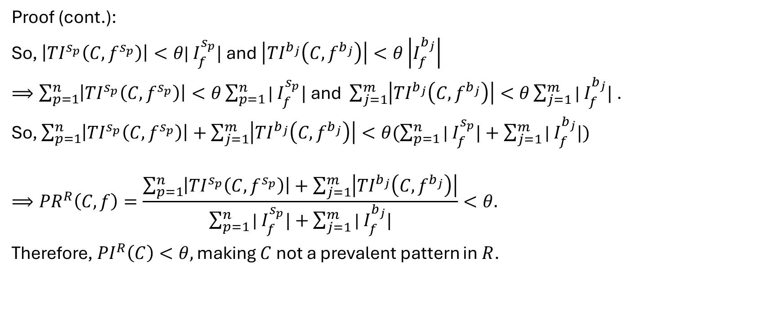
Lemma 2
$$Let R be a region with n subregions s_{1}, s_{2}, …, s_{n}, and m border regions$$
$$b_{1},b_{2},…, b_{m}. A border region is an overlapping geographical area where$$
$$two subregions touch. Let C be a colocation pattern and f be the feature$$
$$in C such that PR\left(C,f\right)<θ ∀s_{1}, s_{2}, …, s_{n} and PR<θ ∀b_{1},b_{2},…, b_{m}.$$
$$Then, PI\left(C\right)<θ for R.$$
Proof (cont.):
So, $\left|{TI}^{s_{p}}\left(C, f^{s_{p}}\right)\right|<θ\text{| }I_{f}^{s_{p}}|$ and $\left|{TI}^{b_{j}}\left(C,f^{b_{j}}\right)\right|<θ\left|I_{f}^{b_{j}}\right|$
$⟹\sum_{p=1}^{n}{\left|{TI}^{s_{p}}\left(C, f^{s_{p}}\right)\right|<θ\sum_{p=1}^{n}{\text{| }I_{f}^{s_{p}}|} }$and $\sum_{j=1}^{m}{\left|{TI}^{b_{j}}\left(C, f^{b_{j}}\right)\right|<θ\sum_{j=1}^{m}{\text{| }I_{f}^{b_{j}}|} }$.
So, $\sum_{p=1}^{n}{\left|{TI}^{s_{p}}\left(C, f^{s_{p}}\right)\right|+\sum_{j=1}^{m}{\left|{TI}^{b_{j}}\left(C, f^{b_{j}}\right)\right|<θ(\sum_{p=1}^{n}{\text{| }I_{f}^{s_{p}}|}+\sum_{j=1}^{m}{\text{| }I_{f}^{b_{j}}|)} }}$
$$⟹{PR}^{R}\left(C,f\right)=\frac{\sum_{p=1}^{n}{\left|{TI}^{s_{p}}\left(C, f^{s_{p}}\right)\right|+\sum_{j=1}^{m}{\left|{TI}^{b_{j}}\left(C, f^{b_{j}}\right)\right|}}}{\sum_{p=1}^{n}{\text{| }I_{f}^{s_{p}}|}+\sum_{j=1}^{m}{\text{| }I_{f}^{b_{j}}|}}<θ.$$
Therefore, ${PI}^{R}\left(C\right)<θ,$ making $C$ not a prevalent pattern in $R$.

Slide 23
Evaluation
Goals
Evaluate the difference in spatial neighborhood relationship constrains across 3 case study regions
Compare the memory reduction rate of our proposed map-based approach with array-based approaches

Slide 24
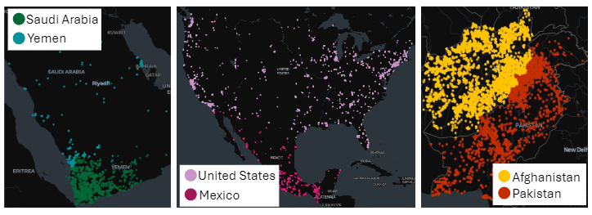
Data Set
Real World
Synthetic
Global Terrorism Database
Year: 1970-2020
Instances: 215k
Number of Attack Types: 8
Pre-generate all final prevalent patterns
Based on (Colocation Mining: A General Approach) [Huang, 2004]

Slide 25
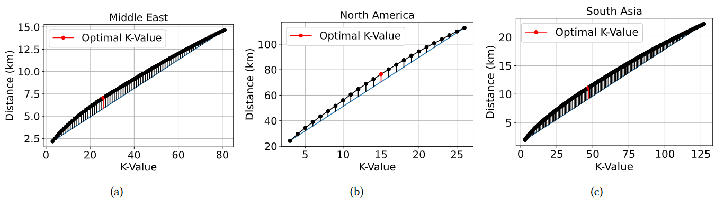
Results: Real-World Data Set
Observation:
Different spatial neighborhood relationship constraint for each region

Slide 26
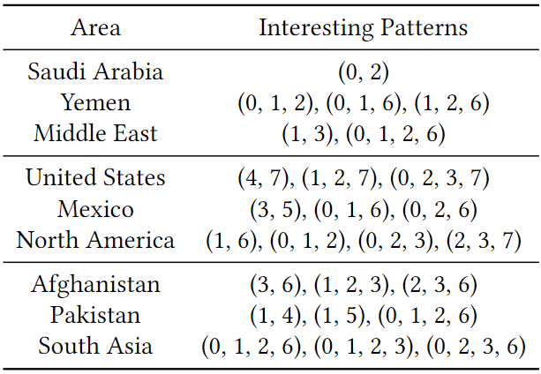
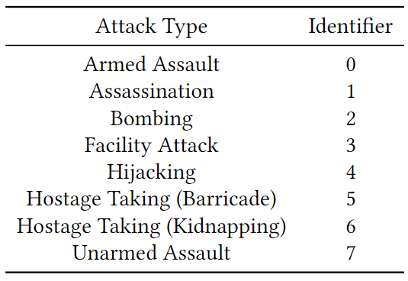
Results: Real-World Data
Observation:
Different interesting patterns in each region

Slide 27
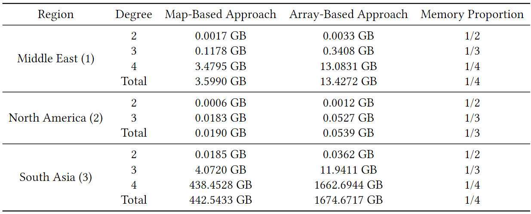
Results: Real World Data Set
Observation:
The higher the degree, the smaller the memory proportion
Our approach uses approximately one-third of the amount of memory of pre-existing array-based approaches

Slide 28
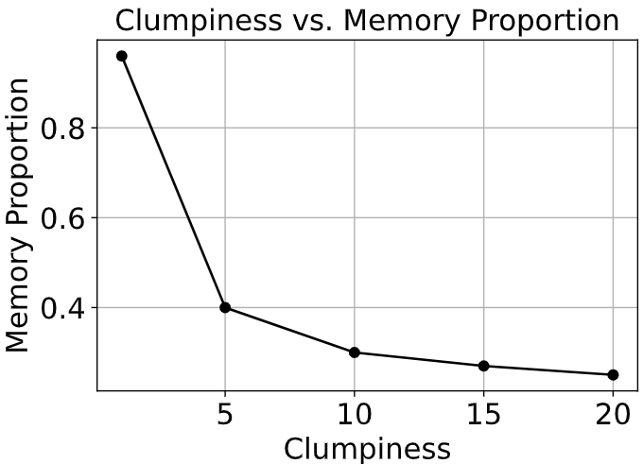
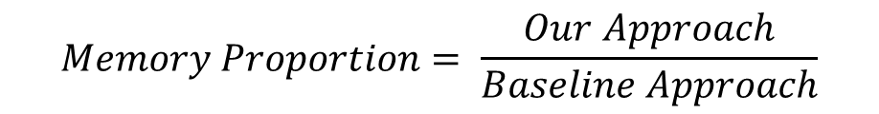
Results: Synthetic Data Set
$$Memory Proportion= \frac{Our Approach}{Baseline Approach}$$
Observation:
The clumpier the data, the smaller the memory proportion
Our approach uses one-third of the amount of memory of pre-existing array-based approaches

Slide 29
Thank you

Slide 30
Appendix

Slide 31
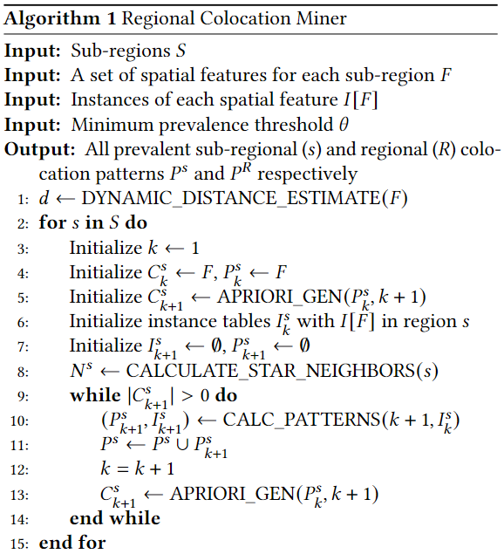
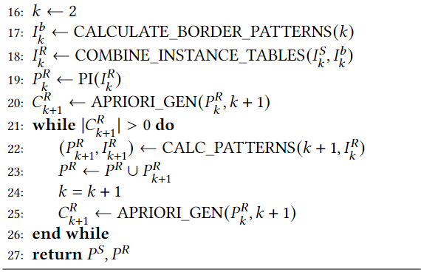

Slide 32
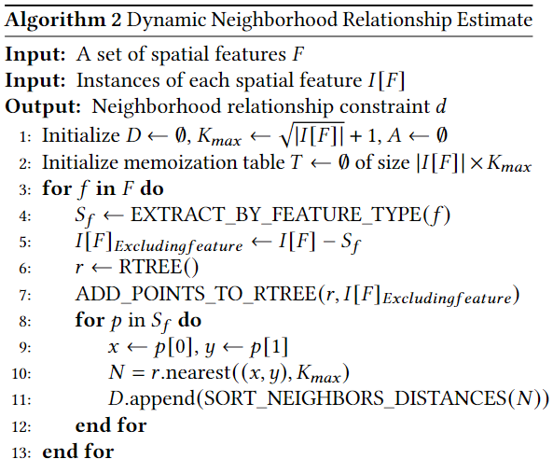
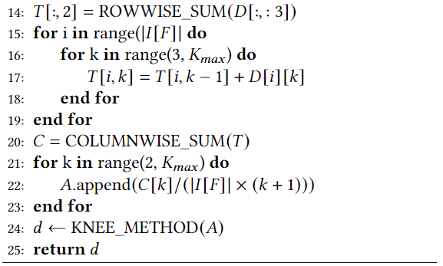

Slide 33
