Slide 1
C/C++ Program Design
Lab 13, Composition & Template
廖琪梅，王大兴

Slide 2
Composition and Template
Class Objects as members
Class templates

Slide 3
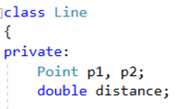
Class Containment(Composition)
Using class members that are themselves objects of another class is referred to as containment or composition or layering.
Containment is typically used to implement has-a relationship, that is, relationship for which the new class has an object of another class.
data in Line class has Point objects

Slide 4
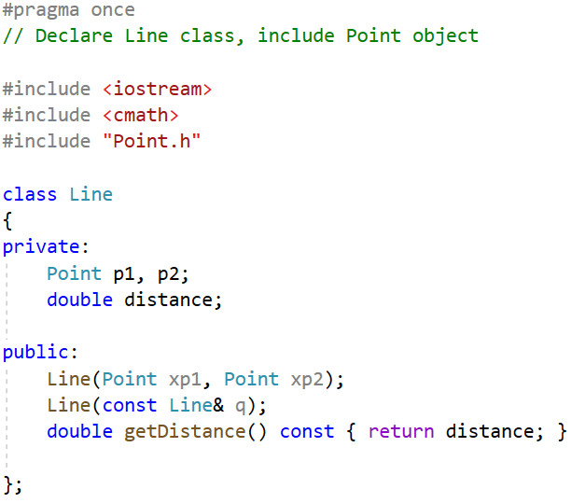
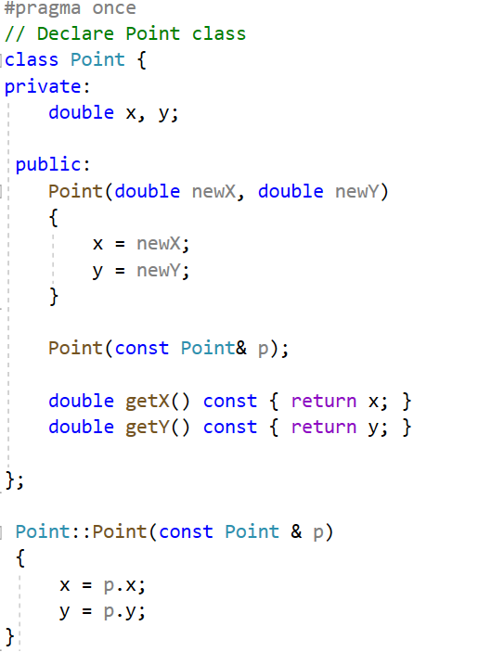
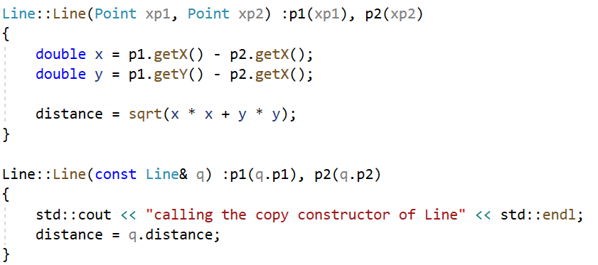
Example:
data in Point class
data in Line class has Point objects
constructor
constructor and
copy constructor
copy constructor
Initialize object first by
initialization list
Initialize object first by initialization list

Slide 5
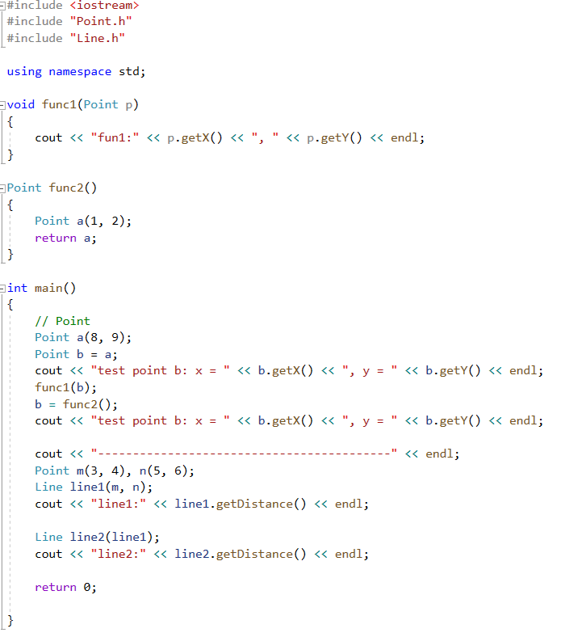
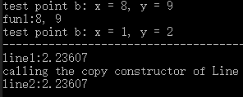
Invoke Point’s constructor
Invoke Point’s copy constructor
Invoke Line’s constructor
Invoke Line’s copy constructor

Slide 6
Private inheritance
Private inheritance can also implement the has-a relationship or is-implemented-in-terms-of(根据某物实现出) relationship.
When to use private inheritance?
When you need to overwrite(override) a virtual function in particular, for a pure virtual base class,
use private inheritance.
When you need to access the protected members, use private inheritance.

Slide 7
Private inheritance
class B
{
public:
virtual int Func1();
protected:
bool Func2();
private:
bool Func3(); // call Func1
};
class D : private B
{
public:
int Func1();
//...
// maybe call B::Func2()
};
virtual function in base class
override the virtual function in derived class
call a protected function of base class in derived class

Slide 8
Pure virtual function and virtual base class
Pure virtual function means the function has only declaration and no definition in the base class.
class Shape
{public:
virtual float area( ) const = 0;
virtual float volume( ) const = 0;
};
two pure virtual functions in the base class
You need not provide implementations of these two functions.
If a base class contains a pure virtual function, it becomes a virtual base class(or abstract base class) who can not create an instance but can defines a pointer such as Shape *p. If subsequence derived classes implement the pure virtual functions, the base pointer can point to the derived object and invoke the virtual functions to show polymorphism.

Slide 9
Composition VS private inheritance
Private inheritance represents is-implemented- terms-of so that subclasses can use the public/protected elements of the base class .
The composition expresses has-a and is implemented- terms-of meaning, which can only use public elements of other classes .
Composition allows you to include more than one subobject of the same class. But inheritance limits you to a single object.
Composition is more common.

Slide 10
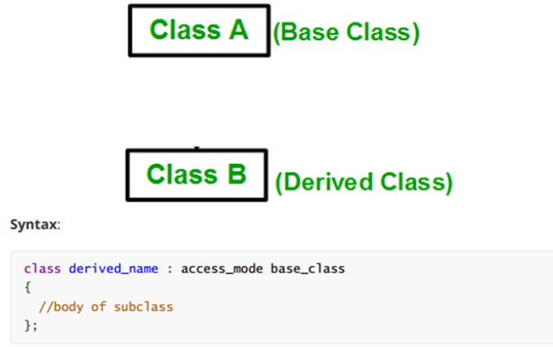
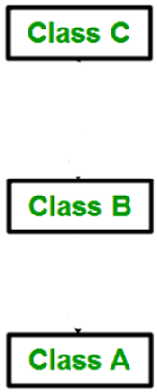
Type of Inheritance
1. Single Inheritance
2. Multilevel Inheritance
(Base Class)
(Directly Derived Class)
(Indirectly Derived Class)

Slide 11
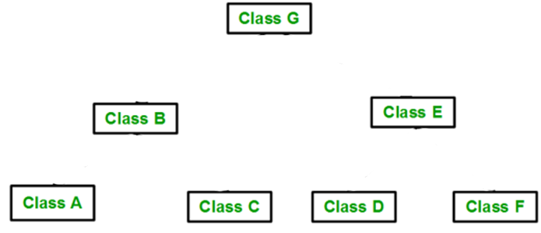
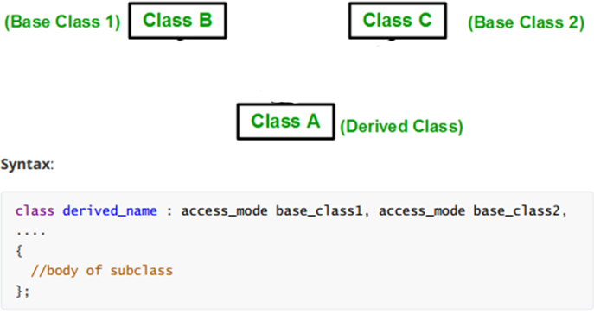
3. Multiple Inheritance(MI)
4. Hierarchical Inheritance

Slide 12
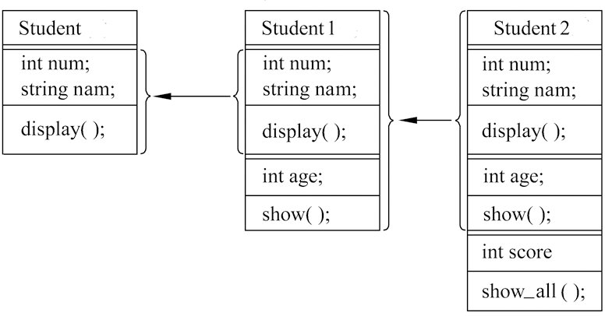
Multilevel inheritance example:
Base class
Directly derived class
Indirectly derived class
Student
Student1
Student2

Slide 13
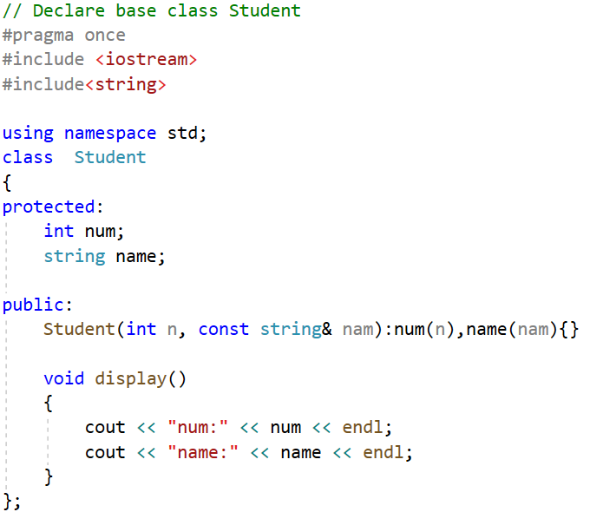
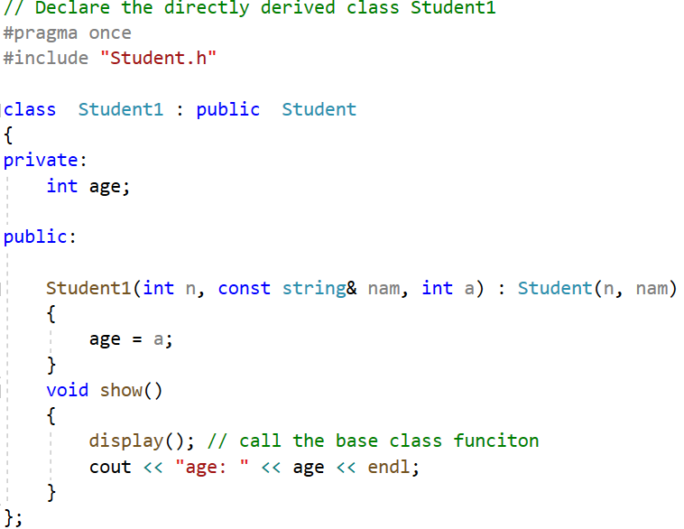
data in class Student1
data in class Student
constructor of Student1
constructor of class Student

Slide 14
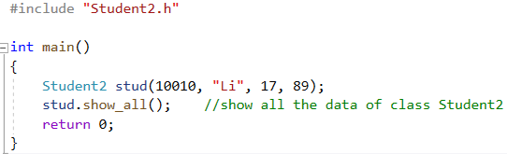
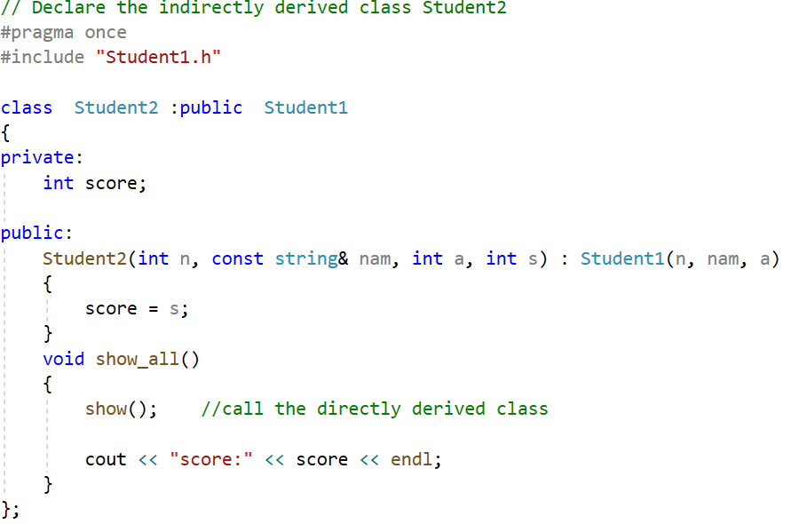

data in class Student2
constructor of Student2

Slide 15
Multiple Inheritance(MI)
MI describes a class that has more than one immediate base class. As with single inheritance, public MI should express an is-a relationship.
Person
you must qualify each base class with the keyword public
Student
Teacher
Graduate has two copies of Person objects. Because both Student and Teacher inherit the Person component, Graduate winds up with two Person components.
Graduate

Slide 16
Virtual Base Classes
Virtual base classes allow an object derived from multiple bases that themselves share a common base to inherit just one object of that shared base class.
virtual and public can appear in either order
A Graduate object will contain a single copy of the Person object.

Slide 17
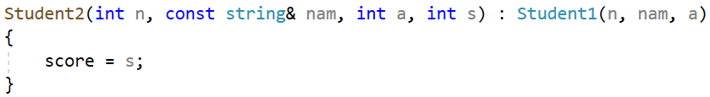
Constructor
With nonvirtual base classes, the only constructors that can appear in an initialization list are constructors for the immediate base classes. But these constructors can, in turn, pass information on to their bases.
Just invoke immediate base class constructor, need not
invoke the upper base class constructor
This automatic passing of information doesn’t work if a class is a virtual base class.
Invoke the Person class(the top-level base class)
constructor explicitly. If you don’t invoke the
constructor, the compiler will invoke its default
constructor.
invoke the Teacher and Student class
(immediate base classes)constructors
initialize its own data

Slide 18
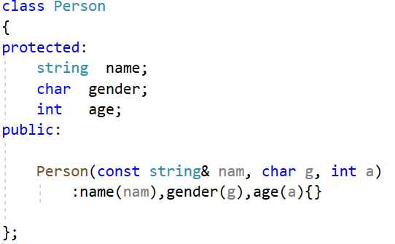
Multiple inheritance example:
Person
data in class Person
Student
Teacher
constructor of Person
Graduate

Slide 19
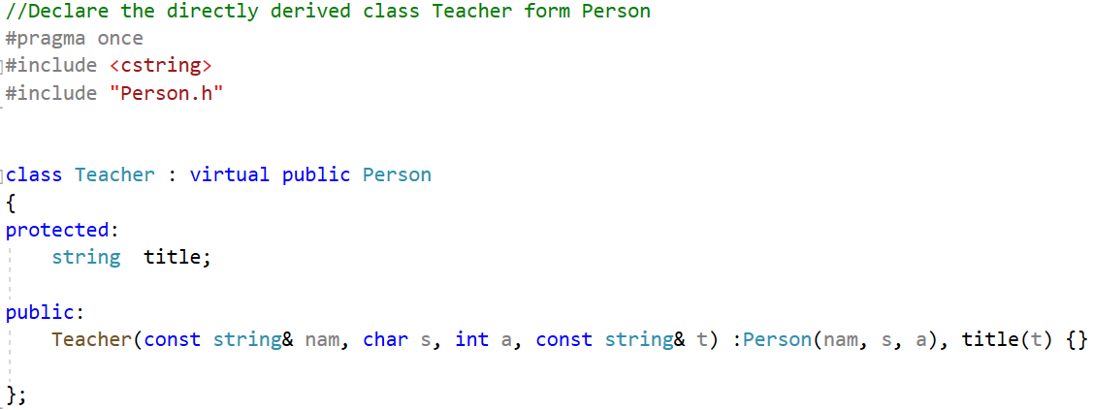
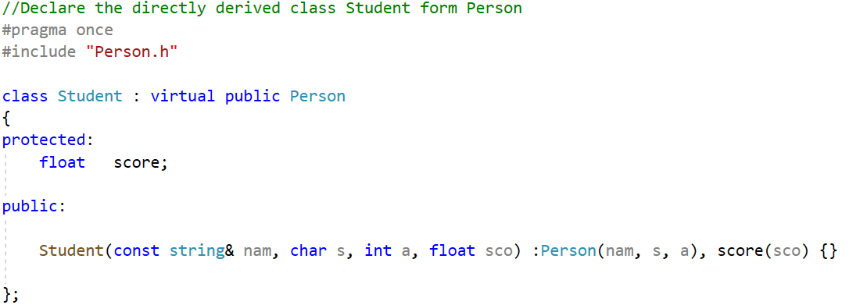
data in class Teacher
data in class Student

Slide 20
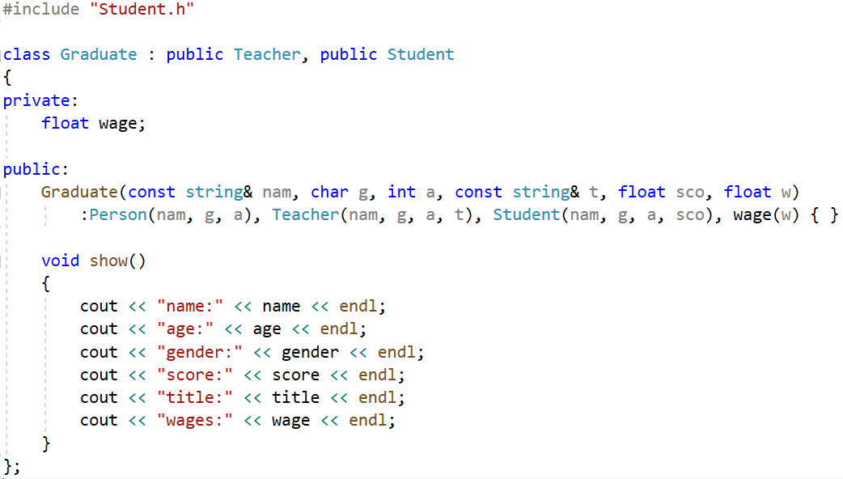
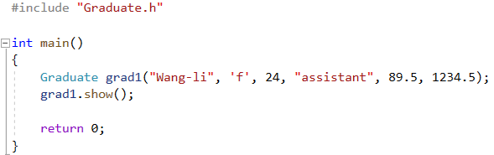
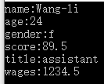
data in class Graduate

Slide 21
Template
A template is a mechanism in C++ that lets you write a function or a class that uses a generic data type. A placeholder is used instead of a real type and a substitution is done by the compiler whenever a new version of the function or class is needed by your program.

Slide 22
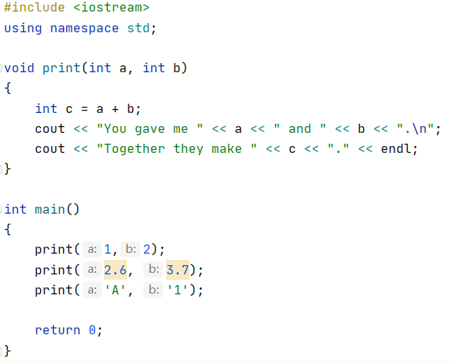
Function Templates
Consider the simple function print:
The print function accepts only
integer, so the floating numbers
2.6 and 3.7 and the characters ’A’
and ‘1’ are coerced to int and are
not treated as they should be.

Slide 23
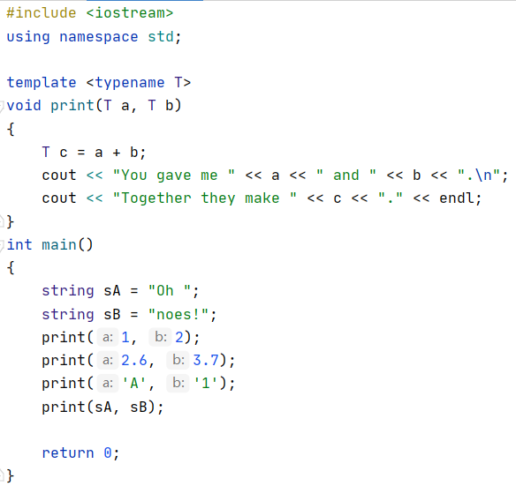
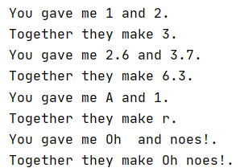
Make print generic with templates
A new version of print is generated for each data type used
as a parameter.

Slide 24
A few notes on the syntax:
The template <typename T> bit can be on the same line as the function type declaration, but it is usually on the line above.
The value T stands for the type the template will be instantiated with. T can be any valid token, but watch out for namespace clashes.
T’s scope is limited to just one function, in the case print.
Notice that we don’t need to do anything special to make print work for new types.
If a placeholder appears more than once in a function’s parameter list, the types you use in their place in the function call must match.

Slide 25
Note: prototypes
To create a prototype for a template function remember to include the template specifier like this:
template <typename T>
void print(T, T);

Slide 26
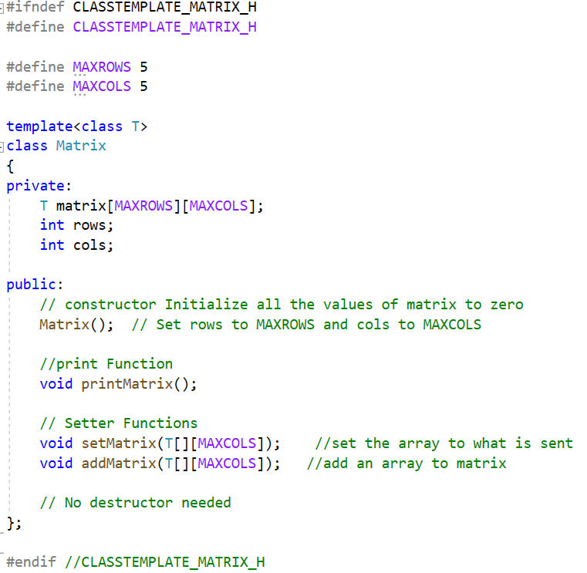
Class Templates
1. Class Definition
data in matrix class

Slide 27
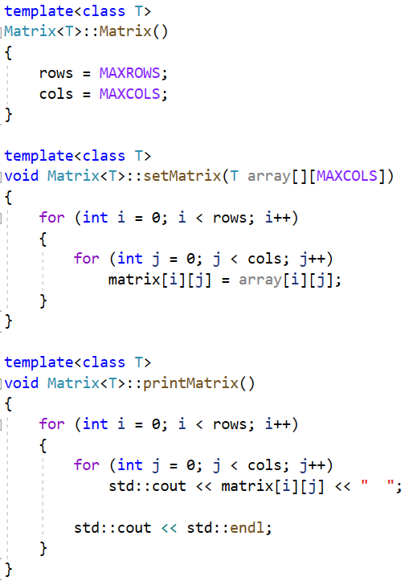
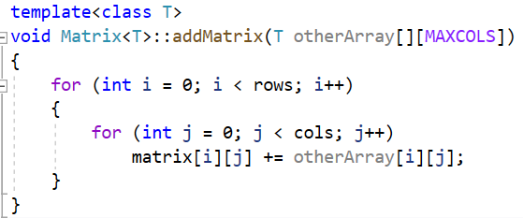
2. Member Function Definition
To refer to the class in a generic way you must include the placeholder in the class name like this:
template <class T>
return_type class_name <T>::
function_name(parameter_list,…)

Slide 28
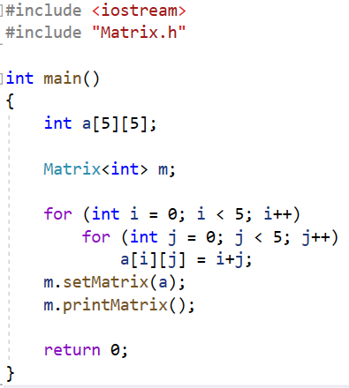

3. Class Instantiation
To make an instance of a class you use this form:
class_name <type> variablename;
For example, to create a Matrix with int you would type:
Matrix<int> m;
Taken together Matrix becomes the name of a new class.

Slide 29
Bringing it All Together
Normally when you write a C++ class you break it into two parts: a header file with the interface, and a .cpp file with the implementation. With templates this doesn’t work so well because the compiler needs to see the definition of the member functions to create new instance of the template class. Some compilers are smart enough to figure out what to do, but some aren’t. These are usually the most efficient way to use templates. We recommend that template classes be declared and implemented in .h files to ensure proper linking. Or you can include .cpp file in your main program instead of including .h file.

Slide 30
A Word of Warning
Templates are powerful, but they are not magical. They do not give data types features that they did not have before. When you design or use a template you should be aware of what operations the data types you will use need to support.

Slide 31
Exercise:
Implement the Matrix class as a template. Supporting at least the following general interface: addition and multiplication of two Matrix objects, a print() member function, a compound += operator, and subscripting supported through a pair of overloaded function call operators, as follows:
float& operator()(int row, int column);
float operator()(int row, int column) const;
In addition, extend it to support arbitrary row and column size using heap memory. Allocate the memory in the constructor and deallocate it in the destructor.

