Slide 1
C/C++ Program Design
Lab 14, Exceptions
廖琪梅，王大兴

Slide 2
Exceptions
Exceptions
RTTI

Slide 3
Exception and Exception Handling
What is an exception?
An exception is a situation, which occurred by the runtime error. In other words, an exception is a runtime error. An exception may result in loss of data or an abnormal execution of program.
Exception handling is a mechanism that allows you to take appropriate action to avoid runtime errors.
Let’s consider a simple example:
a is divided by b, if b equals to zero, what will happen?

Slide 4
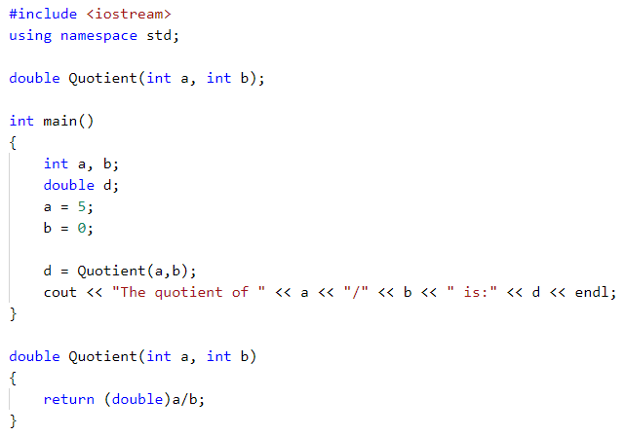
Example of a program without exception handling
When divisor is zero, the compiler generates a special floating-point value that represents infinity; cout displays this value as Inf, inf or INF.

Slide 5
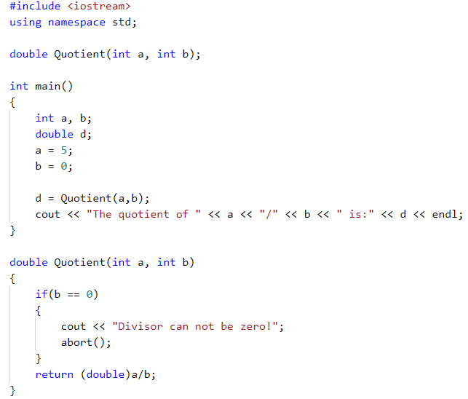
Example of a program with if statement to judge whether the divisor is zero.
If the divisor is zero, terminates the program.
You can also use exit() function.

Slide 6
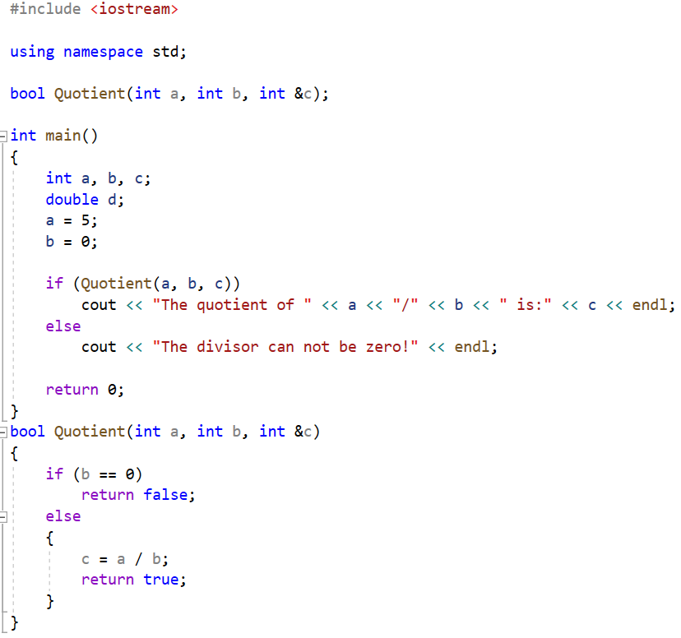
Example of a program with the return value to judge the condition
Check whether the divisor is zero by the return value

Slide 7
Exception handling
C++ provides three keywords to support exception handling
try: The try block contain statements which may generate exceptions.
throw: When an exception occurs in try block, it is thrown to the catch block using throw keyword.
catch: The catch block defines the action to be taken when an exception occurs.

Slide 8
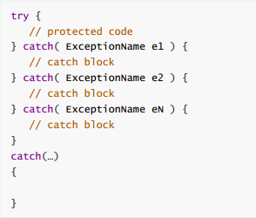
The syntax for using try/catch as follows:
Catches any type exception
You can list down multiple catch statements to catch different type of exceptions in case your try block raises more than one exception in different situations.

Slide 9
How does exception handling work
When a problem is detected during the computation, an exception is raised by using keyword throw.
The raised exceptions are handled by the catch block. This exception handler is indicated by the keyword catch. The catch block must be used immediately after the try block.
try block is responsible for testing the existence of exceptions.

Slide 10
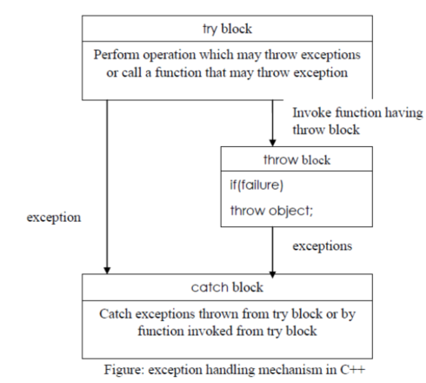
The following figure explains more about this:
Steps taken during exception handling:
1. Hit the exception(detect the problem causing the exception)
2. Throw the exception(inform that an error has occurred)
3. Catch the exception(receive the appropriate actions)
4. Handle the exception(take appropriate actions)

Slide 11
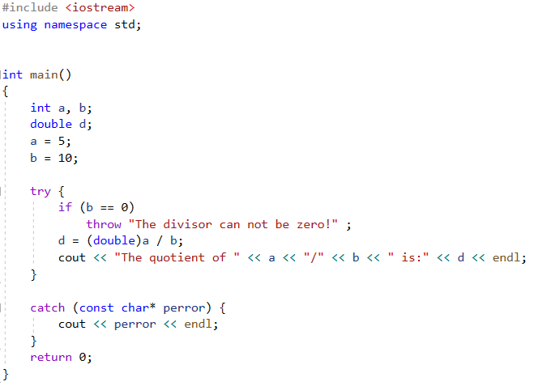
Example of a program with exception handling using try and catch
Throw exception in try block
match

Slide 12
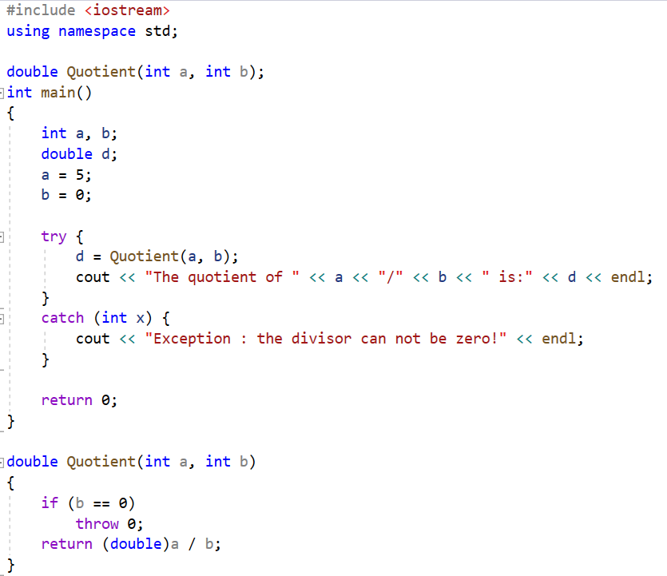
Example of a program with exception handling using try and catch
match

Slide 13
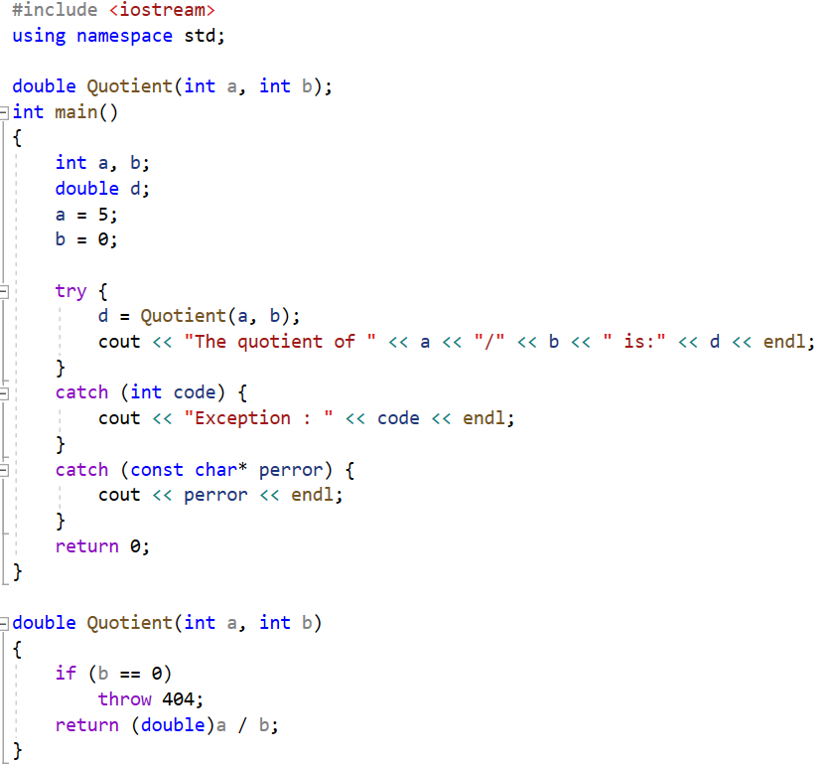

Example of a program with exception handling using try and catch

Slide 14
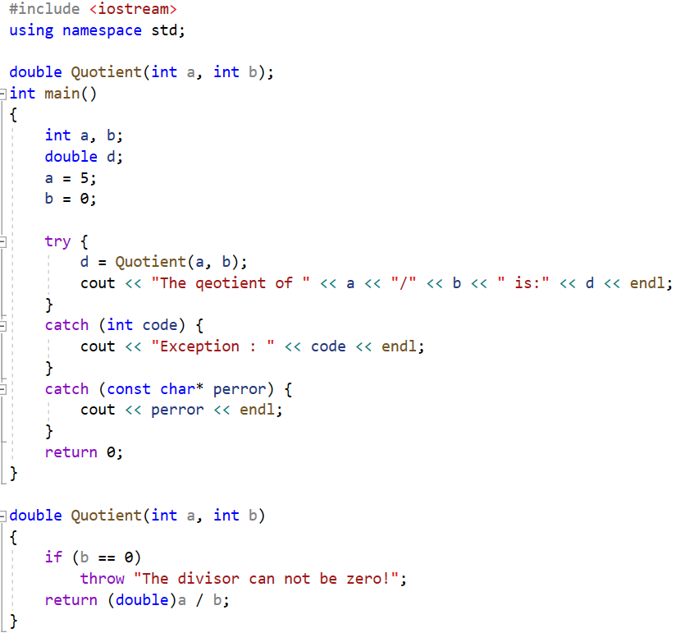
Example of a program with exception handling using try and catch

Slide 15
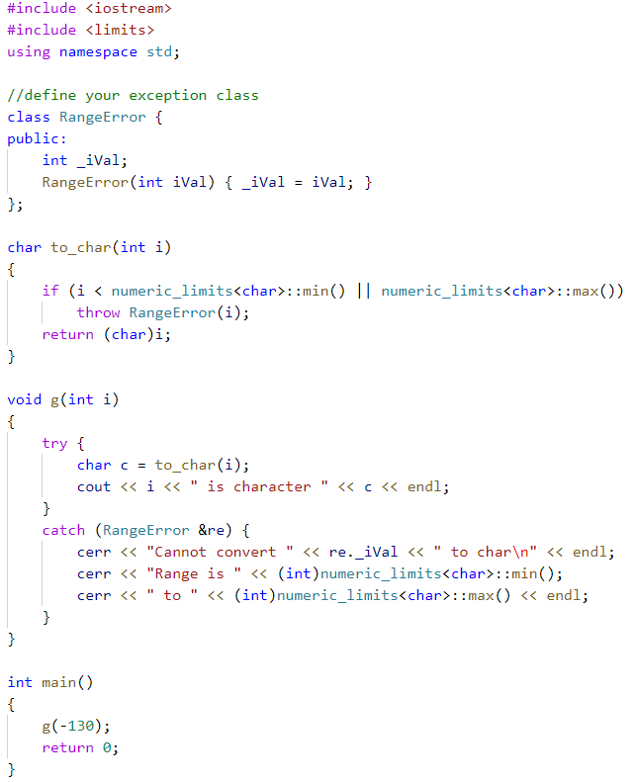

Define and using exceptions
Define your exception class
Throw the exception and invoke the constructor
Catch and handle the exception

Slide 16
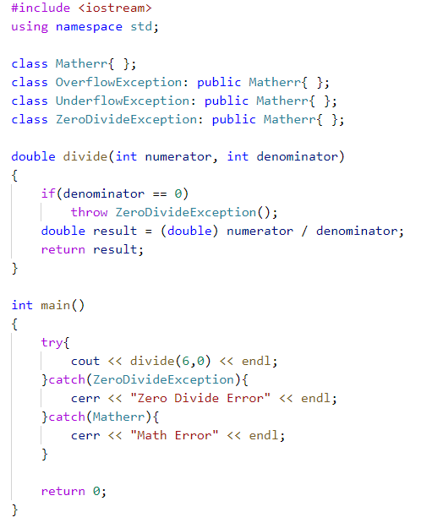
Handling exceptions from a inheritance hierarchy

Slide 17
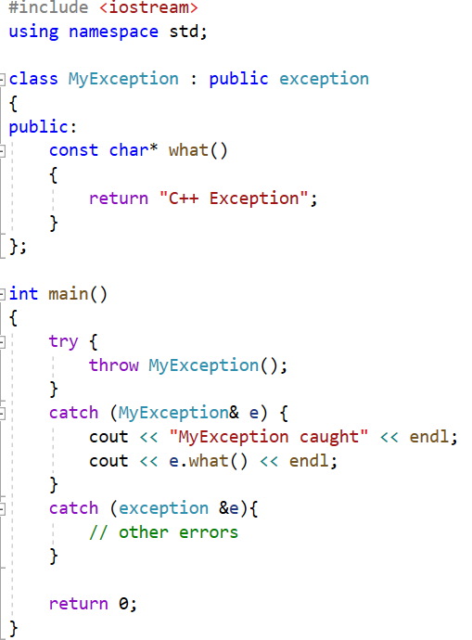

exception class and what() method
You can define your own exceptions by inheritance of exception class.
what() is a public method provided by exception class which returns a string and it has been overridden by all the child exception classes.

Slide 18
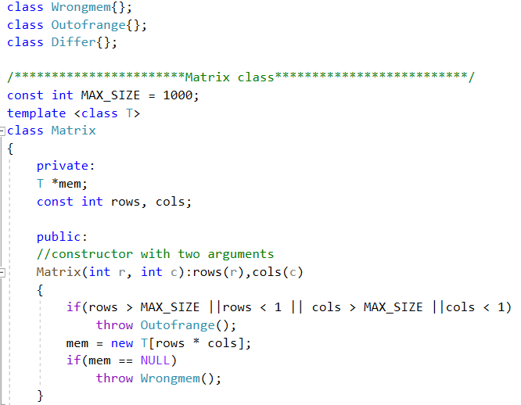
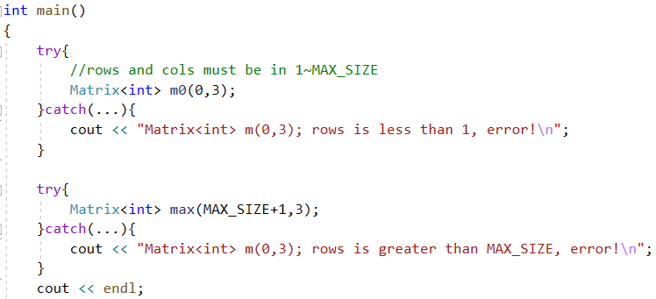

Slide 19
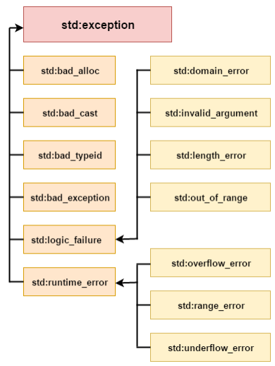
C++ Standard Exceptions
C++ provides a list of standard exceptions defined in which we can use in our programs. These are arranged in a parent-child class hierarchy shown right.

Slide 20
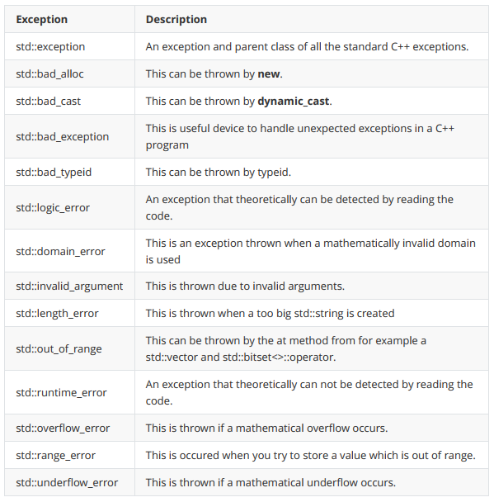
Here is the small description of each exception mentioned in the above hierarchy:

Slide 21
RTTI(Run-Time Type Identification)
The intent of RTTI is to provide a standard way for a program to determine the type of object during runtime.
RTTI is provided through two operators:
typeid operator, which returns the type of a given expression
dynamic_cast operator, which safely converts a pointer or reference to a base type into a pointer of reference to a derived type.

Slide 22
dynamic_cast operator
The dynamic_cast operator is used to safely convert a pointer or reference to a base class to a pointer or reference to a derived class, and use a pointer or reference to a derived class to call a non-virtual function.
dynamic_cast < type-id > ( expression )
In all cases, the type of expression must be either a class type that is publicly derived from the type-id type, a public base class of the type-id which points to the type-id, or the same as the type-id. If expression has one of these types, then the cast will succeed. Otherwise, the cast fails. If a dynamic_cast to a pointer type fails, the result is 0. If a dynamic_cast to a reference type fails, the operator throws an exception of type bad_cast.

Slide 23
There must be at least one virtual function in the class B, otherwise it fails to compile.
class B { ... };
class D : public B { ... };
void f()
{
B* pb = new D;
B* pb2 = new B;
D* pd = dynamic_cast<D*>(pb); // ok: pb points to D
...
D* pd2 = dynamic_cast<D*>(pb2); // fail,pb2 points to B not D
// pd2 is NULL
...
}

Slide 24
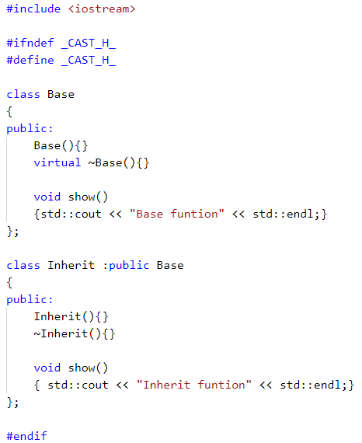
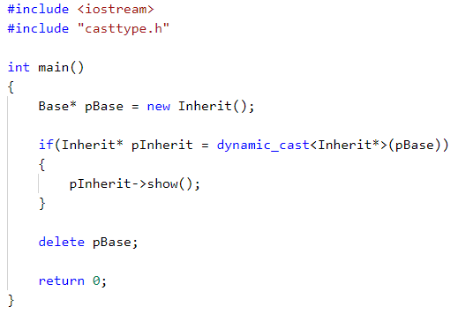
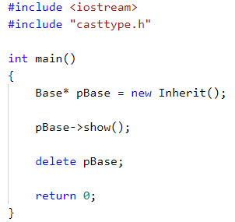
You can check whether the downcast is successful by if statement.
if (Derived *dp = dynamic_cast<Derived*>(bp)) //bp is a base class pointer
{
}
If bp points to a Derived object, then the cast will initialize dp to point to the Derived object to which bp points. In this case, it is safe for the code inside the if to use Derived operations. Otherwise, the result of the cast is 0.
Invoke the show() of base
class, though pBase points
to the derived object.
Invoke the show() of derived class, because
pBase is converted to the derived pointer.

Slide 25
typeid operator
typeid operator can tell you what type is the object.
typeid(expression)
The operand can be any expression or type name.
The typeid operator returns a reference to a type_info object, where type_info is a class
defined in the typeinfo header file. The type_info class overloads the == and != operators
so that you can use these operators to compare types.

Slide 26
Derived *dp = new Derived;
Base *bp = dp;
// compare the type of two objects at run time
if (typeid(*bp) == typeid(*dp))
{ … }
// test whether the run-time type is a specific type
if (typeid(*bp) == typeid(Derived))
{ … }
the operands to the typeid are objects, so use *dp not dp

Slide 27
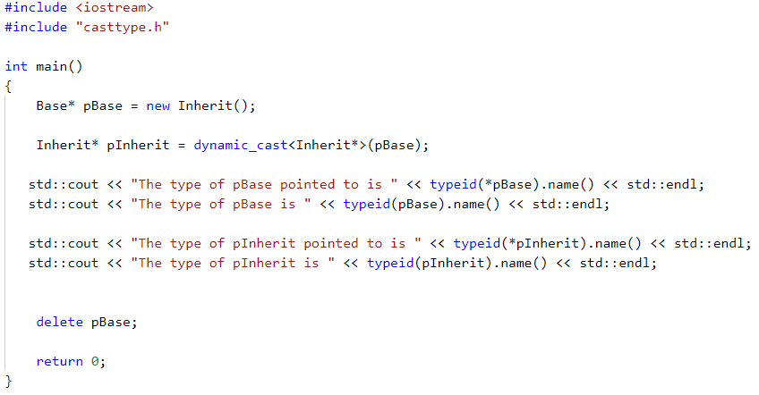

type_info class includes a name() member that returns an string that is typically the name of the class.

Slide 28

Standard output and standard error
Apart from the cout you have used before, there is another output stream you can use call stardad error.
The cout put data into “standard output”, while the cerr put data into “standard error”.
#include <iostream>
using std::cout;
using std::cerr;
using std::endl;
int main() {
cout<<"Hello world 1."<<endl;
cerr<<"Hello world 2."<<endl;
return 0;
}

Slide 29
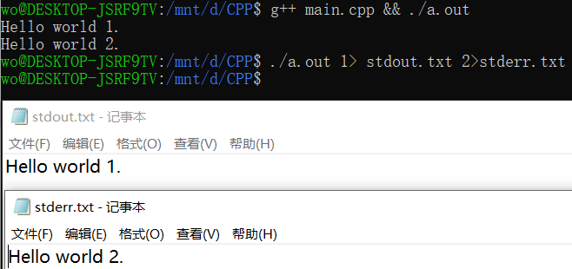
Standard output and standard error
At first it does not make a difference. But you can redirect the streams.
In the example below, we redirect the standard output to “stdout.txt” and the standard error to “stderr.txt”
#include <iostream>
using std::cout;
using std::cerr;
using std::endl;
int main() {
cout<<"Hello world 1."<<endl;
cerr<<"Hello world 2."<<endl;
return 0;
}

Slide 30
Standard output and standard error
Conventionally, we put the output of the program in standard output, and the error information, log information in standard error, even if the language does not require this.
#include <iostream>
using std::cout;
using std::cerr;
using std::endl;
int main() {
cout<<"Hello world 1."<<endl;
cerr<<"Hello world 2."<<endl;
return 0;
}

Slide 31
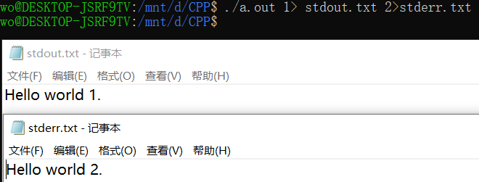
Standard output and standard error
You can do the same with c language.
#include <cstdio>
int main() {
fprintf(stdout, "Hello world 1.\n");
fprintf(stderr, "Hello world 2.\n");
return 0;
}
You may need to search for “linux file descriptor table” to understand the basic idea behind these concepts.

Slide 32

assertion
assertion is used to check a condition. If the condition is false, the program fail.
#include <cstdio>
#include <assert.h>
void printStr( const char* str ) {
assert( str != NULL );
printf("%s\n", str);
}
int main() {
printStr("Hello world.");
printStr(0);
return 0;
}

Slide 33
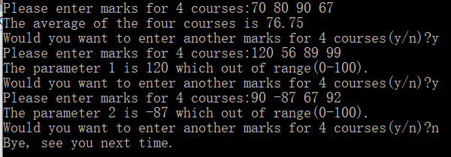
Exercise 1
Write a function calculateAverage() which takes four int arguments which are marks for four courses in the semester and returns their average as a float.
The calculateAverage() function should take only valid range for marks which is between 0-100. If the marks are out of range throw an OutOfRangeException – define this exception as a class.
Invoke the calculateAverage() function in main function and get the following inputs and outputs:

Slide 34
Exercise 2
Rewrite exercise 1, using assert instead of exceptions this time.

