Slide 1
C/C++ Program Design
Lab 15, Friend classes and Nested classes
廖琪梅，王大兴

Slide 2
Friend classes and Nested classes
Friend class
Nested class

Slide 3
Friend Functions
A friend function of a class is a non-member function that has the right to access the private and protected class members.
To declare a non-member function as a friend of a class, place the function prototype in the class definition and precede it with the keyword friend.
friend return_type functionName (parameter list);

Slide 4
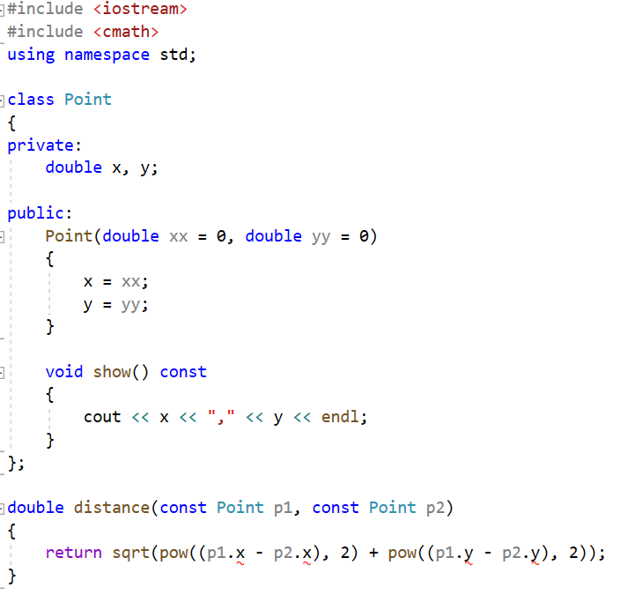
The private data members can not be accessed outside the class

Slide 5
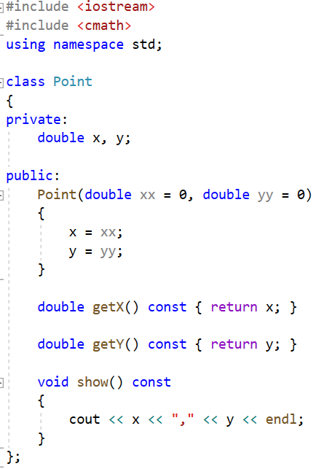
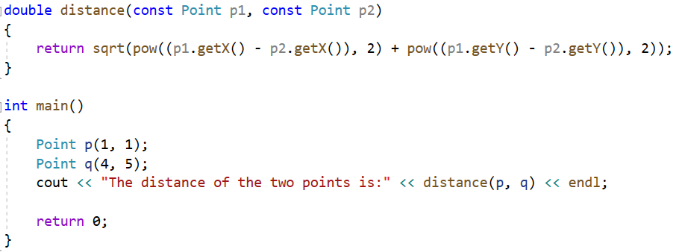
Can distance function be defined as the member function?

Slide 6
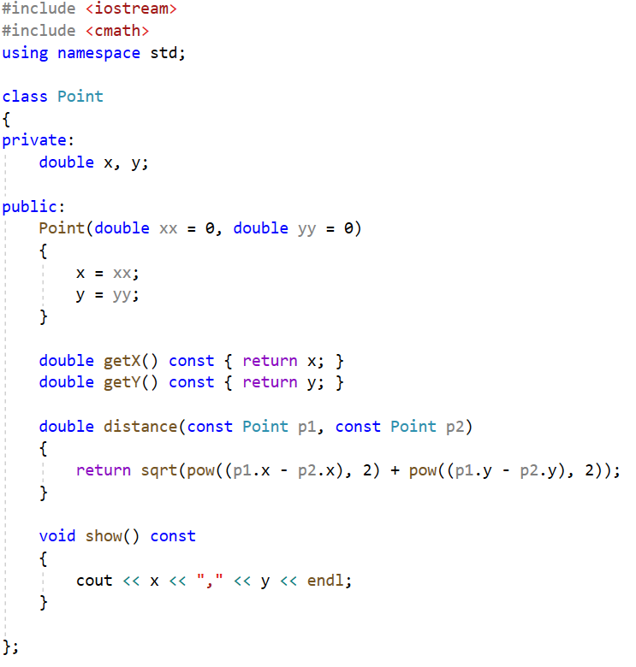
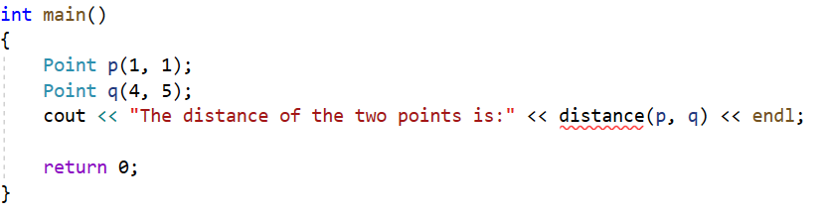
The distance function is defined as the member function.
The member function can access the private members of the class
You cannot invoke the distance function like this,
because it is a member function, which is invoked by object using . operator.

Slide 7
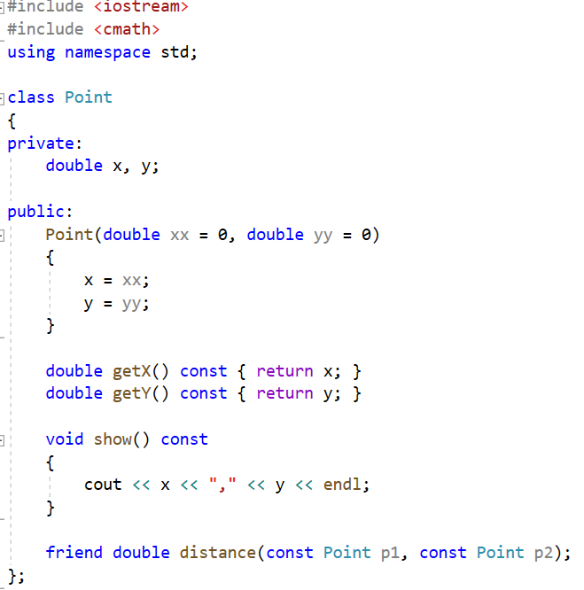
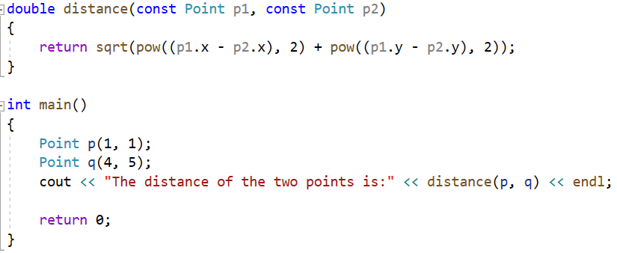
You can define the distance function as a friend function, which can access the private data of Point class.
Declare the friend function inside the class, using friend keyword.
The friend function can access the private data of the class.
You can invoke the distance function directly,
because it isn’t a member function of the class.

Slide 8
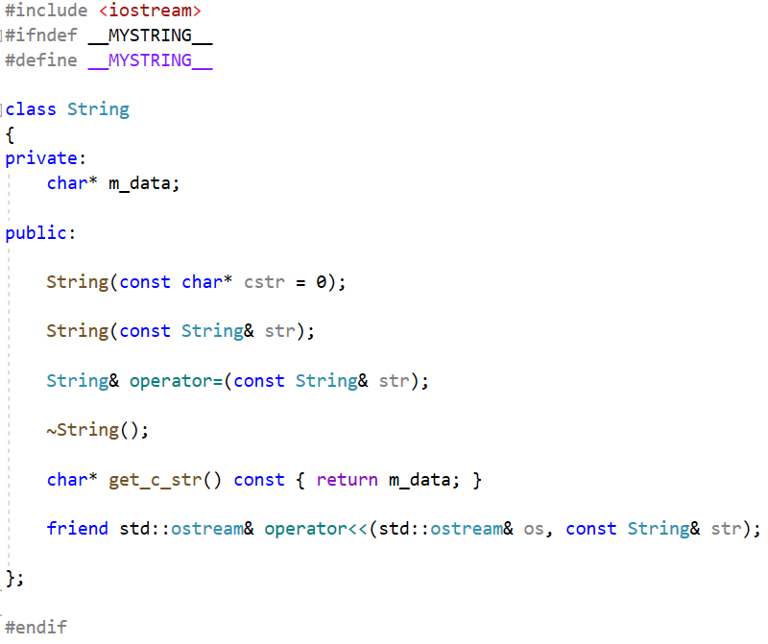
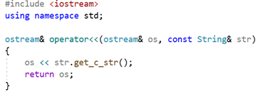
In the previous chapter we also used other friend functions, such as operator overloading functions.

Slide 9
Friend Classes
Entire classes or member functions of other classes may be declared to be friends of another class.
To declare all member functions of class ClassTwo as friend of ClassOne, place a declaration of the form
friend class ClassTwo;
in the definition of class ClassOne. That means all member functions of class ClassTwo have the right to access the private and protected class members of ClassOne.
The friend declaration(s) can appear anywhere in a class and are not affected by access specifiers public or private or protected.

Slide 10
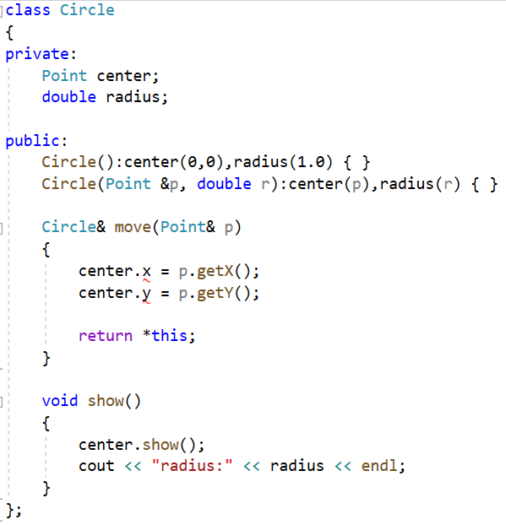
Let’s consider an example: we have a Circle class in which it has a subobject (center point) of Point class--class containment(composition). Can we access the center’s private member in the Point class?
class containment(or class composition)
In move function we want to set the center to the new point p.
But you cannot access the center’s private members x and y.
You can access the public members of the center.

Slide 11
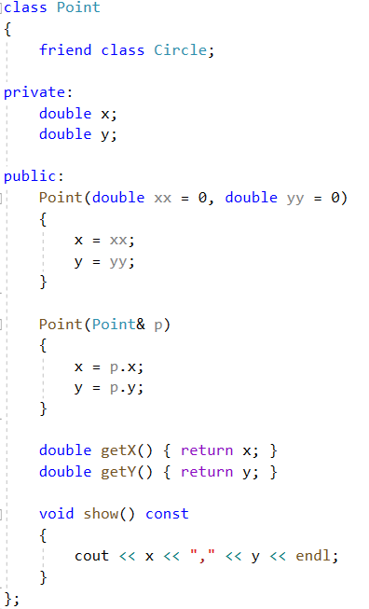
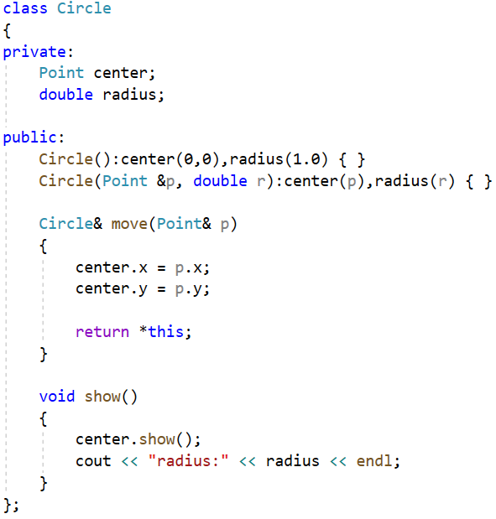
This time you can declare the Circle class as a friend class of the Point class.
This declaration is necessary which is called forward declaration.
Declare the Circle class as a friend of the Point class. That means in Circle class, its member functions can access the private members of the Point class.
Member function in the Circle class can access the private member of the Point class.

Slide 12
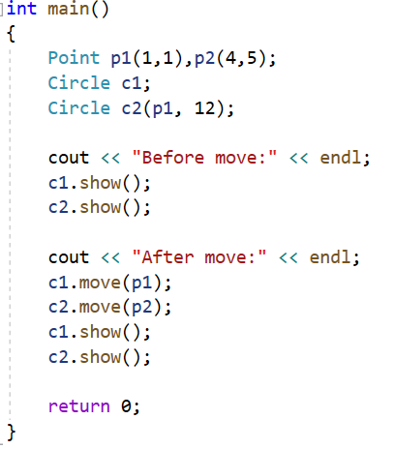
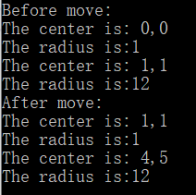

Slide 13
Notes:
Friendship is granted, not taken---for class B to be a friend of class A, class A must explicitly declare that class B is its friend.
Friendship is not symmetric– if class A is a friend of class B, you cannot infer that class B is a friend of class A.
Friendship is not transitive ---if class A is a friend of class B and class B is a friend of class C, you cannot infer that class A is a friend of class C.
When to use friend class?
If one class(or object) is not another class(or object) and vice versa, so the is-a relationship of public inheritance doesn’t apply. Nor it is either a component of the other, so the has-a relationship of containment or of private or protected inheritance doesn’t apply. This suggests making the one class a friend to the other class.
Although friends do grant outside access to a class’s private portion, they don’t really violate the spirit of object-oriented programming. Instead, they provide more flexibility to the public interface.

Slide 14
Nested Class
The class declared within another is called a nested class, and it helps avoid name clutter by giving the new type class scope.
The usual reasons for nesting a class are to assist in the implementation of another class and to avoid name conflicts.

Slide 15
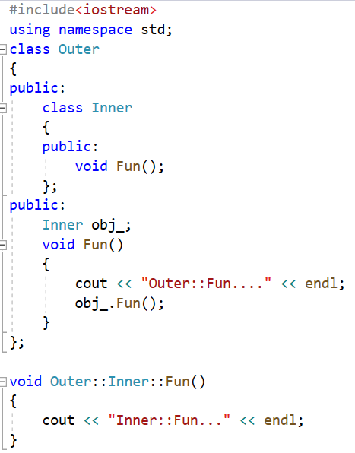
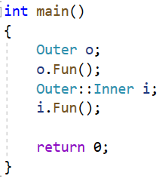

If a nested class is declared in a public section of a second class(in the example Outer class), it is available to the second class, to classes derived from the second class, and, because it’s public, to the outside world. However, because the nested class has class scope, it has to be used with a class qualifier in the outside world.
Declare a nested class Inner
inside the Outer class
Define an object of
the nested class Inner
Invoke the function of Inner object
Define the function of the nested class Inner, using a class qualifier in the outside
Define an object of the Outer class
Define an object of the Inner class using a class qualifier

Slide 16
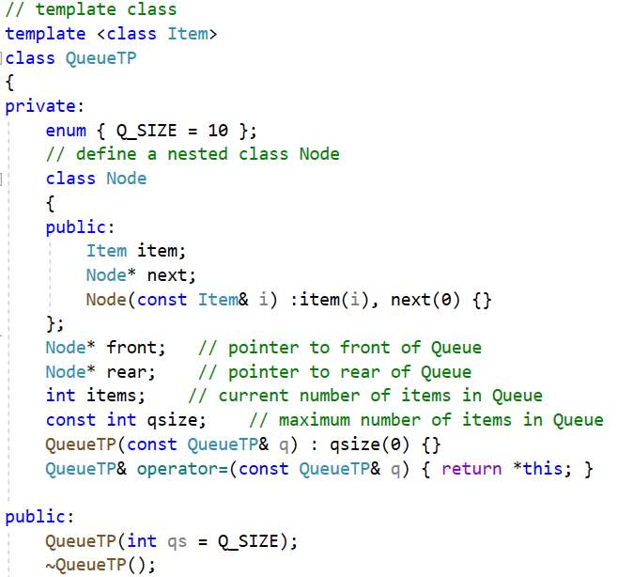
If a nested class is declared in a private section of a second class, it is known only to that second class. This applies, for example, to the Node class nested in the QueueTP declaration . Hence, QueueTP members can use Node objects and pointers to Node objects, but other parts of a program don’t even know that the Node class exists. If you were to derive a class from QueueTP, Node would be invisible to that derived class, too, because a derived class can’t directly access the private parts of a base class.
If the nested class is declared in a protected section of a second class, it is visible to that class but invisible to the outside world. However, in this case, a derived class would know about the nested class and could directly create objects of that type.

Slide 17
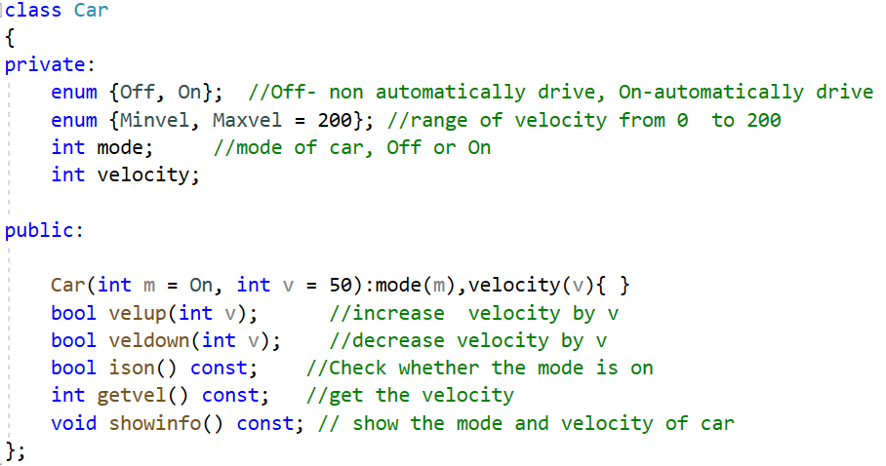
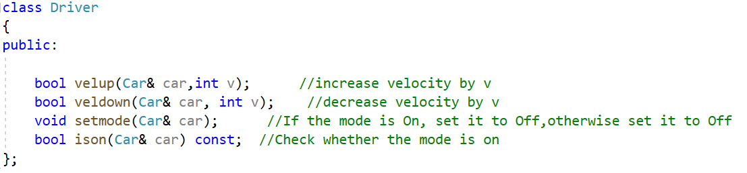
Exercise
There are two classes named Car and Driver, suppose the car can drive automatically, and driver also can drive the car. The declarations of car and driver are as follows:

Slide 18
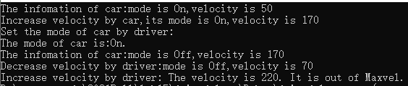
Implement all the member functions of the two classes and make Driver as Car’s friend class so that it can access the members of Car. Write a program to test the two classes.
Output sample:

