Slide 1
C/C++ Program Design
Lab 7, function overloading & function template
廖琪梅，王大兴

Slide 2
Functions Overloading & Template
Function overloading
Function template
Recursive function
Pointers to functions

Slide 3
Inline Function
C++ provides inline functions to help reduce function-call overhead(to avoid a
function call). You should place the qualifier inline before return type in the function prototype.
Default Arguments
Default arguments must be specified in the function prototype and must be rightmost(trailing).

Slide 4
Function Overloading
Function overloading is used to create several functions of the same name that
perform similar tasks, but of different data types. The C++ compiler selects the
the proper function to call by examining the number, types and order of the
arguments.
1.the same fuction name
2.different parameter list

Slide 5
Three ways to overload functions:
1. Number of parameters
int add(int, int);
int add(int, int, int);
A function with default arguments omitted might be called identically to another overloaded function, which causes a compilation error.
Use caution when overloading functions with default parameters, because this may cause ambiguity.
2. Data type of parameters
int add(int, int);
float add(float, float);
3. Sequence of data type of parameters
float add(float, int);
float add(int, float);
Note: The same function signature but different return type is not a valid function overloading example. This will throw compilation error.
int add(int, int);
float add(int, int);

Slide 6
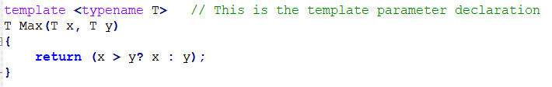
Function Templates
The syntax of templates:
Starts with the keyword template
You can also use keyword class instead of typename
T is a template argument that accepts different data types

Slide 7
compile internally generates and adds right code respectively.
output:

Slide 8
When you declare or define a function template, template <typename T> or
template <class T> can not be omitted.
When you declare or define several function templates, every function must include template <typename T> or template <class T> before function header.
Template functions can also be overloaded.

Slide 9
Overloaded template functions
Function
prototype
Overloaded template functions
Output:

Slide 10
Recursive function
A function that calls itself is known as recursive function. And, this technique is known as recursion. Recursion is used to solve various mathematical problems by dividing it into smaller problems.
In recursive function, you must give the base case or stopping condition to stop the recursive call. Usually, if statement is used to indicate the base case.

Slide 11
Disadvantages of Recursion:
Recursive programs are generally slower than nonrecursive programs. Because it needs to make a function call so the program must save all its current state and retrieve them again later. This consumes more time making recursive programs slower.
Recursive programs requires more memory to hold intermediate states in a stack. Non recursive programs don’t have any intermediate states, hence they don’t require any extra memory.

Slide 12
Pointer to Function(Function Pointer)
Normally, a function pointer is used as a parameter. When you invoke the function, the corresponding argument is the function name.
Note: Do not omit the () of the pointer when your declare a function pointer.
Example:
int findmax(int, int);
int (*funptr)(int,int);
funptr = findmax;
int max = funptr(3,5);
Declaring a function
Declaring a pointer to a function
Assigning the address of a function to the pointer
Calling the function by the pointer

Slide 13


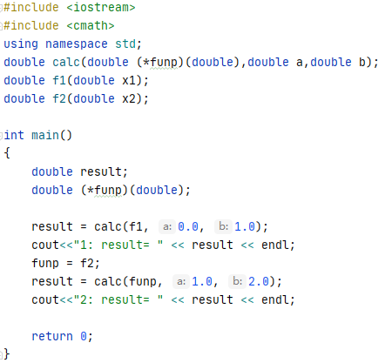
Example:
Compute the definite integral, suppose
calculate the following definite integrals
function pointer as a parameter
Declaring a function pointer
Calling the function by function name
Assigning the address of function f2 to the pointer
Calling the function by function pointer

Slide 14
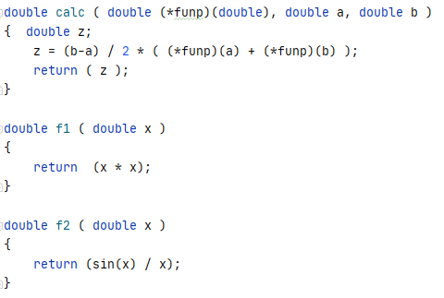

Output:

Slide 15
qsort() in general utilities library stdlib.h
The quick sort method is one of the most effective sorting algorithms. qsort() function sorts an array of data object.
void qsort(void *base, size_t nmemb, size_t size, int(*compar)(const void *, const void *));
void *base: pointer to the beginning of the array to be sorted, it permits any data pointer type to be typecast to a pointer-to-void.
size_t nmemb: number of items to be sorted.
size_t size: the size of the data object, for example, if you want to sort an array of double, you would sizeof(double).
int (*compar)(const void *, const void *): a pointer to a function that returns an int and take two arguments, each of which is a pointer to type const void. These two pointers point to the items being compared.

Slide 16
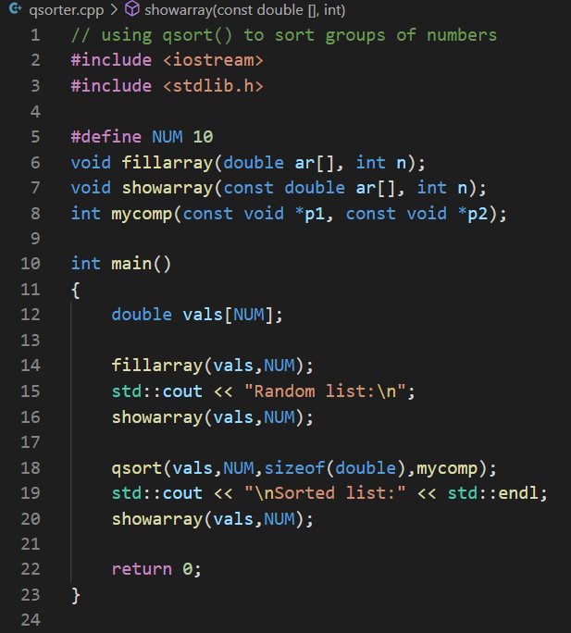
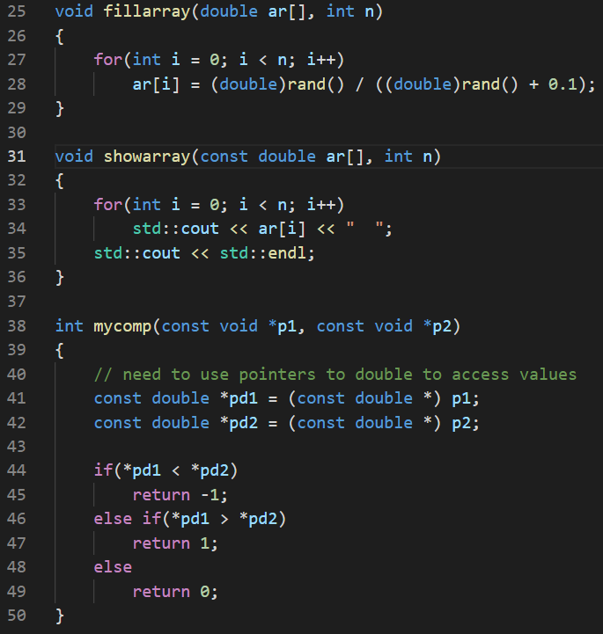
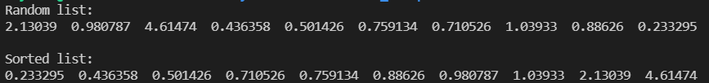
convert void pointer to the pointer of proper type
give the sorting rule

Slide 17
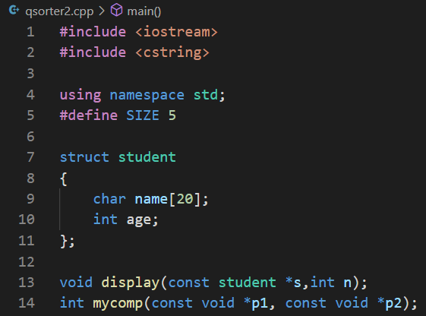
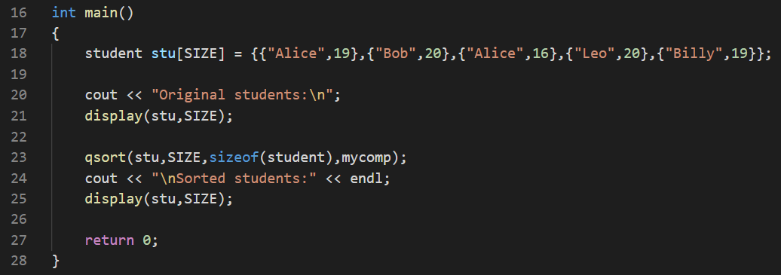
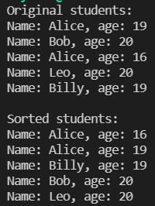
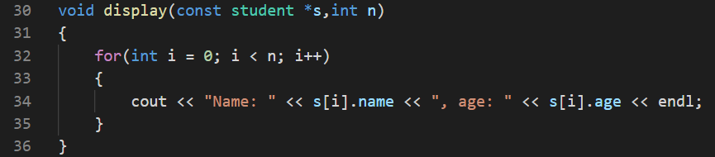

Slide 18
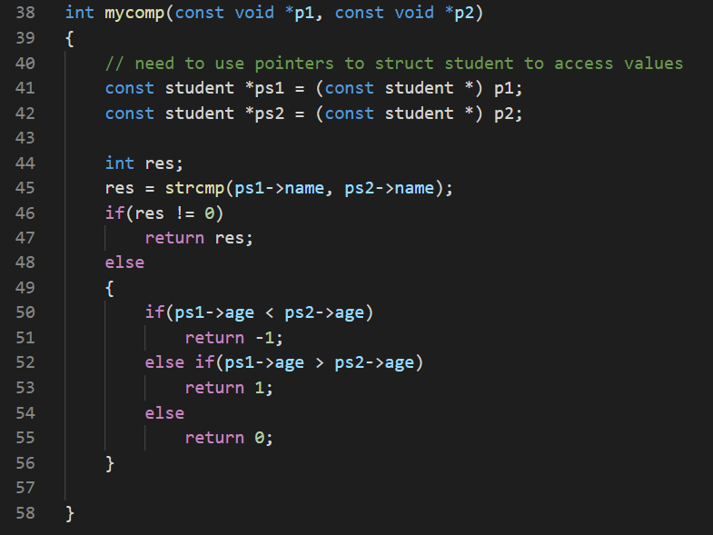
If the name is the same, sort by age

Slide 19

Exercise 1
Define a default arguments function to display a square of any character.
void displaySquare(int side, char filledCharacter);
For example, if side is 5, filledCharacter is ‘#’, the function displays as follows:
In default case, side is 4, filledCharacter is ‘*’.
Write a test program to call the displaySquare function using default arguments and non-default arguments respectively and show the result.

Slide 20
Exercise 2
Overload a function int vabs(int * p, int n) which can calculate the sum of the absolute values of the elements in an array, the array can be int, float and double.
Should n be int or size_t? what's the difference?

Slide 21
Exercise 3
Write a program that uses a function template called minimum to determine the smaller of two arguments. Test the program using integer, character and floating-point number arguments.

