Slide 1
C/C++ Program Design
Lab 9, Class
廖琪梅，王大兴

Slide 2
Class
Define and implement a Class
Class constructor and destructor
const member variables and const member functions
Static member variables and static member functions
this pointer

Slide 3
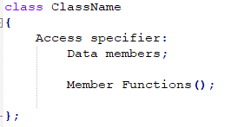
Define and implement a class
The class name serves as a type name in the same way as the built-in type names such as int and double.
Define a class
keyword
class name
private/public/protected
member variables declaration
member functions declaration
end of class with a semicolon

Slide 4
Define and implement a class
The private keyword makes members private. Private members can be accessed only inside the same class. We usually make data private to prevent them from being modified outside the class. This is known as data encapsulation (data hiding).
The public keyword makes members public. Public members can be accessed out of the class. We usually make functions public for accessing outside the class.
Note: Private is the default access specifier for a class in C++. This means that if no access specifier is specified for the members in a class, then it is considered private.
A private data field cannot be accessed by an object from outside the class. To make a private data field accessible, provide a getter method to return its value. To enable a private data field to be updated, provide a setter method to set a new value.

Slide 5
Class Constructors and Destructors
A class constructor is a special member function:
1. Has exact same name as the class
2. No return value
3. It is a public member function of the class
4. Invoked whenever you create objects of that class
Constructors can be very useful for setting initial values for certain member variables.
If you do not provide a constructor, C++ compiler generates a default constructor (has no parameters and an empty body) for you.
Note:The constructor can be overloaded, be careful the constructor with default arguments.

Slide 6
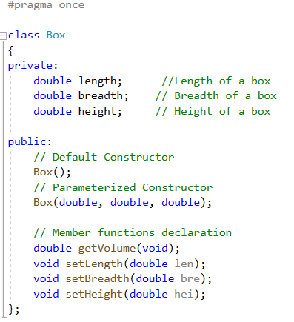
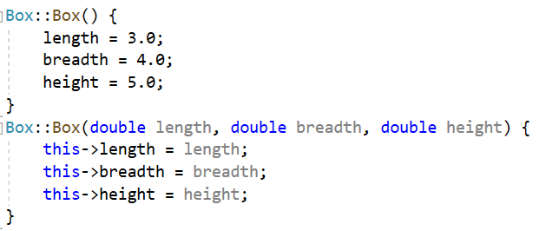
Implementation of functions using the scope resolution operator(::)
“this” is a pointer points to the object itself

Slide 7
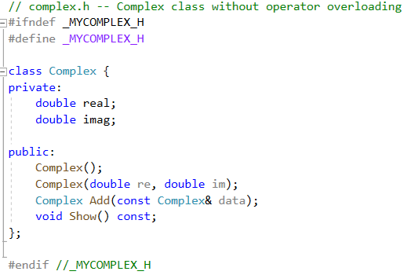
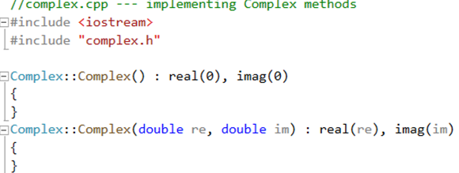
initialization list
The member initialization list is set off from the parameter list by a colon. It is a comma-separated list in which the value to be assigned the member is placed in parentheses following the member's name.
The member initialization list is used primarily to pass arguments to member class object constructors.

Slide 8
Default constructor
A default constructor is a constructor that is used to create an object when you don’t provide
explicit initialization values. If you don not provide any constructors, the compiler will automatically
supplies a default constructor. It’s an implicit version of a default constructor, and it does nothing.
There is only one default constructor in a class.
If you define any constructor for a class, the compiler will not provide default constructor. You must define your own default constructor that takes no arguments.
You can define a default constructor two ways. One is to provide default values for all the arguments to the existing constructor:
Box(double len = 1.0, double bre = 1.0, double hei = 1.0);
The second is to use function overloading to define a second constructor that has no arguments:
Box( );
NOTE: You can have only one default constructor, so be sure that you don’t do both.

Slide 9


Creating objects
When you create an object, the constructor will be invoked automatically. If you define default constructor, you can declare object variables without initializing them explicitly.
You shouldn’t be misled by implicit form of the nondefault constructor.
second() is a function that returns a Box object.
When you implicitly call the default constructor, do not use parentheses.

Slide 10
Destructors
A class destructor is also a special member function:
1.A destructor name is the same as the classname but begins with tilde(~) sign.
2. Destructor has no return value.
3. A destructor has no arguments.
4. There can be only one destructor in a class.
5. The compiler always creates a default destructor if you fail to provide one for a class.
6. Invoke when an object goes out of scope or the delete is applied to a pointer to the object.
Destructor can be very useful for releasing resource before coming out of the program like closing files, releasing memories etc.
Note:The destructor can not be overloaded.

Slide 11
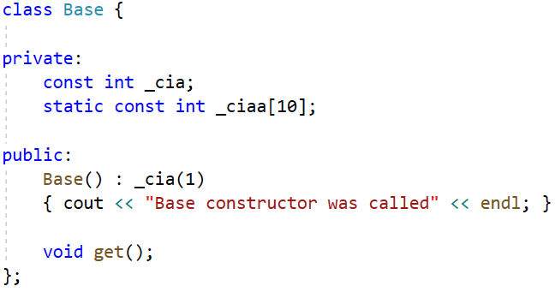
const member variables and member functions
If some member variables need not be modified, these variables can be defined as const. These const member variables can be initialized by initialization list.
const member variable
Initialize the const member variable by initialization list
Initialize the static const array outside the class definition

Slide 12
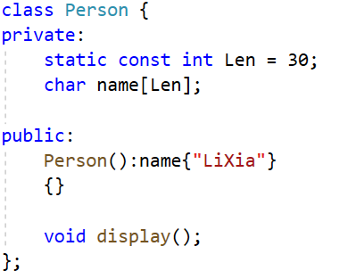
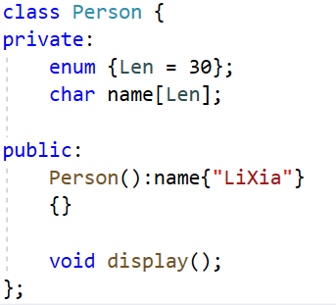
const member variables and member functions
static const member variable can be initialized when it is defined
Define an enumeration

Slide 13
const member variables and member functions
The const modifier follows the parameter list of the function, such function is called const member function. const indicates that the data of the class would not be modified by the function.
A const member function defined outside the class body must specify the const modifier in both its declaration and definition.

Slide 14

const member variables and member functions

Slide 15
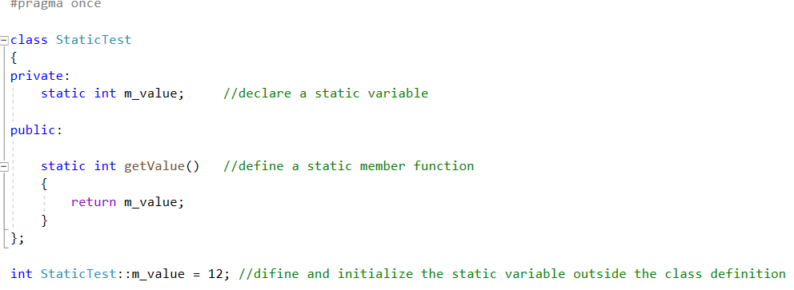
static member variables and member functions
A static data member represents a single, shared instance of that member that is accessible to all the objects of that class.
You must provide an explicit definition of that instance within a program text file. The definition looks like the global definition of an object except that its name is qualified with the class scope operator: :
static member variable can not be initialized when it is defined
static member variable must be initialized outside the class definition

Slide 16
static member variables and member functions
A static member function can be invoked independently of a class object in exactly this way. A member function can be declared as static only if it does not access any nonstatic class members. We make it static by prefacing its declaration within the class definition with the keyword static
Define a static member function

Slide 17
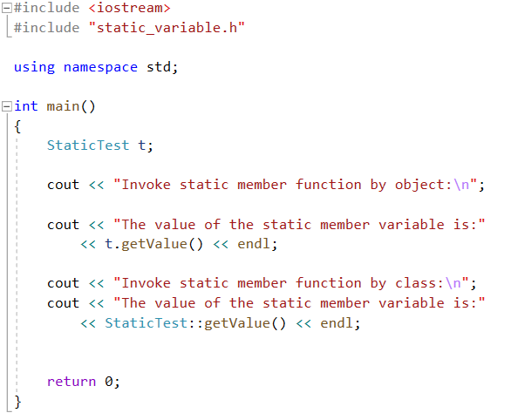
You can use object or class to access the static members.

Slide 18
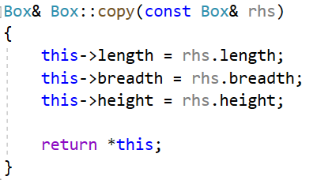
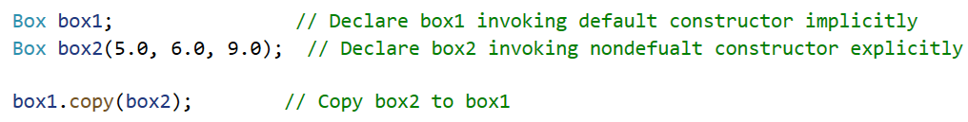
this pointer
There’s only one copy of each class’s functionality, but there can be many objects
of a class. Every object has access to its own address through a pointer called this.
The this pointer is passed(by the compiler) as an implicit argument to each of the
object’s non-static member functions.
Within a member function, the this pointer addresses the class object that invokes the member function. In our example, box1 is addressed by the this pointer.
Inside a class member function, the this pointer provides access to the class object through which the member function is invoked. To return box1 from within copy(), we simply dereference the this pointer.

Slide 19
Exercise:
Create a class called Complex for performing arithmetic with complex numbers. Write a program to test your class. Complex numbers have the form
realPart + imaginaryPart * i
Use two member variables to represent the private data of the class. Provide a constructor that enables an object of this class to be initialized when it’s declared. The constructor should contain default values in case no initializers are provided. Provide public member functions that perform the following tasks:

Slide 20
Exercise:
a) add—Adds two Complex numbers: The real parts are added together and the imaginary parts are added together.
b) subtract—Subtracts two Complex numbers: The real part of the right operand is subtracted from the real part of the left operand, and the imaginary part of the right operand is subtracted from the imaginary part of the left operand.
c) display—Displays a Complex number in the form of a + bi or a - bi, where a is the real part and b is the imaginary part.
Tip: If a member function does not modify the member variables, define it as
const member function.

