Slide 1
C/C++ Program Design
Lab 11, dynamic memory in classes
廖琪梅，王大兴

Slide 2
Dynamic memory in classes
Constructor and destructor
Copy constructor
Assignment operator
Return objects
Pointers to objects
Smart pointers

Slide 3
Constructor and Destructor
To define a class containing a pointer member, you should think more carefully about
four things: constructor, destructor, copy constructor and assignment operator.
In constructor, first, use new to allocate enough memory to hold the data where the
pointer points to. Second, initialize the storage space with proper data.
In destructor, release the memory using delete.

Slide 4
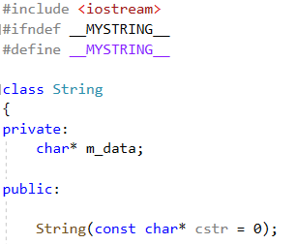
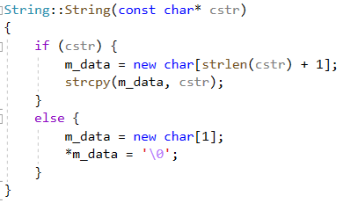
There is a pointer-to-char member in the class declaration, which means that the class declaration does not allocate storage space of the string itself. Instead, it uses new in the constructor to allocate space for the string. The constructor must allocate enough memory to hold the string, and then it must copy the string to that location.

Slide 5
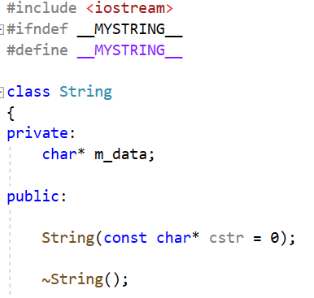

The destructor must delete the member points to memory allocated with new. When the String object expires, the m_data pointer expires. But the memory m_data pointed to remains allocated unless you use delete to free it.
Note：use new[] to allocate memory, use delete[] to free the memory.

Slide 6
Copy Constructor
A copy constructor is used to copy an object to a newly created object. It is used during initialization. A copy constructor for a class normally has this prototype:
Class_name (const Class_name & );
It takes a constant reference to a class object as its argument.
The default copy constructor performs a member-by-member(memberwise) copy of the non-static members (memberwise copying, also sometimes called shallow copying). Each member is copied by value.

Slide 7
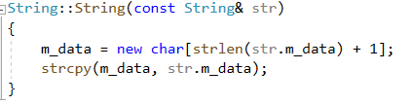
If a class member contains a pointer, the default copy constructor performs a member-by-member copy and copies by value. This means it just copies pointer, the two pointers points to the same object.
You should provide an explicit copy constructor and copy the data to the member. This is called deep copy.
What makes defining the copy constructor necessary is the fact that some class members are new-initialized pointers to data rather than the data themselves.

Slide 8
A copy constructor is usually called in the following situations:
1. When a class object is returned by value.
2. When an object is passed to a function as an argument and is passed by value.
3. When an object is constructed from another object of the same class.
4. When a temporary object is generated by the compiler.
The following four definitions(constructing an object from another object) invoke a copy constructor:
Complex c1 (c2);
Complex c3 = c1;
Complex c4 = Complex(c1);
Complex *pc = new Complex(c1);
This statement initializes a anonymous object to c1 and assigns the address of the new object t the pc pointer.

Slide 9
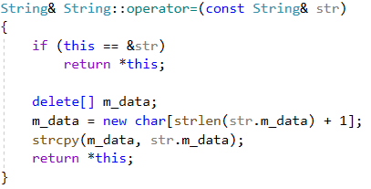
Assignment Operator
An implicit assignment operator(=) performs a memberwise(member-to-member) copy.
You should provide an explicit assignment operator definition to make a deep copy. The implementations is similar to that of the copy constructor, but there are some differences:
Because the target object may already refer to previously allocated data, the function should use delete [] to free former obligations.
The function should protect against assigning an object to itself; otherwise, the freeing of memory described previously could erase the object’s contents before they are reassigned.
The function returns a reference to the invoking object.
object assigned to itself
free old string
get space for new string
copy the string
return reference to invoking object

Slide 10
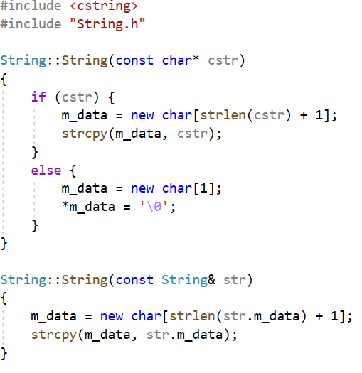
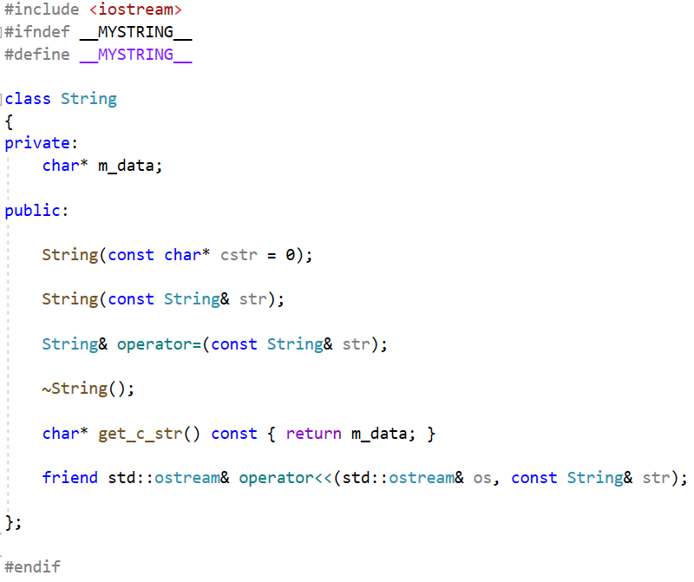
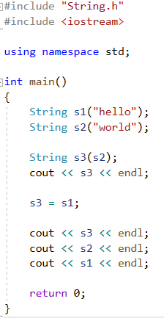
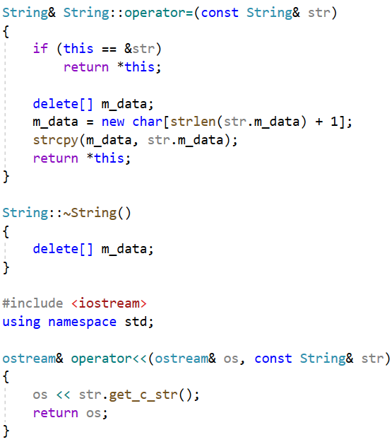

Slide 11
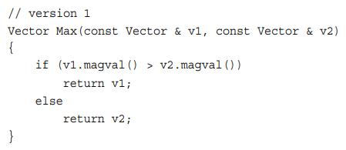
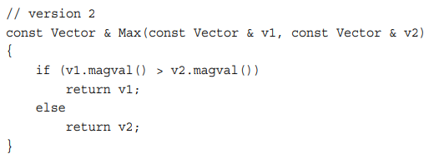
Return object
When a member function or standard function returns an object, you have choices. The function could return a reference to an object, a constant reference to an object, an object, or a constant object.
1. Returning a reference to a const object
For example, suppose you wanted to write a function Max() that returned the larger of two Vector object.
Returning an object invokes the copy constructor, whereas returning a reference doesn’t.
The reference should be to an object that exists when the calling function is executing.

Slide 12
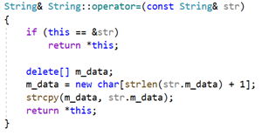

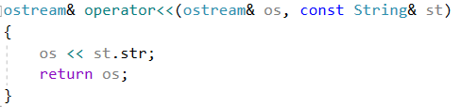

2. Returning a reference to non-const object
Two common examples of returning a non-const object are overloading the assignment operator
and overloading the << operator for use with cout. The first is done for reasons of efficiency, and
the second for reasons of necessity.
The return value of operator=() is used for chained assignment.
Returning a reference allows the function to avoid calling the String copy
constructor to create a new String object. In this case, the return type is
not const because the operator=() method return a reference to s2, which
it does modify.
The return type has to be ostream &
and not just ostream. The ostream class
does not have a public copy constructor.
The return value of operator<<() is used for chained output.

Slide 13
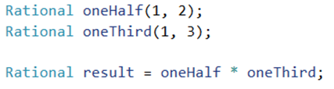

3. Returning an object
If the object being returned is local to the called function, then it should not be returned by reference
because the local object has its destructor called when the function terminates. Thus, when control
return to the calling function, there is no object left to which the reference can refer.
The statement invokes the Rational constructor to create a temporary Rational
object and returns the object to the caller. The function shouldn’t return a
reference to a temporary object, it should return an actual Rational object,
so the return type is object not reference.
There is the added expense of calling the copy constructor to create the returned object, but that is
unavoidable.

Slide 14

4. Returning an const object
The definition of Rational::operator*() allows these two usage as follows:
The expression oneHalf * oneThird stands for the temporary object which the copy constructor constructs.
In the statement 1, the temporary object is assigned to result, but in statement 2, the multiple of oneHalf and
oneThird is assigned to an temporary object. This causes misuse.
Declare the return type as a const object. Then statement 1 is still allowed but the statement 2
becomes invalid.

Slide 15
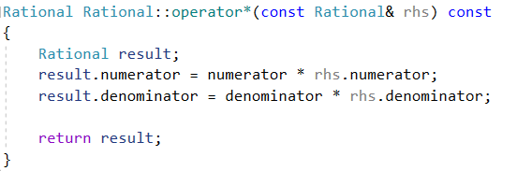
Don’t try to return a reference when you must return an object.
The return type is an object not a reference.
Don’t return a reference that refers to a local object.

Slide 16
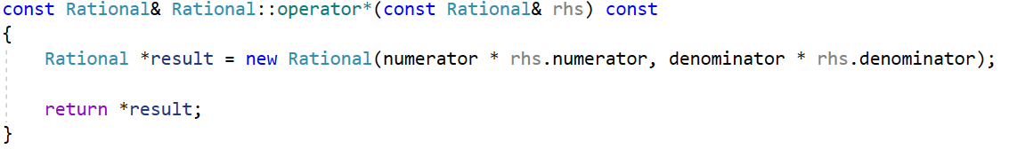
Don’t try to return a reference when you must return an object.
The return type is a reference.
Through the use of new, a heap-based object is constructed.
You can return a reference to that.
Remember, release the memory in the caller. But in some cases, you can not release any memory
and cause memory leak.
There are two calls to operator* in the same statement, hence two uses of new that need to be undone with uses of delete. Yet there is no reasonable way to do that.

Slide 17
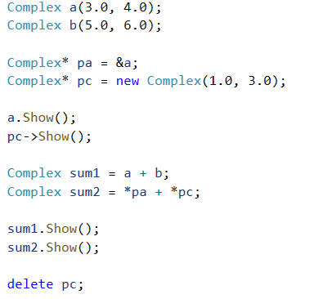
Using Pointers to Objects
A pointer can point to not only build-in types but also objects.
A Complex pointer is initialized by an existing object
A Complex pointer is initialized by a dynamic memory using new operator
Call a member function by -> operator
Access a Complex object by dereferencing operator(*)
Release the memory using delete operator

Slide 18
Smart pointers
To make using dynamic memory easier (and safer), the new library provides two
smart pointer types(unique_ptr and shared_ptr) that manage dynamic objects.
A smart pointer acts like a regular pointer with the important exception that it
automatically deletes the object to which it points. A smart pointer is a class
template defined in the std namespace in the <memory> header file.

Slide 19
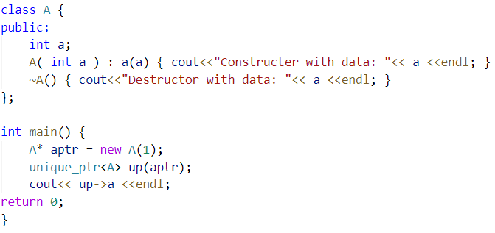

Unique pointer
C++ provides unique pointers to help manage your dynamic memory.
A unique pointer object take ownership of a pointer.
When the unique pointer is deleted, the memory is freed too.
You can initialize it with a raw pointer.

Slide 20
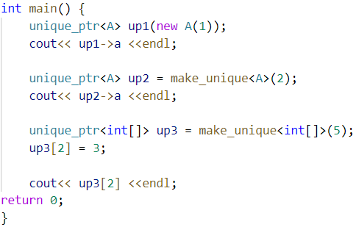
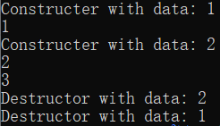
Unique pointer
There are several ways to use a unique pointer:

Slide 21
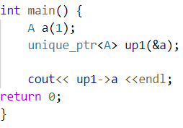
Unique pointer
Does smart pointers always solve our problems?
Can we do this?

Slide 22
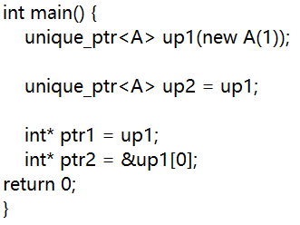
Unique pointer
Try the following code:

Slide 23
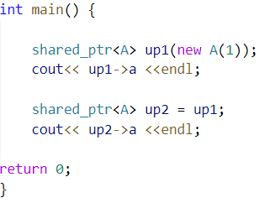

Shared pointer
C++ provides shared pointer to help manage your dynamic memory.
You can make several shared pointers points to one piece of memory.
If the last one of them is released, the dynamic memory is released.

Slide 24
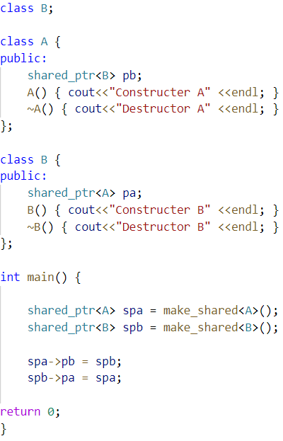
Shared pointer
Does shared pointer always releases memory?
Can we do this?

Slide 25
Exercise:
Create a class for matrices which elements are in float. The class should support the follow operations and has no memory management problem. When a matrix is assigned to another by =, the two matrices will share the same data.
class Matrix{...};
Matrix a(3,4);
Matrix b(3,4);
Matrix c = a + b;
Matrix d = a * 2.0f;

