Slide 1
C/C++ Program Design
Lab 12, class inheritance
廖琪梅，王大兴

Slide 2
Class inheritance
Class inheritance
Static binding and dynamic binding
Polymorphism (virtual function)
Inheritance and dynamic memory allocation

Slide 3
Class inheritance
Inheritance is one of the most important feature of object-oriented programming. Inheritance allows us to define a class in terms of another class, which makes it easier to maintain an application. This also provides an opportunity to reuse the code functionality and fast implementation time.
The existing class is called the base class, and the new class is called the derived class.
Every derived-class object is an object of its base class, represents an is-a relationship.

Slide 4
Class inheritance
Inheritance syntax:
class derived_class_name : access_mode base_class_name
{
// body of subclass
};
Subclass,Derived class, Child class
public, protected, private
Base class, Super class, Parent class
The derived class consists of two parts:
The subobject of its base class (consisting of the non-static base class data members)
The derived class portion (consisting of the non-static derived class data members)

Slide 5
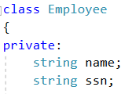

base class
base-class constructor, initialize all non-static base class members
member initialization list
base class data members
derived class
passing arguments from the derived-class
constructor to the base-class constructor
initialize derived class
non-static data member
derived class data member
invoke base-class constructor
derived-class constructor, invoke base class constructor and initialize its own non-static data members
derived-class copy constructor
invoke the base-class copy constructor
The base class didn’t define a copy constructor, but the compiler automatically generates a copy constructor which does memberwise copying. That’s fine, because of no dynamic memory allocation.

Slide 6
NOTE：
Initialization list can be used only with constructors.
You must use initialization list to initialize a reference data member.
Data members are initialized in the order in which they appear in the class declaration, not in the order in which initializers are listed.
It’s more efficient to use the member initialization list for members that are themselves class objects.

Slide 7
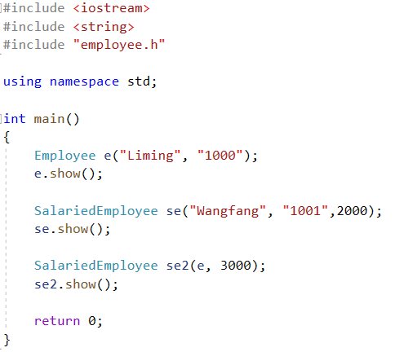

create a base class object, invoking the base class constructor
create a derived class object, invoking base class constructor
and then invoking derived class constructor
create a derived class object, invoking base class copy constructor and then
invoking derived class copy constructor
Note: No destructor is defined in the base or derived class, the compiler will provide one without doing anything.

Slide 8
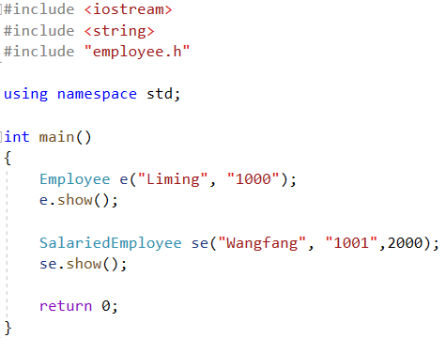
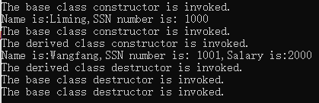
Note：When creating an object of a derived class, a program first calls the base-class
constructor and then calls the derived-class constructor. When an object of a derived
expires, the program first calls the derived-class destructor and then calls the base-class
destructor. That is, destroying an object occurs in the opposite order used to constructor
an object.
When you define destructor in base and derived class, they
are invoked when the objects expire.

Slide 9
Special relationships between derived and base classes
1. A derived-class object can use base-class methods, provided that the methods are not private.
2. A base-class pointer can point to a derived-class object without an explicit type cast and a
base-class reference can refer to a derived-class object without an explicit type cast.
3. Functions defined with base-class reference or pointer arguments can be used with either base-class
or derived-class object.

Slide 10
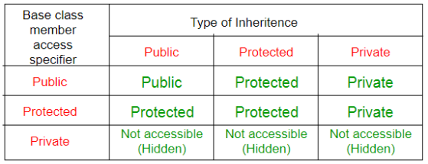
The below table shows the access specifier of the members of base class in the sub class when derived in public, protected and private modes:
In a base class definition, if a member declared as protected can be directly accessed by the derived classes but cannot be directly accessed by the general program.

Slide 11
Static Binding vs Dynamic Binding
For non-virtual function, the compiler selects the function that will be invoked at compiled-time(known as static binding).
The function selected depends on the actual type that invokes the function(known as dynamic binding or late binding).
Dynamic binding in C++ is associated with methods invoked by pointers and references, and this is governed, in part, by the inheritance process.

Slide 12
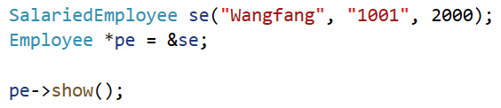
If show() is not declared as virtual in the base class, pe->show() goes by the pointer type(Employee *) and invokes Employee::show(). The pointer type is known at compile time, so the compiler can bind show() to Employee::show() at compile time. In short, the compiler uses static binding for non-virtual method.
If show() is declared as virtual in the base class, pe->show() goes by the object type(SalariedEmployee) and invokes SalariedEmployee::show(). The object type might only be determined when the program is running. Therefore, the compiler generates code that binds show() to Employee::show() or SalariedEmployee::show(), depending on the object type, while the program executes. In short, the compiler uses dynamic binding for
virtual methods.

Slide 13
Polymorphism
Polymorphism is one of the most important feature of object-oriented programming. Polymorphism works on object pointers and references using so-called dynamic binding at run-time. It does not work on regular objects, which uses static binding during the compile-time.
There are two key mechanisms for implementing polymorphic public inheritance:
1. Redefining base-class methods in a derived class
2. Using virtual methods

Slide 14
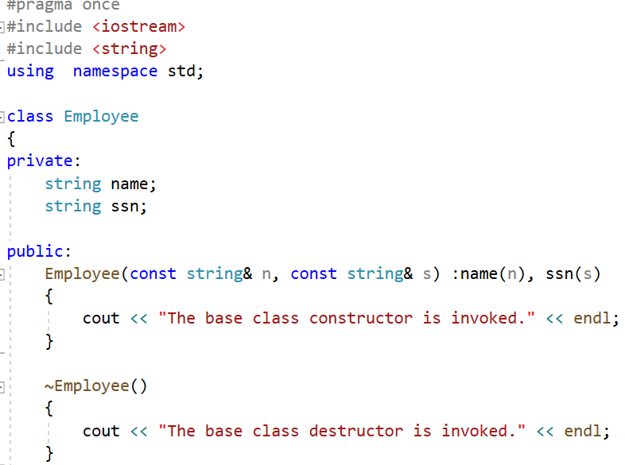
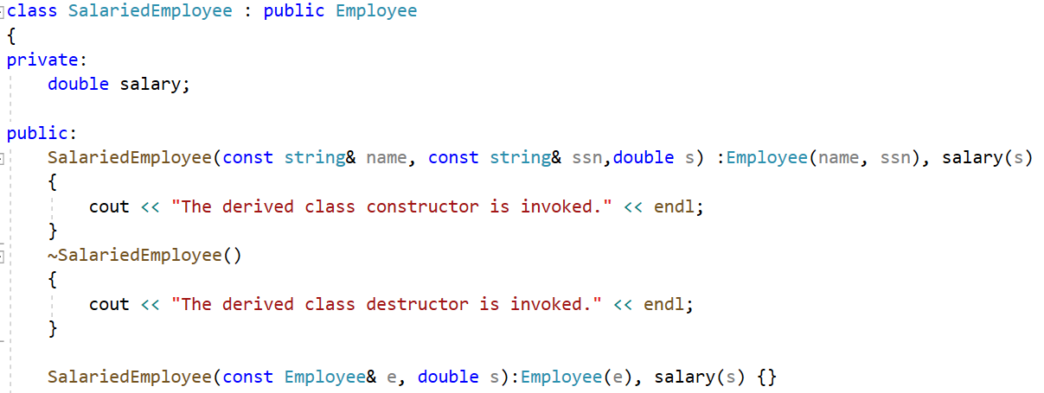
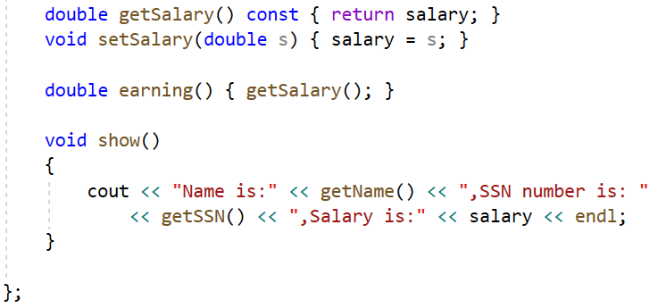
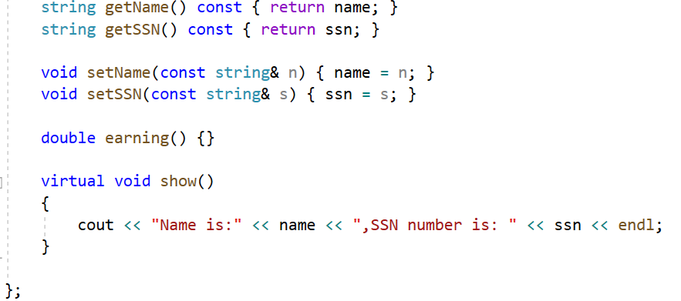
derived class
base class
if the access specifier is protected,
the derived class can access the data
override the function show() in SalariedEmployee
invoke base class method in derived class to get the name and snn
If you use the keyword virtual, the program choose a method based on the type of
object the reference or pointer refers to rather than based on the reference type or
pointer type.

Slide 15
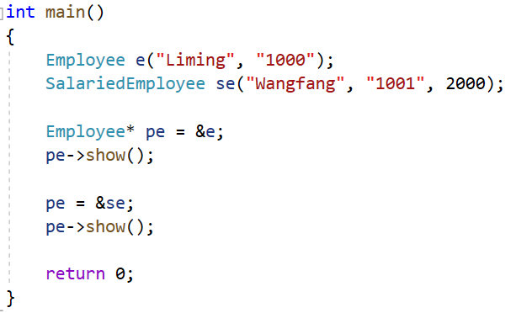
The pointer type of pe is Employee, it points to a different object respectively,
and invokes different objects’ show() functions. This is polymorphism.

Slide 16
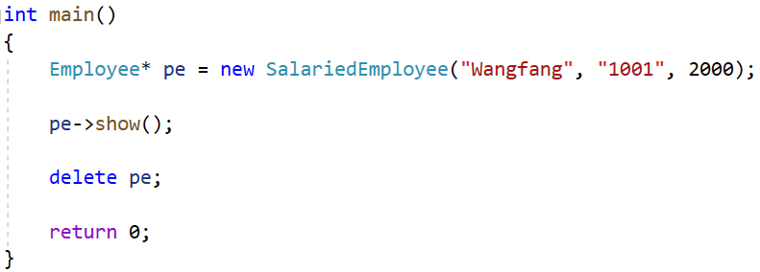

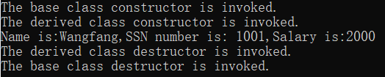
Destructors
If the destructors is not virtual, the delete statement invokes the ~Employee() destructor.
This frees memory pointed to by the Employee component of the SalariedEmployee object
not memory pointed to by SalariedEmployee component.
If the destructor is virtual, the same code invokes the ~SalariedEmployee() destructor, which frees memory pointed to by the SalariedEmployee component, and then calls the ~Employee() destructor to free memory pointed to by the Employee component.

Slide 17
Inheritance and Dynamic Memory Allocation
If a base class uses dynamic memory allocation and redefines assignment operator and a copy constructor, how does that affect the implementation of the derived class? The answer depends on the nature of the derived class.
If the derived class does not itself use dynamic memory allocation, you needn’t
take any special steps.
If the derived class does use new to allocate memory, you do have to define an explicit destructor, copy constructor, and assignment operator for the derived class.

Slide 18
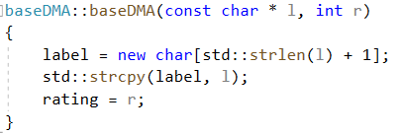
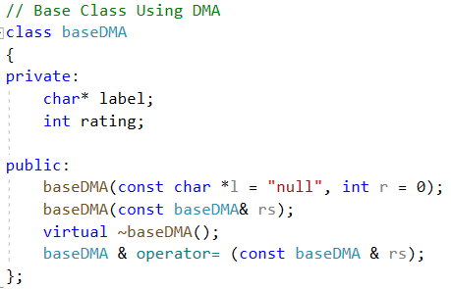
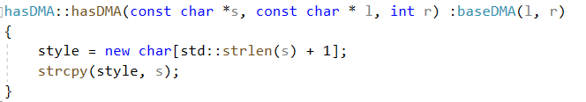
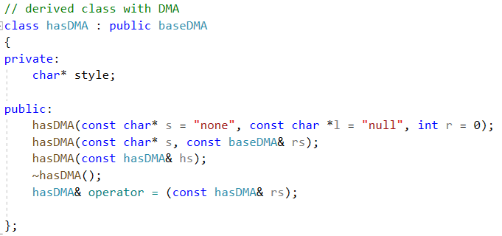


base class constructor
base class
derived class constructor
derived class
The data fields both in the base class
and the derived class hold pointers,
which indicate they would use dynamic
memory allocation.
A derived class destructor automatically calls the base-class destructor, so its own responsibility is to clean up after what the derived-class destructors do.

Slide 19
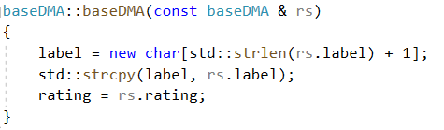
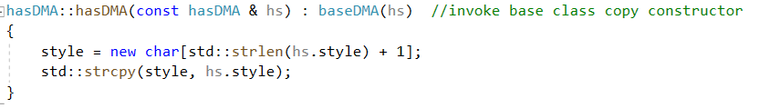
Consider copy constructor:
the base-class baseDMA copy constructor
The derived class hasDMA copy constructor only has accesse to
hasDMA data, so it must invoke the baseDMA copy constructor
to handle the baseDMA share of the data.
The member initialization list passes a hasDMA reference to a baseDMA constructor.
The baseDMA copy constructor has a baseDMA reference parameter, and a base class reference
can refer to a derived type. Thus, the baseDMA copy constructor uses the baseDMA portion of the
hasDMA argument to constructor the baseDMA portion of the new object.

Slide 20
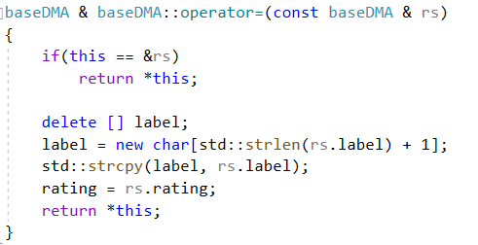
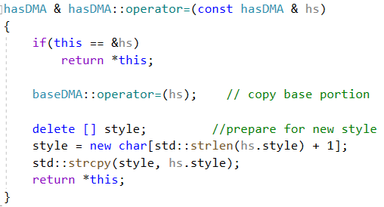
Consider assignment operators:
the base-class baseDMA assignment operator
Because hasDMA uses dynamic memory allocation,
it needs an explicit assignment operator. Being a
hasDMA method, it only has direct access to hasDMA
data.
An explicit assignment operator for a derived class also has to take care of assignment for the
inherited base class baseDMA object. You can accomplish this by explicitly calling the base class
assignment operator.

Slide 21
Exercise:
1. Design a stereo graphic class (CStereoShape class), and meet the following requirements:
A virtual function GetArea, which can get the surface area of the stereo graphic. Here we let it print out CStereoShape::GetArea() and return a value of 0.0, which means that CStereoShape’s GetArea is called.
A virtual function GetVolume, which can get the volume of the stereo graphic. Here we let it print out CStereoShape::GetVolume() and return a value of 0.0, which means that CStereoShape’s GetVolume is called.
A virtual function Show, which print out the description of the stereo graphics. But here we let it print out CStereoShape::Show(), which means that show of CStereoShape is invoked.
A static private integer variable named numberOfObject, whose initial value is 0, which denotes the number of Stereo graphics generated by our program.
A method named GetNumOfObject() that returns the value of numberOfObject.
Add constructor functions based on requirement.

Slide 22
2. Design a cube class (CCube class), which inherits the CStereoShape and meets the following requirements:
A no-arg constructor that creates a default Cube.
A constructor with parameters whose parameters correspond to the length, width, and height of the cube, respectively.
A copy constructor that creates a Cube object with the specified object of Cube.
Override GetArea, GetVolume of the CStereoShape class to complete the calculation of the surface area and volume of the cube, respectively.
Override Show() of the CStereoShape class to print out the description (includes length, width, height, the surface area and volume) for the Cube object.

Slide 23
3. Design a sphere class (CSphere class), which inherits the CStereoShape and meets the following requirements:
A no-arg constructor that creates a default Sphere.
A constructor with parameters whose parameters correspond to the radius of the Sphere.
A copy constructor that creates a Sphere object with the specified object of Sphere.
Override GetArea, GetVolume of the CStereoShape class to complete the calculation of the surface area and volume of the sphere, respectively.
Override Show() of the CStereoShape class to print out the description (includes radius, the surface area and volume) for the Sphere object.

Slide 24
4. Write a test program and complete at least the following tasks in the main functions:
Create a Ccube object named a_cube, which the length, width and height are 4.0, 5.0, 6.0 respectively.
Create a CSphere object named c_sphere, which radius is 7.9.
Define the CStereoShape pointer p, point p to a_cube, and then print the information of a_cube to the terminal by p.
Point p to c_sphere, then print the information of c_sphere to the terminal by p.
Points out the number of Stereo graphics created by the test program.
Note that you may need to use the “setf( )” and “precision( )” formatting methods to set output mode.
Output sample:

