Slide 1
C/C++ Program Design
Lab 2, data types and arithmetic operators
王大兴，廖琪梅，于仕琪

Slide 2
Data types and arithmetic operators
Commonly used data types (integers, floats, ...).
Overflow
Test integer range
Conversion between char and integer
Test float number precision

Slide 3
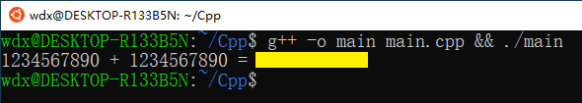
Commonly used data types: integer
Declaring integers and doing simple arithmetic operations:
#include <iostream>
using std::cout;
using std::endl;
int main() {
int a = 1234567890;
int b = 1234567890;
int sum = a+b;
cout<<a<<" + "<<b<<" = "<<sum<<endl;
return 0;
}
Run the following command in your terminal and see what happens:

Slide 4

Commonly used data types: float
Declaring floating point numbers and doing simple arithmetic operations:
#include <iostream>
using std::cout;
using std::endl;
int main() {
float a = 1234567.0;
float b = 1.0;
float sum = a+b;
cout<<a<<" + "<<b<<" = "<<sum<<endl;
return 0;
}
Run the following command in your terminal and see what happens:

Slide 5
Integer overflow
Integers are stored in memory as a few number of bytes.
The range of integers that can be properly represented is limited.
Calculating numbers outside this range causes errors.

Slide 6

Conversion between char and integer
The character type of c++ is char. Char and int can be converted.
Characters are a type of integers in memory.
#include <cstdio>
int main() {
char c = 'C';
int i = c;
printf("Convert '%c' to integer: %d\n", c, i );
return 0;
}
Run the following command in your terminal and see what happens:

Slide 7
Conversion between char and integer
You already know the integer value of character ‘C’, but why?
ASCII table.

Slide 8

Floating point precision
The range of floating point numbers is also limited.
Floating point numbers also have precision problems.
#include <iostream>
using std::cout;
using std::endl;
int main() {
float a = 0.1f;
float sum = a+a+a+a+a+a+a+a+a+a;
cout<<"sum: "<<sum<<endl;
cout<<"sum equals to 1? "<<(sum==1.0)<<endl;
return 0;
}
Try the code on the left to see what happens.
Note that (sum==1.0) is a bool value, 1 means “true” and 0 means “false”.

Slide 9
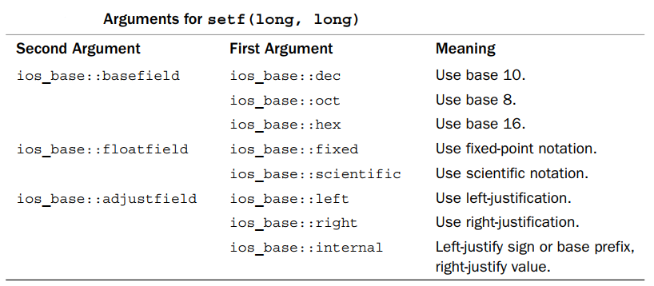
C++ provides two methods to control the output formats
Using member functions of ios class
Using iomanip manipulators
Using member functions of ios class
1. cout.setf( fmtflags, fmtflags)

Slide 10
Using member functions of ios class
2. cout.width(len) //set the field width
3. cout.fill(ch) // fill character to be used with justified field
4. cout.precision(p) // set the precision of floating-point numbers

Slide 11
Using iomanip manipulators
#include <iomanip>
1. setw(p)
2. setfill(ch)
3. setprecision(d)

Slide 12
cout.unsetf( )

Slide 13
1. sizeof operator returns the size, int bytes, of a type or a variable.
Exercises
Compile the following program, what are the warnings? How to correct them?
#include <stdio.h>
#include <stdbool.h>
int main()
{
printf("\nPrint size of the fundamental types:\n");
printf("-----------------------------------------\n");
printf("The sizeof(char) is: %d bytes.\n", sizeof(char));
printf("The sizeof(short) is: %d bytes.\n", sizeof(short));
printf("The sizeof(int) is: %d bytes.\n", sizeof(int));
printf("The sizeof(long) is: %d bytes.\n", sizeof(long));
printf("The sizeof(long long) is: %d bytes.\n", sizeof(long long));
printf("The sizeof(float) is: %d bytes.\n", sizeof(float));
printf("The sizeof(double) is: %d bytes.\n", sizeof(double));
printf("The sizeof(long double) is: %d bytes.\n", sizeof(long double));
printf("The sizeof(bool) is: %d byte.\n", sizeof(bool));
return 0;
}

Slide 14
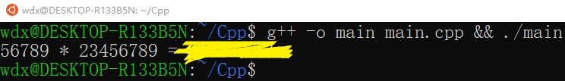
2. Write a program to calculate integer multiplication: 56789 x 23456789, and then print the result. Find a method to get the correct answer if there is something wrong.
Exercises

Slide 15
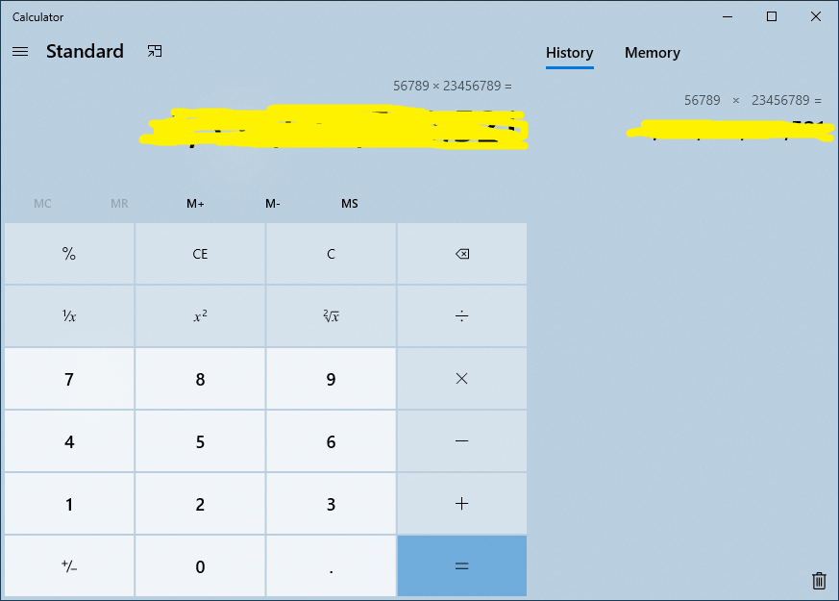
Verify the result using a calculator.
Congratulations if you get the right result!
If the result is wrong, what could be the reason?

Slide 16
3. Try conversions between char and int
Exercises
Choose some integers you like. Convert then to chars and print them.
Or you can choose some chars and convert them to int.
There are some special characters in the table, try some of them!
https://www.tutorialspoint.com/html/ascii_table_lookup.htm

Slide 17
Exercises
4. Run the following source code and find why the variable f2 is not 1.
void printFloat(float num)
{
int inum = *(int*)&num;
for (int i = 0; i < 32; ++i) {
cout << ((inum&0x80000000) ? 1 : 0);
if (i == 0 || i == 8)
cout << " ";
inum <<= 1;
}
cout << endl;
}
int main()
{
float f1 = 1.0;
cout<<"f1 = "<<f1<<endl;
cout<<"The binary presentaion of f1"<<" is:"<<endl;
printFloat(f1);
cout<<endl;
float a = 0.1f;
float f2 = a+a+a+a+a+a+a+a+a+a;
cout<<"f2 = "<<f2<<endl;
cout<<"The binary presentaion of f2"<<" is:"<<endl;
printFloat(f2);
cout<<endl;
return 0;
}

