Slide 1
C/C++ Program Design
Lab 4, Compound Types
廖琪梅, 王大兴, 于仕琪

Slide 2
Compound Types
Array, C-style string, string, structure, enumeration
Input and output
cmake

Slide 3
Array
Arrays are fixed-size collections consisting of data items of the same type.
The index of an array is from 0.
C++ compiler does not report whether the array is out-off-bounds.

Slide 4

Array
#include <iostream>
using std::cin;
using std::cout;
using std::endl;
int main() {
int arr[10];
arr[0] = 0;
arr[1] = 1;
// print the first element in arr
cout<<arr[0]<<endl;
// this is wrong:
// cout<<arr[10]<<endl;
return 0;
}

Slide 5
C-style string and string
C-style string is an array of characters whose last character must be a null character denoted as \0.
string is a class of C++, it can be used as a type.

Slide 6
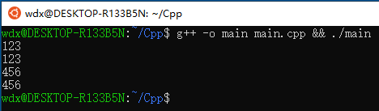
C-style string and string
#include <iostream>
#include <string>
using namespace std;
int main() {
// This is c-string
char str1[100];
cin>>str1;
cout<<str1<<endl;
// This is string
string str2;
cin>>str2;
cout<<str2<<endl;
return 0;
}

Slide 7
Structure
Structure is a collection which can hold items of more than one data type.
A structure is a user-definable type, first declare a structure and then define a variable of the structure.
Use membership operator(.) to access the member of a structure.
If the structure variables are from the same structure, assignment operation of them can be done by equal sign(=).
Arrays of structures are the arrays whose elements are structures.

Slide 8

Structure
#include <iostream>
using namespace std;
struct Rectangle {
int width;
int height;
};
int main() {
Rectangle rec;
rec.width = 1;
rec.height = 2;
cout<<rec.width<<" "<<rec.height<<endl;
return 0;
}

Slide 9
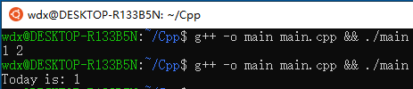
Enumeration
If you want to model seven days in a week, you can define a enumeration.
#include <iostream>
using namespace std;
enum Days { SUNDAY, MONDAY, TUESDAY, WEDNESDAY, THURSDAY, FRIDAY, SATURDAY };
int main() {
Days today = MONDAY;
Days tomorrow = TUESDAY;
cout<<"Today is: "<<today<<endl;
return 0;
}

Slide 10
Keyboard input and terminal output of string
1. C: scanf & printf
%d ----int
%f ----float
%c -----char
%s -----string
Why only
Computer?
scanf uses whitespace—spaces, tabs, and newlines to separate a string.

Slide 11
2. C: gets & puts
There is a warning due to using gets().
You can use fgets() function instead.
Use gets to gain a sentence with a space. gets() stops reading input when it encounters a newline or End of file.

Slide 12
3. C++: cin & cout
The cin is to use whitespace-- spaces, tabs, and newlines to separate a string.

Slide 13
4. C++: cin.getline( ) & cin.get( )

Slide 14
4. C++: cin.getline( ) & cin.get( )
If the length of input string is greater than 20,
it can only store first 19 characters in str.

Slide 15
4. C++: cin.getline( ) & cin.get( )
getline() and get() both read an entire
input line—that is, up until a newline
character. However, getline() discard
the newline character, whereas get()
leave it in the input queue.
Program runs
without entering
another string

Slide 17
C++ string using string data type
getline() function takes the input
stream as the first parameter which
is cin and str as the location of the
line to be stored.

Slide 18

What is CMake?
CMake is an open-source, cross-platform family of tools designed to build, test and package software. CMake is used to control the software compilation process using simple platform and compiler independent configuration files, and generate native makefiles and workspaces that can be used in the compiler environment of your choice.
For more information https://cmake.org/

Slide 19
CMake needs CMakeLists.txt to run properly.
A CMakeLists.txt consists of commands , comments and spaces.
The commands include command name, brackets and parameters ,
the parameters are separated by spaces. Commands are not case sensitive.
Comments begins with ‘#’.

Slide 20
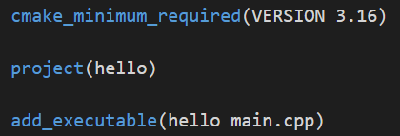
1. A single source file in a project
The most basic project is an executable built from source code files. For simple projects, a three-line CMakeLists.txt file is all that is required.
Specifies the minimum required version of CMake.
Use cmake --version in Vscode terminal window to check the cmake version in your computer.
Defines the project name.
Adds the hello executable target which will be built from main.cpp.
Suppose we have a main.cpp file
The first parameter indicates the filename of executable file.
The second parameter indicates the source file.
Store the CMakeLists.txt file in the same directory as the main.cpp.

Slide 21
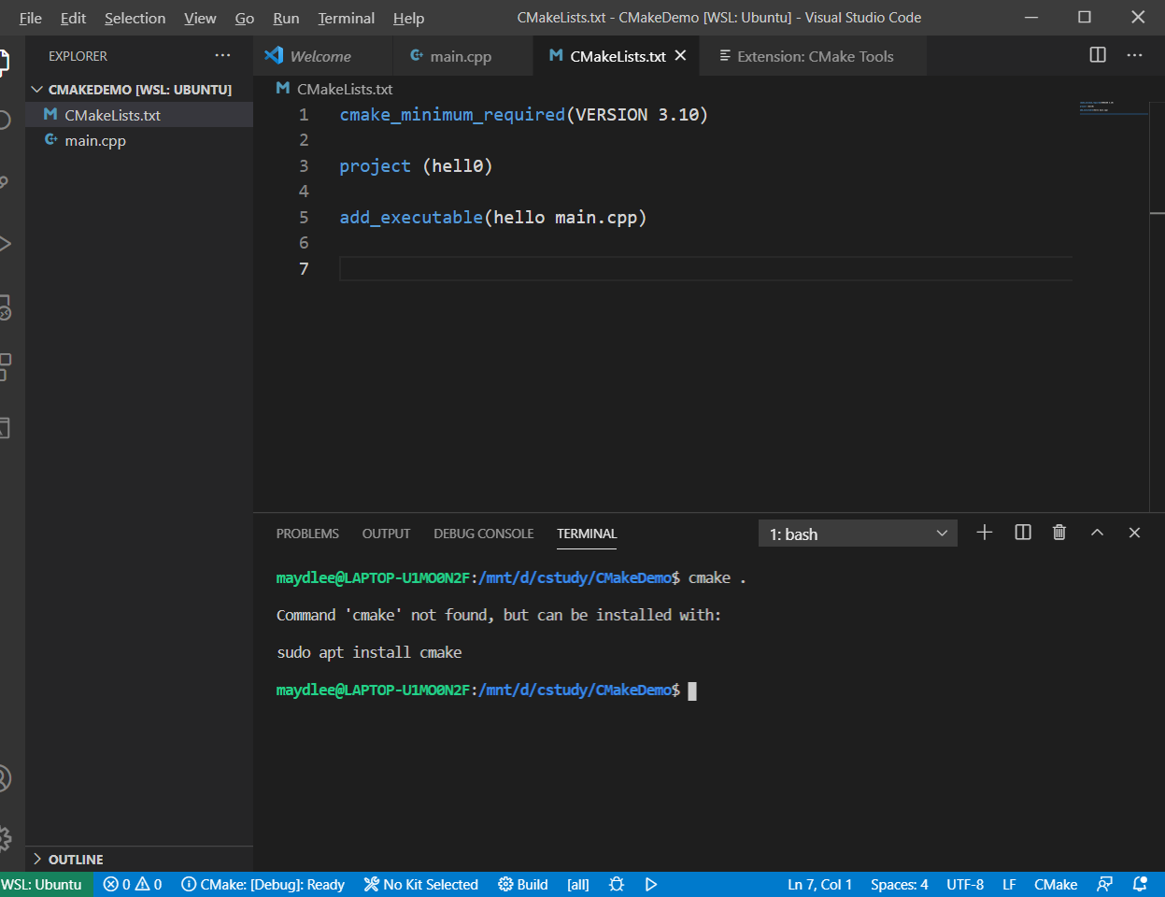
Type cmake . to generate makefile
Install cmake first by instruction

Slide 22
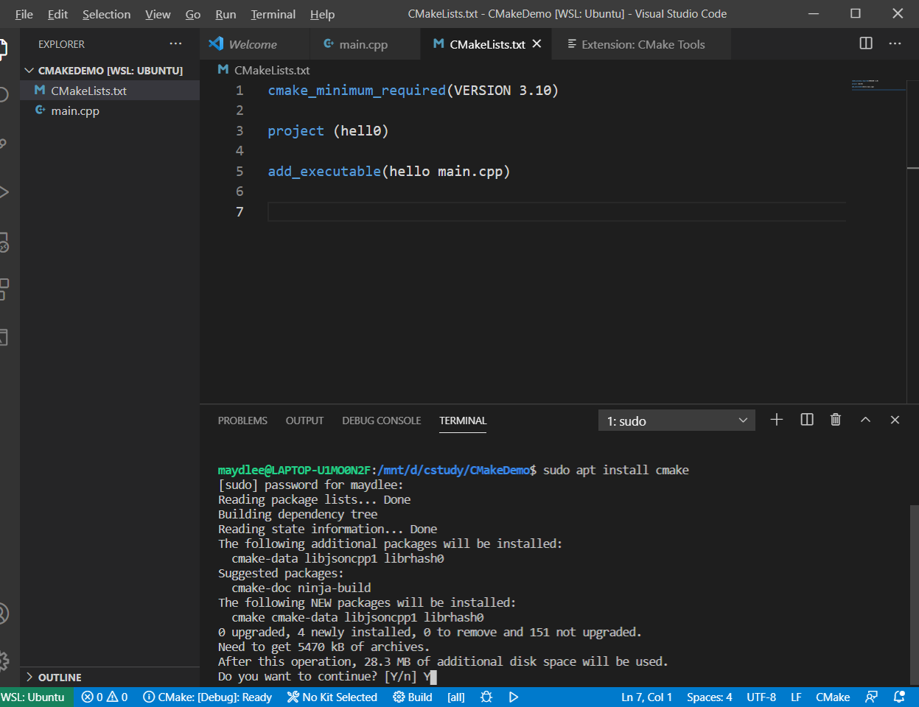

Slide 23
Run cmake to generate makefle,
. indicates the makefile is stored in the current directory.
makefile file is created automatically after running cmake in the current directory.

Slide 24
Execute make to compile
the program.
Run the program

Slide 25
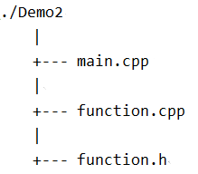
./CmakeDemo2
2. Multi-source files in a project
There are three files in the same directory.
Add the function.cpp to the add_executable command.

Slide 26
2. Multi-source files in a project
If there are several files in directory, put each file into the add_executable command is not recommended. The better way is using aux_source_directory command.
aux_source_directory (<dir> <variable>)
The command finds all the source files in the specified directory indicated by <dir> and stores the results in the specified variable indicated by <variable>.

Slide 27
2. Multi-source files in a project
Store all files in the current directory into DIR_SRCS.
Compile the source files in the variable by ${ } into an executable file named CmakeDemo2

Slide 28
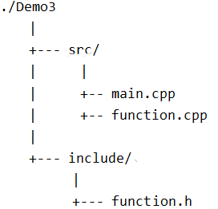
3. Multi-source files in a project in different directories
./CMakeDemo3
We write CMakeLists.txt in CmakeDemo3 folder.
All .cpp files are in the src directory
Include the header file which is stored in
include directory.

Slide 29
For more about Cmake(cmake tutorial):
https://cmake.org/cmake/help/latest/guide/tutorial/index.html
https://riptutorial.com/cmake

Slide 30
Exercises 1 (in-class)
Declare a structure named stuinfo and four function prototypes below in a stuinfo.hpp. Implement the four functions in a stufun.cpp. Write a main.cpp which contains main() and demonstrate all the features of the prototyped functions.
Write a MakeLists.txt for cmake to create Makefile automatically. Run cmake and make, and then run your program at last.
struct stuinfo
{
char name[20];
double score[3];
double ave;
};
Function prototypes:
void inputstu(stuinfo stu[] , int n), asks the user to enter each of the preceding items of information to set the corresponding members of the structure.
void showstu(stuinfo stu[] , int n) ,displays the contents of the structure, one student one line.
void sortstu(stuinfo stu[] , int n), sorts in descending order of average of three scores.
bool findstu(stuinfo stu[] , int n, char ch[]), finds if given characters is the student’s name.

Slide 31
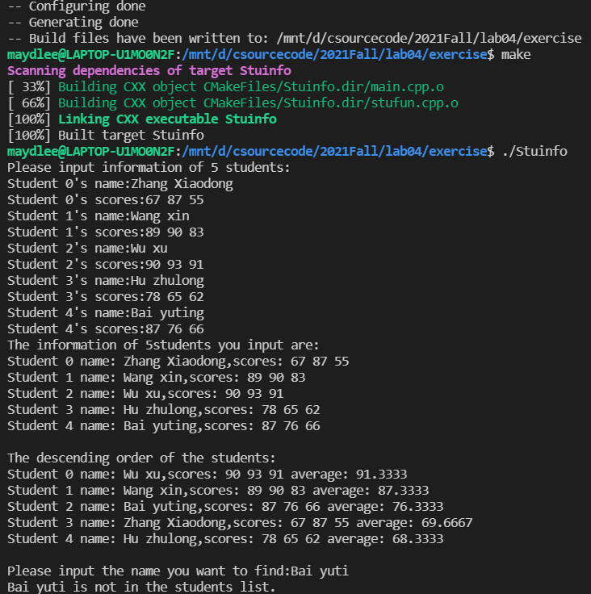

Slide 32
Exercise 2 (Homework, by Sunday)
Design a struct “DayInfo” which contains two enumeration types as its member. The first is an enum “Day” for (Sunday, Monday, ...), and the second is an enum “Weather” for (Sunny, Rainy, ...).
Define a boolean function “bool canTravel( DayInfo )” . It will return true if the day is at weekend and the weather is good.
Call function canTravel() in main().

