Slide 1
C/C++ Program Design
Lab 5, pointers and dynamic memory
王大兴，廖琪梅

Slide 2
Pointers and Dynamic Memory
Pointers
Dynamic Memory
Debugging with gdb
Debugging with vscode

Slide 3
Pointers
A pointer is a special type who holds the address of a value.
A pointer can point to a variable, a structure, an array and so on.
Use reference operator(&) to get the address of a variable and dereference operator(*) to get the value stored in the memory address.
Caution:
When you create a pointer, the computer allocates memory to hold an address, but it does not allocate memory to hold the data to which the address points.
Initialize a pointer to a definite and appropriate address before you apply the dereferencing operator (*) to it.

Slide 4
Pointers to array
When a pointer points to an array, it needs not use & to get the address of array, because the array name is a constant address. Dereference operator(*) combines with shifting the pointer to access the elements’ value rather than using subscript (index) .
Caution:
When shifting a pointer to an array, it can be out of bound without any warning, do not use such pointer to access(or modify) the content of that address.

Slide 5
Dynamic Memory
With C style, you can use calloc or malloc function to allocate memory for a pointer.
When you are not in need of memory any more, you should release that memory by calling the function free().
With C++ style, you can use new operator to allocate memory for a pointer and
delete operator to release that memory.
Caution:
When you request memory by function or operator, check the pointer whether it is NULL.
When allocating a contiguous memory by new [], de-allocate by delete []. Be careful, memory leak.

Slide 6
Debugging with gdb
Debugging is a common process in the software development process.
Let us assume we don’t know why the following code went wrong:
#include<iostream>
using std::cout;
using std::endl;
int plus( int a, int b ) {
return a + b;
}
int main() {
int a = 1234567890;
int b = 1234567890;
int c = plus(a, b);
cout<<"a + b = "<<c<<endl;
return 0;
}
a + b = -1825831516

Slide 7
Debugging with gdb
One common way of debugging: inserting “cout” everywhere.
Simple to understand.
After you find the bug, you need to remove all
the “cout”, could take a lot of time.
Using gdb could be a better choice.
int plus( int a, int b ) {
cout<<"in plus "<<a<<endl;
cout<<"in plus "<<b<<endl;
return a + b;
}
int main() {
int a = 1234567890;
cout<<"in main "<<a<<endl;
int b = 1234567890;
cout<<"in main "<<b<<endl;
int c = plus(a, b);
cout<<"a + b = "<<c<<endl;
return 0;
}

Slide 8
Debugging with gdb
First step of using gdb:
Compile the program with -g, tell the compiler to include the symbol table. You can not debug the program without -g.
For example, run the following command to compile main.cpp:
g++ -g -o main main.cpp

Slide 9
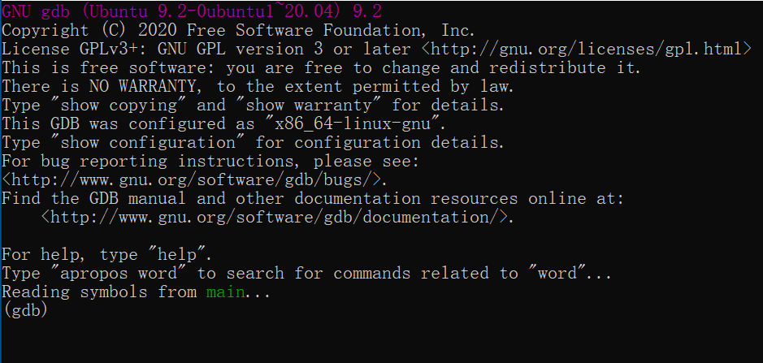
Debugging with gdb
Next, running the compiled program with gdb:
gdb program_name
For example, if your executable name is “main”, then run:
gdb main
You see something like
this:

Slide 10
Debugging with gdb
Now gdb is running, you can execute some command on the gdb.
Using the “run” command to make gdb execute your program

Slide 11
Debugging with gdb
One important feature of gdb is that it can execute to some point of the program, and see the current state of the program.
Suppose we want to insert a “break point” before
int c = plus(a,b);
#include<iostream>
using std::cout;
using std::endl;
int plus( int a, int b ) {
return a + b;
}
int main() {
int a = 1234567890;
int b = 1234567890;
int c = plus(a, b);
cout<<"a + b = "<<c<<endl;
return 0;
}
Insert break point before:
int c = plus(a,b);

Slide 12
Debugging with gdb
Press “q” and enter to quit the execution, and rerun “gdb main” to execute gdb on the “main” executable.
Press “l” and enter to list the line numbers.
We need to insert a break point at the 12th line.

Slide 13
Debugging with gdb
Set a break point at the 12th line with:
break 12
See the output:

Slide 14
Debugging with gdb
Print current state of variables, for example, print variable a:
print a
See the output:
Because we haven’t run anything yet.

Slide 15
Debugging with gdb
Now let’s “execute” run and “print a” again.

Slide 16
Debugging with gdb
Two information we can get from here:
The run command will stop at the position of the break point as line 12.
The print command prints the variable “a” successfully.

Slide 17
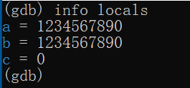

Debugging with gdb
Using “info locals” to show all the variables in the current stack:
And use “bt” to print the function stack:

Slide 18
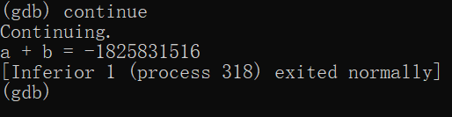
Debugging with gdb
Now that our program is waiting here.
We can use “continue” command to make the program continue to run.

Slide 19
Debugging with gdb
You may need to refer to the GNU document for more detail:
https://www.gnu.org/software/gdb/documentation/
Or if you could search for a beginner tutorial.

Slide 20
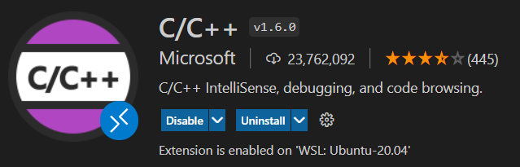
Debugging with vscode
After you know how to use gdb in a command line, you may want to use vscode to do the debugging.
From the directory of your C/C++ codes, run “code .” to start vscode.
You probably have already installed the C/C++ extension, if not, install it:

Slide 21
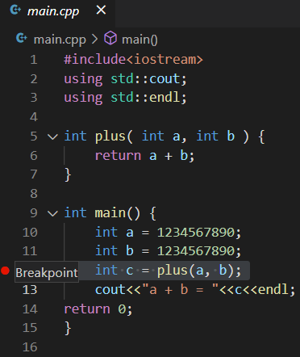
Debugging with vscode
Not when you click on the left, you can easily set break points.
You can remove a break point by
clicking again.

Slide 22
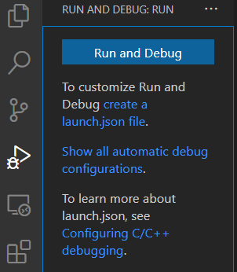
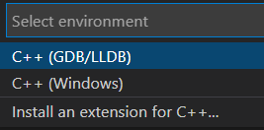
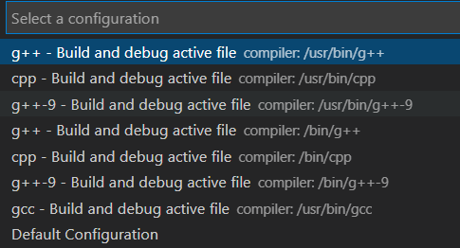
Debugging with vscode
Now click the “run and debug” to debug the program.
Everything will run automatically.

Slide 23
Debugging with vscode
https://code.visualstudio.com/Docs/editor/debugging

Slide 24
Exercise 1
Write a program that use new to allocate the array dynamically of five integers.
The five values will be stored in an array using a pointer.
Print the elements of the array in reverse order using a pointer.

Slide 25
Exercise 2
Allocate memory for an array of characters, modify elements by integer values one by one, then print out the result as a string. Please try to modify the element out of range and see what will happen.

Slide 26
Exercise 3
Using gdb or vscode to debug the following program:
#include<iostream>
using std::cout;
using std::endl;
// naive approach to see if num is a prime number
bool isPrime( int num ) {
for( int i = 1; i <= num; ++ i )
if( num % i == 0 )
return false;
return false;
}
int main() {
int a = 23;
cout<<isPrime(a)<<endl;
return 0;
}

