Slide 1


Make It or Break It: . what does it take to achieve theatrical success on Broadway?
Nashville Software School
Part-Time Data Analytics Cohort 6
A Capstone Project by Abi Inglis
Notes:
Hi there! Anyone who knows me well knows that I am a less-than-secretive theatre nerd. I’m only slightly embarrassed about it. But truth be told, I owe a lot of my career success and current passions to theatre and the performing arts. My first foray into having a love of data (or interest in it at all!) was as a teenager, when I would read playbill.com articles in my free time, combing through the weekly gross revenue reports, looking for signs that a show was succeeding… or taking a downturn towards inevitable closure. So, for my data analytics capstone, it felt natural to return to the industry and the data that put me on the path to NSS: what makes a Broadway show successful?

Slide 2
Agenda
What defines “success”?
Case Study: top ten highest-grossing shows of all time
Show-by-show detail
Theatre seat capacity detail
Calendar detail
Conclusions
Notes:
I first want to discuss what success means in the commercial theatre industry, to put a definition towards our admittedly abstract end goal. We will then take a bit to dig into trends regarding what are widely considered to be the most successful shows of all time, based on the metric of gross revenue. We will then take a look at a dashboard that allows a user to evaluate trends on a show-by-show basis. After that, I will discuss the different theaters that Broadway shows can run in – the seat capacities, the turnover of shows in each house, etc. We will also look into how time of year and calendar cycle affects the success of a play or musical. We will pull all of this together to see if we can identify any quantifiable indicators of the success or failure of a Broadway production.

Slide 3
What is “success?”
Revenue? Profit? Awards and Acclaim? Longevity?
Notes:
So I want to start with this thought: what does it mean for a Broadway show to be successful? Off the bat, we’re looking at a big limitation of this project: in this industry, commercial success is, in a lot of ways, very subjective. It might mean earning the most revenue. But without knowing the expenses acting against the revenue, that might not be enough. Every show has different expenses – personnel costs vary with cast size and production needs, some marketing budgets are larger than others, etc. Beyond simple expenditures, a portion of every week’s revenue gets sent to the producers and investors as a partial recoupment payment, which varies show to show based on the producing team size.
Another metric that people turn to is the award cycle: did a production win Best Musical or Best Play at that year’s Tony Awards, or did their star actor nab a best leading actor statuette? This is a faulty metric as well, because it is impossible to normalize to account for similarly popular or high-quality shows that open in the same year. There are also many regulations and benchmarks that a show must meet to qualify for a Tony nomination in the first place, so plenty of very popular shows that are otherwise successful may get “snubbed” each year.
Another potential metric, and one of my favorite indicators of success, is longevity. Does a show stay open for a long period of time? Is the potential audience big enough, or are people willing to come again? As an example, The Phantom of the Opera opened in January of 1988, and has only closed for the COVID-19 pandemic-induced shut down. By all manners of logic, that would certainly qualify as a successful show.
All this to say, the concept of “success” in this scenario is a bit hard to pin down – there isn’t really a reliable metric to use as a benchmark to label a show successful or otherwise. As such, I’ll tell you right now – we will not answer the intended question of this project today. If we could, every show would be exactly the same, and theatrical investors and producers alike would be out of a job.

Slide 4
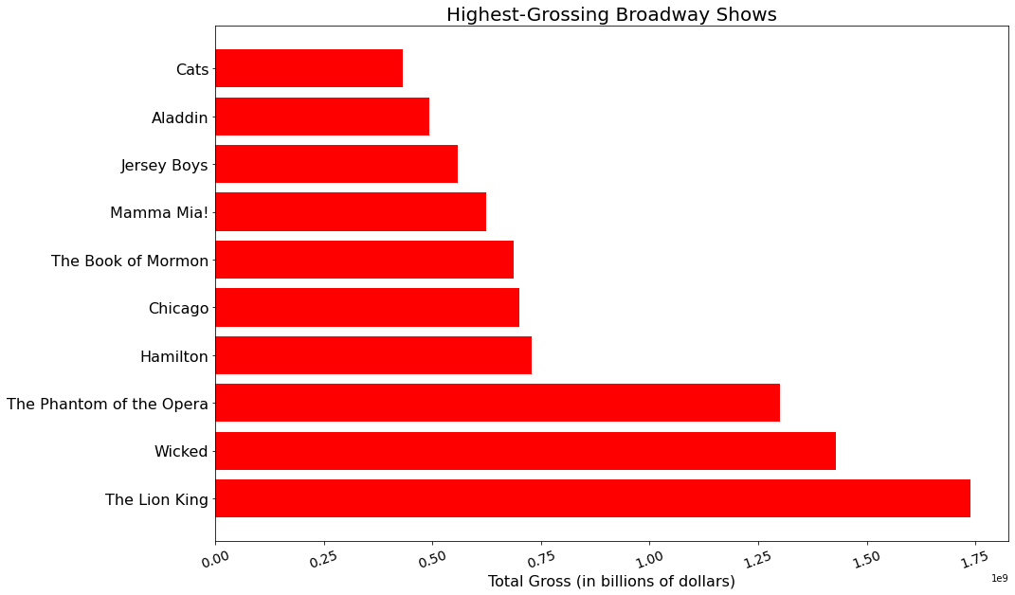

Slide 5
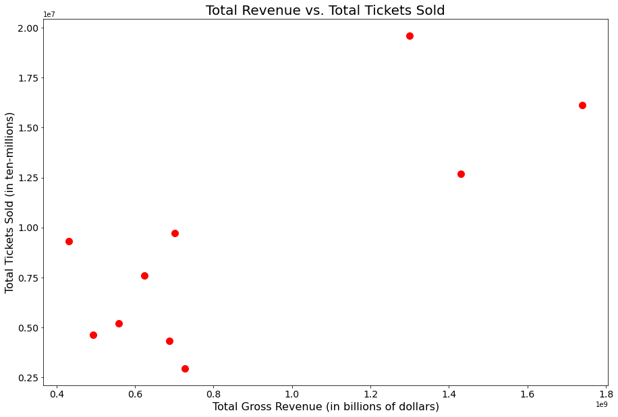

Slide 6
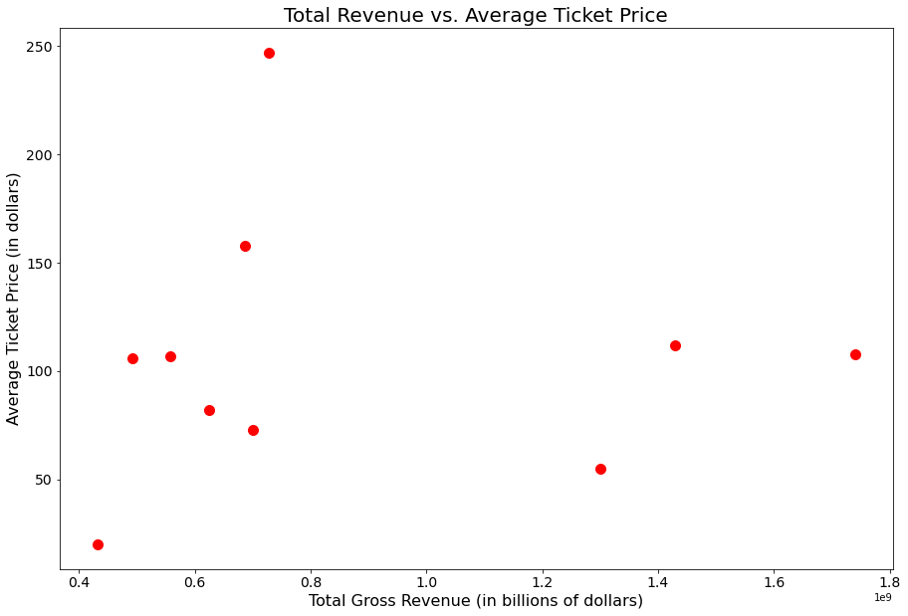

Slide 7
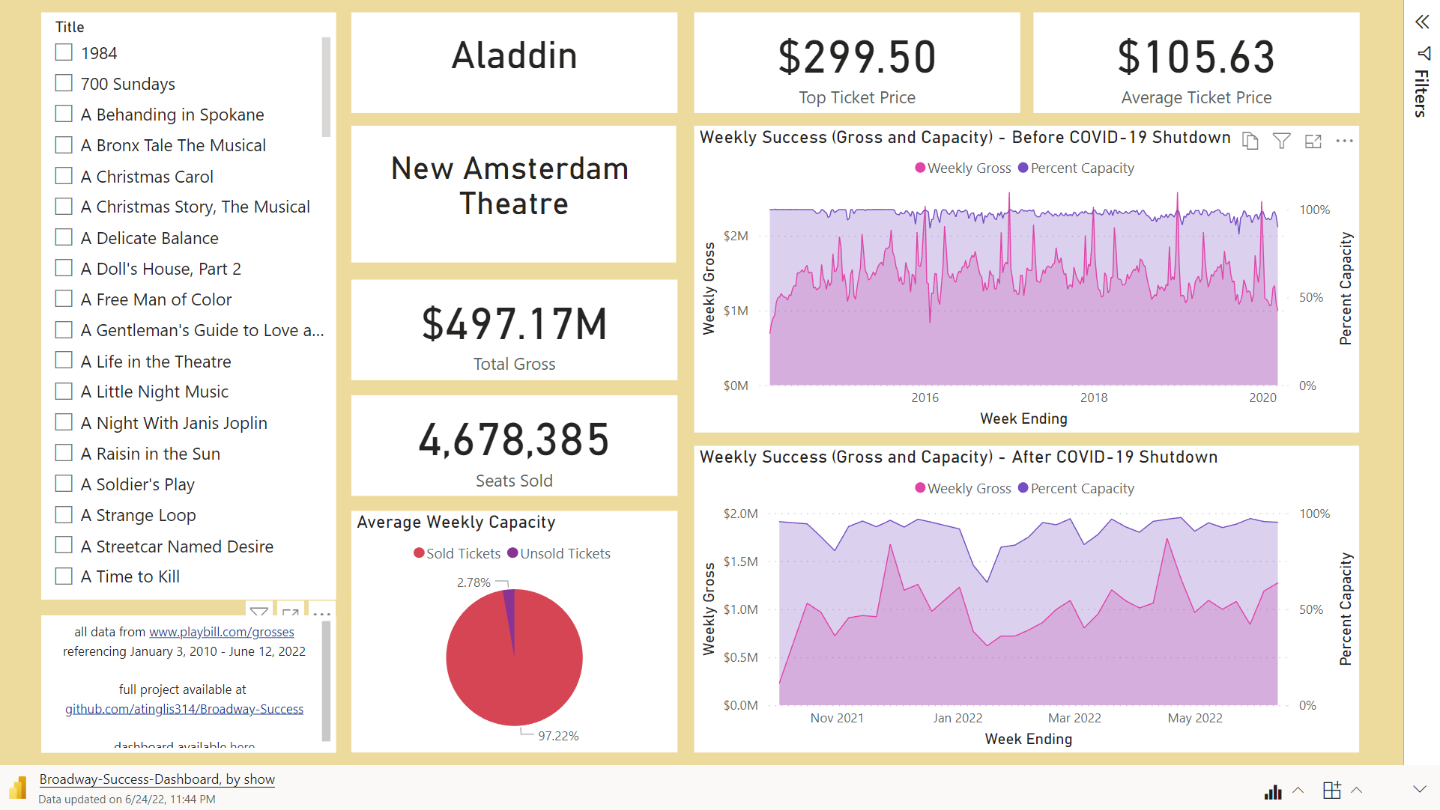

Slide 8
What about location?

Slide 9
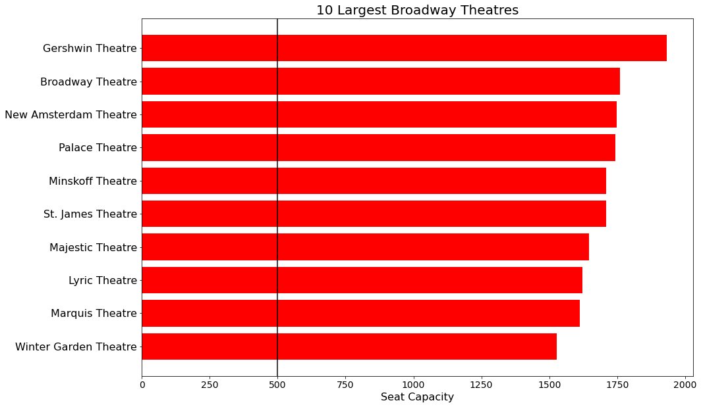

Slide 10
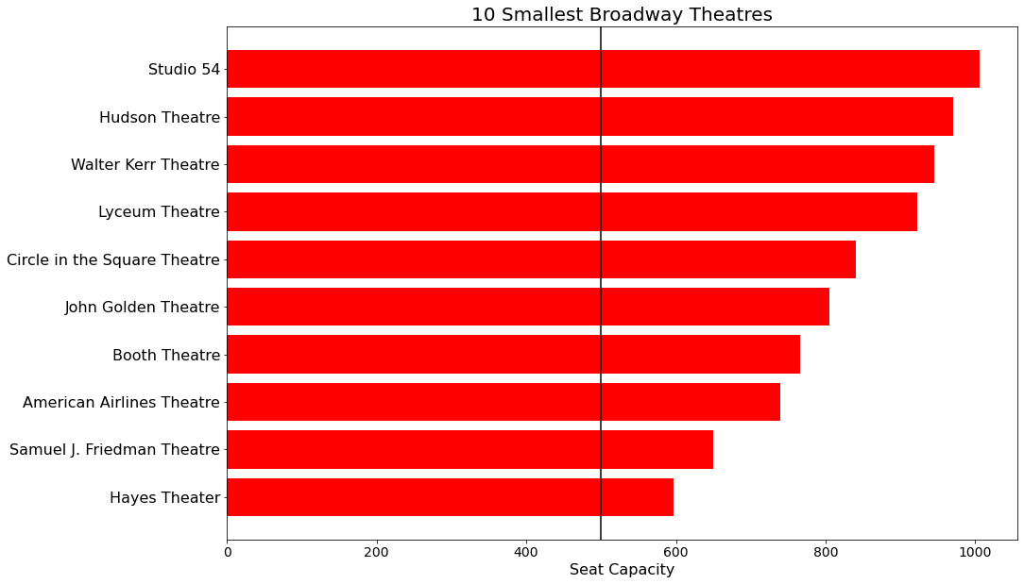

Slide 11
Scatter of count of shows v capacity? Indicate popularity and/or longevity

Slide 12
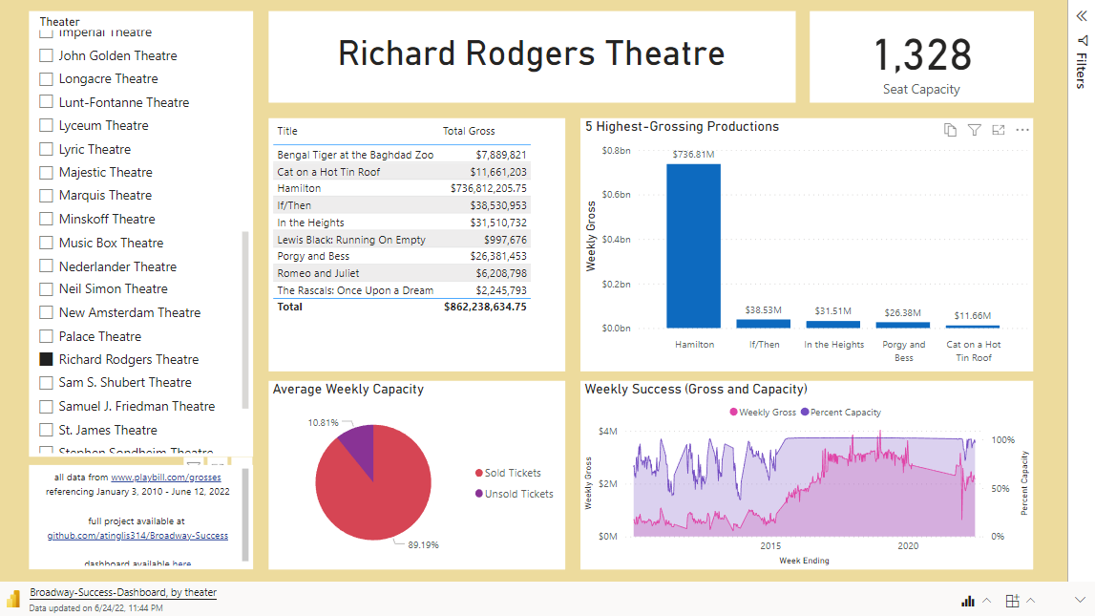

Slide 15
What about time of year?

Slide 16
