Slide 1


Make It or Break It: . what does it take to achieve theatrical success on Broadway?
Nashville Software School
Part-Time Data Analytics Cohort 6
A Capstone Project by Abi Inglis
Notes:
Hi there! Anyone who knows me well knows that I am a less-than-secretive theatre nerd. I’m only slightly embarrassed about it. But truth be told, I owe a lot of my career success and current passions to theatre and the performing arts. My first foray into having a love of data (or interest in it at all!) was as a teenager, when I would read playbill.com articles in my free time, combing through the weekly gross revenue reports, looking for signs that a show was succeeding… or taking a downturn towards inevitable closure. So, for my data analytics capstone, it felt natural to return to the industry and the data that put me on the path to NSS: what makes a Broadway show successful?

Slide 2
Agenda
What defines “success”?
Case Study: top ten highest-grossing shows of all time
Show-by-show detail
Theatre seat capacity detail
Calendar detail
Conclusions
Notes:
I first want to discuss what success means in the commercial theatre industry, to put a definition towards our admittedly abstract end goal. We will then take a bit to dig into trends regarding what are widely considered to be the most successful shows of all time, based on the metric of gross revenue. We will then take a look at a dashboard that allows a user to evaluate trends on a show-by-show basis. After that, I will discuss the different theaters that Broadway shows can run in – the seat capacities, the turnover of shows in each house, etc. We will also look into how time of year and calendar cycle affects the success of a play or musical. We will pull all of this together to see if we can identify any quantifiable indicators of the success or failure of a Broadway production.

Slide 3
What is “success?”
Revenue? Profit? Awards and Acclaim? Longevity?
Notes:
So I want to start with this thought: what does it mean for a Broadway show to be successful? Off the bat, we’re looking at a big limitation of this project: in this industry, commercial success is, in a lot of ways, very subjective. It might mean earning the most revenue. But without knowing the expenses, that might not be enough information. Beyond simple operation costs, a portion of every week’s revenue gets sent to the producers and investors as a partial recoupment payment, which varies show to show based on the producing team size and contract.
Another metric that people turn to is how many Tony Awards a show won. This is a faulty metric as well, because it is impossible to normalize to account for similarly popular or high-quality shows that open in the same year. There are also many regulations and benchmarks that a show must meet to qualify for a Tony nomination in the first place, so plenty of very popular shows that are otherwise successful may get “snubbed” each year.
Another potential metric, and one of my favorite indicators of success, is longevity. Does a show stay open for a long period of time? Is the potential audience big enough, or are people willing to come again?
All this to say, the concept of “success” in this scenario is a bit hard to pin down. As such, I’ll tell you right now – we will not answer the intended question of this project today. If we could, every show would be exactly the same, and theatrical investors and producers alike would be out of a job.

Slide 4
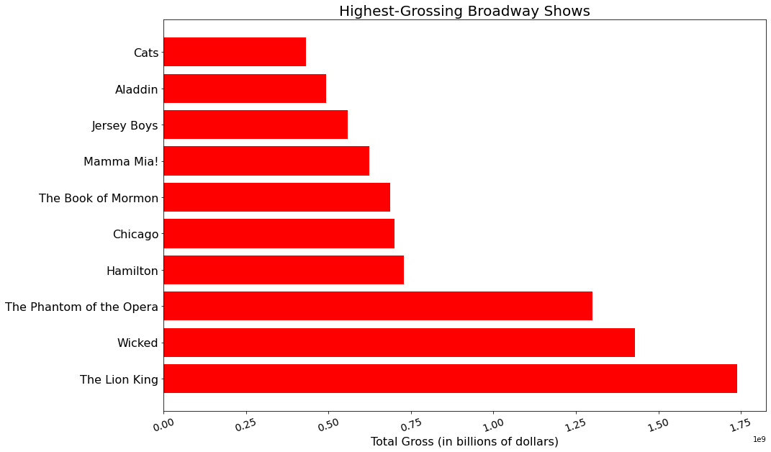
Notes:
One of the most widely-accepted metrics, though, is gross revenue – likely because it’s the simplest. To start my analysis, I wanted to look into which shows have made the most money, ever. I expected Phantom of the Opera to be at the top of this list since it has been continuously open (aside from during COVID) for 34 years and counting. However, Lion King and Wicked took the top spots (24 years and 19 years respectively), which isn’t hugely surprising considering that they are more family-friendly and have a much wider age demographic potential in their audience.
Of note, all but 3 of these shows listed are still open today. Cats, Jersey Boys, and Mamma Mia all have ended their Broadway runs.
One other thing that did surprise me here was that Hamilton ranked so high up – it’s been running for almost 7 years now, but the current revival of Chicago has been running for almost 26 years. For a show to surpass that revenue mark so quickly is genuinely astounding – though it’s no surprise, if you’ve ever tried to buy a ticket to Hamilton, you’d know how they made that money. Ticket prices are incredibly high!

Slide 5
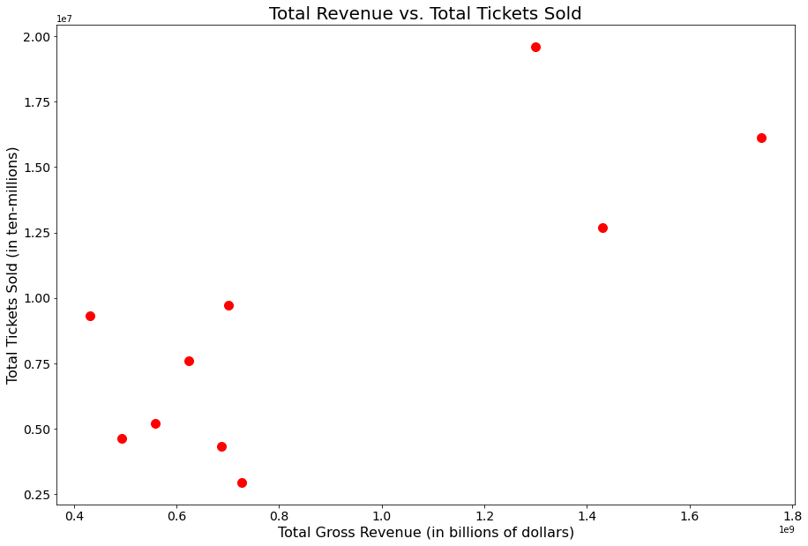
Notes:
Here we are looking at a plot of the total revenue and the total tickets sold for those ten highest-grossing shows. It may seem a bit obvious that there’s some correlation here, as one factor directly causes the other. But there is a bit of deviation which is largely driven by different-than-average ticket prices. The highest point here is referencing the phantom of the opera, which we already know has been running for a very long time and consequently has sold many tickets. Contrastingly, the lowest point here is referencing Hamilton – which has made a ton of revenue in a short time and has sold comparatively very few tickets. Phantom and Hamilton are the third- and fourth- highest grossing shows, but the spread on this plot between them is immense.

Slide 6
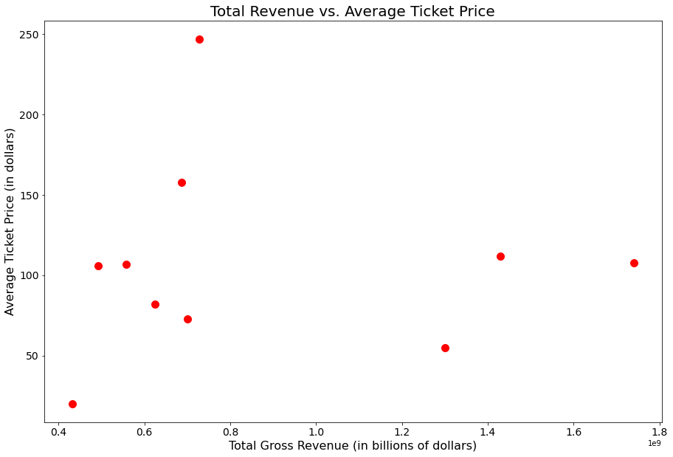
Notes:
So, I wanted to look at the same revenue/ticket correlation but as compared to the average ticket price, rather than a count. The correlation is much looser and less obvious here. This indicates that ticket pricing is not nearly as much of a factor in ultimate success as it may initially seem.

Slide 7
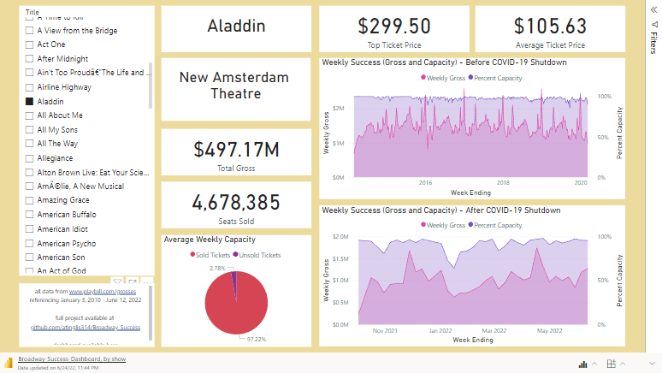
Notes:
Here is a dashboard that I created in Power BI that can be filtered by show to look at several indicators. The two stacked area charts reference the same metric, but the top is up to and including early March of 2020, and the bottom is after August 2021, when theaters were allowed to reopen following the COVID shutdown. Consequently, several of the show options here will have a blank chart in that space, if they closed prior to COVID or have opened since. We will be looking at some shows that were open in both time frames.
Here is Aladdin, the stage translation of the beloved Disney movie. Aladdin has been running for several years now, and pre-pandemic was reliably fairly sold out. Post-pandemic has shown a bit more volatility, which isn’t especially surprising, and is true for other shows as well.
Here we have Hamilton, which is notoriously fully sold and making a comparatively unbelievable amount of money every week, but even here is a huge dip in December of 2021, when they had to cancel several shows around the holidays due to COVID-19 in the cast. This happened to several broadway shows this year.
You may have noticed here, especially in those top area charts reflecting pre-covid times, that there is a pretty regular up-and-down cycle year over year. We will look into that in a bit.

Slide 8
What about location?
Notes:
With all the consideration of ticket sales and capacity, I started wondering how much the physical theater that a show is in plays a role. For a broadway house to qualify to be “on broadway” (not the street, the broad term for the theater district), it has to have at least 500 seats. A theater in the same district in Manhattan with 400 seats would be deemed “off-broadway” (fun fact!)
So I wanted to look at the largest and smallest theaters to see if I could identify any trends to dig into.

Slide 9
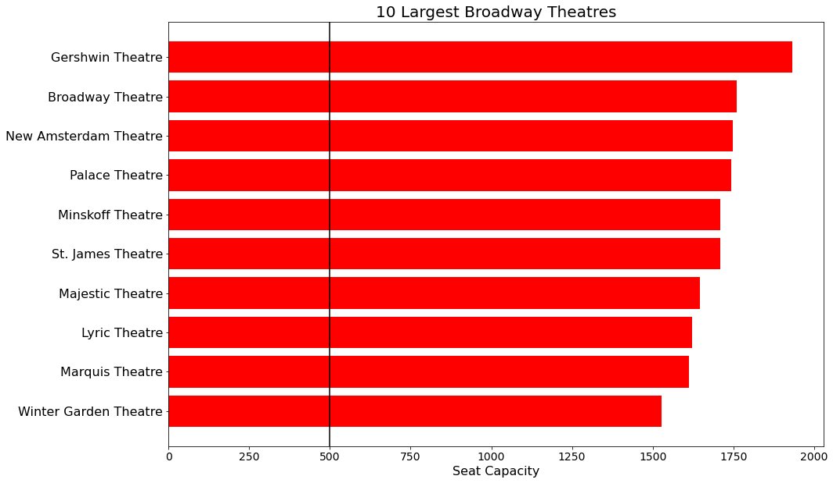
Notes:
I had some success here, but not as much as I had hoped. This graphic shows the 10 largest houses on broadway by seat capacity. The black vertical line at 500 serves two purposes here – one, to show you how much larger these theaters are than off-broadway houses; two, to orient you to the next slide, which shows the smallest venues.
The Gershwin takes the lead with almost 2,000 seats to sell every performance – the fact that Wicked sells out most nights, and has been for 19 years, is honestly astounding to me.
The stars by the names here represent theaters that house (or have in the past) one of those top-ten highest grossing shows from earlier. So we see overlap here, but not complete overlap – there are large theaters that haven’t had as-successful shows, and there are very successful shows that have been in much smaller theaters. Hamilton, for example, is in the Richard Rogers theater, which comes in at about 1300 seats and is considered a mid-sized house.

Slide 10
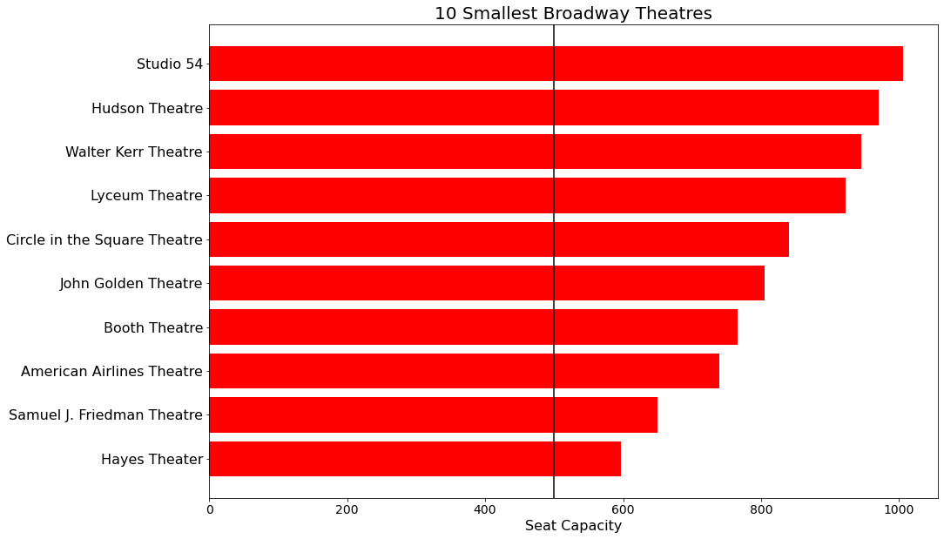
Notes:
These are the ten smallest theaters, again with that line at 500 seats. Some of them – the Hayes and the Friedman in particular – are really quite small. They are popular for smaller shows, especially plays, because they have a much more intimate audience feel. But, with limited ticket inventory, it’s no surprise that these theaters don’t house the high-grossing shows. Which begs the question, which I unfortunately don’t have the answer to – why would a producer want a show to be in one of those houses? Does it doom the show from the start if revenue potential is low?

Slide 11
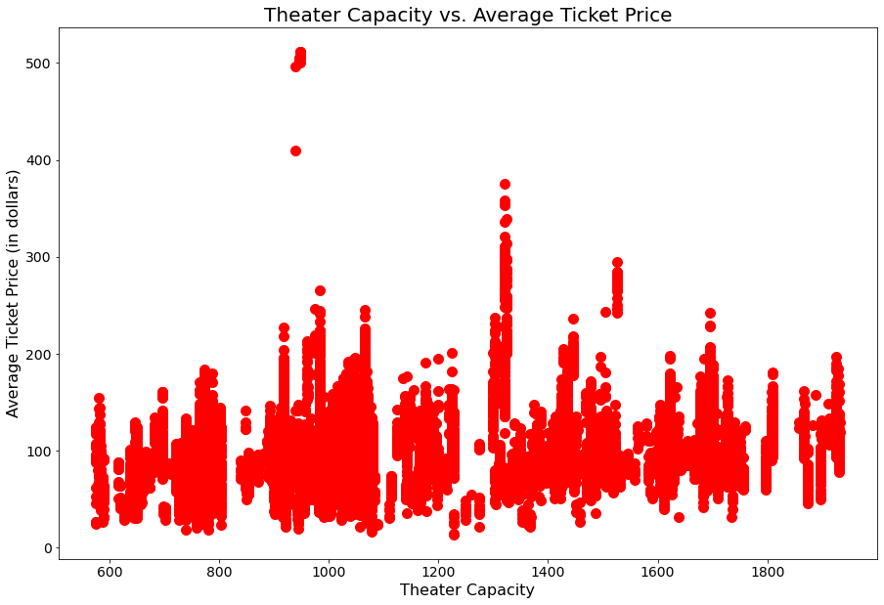
Notes:
So, I dug into average ticket prices again, and was disappointed to see that there wasn’t that much variance. A trend line here would show that the average ticket price for a broadway show sits around $100, regardless of theater capacity. Sure, there is a bit of an incline, but… not enough of one to be hugely consequential.

Slide 12
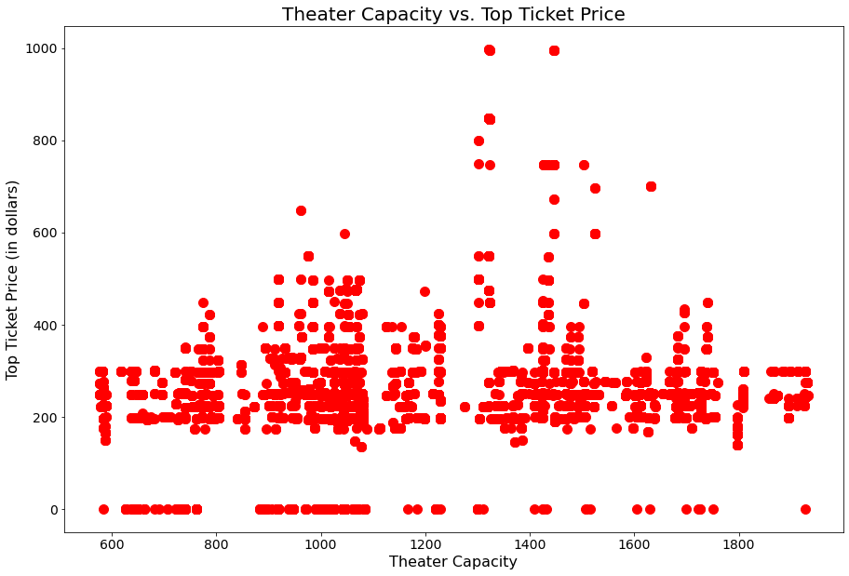
Notes:
Top ticket prices showed a similarly disappointing lack of trend. The top ticket price axis, for reference, is twice as high as the one on the prior slide – average ticket prices top out at $500 in the last 12 years, while top ticket prices are sitting at about $1000. I bet you can guess who one of them is!!!
Hamilton, of course. The other is Springsteen on Broadway, which I had the pleasure of working on when I lived and worked in NYC. (fun fact! and slight brag, I apologize.)

Slide 13
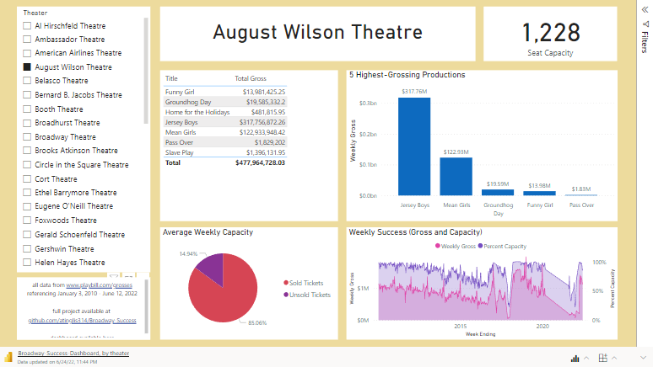
Notes:
So, here is a dashboard that is filterable by theater. It shows a list of the productions that have been in each theater (in the past 12 years, as restricted by my data set), the highest grossing productions in each theater, and a similar look at the gross/capacity dichotomy, which if you hover over a particular point, you can see what show was playing at the time. I won’t spend too much time here, because truthfully, there wasn’t anything that I noticed that was unexpected or hugely indicative of trend.

Slide 14
What about time of year?
Notes:
Remember earlier I mentioned the apparently cyclical trend over time? Let’s dig into that a bit. It makes sense that there would be some peaks – holiday season, summertime, peak tourist and vacation times, right? But what about those lows?

Slide 15
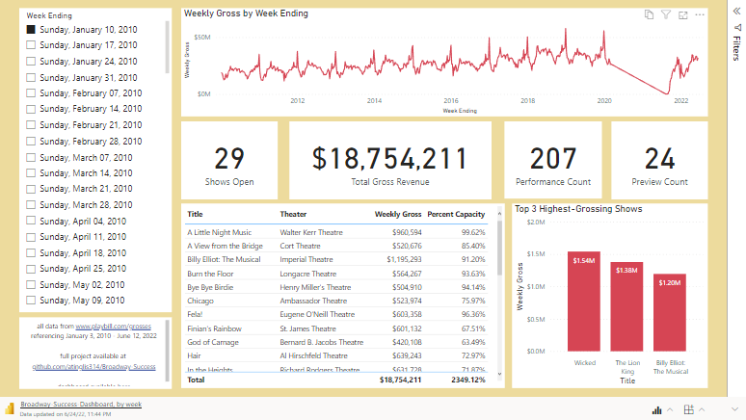
Notes:
For my final dashboard of the presentation, this one is filterable by week. This top line graph is stagnant, and shows the total weekly gross for every open show in the NYC broadway district over the entire 12 year dataset. Ignore that sharp downwards line towards the end – there are no data points there, it represents the COVID shutdown.
Leading up to the pandemic closure, we see a general increase in total revenue industry-wide. This is good news at first glance – shows are making more money, people are loving the theater and continuing to go, etc – but it also could be indicative of rising ticket prices, which is making the theater industry less accessible to the masses.
If you hover across the line graph, you’ll notice that pretty reliably, the big dips in revenue are in September and January. I have a hypothesis for this, but it’s speculative without pulling in more data, which is a continued goal of this project for me. For now, I suspect that this has to do with the awards cycle. The Tony Awards are in June every year, and new shows rely on Tony wins to drive audiences to want to come see them. If that does not happen, a failing show will announce a closing date in August or so, and several theaters are likely empty in the late summer/early fall, as new shows get ready to open in the recently-vacated venue. Meanwhile, a popular time for shows to open is late March into April, because the end of April is the cutoff date for Tony eligibility each year. A show that opens in the spring has less risky time to lose money prior to awards season.
And then, of course, those peaks are at the end of December every year. The holiday season is one of the most popular travel times. Of course those late-December weeks see increases in ticket sales (and likely ticket prices due to demand!)

Slide 16
Conclusions and Trends
There is some correlation between seat capacity of the house and the financial success of a show
Some theaters (especially smaller ones) have frequent turnover of shows
Plays tend to be less lucrative than musicals
There is a definitive time cycle to the industry-wide success
Notes:
So, while any concrete answers to my driving question were difficult to discern with my data limitations, we did see some trends worth pointing out.
There is correlation between seat capacity of a venue and the success of a show there – which may seem obvious, but could also be a risky bet if the show isn’t popular.
Some theaters have very frequent turnover of shows, which gives a production less time to earn money and less longevity, leading to less success by most definitions.
Plays tend to earn less money than musicals.
There is definitely a natural cycle to the ebbs and flows of revenue as the calendar year progresses.

Slide 17
Final Thoughts
External Factors
What’s Next for This Project?
Subject matter
Original v. familiar story
Including translations both directions
Digital presence and marketing
Star power and awards
Cast/Crew size, production expenses
Investor Recoupment Schedule
Cast Recordings and sountracks
Expand dataset more than 12 years
Target: January 1988
Include Tony Award nominations and wins (in all categories)
Utilize Spotify API to evaluate streaming data for cast recordings
Compare with weekly success
Compare with pre/post Awards
Tony and Grammy
Compare with pre/post open date
Notes:
I wanted to address some final thoughts, especially considering the data is a bit inconclusive and the topic of this project is so nuanced.
In terms of external factors that also play a role in the answer to my data question – what makes a Broadway show successful? Some things to consider:
Is the subject matter something that is audience-friendly, or poignant in a way that doesn’t make people too uncomfortable? Public perception obviously plays a role.
Is the story familiar to us – based on the life of a historical figure, or a translation of music or a book or movie we already know and love?
Is the show well marketed, and nowadays, does it have a strong social media presence?
Are there popular actors or big names in the lead roles, and did the show win any awards?
If it’s a musical, is there a cast recording or soundtrack that people are loving? All of these questions and more will affect the relative success of a production, so it’s no surprise my analysis was inconclusive and speculative. The topic is admittedly too abstract.
In terms of my next steps and goals for the continued life of this project – I’d love to look at more data. My target date to expand my timeline to is January 1988, when Phantom of the Opera opened, to at least include the full run of the longest-running show still open (or in history, for that matter). I would also like to pull in Tony Award data, which will take a considerable amount of manual effort, as the full list does not live in one place that I could find. I would also LOVE to use the Spotify API to pull in information about the popularity of cast recordings of musicals specifically, especially now that, with the rise of social media (especially TikTok), we are seeing a trend of popular soundtracks predating the opening night date of a show (historically, a show only released a cast album if it was already open and popular – which is still true to an extent – but there have been several recent examples of a very popular recording driving the future success of a show that hasn’t even opened yet).

Slide 18
Thank You!
Notes:
With that, I thank you so much for your time today, and I look forward to continuing my deep dive into this topic!

