Slide 1


Make It or Break It: . what does it take to achieve theatrical success on Broadway?
Nashville Software School
Part-Time Data Analytics Cohort 6
A Capstone Project by Abi Inglis
Notes:
Hi there! Anyone who knows me well knows that I am a less-than-secretive theatre nerd. I’m only slightly embarrassed about it. But truth be told, I owe a lot of my career success and current passions to theatre and the performing arts. My first foray into having a love of data was as a teenager, when I would read playbill.com articles in my free time, and pouring through the weekly gross revenue reports, looking for signs that a show was succeeding… or taking a downturn. So, for my data analytics capstone, it felt natural to return to the industry and the data that put me on the path to NSS: what makes a Broadway show successful?

Slide 2
Agenda
What defines “success”?
Case Study: top ten highest-grossing shows of all time
Show-by-show detail
Theatre seat capacity detail
Calendar detail
Conclusions
Notes:
I first want to discuss what success means, to put a definition towards our abstract end goal. We will then take a bit to dig into trends regarding what are widely considered to be the most successful shows of all time, based on the metric of gross revenue. We will then take a look at a dashboard that allows a user to evaluate trends on a show-by-show basis. After that, I will discuss the different theaters that Broadway shows can run in – the seat capacities, the turnover of shows in each house, etc. We will also look into how time of year affects the success of a play or musical. We will pull all of this together to see if we can identify any quantifiable indicators of the success or failure of

Slide 3
What is “success?”
Revenue? Profit? Longevity? Awards and Acclaim?

Slide 4
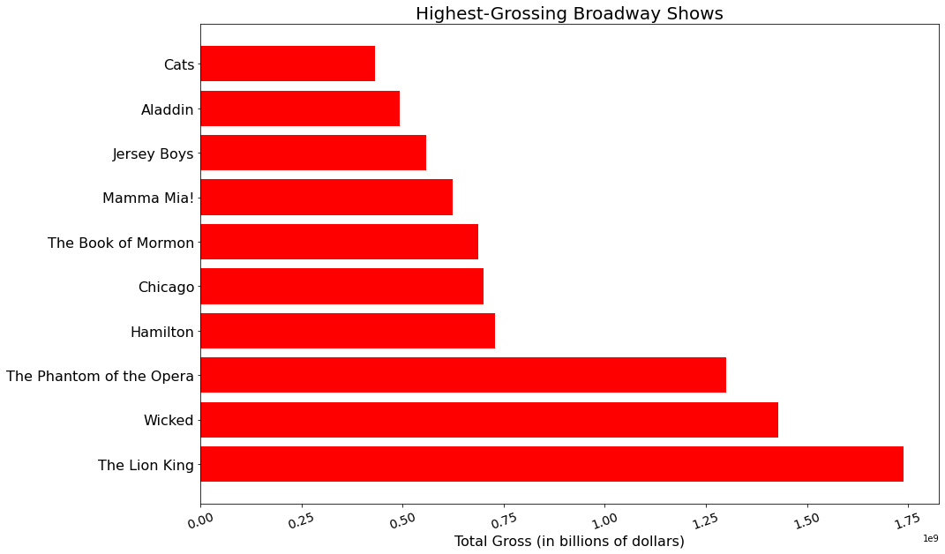

Slide 5
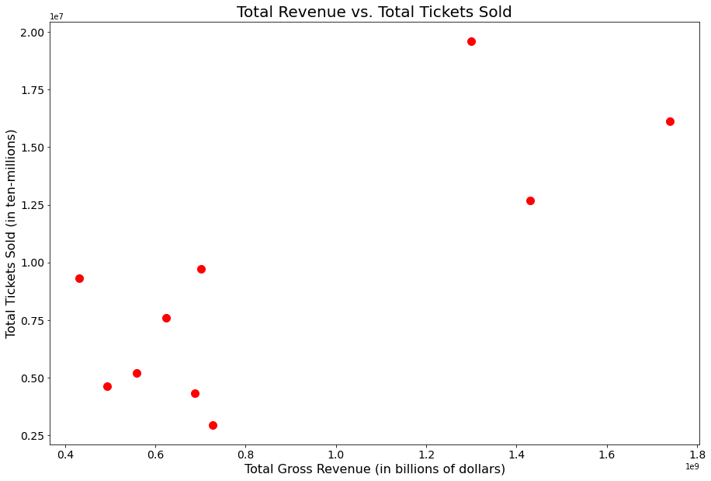

Slide 6
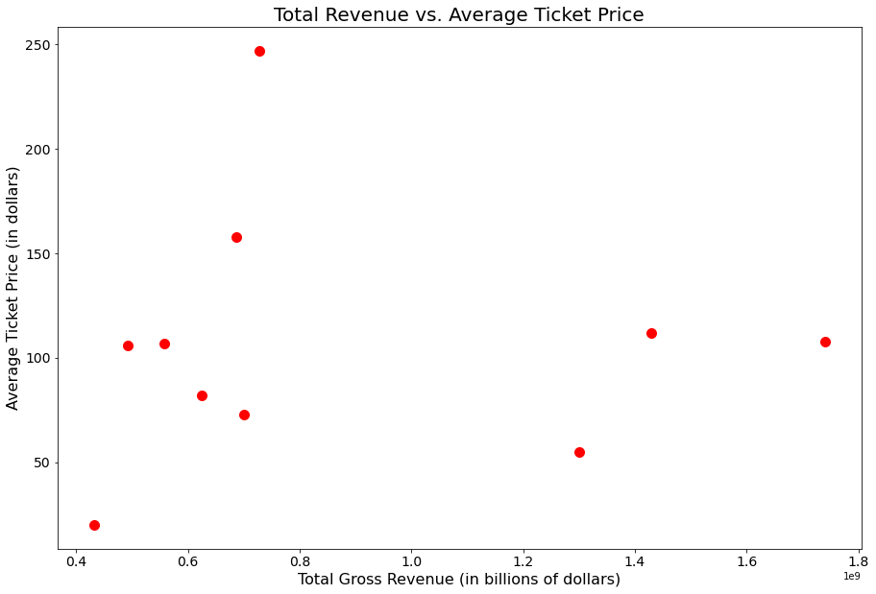

Slide 7
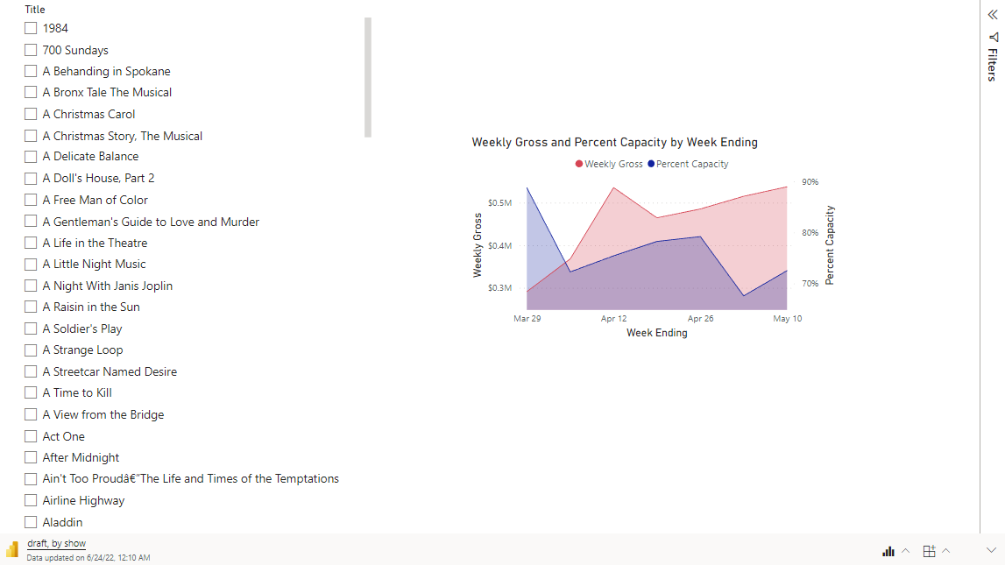
Dashboard with filter by show

Slide 8
What about location?

Slide 9
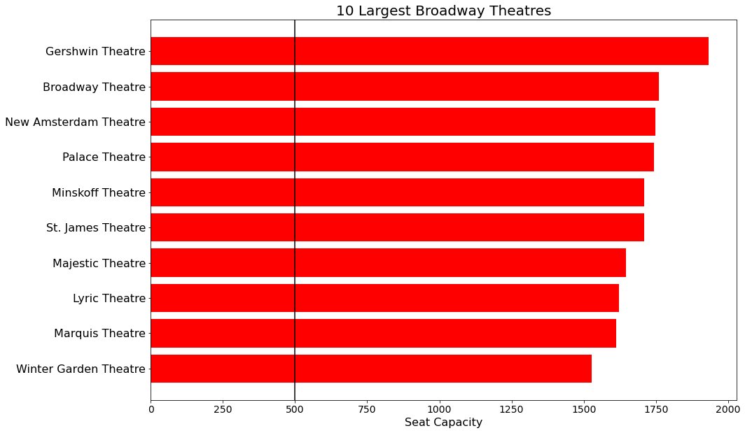

Slide 10
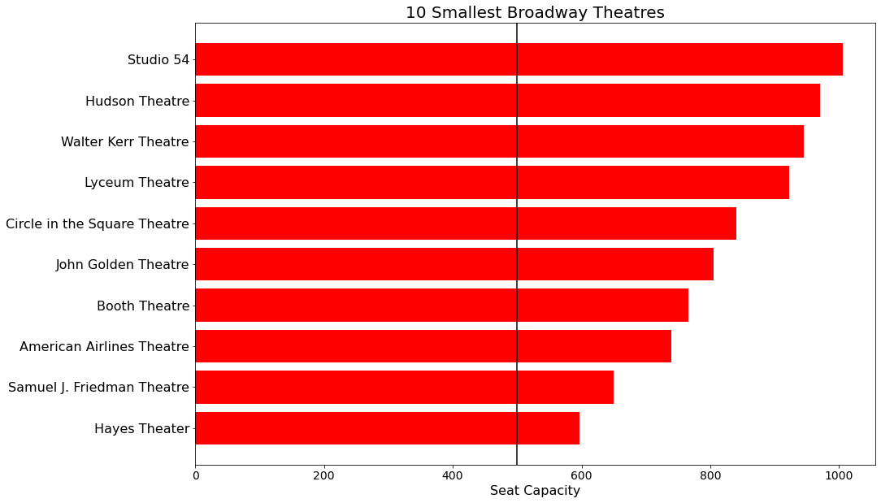

Slide 11
Scatter of count of shows v capacity? Indicate popularity and/or longevity

Slide 12
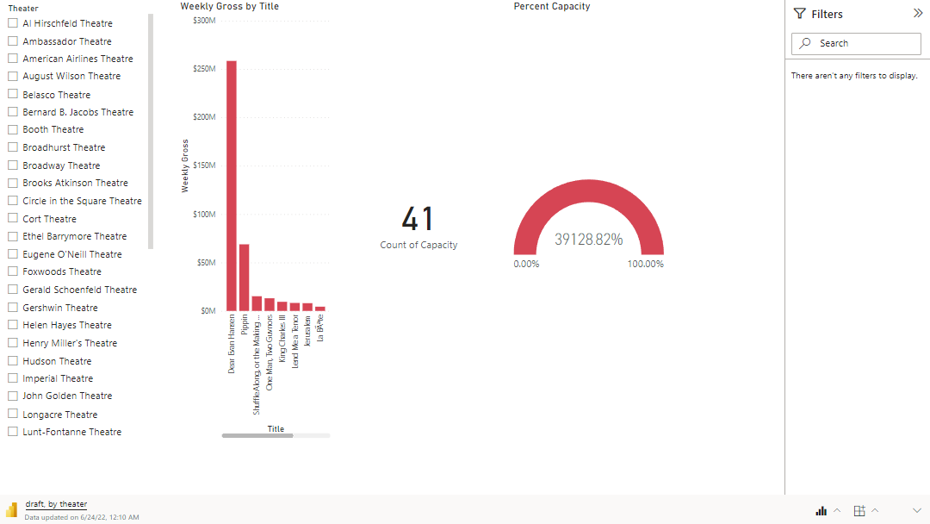

Slide 15
What about time of year?

Slide 16
