Slide 1


Make It or Break It: . what does it take to achieve theatrical success on Broadway?
Nashville Software School
Part-Time Data Analytics Cohort 6
A Capstone Project by Abi Inglis

Slide 2
Agenda
What defines “success”?
Case Study: top ten highest-grossing shows of all time

Slide 3
What is “success?”
Revenue? Profit? Longevity? Awards and Acclaim?

Slide 4
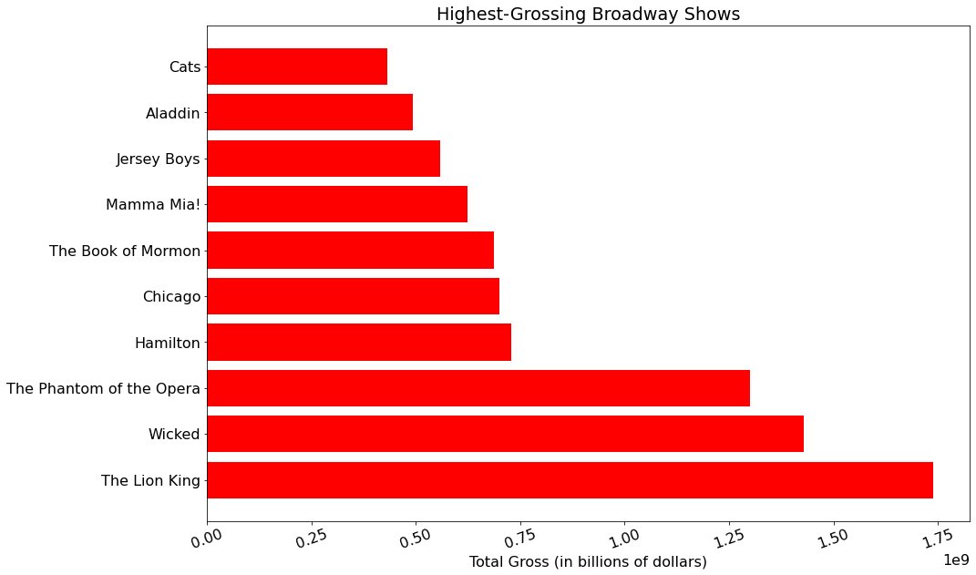

Slide 5
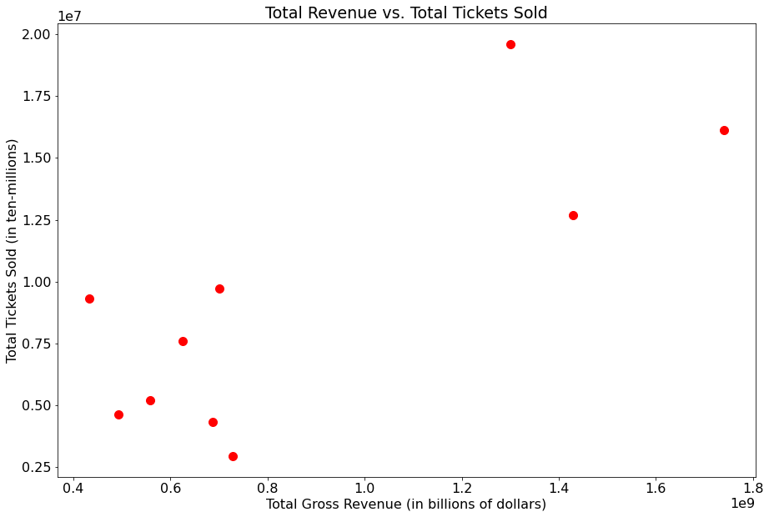

Slide 6
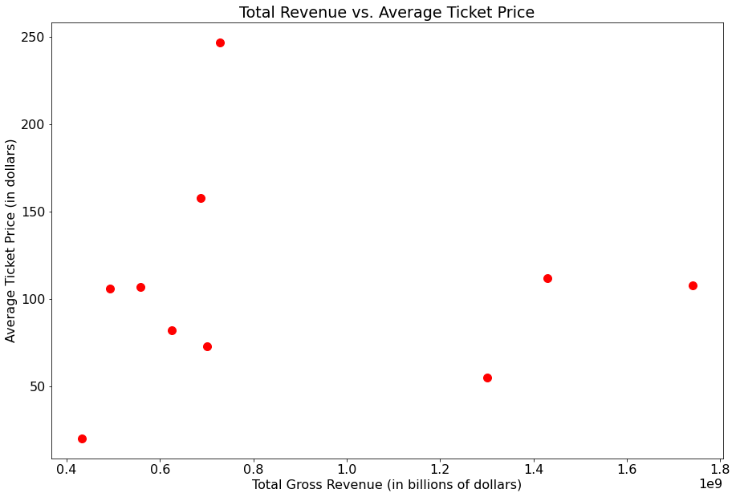

Slide 7
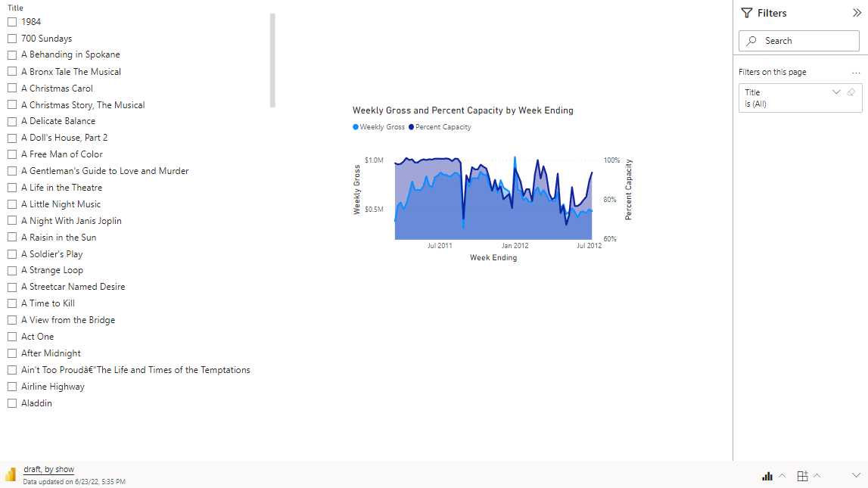
Dashboard with filter by show

Slide 8
What about location?

Slide 9
Graphic about largest/smallest houses by capacity

Slide 10
Scatter of count of shows v capacity? Indicate popularity and/or longevity

Slide 11
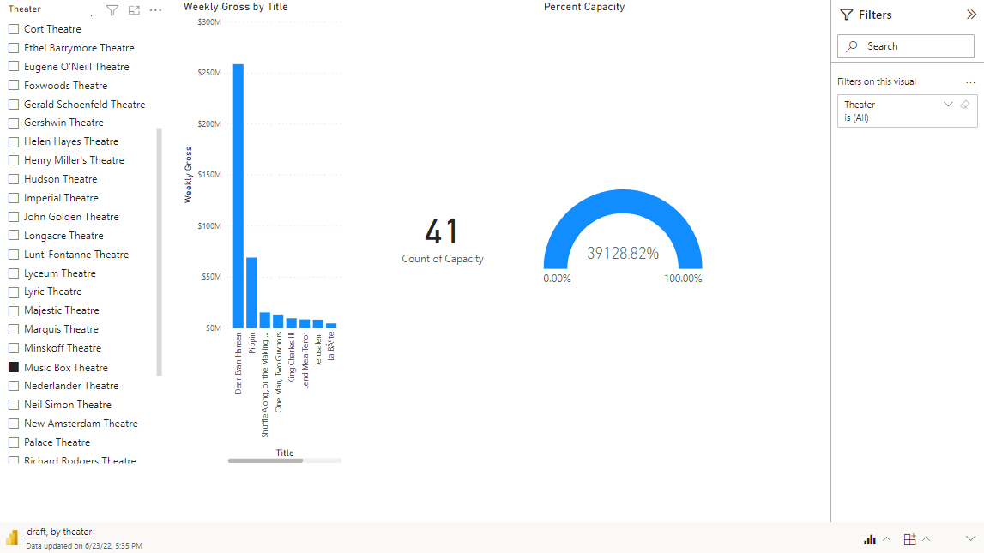

Slide 15
