Slide 1

DATA 601 PROJECT
Can We Predict
Tomorrow’s Economy?
Forecasting Next-Year GDP Per Capita
with Machine Learning
Abijeet Dhillon, Noor Fatima, Tam Nguyen
Date: Oct. 5th, 2026
Notes:
Hi everyone. Our project aims to forecast the next year GDP per capita of a country.

Slide 2
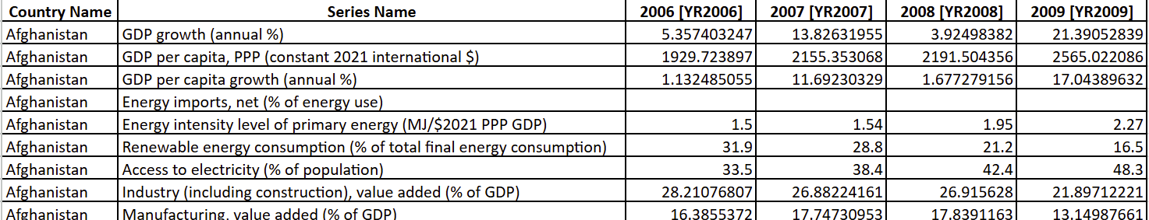
About the Data
Data Source: World Bank — World Development Indicators (WDI)
193
2006–2021
22
GDPₜ₊₁
Countries
Analysis period
Selected indicators
Prediction target
Indicator Groups
Economic
GDP • inflation • trade • capital formation
Energy
energy use • electricity access • energy intensity
Industry & Infrastructure
manufacturing • electricity measures
Development & Environment
urbanization • CO₂ • country characteristics
Notes:
We used World Bank data for 193 countries from 2006 to 2021, using indicators related to the economy, energy, and infrastructure.

Slide 3
2. Data Preprocessing
Preparing a consistent country-year dataset before EDA and machine learning
1
2
3
4
Reshape
Select Years
Filter GDP Data
Missing Predictors
→
→
→
Wide → country-year
2006–2021
217 → 193 countries
Keep NA for EDA
Each row = one country in one year
The missing percentage increases sharply after 2021 (>20%)
Remove countries missing GDP per capita OR GDP growth
Impute later inside the ML pipeline
Why remove these 24 countries?
GDP is used to construct the ML prediction target, so complete GDP per capita and GDP growth history is required.
Country filtering
(3,472, 26)
384
11.06%
(3,088, 26)
shape before
rows removed
of rows removed
shape after
Notes:
Initially, we removed countries with missing GDP information, and filled the remaining missing values.

Slide 4
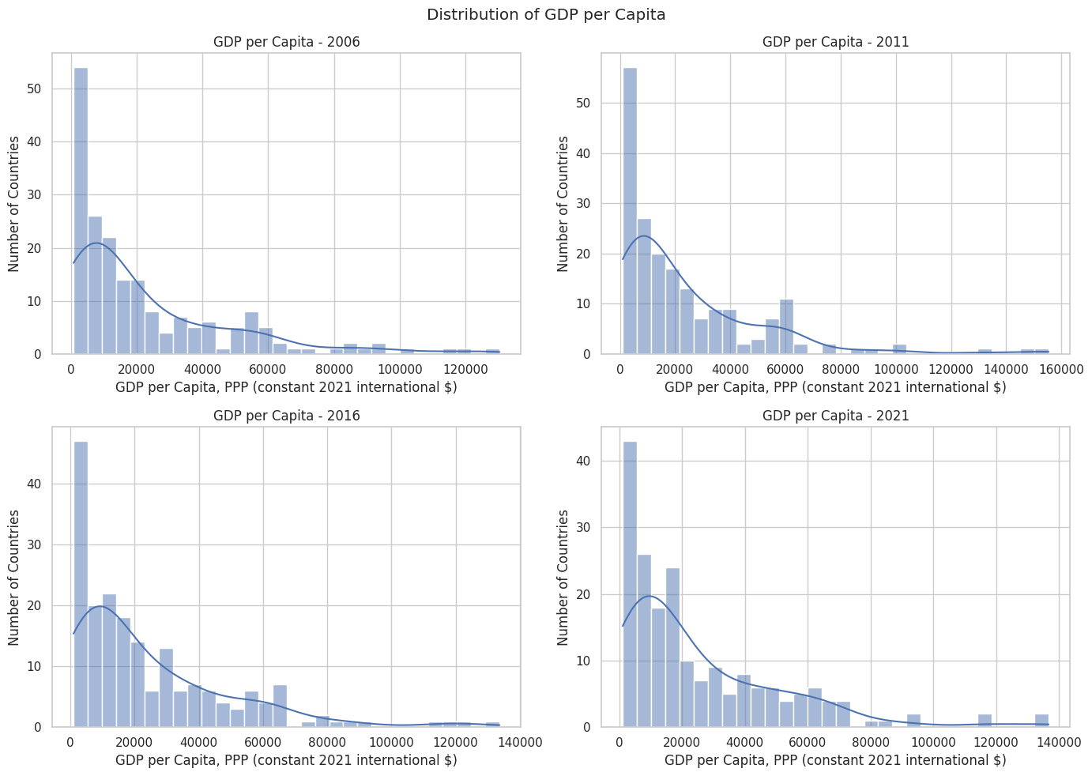
3. Exploratory Data Analysis
GDP per capita is strongly right-skewed
Notes:
Our EDA showed that GDP per capita distribution is strongly right-skewed.

Slide 5
4. Model & Metric Selection
Supervised regression: Year t indicators → continuous GDP per capita in Year t+1
Linear Regression
Decision Tree
Random Forest
XGBoost
WHY
Simple, interpretable baseline
WHY
Capture nonlinear relationships
WHY
Stable ensemble; reduce tree overfitting
WHY
Powerful nonlinear boosted ensemble
HOW
Weighted linear combination
HOW
Recursive predictor splits
HOW
Many trees → average predictions
HOW
Sequentially correct prior errors
How we evaluate the models
MAE ↓
PRIMARY
RMSE ↓
SUPPORTING
R² ↑
SUPPORTING
Average absolute error in GDP-per-capita units
Penalizes large prediction errors more strongly
Proportion of variation in GDP explained
Selection strategy: compare 4 baselines → pick best performance model → tuning → select final model
Notes:
Since GDP per capita is a continuous number, this is a supervised regression problem. We compared four models, Linear Regression, Decision Tree, Random Forest, and XGBoost, and compared them using MAE, RMSE, and R^2.

Slide 6
5. Machine Learning Data Preparation
1
Create Forecast Target
2
Chronological Split
3
Encode Country
Year t predictors → GDP per capita at t+1
Train: 2006–2015 = 10 years → 66.7%
Validation: 2016–2017 = 2 years → 13.3%
Test: 2018–2020 = 3 years → 20%
One-Hot Encoding
Example: 2019 indicators → predict 2020 GDP
Include country information without numeric ranking
4
Handle Missing Predictors
Missing Indicator
+ Forward Fill
+ Training Median
+ Leakage Control
44 inputs entering feature selection = 24 original + 20 missing indicators
5
Feature Selection: Compare Top-Ranked Feature Sets
Chronological validation using predictor years 2016–2017
Feature set
MAE ↓
RMSE ↓
R² ↑
Missing-Indicator Check
Final Feature Reduction
Top 3
666.04
1,325.12
.9974
Top 5
642.86
1,278.51
.9976
Top 10 only
MAE 626.29
44 VARIABLES
Top 10
582.29
1,216.47
.9978
24 original + 20 missing indicators
Top 10 + flags
MAE 581.39
↓
Top 15
618.88
1,323.24
.9974
RMSE = 1,201.66
R² = .9978
17 VARIABLES
Top 20
623.71
1,276.65
.9976
10 original + 7 missing indicators
→ Keep 7 missing indicators
27 fewer inputs • 61.4% reduction
→ Top 10 selected
Lowest MAE = 582.29
Notes:
Next, we prepared our dataset to fit the model.
We started by creating the forecast target and splitting the data chronologically into training, validation, and test sets.
We also encoded country information and handled missing values while preventing data leakage.
For feature selection, we compared different feature sets. The top 10 features gave the lowest validation MAE, and after adding useful missing indicators, we reduced the model from 44 variables to 17

Slide 7
6. Model Performance: Baseline → Tuning → Optimization
1 BASELINE MODELS
2 AFTER TUNING
3 AFTER OPTIMIZATION
Compare all 4 models on validation data
Optimize the two selected ensembles
Test log-transformed GDP target
Model
MAE ↓
RMSE ↓
R² ↑
Random Forest
Random Forest + Log
Decision Tree
948.53
2,233.23
.9925
Best parameters = baseline settings
MAE
$604.34
Random Forest ✓
590.61
1,228.36
.9977
MAE
$590.61
RMSE
$1,257.66
RMSE
$1,228.36
→ Log target did not improve RF
Linear Regression
865.09
1,512.66
.9966
→ No material improvement
XGBoost + Log
XGBoost ✓
693.83
1,518.44
.9965
XGBoost
MAE
$595.45
200 trees • depth 5 • LR .05 • subsample 1.0
RMSE
$1,221.49
MAE
$601.22
SELECT FOR NEXT STAGE
→ Log target improved XGBoost
Random Forest + XGBoost
RMSE
$1,245.98
Bagging vs. Boosting
→ MAE improved by $92.61
Train–Validation gap ≈ $180.11
FLOW
4 Baselines → Select RF + XGBoost → Tune Both → Test Log Target → Select XGBoost + Log for better generalization
Notes:
Then, we trained and compared four baseline models. Random Forest and XGBoost performed best, so we selected them for tuning.
Tuning improved XGBoost, while Random Forest stayed about the same.
since GDP is strongly right skewed, we use a log to transfrom GDP target. It improved XGBoost, so XGBoost with log GDP is our final model

Slide 8
7. Final Model Selection and Training
Final Model Setup
Performance
What does it mean?
XGBoost + Log GDP
MAE ↓
RMSE ↓
R² ↑
1
High test R²
Tuned parameters
The model still explains
97.82% of test variation.
Train
2006–2017
$426.45
$841.13
0.9989
200 trees
max_depth = 5
learning_rate = 0.05
subsample = 1.0
2
Error increased
Test
2018–2020
Test MAE is 3.46× train MAE →
generalization is weaker.
$1,476.45
$3,753.32
0.9782
Final training
3
Benchmark matters
Train + validation combined
2006–2017
Naive
benchmark
XGBoost has higher MAE than naive,
but slightly lower RMSE and higher R².
$1,399.39
$3,837.94
0.9772
↓
Frozen model
Generalization gap
MAE gap = $1,050.00
Key takeaway
Test once: 2018–2020
Strong fit ≠ clear improvement
over a simple GDP baseline.
Notes:
Our final model is XGBoost trained on log GDP, using the tuned settings from cross-validation. We trained it on 2006 to 2017 and tested it once on 2018 to 2020. On the test set, R² is 0.978, so the model still explains almost all the variation. But the average error rises from about $426 in training to $1,476 in testing, which is 3.5 times higher, so generalization is weaker. We also compared against a naive benchmark that just predicts next year's GDP equals this year's. The benchmark has a slightly lower MAE, so our model is only about as good as that simple baseline.

Slide 9
8. Error Analysis: Where Does the Model Struggle?
1 Error by Predictor Year
2 What Drives Error?
3 Largest Errors
Predictor year → forecasts the following year
Size of GDP change
Largest single error
2018 → 2019
$520
Smallest-change group
$532 MAE • 1.6%
Macao SAR, China
Median % err: 1.6%
Largest-change group
$3,449 • 11.0%
Predictor year: 2019
→ Sudden changes are much harder to predict
Current GDP
$133,454
2019 → 2020
$2,350
Median % err: 6.9%
Actual next year
$59,663
GDP level
Predicted
$128,832
2020 → 2021
$1,560
Lowest quartile
$136 MAE
Absolute error
$69,169
Median % err: 4.0%
Highest quartile
$3,373 MAE
Actual GDP change: −55.3%
Median % errors remain roughly
Error concentration
2019 → 2020 is the hardest period
2.5%–5.2% across quartiles
Top 10 countries → 29.2% of total error
MAE ≈ 4.5× the 2018 level
→ Richer economies have larger dollar errors
Top 5% observations → 33.9%
Main finding: the generalization gap is concentrated in sudden economic changes—especially the 2020 shock and subsequent rebound.
Notes:
The gap comes mainly from sudden economic changes. Error is highest when predicting 2020, at $2,350, versus $520 for 2019. The biggest miss is Macao, where GDP fell 55 percent. So the model works in stable years but struggles with shocks like COVID.

Slide 10
THANK YOU
for listening
Q & A
Questions • Comments • Discussion
We'd be happy to hear your questions.

Slide 11
Appendix 1. Feature Selection
1 Permutation Importance
2 Chronological Validation
3 Final Input Checks
Training-period ranking • Country excluded
5-Fold Expanding-Window Validation
Missing indicators
Top 10 ranked predictors
Train on past → validate on next period
Top 10 only
MAE $626.29
1. Current GDP per capita
24,167.8
Feature set
5-Fold Avg. MAE
Top 10 + missing flags
MAE $581.39
2. Inflation
50.1
Top 3
$666.04
→ Keep 7 related missing flags
3. Electric power consumption
18.3
4. Energy use per capita
17.3
Top 5
$642.86
Country sensitivity check
5. CO₂ emissions per capita
16.9
6. Urban population
14.0
Compare the same selected predictors:
Top 10
$582.29
7. GDP per capita growth
11.7
WITHOUT Country ↔ WITH Country
8. Renewable energy consumption
9.2
Top 15
$618.88
Country tested separately from the
permutation ranking.
9. Internet use
7.3
10. Energy intensity
7.0
Top 20
$623.71
Final numeric inputs: 10 + 7 flags = 17
Value = mean increase in MAE after shuffling
Selected: Top 10
Lowest average MAE across 5 folds
Result: Top 10 predictors had the lowest 5-fold average MAE; adding missing indicators improved performance further.

Slide 12
Appendix 2. What Drives Next-Year GDP Predictions?
Interpreting feature contributions — not just model accuracy
Permutation Importance Ranking
What does this tell us?
Increase in MAE when each feature is shuffled
1. Current GDP per capita
24,167.8
1 GDP persistence dominates
Current GDP carries far more predictive information than any other feature.
2. Inflation
50.1
3. Electric power consumption
18.3
4. Energy use per capita
17.3
2 Other indicators add smaller signals
Inflation, energy/electricity use, emissions, urbanization and GDP growth contribute additional information.
5. CO₂ emissions per capita
16.9
6. Urban population
14.0
7. GDP per capita growth
11.7
3 Importance ≠ causal effect
8. Renewable energy consumption
9.2
Permutation importance tells us how useful a feature is for prediction — not whether it causes GDP to rise or fall.
9. Internet use
7.3
10. Energy intensity
7.0
This dominance helps explain why the naive GDP benchmark was so difficult to beat.
Connection to benchmark
Main insight: short-term GDP forecasting is driven primarily by GDP persistence; other indicators provide incremental predictive information.

