Slide 1


DATA 602 PROJECT
Energy Consumption
and Economic Growth
Exploring Energy-Use Patterns and
Economic Development Across Countries
Abijeet Dhillon, Noor Fatima, Tam Nguyen
Date: Oct. 6th, 2026
Photo: Britannica

Slide 2
Why Energy Matters for Economic Development
Energy conditions can shape productivity, costs and the way economies develop over time.
01 RELIABLE ENERGY
02 CURRENT CONCERNS
03 CHANGING PATTERNS
Supports daily activity, production and transportation. Unreliable supply can reduce productivity and increase business costs.
Energy supply, energy security and rising costs can extend into inflation, financial markets and wider economic conditions.
Energy use is not constant. Countries at different stages of development may follow different energy-consumption paths.
WHY UNDERSTANDING THIS MATTERS
Energy & infrastructure
Economic planning
Understanding energy-use patterns can support better long-term economic and energy decisions.
Plan for changing energy needs.
Understand energy–development patterns.
Investment decisions
Environmental policy
Inform resource allocation.
Consider growth, energy use and emissions.
These connections motivate a closer statistical look at energy use across countries.
2
Notes:
Energy is the backbone of an economy. It powers daily activity, production and transport, and when supply is unreliable or costs rise, productivity falls and the effects spread into inflation and financial markets. Energy use also isn't constant: countries at different stages of development may follow different energy paths. That motivates a closer statistical look

Slide 3
Our Research Questions
We focus on differences in energy-use change and the relationship between energy use and GDP.
RQ1
GROUP COMPARISON
RQ2
ENERGY & GDP
Did the change in energy consumption per capita from 2010 to 2021 differ between countries with lower and higher initial levels of economic development?
What is the relationship between energy consumption per capita and GDP per capita across countries in 2021, and how much of the variation in GDP per capita is explained by differences in energy consumption per capita?
Welch t-test + permutation test
Simple linear regression
3
Notes:
We ask two questions. First, did the change in energy use per capita from 2010 to 2021 differ between countries with lower and higher initial development? We tested that with a Welch t-test and a permutation test. Second, what is the relationship between energy use and GDP per capita in 2021, and how much of the variation does energy explain? For that we used simple linear regression

Slide 4
Data & Study Design
Global country-level data from the World Bank’s World Development Indicators.
ANALYTICAL SAMPLE
KEY VARIABLES
HOW THE DATA ARE USED
142
Energy use per capita
RQ1 • 2010 → 2021
kg of oil equivalent
per capita
countries with sufficient data
for both analyses
Calculate 2010–2021 energy-use change. Split countries by median 2010 GDP per capita: lower vs. higher initial development.
GDP per capita
DATA SOURCE
RQ2 • 2021
PPP, constant 2021
international dollars
World Bank
World Development Indicators
Model the relationship between 2021 energy consumption per capita and 2021 GDP per capita.
Complete-case approach • no imputation for missing required analysis data
4
Notes:
Our data come from the World Bank's World Development Indicators, with 142 countries that have sufficient data. The key variables are energy use per capita and GDP per capita, in PPP (purchasing power parity) constant 2021 dollars. For the first question we calculate each country's 2010 to 2021 change and split countries at the median 2010 GDP. For the second we use 2021 only. We used complete cases and did no imputation.

Slide 5
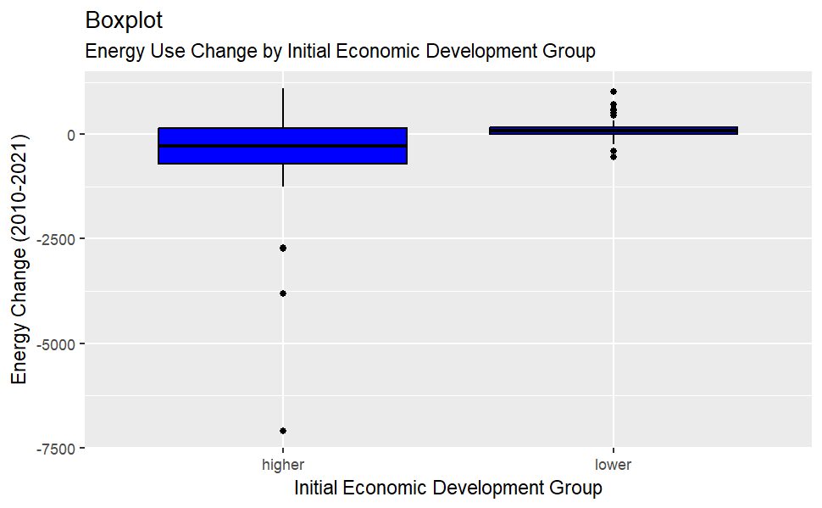
RQ1 — What Does the Data Show?
Energy-use changes differ sharply between the two initial-development groups.
HIGHER INITIAL DEVELOPMENT
−445.8 kg
SD = 1,115.3 kg
Mean change in energy use per capita, 2010–2021
LOWER INITIAL DEVELOPMENT
+121.7 kg
SD = 230.6 kg
Mean change in energy use per capita, 2010–2021
Higher-development countries decreased on average, while lower-development countries increased.
5
Notes:
Our first research question asks if energy use changes differently between the two development groups?
Between 2010 and 2021, energy use in the higher development group fell by about 440 kilograms, on average. In the lower development group, it rose by about 120 kilograms.
Higher development countries tended to use less energy per person, while lower development countries tended to use more.
Energy use changes also varied much more in the higher development group, with a standard deviation of around 1,100, compared with around 230 in the lower group.

Slide 6
RQ1 — Statistical Results
The two development groups show a statistically significant difference in mean energy-use change.
HYPOTHESES
STATISTICAL RESULTS
Δ Energy = Energy Use₂₀₂₁ − Energy Use₂₀₁₀
Welch t-test
t = −4.20 • p ≈ 0.00007
H₀:
μΔ,Higher = μΔ,Lower
Permutation test
p ≈ 0.0005
Hₐ:
μΔ,Higher ≠ μΔ,Lower
95% CI (Higher - Lower)
[-836.7039 and -298.2768]
WHAT THIS MEANS
There is sufficient evidence that mean energy-use change differs between the two initial-development groups.
Higher-development countries decreased on average, while lower-development countries increased.
6
Notes:
To test whether this difference likely extends beyond the countries in our sample.
Our null hypothesis was that both groups had the same average change in energy use. The alternative hypothesis was that their average changes are different.
We used a Welch t-test, which gave a t-statistic of about minus 4.2 and a p-value close to zero. A permutation test gave a p-value close to zero as well.
The 95% confidence interval for the difference between the higher and lower groups was also entirely negative.
Since both p-values were well below our significance level of 0.05, we rejected the null hypothesis.
This all supports the conclusion that the two groups had different changes in mean energy use.

Slide 7
RQ1 — Sensitivity Analysis
Does the same pattern remain when the pandemic years are excluded?
We repeated the analysis using 2010 → 2019, while keeping the same development groups based on 2010 GDP per capita.
2010 → 2021
−567.49 kg
2010 → 2019
−473.26 kg
Difference in mean energy-use change (Higher − Lower)
2010 → 2019 EVIDENCE
Welch t-test: p ≈ 0.0003 • Permutation test: p = 0.0005 • 95% CI: [−719.11, −227.42] kg
WHAT THIS MEANS
The gap becomes smaller, but the direction and statistical conclusion remain the same.
The difference in energy-use paths was already present before the 2020–2021 pandemic period.
7
Notes:
One concern was that our data included 2020 and 2021, when COVID-19 lockdowns and changes in economic activity may have affected energy use.
We wanted to confirm our conclusion would hold without those years, so we repeated the analysis from 2010 to 2019, keeping everything else the same.
For 2010 to 2021, the difference between the groups was about 570 kilograms, but ending in 2019 reduced that gap to about 470 kilograms.
However, the conclusion stayed the same. The Welch t-test still gave a very small p-value, the permutation test’s p-value was unchanged, and the confidence interval was again entirely negative.
From this, we can conclude higher and lower development countries showed different changes in energy use, on average.

Slide 8
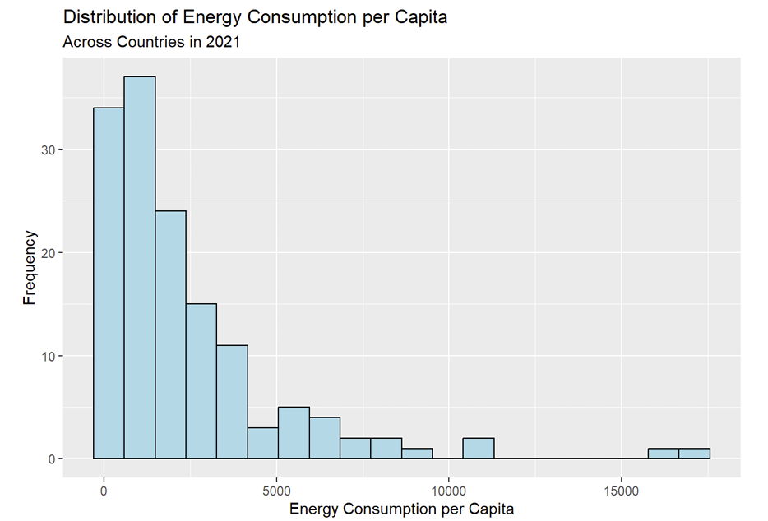
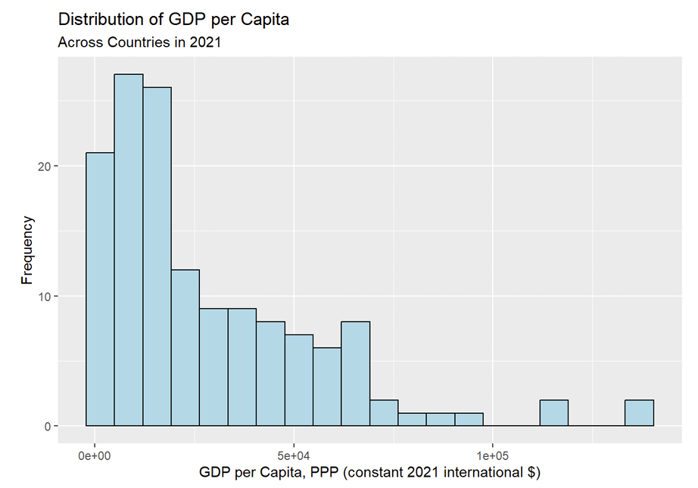
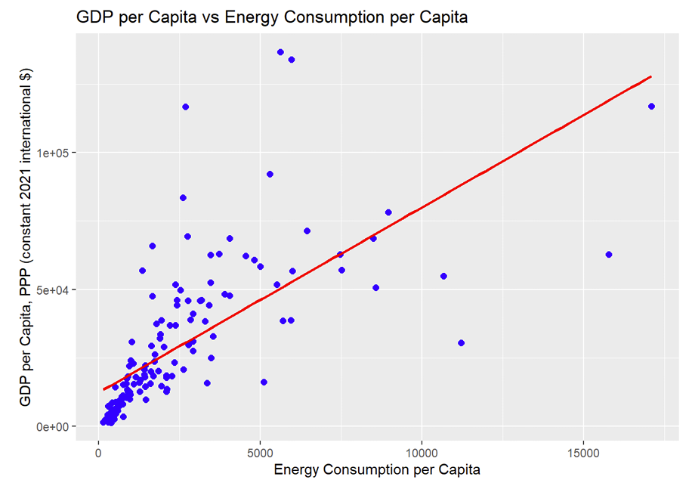
RQ2 — Exploring Energy & GDP in 2021
The distributions are strongly right-skewed, while the two variables show a positive association.
ENERGY USE PER CAPITA
GDP PER CAPITA
ENERGY USE vs. GDP
The distributions of both variables are right-skewed
The scatterplot suggests a positive relationship between energy consumption per capita and GDP per capita.
However, the extreme values and uneven spread suggest the original-scale regression conditions need to be checked.
8
Notes:
Now, moving to our second research question, we examine the relationship between energy consumption per capita and GDP per capita across countries in 2021.
First, we explored the distributions of both variables. As we can see from the two histograms, both variables are strongly right-skewed, with a few countries having extremely high values.
The scatterplot shows a clear positive relationship: countries with higher energy consumption tend to have higher GDP per capita.
However, we can also see some extreme values and an uneven spread. So, before making any statistical inference, we need to check if the assumptions of the linear regression model are satisfied.

Slide 9
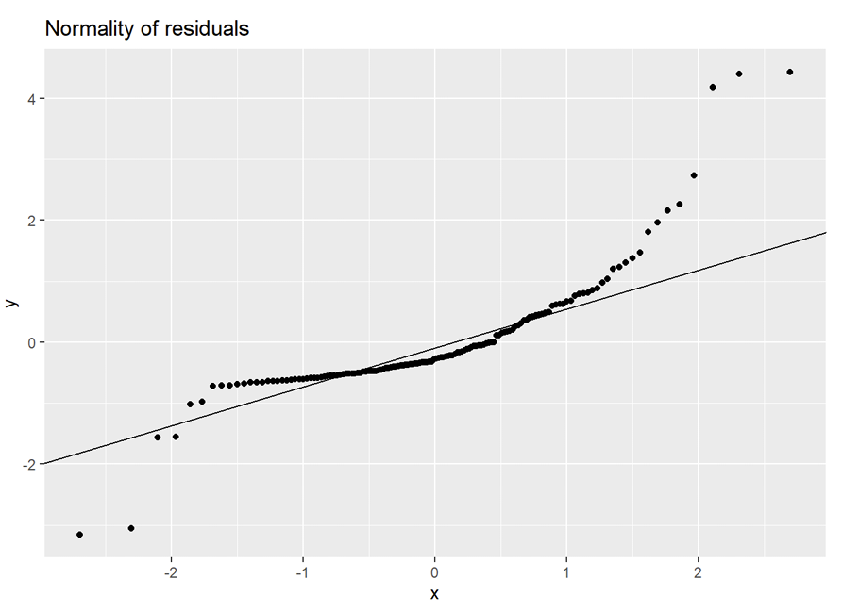
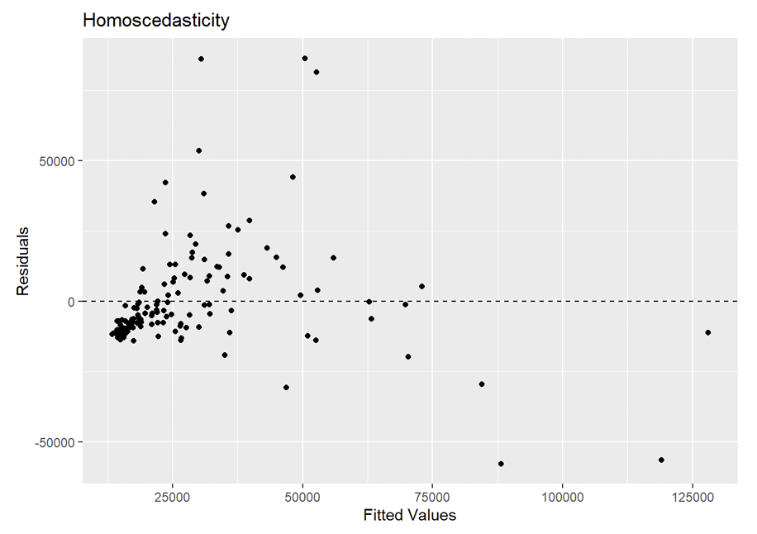
RQ2 — Checking the Original Regression Model
The original-scale relationship is positive, but the residual diagnostics show that key model conditions are not satisfied.
Original model: GDP per capita = β₀ + β₁(Energy consumption per capita) + ε
NORMALITY OF RESIDUALS
HOMOSCEDASTICITY
Residuals are not approximately normal.
Constant variance is violated.
These diagnostics motivate transforming both energy use and GDP per capita before refitting the model.
9
Notes:
Next, we fitted the original linear regression model, with GDP per capita as the response variable and energy consumption per capita as the predictor.
First, the residuals do not follow the straight line. This suggests that the residuals are not approximately normal.
Second, the residual plot shows an uneven spread as the fitted values increase. This means the constant variance assumption is violated.
Although the relationship is positive, key regression assumptions are not satisfied, we decided to use log to transform both variables and then refit the model.

Slide 10
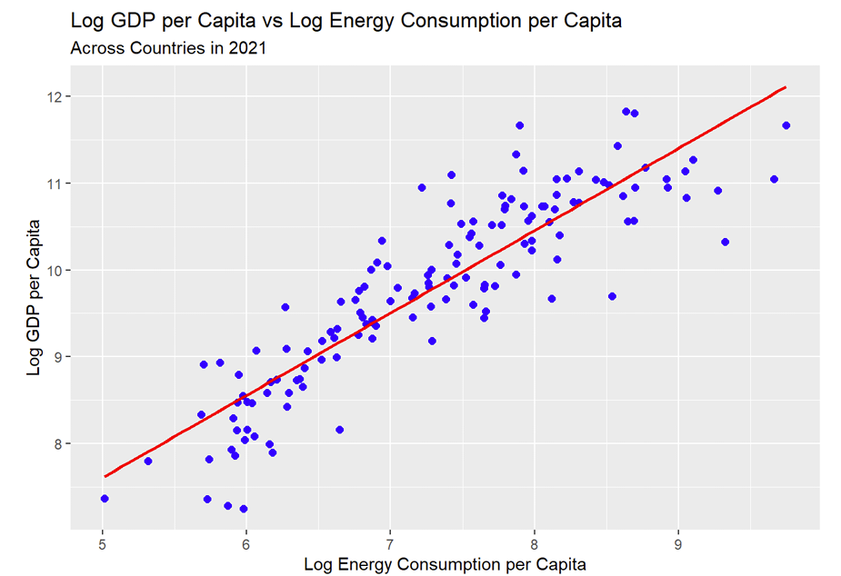
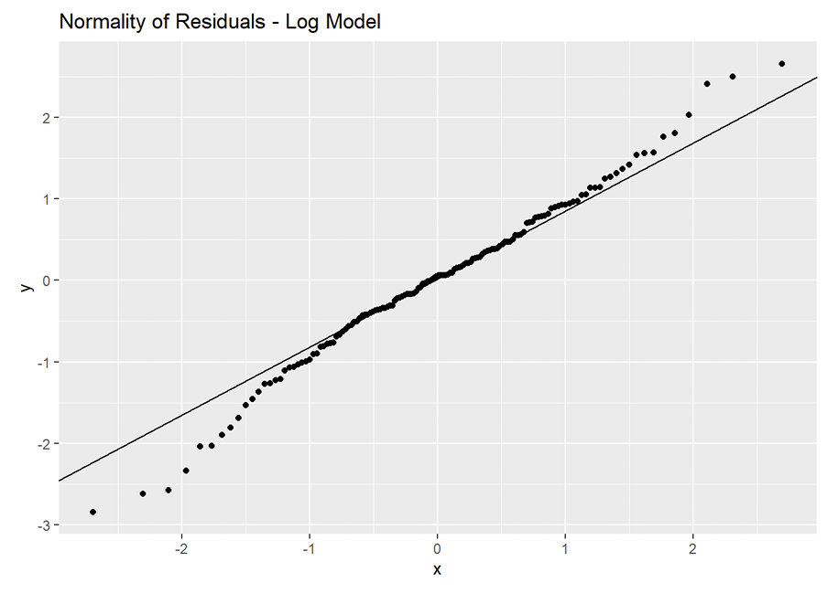
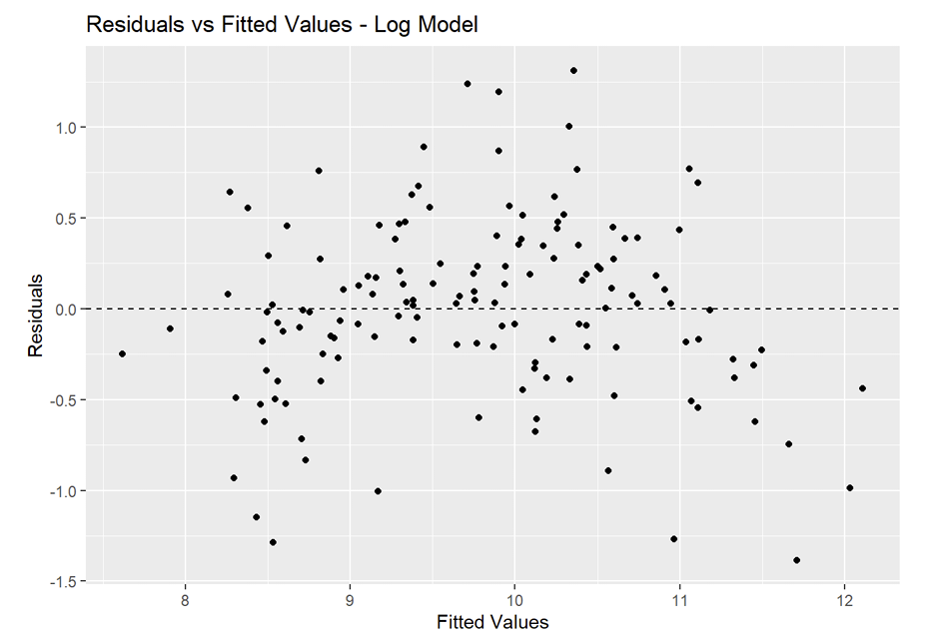
RQ2 — Log Transformation Improves the Model
After the original model failed key diagnostic checks, both GDP per capita and energy use were transformed using logarithms.
log(GDP) = β₀ + β₁ log(Energy) + ε
LOG–LOG RELATIONSHIP
NORMALITY — LOG MODEL
CONSTANT VARIANCE — LOG MODEL
A clearer linear relationship after transformation.
Residuals lie much closer to the reference line.
Residual spread is more consistent across fitted values.
The regression assumption were reasonably satisfied, so the log-transformed model is used for the final RQ2 inference.
10
Notes:
After we applied a log transformation to both variables, the results show a clear improvement.
On the left, the log-log scatterplot shows a more linear relationship.
In the middle, the residuals are now much closer to the reference line, so the normality condition has improved.
And on the right, the residuals have a more consistent spread across the fitted values, so the constant variance condition has also improved.
Therefore, the regression assumptions are now reasonably satisfied, and we use this log-transformed model for our final statistical inference.

Slide 11
RQ2 — Statistical Results
How strongly is energy consumption per capita associated with GDP per capita across countries in 2021?
WHAT THIS MEANS
MODEL & HYPOTHESIS
log(GDP) = β₀ + β₁ log(Energy) + ε
A 1% increase in energy use per capita is associated with about a 0.95% increase in GDP per capita, on average.
H₀: β₁ = 0
Hₐ: β₁ ≠ 0
ESTIMATED REGRESSION MODEL
log(GDP) = 2.8695 + 0.9479 × log(Energy)
The p-value is far below 0.05 and the 95% confidence interval does not include 0.
STRENGTH OF THE RELATIONSHIP
STATISTICAL RESULTS
r = 0.8872
Strong positive linear association
Slope (β̂₁)
0.9479
p-value
7.04 × 10⁻⁴⁹
R² = 0.7871
78.71% of the variation in log GDP per capita is explained by log energy use.
95% CI
[0.8656, 1.0303]
Pearson r
0.8872
R²
0.7871
11
Notes:
Finally, here are the results from our log-transformed model.
We tested the null hypothesis that the slope is zero against the alternative that the slope is not zero.
The estimated slope is 0.9479, the a p-value is extremely close to zero. The entire 95% confidence interval are above 0. Therefore, we reject the null hypothesis and have sufficient statistical evidence to conclude that there is a significant positive relationship between energy consumption and GDP per capita.
We have an R-squared of 0.787. This means approximately 78.7% of the variation in log GDP per capita is explained by its linear relationship with log energy consumption.

Slide 12
Final Discussion
The two analyses tell a more broader story than simply “more energy means more economic development.
RQ1
RQ2
Energy-use trajectories differ across development stages.
Across countries, higher energy use is closely associated with higher GDP per capita.
From 2010–2021, lower-development countries increased energy use per capita on average, while higher-development countries decreased.
The pattern was not solely a pandemic effect.
A 1% increase in energy use was associated with about a 0.95% increase in GDP per capita.
The model explained 78.71% of variation in log GDP.
Taken together, the results suggest that energy and economic development are strongly connected, but the relationship is dynamic: countries with higher income tend to use more energy, while changes in energy use over time may follow different paths as economies develop.
These findings describe cross-country patterns and associations; they should not be interpreted as evidence that changes in energy use cause changes in GDP.
12
Notes:
For the first question, lower-development countries increased their energy use on average, while higher-development countries decreased it, and both tests found the difference significant. When we repeated the analysis for 2010 to 2019, the result held, so it isn't just a pandemic effect. For the second question, a 1% increase in energy use is associated with about a 0.95% higher GDP per capita, and the model explains about 78.7% of the variation in log GDP. Together, energy and development are strongly connected, but the relationship changes over time. These are associations, not proof that energy causes GDP growth

Slide 13
Thank You for Listening
Questions & Discussion
13
Notes:
Why use the median to divide the groups? The median gives us a simple and objective cutoff and creates two similarly sized groups.
Why not use the mean GDP as the cutoff?GDP per capita can be strongly affected by very high-income countries. The median is less sensitive to extreme values.
Why did you use Welch’s t-test? Welch’s t-test compares two independent means without requiring the two groups to have equal variances.
Why not use a paired t-test? Because we already calculated one change value for each country, and then we compare those change values between two independent groups.
Why did you also use a permutation test?It provides another way to test the group difference with fewer distributional assumptions.
Can you say every lower-development country increased energy use? No. We are comparing group averages. Individual countries can behave differently.
Why did you log both variables instead of only GDP? Both variables were strongly right-skewed, so transforming both produced a clearer linear relationship and better diagnostics.
Why can you interpret the slope as a percentage?, Because both variables are log-transformed. In a log-log model, the slope represents the percentage change in Y for a 1% change in X.
If you switch X and Y, will the regression be the same? No. Regression is directional, so switching X and Y changes the regression equation. Correlation, however, stays the same.
What is a Type I error here? Concluding there is a relationship between log energy and log GDP when there actually is no relationship in the population.
Why not just remove the extreme countries instead of using logs? Extreme values are not necessarily errors. They are real countries, so we should not remove them without justification. Log transformation reduces their influence while keeping the observations
What is your biggest limitation?This is observational, cross-sectional data from one year, so we can identify association but cannot establish causation.

