Slide 1
ALIZON SCHOOL OF MEDICAL & DIGITAL INTELLIGENCE
Pharmacy AI · Module 1 — AI Foundations & Digital Systems
How to do Practical 1 and Practical 2
What the practical is, what you are doing, and how to work it
Practical 1 · Designing a Drug-like Candidate using Machine Learning (Unit 1)
Practical 2 · Data Breach Response Simulation (Unit 3)

Slide 2
Module 1 · overview
Two practicals, two different skills
 | Practical 1 | Practical 2
Unit | Unit 1 | Unit 3
You are | Designing a drug-like candidate | Responding to a live data breach
You work with | A molecule and its predicted properties | An incident arriving on a clock
The skill | Reading an AI prediction and acting on it | Deciding correctly under time and pressure
Assessed by | Question paper (20) + report | Six-criterion rubric out of 100
Both are AI-foundation practicals: one asks what the model predicts and what you do about it, the other asks what you do when digital systems fail and personal data is exposed.
ALIZON OS · Pharmacy AI · Module 1 — AI Foundations & Digital Systems

Slide 3
Before either practical
The shape of every practical
Briefing — aim, principle, theory, requirements, procedure and guided method. Read it before touching anything.
The work area — the molecule builder, or the incident room. This is where the marks are earned.
Result & Record — the generated report and your mark.
You then write your own report, attach the required PDFs and submit it to faculty.
Download PDF gives you a real PDF file of the letterheaded report to keep.
Everything in both practicals is simulated for teaching. No molecule here is a medicine and no record here belongs to a real person.
ALIZON OS · Pharmacy AI · Module 1 — AI Foundations & Digital Systems

Slide 4
PRACTICAL 1 · UNIT 1
Designing a Drug-like Candidate using Machine Learning

Slide 5
Practical 1 · what you are doing
Aim
To design a candidate drug molecule in-silico, correct faulty candidates, and evaluate its drug-likeness and predicted oral bioavailability using an AI (machine-learning) model.
You will need
AI molecule synthesizer / design tool
Property sliders (MW, LogP, TPSA, H-bond donors/acceptors, rotatable bonds)
Machine-learning drug-likeness classifier
Lipinski & Veber rule references
Built-in report generator
ALIZON OS · Pharmacy AI · Module 1 — AI Foundations & Digital Systems

Slide 6
Practical 1 · why it works
Principle
Most oral drugs share physicochemical properties captured by Lipinski’s Rule of Five (MW ≤ 500, LogP ≤ 5, H-bond donors ≤ 5, acceptors ≤ 10) and Veber’s rules (rotatable bonds ≤ 10, TPSA ≤ 140). A machine-learning classifier learns the relationship between these descriptors and drug-likeness/bioavailability, screening candidates rapidly before laboratory work.
AI/ML/DL learn patterns from data. A logistic-regression classifier outputs a probability (0–1) of drug-likeness from molecular descriptors. High TPSA and molecular weight reduce membrane permeability and oral absorption; balanced lipophilicity (LogP ~2–3) improves it. In-silico screening cuts cost and time in early drug discovery.
ALIZON OS · Pharmacy AI · Module 1 — AI Foundations & Digital Systems

Slide 7
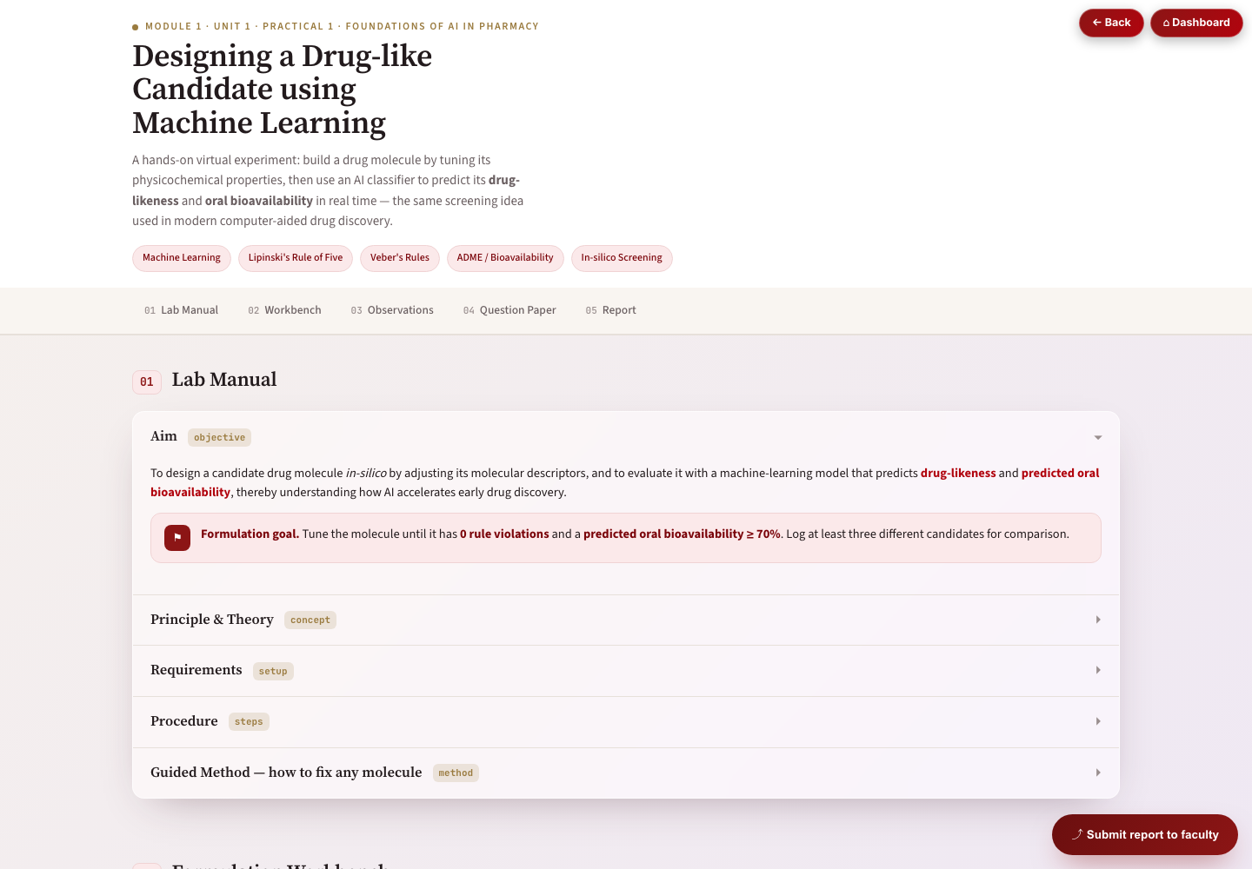
Practical 1 · screen tour
What is on the bench
 | Panel
1 | Lab Manual — the experiment sheet you work from
2 | Molecule Builder — load a scaffold, then edit it
3 | AI Analysis — predicted properties and gauges
4 | Formulation Workbench
5 | Fix the Medicine — nine clinical challenges
6 | Observation Table — recorded as you go
7 | Practical Question Paper — assigned by code
8 | Generate Report
01 Lab Manual — the experiment sheet, opened at the Aim
ALIZON OS · Pharmacy AI · Module 1 — AI Foundations & Digital Systems

Slide 8
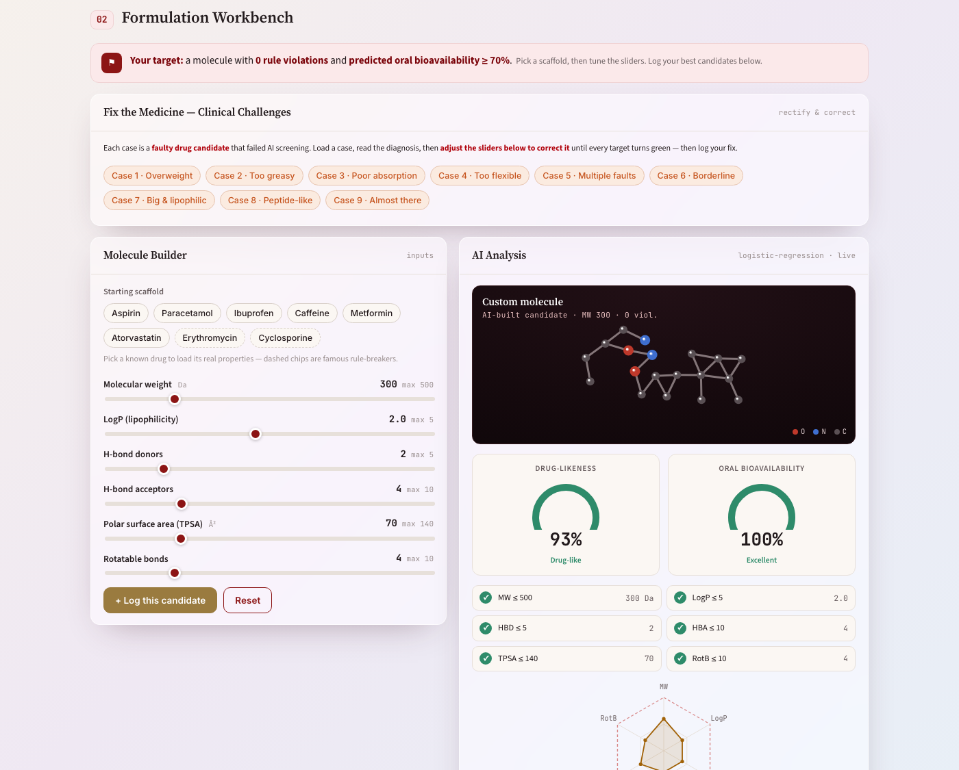
Practical 1 · the bench
Molecule Builder and AI Analysis, side by side
02 Formulation Workbench — sliders on the left, the AI verdict on the right. Every rule that passes turns green.
ALIZON OS · Pharmacy AI · Module 1 — AI Foundations & Digital Systems

Slide 9
Practical 1 · what the AI reports
The properties you are reading
Descriptor | Target | What it means
MW | ≤ 500 | Molecular weight
LogP | ≤ 5 (ideal 1–3) | Lipophilicity
HBD | ≤ 5 | Hydrogen-bond donors
HBA | ≤ 10 | Hydrogen-bond acceptors
TPSA | ≤ 140 (< 90 well absorbed) | Topological polar surface area
RotB | — | Rotatable bonds — molecular flexibility
A candidate that meets the targets is predicted to be more drug-like by mouth. It is a prediction from the structure, not a measurement in a patient.
ALIZON OS · Pharmacy AI · Module 1 — AI Foundations & Digital Systems

Slide 10
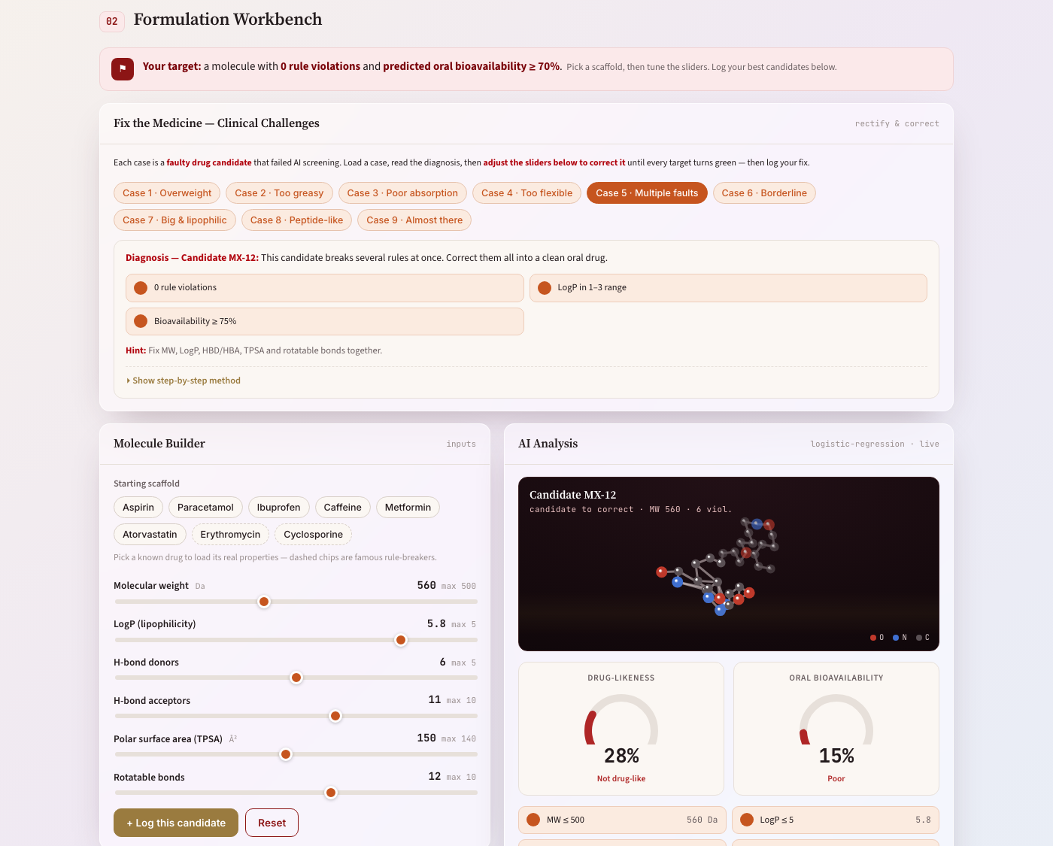
Practical 1 · how to do it
Procedure, in order
Load a molecular scaffold into the AI synthesizer.
Tune the physicochemical properties using the sliders.
Correct any candidate that violates Lipinski or Veber rules.
Read the AI gauges for predicted drug-likeness and oral bioavailability.
Select your best candidate and record its properties.
Generate the report with your results.
A faulty candidate loaded from Fix the Medicine — read the diagnosis, then correct it
ALIZON OS · Pharmacy AI · Module 1 — AI Foundations & Digital Systems

Slide 11
Practical 1 · the challenges
Fix the Medicine — nine cases
Case 1 · Overweight
Case 2 · Too greasy
Case 3 · Poor absorption
Case 4 · Too flexible
Case 5 · Multiple faults
Case 6 · Borderline
Case 7 · Big & lipophilic
Case 8 · Peptide-like
Case 9 · Almost there
Each case has one identifiable fault. Name the rule that is broken before editing the molecule — then fix that, and check you have not broken another.
ALIZON OS · Pharmacy AI · Module 1 — AI Foundations & Digital Systems

Slide 12
Practical 1 · the rules
Guided method
Start from a scaffold and watch the AI gauges as you adjust each property.
Keep MW ≤ 500 and LogP around 2–3; lower TPSA below ~90 to raise predicted bioavailability.
Fix any rule violation the model flags (e.g. too many H-bond donors).
Compare candidates and keep the one with the highest drug-likeness and bioavailability.
Name your best molecule and generate the report.
ALIZON OS · Pharmacy AI · Module 1 — AI Foundations & Digital Systems

Slide 13
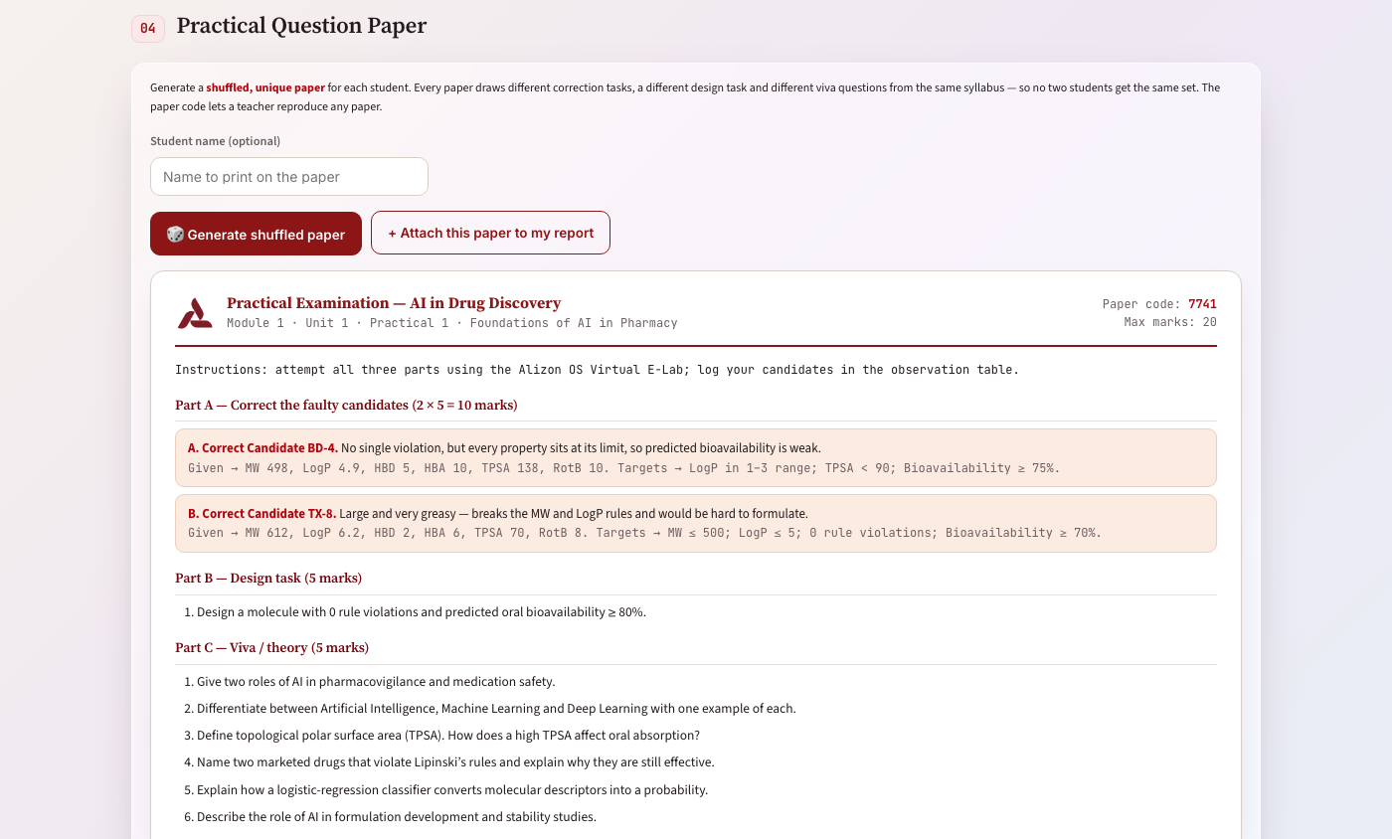
Practical 1 · assessment
Question paper and report
Section | Task | Marks
Part A | Correct the faulty candidates | 2 × 5 = 10
Part B | Design task | 5
Part C | Viva / theory | 5
Total |  | 20
Your report must contain
Experiment · Principle · Best Designed Candidate · Method · Observation Table · Observation · Result · Discussion · Conclusion
04 A generated paper — every student gets a different one, traceable by its paper code
ALIZON OS · Pharmacy AI · Module 1 — AI Foundations & Digital Systems

Slide 14
Practical 1 · teaching notes
What to draw out in class
The rules are a guide, not a law. A violation is something the student must explain, not an automatic fail — real marketed drugs break them.
The gauges are model predictions, not measurements. Say so out loud: bioavailability here is estimated from the descriptors, not observed in a patient.
Each "Fix the Medicine" case has one identifiable fault. Make students name which rule is broken BEFORE they start editing the molecule.
The observation table must be filled as they work. A student who reconstructs it at the end has skipped the experiment and it shows in the discussion.
ALIZON OS · Pharmacy AI · Module 1 — AI Foundations & Digital Systems

Slide 15
PRACTICAL 2 · UNIT 3
Data Breach Response Simulation

Slide 16
Practical 2 · what you are doing
Aim
To respond to a live personal data breach in a hospital pharmacy — containing it, assessing its scope and risk, deciding notifiability under the Digital Personal Data Protection Act, and handling the requests and pressures that arrive while the response is under way.
You will need
Live incident with an inbox that develops as the response proceeds
Scope data — number of Data Principals and categories of personal data involved
Containment action set requiring correct sequencing
DPDP Act 2023 notification framework
A subject access request from an affected individual
ALIZON OS · Pharmacy AI · Module 1 — AI Foundations & Digital Systems

Slide 17
Practical 2 · why it works
Principle
A personal data breach is any event leading to unauthorised access to, or disclosure, loss or alteration of, personal data. In healthcare the data is sensitive by nature, and the harm is rarely financial: it is stigma, discrimination, loss of employment, damaged relationships and the erosion of the trust on which clinical disclosure depends. Response follows a fixed sequence. Contain first, working outward from what you still control to what you do not.
Remember: containment comes before investigation. Every hour the exposure continues the breach grows, and the instinct to establish the facts first is the instinct that lets a leak keep leaking.
Two pressures arrive predictably during a breach response and both must be refused. The first is the request to disclose aggregate figures to the press on the argument that counts are not personal data. In a defined cohort this is false: small cell counts within a known group at a known institution over a known period are a recognised disclosure risk, which is precisely why statistical disclosure control suppresses them…
ALIZON OS · Pharmacy AI · Module 1 — AI Foundations & Digital Systems

Slide 18
Practical 2 · the incident
What arrives, and when
INC-2026-0803 · Data Breach Response
Mon 08:12 — the exposure is discovered
Mon 08:40 — pressure to keep producing the discharge lists
Mon 11:05 — a subject access request arrives
Mon 14:20 — a request for an improper disclosure
The events arrive while you are still dealing with the first one. That is deliberate — the practical assesses what you do under pressure, not what you would do with unlimited time.
ALIZON OS · Pharmacy AI · Module 1 — AI Foundations & Digital Systems

Slide 19
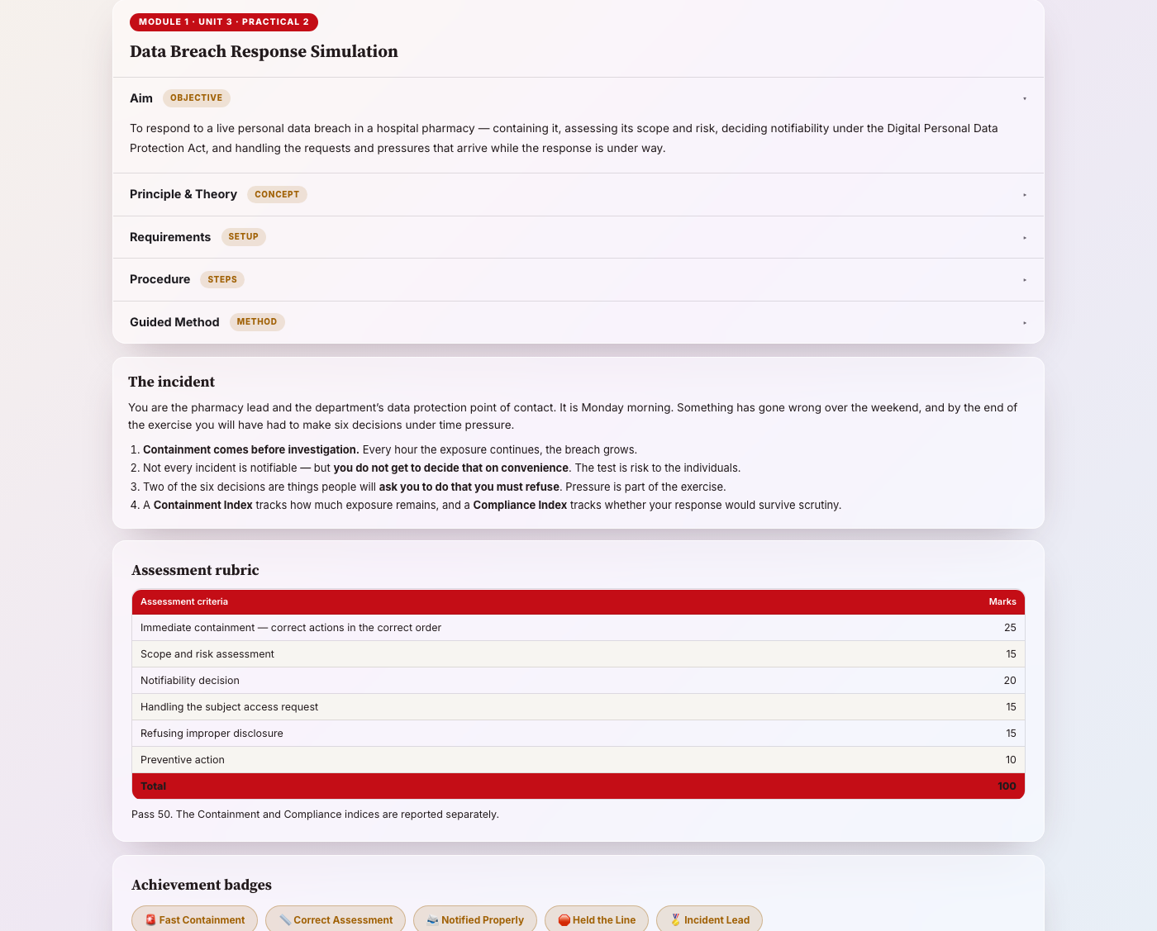
Practical 2 · screen tour
What is in the incident room
 | Panel
1 | Incident inbox — events arrive on a clock
2 | The incident — what is known so far
3 | Stage-by-stage decisions
4 | Assessment rubric — visible while you work
5 | Achievement badges
6 | Incident report & regulatory outcome
The briefing — read before the clock starts
ALIZON OS · Pharmacy AI · Module 1 — AI Foundations & Digital Systems

Slide 20
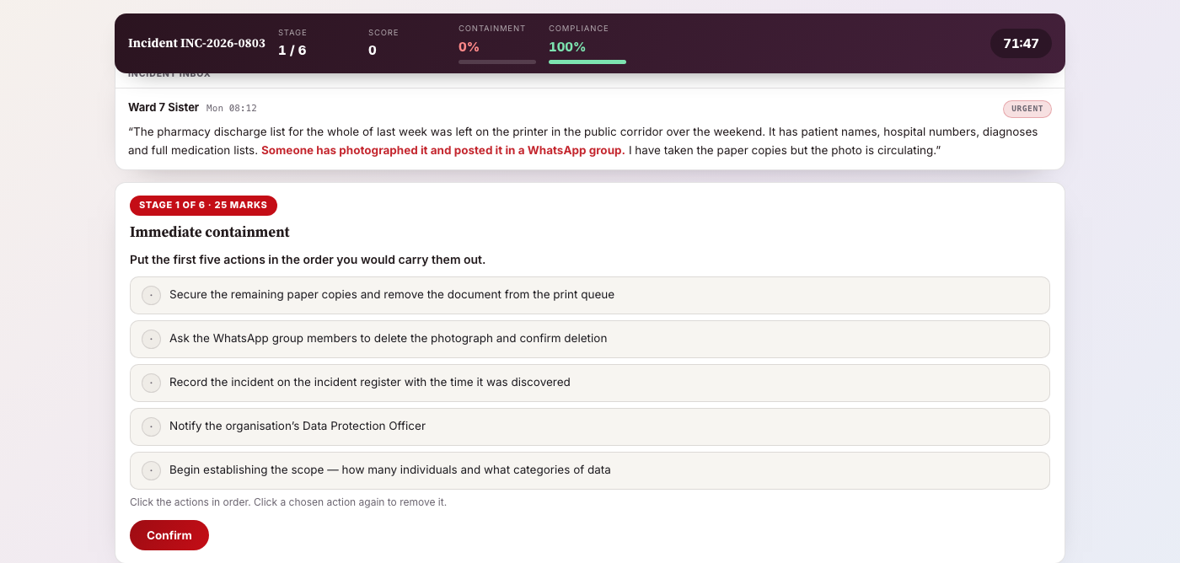
Practical 2 · how to do it
Procedure, in order
Contain the exposure in the correct order, securing what you control before pursuing what you do not.
Assess the risk by consequence to the individuals, not by the format of the record.
Decide notifiability and notify both the Board and every affected Data Principal.
Handle the subject access request — verify identity, inform, and disclose their own data within the statutory period.
Refuse the improper disclosure, refer it to the proper channel and document the approach.
Propose preventive action that removes the conditions that made the breach possible.
Stage 1 of 6 · Immediate containment · 25 marks — order the five actions against the clock
ALIZON OS · Pharmacy AI · Module 1 — AI Foundations & Digital Systems

Slide 21
Practical 2 · the rules
Guided method
Secure the paper and the print queue before chasing the photograph — you cannot unshare a message, but you can stop the next one.
Write down the discovery time immediately; every clock in the response starts there.
Assess risk by asking what the worst realistic consequence is for the most vulnerable person on the list.
Treat no financial data was involved as irrelevant when the data is clinical.
When someone tells you a number is not personal data, ask how small the group is.
Never delete, reset or tidy anything during an incident — preserve first, explain later.
Choose preventive actions that would have stopped this specific breach without anyone having to remember anything.
Golden rule: notifiability is decided by risk to the individuals, not by how inconvenient notification would be. And small counts within a defined clinical cohort — nine patients from the addiction service — are close to identifying, whatever anyone tells you about aggregate figures.
ALIZON OS · Pharmacy AI · Module 1 — AI Foundations & Digital Systems

Slide 22
Practical 2 · assessment
How the 100 marks are awarded
Assessment criterion | Marks
Immediate containment | 25
Scope and risk assessment | 15
Notifiability decision | 20
Handling the subject access request | 15
Refusing improper disclosure | 15
Preventive action | 10
Total | 100
The rubric is on screen while you work. Containment carries the most marks, and preventive action — the smallest — is the only one that stops it recurring.
ALIZON OS · Pharmacy AI · Module 1 — AI Foundations & Digital Systems

Slide 23
Practical 2 · teaching notes
What to draw out in class
Containment carries the most marks (25) and it is an ordered task: secure what you control before chasing what you do not.
Notifiability is a threshold decision, not a reflex. Students must say what made it notifiable — or defensibly why it was not.
The access request and the improper-disclosure pressure arrive WHILE the incident is live. Handling pressure under time is the skill being assessed.
Preventive action is the smallest weight and the only one that stops it happening again. Do not let them skip it because the clock is running.
ALIZON OS · Pharmacy AI · Module 1 — AI Foundations & Digital Systems

Slide 24
Delivery
Running the session
Stage | What the tutor does | Time
Briefing | Read the aim and principle together. | 10 min
Demonstration | Build one molecule, or open one incident event — then stop. | 10 min
Independent work | Students work alone. Let them break a rule and see the gauge move. | 45 min
Report | Write, attach PDFs, submit to faculty. | 20 min
Debrief | Compare two students who fixed the same case differently. | 15 min
ALIZON OS · Pharmacy AI · Module 1 — AI Foundations & Digital Systems

Slide 25
Submission
What you hand in
The practical generates your result automatically on the Result & Record tab.
You then write your own report — a minimum word count is enforced before it can be generated.
Download PDF produces a real PDF file of the letterheaded report. Keep it.
Attach the required PDFs and submit. It goes to the faculty evaluation queue.
Faculty return a mark, and it appears on your dashboard against Module 1.
ALIZON OS · Pharmacy AI · Module 1 — AI Foundations & Digital Systems

Slide 26
Limitations
State these plainly
Every molecule, patient, record and incident in these practicals is simulated for teaching.
The predicted properties are model estimates from structure — not laboratory measurements and not clinical results.
Nothing produced here may be used to make a decision about a real medicine or a real patient.
The regulatory judgements are exercises in principle. Follow your institution’s actual procedure in practice.
Students must state these limitations in their own report — it carries marks in the discussion.
ALIZON OS · Pharmacy AI · Module 1 — AI Foundations & Digital Systems

Slide 27
Questions
Pharmacy AI · Module 1 · Practicals 1 and 2
ALIZON OS

