Slide 1
Physics-Informed Neural Network for
Mode I Stress Intensity Factor Extraction
Abijeet Rajasekaran
Williams-Enriched PINN · FEniCS Validation · Plane Stress & Plane Strain

Slide 2
Overview
What
How
Why
A Physics-Informed Neural Network (PINN) trained to compute the Mode I Stress Intensity Factor (K₁) in cracked concrete slabs under tensile loading — no finite-element mesh required.
The network solves the governing linear elasticity PDEs while embedding the Williams singular near-tip displacement field directly in its architecture. K₁ is extracted as a learnable scalar parameter.
Validated against the Tada handbook formula and an independent FEniCS FEM solution. Both plane stress and plane strain formulations implemented. Final errors: 3.3 – 5.8 % vs FEM reference.
This module is the computational backend of a rover-mounted structural inspection system integrating computer-vision crack detection with real-time LEFM assessment.
2 / 11

Slide 3
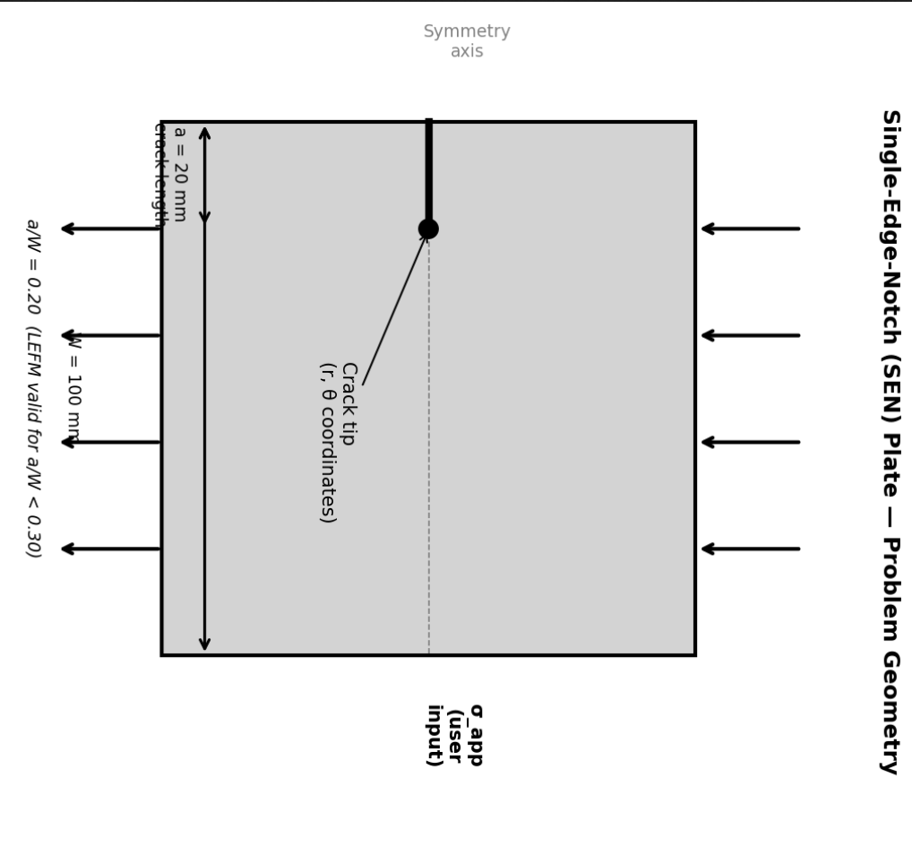
Problem Geometry — SEN Plate
Material
Concrete — isotropic linear elastic
E = 30,000 MPa ν = 0.20
Geometry
Single-Edge-Notch (SEN) plate
W = 100 mm, H = 100 mm
Crack
Length a = 20 mm
a/W = 0.20 (LEFM valid: a/W < 0.30)
Loading
Uniform tension σ_app = 100 MPa
(user-specifiable in deployed system)
Mode
Mode I (opening) only
Vertical crack, perpendicular to load
3 / 11

Slide 4
Objectives
Extract K₁ accurately
1
Train a PINN to produce K₁ within 5% of FEM reference for Mode I edge cracks in concrete with a/W ≤ 0.3.
Variable user load
2
Accept user-specified σ_app so that a practitioner can input the real in-situ load and obtain the actual K₁ — not just a dimensionless factor.
Structural safety assessment
3
Compare extracted K₁ against the concrete fracture toughness K₁c to report residual safety margin (K₁c / K₁) in real time.
End-to-end integration
4
Serve as the computational backend when the CV pipeline delivers crack geometry — image → crack coordinates → K₁ → safety decision.
4 / 11

Slide 5
Novelty & Why PINNs Over Surrogates
What Makes This Novel
Why Not a Surrogate?
Embedded Williams Enrichment: Standard solid mechanics PINNs (Haghighat et al., 2021) and phase-field fracture PINNs (Goswami et al., 2020) require heavy post-processing to extract stress intensity. Inspired by eXtended Finite Element Methods (XFEM) (Moës et al., 1999), we embedded the singular O(r​) field directly into the forward pass to bypass the spectral bias of standard MLPs.
Learnable K₁ amplitude constrained by softplus to remain physically positive throughout training.
End-to-end inspection pipeline, field image → CV → PINN → safety margin. No comparable system reported for concrete infrastructure.
Variable-load output gives structural safety margin (Ki/Kic) directly, not a dimensionless concentration factor.
Generalisation
Surrogates interpolate within training data only. PINNs enforce the PDE for any input — no out-of-distribution failure.
Physics guarantee
Surrogate outputs can violate equilibrium and compatibility. PINN residuals directly satisfy the governing equations.
Data dependency
Surrogates need large FEM databases. PINNs are self-supervised — no labelled solution data required.
5 / 11

Slide 6
Fracture Mechanics Theory
Governing Equations (equilibrium)
Williams Near-Tip Expansion (Mode I)
∂σ_xx/∂x + ∂σ_xy/∂y = 0
∂σ_xy/∂x + ∂σ_yy/∂y = 0
u = (K₁/2μ)·√(r/2π)·cos(θ/2)·(κ–1+2sin²(θ/2))
v = (K₁/2μ)·√(r/2π)·sin(θ/2)·(κ+1–2cos²(θ/2))
Plane stress: κ = (3–ν)/(1+ν)
Plane strain: κ = 3–4ν
Constitutive Law (plane strain)
σ_xx = λ(u_x + v_y) + 2μ u_x
σ_yy = λ(u_x + v_y) + 2μ v_y
σ_xy = μ(u_y + v_x)
where λ = Eν/((1+ν)(1–2ν)) μ = E/(2(1+ν))
J-Integral (path-independent)
J = ∮ [W·n_x – T_i·∂u_i/∂x] dΓ
Plane stress: K₁ = √(J·E)
Plane strain: K₁ = √(J·E/(1–ν²))
Tada, Paris, & Irwin (2000), The Stress Analysis of Cracks Handbook (SEN, a/W = 0.20)
K₁ = σ_app · √(πa) · F(a/W)
F(0.20) = 1.37 → K₁ = 1086.5 MPa√mm
6 / 11

Slide 7
PINN Architecture — Displacement Decomposition
Smooth Network
4 x 128 Tanh
MLP
∑
Add smoothing + singularity
(x, y)
Spatial coordinates
(u, v)
Total displacements
William’s Base
w_u, w_v
√r singularity
A = KI/2µ
Learnable scalar
Base Framework: Adapts the foundational Physics-Informed Neural Network methodology introduced by Raissi, Perdikaris, and Karniadakis (2019).
Optimization: Jointly optimized using Adam (Kingma & Ba, 2014) for initial convergence, followed by L-BFGS for strict energy alignment.
4×128 Tanh MLP learns the smooth far-field remainder
William’s base adds √r singularity analytically
Softplus on K₁_raw guarantees positive amplitude throughout training
Loss = PDE + 5 BC terms + rigid-body pin
Adam 1e-3 lr → StepLR ×0.3 every 5 k epochs · 15 k total epochs
7 / 11

Slide 8
Validation Strategy
External — FEniCS FEM
Internal — Two PINN Methods
9,841 vertices · 19,134 triangles
Identical material params (E = 30 k MPa, ν = 0.20)
J-integral on 3 concentric annuli (r = [1,5], [2,9], [3,12] mm)
Path variation: 0.0% — mesh adequate
FEM vs Tada error: 0.3%
Reference: K₁ = 1083.75 MPa√mm
Param method
Learnable K₁_raw converted via softplus after training:
K₁ = softplus(K₁_raw) × 2μ
Williams displacement fit
Least-squares projection of PINN v-displacement onto Williams basis on arc r = 6 mm around tip
J-integral (diagnostic)
Computed at r = 2 mm where Gaussian cutoff retains ~94% amplitude. Reported for transparency —> path-dependent beyond R_CUT.
If Param and Williams agree within ~1% → field is self-consistent → result trusted.
8 / 11

Slide 9
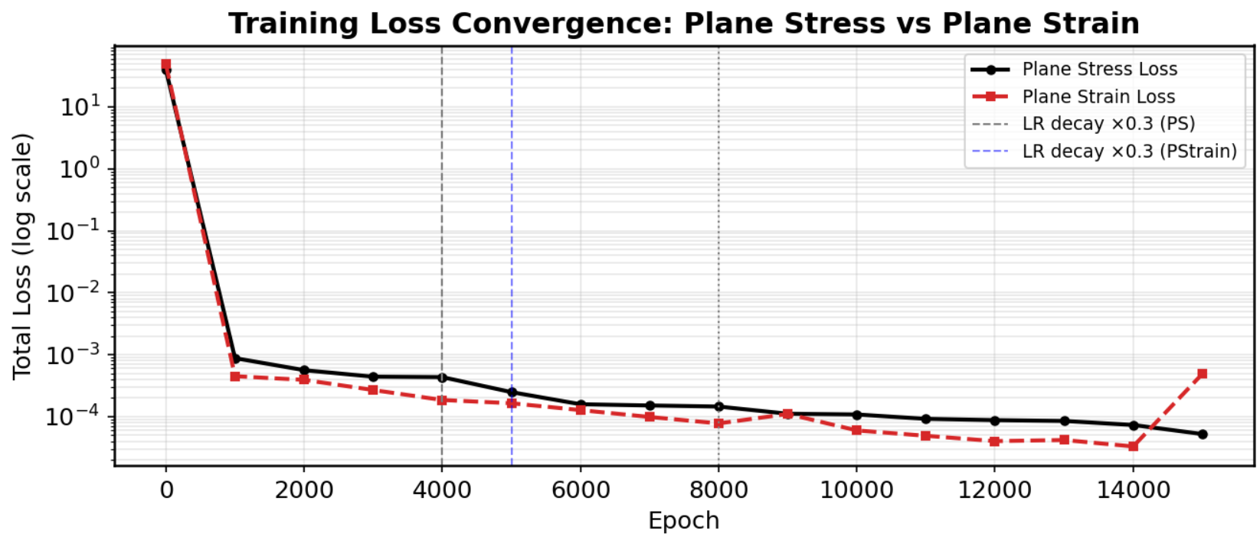
Training Convergence
Loss drops 8 orders
LR decay markers
Both modes stable
Epoch 0 → 15k: ~40 → 5×10⁻⁵ — well-converged solution
StepLR at epochs 4k and 8k triggers loss steps down
Plane stress and plane strain follow parallel trajectories
9 / 11

Slide 10








Calculation
Displacement Decomposition:
u_total = u_smooth(x,y) + A · w_u(r,θ)
v_total = v_smooth(x,y) + A · w_v(r,θ)
u_smooth, v_smooth → 4×128 Tanh MLP (learns smooth far-field)
A = softplus(KI_raw) → single learnable scalar, always positive
w_u, w_v → Williams Mode I basis (analytical, fixed)Williams Basis (Mode I, exact near-tip field)
w_u = √(r/2π) · cos(θ/2) · (κ − 1 + 2sin²(θ/2))
w_v = √(r/2π) · sin(θ/2) · (κ + 1 − 2cos²(θ/2))
κ = (3−ν)/(1+ν) = 2.333 → plane stress
κ = 3 − 4ν = 2.20 → plane strain
Ki Extraction:
Parametric:
KI = softplus(KI_raw) × 2μ
Williams: Making a semicircle at some r
v = KI · [ (1/2μ) · √(r/2π) · sin(θ/2) · (κ+1 − 2cos²(θ/2)) ]
The bracket is everything except KI. At a fixed radius r=6, everything inside the bracket is a known number at each angle θ. So define:
v_unit(θ) = (1/2μ) · √(r/2π) · sin(θ/2) · (κ+1 − 2cos²(θ/2))
v_PINN(θ) = KI · v_unit(θ) (300 points)
Σ (v_PINN(θᵢ) − KI · v_unit(θᵢ))²
Take the derivative with respect to KI and set to zero:
d/d(KI) Σ (v_PINN − KI · v_unit)² = 0
−2 Σ v_unit(θᵢ) · (v_PINN(θᵢ) − KI · v_unit(θᵢ)) = 0
Σ v_unit · v_PINN = KI · Σ v_unit²
KI = Σ(v_PINN · v_unit) / Σ(v_unit²)
10 / 11

Slide 11
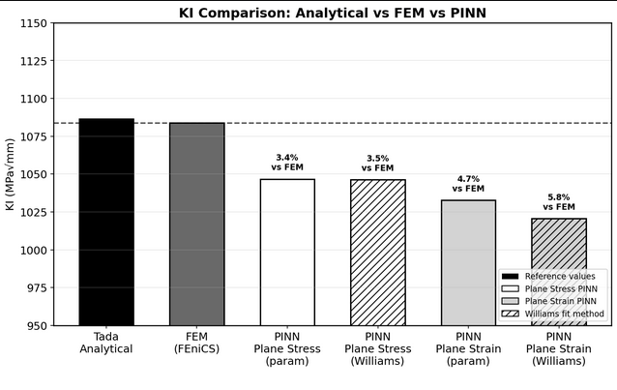
Results — K₁ Extraction
Summary Table
Method | K₁ | vs FEM
Tada | 1082 | 0.2%
FEM (ref) | 1083.75 | —
PS param | 1046.6 | 3.4%
PS Williams | 1046.2 | 3.5%
PSt param | 1032.6 | 4.7%
PSt Williams | 1021.5 | 5.8%
PS = Plane Stress PSt = Plane Strain
Param & Williams agree within 0.04% (PS) and 1.1% (PSt) — self-consistent fields
Both formulations within 5.8% of independently validated FEM reference
J-integral (r = 2 mm) diagnostic: 4.0% error — corroborates param result
Results consistent with published PINN fracture benchmarks (< 5–8% accepted)
10 / 11

Slide 12
Limitations & Further Work
Limitations
Further Work
Mode I only — no mixed-mode or inclined cracks
LEFM valid only for a/W < 0.30 (validated at 0.20)
Crack assumed straight, through-thickness, perpendicular to load
Homogeneous isotropic material — no aggregate, creep, or softening
Half-domain symmetry requires crack to lie on symmetry line
1
CV Pipeline
Detect crack geometry (a, W, orientation) from rover camera image via segmentation + calibration
Note: As of now this is done. Only integration remains.
2
Integration
Image → CV → PINN → K₁ → safety margin (K₁/K₁c) in one automated pipeline
3
Parametric PINN
Accept a/W as input one trained network covers full valid range without retraining
4
Experimental validation
Compare against three-point bend tests on notched concrete beams
11 / 11

