Slide 1
KEYBOARD HOOK BEHAVIORAL DETECTOR
Layered, explainable risk scoring for keylogger-capable processes on Windows
Submitted By
Abijit
Notes:
Introduce the project: a Windows user-mode tool that finds processes capable of installing keyboard hooks and judges their risk over time.

Slide 2
Introduction
Problem Definition
Literature Survey
Inferences
Proposed System
Architecture
Implementation (Tools Used)
Results and Discussions
References
Conclusion
Outline

Slide 3
Introduction
Windows lets any program register a keyboard hook (SetWindowsHookEx) to observe keystrokes. Hotkeys, game overlays, accessibility tools and chat applications rely on it.
Keyloggers abuse the same mechanism. MITRE ATT&CK catalogues it as T1056.001 (Input Capture: Keylogging), used to steal passwords and private messages.
This project is a Windows user-mode monitoring tool that identifies processes capable of installing keyboard hooks and evaluates their risk over time.
It does not intercept keystrokes, inject code or run at kernel level. It follows capability detection, behavior observation and risk persistence, the approach used by modern EDR telemetry agents.
Notes:
Hooks are a normal Windows feature, which is why keylogger detection is hard.

Slide 4
Problem Definition
Many legitimate applications (Discord, browsers, game overlays, accessibility tools) use keyboard hooks, so hook capability alone does not indicate malicious intent.
Judging a process from a single observation produces noisy alerts: a brief benign event looks the same as sustained suspicious behavior.
Hash and signature matching cannot recognize unseen or repacked keyloggers, and a bare malware probability from a black-box model cannot be audited or defended.
A behavioral approach is needed that flags the dangerous few, escalates only when suspicious behavior persists, and can explain every score.
Notes:
State the problem as a precision problem.

Slide 5
Literature Survey (1/5)
SL No. | RESEARCH PAPER | KEY FINDINGS | LIMITATIONS
1 | Bait Your Hook: A Novel Detection Technique for Keyloggers [2010] | Injects bait keystrokes and checks whether a process's I/O activity correlates with them. | Needs active probing of the system No trust or history context
2 | KLIMAX: Profiling Memory Write Patterns to Detect Keystroke-Harvesting Malware [2011] | Profiles how processes write keystroke data to memory to spot keyloggers. | Needs runtime memory monitoring Dynamic evidence only
Notes:
Papers are listed with their key finding and the limitation this project addresses.

Slide 6
Literature Survey (2/5)
SL No. | RESEARCH PAPER | KEY FINDINGS | LIMITATIONS
3 | Effective and Efficient Malware Detection at the End Host [2009] | Matches system-call behavior graphs of known malware against programs at run time. | Needs prior samples of each family Novel behavior can slip through
4 | A Survey on Automated Dynamic Malware-Analysis Techniques and Tools [2012] | Reviews dynamic analysis: API hooking, function-call monitoring and information-flow tracking. | Analysis-aware malware can evade Heavy for always-on monitoring
Notes:
Papers are listed with their key finding and the limitation this project addresses.

Slide 7
Literature Survey (3/5)
SL No. | RESEARCH PAPER | KEY FINDINGS | LIMITATIONS
5 | Limits of Static Analysis for Malware Detection [2007] | Shows that code obfuscation can defeat static analysis of binaries. | Static signals alone are not conclusive Motivates combining several signals
6 | PE-Miner: Mining Structural Information to Detect Malicious Executables in Realtime [2009] | Classifies executables from structural PE features such as headers, imports and resources. | General malware verdict Not keylogger-specific
Notes:
Papers are listed with their key finding and the limitation this project addresses.

Slide 8
Literature Survey (4/5)
SL No. | RESEARCH PAPER | KEY FINDINGS | LIMITATIONS
7 | Deep Neural Network Based Malware Detection Using Two-Dimensional Binary Program Features [2015] | Feeds byte-entropy, string, import and metadata features to a deep neural network. | Black-box model, hard to explain Not keylogger-specific
8 | Malware Detection by Eating a Whole EXE [2018] | Trains a convolutional network (MalConv) directly on raw executable bytes. | Opaque decisions Needs large training data
Notes:
Papers are listed with their key finding and the limitation this project addresses.

Slide 9
Literature Survey (5/5)
SL No. | RESEARCH PAPER | KEY FINDINGS | LIMITATIONS
9 | EMBER: An Open Dataset for Training Static PE Malware Machine Learning Models [2018] | Releases about 1.1 million PE files with features and a gradient-boosted baseline. | One file, one score No behavior over time
10 | A Learning Model to Detect Maliciousness of Portable Executable Using Integrated Feature Set (ClaMP) [2019] | Combines raw and derived PE-header features; 5,210 labeled executables released publicly. | Header-based malware verdict No keylogger or temporal context
Notes:
Papers are listed with their key finding and the limitation this project addresses.

Slide 10
Inferences
Dynamic keylogger detectors work but are intrusive and heavy for always-on use, so a passive, read-only, user-mode approach is preferred.
Static ML on PE features is accurate for malware in general but is not keylogger-specific; an import-table fingerprint mapped to MITRE ATT&CK fills that gap.
Single-snapshot verdicts and black-box scores are hard to trust; scoring over time with an explainable rule engine addresses this.
Hook capability is common in benign software, so ML evidence should only amplify a rule-based trigger, supported by an allowlist and risk decay.

Slide 11
Proposed System (1/2)
The proposed system scores every hook-capable process with three independent, complementary layers.
  Rule engine: DLL and signature inspection with temporal event weights, decay and an allowlist.
  Malware ML: a RandomForest classifier trained on 5,210 real labeled executables (ClaMP dataset, 67 PE-header features).
  Keylogger API fingerprint: weighted static match of the import table against Windows APIs mapped to MITRE ATT&CK.
No single layer can escalate risk alone: the ML and API scores only add a bonus to an event that already carries a rule-based weight.

Slide 12
Proposed System (2/2)
Risk scoring
EVENT | WEIGHT
SUSPECT_DETECTED | +15
HOOK_APPEARED | +10
NEW_HOOK_MODULE | +35
HOOK_REMOVED | −10
weight = event_weight
+ round(10 × ml_risk_score)
+ round(12 × keylogger_api_score)
score = min(150, score + weight)
score = score − 5 per cycle
Bonuses apply only when the event's base weight is positive.
Hook events add nothing until a suspect has been detected.
Allowlisted software always scores 0.
RISK LEVEL | SCORE
LOW | below 30
MEDIUM | 30 and above
HIGH | 60 and above
Notes:
Score is capped at 150 and decays by 5 per analysis cycle.

Slide 13
Architecture (1/2)
main_controller.py: scan every 10 s, analyze every 3 cycles (single warm process)
Scanner
psutil, user32.dll,
DLL signatures
ML Analysis
one PE parse feeds
both ML layers
Snapshots
timestamped JSON,
auto-pruned
Temporal Analyzer
diffs snapshots
into events
Risk Engine
gated score
+ decay
Report CLI
(terminal table)
Web dashboard
(Flask, read-only)
temporal_state.json
(persistent risk memory)
Figure 6.1: Architecture of the proposed system
Notes:
The controller calls the scanner and analyzer in-process so the ML model stays warm. The dashboard and CLI only read temporal_state.json.

Slide 14
Architecture (2/2)
Capability classification
Behavior events
Enumerate processes with psutil; skip allowlisted names.
Check whether user32.dll is mapped; if not, skip.
Non-system DLL loaded: DLL_HOOK_SUSPECT. Otherwise an executable outside the Windows folder: EXE_HOOK_SUSPECT.
Score the executable: signature, SHA-256, malware ML and ATT&CK API fingerprint.
EVENT | TRIGGER
SUSPECT_DETECTED | First sighting of a hook-capable process
HOOK_APPEARED | Hook DLLs appear where there were none
NEW_HOOK_MODULE | A new hook-carrying DLL is added
HOOK_REMOVED | Hook capability disappears; risk falls
A process identity is the executable path plus its creation time, so it stays stable across PID reuse.

Slide 15
Implementation Details (1/3)
COMPONENT | TOOL / LIBRARY | PURPOSE
Language | Python 3.10 / 3.11 | About 2,000 lines across 16 modules
Process enumeration | psutil | Running processes and their memory maps
PE parsing | pefile | 67 header-level features per executable
Machine learning | scikit-learn, joblib | RandomForest training; model save and load
Signature check | ctypes + WinVerifyTrust | Authenticode check with no subprocess
Dashboard | Flask, JavaScript, CSS | Live, read-only risk view on 127.0.0.1
Testing and CI | pytest, GitHub Actions | Ubuntu and Windows runners
Data and knowledge | ClaMP dataset, MITRE ATT&CK | Training data and API taxonomy

Slide 16
Implementation Details (2/3)
Dataset: ClaMP, 5,210 real Windows executables (2,722 malware, 2,488 benign) reduced to PE-header features; no malware is collected or run.
Features: raw DOS and file-header fields, 15 file characteristics bits, optional-header fields, 11 DllCharacteristics bits, section entropy and suspicious-section counts (67 in total).
Training: RandomForestClassifier on an 80/20 stratified split; the CI build fails if accuracy drops below 90%.
Inference: one PE parse per executable is shared by both ML layers and cached per path (functools.lru_cache).
The scanner and analyzer run in-process, so the model is loaded once instead of every cycle.

Slide 17
Implementation Details (3/3)
API CATEGORY | ATT&CK | EXAMPLE APIs
Low-level keyboard hooks | T1056.001 | SetWindowsHookExA/W, CallNextHookEx
Key-state polling | T1056.001 | GetAsyncKeyState, GetKeyState
Raw input capture | T1056.001 | RegisterRawInputDevices, GetRawInputData
Foreground-window tracking | T1056.001 | GetForegroundWindow, GetWindowTextW
Screen capture | T1113 | BitBlt, CreateCompatibleBitmap
Clipboard capture | T1115 | GetClipboardData, OpenClipboard
Registry Run-key persistence | T1547.001 | RegSetValueExW, RegCreateKeyExW
Network exfiltration | T1071.001 | InternetOpenW, HttpSendRequestW
Debugger evasion | T1622 | IsDebuggerPresent
Sandbox evasion | T1497 | GetTickCount, QueryPerformanceCounter
Table 7.1: Keylogger API fingerprint categories mapped to MITRE ATT&CK

Slide 18
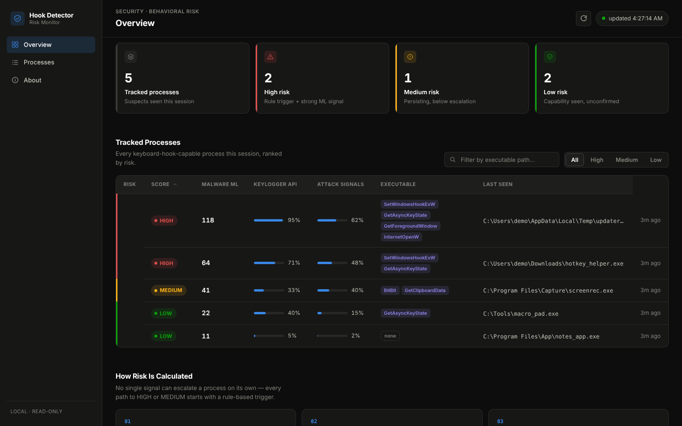
Results and Discussion (1/8)
Figure 8.1: Risk dashboard (demo data)

Slide 19
Results and Discussion (2/8)
RISK | SCORE | MALWARE ML | KEYLOGGER API | ATT&CK SIGNALS | EXECUTABLE
HIGH | 118 | 95% | 62% | SetWindowsHookExW, GetAsyncKeyState, … | …\Temp\updater_svc.exe
HIGH | 64 | 71% | 48% | SetWindowsHookExW, GetAsyncKeyState | …\Downloads\hotkey_helper.exe
MEDIUM | 41 | 33% | 40% | BitBlt, GetClipboardData | …\Capture\screenrec.exe
LOW | 22 | 40% | 15% | GetAsyncKeyState | C:\Tools\macro_pad.exe
LOW | 11 | 5% | 2% | - | …\App\notes_app.exe
The report ends with a summary line: 5 process(es) tracked, 2 HIGH, 1 MEDIUM.
Table 8.1: Risk report from python -m scanner.report (demo data)

Slide 20
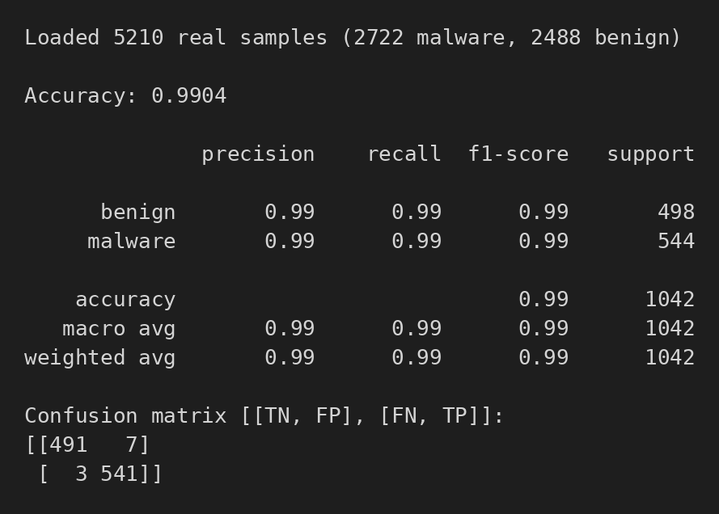
Results and Discussion (3/8)
Figure 8.2: Output of train_model.py on the ClaMP dataset

Slide 21
Results and Discussion (4/8)
CLASS | PRECISION | RECALL | F1-SCORE | SUPPORT
Benign | 0.99 | 0.99 | 0.99 | 498
Malware | 0.99 | 0.99 | 0.99 | 544
Accuracy |  |  | 0.99 | 1042
 | PRED. BENIGN | PRED. MALWARE
Actual benign | 491 | 7
Actual malware | 3 | 541
Table 8.2: Classification report
Table 8.3: Confusion matrix
Overall accuracy is 0.9904 on 1,042 held-out samples (80/20 stratified split): 10 misclassified, of which 7 are false alarms and 3 are misses.

Slide 22
Results and Discussion (5/8)
Figure 8.3: Top 8 feature importances of the RandomForest model

Slide 23
Results and Discussion (6/8)
Figure 8.4: Risk score over time (simulated with the project's risk engine; ML 0.9, API 0.55)

Slide 24
Results and Discussion (7/8)
Malware ML layer: 99.04% held-out accuracy on ClaMP. This measures general malware detection on a public dataset, not live keylogger detection.
Speed: scoring one new executable takes about 75 ms, a repeat of the same path under 1 ms (cache), and the model is loaded once (about 1 s) at startup.
A real run flagged a GPU-vendor overlay (hotkey and recording) at a score of 536, because such software legitimately uses the same APIs as a keylogger.
Fix: recalibrated API weights, halved the ML bonus scales (20 to 10, 25 to 12) and capped the score at 150. The same scenario now peaks at 145 and returns to LOW in about 15 cycles.

Slide 25
Results and Discussion (8/8)
Testing: 20 tests pass and 5 Windows-only tests are skipped on Linux; the Windows-only suite runs on a Windows CI runner.
Limitation: static capability evidence cannot separate a legitimate overlay from a keylogger, so trusted software is handled by an allowlist and gating.
Limitation: the keylogger layer is a rule engine rather than a trained model, because no public labeled keylogger dataset exists; live monitoring is Windows-only.
Future work: publisher-based trust instead of a name-only allowlist, alert and log export, and testing against more benign overlay and macro applications.

Slide 26
References (1/3)
[1] Ortolani, S., Giuffrida, C., & Crispo, B. (2010). Bait your hook: a novel detection technique for keyloggers. Recent Advances in Intrusion Detection (RAID 2010), Springer.
[2] Ortolani, S., Giuffrida, C., & Crispo, B. (2011). KLIMAX: profiling memory write patterns to detect keystroke-harvesting malware. Recent Advances in Intrusion Detection (RAID 2011), Springer.
[3] Kolbitsch, C., Comparetti, P. M., Kruegel, C., Kirda, E., Zhou, X., & Wang, X. (2009). Effective and efficient malware detection at the end host. USENIX Security Symposium.
[4] Egele, M., Scholte, T., Kirda, E., & Kruegel, C. (2012). A survey on automated dynamic malware-analysis techniques and tools. ACM Computing Surveys, 44(2).
[5] Moser, A., Kruegel, C., & Kirda, E. (2007). Limits of static analysis for malware detection. Annual Computer Security Applications Conference (ACSAC).

Slide 27
References (2/3)
[6] Shafiq, M. Z., Tabish, S. M., Mirza, F., & Farooq, M. (2009). PE-Miner: mining structural information to detect malicious executables in realtime. Recent Advances in Intrusion Detection (RAID 2009), Springer.
[7] Saxe, J., & Berlin, K. (2015). Deep neural network based malware detection using two dimensional binary program features. arXiv:1508.03096.
[8] Raff, E., Barker, J., Sylvester, J., Brandon, R., Catanzaro, B., & Nicholas, C. (2018). Malware detection by eating a whole EXE. arXiv:1710.09435.
[9] Anderson, H. S., & Roth, P. (2018). EMBER: an open dataset for training static PE malware machine learning models. arXiv:1804.04637.
[10] Kumar, A., Kuppusamy, K. S., & Aghila, G. (2019). A learning model to detect maliciousness of portable executable using integrated feature set. Journal of King Saud University: Computer and Information Sciences, 31(2). Dataset: github.com/urwithajit9/ClaMP

Slide 28
References (3/3)
[11] Breiman, L. (2001). Random forests. Machine Learning, 45(1), 5-32.
[12] Pedregosa, F., et al. (2011). Scikit-learn: machine learning in Python. Journal of Machine Learning Research, 12, 2825-2830.
[13] MITRE ATT&CK. Input Capture: Keylogging (T1056.001). https://attack.mitre.org/techniques/T1056/001/
[14] Microsoft. SetWindowsHookExA function (winuser.h). https://learn.microsoft.com/en-us/windows/win32/api/winuser/nf-winuser-setwindowshookexa

Slide 29
Conclusion
The project delivers a Windows user-mode detector that combines a rule-based temporal engine, a malware classifier trained on real data and a MITRE ATT&CK-mapped keylogger API fingerprint.
ML and API evidence can only amplify a rule-based trigger. Together with gating, decay, a score cap and an allowlist, this keeps benign hook users from being flagged while persistent suspicious behavior still escalates.
Every score traces back to a named event or API, so each decision can be explained.

Slide 30
THANK YOU!

