Slide 1
IIT Roorkee Final Project (Cloudxlab)
ABIJITH PRADEEP

Slide 2
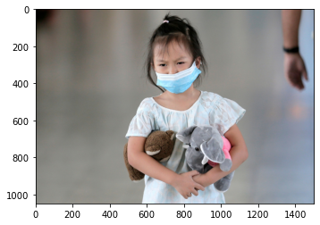
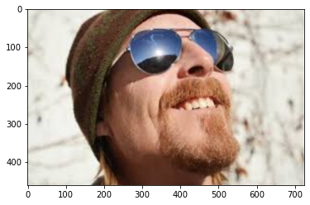
Objective
The problem statement of this project is to detect faces with masks and faces with no masks.
We are supposed to find out the box co-ordinates surrounding the face.

Slide 3
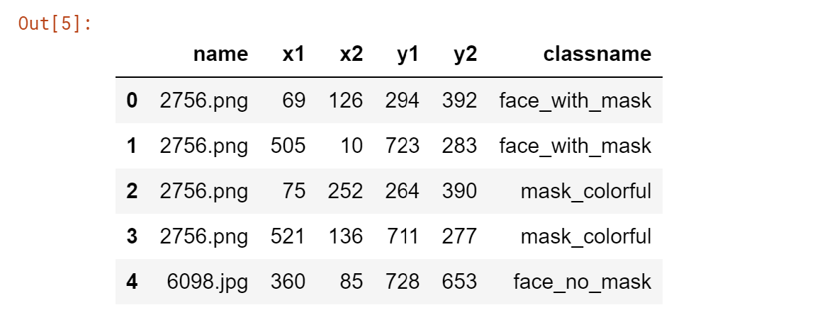
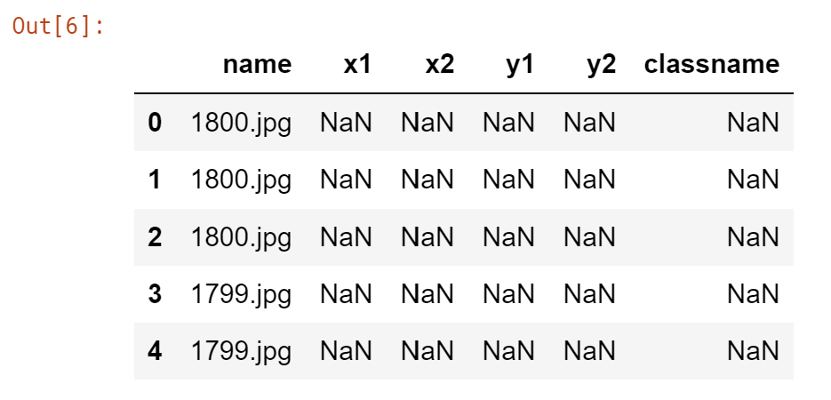
Approach
Using the face mask detection dataset in Kaggle I have collected, explored and pre-processed the data required for training the model.
The two files are train.csv and submission.csv
The train.csv file is used for training the model but the submission.csv contains the images with null values which I will use for classifying and detected the box around the face of the image.

Slide 4
Approach
I have used the mtcnn library which contains a detector for detecting and extracting the box of faces in an image.
Then I used the training data and fit it into the keras sequential model. The model is Long Short term Memory (LSTM) model with batch size as 5 and 30 epochs.
The mtcnn’s detect_faces function returns a dictionary of dictionary. The internal dictionary named ‘box’ contains the co-ordinates for the rectangular plot around the face(s) of the image.
The mtcnn is just for the accurate visualisation. The LTSM model that I trained will be used to predict the test images. As said before, the detect faces gets the box co-ordinates and we can signal the viewers that the face has been detected. The model is used for predicting what class the test images lie under.

Slide 5
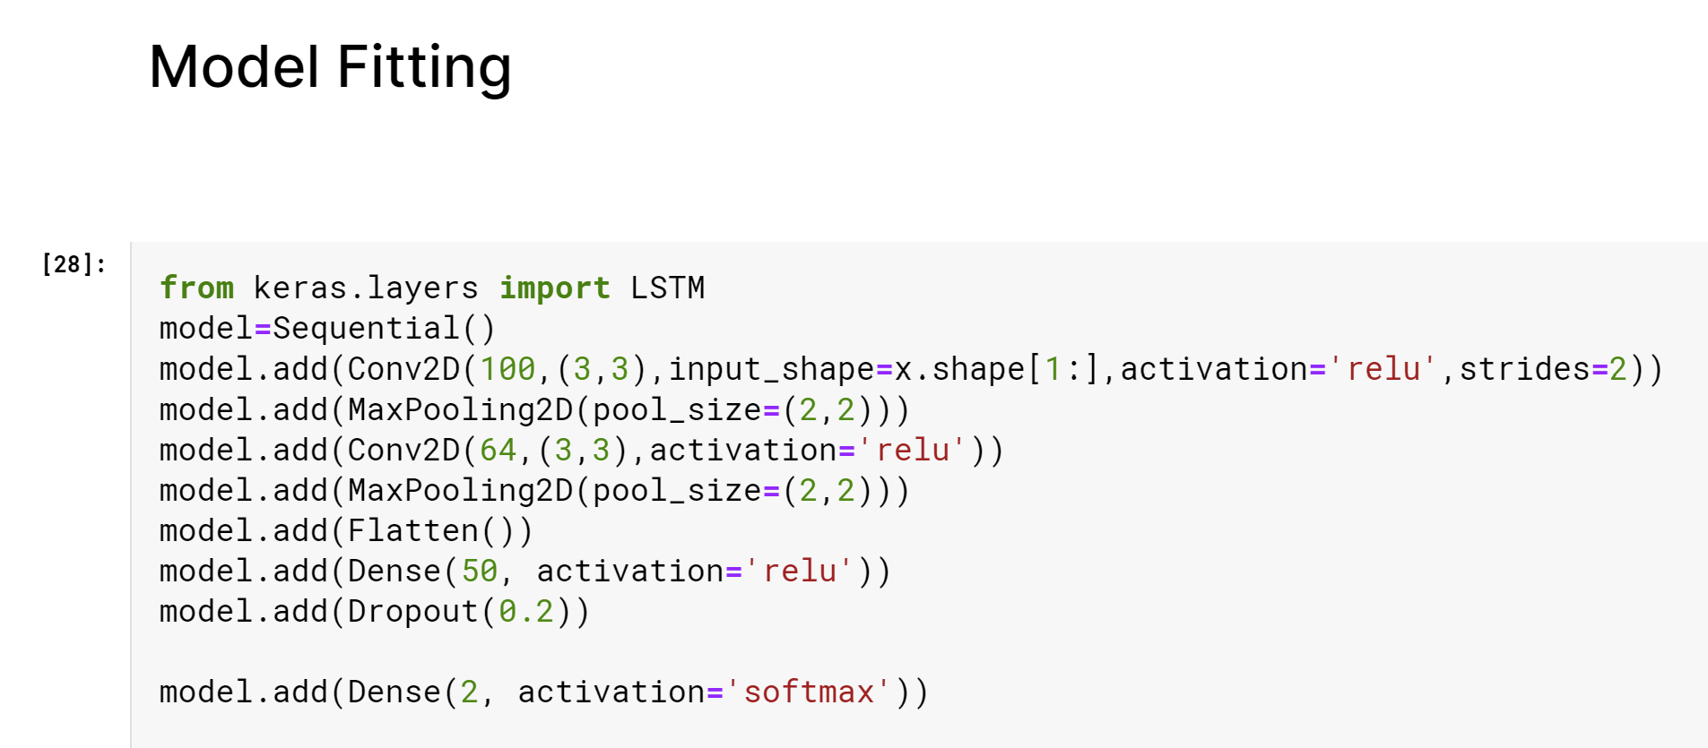
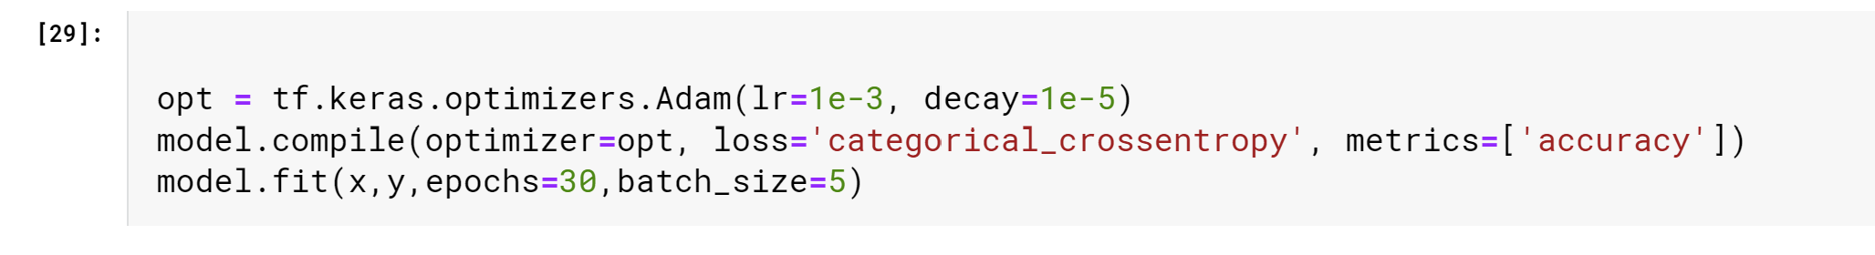
Approach

Slide 6
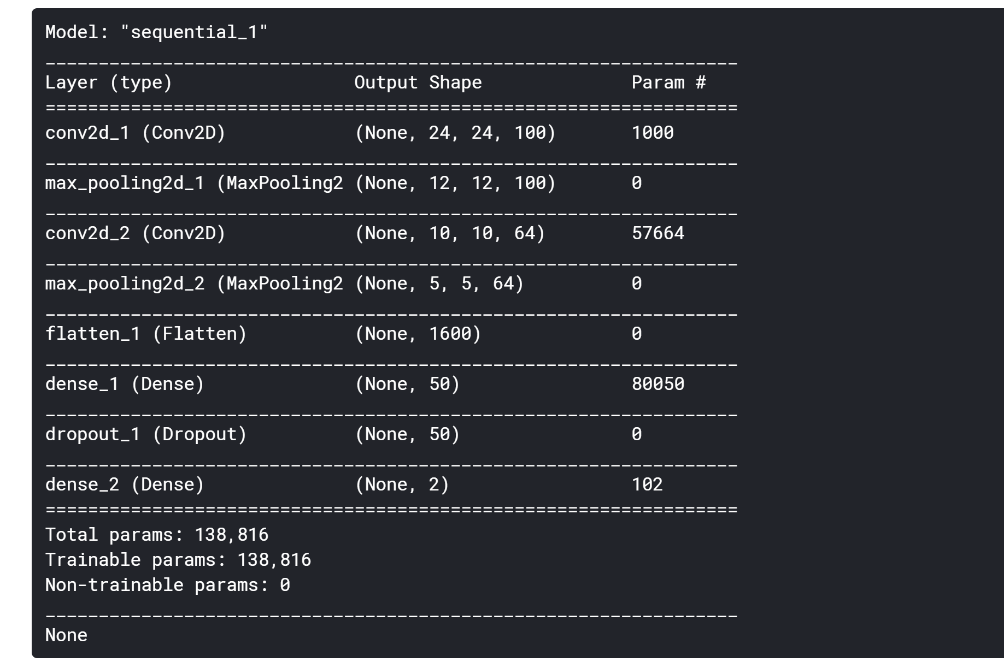
Model Summary

Slide 7
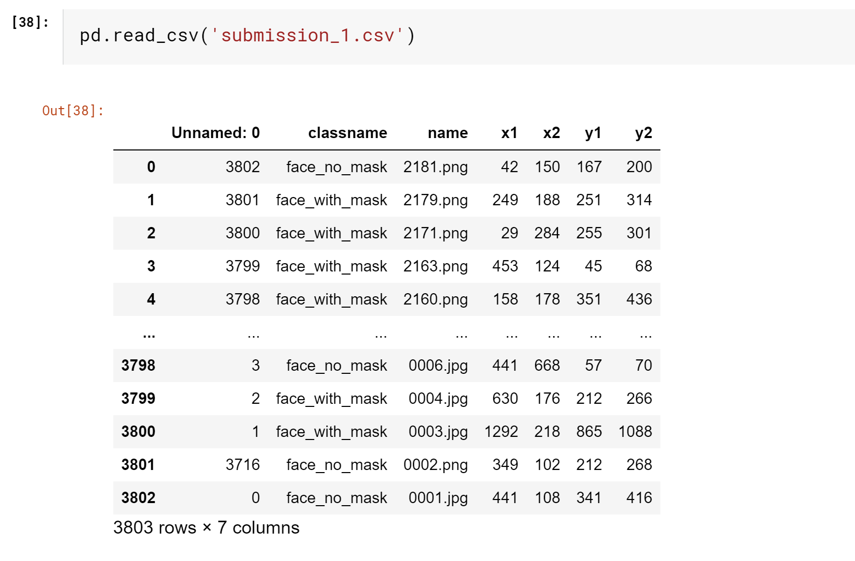
Results
The results are stored in a csv file called submission_1.csv.
They have the predicted class name, predicted co-ordinate for rectangular plot.

Slide 8
Inferences
We have now detected the faces in each image by drawing a rectangular plot in the image around the face.
If there are multiple faces in the image then it’ll draw the same number of box plots.

Slide 9
Improvising
The project can be towards becoming a scanner that after detecting the face tells how correct the mask has been worn.
By using another model to train images that have people wearing masks correctly.
One can add a web cam feature to scan the face correctly while entering an organization. For instance, if the person isn’t wearing the mask correctly (not covering nose or hanging mask below chin etc.) he won’t be allowed to enter the organization.

