Slide 1

ResNet-50 Convolutional Neural Network Model
AMAL THILAKAN

Slide 2

INTRODUCTION
The ResNet architecture is considered to be among the most popular Convolutional Neural Network architectures around.
Introduced by Microsoft Research in 2015,
Residual Networks (ResNet in short) broke several records when it was first introduced in this paper by He. et. al.

Slide 3
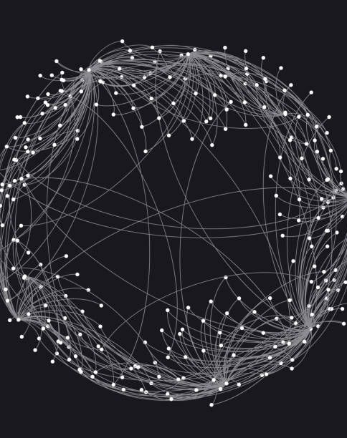
A Residual Neural Network is a deep learning model in which the weight layers learn residual functions with reference to the layer inputs.
A Residual Network is a network with skip connections that perform identity mappings, merged with the layer outputs by addition.
It behaves like a Highway Network whose gates are opened through strongly positive bias weights. This enables deep learning models with tens or hundreds of layers to train easily and approach better accuracy when going deeper.

Slide 4

Why ResNet? The requirement for a model like ResNet arose due to a number of pitfalls in modern networks at the time.

Slide 5
Difficulty in training deep neural networks:
As the number of layers in a model increases,
the number of parameters in the model increases exponentially.
For each Convolutional layer, To put it into context,
a simple 7x7 kernel Convolution layer from 3 channels to 32 channels adds 4736 parameters.
An increase in the number of layers in the interest of experimentation leads
to an equal increase in complexity for training the model.
Training then requires greater computational power and memory.

Slide 6
2. More expressive, less different:
A neural network is often considered to be a function approximator.
It has the ability to model functions given input, target and a comparison between the
function output and target. Adding multiple layers into a network
makes it more capable to model complex functions. But results published in the paper
stated that a 18-layer plain neural network performs considerably better than a 34-layer plain neural network

Slide 7
3. Vanishing/Exploding Gradient:
This is one of the most common problems plaguing the training of larger/deep neural networks
and is a result of oversight in terms of numerical stability of the network’s parameters.
During back-propagation, as we keep moving from the deep to the shallow layers,
the chain rule of differentiation makes us multiply the gradients. Often, these gradients are small

Slide 8

Residual Network: In order to solve the problem of the vanishing/exploding gradient, this architecture introduced the concept called Residual Blocks.
In this network, we use a technique called skip connections. The skip connection connects activations of a layer to further layers by skipping some layers in between. This forms a residual block.
Resnets are made by stacking these residual blocks together.

Slide 9

What is ResNet-50 Model ?
ResNet stands for Residual Network and is a specific type of convolutional neural network (CNN) introduced in the 2015 paper "Deep Residual Learning for Image Recognition" by He Kaiming, Zhang Xiangyu, Ren Shaoqing, and Sun Jian.
CNNs are commonly used to power computer vision applications.
ResNet-50 is a 50-layer convolutional neural network (48 convolutional layers, one MaxPool layer, and one average pool layer). Residual neural networks are a type of artificial neural network (ANN) that forms networks by stacking residual blocks.

Slide 10
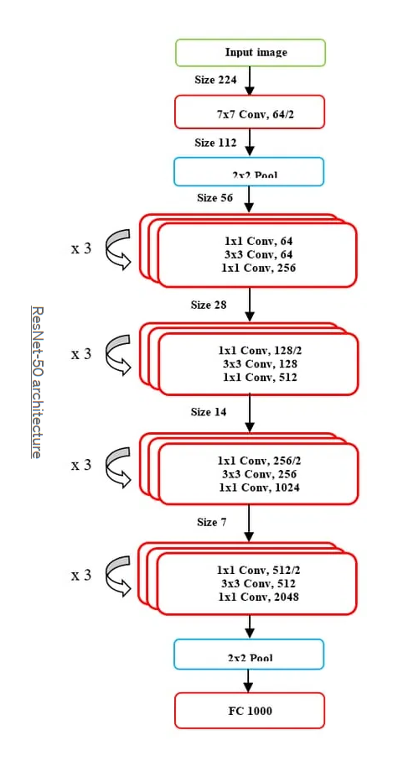
RESNET ARCHITECTURE

Slide 11
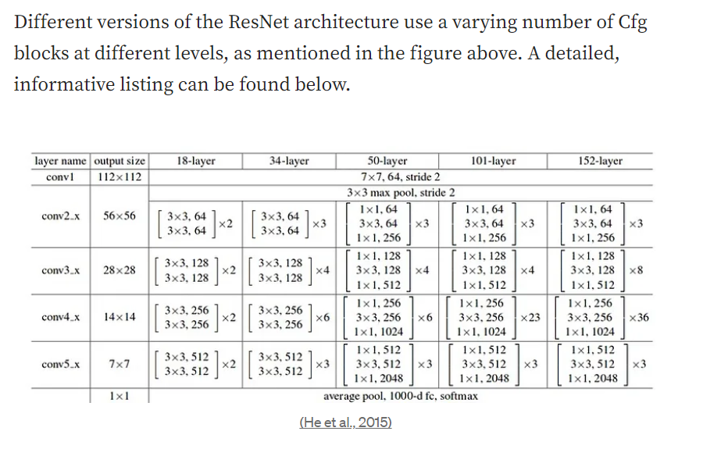

Slide 12
THANK YOU

