Slide 1

Software Engineering Mini-Project
Name: Abijith Trichur Ramachandran (1rv17cs006)
abeer vaishnav (1rv17cs004)

Slide 2
Introduction:
Purpose: The cardinal purpose of the project is to provide a maintenance system for the world-wide database for satellites in the Earth’s orbits. With the recent developments in the technology and wide spread awareness of space technology among young minds, there’s an increase in the number of satellite manufacturing and launches since the past decade. Therefore, a need for a satellite management system has emerged in order to keep track of various satellites so as to accommodate newer satellites in the orbit. For the same, a user-friendly Graphical User Interface (GUI) has been developed in order to simplify the planning process for new as well as existing large-, small-, micro-, nano- and cube-satellites.

Slide 3
Introduction …
Project Scope: The project provides comprehensive support for keeping track of useful data related to different satellites, their manufacturing organizations, owner organizations and the consumer organizations. It enables a log in, registration and authentication system in order to define the access hierarchy within the software bounds. It provides an interactive interface which allows all types of users to access their satellites’ parameters in an organized fashion. The user can search for a particular satellite by name, type, launching organization, manufacturing organization and orbital position parameters. The software keeps track of details of each satellite such as project timeline, launch date, mission life, orbital parameters, launch organization, manufacturing organization, etc. It consists of a in-built visualization tool for giving a 3-D view of the orbit to the user using the TLE files of the satellite.

Slide 4
PRODUCT DESCRIPTION
This product is a replacement for the existing satellite management system. It is a web-based system implementing the client-server model. All satellite information is maintained in a database, located on a web server. The product offers hardware interface for cross-platform support, user interface for user account creation, user interface for a local search engine based on keywords for searching the whole satellite database. A built-in visualization tool in the software helps the user to visualise the orbit of various satellites around the Earth in a 3-D perspective. The system interfaces encompass account creation, existing satellite display and search (by local search engine within the software) and calculation of new orbits for future missions by any organization.

Slide 5
Product Functions
Login, authentication and sign-up of users
The project provides provision for registration and login of different users using credentials such as (email and password). Authentication is provided by means of email verification and privilege is provided based on affiliated and connection with an organisation.
Tracking live position and orientation of satellites
Epoch time, orbital inclination, right ascension of ascending node, eccentricity, argument of perigee, mean motion, mean anomaly and drag. Time for LOS based upon the geographical location of the user.
Graphical representation of satellite with respect to earth
Plots the 3D model of the satellite and its trajectory around the earth in a graphical environment.
Display description of the satellite and its associated organisation
Displays all the details regarding the orientation and positioning of the satellite along with the organisations associated and affiliated with for its function and uses.
Modification of satellite data
Provides functionality to modify satellite data such as the TLE files, orbit correction, etc by certain personnel, qualified to do so (i.e. if they own the satellite or were responsible for launching the satellite)

Slide 6
User Classes and Characteristics
1. Scientists and Academicians
Scientists and Academicians are required to have a basic knowledge of accessing the satellite management system in order to be able to use the software for academic purpose. They can also take help of the software to plan for a time-window for communication with the satellite.
2. Manufacturing Organisation
The manufacturing organization will have partial control over the satellite’s data and control and upload any necessary data modifications done to the satellite by their ground station.
3. Owner Organisation
The owner organization (if different from the manufacturing organisation) will have the full control of the satellite data including modification of its critical information
4. Administrators
Administrators of the web application are expected to have technical expertise over the whole software and will be the main stakeholders for any modifications being done to the satellite database.
5. Operating Personnel
Operating personnel are expected to have high level technical expertise in order to debug errors as well as maintain proper health parameters for the server.

Slide 7
System Features
The system is designed for wide range of users from academicians, scientists to major space organisations.
The features designed for academicians and scientists are based on retrieval of satellite information and 3D plotting of live positioning and orientation of the satellite with respect to Earth.
The features designed for organisations includes the ones based for scientists and academicians. The organisations are enabled with modifying, updating the resources, satellites under their organisation.

Slide 8
System Features …
Administrator Utilities:
These features allow administrators to manage information related to the satellite database and access it in an organised way when needed.
Add and Update satellite information
Utilities for Scientists / Academia:
These features allow the scientists and members of academia to view, conceptualize and acquire information from the satellites for performing their research and development activities.
Retrieve information of satellite, manufacturing organisation, owner organisation and launch location.
Tracking the satellite’s orbit.

Slide 9
System Features …
Participating Organisations:
These features allow all the organisations involved to maintain, access and update their details and the details of the satellites they own.Retrieve information of satellite, manufacturing organisation, owner organisation and launch location.
Add and update the satellite data

Slide 10
Tools Used:
Front End:
HTML
CSS
BOOTSTRAP
MATERIAL UI
Back End:
NodeJS
XAMPP
MySQL
MongoDB
Python packages

Slide 11
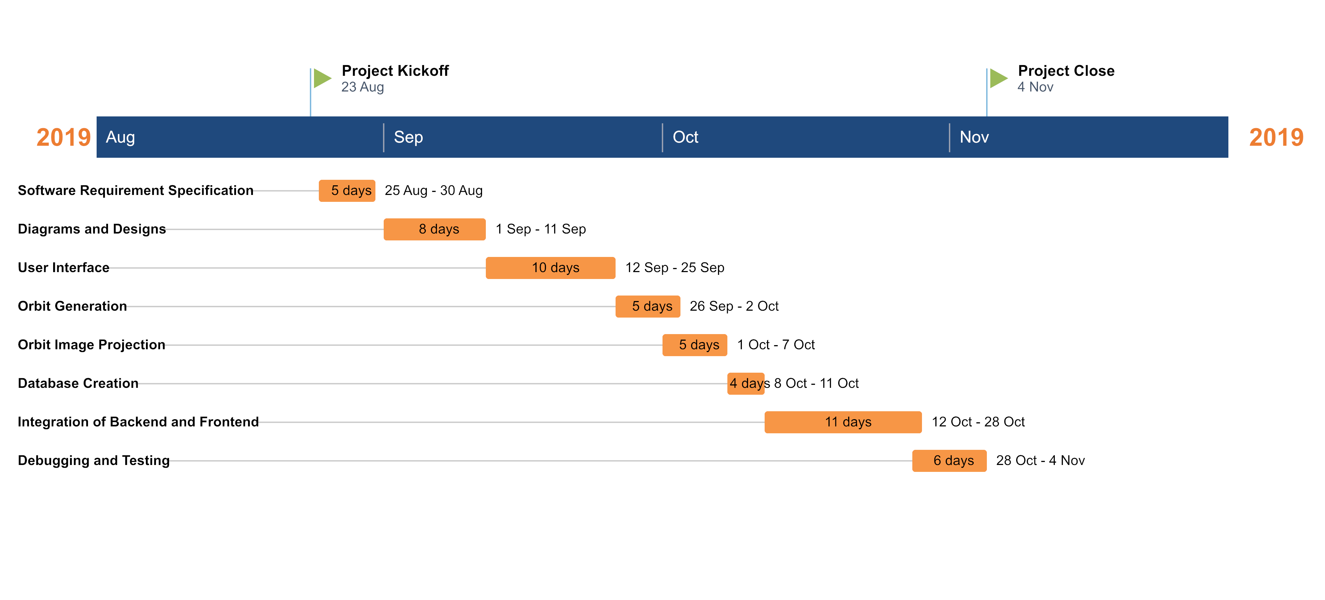
Gantt Chart

Slide 12
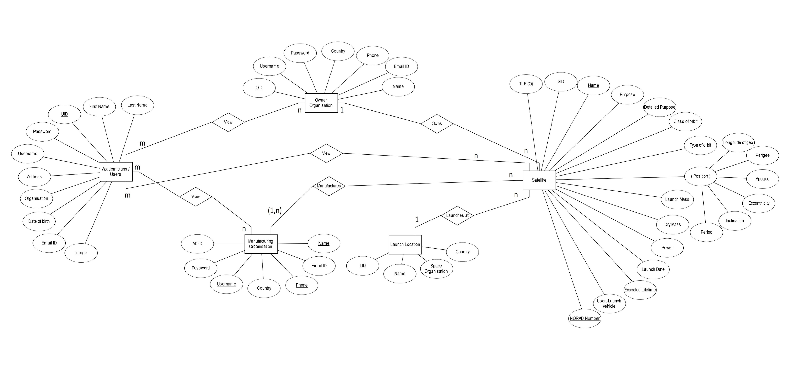
Entity Relationship Diagram

Slide 13
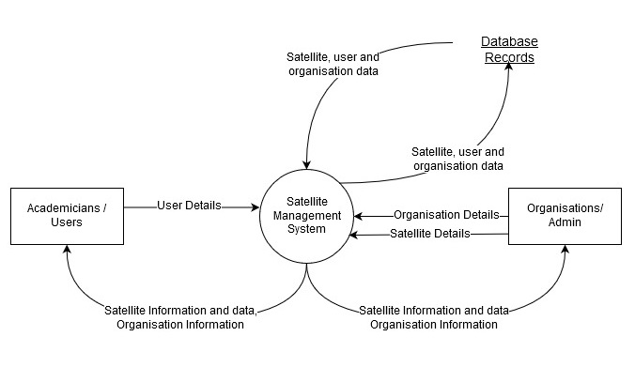
Data Flow Diagram
Level 0

Slide 14
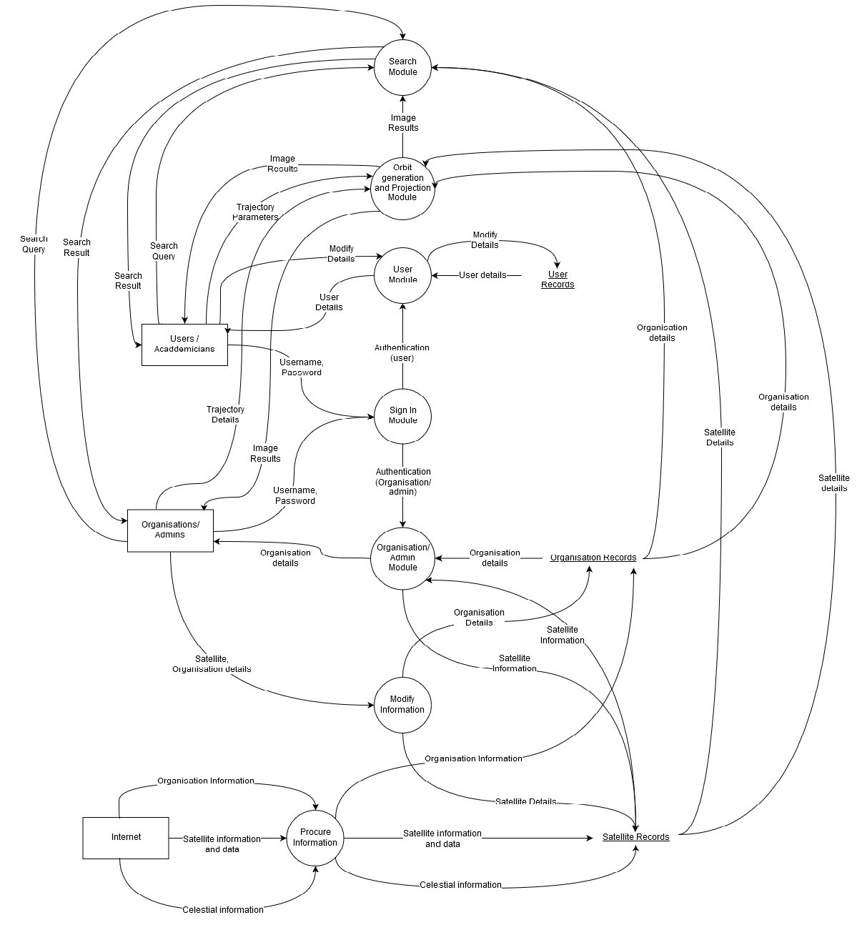
Data Flow Diagram…
Level 1

Slide 15
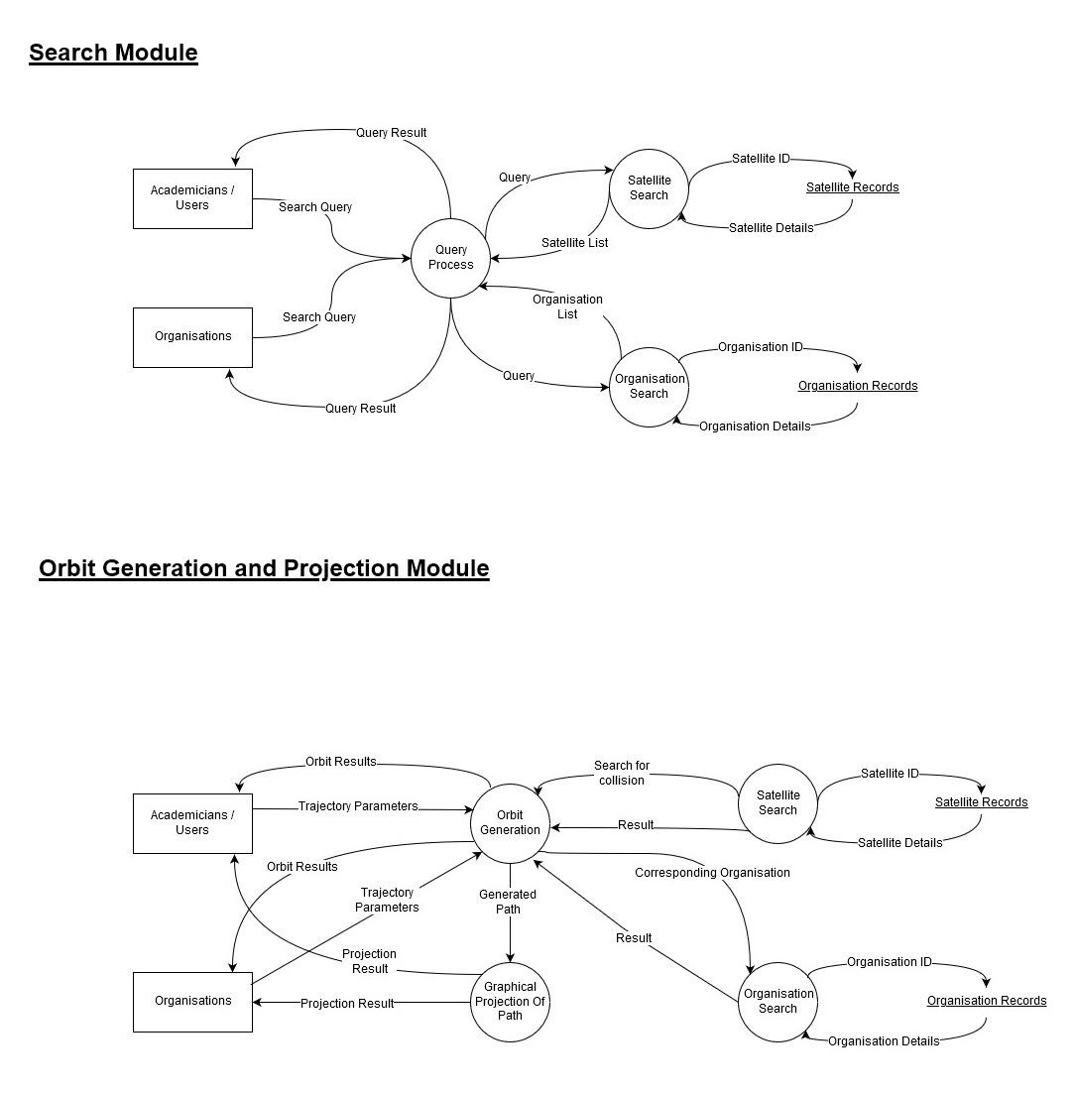
Data Flow Diagram…
Level 2

Slide 16
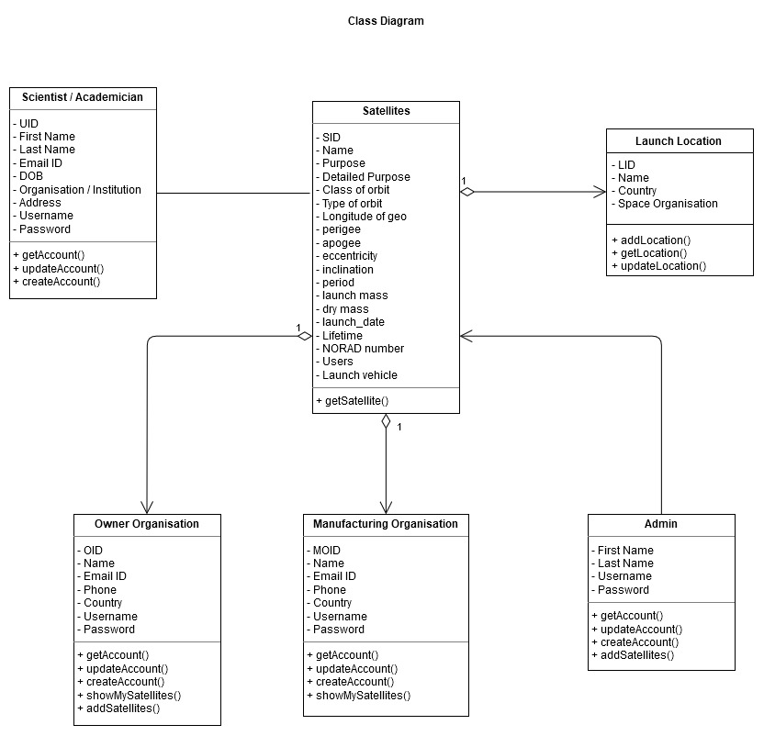
Class Diagram

Slide 17
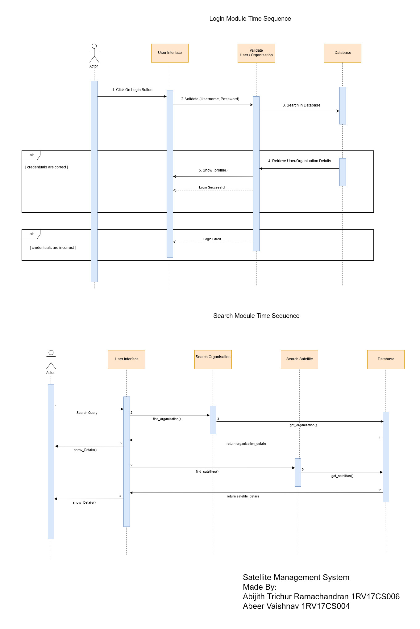
Sequence Diagram

Slide 18
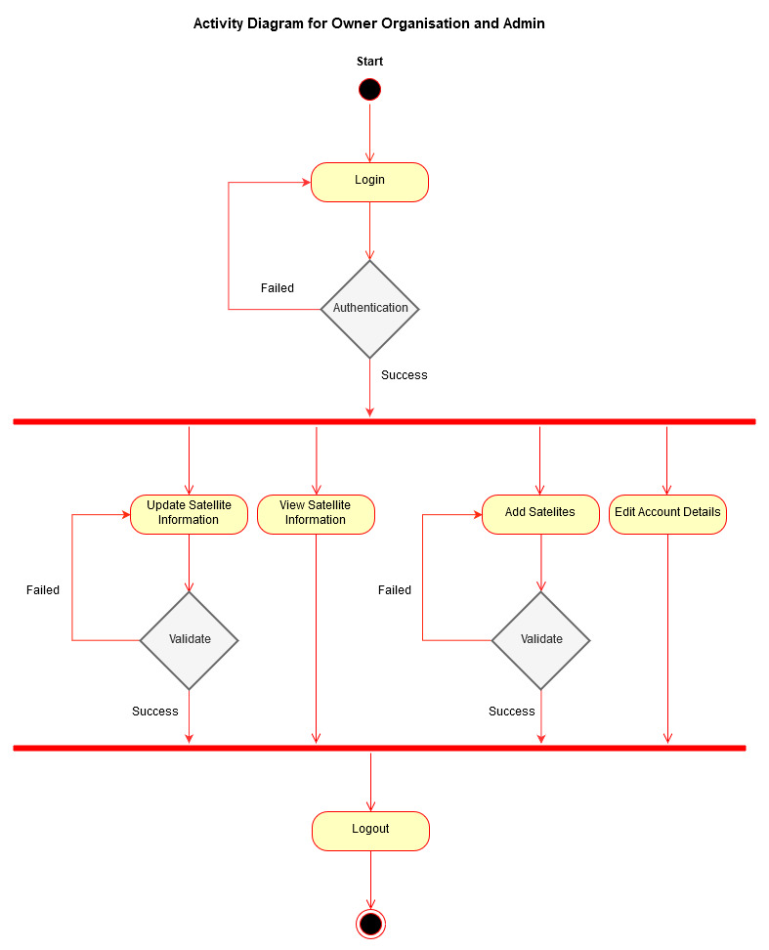
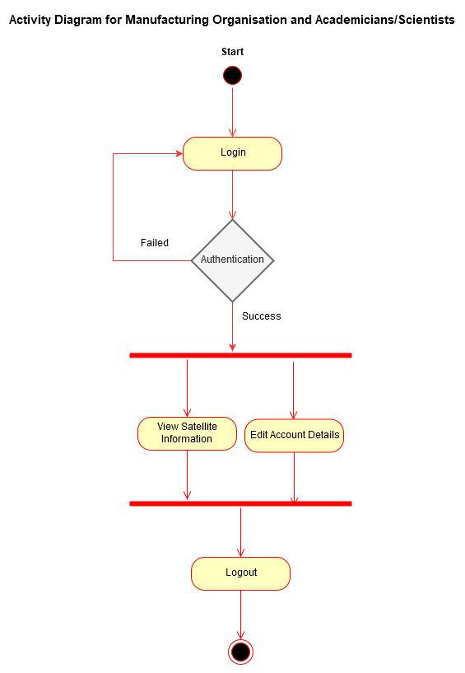
Activity Diagram

Slide 19
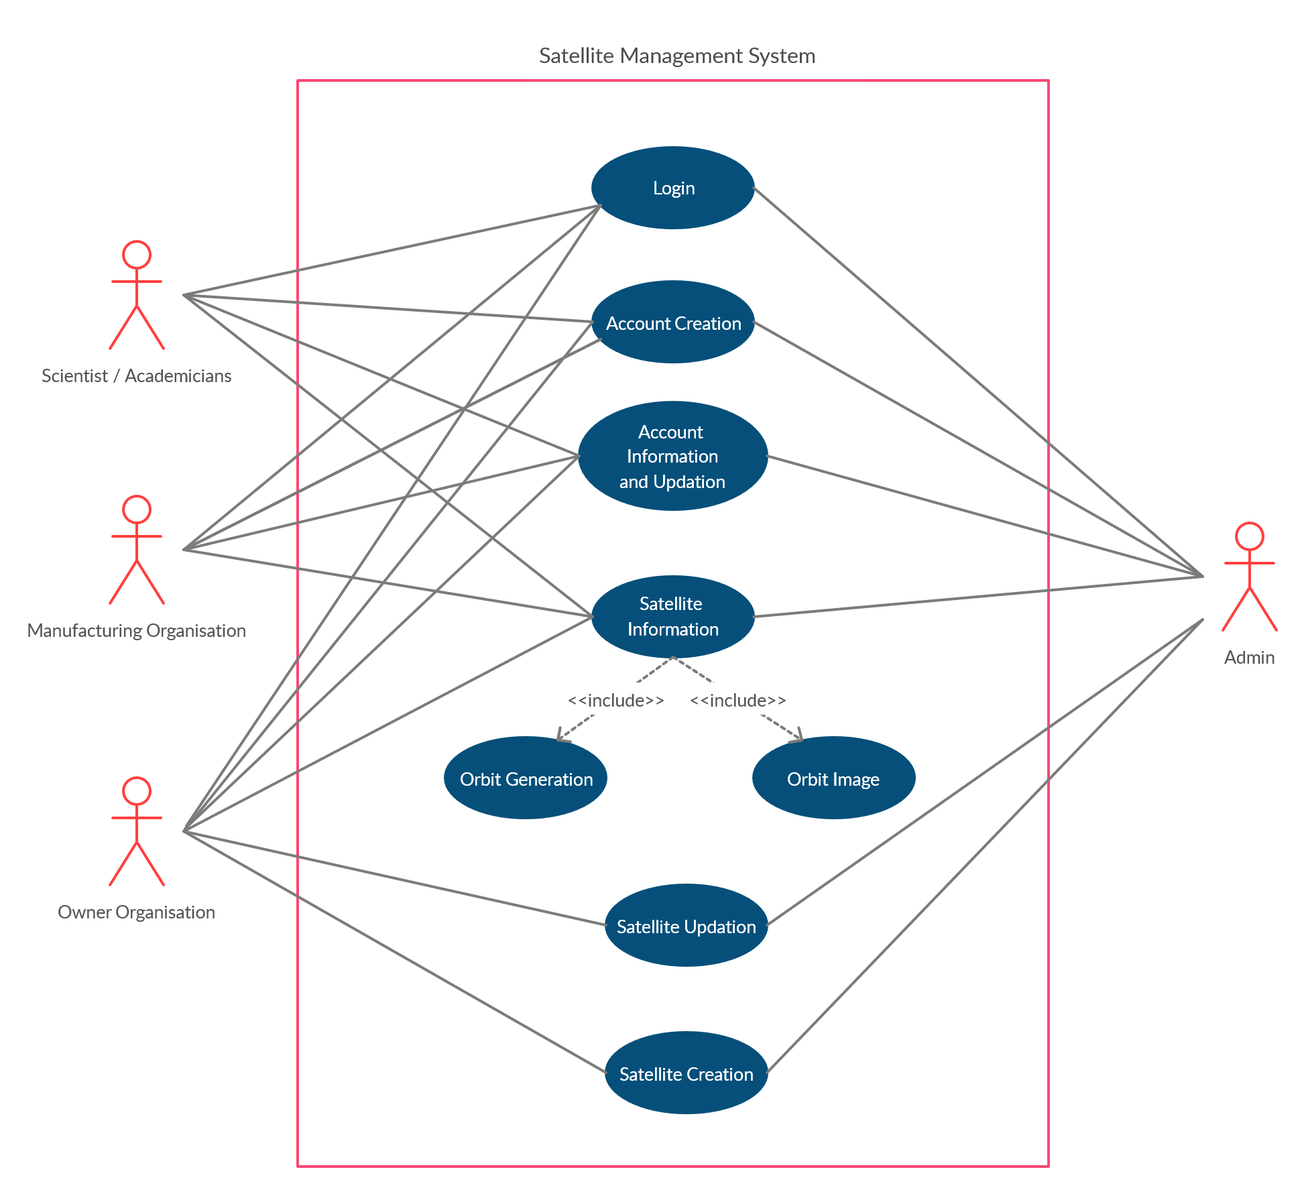
Use Case Diagram

Slide 20
Test Case:
Function | Test Cases | Output
Login | Valid Username, Password | Logged in as an appropriate user
 | Invalid Username, Password | Remains in same page
Add scientist/academician | Valid information with unique username | Information added to the database
 | Valid information with non unique username | Not added to the database, remains in same page
Add Manufacturing Organisation | Valid information with unique username | Information added to the database
 | Valid information with non unique username | Not added to the database, remains in same page
Add Owner Organisation | Valid information with unique username | Information added to the database
 | Valid information with non unique username | Not added to the database, remains in same page
Add Admin | Valid information with unique username | Information added to the database
 | Valid information with non unique username | Not added to the database, remains in same page
Add Satellite | Valid information with unique name | Information added to the database
 | Valid information with non unique name | Not added to the database, remains in same page
Update scientist/academician details | Valid type of data | Data is modified
 | Invalid type of data | Notify failed updation
Update manufacturing organisation details | Valid type of data | Data is modified
 | Invalid type of data | Notify failed updation
Update owner organisation details | Valid type of data | Data is modified
 | Invalid type of data | Notify failed updation
Update admin details | Valid type of data | Data is modified
 | Invalid type of data | Notify failed updation
Update satellite details | Valid type of data | Data is modified
 | Invalid type of data | Notify failed updation
Enter Search Field | Enter any relevant data | Appropriate result displayed, if found

Slide 21
Example Test Case Results:
Acceptance Testing
Type of data | Input | Output
Email | Myemail.com | Invalid
 | My_email@gmail.com | Valid
Username (min-length=5) | Abc1 | Invalid
 | Ronald_07 | Valid
Password (min-length=8) | Pass_01 | Invalid
 | Password123 | Valid
User Date of birth (1900-01-01 – 2003-12-31) | 2019-01-04 | Invalid
 | 1999-03-11 | valid
Class of user | Functions / actions provided
Scientists / Academicians | Add and update user information, View satellite data
Admin | Add and update admin information, add update and view satellite information
Manufacturing Organisation | Add and update manufacturing organisation information, View satellite data, Show organisations satellite data
Owner Organisation | Add and update owner organisation information, add, update and view satellite data

Slide 22
Integration testing
• Only after admin or owner organisation adds satellites, all types of users can view the satellite in the search bar
• Admins and owner organisations can update only existing satellite information
• Owner organisations and manufacturing organisation can also view the satellites they own or manufacture respectively
System Testing
• Usability - Easy to use, system meets its objectives
• Regression testing - username cannot be updated
• Migration – allowed, OS independent
• Functional Testing – Appropriate results are displayed for the functions executed

Slide 23
Thank You

