Slide 1
Lecture 11
Log-linear regression
Examples plus
Case study of excess deaths due to Hurricane Maria

Slide 2
Review of Lecture 10
Use of “marginal” and “conditional” to describe logistic models
Lecture 4:
Marginal model: here we were correlating Y (binary) with a single X (binary), i.e. evaluating the unadjusted relationship
Conditional model: We added information about another covariate C (possible confounding variable), this makes the interpretation of the log odds ratio for X conditional, i.e. among persons with the same value of C, the relative odds of Y comparing those with and without X are exp(beta_X)
Lecture 9 and 10:
Now we are in the case of correlated data: longitudinal or clustered
Marginal model: defines that the goal is to make comparisons across subsets of the population or among the same population at different time points, i.e. how does odds of Y differ when I look at individuals with X = 1 or X = 0
Conditional model: Among persons from the same cluster, how does odds of Y differ when I look at units with X = 1 or X = 0 (only among persons from the same cluster).

Slide 3
Log-linear models for count variables
Count variable
Takes on values of non-negative integers
0, 1, 2, …, 3321, ….. 10001, ….
Counts of outcomes of interest occurring within a given time range or group of eligible persons
Number of non-accidental deaths per day in Chicago
Number of days of work missed due to illness within a year
Number of myocardial infarctions (MIs) among patients at risk for MI
Variability tends to increase as mean increases
Effects of predictors tend to be multiplicative (reflecting relative changes not absolute change)

Slide 4
Poisson process
Poisson process defines how observations of events of interest occur over time or space
Imagine a range of time [0,T] and breaking that range of time into small bins [t, t+dt]
Pr(Event occurs in [t,t+dt]) = λ dt
Pr(2 or more events occur in [t, t+dt]) ~ 0
Memoryless property: chance of an event in one interval is independent of the chance of an event in a future interval
In a Poisson process, the event times in an interval [0,T] are uniformly distributed, that is, have equal chance of occurring anywhere in the part of the interval.

Slide 5
Poisson process
The number of events X occurring in the interval [0,T] follows a Poisson distribution
Probability mass function:
See page 3 of Lecture 10 handout for derivation.
The mean and variance of X is λ T

Slide 6
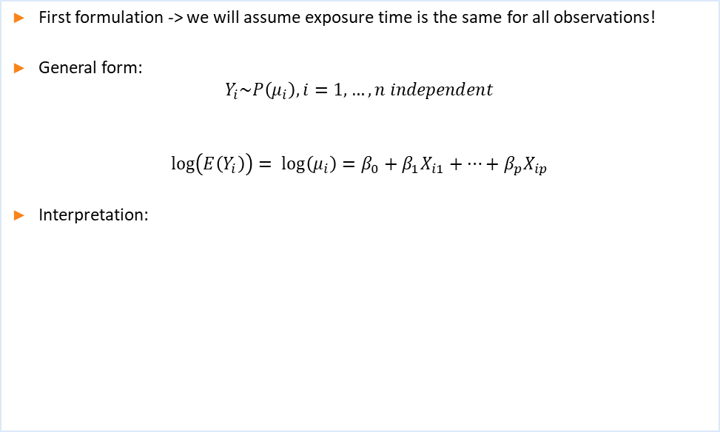
Log-linear model
First formulation -> we will assume exposure time is the same for all observations!
General form:
$$Y_{i}\sim P\left(μ_{i}\right),i=1, …, n independent$$
$$\log\left(E\left(Y_{i}\right)\right)= \log\left(μ_{i}\right)=β_{0}+β_{1}X_{i1}+…+β_{p}X_{ip}$$
Interpretation:

Slide 7
Log-linear model
First formulation -> we will assume exposure time is the same for all observations!
Hypothetical example: a study of insulin-dependent diabetic patients followed for 4 weeks after acquiring an insulin pump. The patients record and report the total number of hypoglycemic episodes during the 4 week follow-up.
The goal of the analysis is to compare the total number of hypoglycemic episodes for male and female diabetic patients

Slide 8
Example: Same exposure time

Slide 9
Example: Same exposure time

Slide 10
Log-linear model
Second formulation -> we will NOT assume exposure time is the same for all observations!
Hypothetical example: a study of insulin-dependent diabetic patients followed up to 4 weeks after acquiring an insulin pump.
Now suppose that not all patients were able to be followed for the entire 4-week period; patients were followed from 10 to 28 days. Patients report the number of hypoglycemic episodes within the duration of the patient’s specific follow-up.
The goal of the analysis is to compare the total number of hypoglycemic episodes for male and female diabetic patients

Slide 11
Example: Variable exposure time
$$Y_{i}\sim P\left(μ_{i}\right)=P(N_{i}λ_{i}),i=1, …, n independent$$

Slide 12
Example: Variable exposure time
$$\log\left(E\left(Y_{i}\right)\right)= \log\left(μ_{i}\right)=\log\left(N_{i}λ_{i}\right)=\log\left(N_{i}\right)+β_{0}+β_{1}{male}_{i}$$

Slide 13
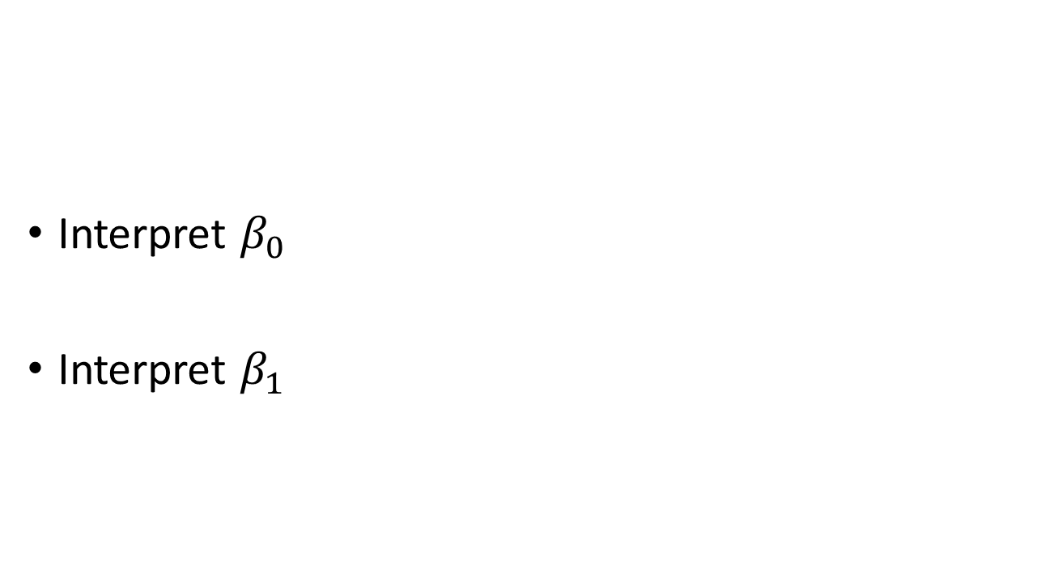
Example: Variable exposure time
$$\log\left(E\left(Y_{i}\right)\right)= \log\left(μ_{i}\right)=\log\left(N_{i}λ_{i}\right)=\log\left(N_{i}\right)+β_{0}+β_{1}{male}_{i}$$
Interpret $β_{0}$
Interpret $β_{1}$

Slide 14
Estimation: Maximum likelihood estimation

Slide 15
Robust variance estimation

Slide 16
Example: Robust variance estimation
Daily non-accidental deaths in Chicago, 1987 – 1994
Log-linear model for daily deaths as a function of:
PM10
Current temperature + average of prior three days (natural spline 3 df)
Time: year, season, month
Data are overdispersed; greater variance than expected by Poisson model

Slide 17
Example: Robust variance estimation

Slide 18
Case Study
Estimation of excess deaths after Hurricane Maria

