Slide 1
Lecture 12
Finish case-study of log-linear regression applied to binned survival data
Continuous time survival analysis

Slide 2
Review of Lecture 12
The data contains information about time to death for inpatients hospitalized for a severe mental disorder. Survival time from hospitalization is in years.
Patients are censored: i.e. we don’t get to follow patients long enough to see when the event occurs for all patients.
In the data, “censor” is 1 if censored; 0 if the patient died; “age” of hospitalization for mental disorder is in years; “male” is 1 for males and 0 for females.

Slide 3
Review of Lecture 12
We “binned” the information about survival into 10-year increments of follow-up

Slide 4
Review of Lecture 12
Incidence: risk per unit time of the event occurring among those that enter the interval
Hazard: the limit of the incidence rate as the interval width goes to zero
Crude estimate: number of events divided by the person-time experienced in the interval
Want a smooth estimate of incidence/hazard using a log linear model:
Assume the number of events per interval Y_{i} ~ Poisson(PT_{i}λ_{i})

Slide 5
Review of Lecture 12
Model A:

Slide 6
Review of Lecture 12
Model fitted values, i.e. Expected deaths per interval time

Slide 7
Log-linear model, Model B
Model B

Slide 8
Log-linear model; Model B

Slide 9
Log-linear model; Models C and D
We would expect the hazard of death to depend on how long one has been in the hospital since we do not live forever. Models C and D estimate the relative risk of death for men as compared to women, controlling for a time-varying baseline hazard
In survival analysis, we refer to the "baseline hazard" as the hazard function when setting exposure variables to 0.

Slide 10
Log-linear model; Models C and D

Slide 11
Log-linear model; Models C and D

Slide 12
Log-linear models: Model E
Finally, we look for evidence that the relative rate for men as compared to women changes over the duration of follow-up
I.e. the proportional hazards assumption is inadequate for our data.
Model E: we center the midpoint variable at 20 years duration so that the male coefficient has a more reasonable interpretation and include interaction between male and years of hospitalization

Slide 13
Log-linear models: Model E

Slide 14
Model comparison

Slide 15
Model comparison

Slide 16
Continuous time survival analysis
Binning survival times is convenient when working from administrative data or data where you do not have access to individual level data
Most natural to treat time as continuous
Review definition of censoring

Slide 17
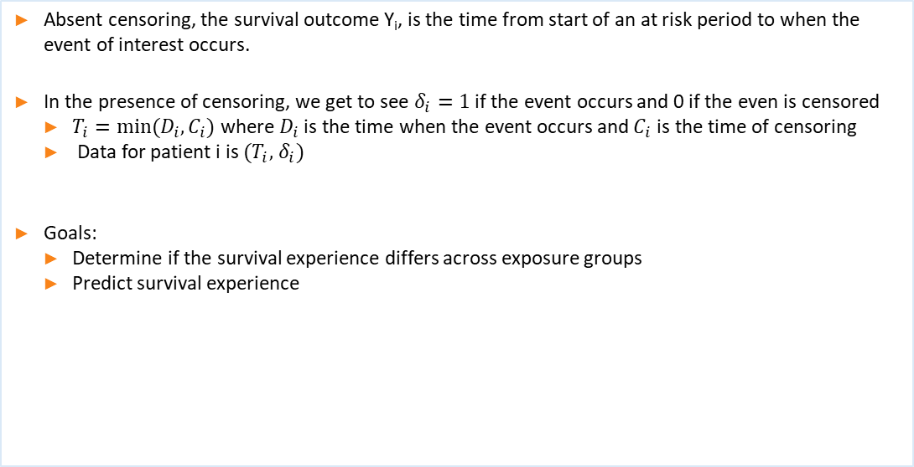
Continuous time survival analysis
Absent censoring, the survival outcome Y_{i}, is the time from start of an at risk period to when the event of interest occurs.
In the presence of censoring, we get to see $δ_{i}=1$ if the event occurs and 0 if the even is censored
$T_{i}=min⁡(D_{i},C_{i})$ where $D_{i}$ is the time when the event occurs and $C_{i}$ is the time of censoring
Data for patient i is $(T_{i},$ $δ_{i})$
Goals:
Determine if the survival experience differs across exposure groups
Predict survival experience

Slide 18
Key survival analysis definitions

Slide 19
Key survival analysis definitions

Slide 20
Common Parametric Models; Exponential

Slide 21
Common Parametric Models: Gamma

Slide 22
Common Parametric Models: Weibull

Slide 23
Analysis of survival analysis outcomes in continuous time
Estimating S(t) via Kaplan-Meier survival function estimate (now)
Testing whether S1(t) = S2(t), via the log-rank test (Lab 7)
Regression of survival outcomes on exposures via Cox Proportional Hazards regression models (Lecture 14)

Slide 24
Kaplan-Meier estimate of the survival function

Slide 25
Kaplan-Meier estimate of the survival function
Using the data for inpatients hospitalized for a severe mental disorder, we will be computing the Kaplan-Meier estimate of the survival function for the female patients. Survival time from hospitalization is in years.

Slide 26
Kaplan-Meier estimate of survival function

Slide 27
Greenwood’s formula for variance of S(t)

Slide 28
Variance of S(t) estimate based on complementary log-log

Slide 29
Example calculations: Greenwood’s formula

Slide 30
Example calculations: Complementary log-log

Slide 31
R implementation

Slide 32
R implementation

Slide 33
Where to next….
Lab: log-rank test comparing two survival functions
Thursday: Cox proportional hazards model

