Slide 1
Lecture 9
Review of logistic regression model assumptions
Models for longitudinal / clustered binary responses

Slide 2
Review of logistic regression assumptions
And solutions to violations
Mean model is correctly specified
Violation impact estimation of association parameters
Plot average predicted vs. observed proportions within quintiles or deciles of predicted values
Plot average predicted vs. observed proportions as a function continuous exposure
Summary tables of average predicted vs. observed proportions by level of categorical exposure
SOLUTION: change your mean model
Observations are independent
Violation impacts estimation of standard errors, confidence intervals, hypothesis tests
SOLUTIONS:
Marginal logistic regression model fit using generalized estimating equations
Conditional logistic regression model

Slide 3
Review of logistic regression assumptions
Variance is correctly specified
Logistic model assumes: Var(Y) = p(1-p)
Under or over-dispersion
Compute Var(Y) and compare with predicted variance, overall or by select variables
SOLUTION:
Bootstrap
GLM: family = “quasibinomial” assumes Var(Y) = φ x p x (1-p) where φ = 1/(n-k) sum of squared Pearson residuals
There are no “influencial” observations
DFFITS or DFBETAS

Slide 4
Two example studies
Placebo-controlled trial to improve respiratory function
111 patients
Baseline + 4 follow-ups
Compare the change in odds from baseline to follow-up across the active treatment vs. placebo groups.
Matched case-control study looking at effect of exogenous estrogens on the risk of endometrial cancer
63 matched sets: one case + 4 controls
Alive in same community at the time of diagnosis for the case, age within 1 year, same marital status and entered community at roughly the same time
Do women who use estrogens, have a history of gall-bladder disease or hypertension at increased risk of endometrial cancer?

Slide 5
Two approaches to modeling
Marginal models
Conditional models

Slide 6
Marginal model: GLM Review
Requires specification of 3 components

Slide 7
Marginal model: GLM review
For a logistic regression model, we derived the likelihood function, log likelihood function and score equations.
Recall the score equation:

Slide 8
Marginal Model: Longitudinal GLM
You need to include one additional element in the model specification

Slide 9
Marginal Model: Longitudinal GLM
In linear models, we could easily write out the joint distribution for Y_{i} , the vector of responses for cluster i
In general, it is hard to write out the joint distribution of a Bernoulli random variable, Poisson random variable, etc.
We don’t use maximum likelihood estimation here
Derive estimates of β using multivariate version of the score equation (estimating equation)

Slide 10
Marginal Model: Generalized Estimating Equations
Estimation procedure is called generalized estimating equations (GEE)
Weighted least squares when Y_{i} is multivariate normal is a special case.
GEE:
GLM:

Slide 11
Example: Exploratory data analysis, mean model
Placebo-controlled trial of respiratory function
Baseline (time 1) and 4 follow-ups (times 2 through 5)
Treatment is assigned after baseline respiratory function is recorded

Slide 12
Example: Mean model specification and interpretation
Model specification:

Slide 13
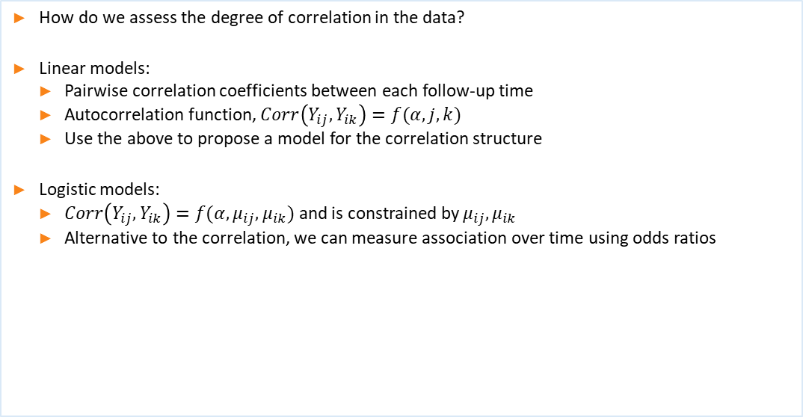
Example: Exploratory data analysis, correlation structure
How do we assess the degree of correlation in the data?
Linear models:
Pairwise correlation coefficients between each follow-up time
Autocorrelation function, $Corr\left(Y_{ij},Y_{ik}\right)=f(α,j,k)$
Use the above to propose a model for the correlation structure
Logistic models:
$Corr\left(Y_{ij},Y_{ik}\right)=f(α,μ_{ij},μ_{ik})$ and is constrained by $μ_{ij},μ_{ik}$
Alternative to the correlation, we can measure association over time using odds ratios

Slide 14
Example: Fitting the model in R using gee

Slide 15
Example: Interpretation of results
Interpretation of parameters:

Slide 16
Example: Comparison across working correlation models
Compare the results to the model fit assuming independence

Slide 17
Conditional Models
Random effects logistic regression model:

Slide 18
Conditional Models

Slide 19
Example: Logistic regression with random intercept
Slopes are log [ ratio of individual odds]!

Slide 20
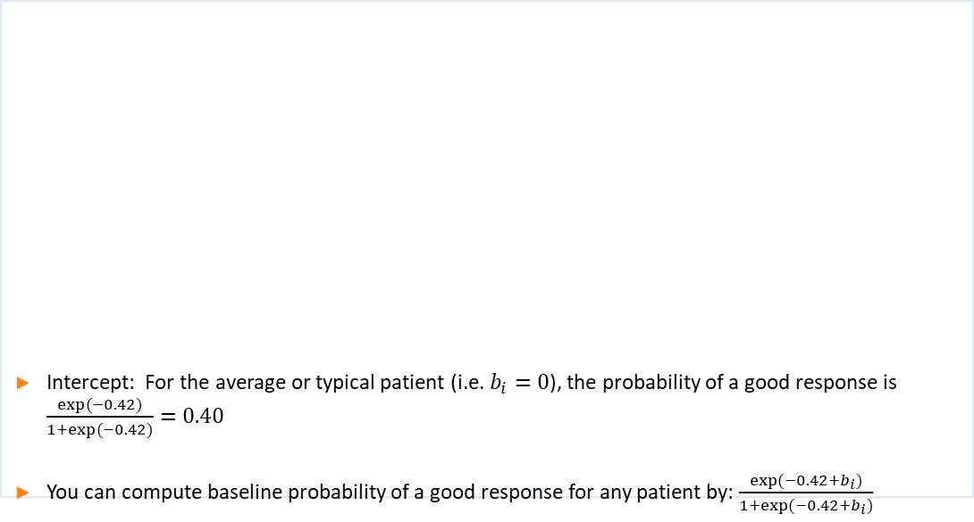
Example: Random intercept logistic model in R using glmer
Intercept: For the average or typical patient (i.e. $b_{i}=0$), the probability of a good response is $\frac{exp⁡(−0.42)}{1+exp⁡(−0.42)}=0.40$
You can compute baseline probability of a good response for any patient by: $\frac{exp⁡(−0.42+b_{i})}{1+exp⁡(−0.42+b_{i})}$

Slide 21
Example: Interpretation

Slide 22
Comparison of marginal and conditional slope terms
Recall our discussion of confounding: Assume b_i is independent of covariates (as we do in random effects models)

Slide 23
Next time…
Quick comments on estimation
Conditional logistic regression where we don’t assume a distribution for b_i
Application to matched case control study
Motivation and regression models for Poisson random variables

