Slide 1
Multiple Comparisons in Genetic and Genomic Studies
Guanghao Qi, PhD
Department of Biostatistics
Johns Hopkins Bloomberg School of Public Health

Slide 2
Outline
Genome-wide association studies (GWAS) and family-wise error rate
Differential expression analysis and false discovery rate

Slide 3
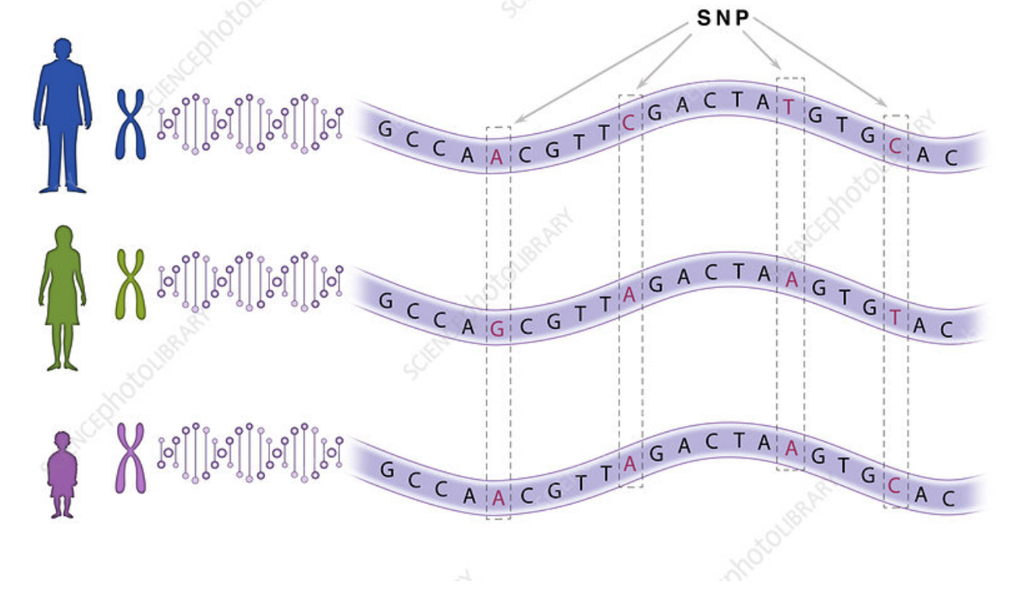
Genetic variants
Source: https://www.sciencephoto.com/media/1010514/view

Slide 4
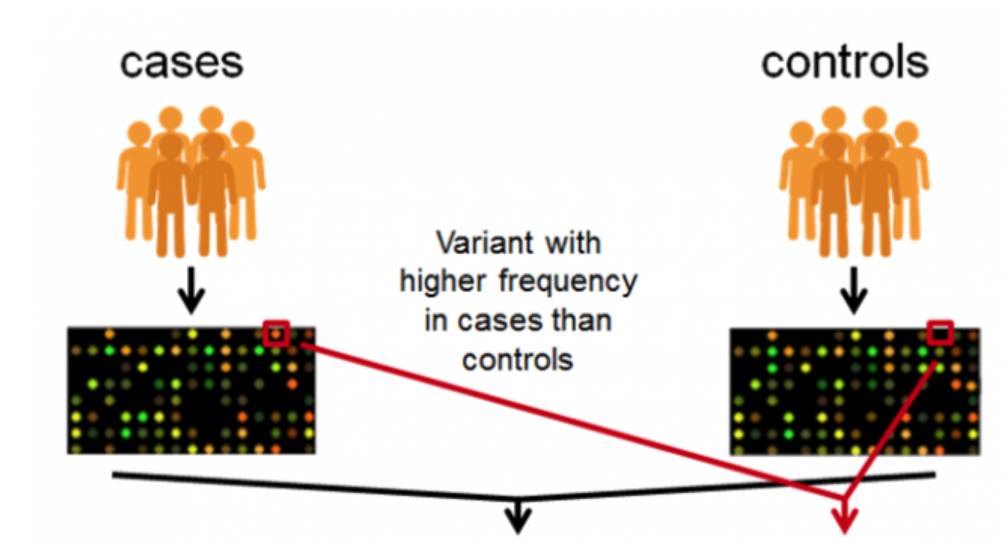
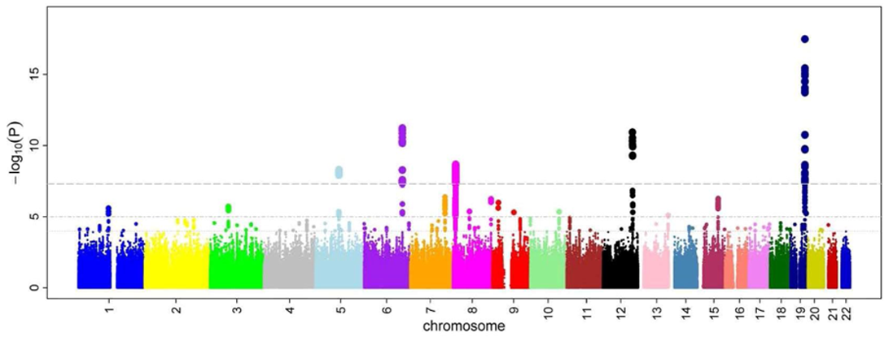
Genome-Wide Association Studies (GWAS)
E.g. type 2 diabetes
Most common type of variant in GWAS:
Single nucleotide polymorphism (SNP)
Manhattan plot:
-log10(P) vs
chromosome position
Source: EMBI-EBI
Notes:
https://www.ebi.ac.uk/training/online/course/gwas-catalog-exploring-snp-trait-associations-2019/what-gwas-catalog/what-are-genome-wide

Slide 5
Logistics of genome-wide association studies
Millions of genetic variants
Testing millions of hypotheses at the same time
Most genetic variants are NOT associated with the phenotype

Slide 6
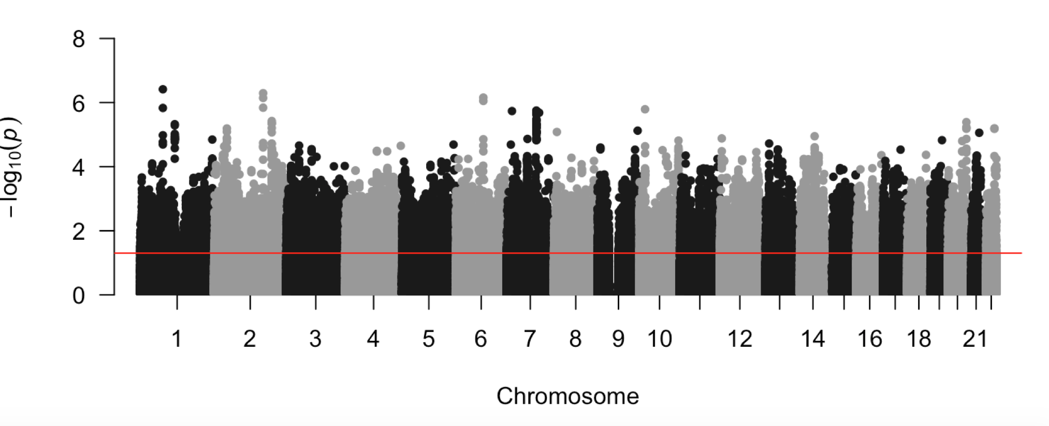
GWAS of female vs. male in UK Biobank
1.07 million genetic variants (SNPs) are tested
64,845 variants are significant at p<0.05!
P=0.05
Neale et al

Slide 7
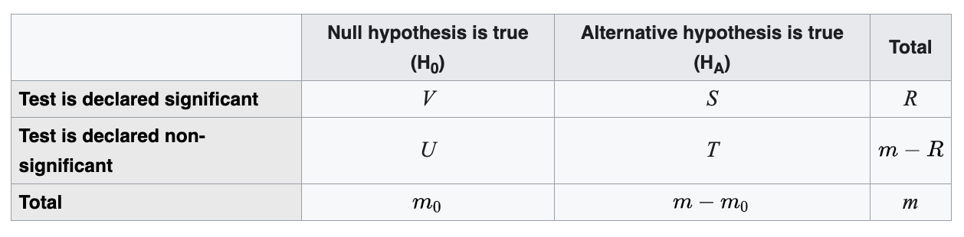

Family-wise error rate (FWER)
Family-wise error rate is the probability of making at least one type I error
$FWER=P(V≥1)$

Slide 8
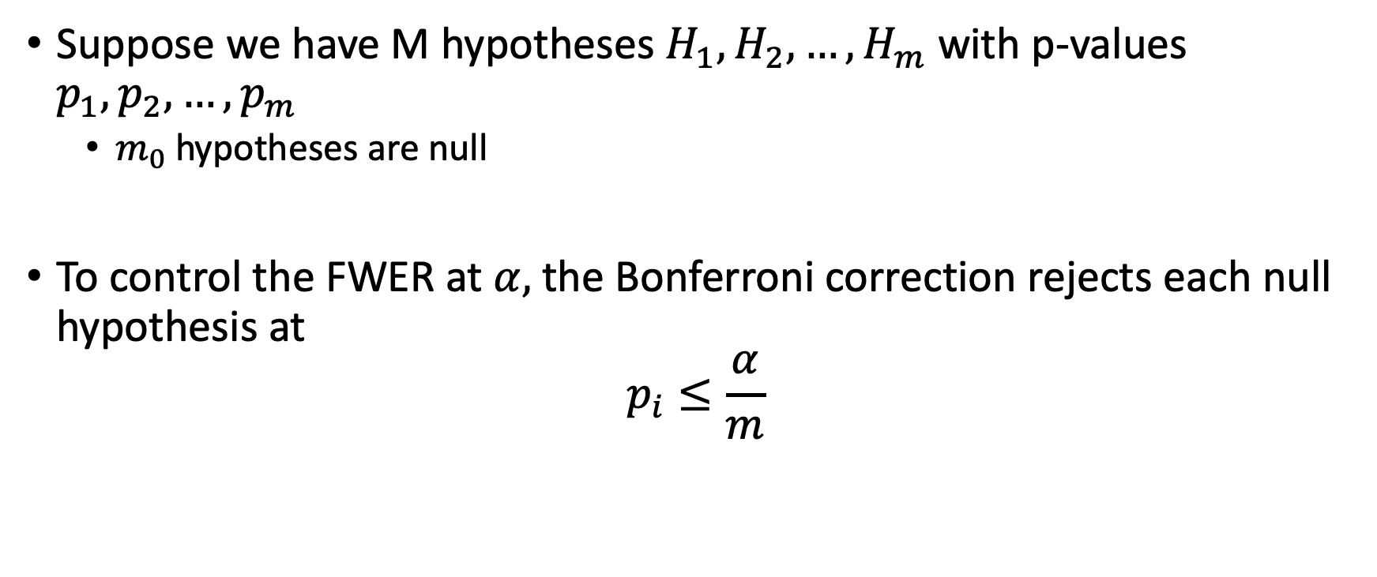
Bonferroni correction
Suppose we have M hypotheses $H_{1}, H_{2}, …, H_{m}$ with p-values $p_{1}, p_{2}, …, p_{m}$
$m_{0}$ hypotheses are null
To control the FWER at $α,$ the Bonferroni correction rejects each null hypothesis at
$$p_{i}≤\frac{α}{m}$$

Slide 9
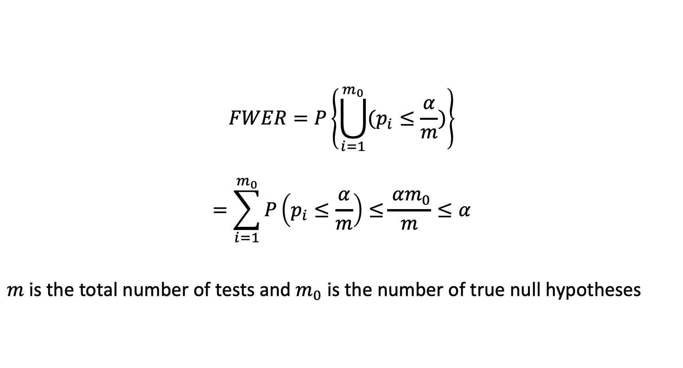
Proof: Bonferroni correction controls FWER
$$FWER=P\left\{\bigcup_{i=1}^{m_{0}}{(p_{i}≤\frac{α}{m})}\right\}$$
$$=\sum_{i=1}^{m_{0}}{P\left(p_{i}≤\frac{α}{m}\right)≤}\frac{{ αm}_{0}}{m}≤α$$
$m$ is the total number of tests and $m_{0}$ is the number of true null hypotheses

Slide 10
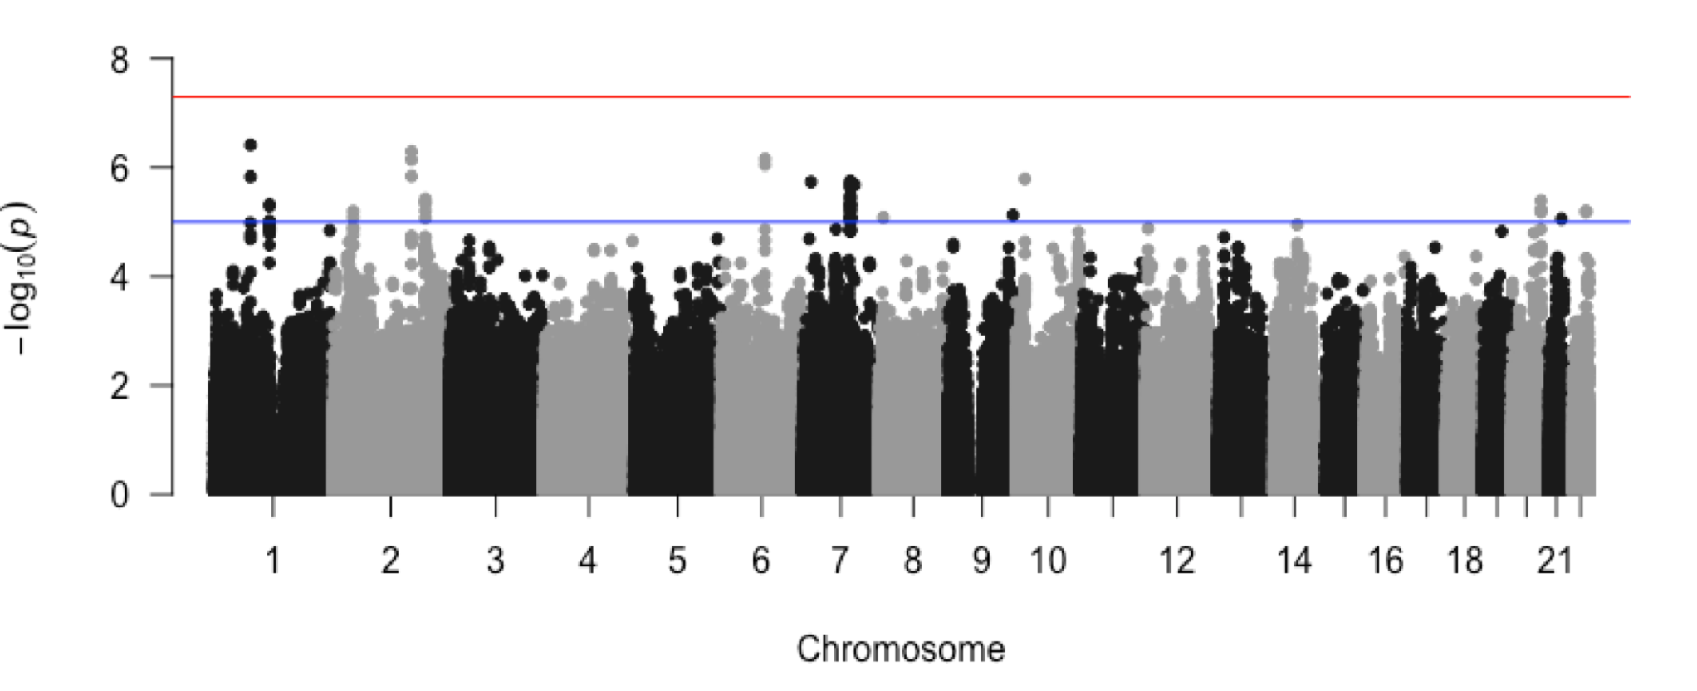
Bonferroni correction in GWAS
GWAS of female vs male
Accounting for 1 million variants: P < 0.05/1e6 = 5e-8
Neale et al

Slide 11
Summary: Bonferroni correction
Bonferroni correction is the main method for multiple comparison adjustment in GWAS
Bonferroni correction is highly conservative
Likely to miss true associations due to low power

Slide 12
False discovery rate

Slide 13
False discovery rate (FDR)
Bonferroni correction controls FWER
Probability of having at least one false positive
However, have one or a few false positives may not be too bad if the majority of the discoveries are true
E.g 5 false positives out of 200 discoveries
Controlling the false discovery rate (FDR) is less conservative and more powerful

Slide 14

Definition of FDR
FDR is the proportion of the rejected null hypotheses which are erroneously rejected
$$FDR=E(V/R)$$

Slide 15
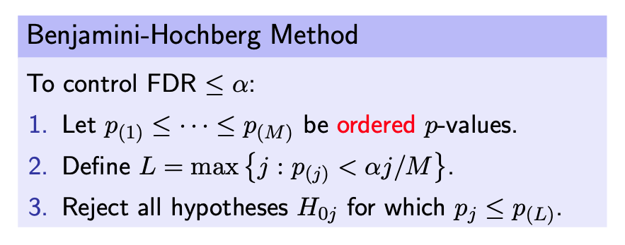
The Benjamini-Hochberg procedure for controlling FDR
First arrange the p-values in ascending order
Then:
Benjamini and Hochberg, 1995
https://cpb-us-w2.wpmucdn.com/blog.nus.edu.sg/dist/0/3425/files/2018/10/Understanding-Benjamini-Hochberg-method-2ijolq0.pdf
Notes:
https://cpb-us-w2.wpmucdn.com/blog.nus.edu.sg/dist/0/3425/files/2018/10/Understanding-Benjamini-Hochberg-method-2ijolq0.pdf

Slide 16

Example: Differential expression analysis
Statquest: https://www.youtube.com/watch?v=tlf6wYJrwKY
Notes:
Statquest: https://www.youtube.com/watch?v=tlf6wYJrwKY

Slide 17
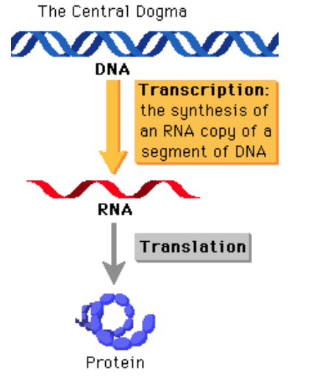
http://www.phschool.com/science/biology_place/biocoach/transcription/overview.html

Slide 18
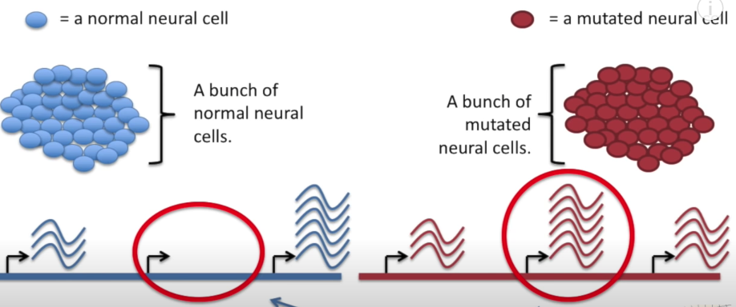
Measuring gene expression: RNA sequencing (RNA seq)

Slide 19
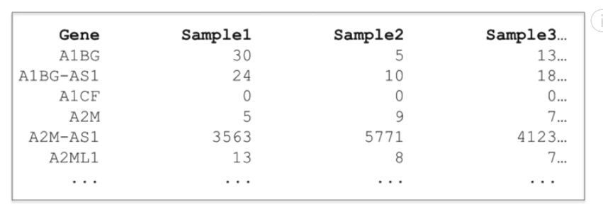
RNA-seq data
Expression level of >20,000 genes in multiple samples

Slide 20
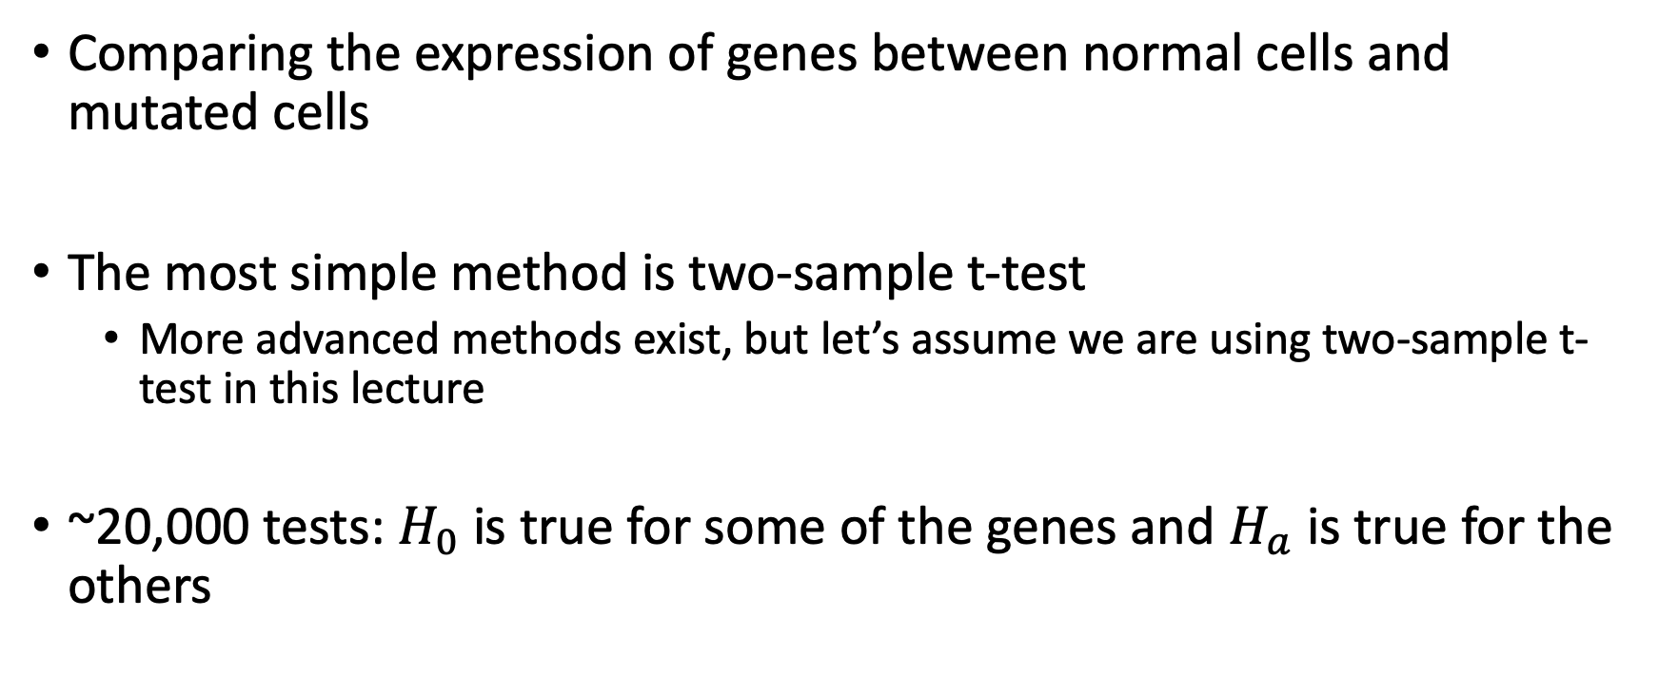
Differential expression analysis
Comparing the expression of genes between normal cells and mutated cells
The most simple method is two-sample t-test
More advanced methods exist, but let’s assume we are using two-sample t-test in this lecture
~20,000 tests: $H_{0}$ is true for some of the genes and $H_{a}$ is true for the others

Slide 21
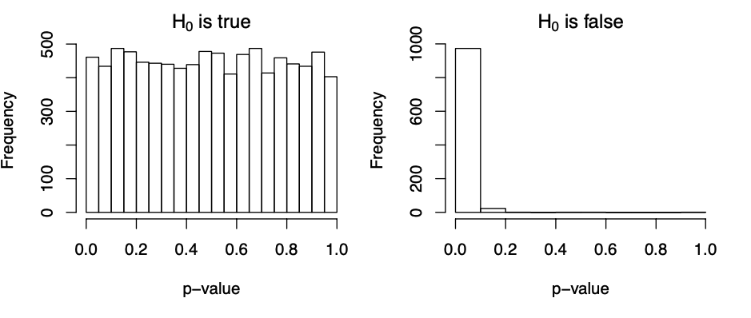
Distribution of p-value among genes with and without differential expression

Slide 22
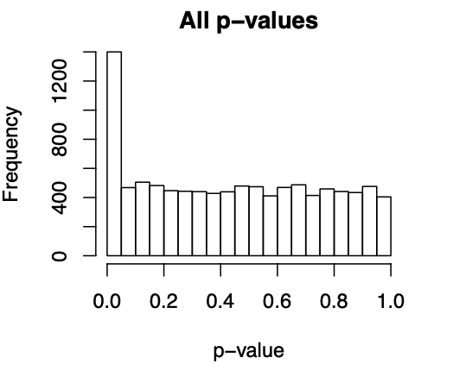

Slide 23
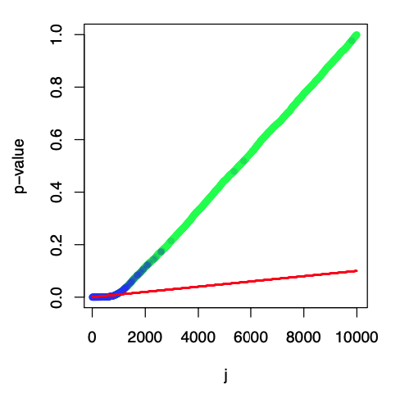
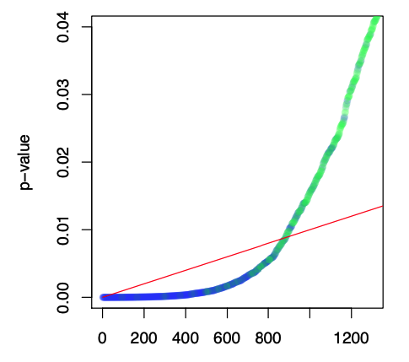


Benjamini-Hochberg revisited
$$p_{i}=αi/m$$
$$p_{i}=αi/m$$

Slide 24
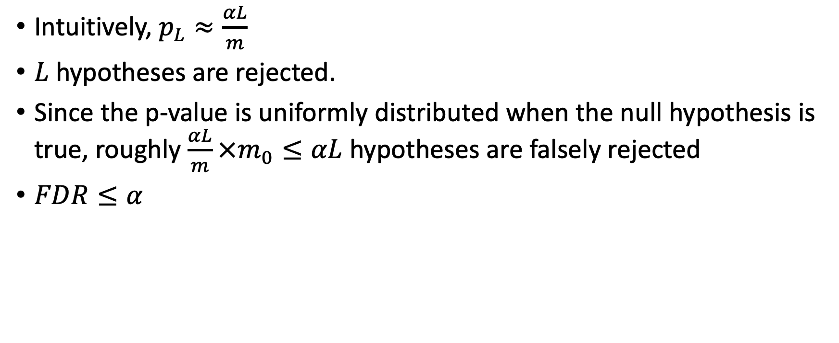
Why does Benjamini-Hochberg control the FDR?
Intuitively, $p_{L}≈\frac{αL}{m}$
$L$ hypotheses are rejected.
Since the p-value is uniformly distributed when the null hypothesis is true, roughly $\frac{αL}{m}×m_{0}≤αL$ hypotheses are falsely rejected
$FDR≤α$

Slide 25
Summary of FDR
The Benjamini-Hochberg procedure controls the FDR if the tests are independent
Can also control the FDR under certain positive dependence
Does not guarantee FDR control under arbitrary dependence
The Benjamini–Yekutieli procedure controls FDR under arbitrary dependence

Slide 26
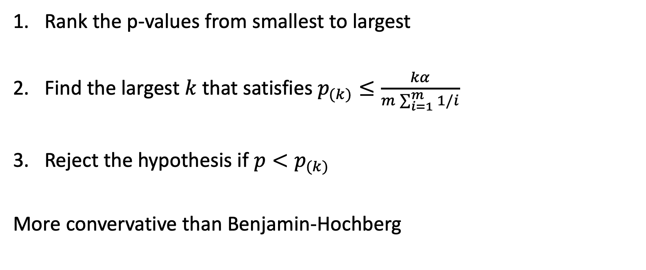
Benjamini–Yekutieli procedure
Rank the p-values from smallest to largest
Find the largest $k$ that satisfies $p_{(k)}≤\frac{kα}{m\sum_{i=1}^{m}{1/i}}$
Reject the hypothesis if ${p<p}_{(k)}$
More convervative than Benjamin-Hochberg

