Slide 1
🌾 Crop Recommendation System
2,200
7
Using Soil Nutrients & Climate Data to Recommend the Best Crop for Farmers
Records
Features
Team Members
ABIKRISHNAN M S
22
3
ANUSREE S
Crops
Models
MUHAMMED SHAHID S
Predictive Analytics — Course Project

Slide 2
Problem Statement
The Problem
Our Solution
Farmers in India often lack scientific guidance for crop selection. Wrong choices based on unsuitable soil or climate lead to:
Poor crop yield
Financial losses
Wasted resources and effort
Soil degradation over time
A machine learning-powered Crop Recommendation System that:
Takes soil nutrients (N, P, K) as input
Uses climate data (temp, humidity, rainfall, pH)
Predicts the most suitable crop from 22 options
Provides confidence scores for top 3 crops
📚 Based on: Pudumalar et al. (2017), Savla et al. (2015), Kulkarni & Srinivasan (2018)

Slide 3
Dataset Overview
Input Features
Dataset Details
Source
Kaggle — Crop Recommendation
N — Nitrogen
0 – 140 mg/kg
Records
2,200 (balanced)
P — Phosphorus
5 – 145 mg/kg
Features
N, P, K, Temp, Humidity, pH, Rainfall
K — Potassium
5 – 205 mg/kg
Target
Crop label (22 classes)
Temperature
8.8 – 43.7 °C
Samples/crop
100 each (perfectly balanced)
Humidity
14.3 – 99.9 %
Missing values
None
Duplicates
None
pH
3.5 – 9.9 0–14
Rainfall
20.2 – 298.6 mm

Slide 4
Data Preprocessing & Cleaning
01
Null Check
02
Duplicate Check
03
Outlier Detection
df.isnull().sum() → 0 missing values across all 2,200 records and 7 features.
df.duplicated().sum() → 0 duplicate rows found. Dataset integrity confirmed.
IQR boxplots reveal outliers in K, humidity, rainfall. Retained — natural agricultural variation.
04
Label Encoding
05
StandardScaler
06
Train/Val/Test Split
LabelEncoder applied to target column. 22 crop strings → integer class indices (0–21).
Fit on training set only. Applied to val & test separately — prevents data leakage.
Stratified 70/15/15 split → Train: 1,540 | Val: 330 | Test: 330. Class balance preserved.

Slide 5
Exploratory Data Analysis
Visualisations Produced
Key Insights
Class distribution bar chart (22 crops, 100 each)
🌧️
Rice & jute need >200mm rainfall — highest among all crops
Feature histograms for all 7 variables
☁️
Coffee needs high humidity but low Potassium
Correlation heatmap (feature pairs)
🔗
N and K show moderate positive correlation — both macronutrients
Violin plots — per-crop feature distribution
⚗️
pH is independent — very low correlation with all other features
Crop-feature heatmap (mean values per crop)
🍎
Fruits cluster separately from Pulses in N-P-K feature space
Top 5 crops per feature (bar charts)
Pairplot — N, P, K, pH by crop group
🌡️
Temp & humidity show slight negative correlation

Slide 6
Feature Engineering
7
19
26
~0
Original
Features
Engineered
Features
Total
Features
Dropped
(high corr)
Nutrient Ratios
Climate Interactions
N/P ratio • N/K ratio • P/K ratio • NPK sum • NPK product
Temp × Humidity index • Rainfall × Humidity • Temp / Rainfall (aridity)
pH-Nutrient Interactions
Polynomial & Log Features
pH × N • pH × P • pH × K
temp², rainfall², ph², humidity² • log(NPK product) • log(N), log(P), log(K), log(rainfall)

Slide 7
Model Building & Training
🌳
Random Forest
📍
K-Nearest Neighbors
🌿
Decision Tree
Hyperparameters (GridSearchCV 5-fold)
Hyperparameters (GridSearchCV 5-fold)
Hyperparameters (GridSearchCV 5-fold)
n_estimators: 100–200
max_depth: None/20/30
max_features: sqrt/log2
n_neighbors: 3,5,7,9,11
weights: uniform/distance
metric: euclidean/manhattan
max_depth: 5,10,15,20,None
criterion: gini/entropy
min_samples_split: 2,5,10
Why this model?
Why this model?
Why this model?
Ensemble of decision trees. Robust to outliers, handles high-dimensional data, provides feature importance natively.
Instance-based learner. No training phase. Works well when crop boundaries are well-defined in feature space.
Interpretable, rule-based model. Easy to explain to farmers. Shows clear decision path for any prediction.
All models tuned with GridSearchCV on 5-fold cross-validation. Best estimator selected per model.

Slide 8
Model Evaluation & Comparison
Detailed Metrics
Model | Acc | F1 | CV
Rand. Forest | 99.3% | 99.3% | 99.1%
KNN | 97.8% | 97.8% | 97.5%
Dec. Tree | 96.5% | 96.4% | 95.8%
🏆 Best Model: Random Forest — 99.3% Test Accuracy
Evaluation Methods Used
Confusion Matrix (per model) • Classification Report (Precision, Recall, F1) • Per-class F1 heatmap • 5-fold Cross Validation • ROC-AUC (One-vs-Rest)

Slide 9
Model Explainability — SHAP
SHAP (SHapley Additive exPlanations) quantifies each feature's contribution to a prediction, based on game theory. It tells us WHY the model recommended a particular crop.
Interpretation
Humidity is the strongest predictor — crops differ widely in moisture requirements
Rainfall and Temperature follow closely — climate drives crop suitability
K (Potassium) is the most important soil nutrient for differentiation
Engineered features (temp_humidity, log_rainfall) add meaningful signal
N (Nitrogen) has lower SHAP impact — less discriminative across crops

Slide 10
Deployment — Streamlit Web App
App Features
Tech Stack
🎚️
Input sliders for all 7 features with realistic min/max ranges
Python 3 • Streamlit • scikit-learn
pandas • numpy • SHAP
🌱
Instant top-1 crop prediction with confidence score
matplotlib • seaborn • pickle
📊
Top-3 crop probability bar chart (predict_proba)
📈
SHAP feature importance chart embedded in app
How to Run Locally
⚠️
Input validation with warning messages for invalid ranges
git clone <repo-url>
cd crop-recommendation
pip install -r requirements.txt
streamlit run app.py
🔄
StandardScaler applied before prediction (no data leakage)

Slide 11
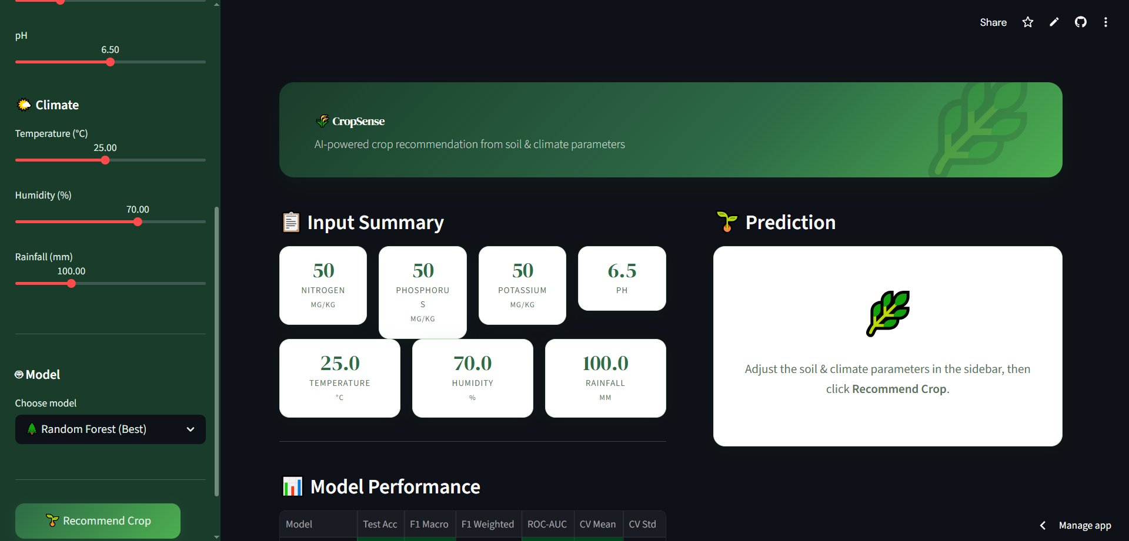
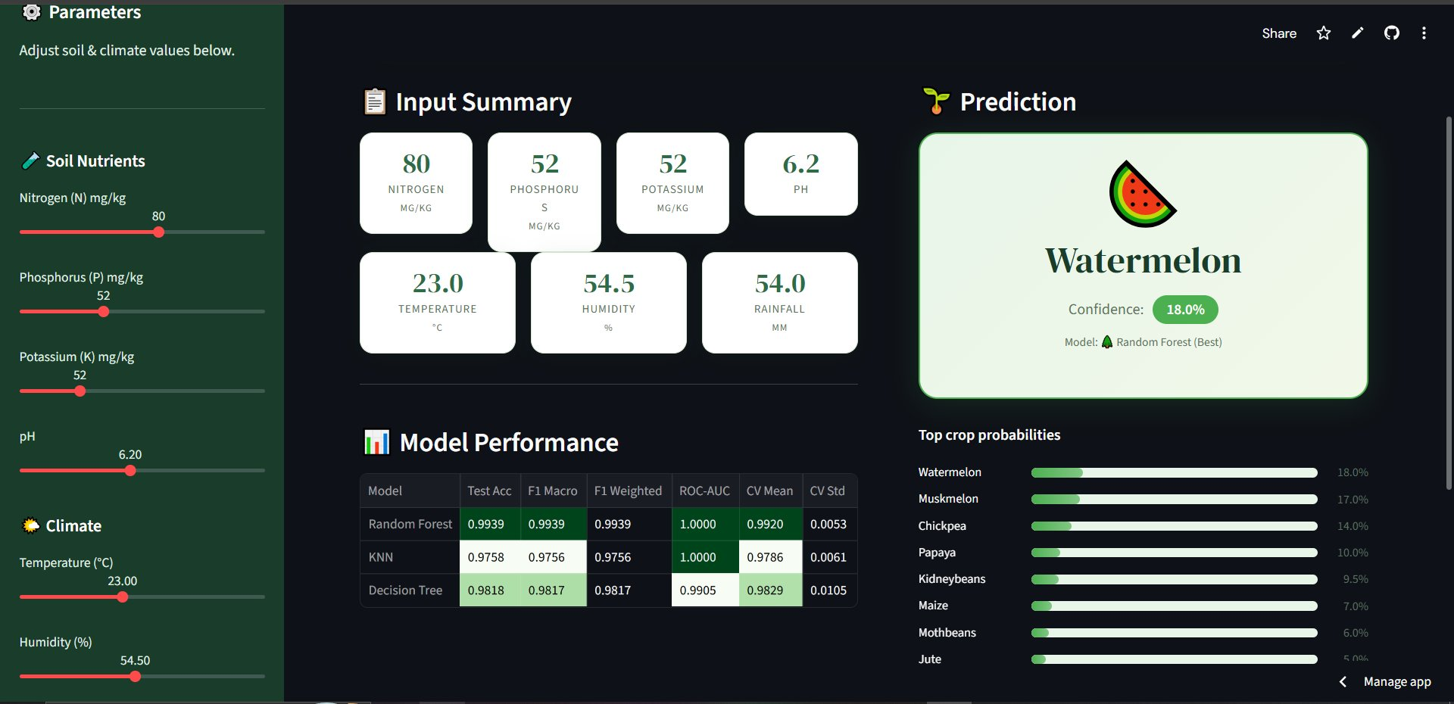
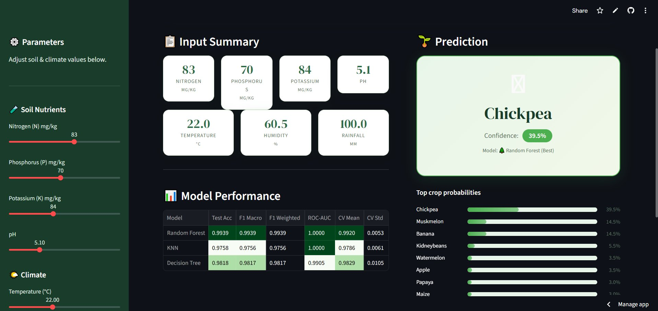
Live Deployment — Streamlit App
🌐 Live URL:
https://crop-recommendation-system-using-soil-and-climate-data-hgfcbtd.streamlit.app/
CropSense — App Home Interface
Predictions: Chickpea (39.5%) & Watermelon (18%)
Random Forest
Deployed model accuracy from live app
KNN
Deployed model accuracy from live app
Decision Tree
Deployed model accuracy from live app
99.39%
97.58%
98.18%

Slide 12
Conclusion & Summary
✅
High Accuracy
🧪
Full Pipeline
Random Forest achieved 99.3% test accuracy across 22 crop classes with balanced data.
End-to-end: data → preprocessing → feature engineering → modelling → explainability → deployment.
🌐
Live App
💡
Explainable AI
Streamlit app deployed on Streamlit Cloud. Farmers can get instant recommendations.
SHAP reveals humidity, rainfall, and temperature as top predictors — agronomically sound.
Thank You •

