Slide 1

Introduction to Linux OS and Bash shell
Ante Bilandzic
(E62, Dense and Strange Hadronic Matter)
Last update: 20260901-1

Slide 2


Outline
Introduction
Linux OS
Bash shell

Slide 3
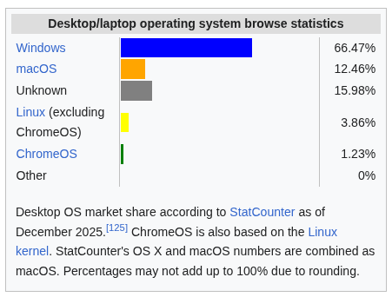
Why Linux OS?
Statistics for all desktop/laptop computers:
Taken from this link

Slide 4
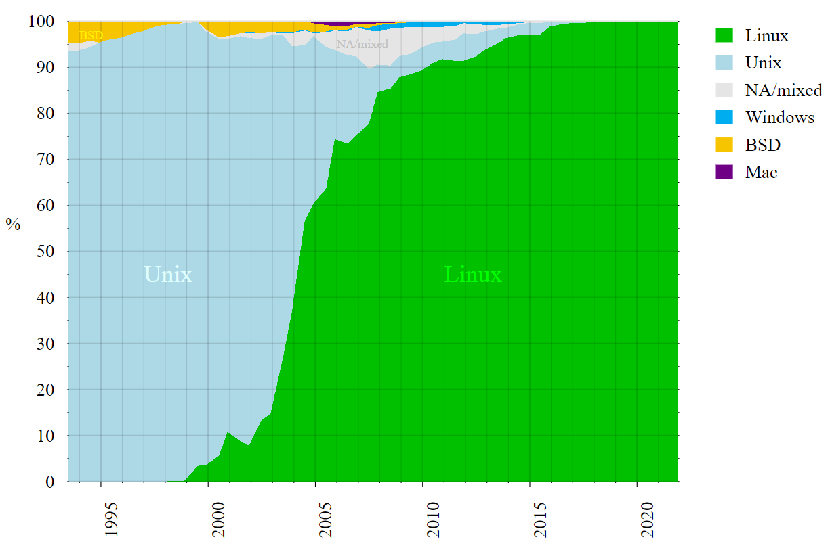
Why Linux OS?
Statistics for all supercomputers:
Taken from this link

Slide 5

Why Linux OS?
Linux is by far the leading operating system in computers used in scientific research (CERN, NASA, etc.)
Linux kernel: developed by Linus Torvalds in the early 90s
GNU (‘GNU’s not Unix’): open source utilities to perform standard actions on the computer – no licensing
Linux kernel + GNU utilities = Linux OS
Initially, the Linux OS was basically a free Unix
Penguin named Tux is the most commonly used logo for Linux

Slide 6
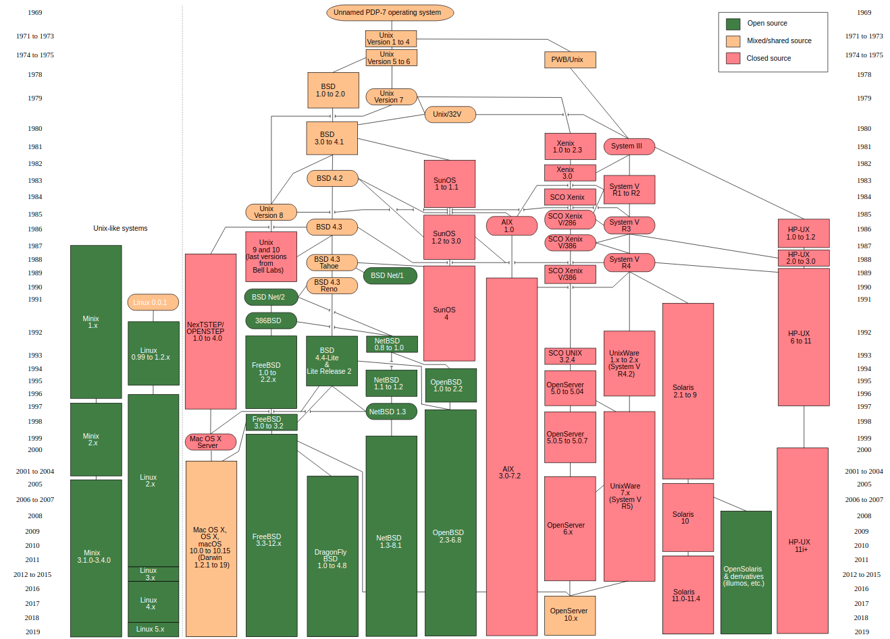
Unix OS
Unix legacy:
The first OS written in a high-level programming language (C)
The first widely portable OS Unix v7 (1979)
Unix family tree – Linux is one of its direct descendants
Mac OS is also part of this family!

Slide 7

Unix OS
Unix was developed at “Bell Labs” in Murray Hill, New Jersey, USA, in the 70’s

Slide 8
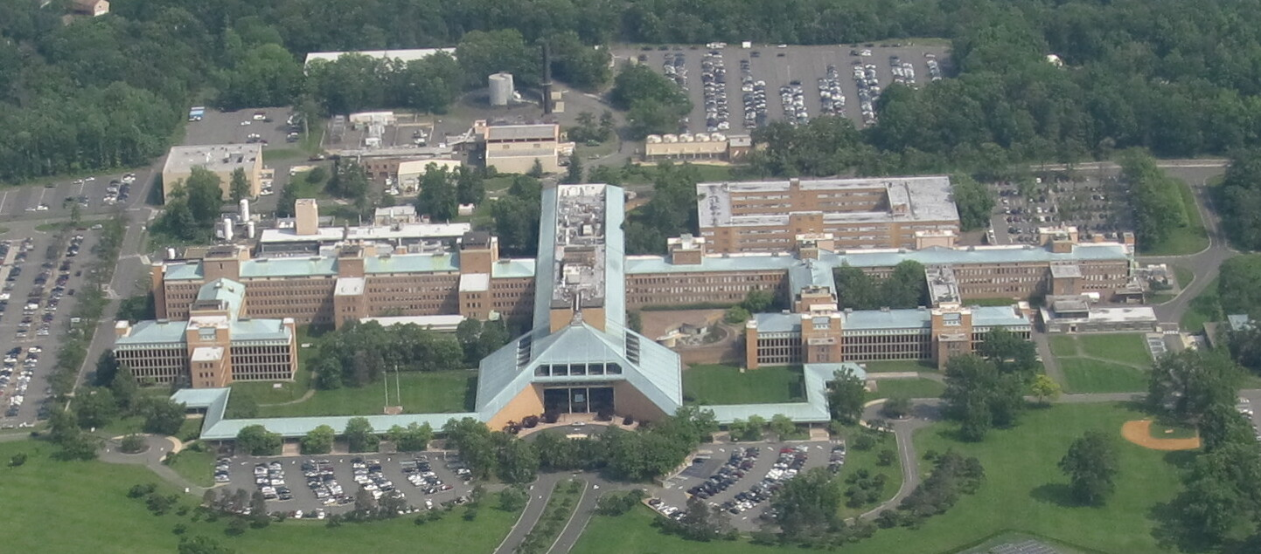
Unix OS
Unix was developed at “Bell Labs” in Murray Hill, New Jersey, USA, in the 70’s

Slide 9

Linux OS
Linux family tree: Common Linux kernel and a plethora of different Linux distributions built on top of it
Full-core: Debian, Red Hat Enterprise, openSUSE, etc.
Specific: Ubuntu, Fedora, CentOS, Linux Mint, etc.
Specific distributions are derivatives of full-core distributions:
Ubuntu is derivative of Debian, Fedora of Red Hat, etc. (see complete tree at https://distrowatch.com/images/other/distro-family-tree.png)
The material presented in this course will be demonstrated on Ubuntu, but it applies also to any other Linux distribution
Regular updates on all distributions: https://distrowatch.com

Slide 10

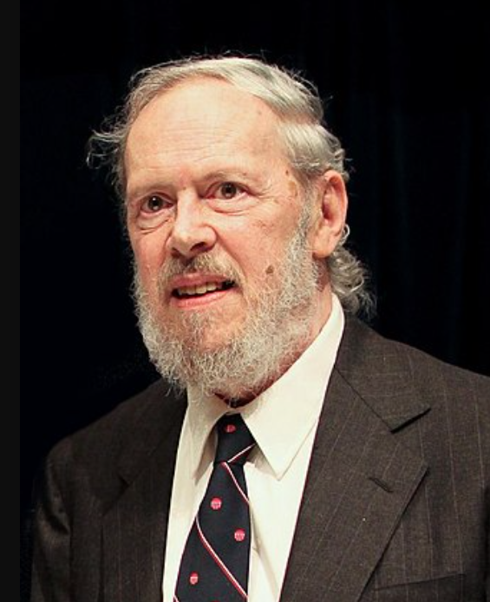

Key people
Ken Thompson
Denis Ritchie
Linus Torwalds
B programming language,
UNIX operating system,
Regular expressions,
UTF-8 encoding,
Go programming language,
Chess tablebases, ...
C programming language,
UNIX operating system,
...
Linux operating system,
Git (version control system),
...

Slide 11
Getting Ubuntu for Windows users
If you have only Windows on your laptop, you could either:
on Windows 11, use Windows Subsystem for Linux :
Open Windows PowerShell and list available Linux distributions with the command:
wsl --list --online
Pick up your favorite Linux distribution, and install it e.g. as follows:
wsl --install Ubuntu-24.04
The rest is easy (pick up your account, etc.)
or, install PuTTY ( https://www.putty.org/ ) and then use it to connect and work remotely on some computer running Linux, on which you have an account

Slide 12
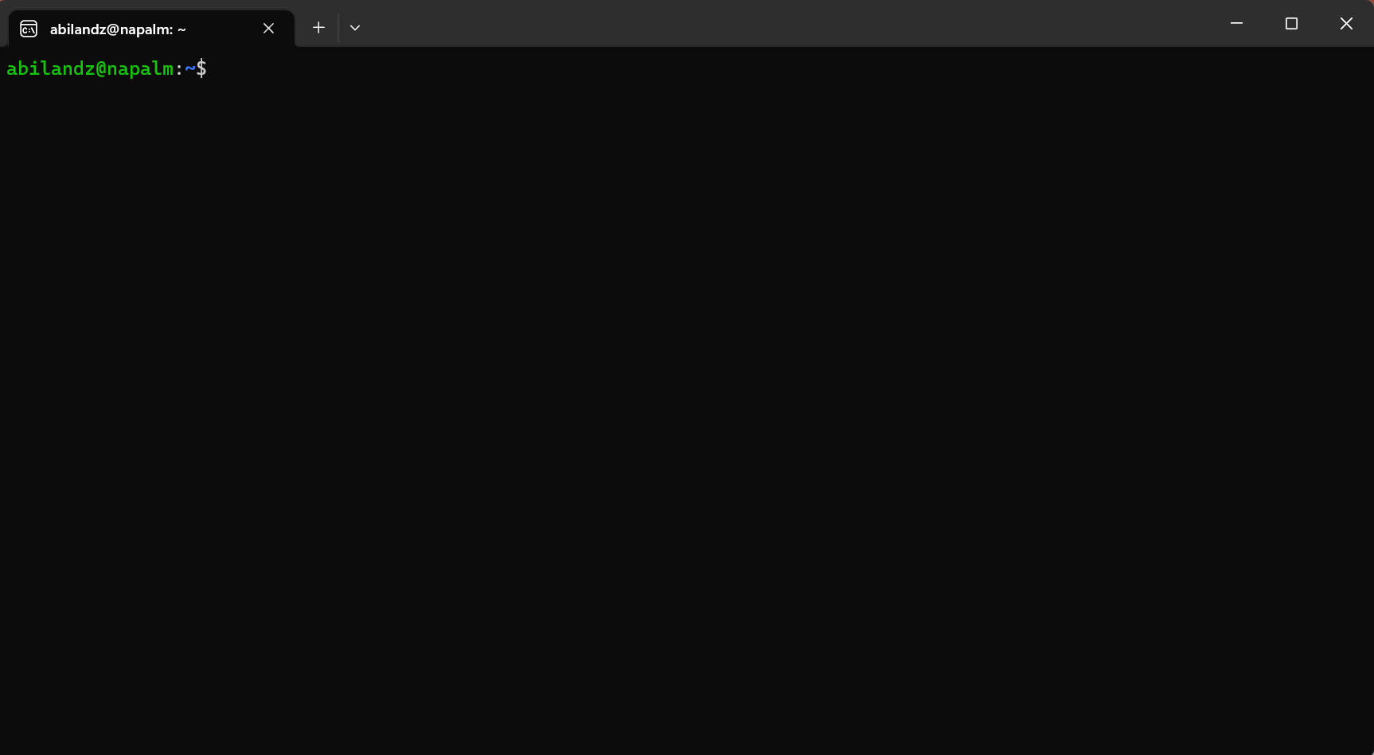
Is this the right crash course for you?
If, after you have opened a terminal in Linux …
… you have asked yourself: ‘What now?’, then this is the right course for you!

Slide 13
Is this the right crash course for you?
What can we do in the terminal?
Not that much with the mouse…
Next, you can start typing and pressing ‘Enter’, but most likely, whatever you have typed in the terminal will produce only error messages
Still, that is something, as it clearly means that there is some secret/magic language that is trying to respond to, or to interpret, your command input, as soon as you have typed something in the terminal and pressed ‘Enter’. What is that secret built-in language available in the terminal?

Slide 14
Linux shells
Loosely speaking, a shell is any program that a user employs to type commands in the terminal (text window)
Example shells:
sh
bash
zsh
ksh
csh
fish
PowerShell (developed by Microsoft)
Since Bash is the default shell on most Linux distributions nowadays, we focus on it
If not set by default, just type bash in the terminal, and you are in the Bash wonderland

Slide 15
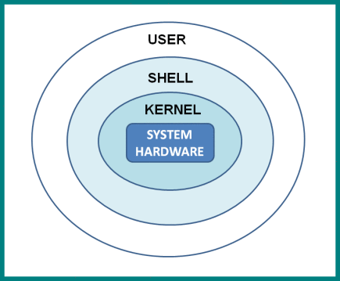
Why shell?
The shell translates the commands you type into a format that the computer can understand
It works both ways: The user is shielded from the Linux kernel, and the Linux kernel is shielded from the user

Slide 16

A bit of Bash history
Initial development by Brian Fox in 1989 as a part of GNU project...
And it’s still alive!
Bash is an acronym for ‘Bourne-again shell’
The original shell ‘sh’ was written in 1977 by Stephen Bourne
Written entirely in C
The Linux kernel is mostly written in C
Executable: /bin/bash
File extension: .sh
Command processor / interpreted / scripting language

Slide 17
The current status of Bash
Bash is well-maintained and is still under regular development
Webpage: https://www.gnu.org/software/bash/
Source code: http://git.savannah.gnu.org/cgit/bash.git
Latest release: version 5.3 (July 3rd, 2025)
The current maintainer: Chet Ramey

Slide 18
Interpreted vs. compiled languages
Interpreted:
write code & execute line-by-line
less reliable (there is no compiler to catch the errors!)
the source code can be easily read and copied
examples: Bash, Python, Mathematica, JavaScript
Compiled:
write code & compile & execute the compiled file (‘binaries’)
generally runs faster than interpreted code
examples: C, C++, Java, Go

Slide 19
Thanks!

