Slide 1

Scientific computing in high-energy physics Lecture 1, 16.04.2026
Ante Bilandzic
(E62, Dense and Strange Hadronic Matter)

Slide 2

Outline of today’s lecture
Course trivia
Free adverts
Linux
Bash
ROOT

Slide 3
Course trivia
PH8124: ‘Scientific computing in high-energy physics’
https://academics.nat.tum.de/org/mh/details/mod/PH8124/
When & where:
Thursday: 14:00-16:00 (hybrid mode)
Physics Department, E62 seminar room 2024
Roomfinder: https://nav.tum.de/room/5101.EG.024
12+ contact days (the last lecture is on July 16th)
Examination:
Homeworks (10 in total)
Oral examination during the presentation of the final project
Contact:
Ante Bilandzic, ante.bilandzic@tum.de
Office PH 2101: https://nav.tum.de/room/5101.EG.101

Slide 4

Course trivia
The presence in person is encouraged
Parallel online coverage via Microsoft Teams (MT)
Why not Zoom?
As of SS2026, TUM no longer offers the licensed Zoom version…
Recurring MT meetings on Thursdays, from 13:30-16:00
MT coordinates will be distributed via the official mailing list to all registered students for this course
Per popular request, lectures are recorded, and recordings shared immediately afterward via email

Slide 5
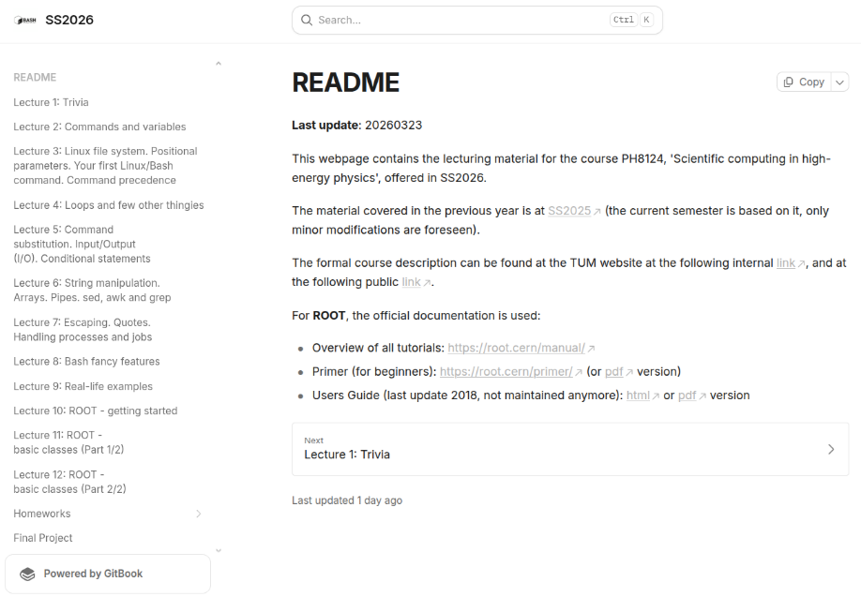
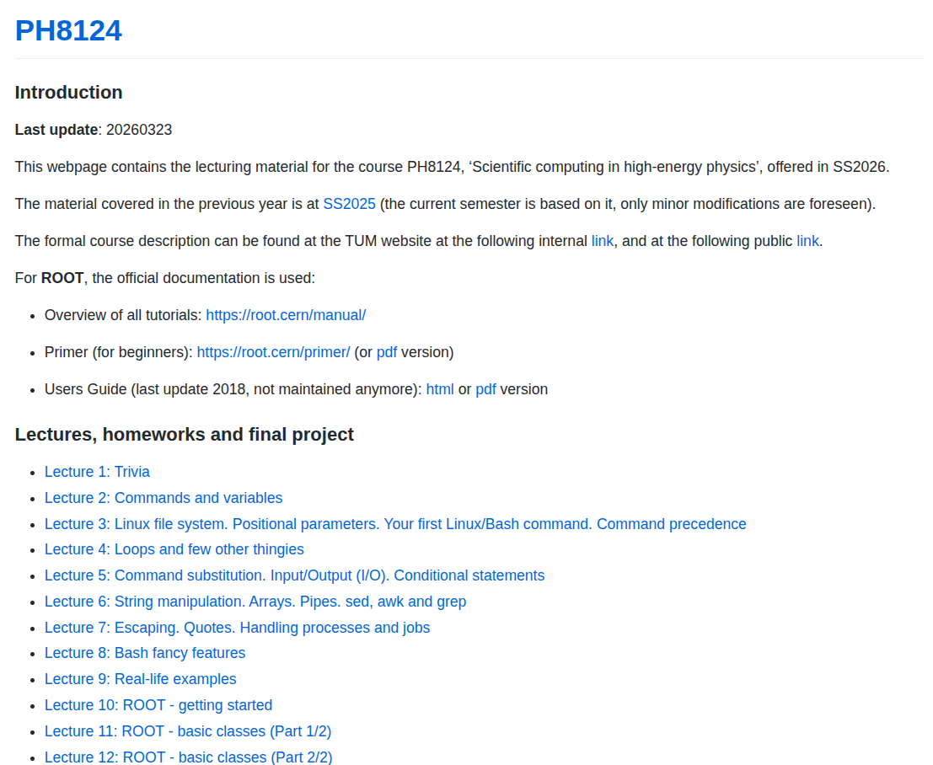
Webpage
The course has a dedicated webpage:
https://abilandz.gitbook.io/ss2026 (GitBook version)
https://abilandz.github.io/PH8124/ (GitHub Pages version)
The layout is different, but the content is exactly the same!

Slide 6
Course trivia
After each lecture, an executive summary of the covered material will be shared via email
The course webpage will be updated regularly
In the same way, I will also share the homework exercises
Recommended literature:
Mendel Cooper: ‘Advanced Bash-Scripting Guide’ (http://tldp.org/LDP/abs/abs-guide.pdf)
Cameron Newham and Bill Rosenblatt, ‘Learning the bash Shell: Unix Shell Programming (In a Nutshell (O'Reilly))’
Richard Blum and Christine Bresnahan, ‘Linux Command Line and Shell Scripting Bible’
ROOT tutorials (https://root.cern/manual/)

Slide 7
Course trivia
Grading:
3 ECTS points
Final grade = grade at the final project examination + ‘one intermediate stepping of 0.3 to the better grade’ if you have completed correctly 75% of all homeworks
There will be in total 10 homework exercises, one after each lecture
Oral examination at the final project presentation:
The topic for the final programming project will be offered at some point towards the end of the lecture
The oral exam of about 25 minutes consists of presenting:
How your programme was designed/implemented?
Testing the execution of your code (crash-free, bug-free, efficiency in terms of CPU usage and memory consumption)
Testing the code flexibility (e.g. how you would add some new feature in the code?)

Slide 8
Course trivia
Preliminary list of topics to be covered:
Linux: filesystem hierarchy and file manipulation, handling processes and jobs, frequently used commands, etc.
Bash: shell environment, variables, string manipulation, built-in commands, aliases, functions, conditional statements, loops, command substitution, command chain, test constructs, piping, redirections, code blocks, subshells, process substitution, brace expansion, regular expressions, here-strings and here-documents, etc.
ROOT: using ROOT GUI, plotting, histogramming, functions, fitting, trees, file merging, writing executables, etc.

Slide 9
Course trivia
Course classification:
At the moment, classified as a ‘Non-physics elective course’
Open both to Bachelor and Masters students
https://academics.nat.tum.de/en/msc/ph/nonphys
Course evaluation:
At some point during the lecture, you will be asked to evaluate this course: Please, do it! (reminder will be sent later)

Slide 10
Trivia
No lecture on:
May 14th – Ascension Day
June 04th – Corpus Christi

Slide 11
Free adverts

Slide 12
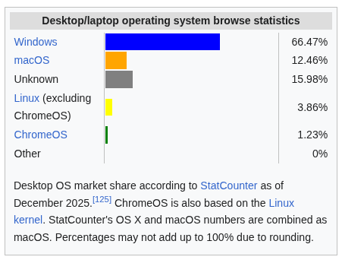
Free advert (#1)
Why Linux? Statistics for all desktop/laptop computers:
Taken from this link

Slide 13
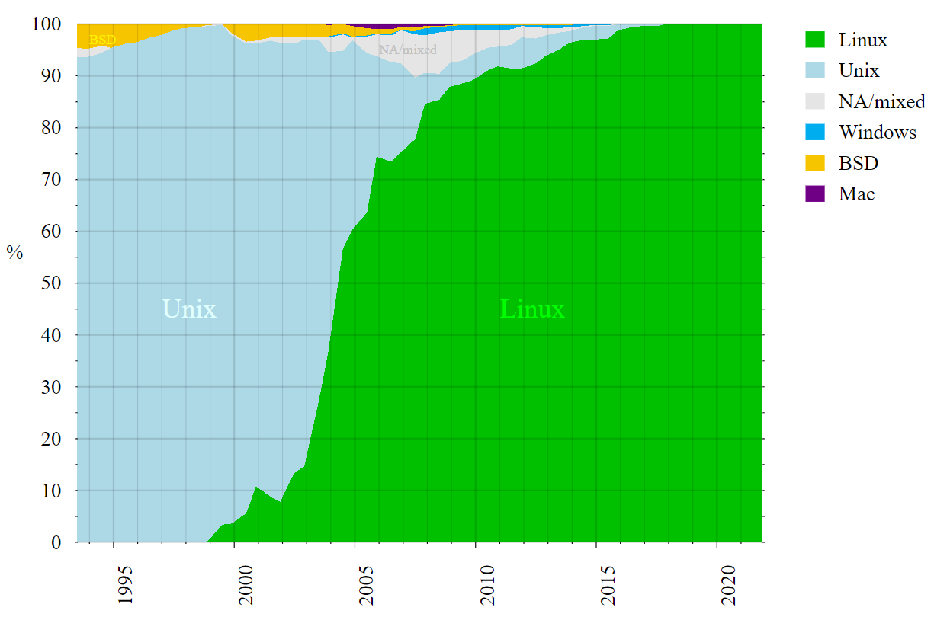
Free advert (#1)
Why Linux? Statistics for supercomputers:
Taken from this link

Slide 14

Free advert (#1)
Why Linux?
Linux is by far the leading operating system in computers used in scientific research (CERN, NASA, etc.)
Linux kernel: developed by Linus Torvalds in the early 90s
GNU (‘GNU’s not Unix’): open source utilities to perform standard actions on the computer – no licensing
Linux kernel + GNU utilities = Linux operating system
Initially, the Linux OS was basically a free Unix
Penguin named Tux is the most commonly used logo for Linux

Slide 15
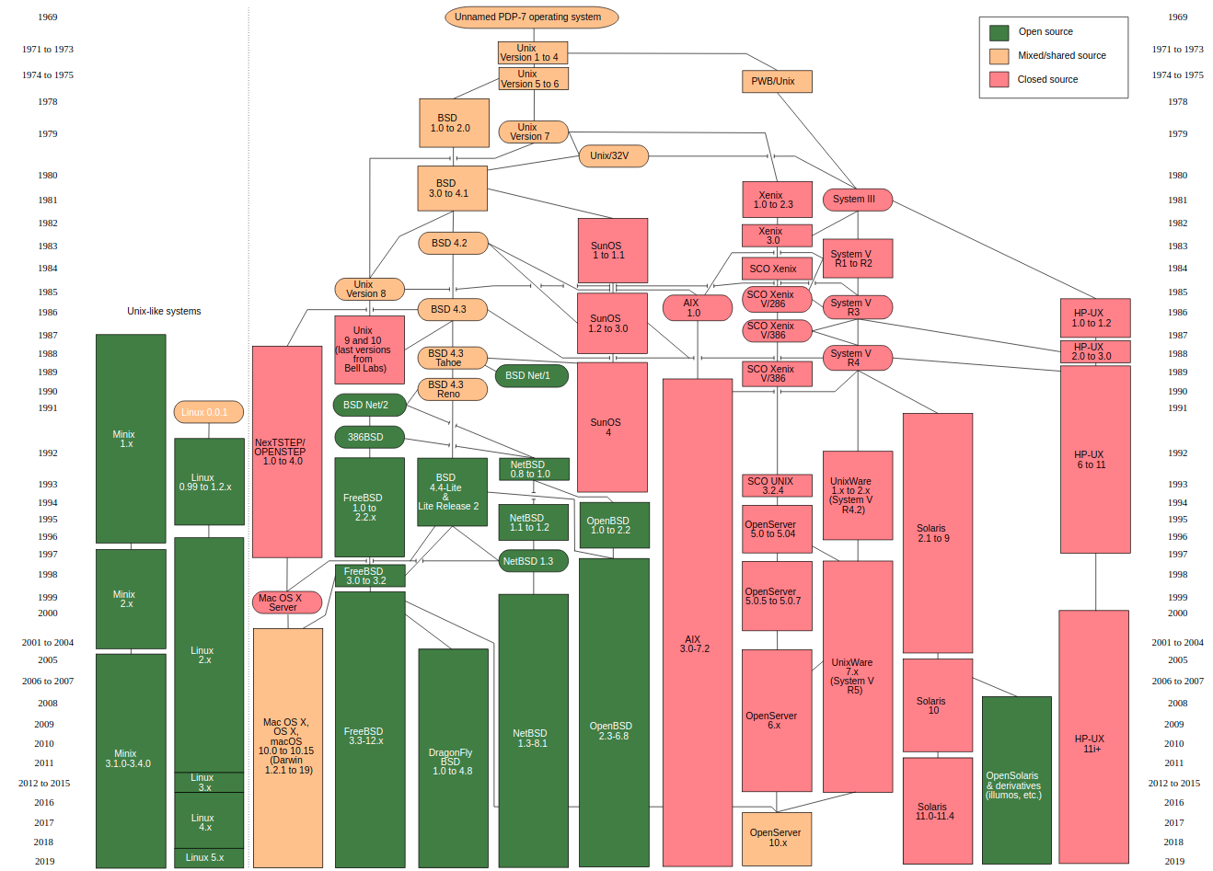
Free advert (#1)
Unix family tree – Linux is one of its descendants

Slide 16
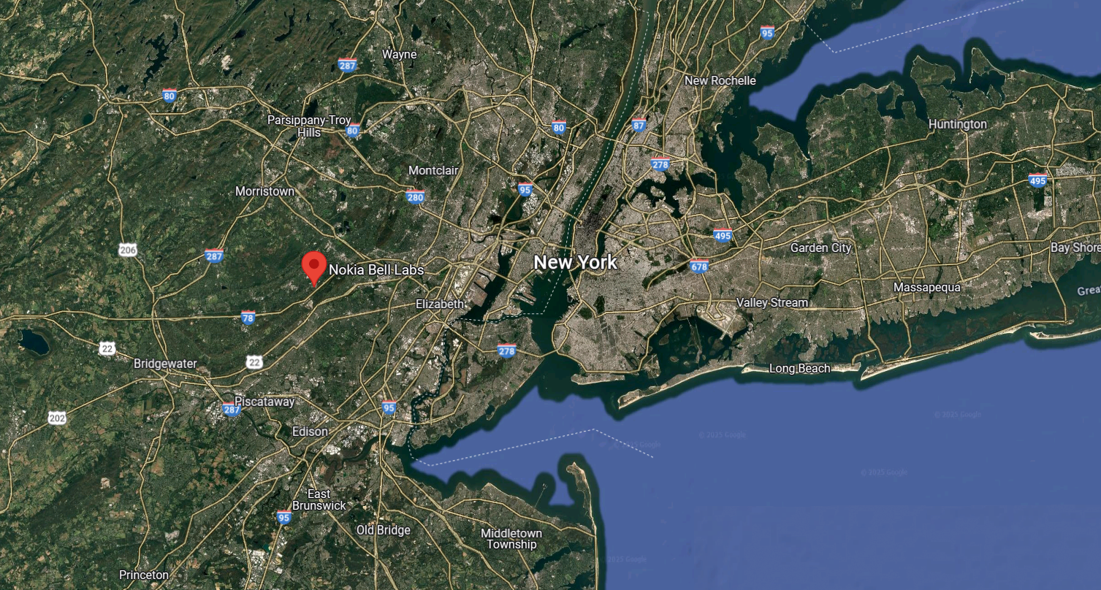
Free advert (#1)
Unix was developed at “Bell Labs” in Murray Hill, New Jersey, USA, in the 70’s

Slide 17
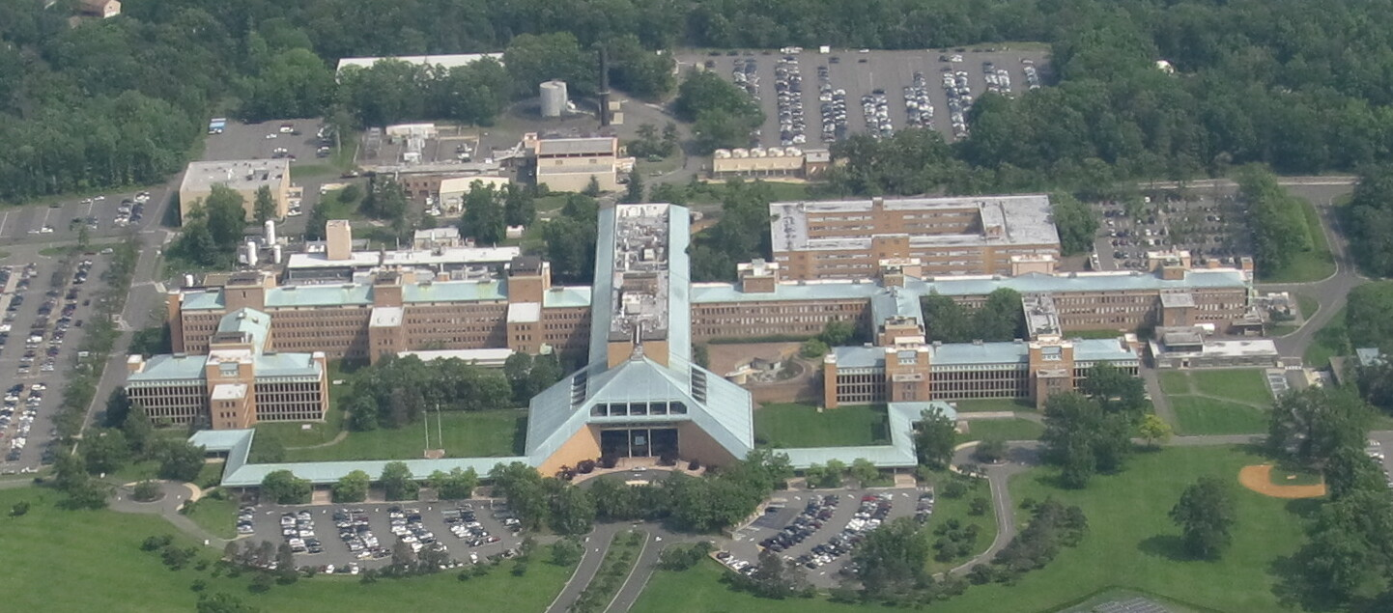
Free advert (#1)
Unix was developed at “Bell Labs” in Murray Hill, New Jersey, USA, in the 70’s

Slide 18

Free advert (#1)
Linux family tree: Common Linux kernel and plethora of different Linux distributions built on top of it
Full-core: Debian, Red Hat Enterprise, openSUSE, etc.
Specific: Ubuntu, Fedora, CentOS, Linux Mint, etc.
Specific distributions are derivatives of full-core distributions:
Ubuntu is derivative of Debian, Fedora of Red Hat, etc. (see complete tree at https://distrowatch.com/images/other/distro-family-tree.png)
The material presented in this course will be demonstrated on Ubuntu, but it applies also to any other Linux distribution
Regular updates on all distributions: https://distrowatch.com

Slide 19
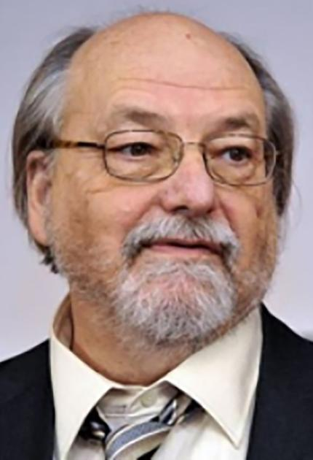
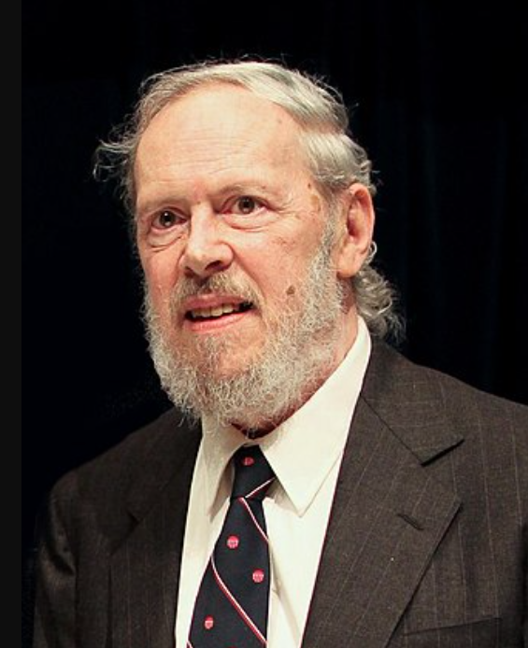

Key people
Ken Thompson
Denis Ritchie
Linus Torwalds
B programming language,
UNIX operating system,
UTF-8 encoding,
Go programming language,
Chess tablebases,
...
C programming language,
UNIX operating system,
...
Linux operating system,
Git (version control system),
...

Slide 20
Getting Ubuntu for Windows users
open Windows PowerShell and list available Linux distributions with: wsl --list --online
If you have only Windows on your laptop, you could either:
on Windows 11, use Windows Subsystem for Linux :
Open Windows PowerShell and list available Linux distributions with the command:
wsl --list --online
Pick up your favorite Linux distribution, and install it e.g. as follows:
wsl --install Ubuntu-24.04
The rest is easy (pick up your account, etc.)
or, install PuTTY ( https://www.putty.org/ ) and then use it to connect and work remotely on some computer running Linux, on which you have an account

Slide 21
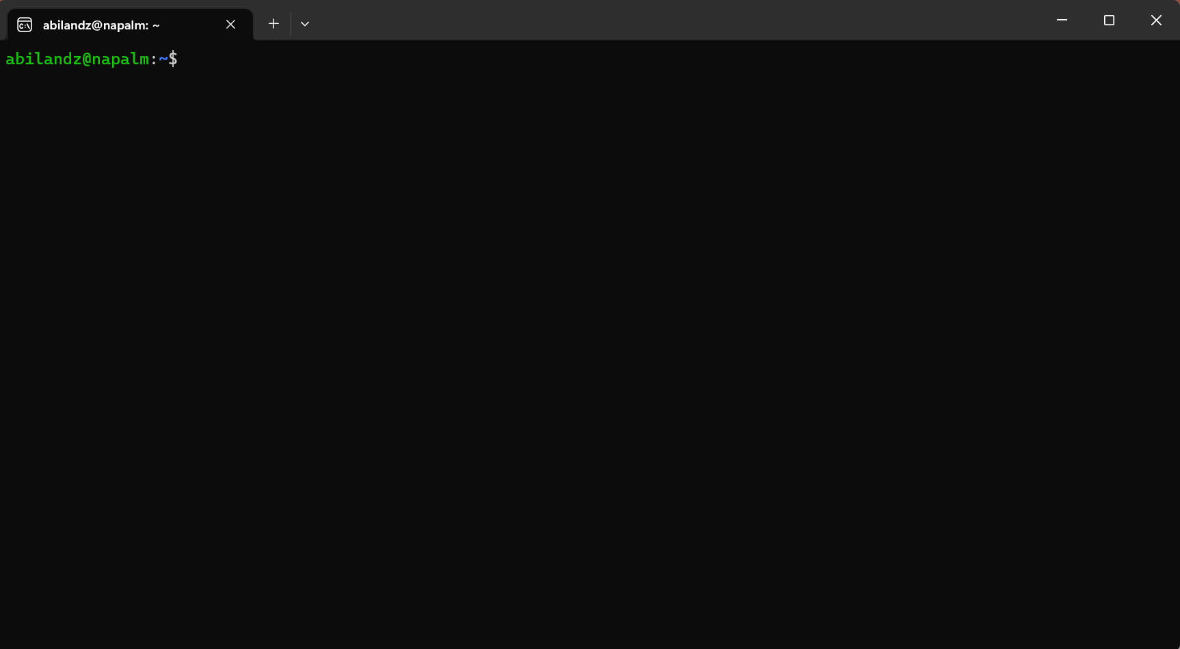
Free advert (#2)
Is this the right course for you?
If, after you have opened a terminal in Linux …
… you have asked yourself: ‘What now?’, then this is the right course for you!

Slide 22
Free advert (#2)
What can we do in the terminal?
Not that much with the mouse…
Next, you can start typing and pressing ‘Enter’, but most likely, whatever you have typed in the terminal will produce only error messages
Still, that is something, as it clearly means that there is some secret/magic language that is trying to respond to, or to interpret, your command input, as soon as you have typed something in the terminal and pressed ‘Enter’. What is that secret built-in language available in the terminal?

Slide 23
Linux shells
Loosely speaking, a shell is any program that a user employs to type commands in the terminal (text window)
Example shells:
sh
bash
zsh
ksh
csh
fish
PowerShell (developed by Microsoft)
Since Bash is the default shell on most Linux distributions nowadays, we focus on it
If not set by default, just type bash in the terminal, and you are in the Bash wonderland

Slide 24
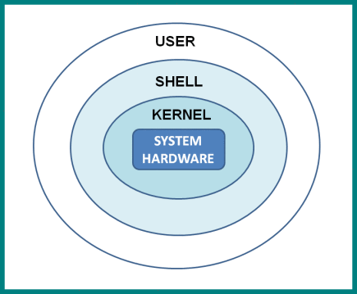
Why shell?
The shell translates the commands you type into a format that the computer can understand
It works both ways: The user is shielded from the Linux kernel, and the Linux kernel is shielded from the user

Slide 25

A bit of Bash history
Initial development by Brian Fox in 1989 as a part of GNU project... And it’s still alive!
Bash is an acronym for ‘Bourne-again shell’
The original shell ‘sh’ was written in 1977 by Stephen Bourne
Written entirely in C
The Linux kernel is mostly written in C
Executable: /bin/bash
File extension: .sh
Command processor / interpreted / scripting language

Slide 26
The current status of Bash
Bash is well-maintained and is under regular development
Webpage: https://www.gnu.org/software/bash/
Source code: http://git.savannah.gnu.org/cgit/bash.git
Latest release: version 5.3 (July 3rd, 2025)
The current maintainer: Chet Ramey

Slide 27
Interpreted vs. compiled languages
Interpreted:
write code & execute line-by-line
less reliable (there is no compiler to catch the errors!)
the source code can be easily read and copied
examples: Bash, Python, Mathematica, JavaScript
Compiled:
write code & compile & execute the compiled file (‘binaries’)
generally runs faster than interpreted code
examples: C, C++, Java, Go

Slide 28
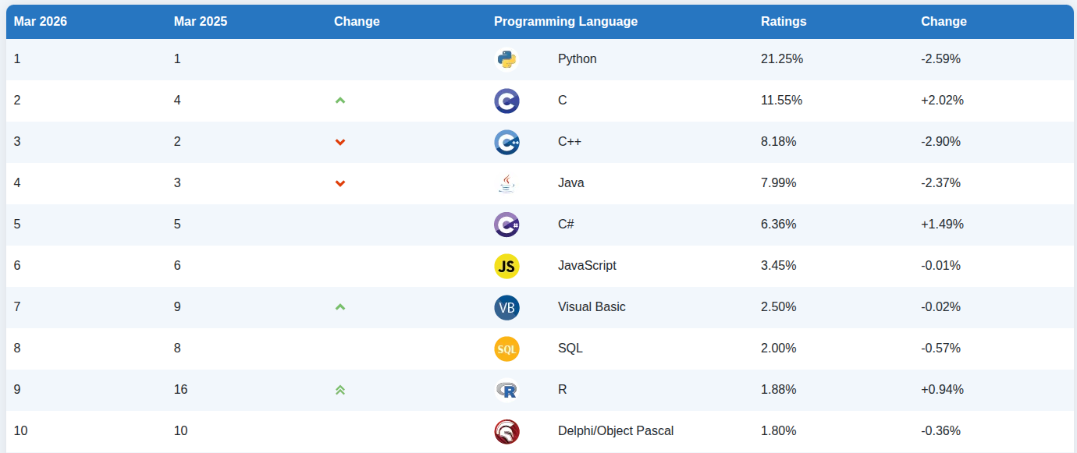
Intermezzo: Popularity of languages
As of recently, Python is the most popular programming language...
https://www.tiobe.com/tiobe-index/

Slide 29
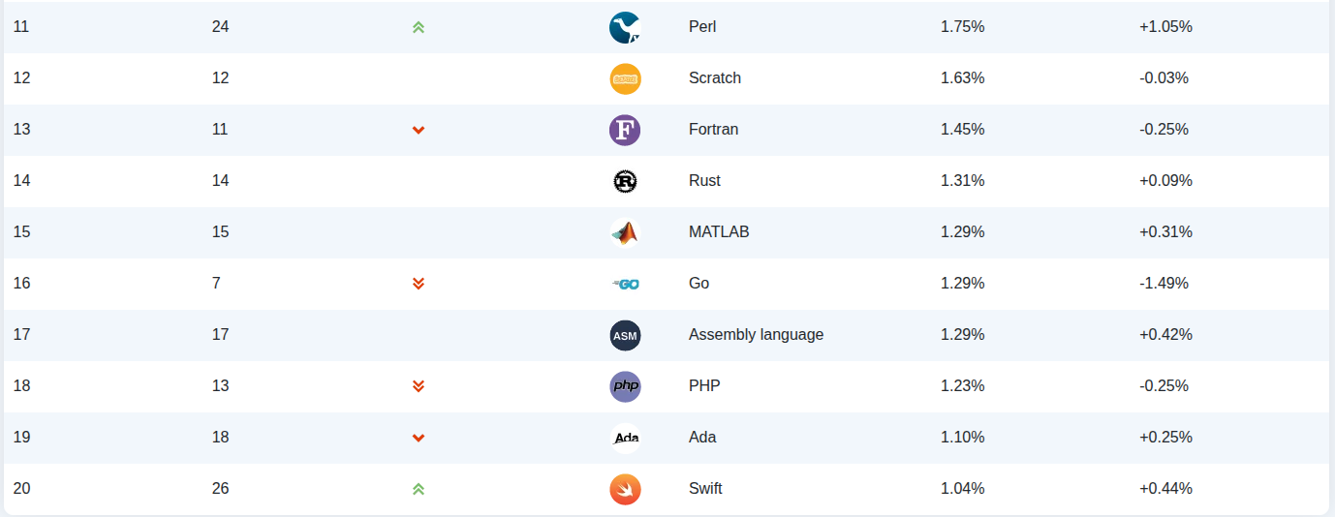
Intermezzo: Popularity of languages
... but some very old languages, like Fortran or COBOL, are still alive!
https://www.tiobe.com/tiobe-index/

Slide 30
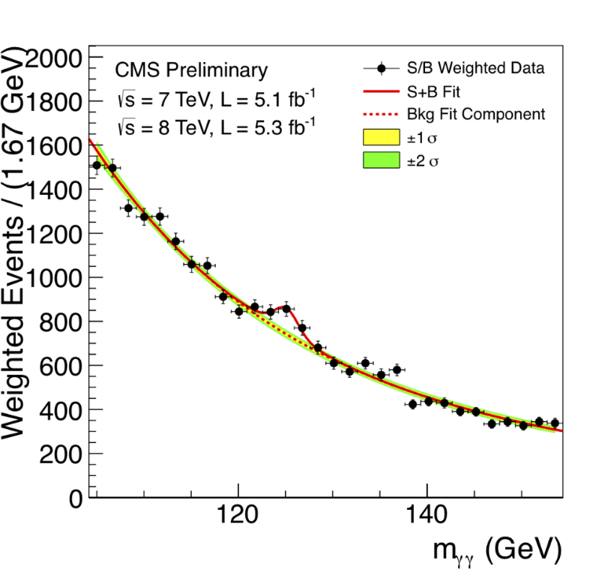
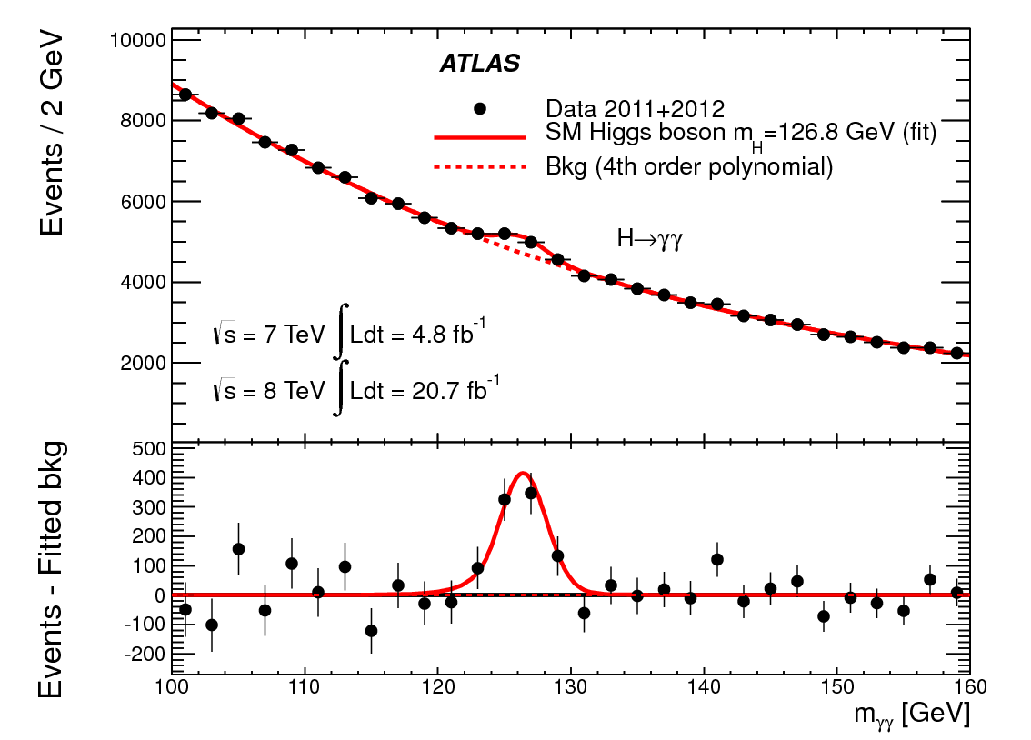
Free advert (#3)
Is this a right course for you? ROOT, what’s that?
If you have ever asked yourself what is the software in which the Higgs discovery plots were actually made …
… then this is the right course for you!
At the very basic level, we can use ROOT for plotting, histogramming, fitting, etc.

Slide 31
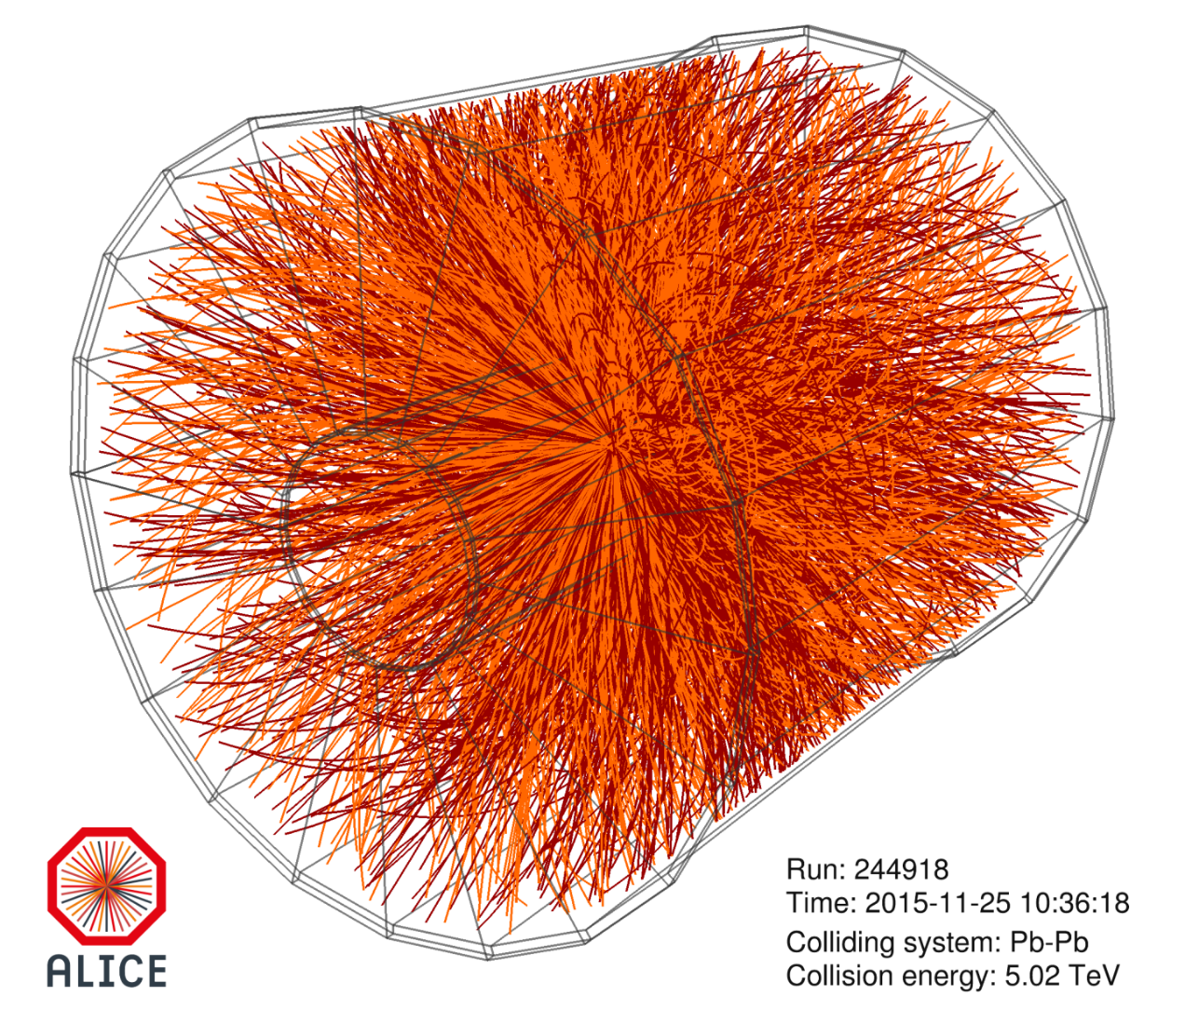
Free advert (#3)
This is the typical heavy-ion event at Large Hadron Collider reconstructed by ALICE Collaboration

Slide 32
Free advert (#3)
Trajectories of more than 10000 particles are reconstructed by AliROOT (C++ code specific to ALICE Collaboration built on top of ROOT)
Most important major collaborations worldwide in high-energy physics currently use ROOT
Also the future ones (e.g. CBM at GSI is developing CbmRoot)

Slide 33
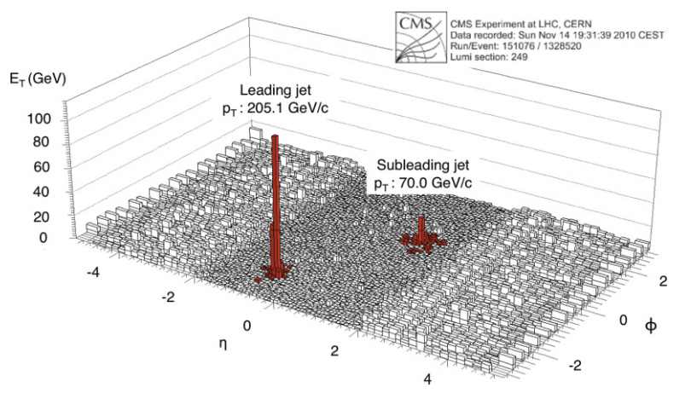
Free advert (#4)
In terms of histogramming quality and performance, it’s difficult to beat ROOT...

Slide 34

ROOT
Object-oriented framework, written in C++ and developed at CERN, for data analysis in high-energy physics
The development was initiated by René Brun and Fons Rademakers in 1994, and is still under active development
Latest release: Version 6.36.10 (March 14th, 2026)
Webpage: https://root.cern.ch/
Root forum: https://root-forum.cern.ch/
Source code: https://github.com/root-project/root

Slide 35
Thanks!

