Slide 1


Scientific computing in high-energy physics Lecture 1, 28.04.2022
Ante Bilandzic
(E62, Dense and Strange Hadronic Matter)

Slide 2

Outline of today’s lecture
Course trivia
Free adverts
Linux
Bash
ROOT

Slide 3
Course trivia
PH8124: ‘Scientific computing in high-energy physics’
https://www.ph.tum.de/academics/org/cc/mh/PH8124/
When & where:
Thursday: 14:00-16:00 (hybrid mode)
Physics Department, E62 seminar room 2024
Roomfinder: https://portal.mytum.de/displayRoomMap?roomid=2024@5101&disable_decoration=yes
12 contact days (last lecture is on July 28th)
Examination:
Homeworks (10 in total)
Oral examination during the presentation of the final project
Contact:
Ante Bilandzic, ante.bilandzic@tum.de
Office PH 2101 (https://www.ph.tum.de/about/visit/roomfinder/?room=2101)

Slide 4
Course trivia
Given the current situation with pandemic, the presence in person during the lecture is not mandatory, but it’s possible
Parallel online coverage via Zoom
TUM offers the licensed version at the following link: https://tum-conf.zoom.us
'Sign In' with your TUM credentials
For this lecture, I have created the recurring meetings on Thursdays, from 13:30-16:00
Zoom coordinates will be distributed regularly via the official mailing list to all registered students for this course
The lectures will be recorded, and recordings shared immediately afterward

Slide 5
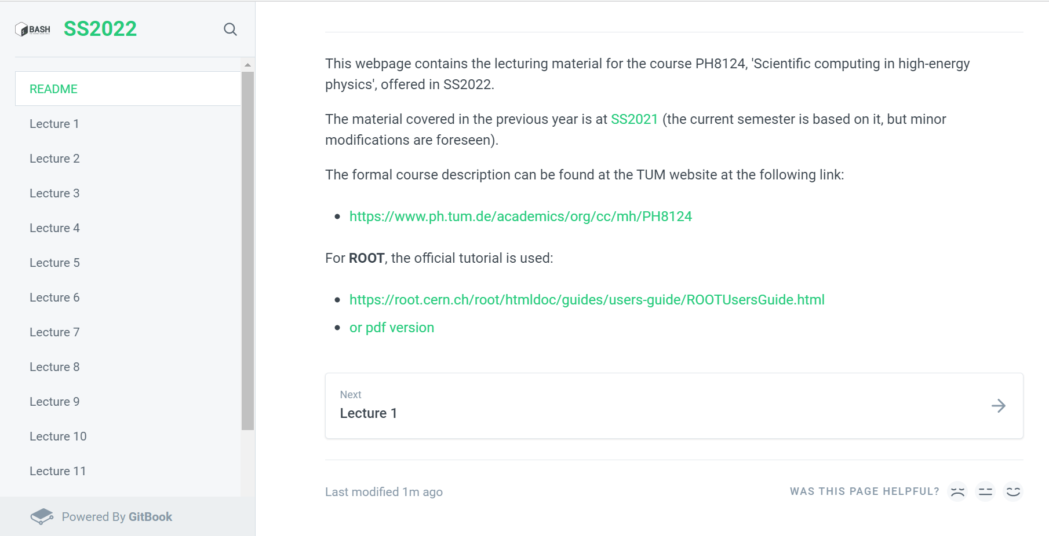
Webpage
The course has a dedicated webpage:
Link: https://abilandz.gitbook.io/ss2022/

Slide 6
Course trivia
After each lecture, executive summary of the covered material will be shared via email
The course webpage will be updated regularly
In the same way, I will also share the homework exercises
Recommended literature:
Mendel Cooper: ‘Advanced Bash-Scripting Guide’ (http://tldp.org/LDP/abs/abs-guide.pdf)
Cameron Newham and Bill Rosenblatt, ‘Learning the bash Shell: Unix Shell Programming (In a Nutshell (O'Reilly))’
ROOT User’s Guide (https://root.cern.ch/root/htmldoc/guides/users-guide/ROOTUsersGuide.html)
Richard Blum and Christine Bresnahan, ‘Linux Command Line and Shell Scripting Bible’

Slide 7
Course trivia
Grading:
3 ECTS points
Final grade = grade at final project examination - ‘1 unit’ if you have completed correctly 75% of all homeworks
There will be in total 10 homework exercises, one after each lecture
Oral examination at the final project presentation:
The topic for the final programming project will be offered at some point towards the end of the lecture
The oral exam of about 25 minutes consists of presenting:
How your programme was designed/implemented?
Testing the execution of your code (crash-free, bug-free, efficiency in terms of CPU usage and memory consumption)
Testing the code flexibility (e.g. how you would add some new feature in the code?)

Slide 8
Course trivia
Preliminary list of topics to be covered:
Linux: filesystem hierarchy and file manipulation, handling processes and jobs, frequently used commands, etc.
Bash: shell environment, variables, string manipulation, built-in commands, aliases, functions, conditional statements, loops, command substitution, command chain, test constructs, piping, redirections, code blocks, subshells, process substitution, brace expansion, regular expressions, here-strings and here-documents, etc.
ROOT: using ROOT GUI, plotting, histogramming, functions, fitting, trees, file merging, etc.

Slide 9
Course trivia
Course classification:
At the moment, classified as a ‘Non-physics elective course’
Open both to Bachelor and Masters students
https://www.ph.tum.de/academics/msc/physics/nonphys/
Course evaluation:
At some point during the lecture, you will be asked to evaluate this course: Please, do it! (reminder will be sent later)

Slide 10
Trivia
No lecture on:
May 26th – Ascension Day
June 16th – Corpus Christi

Slide 11
Free adverts

Slide 12
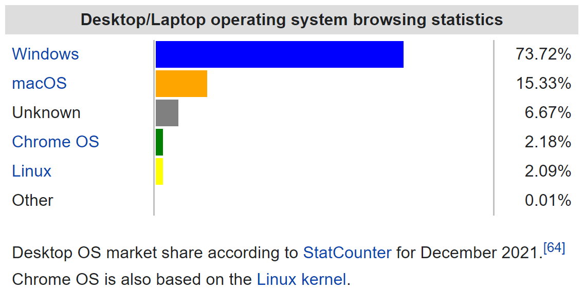
Free advert (#1)
Why Linux? Statistics for all desktop/laptop computers:

Slide 13
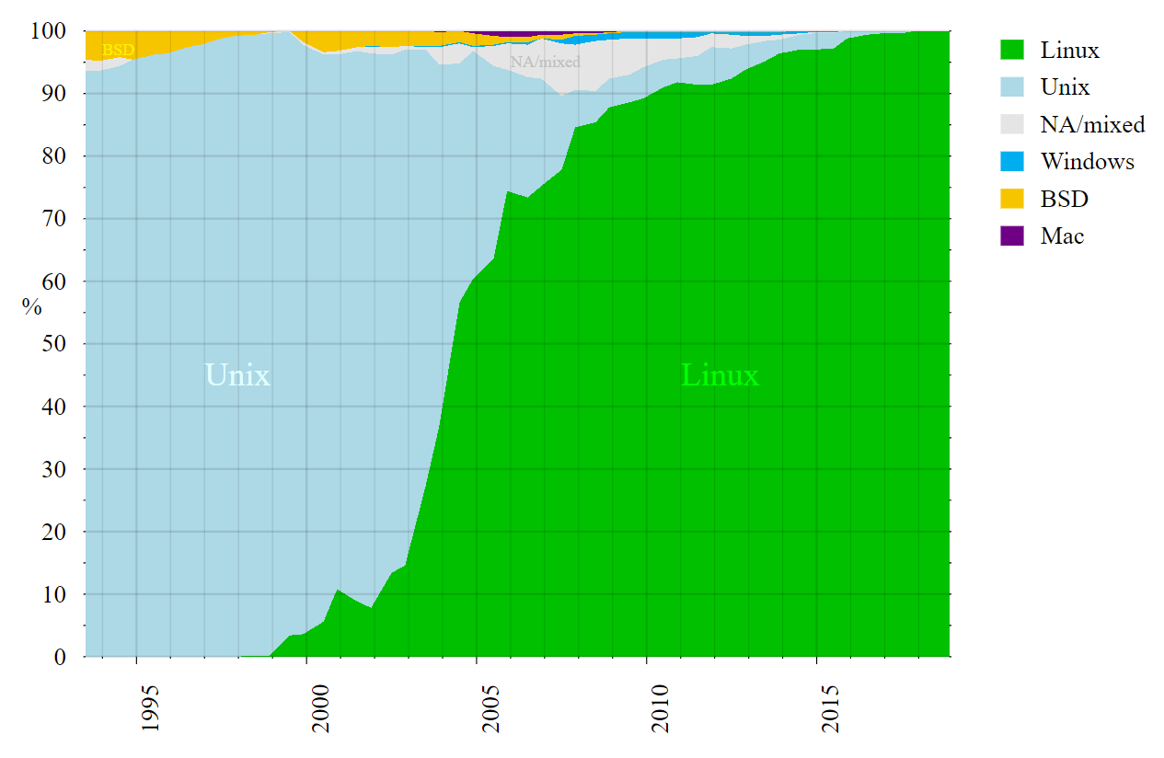
Free advert (#1)
Why Linux? Statistics for supercomputers:

Slide 14
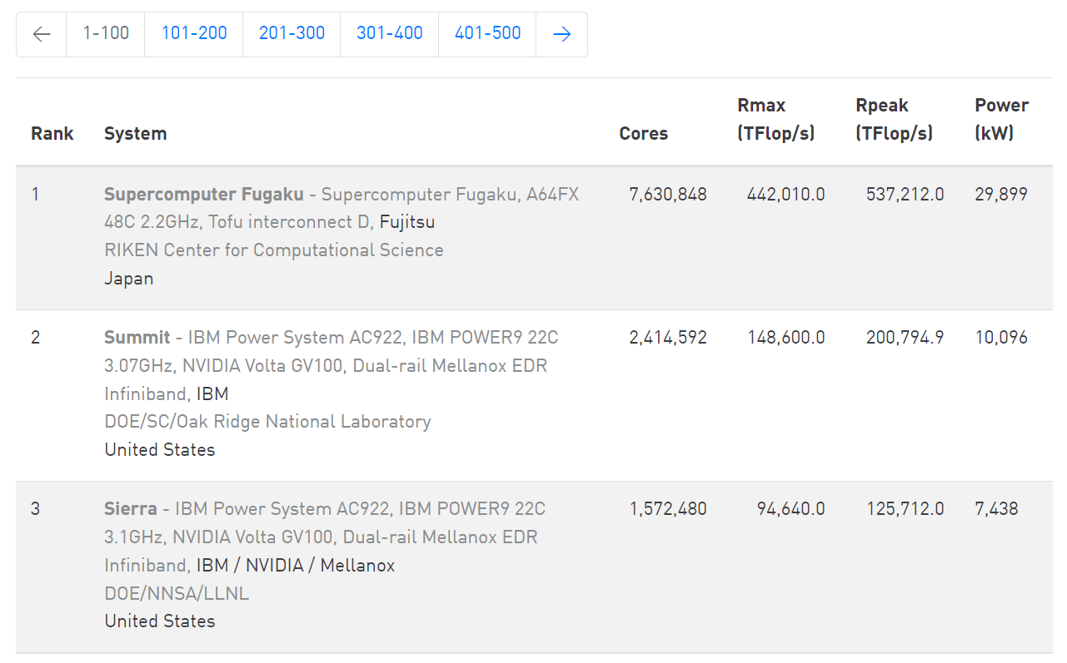
Free advert (#1)
The most powerful supercomputers (November, 2021):
https://www.top500.org

Slide 15

Free advert (#1)
Why Linux?
Linux is by far the leading operating system in computers used in scientific research (CERN, NASA, etc.)
Linux kernel: developed by Linus Torvalds in the early 90s
GNU (‘GNU’s not Unix’): open source utilities to perform standard actions on the computer - no licencing
Linux kernel + GNU utilities = Linux operating system
Initially, the Linux OS was basically a free Unix
Penguin named Tux is the most commonly used logo for Linux

Slide 16
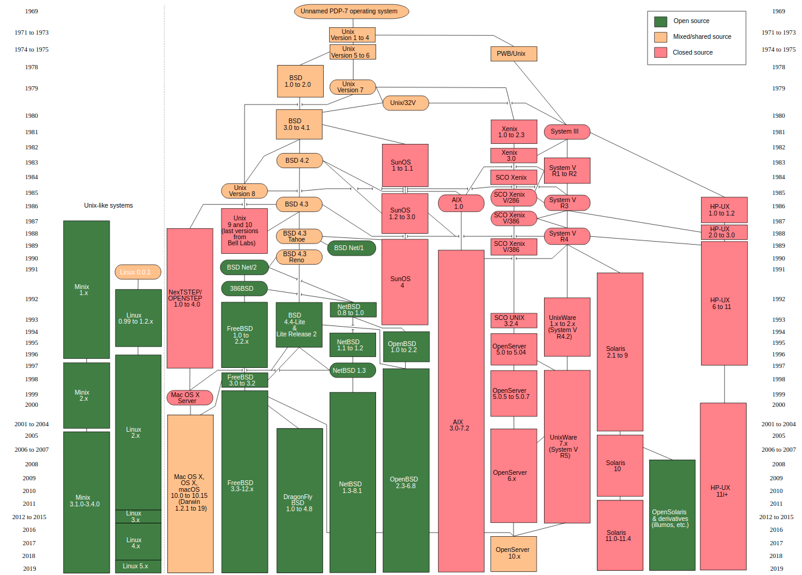
Free advert (#1)
Unix family tree – Linux is one of its descendants

Slide 17

Free advert (#1)
Linux family tree: Common Linux kernel and plethora of different Linux distributions built on top of it
Full-core: Debian, Red Hat Enterprise, openSUSE, etc.
Specific: Ubuntu, Fedora, CentOS, Scientific Linux, Linux Mint, etc.
Specific distributions are derivatives of full-core distributions:
Ubuntu is derivative of Debian, Fedora of Red Hat, etc. (see complete tree at https://distrowatch.com/images/other/distro-family-tree.png)
The material presented in this course will be demonstrated on Ubuntu, but it applies also to any other Linux distribution
Regular updates on all distributions: https://distrowatch.com

Slide 18

Getting Ubuntu for Windows users
If you have on your laptop only Windows, you could either:
install Ubuntu on Windows from the following link
https://www.microsoft.com/en-us/p/ubuntu/9nblggh4msv6?activetab=pivot:overviewtab
install PuTTY ( https://www.putty.org/ ) and then use it to connect to some computer running Linux, on which you have an account with access rights

Slide 19
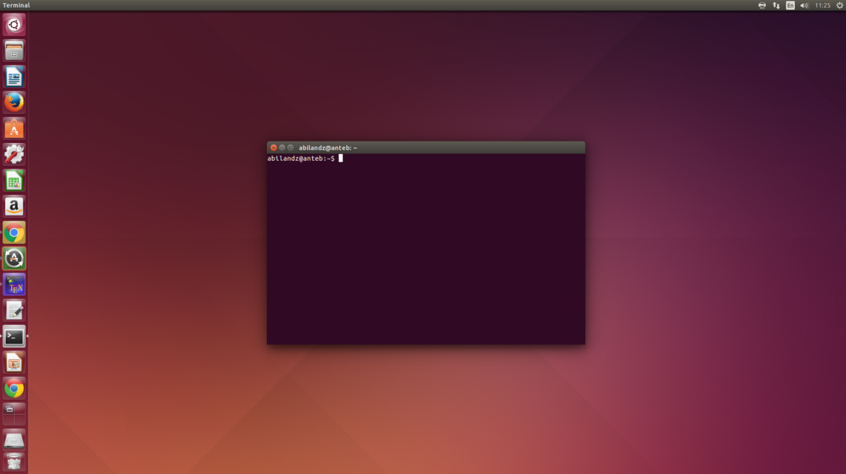
Free advert (#2)
Is this a right course for you?
If, after you have opened a terminal in Linux …
… you have asked yourself: ‘What now?’, then this is the right course for you!

Slide 20
Free advert (#2)
What can we do in the terminal?
Not that much with the mouse…
Next, you can start typing and pressing ‘Enter’, but especially if you do it for the first time most likely whatever you have typed in the terminal will produce only the error messages
Still, that is something, as it clearly means that there is some secret/magic language which is trying to respond to, or to interpret, your command input, as soon as you have typed something in the terminal and pressed ‘Enter’. What is that secret built-in language available in the terminal?

Slide 21
Linux shells
Loosely speaking, shell is any program that user employs to type commands in the terminal (text window)
Example shells:
sh
bash
zsh
ksh
csh
fish
PowerShell (developed by Microsoft!)
Since Bash is the default shell on most Linux distributions nowadays, we focus on it
If not set by default, just type bash in the terminal, and you are in the Bash wonderland

Slide 22
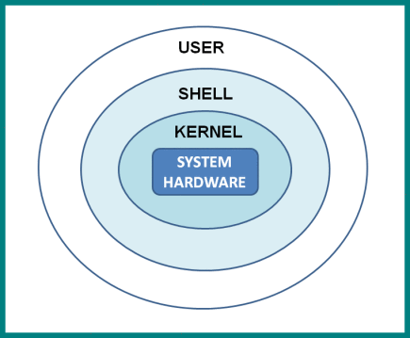
Why shell?
The shell translates the commands you type into a format which the computer can understand
It works both ways: User is shielded from Linux kernel, and Linux kernel is shielded from user

Slide 23

A bit of Bash history
Initial development by Brian Fox in 1989 as a part of GNU project... And it’s still alive!
Bash is an acronym for ‘Bourne-again shell’
The original shell ‘sh’ was written in 1977 by Stephen Bourne
Written entirely in C
Linux kernel is mostly written in C
Executable: /bin/bash
File extension: .sh
Command processor / interpreted / scripting language

Slide 24
The current status of Bash
Bash is well maintained and is under regular development
Webpage: https://www.gnu.org/software/bash/
Source code: http://git.savannah.gnu.org/cgit/bash.git
Latest release: version 5.1.16 (January 5, 2022)
The current maintainer: Chet Ramey

Slide 25
Testing Bash code online?
In the case you do not have currently the access to the computer running Linux, you can test your Bash code online
For instance: https://www.tutorialspoint.com/execute_bash_online.php
Use this link only as a temporary solution, as this is not a development environment

Slide 26
Interpreted vs. compiled languages
Interpreted:
write code & execute line-by-line
less reliable (there is no compiler to catch the errors!)
source code can be easily read and copied
examples: Bash, Python, Mathematica, JavaScript
Compiled:
write code & compile & execute the compiled file (‘binaries’)
generally runs faster than interpreted code
examples: C, C++, Java, Go

Slide 27
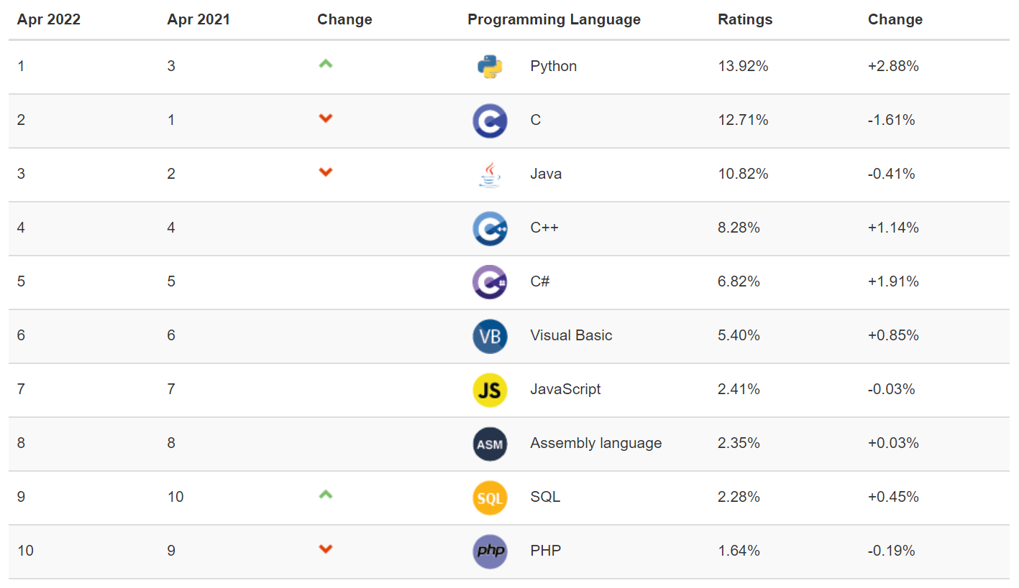
Intermezzo: Popularity of languages
As of recently, Python is the most popular programming language
https://www.tiobe.com/tiobe-index/

Slide 28
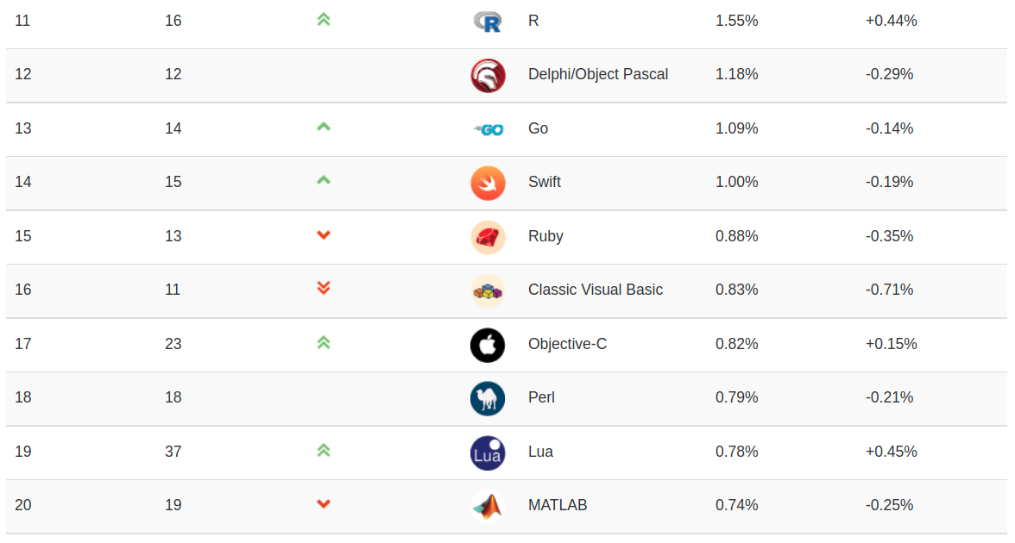
Intermezzo: Popularity of languages
As of recently, Python is the most popular programming language
https://www.tiobe.com/tiobe-index/

Slide 29
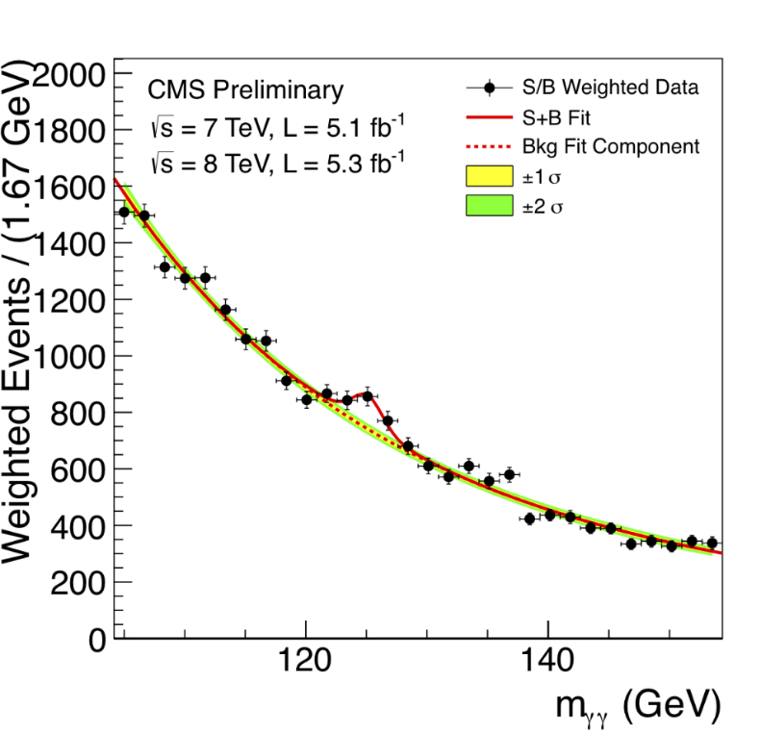
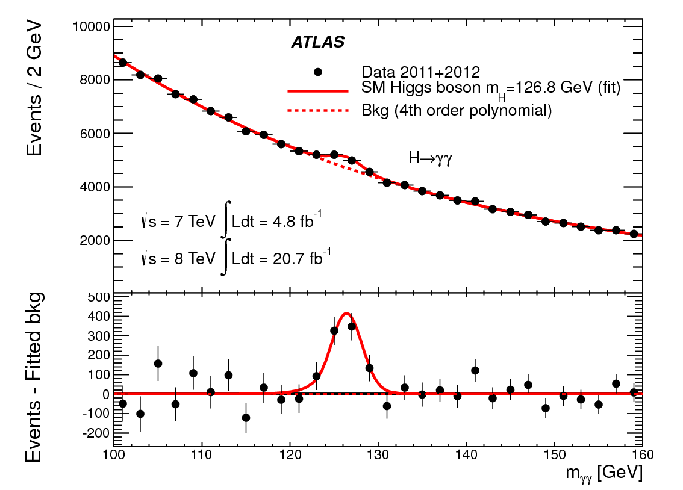
Free advert (#3)
Is this a right course for you? ROOT, what’s that?
If you have ever asked yourself what is the software in which the Higgs discovery plots were actually made …
… then this is the right course for you!
At the very basic level, we can use ROOT for plotting, histogramming, fitting, etc.

Slide 30
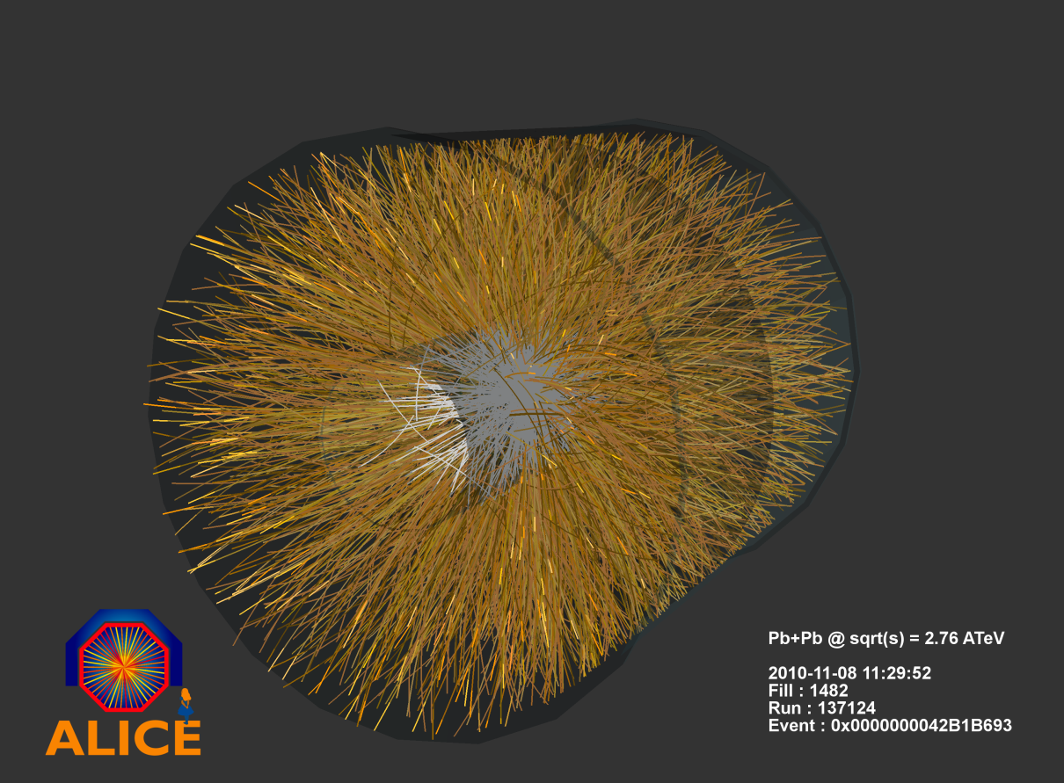
Free advert (#3)
This is the typical heavy-ion event at Large Hadron Collider reconstructed by ALICE Collaboration

Slide 31
Free advert (#3)
Trajectories of more than 10000 particles are reconstructed by AliROOT (C++ code specific to ALICE Collaboration built on top of ROOT)
Most important major collaborations worldwide in high-energy physics currently use ROOT
Also the future ones (e.g. CBM at GSI, which will start data taking in 2025, is developing CbmRoot)

Slide 32
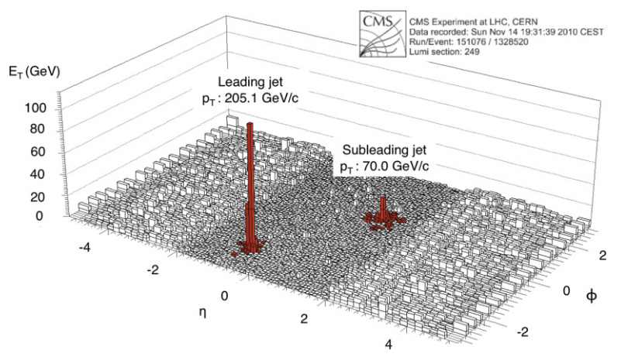
Free advert (#4)
In terms of histogramming quality and performance, it’s difficult to beat ROOT...

Slide 33

ROOT
Object-oriented framework, written in C++ and developed at CERN, for data analysis in high-energy physics
The development was initiated by René Brun and Fons Rademakers in 1994, and is still under active development
Latest release: Version 6.26/00 (March 3, 2022)
Webpage: https://root.cern.ch/
Root forum: https://root-forum.cern.ch/
Source code: https://github.com/root-project/root

Slide 34
Thanks!

