Slide 1
WishNu
Website presentation
Design, visitor experience and architecture
Client review
13 November 2026
WishNu Construction & Development
01
Notes:
This presentation introduces the current WishNu website and the client experience. It includes ten slides in total. The website is a local implementation, with publication and live enquiry delivery to be confirmed.
Sources: src/App.tsx; src/index.css

Slide 2
A website that supports project enquiries
Help hotel owners understand WishNu’s experience, explore relevant work and start a project conversation.
20
2013
3 states
completed hotel projects
experience begins
Indiana, Ohio and Michigan
WishNu Construction & Development
02
Notes:
The company figures come from the supplied website content. They are not independently audited. The website presents renovation and reopening experience while describing ground-up hotel construction as an expanding offering. The objective is to make that experience easier for prospective clients to assess.
Sources: src/data.ts; src/components/About.tsx

Slide 3
The curtain entrance
A branded welcome opens into the homepage
Welcome
WishNu identity
Enter WishNu
Visitor chooses to continue
Curtains open
Two panels move apart
Homepage
Hotel imagery and headline
1.25-second entrance transition. Skip and Escape remain available.
WishNu Construction & Development
03
Notes:
The existing welcome screen includes an initial curtain reveal. The updated Enter action uses a second curtain opening to reveal the already-mounted homepage underneath. It completes after 1,250 milliseconds. Reduced-motion visitors bypass the timed transition. Session storage remembers entry for the browser session. Direct section anchors bypass the welcome, and #welcome explicitly replays it. The footer also offers replay. This is website behavior, not an embedded PowerPoint animation.
Sources: src/components/WelcomeScreen.tsx; src/App.tsx; src/index.css

Slide 4
Visual design and motion
Building places.
Elevating stays.
Burgundy, cream and gold
Large editorial typography
Hotel photography as the focus
Image wipes introduce each featured hotel. Scroll reveals and subtle parallax carry the motion through the page.
WishNu Construction & Development
04
Notes:
The website uses DM Sans and Cormorant Garamond. The presentation uses Arial for portable editing. The design takes inspiration from the Maman reference, retaining WishNu branding and its own content. Three unwanted construction photos have been removed. Hero slides feature hotel properties. Shared reveal effects, section rules and hover transitions create continuity. CSS and JavaScript honor reduced-motion preferences.
Sources: src/components/Hero.tsx; src/components/SiteMotion.tsx; src/components/ui.tsx; src/index.css; https://www.maman-corp.com/

Slide 5
Website structure
Introduction
Welcome and homepage
Project evidence
Portfolio and renovation results
Project conversation
Contact details and enquiry form
Experience
Construction services
Hotel inspiration
Building process
Development expansion
Footer and welcome replay
One continuous page with section navigation and project-detail dialogs
WishNu Construction & Development
05
Notes:
This is a grouped information architecture, not separate application routes. Actual section order: home, marquee, about, services, projects, renovation results, hotel inspiration, process, expansion, contact and footer. The header links to Home, Experience, Services, Projects, Results and Contact. Project details open in a dialog.
Sources: src/App.tsx; src/components/Navbar.tsx; src/components/Projects.tsx

Slide 6
Construction services
Ground-up hotel construction
Full renovation and conversion
An expanding offering for new hotel development
Building systems, rooms and property finishes
PIP and partial renovation
Closed-property reopening
Targeted improvements for brand requirements
Coordinated work through opening readiness
Construction completion
Upgrades and maintenance
A path forward for unfinished hotel projects
Focused repairs and ongoing property upkeep
WishNu Construction & Development
06
Notes:
These six service categories match the website. Ground-up development is described as an expanding offering. Do not describe it as a completed portfolio of ground-up work unless the client supplies evidence.
Sources: src/components/Services.tsx

Slide 7
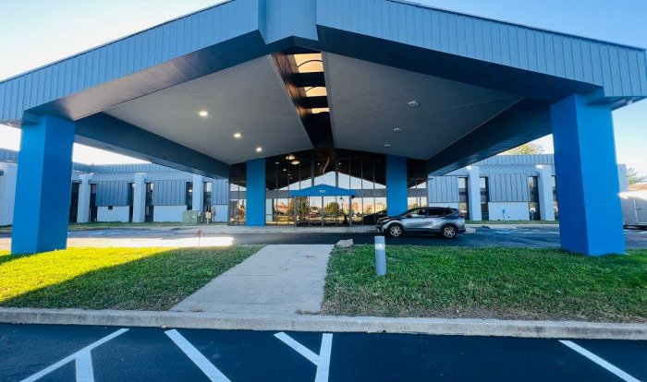
The portfolio makes experience tangible
Bliss Point Inn
Kokomo, Indiana
Filter by project scope
Search by property or city
Open photos and project details
Explore more properties
Published property photograph
WishNu Construction & Development
07
Notes:
The website offers filters, search, show more and property-detail dialogs. Published photos illustrate properties and do not establish renovation before-and-after evidence. Historical hotel names and representative-photo disclosures remain in the website. The photographed property is BlissPoint Inn Kokomo. No fabricated performance figures are included here.
Sources: src/components/Projects.tsx; src/components/PropertyPhoto.tsx; src/propertyPhotos.ts; https://www.blisspointinns.com/blisspoint-inn-suites-kokomo.html; https://www.blisspointinns.com/media/catalog/product/cache/8f8fc99967f1f6da36182268eaf001fc/k/o/kokomo.jpeg

Slide 8
Technical architecture
Visitor browser
Desktop or mobile
React application
Sections and interactions
Static website host
Production build output
Structured content
Company, projects and photos
Google Apps Script
Enquiry endpoint
Build tools: Vite, TypeScript and Tailwind CSS
WishNu Construction & Development
08
Notes:
React runs in the visitor browser. Vite creates a static production build. The current configuration uses the single-file plugin to inline frontend assets into dist/index.html, while property photography remains hosted externally. Structured content lives in source modules. The contact form makes an HTTP POST to the configured Google Apps Script endpoint. A hosting provider is not established by this diagram. The host represents the intended deployment location.
Sources: package.json; vite.config.ts; src/data.ts; src/portfolio.ts; src/propertyPhotos.ts; src/components/contact/ContactForm.jsx

Slide 9
How an enquiry reaches the business
Contact form
Required fields and spam trap
POST request
Project details as JSON
Apps Script
Configured backend endpoint
Business records
Google Form and Sheet
Email notification
Business inbox
Visitor feedback
Success or error message
Live delivery and deployed backend behavior still require an end-to-end test
WishNu Construction & Development
09
Notes:
The form requires name, email, phone, project type, location and message. Browser-native constraints validate required fields. A honeypot helps catch automated submissions. Frontend code posts JSON as text/plain and checks the returned success value. The supplied backend script creates a Google Form response, appends a Sheet row and sends an email. It then returns JSON. The configured deployed script has not been inspected or tested here, so storage and email delivery are not verified. The arrows summarize handling, not separate sequential APIs between each output. The success response returns from Apps Script to the browser.
Sources: src/components/contact/ContactForm.jsx; src/data.ts; google-apps-script-contact-submitter.gs

Slide 10
Client review and next steps
The demonstration
Before launch
Curtain entrance and homepage
Portfolio search and project details
Services, results and contact form
Approve content and property photos
Confirm hosting and domain
Test enquiry storage and email
Complete mobile and browser review
WishNu Construction & Development
WishNu Construction & Development
10
Notes:
Demonstrate the local website. Use #welcome or the footer replay to show the entrance. Show a project search and open a property dialog. Production compilation passed after the visual redesign, while full browser verification remains pending. The developer should complete a live enquiry test without assuming that a configured endpoint proves delivery. Obtain client confirmation for published property images and factual claims before publication.
Sources: src/components/WelcomeScreen.tsx; src/components/Projects.tsx; src/components/Footer.tsx; src/components/contact/ContactForm.jsx

