Slide 1
JPEG Decoder Implementation in Matlab

Slide 2
What is JPEG?
The term "JPEG" is an acronym for the Joint Photographic Experts Group.
Commonly used method of lossy comression for photographic images.
The degree of compression can be adjusted, allowing a selectable tradeoff between storage size and image quality.
JPEG typically achieves 10:1 compression with little perceptible loss in image quality.
The JPEG standard specifies the codec, which defines how an image is compressed into a stream of bytes and decompressed back into an image, but not the file format used to contain that stream.

Slide 3
Typical Usage
The JPEG compression algorithm is at its best on photographs and paintings of realistic scenes with smooth variations of tone and color.
Most common image format used by digital cameras.
Most common format for storing and transmitting photographic images on the www.
May not be as well suited for line drawings and other textual or iconic graphics, where the sharp contrasts between adjacent pixels can cause noticeable artifacts.
Also not well suited to files that will undergo multiple edits.
It should not be used in scenarios where the exact reproduction of the data is required.

Slide 4
Elements specified in JPEG specification
Three elements specified in the JPEG Specification:
a) An encoder
b) A decoder
c) The interchange format

Slide 5
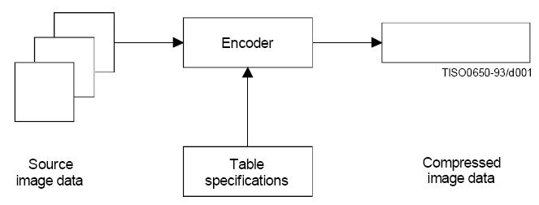
Encoder
An encoder is an embodiment of an encoding process.
An encoder takes as input digital source image data and table specifications, and by means of a specified set of procedures generates as output compressed image data.

Slide 6
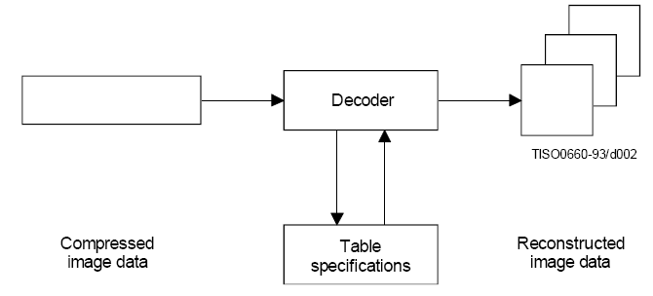
Decoder
A decoder is an embodiment of a decoding process.
A decoder takes as input compressed image data and table specifications, and by means of a specified set of procedures generates as output digital reconstructed image data.

Slide 7
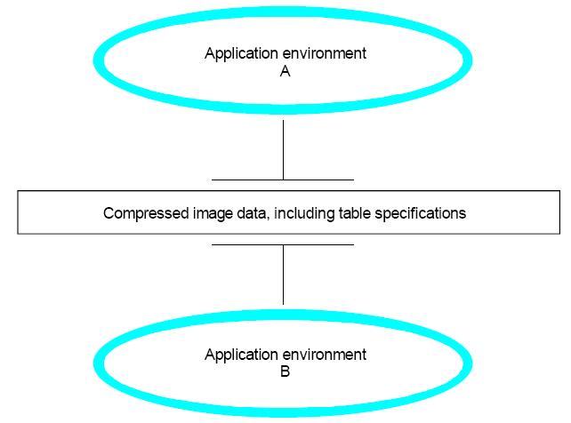
Interchange format
The interchange format is a compressed image data representation which includes all table specifications used in the encoding process.
The interchange format is for exchange between application environments.

Slide 8
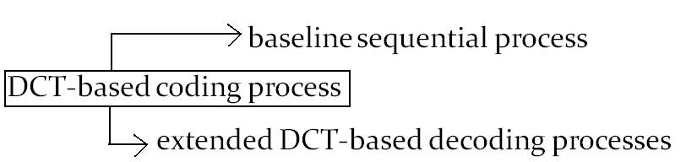
Lossy and Lossless Compression
Lossy compression
Those based on the discrete cosine transform (DCT) are “lossy”.
Though this mode allows substantial compression, it still produces a reconstructed image with high visual fidelity to the encoder’s source image.

Slide 9
Lossy and Lossless Compression
Lossless compression
This class of coding processes is not based upon the DCT.
This mode is provided to meet the needs of applications requiring lossless compression.
These lossless encoding and decoding processes are used independently of any of the DCT-based processes.

Slide 10
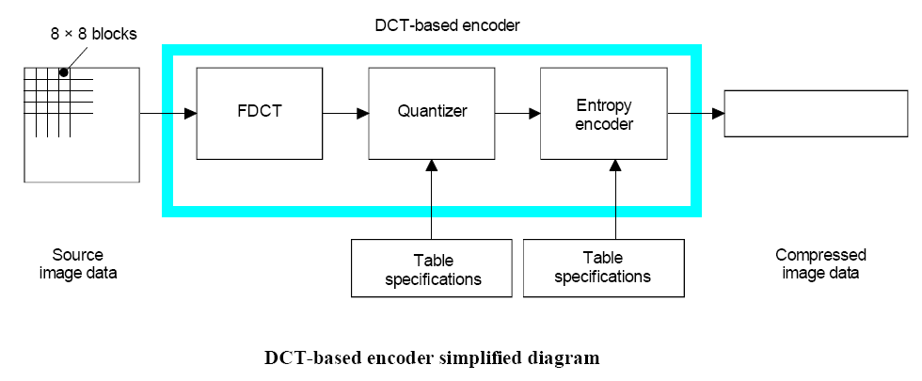
DCT based Encoding

Slide 11
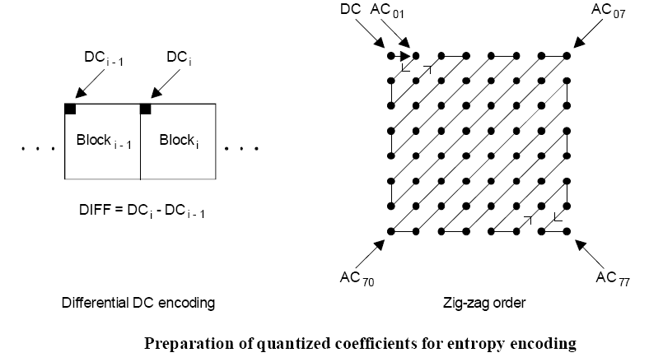
DCT based Encoding

Slide 12
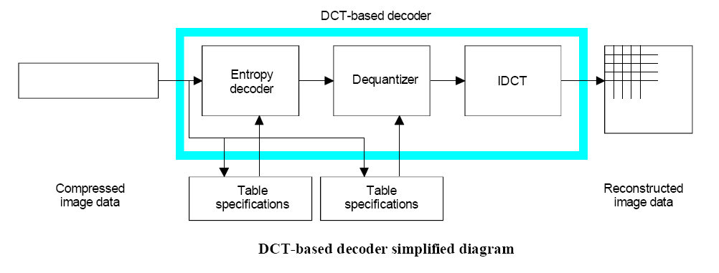
DCT based Decoding

Slide 13
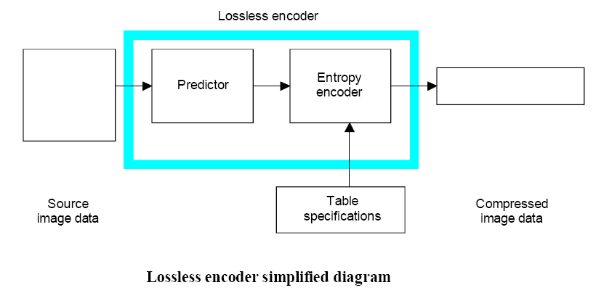
Lossless Encoding

Slide 14
Modes of Operation
There are four distinct modes of operation under which the various coding processes are defined:
1) Sequential DCT-based
2) Progressive DCT-based
3) Lossless, and
4) Hierarchical

Slide 15
Sequential DCT-based
For the sequential DCT-based mode, 8 x 8 sample blocks are typically input block by block from left to right, and block-row by block-row from top to bottom.
After a block has been transformed by the forward DCT, quantized and prepared for entropy encoding, all 64 of its quantized DCT coefficients can be immediately entropy encoded and output as part of the compressed image data.

Slide 16
Progressive DCT-based
For the progressive DCT-based mode, 8 x 8 blocks are also typically encoded in the same order, but in multiple scans through the image.
This is accomplished by adding an image-sized coefficient memory buffer between the quantizer and the entropy encoder.
As each block is transformed by the forward DCT and quantized, its coefficients are stored in the buffer.
The DCT coefficients in the buffer are then partially encoded in each of multiple scans.

Slide 17
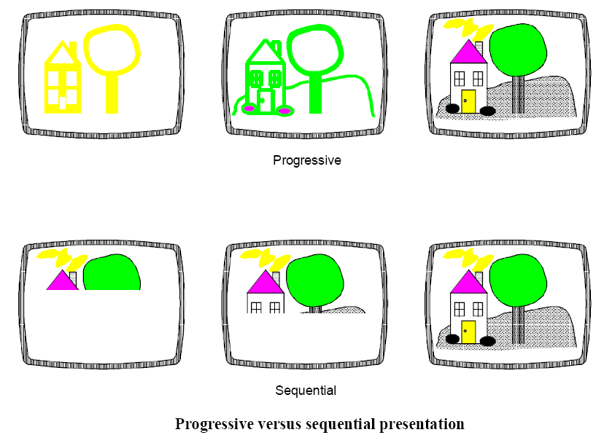
Progressive v/s Sequential

Slide 18
Hierarchical
In hierarchical mode, an image is encoded as a sequence of frames.
These frames provide reference reconstructed components which are usually needed for prediction in subsequent frames.
Except for the first frame for a given component, differential frames encode the difference between source components and reference reconstructed components.
The coding of the differences may be done using only DCT-based processes, only lossless processes, or DCT-based processes with a final lossless process for each component.
Downsampling and upsampling filters may be used to provide a pyramid of spatial resolutions.
Useful in environments which have multi-resolution requirements

Slide 19
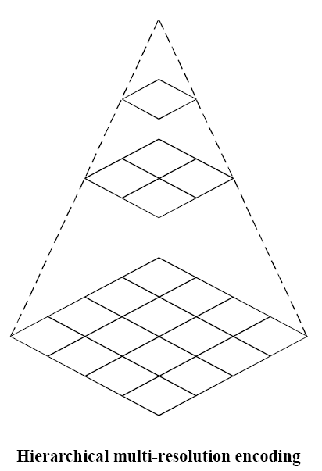
Hierarchical

Slide 20
Decoder requirements
A decoder shall
a) with appropriate accuracy, convert to reconstructed image data any compressed image data with parameters within the range supported by the application, and which comply with the interchange format syntax for the decoding process embodied by the decoder;
b) accept and properly store any table-specification data which comply with the abbreviated format for table specification data syntax for the decoding process embodied by the decoder;
c) with appropriate accuracy, convert to reconstructed image data any compressed image data which comply with the abbreviated format for compressed image data syntax for the decoding process embodied by the decoder, provided that the table-specification data required for decoding the compressed image data has previously been installed into the decoder.

Slide 21
Markers
Markers serve to identify the various structural parts of the compressed data formats.
Most markers start marker segments containing a related group of parameters; some markers stand alone.
All markers are assigned two-byte codes: an X’FF’ byte followed by a byte which is not equal to 0 or X’FF’.
Any marker may optionally be preceded by any number of fill bytes, which are bytes assigned code X’FF’.

Slide 22
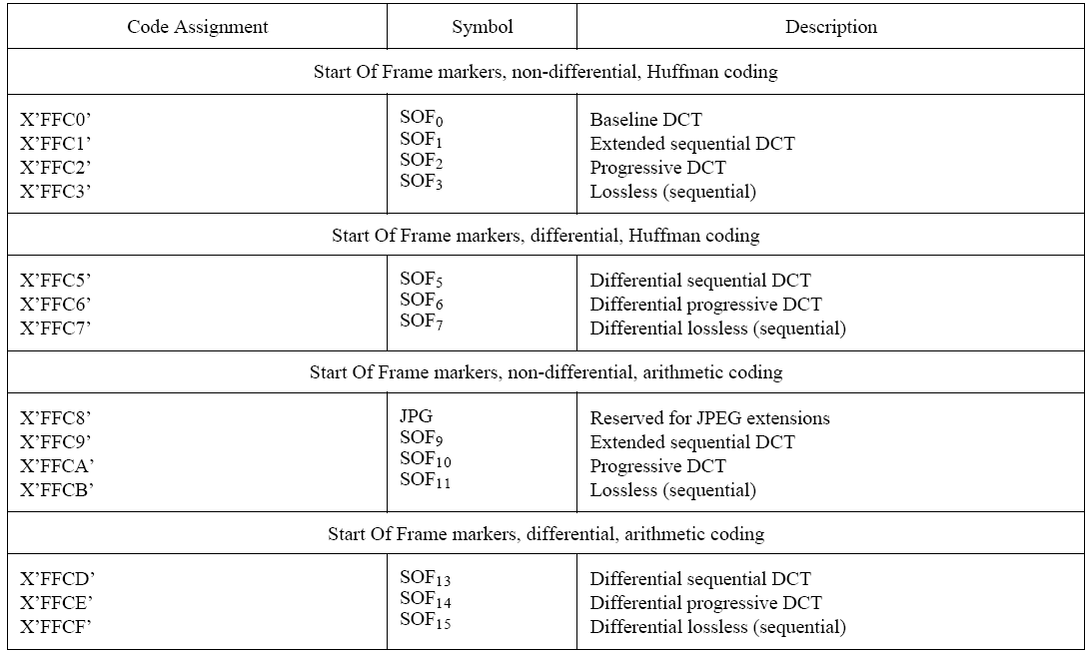
Marker code assignments

Slide 23
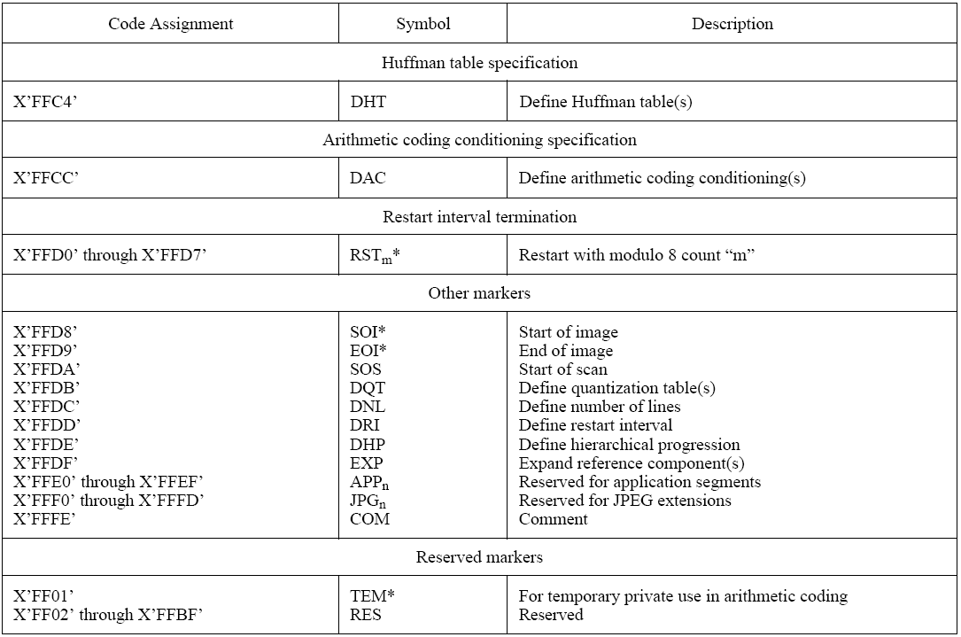

Slide 24
General sequential and progressive syntax
This clause specifies the interchange format syntax which applies to all coding processes for sequential DCT-based, progressive DCT-based, and lossless modes of operation.

Slide 25
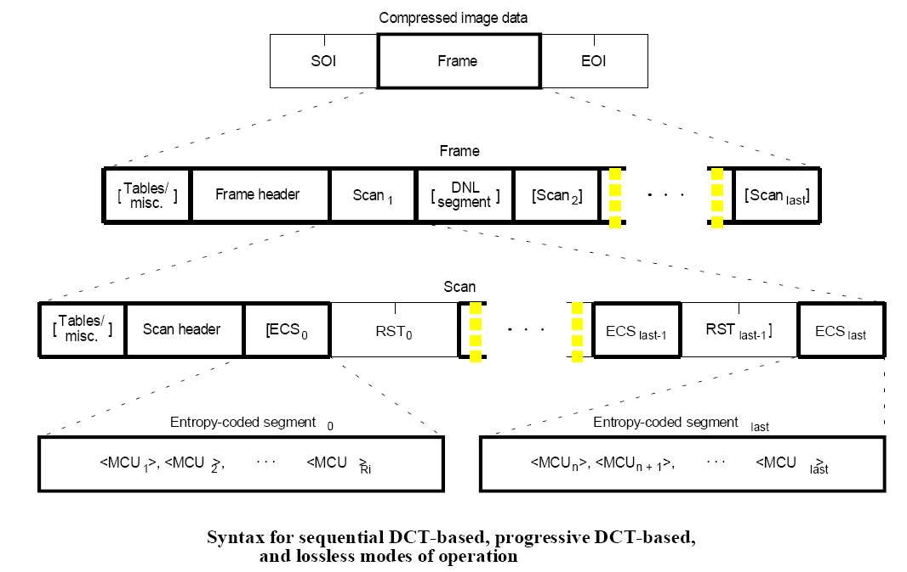
High Level Syntax

Slide 26
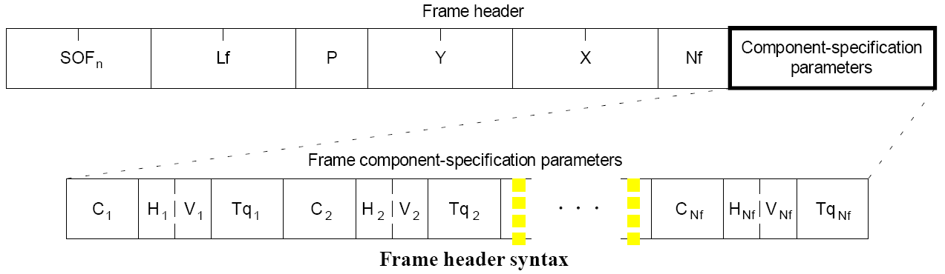
Frame Header Syntax

Slide 27
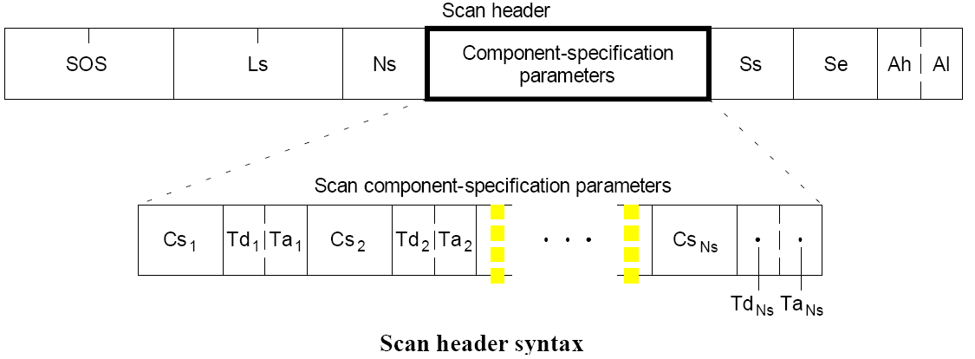
Scan Header Syntax

Slide 28
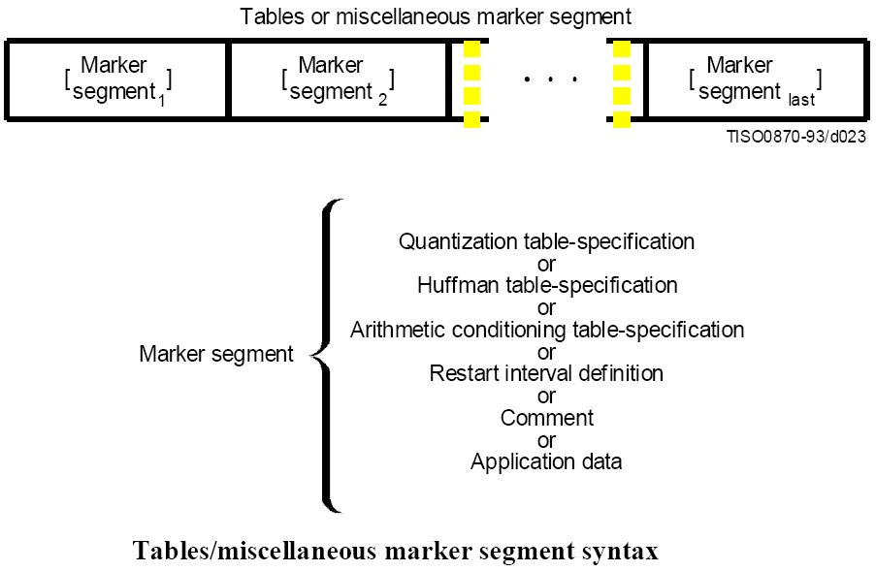
Table-specification and miscellaneous marker segment syntax

Slide 29
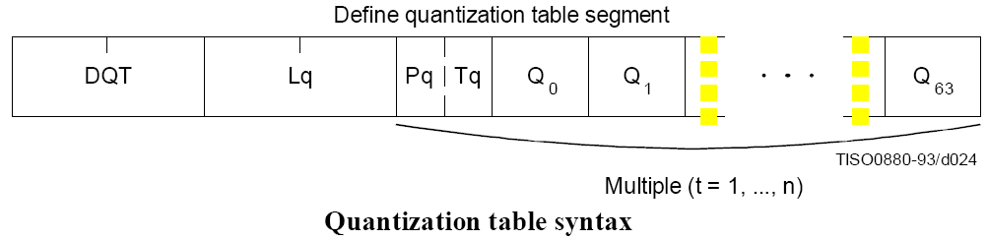
Quantization table-specification syntax

Slide 30
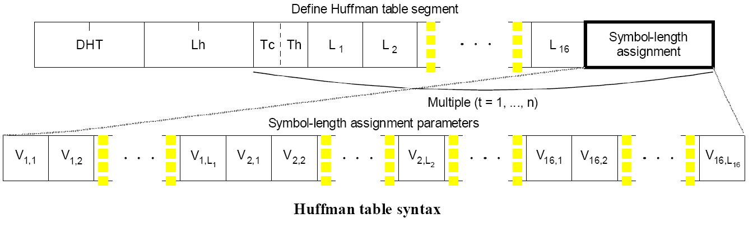
Huffman table-specification syntax

Slide 31
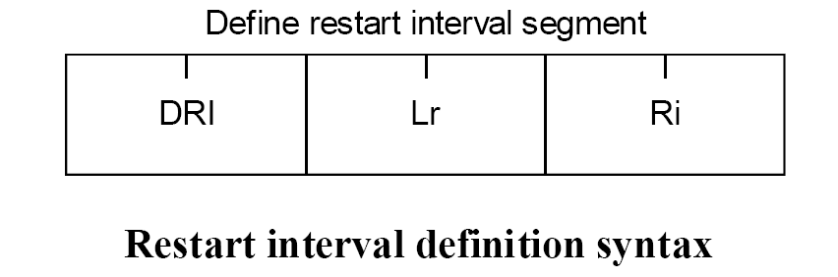
Restart interval definition syntax

Slide 32
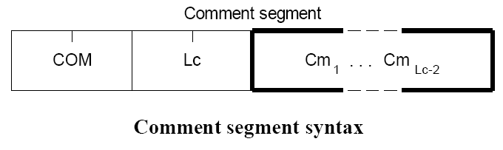
Comment syntax

Slide 33
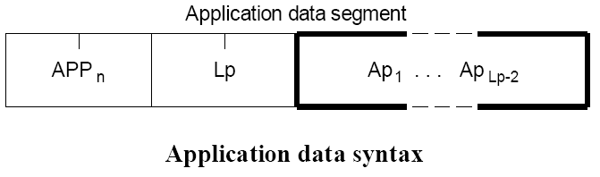
Application data syntax

Slide 34
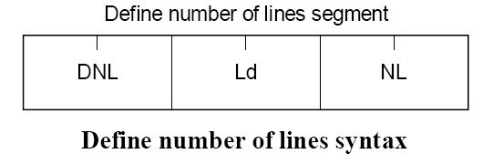
Define number of lines syntax

Slide 35
Control procedure for decoding compressed image data

Slide 36
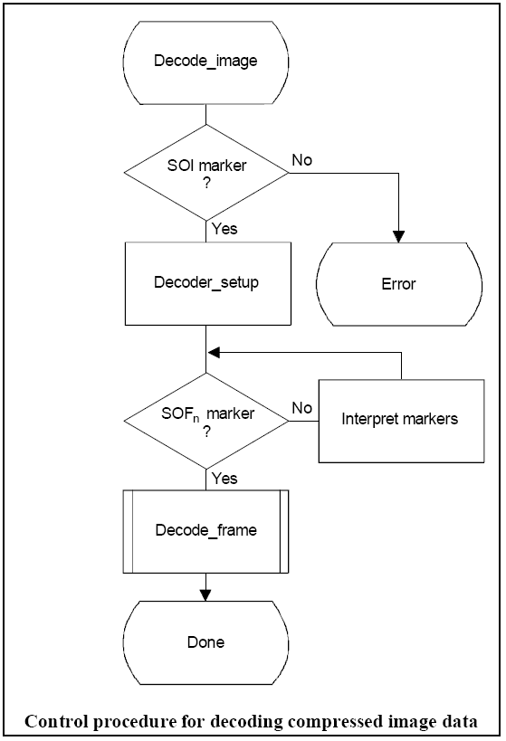

Slide 37
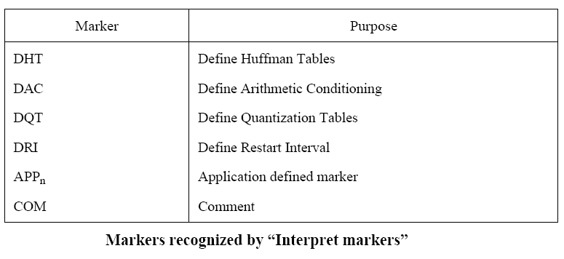
Interpret Markers

Slide 38
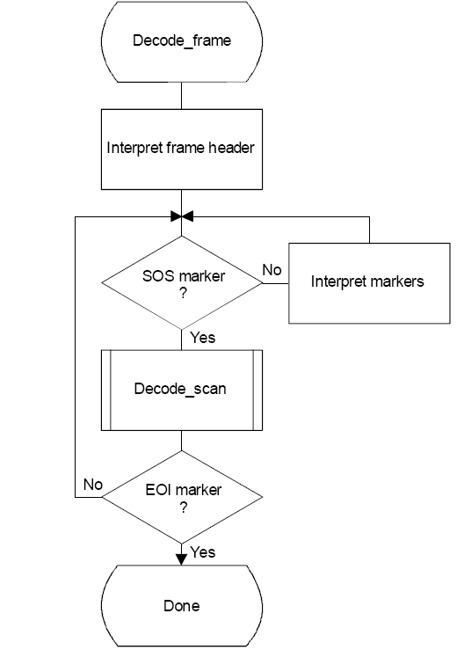
Control procedure for decoding a frame

Slide 39
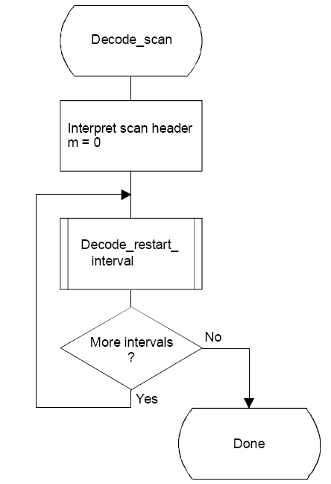
Control procedure for decoding a scan

Slide 40
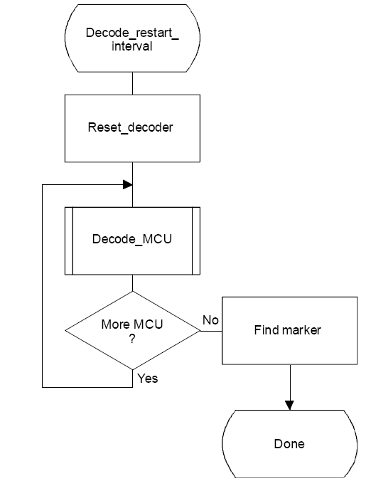
Control procedure for decoding a restart interval

Slide 41
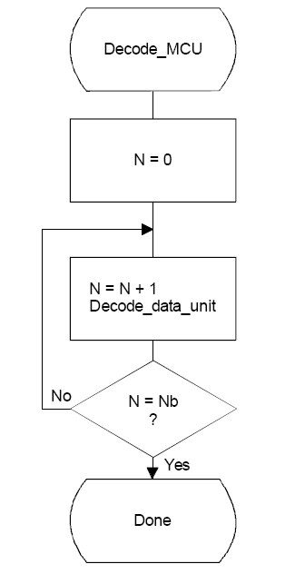
Control procedure for decoding a minimum coded unit (MCU)

Slide 43
DCT based Decoding

Slide 44
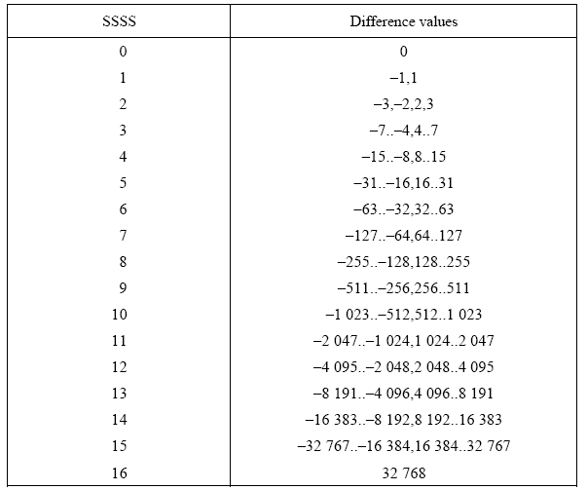
Difference categories for lossless Huffman coding

Slide 45
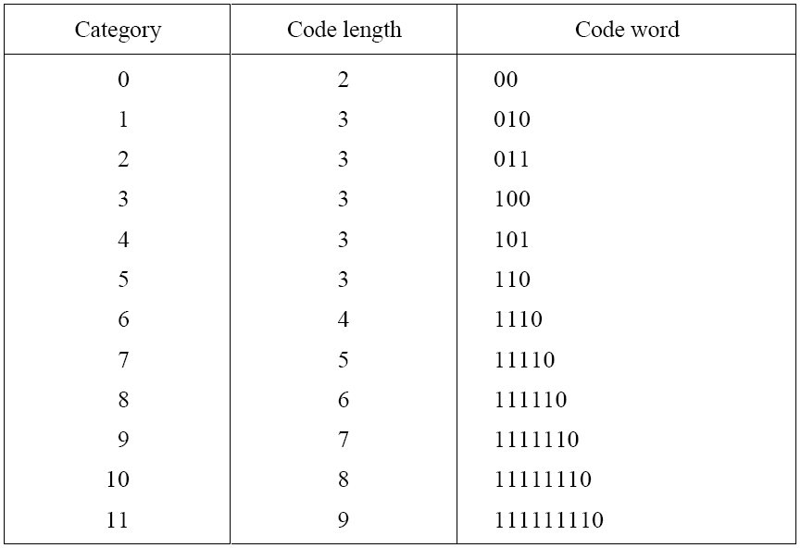
Table for luminance DC coefficient differences

Slide 46
Table for luminance DC coefficient differences
The 16 bytes which specify the list of code lengths for the DC huffman table are
X’00 01 05 01 01 01 01 01 01 00 00 00 00 00 00 00’
The set of values following this list is
X’00 01 02 03 04 05 06 07 08 09 0A 0B’

Slide 47
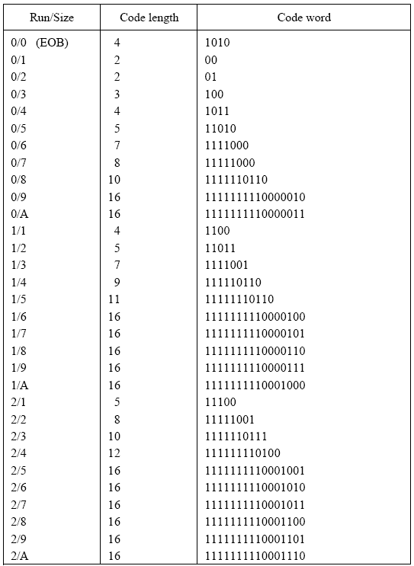
Table for luminance AC coefficients

Slide 48
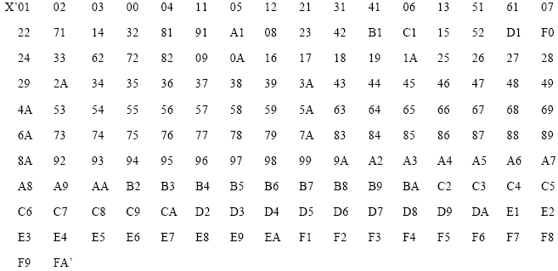
Table for luminance AC coefficients
The 16 bytes which specify the list of code lengths for the table are
X’00 02 01 03 03 02 04 03 05 05 04 04 00 00 01 7D’
The set of values which follows this list is

Slide 49
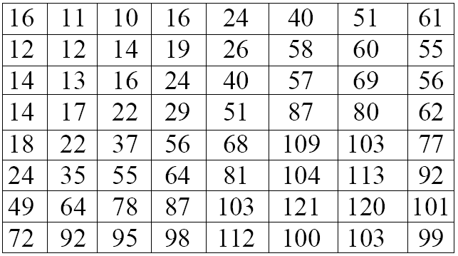
Luminance quantization table

Slide 50
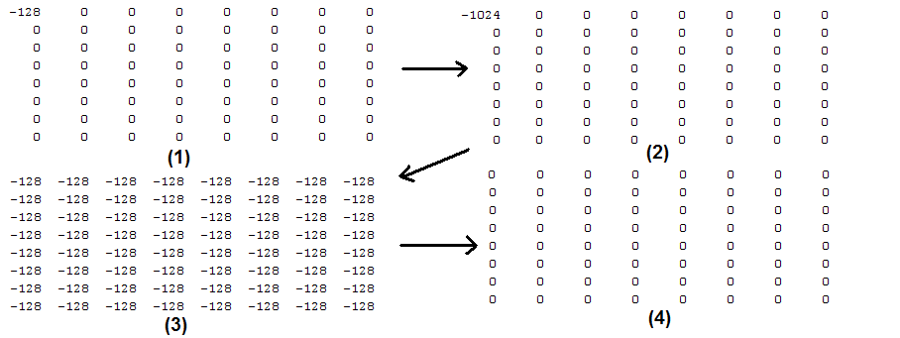
Entropy coded data for ‘zero.jpeg’ :- “111110011111111010111111”

Slide 51
Thank You

